Slide 1
STRATEGIC MANAGEMENT
MGMT 4P90
Week 1: Course Overview
Dr. Trish Ruebottom
truebottom@brocku.ca

Slide 2
Today’s goals
Get to know each other
Structure and purpose of this course
Strategize a little, begin to understand what strategy is all about
Consider the purpose of organizations and how that defines their strategy

Slide 3
AGENDA
What is Strategy?
About the Course
Apple Case Study
  Creating a strategy
BREAK
Organizational Purpose
  Components of strategy
  Exercise: Corner Store Negotiations
  Shareholders vs. Stakeholders

Slide 4
Ice-breaker
1) Write down:
  The month you were born
  Your favorite continent to visit
  Which languages do you speak
  In what neighborhood/city you live
  Your favorite musician/ band

Slide 5
Ice Breaker (cont)
2) Now find people who:
Were born in the same month as you
Love the same continent
Speak the same number of languages as you
Live in the same neighborhood/city as you
Have the same favorite musician/ band as you
You must find different people for each of the items/ questions
Write their names down and whoever finishes first win full participation marks for today’s class!

Slide 6
What is Strategy?
How do we understand what strategy is?
  How do you strategize?
    What do I mean? How do you do well in school, your job, or a sport…

Slide 7
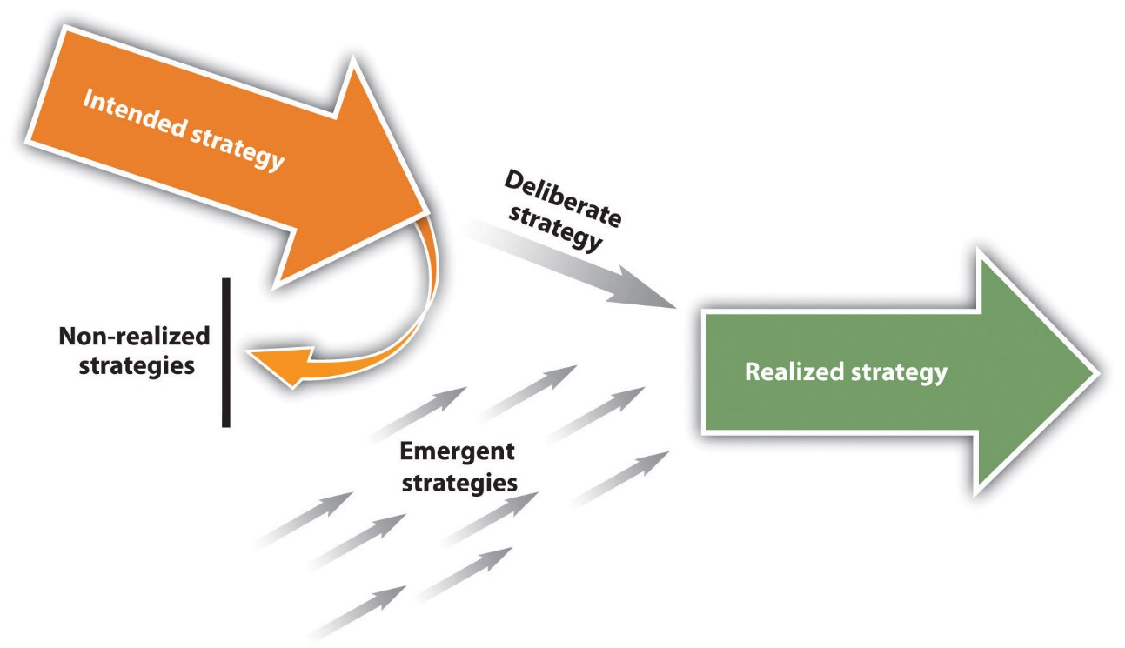
Intended and Emergent Strategies
Intended Strategy: An intended strategy is the strategy that an organization hopes to execute.
  A non-realized strategy refers to the parts of the intended strategy that are abandoned.
A realized strategy is the strategy that an organization actually follows.
  A product of a firm’s intended strategy, the firm’s deliberate strategy, and its emergent strategy (the unplanned strategy that arises in response to unexpected opportunities and challenges).
© 2015 by Flat World Education, Inc.

Slide 8
The First Strategists: Lessons of Greeks & Romans in War & Nation Building
Greek verb strategos means “army leader” and the noun stratego refers to defeating an enemy by effectively using resources.
Epaminondas
Defeat the enemy at the strongest point, not at the weakest
Alexander the Great
Decisions can only be made when the circumstances arise

Slide 9
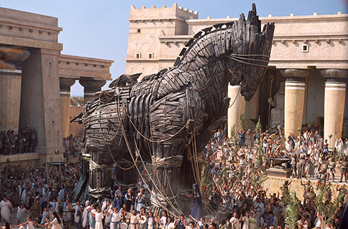
Most famous example of strategy in ancient times involves the Trojan Horse.

Slide 10
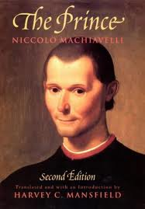
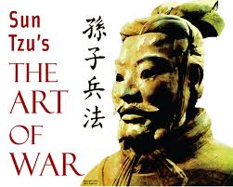
Machiavelli and Sun Tzu
Strategy as warfare and a battle to be ‘fought’, delayed, or avoided in order to defeat/survive your enemy. Rationales were based upon holding onto political power and suppressing others.

Slide 11
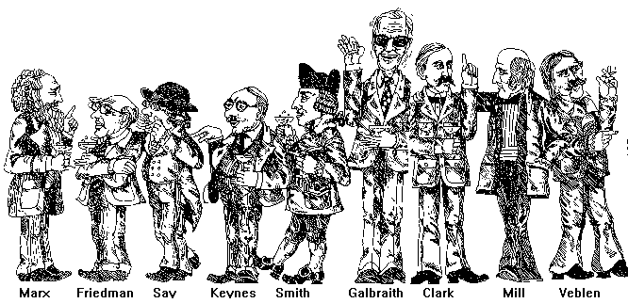
Economists
Strategy as a rational decision to be made.

Slide 12
By the late 20th century, organizations needed more perspectives on strategy as we began to understand more about human nature and business problems became increasingly difficult and harder to solve

Slide 13
As marketplaces and organizations become more complex so did the problems
Characteristics of Wicked Problems
Interconnectedness
Strong connections link each problem to other problems
Complicatedness
Numerous elements with relationships among them including feedback loops
Uncertainty
Exist in a dynamic environment
Ambiguity
Can be seen in different ways and there is no single ´correct view´
Conflict
There is often a need to trade off ´goods´ against ´bads´
Social constraints
Social, organizational, and political constraints
(Mason and Mitroff, 1981)

Slide 14
“New” field of Strategy has emerged
It focuses on how…
  Economic factors
  Political factors
  Sociological factors
  Cognitive factors
…influence our strategies and our organization’s ability to gain competitive advantage within marketplaces
My teaching perspective is: Strategy is about continually learning about your organization and environment in order to solve problems and make coherent decisions on what actions to take

Slide 15

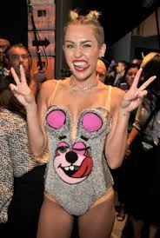

Strategic or Stupid?

Slide 16
Goals for this Course
Understand that strategy is all around us
Define: What is strategy?
Develop an understanding of strategic language, frameworks and plans
  Be able to effectively participate in the process, apply frameworks to develop strategy
Use strategy to advance the goals of our organizations and our careers

Slide 17
The Strategic Management Process: What should organizations DO?
Strategic Planning
Strategic Implementation & Evaluation
Strategic Analysis

Slide 18
The Strategic Management Process: What should organizations DO?
External Analysis: Porter’s 5 Forces, PESTEL Analysis
Corporate Level Strategy: Synergy v. responsiveness, profit pools
Network Level Strategy: 4Cs
International Strategy: Modes of entry, cultural fit
Business Level Strategy: Generic Strategies, Competitive Moves
Strategy & Innovation: Blue Ocean Strategy, 1st Mover Advantage
Org Design & Strategic Control: Balanced Scorecard
+
Internal Analysis: RBV, Value Chain, Positioning

Slide 19
Methods for meeting goals
Theory lectures: posted on sakai
(posted right before class)
Exercises: NOT posted
Cases (and a simulation): NOT posted
And the odd video
NEED TO TAKE NOTES!!

Slide 20
Methods
Evaluation Component | Grade Weight | Due Date
Quiz | 10% | Week 4
Term Test | 35% | Week 10
Group Strategic Plan External Analysis Presentation Final Presentation Final Report | 5% 10% 20% | Week 8 Week 12 Week 12
Participation Case Assignments Class Participation* Group participation | 5% 10% 5% | Each case week Week 12
Total | 100%
*It is your responsibility to remember your name plate each week. You will not receive participation marks if you do not have a name plate.

Slide 21
Ground Rules
Do the assigned readings before the class
  READ CASE STUDIES BEFORE CLASS
  Hand in case assignments at the beginning of the class (in hard copy)
Attend and actively participate in class and contribute thoughtful input to the discussions
  BRING YOUR NAMEPLATE EVERY CLASS
Be respectful to your fellow students
Technology: turn off cell phones and mobile devices
  Laptops are permitted for note-taking and research purposes only

Slide 22
Any questions about the course?

Slide 23

Apple Case Study
Currently Apple is the one of the most innovative and most admired companies (McGregor, 2008). It is the world’s largest company by market value.
HISTORY
Immediate success of Apple’s software and hardware was followed by a long decline. Steve Jobs was publicly fired in 1985.
Decline in computer market continued as Apple competed with hardware and software firms based on quality of their coupled hardware and software
  Microsoft decoupled software… got on every non-Apple computer
    But Apple has an extremely committed community of users
1997 Apple hired Jobs back, refocused the strategy
2001 iPod (iTunes), 2008 iPhone, 2010 iPad
Apple sold its billionth iPhone, however Apple's
growth is slowing, stock is stagnating and
it’s facing concerns about its future

Slide 24
What are Apple’s strengths and weaknesses?

Slide 25
As of right now…
But some serious concerns…
The market share in the PC industry remains below 10%
The future success of Apple’s iPod, iPhone, and iPad is uncertain - products are in the maturity phase and competitors are imitating and there is hyper-price competition
Apple Watch…?
Software is STILL bundled with hardware
Expectations are extremely high
The immediate future seems rosy…
Shares jumped after the launch of iPhone 7
Industry leader
Expectations are extremely high

Slide 26

The challenge for strategic thinking…
“You can’t just ask customers what they want and then try to give that to them. By the time you get it built, they’ll want something new”
-Steve Jobs

Slide 27
Create a 5-year strategy for Apple
2011 Mission: Apple is committed to bringing the best
personal computing experience to students, educators,
creative professionals and consumers around the world
through its innovative hardware, software and Internet offerings
Re-develop a more coherent and accurate mission statement
From what you know of Apple…develop 3 strategic priorities that Apple should focus on over the next 5 years
What do these look like?
  Priorities: three bullet point sentences
    Continue to in…in order to… (i.e., Apple should enter the cattle? industry in order to…Apple should develop a <specific product> in order to…)
Remember, Strategy is defined as, “continually learning about your organization and environment in order to solve problems and make coherent decisions on what actions to take”

Slide 28
Organizational Purpose: Strategy
What does the organization do? What does it NOT do?
How does it do it? What rules does it follow?
What are the steps to achieving its strategy?
Elements: Vision, mission, values, strategic priorities and goals

Slide 29
Vision
What does the organization want to become?
Future-oriented and aspirational
GSB Vision:
A leading business school in experiential education and scholarly activities

Slide 30
Mission
What does the organization do? How does it do it?
GSB Mission: Goodman is a globally oriented and community dedicated business school that engages and challenges through scholarly initiatives, education and practice
Direction
Defining the boundaries within which strategic choices and actions must take place.
Legitimization
Conveying to all the stakeholders inside and outside the company that the firm is pursuing valuable activities in a proper way.
Motivation
Inspiring individuals to work together in a particular way.

Slide 31
Values
What are the rules that bound behavior as the organization works to achieve its vision and mission?
GSB Values:
Passion, Perseverance, Professionalism

Slide 32
Strategic Priorities and Goals
What steps should the organization take to work towards its vision and mission?
How will the organization assess its progress?
  The most effective goals are those that are SMART: specific, measurable, aggressive, realistic, and time-bound.

Slide 33
Corner Store Negotiations Exercise

Slide 34
Debrief

Slide 35
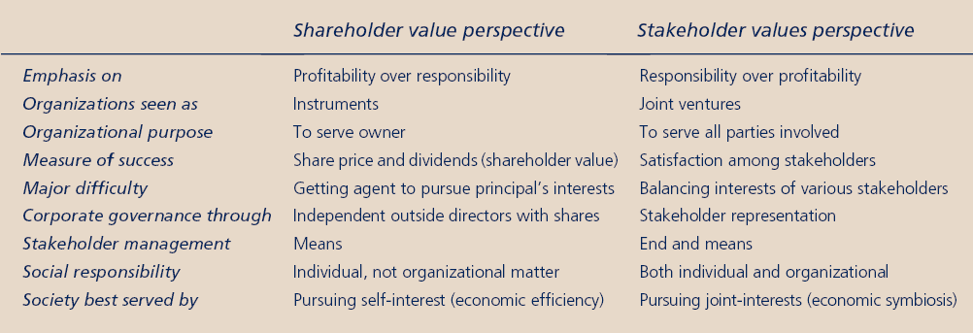
Perspectives on Organizational Purpose
What is the purpose of an organization?

Slide 36
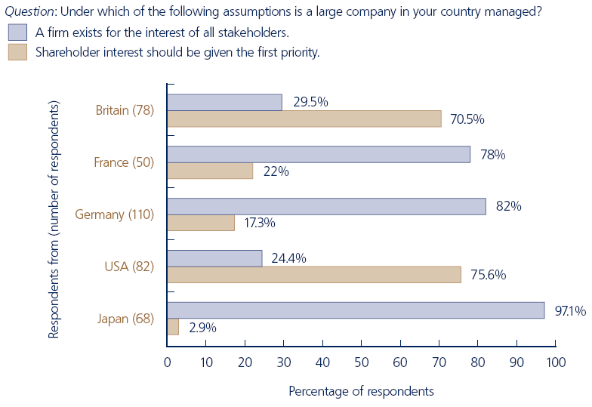
Shareholders vs. Stakeholders

Slide 37
Cognitive abilities
It is important to recognize our strengths and limitations
Limited information sensing ability
Due to the physical inability to be everywhere, all the time, noticing everything
Limited information processing capacity
Limitations
Humans do not have unlimited data processing abilities
Limited information storage capacity
People have only limited capacity for storing information
We have strengths and limitations to our cognitive abilities that prevented us from accurately counting the number of F’s.

Slide 38
Implications for Strategic Thinking
Our limited cognitive abilities mean that we focus on information that we ASSUME to be most relevant, based on past experience
Assumptions and cognitive maps limit our ability to see problems in new ways and creatively develop new solutions

Slide 39
Summary
We thought about why we are taking a course on strategy
Discussed the structure and purpose of this course
Strategized a little about a famous, successful company
Explored organizational purpose
  Strategy elements: vision, mission, values, strategic priorities and goals
  Shareholders vs. Stakeholders – an artificial division

Slide 40
The Strategic Management Process: What should organizations DO?
External Analysis: Porter’s 5 Forces, PESTEL Analysis
Corporate Level Strategy: Synergy v. responsiveness, profit pools
Network Level Strategy: 4Cs
International Strategy: Modes of entry, cultural fit
Business Level Strategy: Generic Strategies, Competitive Moves
Strategy & Innovation: Blue Ocean Strategy, 1st Mover Advantage
Org Design & Strategic Control: Balanced Scorecard
+
Internal Analysis: RBV, Value Chain, Positioning

Slide 41
The Strategic Management Process: What should organizations DO?
Strategic Planning
Strategic Implementation & Evaluation
Strategic Analysis

Slide 42
A sample test question
Short answer question
Define strategy. Your answer must include concepts from class, the text or handouts; it must be complete.

Slide 43
NEXT CLASS
David Depietro – service learning presentation
  Form groups

