Slide 1
Company Analysis: McDonald's International Financing Activities
Neil Gill, 101010920

Slide 2
Objective
Provide a profile of the McDonald’s Corporation
Define the activity of International Franchising
Analyze McDonald’s participation in international franchising
Provide an overview of the general business environment McDonald’s franchisees face abroad
Offer recommendations to improve McDonald’s franchising process

Slide 3

Company Profile
Massive international limited fast food restaurant chain (Adams, 2013)
36 525 restaurants in 119 countries (Statista, 2016)
  ~80% are franchised
Founded in 1955 (Ray Kroc) (McDonalds, 2016)
“Be our customer’s favourite place and way to eat and drink”
  Universal experience
  Plan to win (Neilson, 2013)
    Use 5 Ps to enhance service
  “3 Legged Stool” (Neilson, 2013)

Slide 4
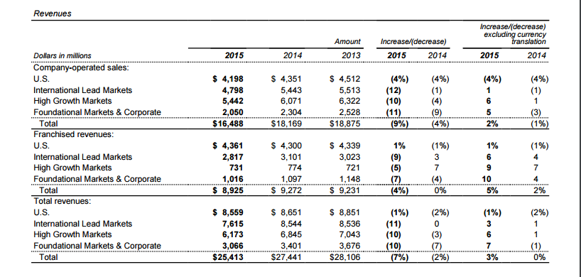
Recent Performance

Slide 5
Recent Performance
McDonald’s is the 9th most valuable brand globally (Forbes, 2016)
#1 Global fast food chain (Forbes, 2012)
Dominance is supported by a local survey
I conducted
  Respondents were 15 of my friends
  Regular consumers of fast food
  Choice between 4 major fast food
  chains in Ottawa

Slide 6
International Franchising
Arrangement where one party (the franchiser) grants another party (the franchisee):
  Right to use its trademark, certain business systems and processes
    Produce/market a good according to certain specifications
  Franchisee pays:
    Franchise fee (1 time)
    Percentage of sales revenue as a royalty (to end of franchising agreement)

Slide 7
International Franchising
Advantages
Gain name recognition
Tried/tested products
Standard building design and décor
Detailed techniques to run and promote the business
Aid in training employees
Ongoing help in promotion/upgrading of products

Slide 8
McDonald’s International Franchising:
Franchise/Corporate relations
Franchises very important to revenues/profits
  Make up the majority of revenues globally (McDonald's Corporation, 2015)
3 legged stool
  Needs of franchisees a part of decisions
  Equally important as suppliers and employees
Franchisees given great autonomy
  Share risks and benefits with corporate (Forbes, 2012)

Slide 9
McDonald’s International Franchising: Purchasing/Operating Costs
Purchase
New=40%
Existing=25%
  Must be paid in equity
  Must be paid off in 7 years max
Generally require $800 000 of liquid capital
Operating
Service: Monthly, 4% of sales
Rent: Monthly, % of sales (varies)

Slide 10
McDonald’s International Franchising Franchise Agreement
Franchisees provide a portion of capital to start-up
  Equipment, Signs, Seating, etc.
Company secures leases for the land/building
Contribute to company’s revenue stream through royalty payments (service fee and rent)

Slide 11
McDonald’s International Franchising
Collective Purchasing Agreement
Company and it’s franchisees purchase:
  Food, packaging, equipment, etc.
    Numerous independent suppliers
Company strictly enforces high standards
  Only order from company approved suppliers
Quality Centers
  Established globally
  Monitor quality

Slide 12
McDonald’s International Franchising Current Initiative
Corporate encouraging franchisees to finance improvements
  Remodeling
  New menu items
  Self service kiosks
  Etc.
Part of a company turnaround plan to combat falling sales

Slide 13
McDonald’s International Franchising Franchisee Issues
Franchisee company relations have never been so poor (Business Insider, 2015)
Franchisee morale is incredibly low
  “The system is broken..” (Business Insider, 2015)
  “We will continue to fall and fail.” (Business Insider, 2015)
Franchisees feel frustrated
  Feel that the company is not considering them in their decisions (Business Insider, 2015)

Slide 14
McDonald’s International Franchising Franchisee Issues
Franchisees have on major gripe with corporate
  Lack of consistent leadership
    Failed initiatives with no clear direction (Egan, 2015)
      Cost falls on franchisees
        “…McCafé coffee, requiring a $15,000 to $20,000 espresso machine.” (Bloomberg, 2015)
    “Trying to be too many things to too many people” (Egan, 2015)
      Even obvious to consumers
        “It feels like they’re trying to appeal to many niches with their remodelling but they end up just with mediocre offerings for multiple niches” (B. Richmond, personal communication, 2016)
    Bloated menus (Business Insider, 2015)

Slide 15
Analysis of the International Business Environment
Asia
  India
    Improved growth due to culturally tailored menu items
  China
    Consumer revolt over food safety scandal
  Japan
    Loss of consumer trust
      Food safety scandal
      Cost cutting worsening consumer experience

Slide 16
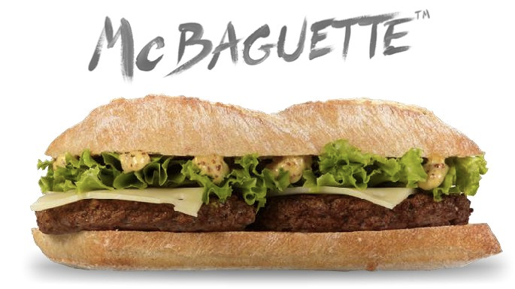
Analysis of the International Business Environment
Europe
  Introduction of locally tailored menu items improved revenues
    France and the McBaguette
  Consumer confidence issues (Eastern Europe)
  Recessions (Greece, Italy)
Latin America
  Introduction of healthier traditional options drove sales
  Poor macroeconomic conditions

Slide 17
Recommendations
Continue to offer franchisee agency
  Cultural adaptation
Tighten quality control in emerging markets
  Harder to win back consumer trust
Test innovations first
  Corporate or willing franchise restaurants
  Current strategy is costly for franchisees
  Franchisee revolt/exit can be avoided

Slide 18
Recommendations
Consider franchisee feedback more
  Poor relationship with franchisees can be toxic
    Will lead to the revolt/exit of franchisees
    Franchising becomes less attractive
      Harder to refranchise
  3 legged stool model cannot work with only 2 legs!

Slide 19
References
McDonald's Corp. (2015). McDonald's Corp. Annual Report. Washington, DC. Retrieved from:http://corporate.mcdonalds.com/content/dam/AboutMcDonalds/Investors%202/2015%20Annual%20Report.pdf
Top 10 Global Fast Food Chains. (2012). Retrieved November 03, 2016, from http://www.forbes.com/pictures/feji45hfkh/top-10-global-fast-food-brands-2/#23b751a92976
The History of the Golden Arches™. (n.d.). Retrieved November 03, 2016, from http://www.mcdonalds.ca/ca/en/our_story/our_history.html
Purchasing Your Franchise. (n.d.). Retrieved November 03, 2016, from http://www.mcdonalds.ca/ca/en/our_story/corporate_info/franchising/purchasing_your_franchise.html
Nielson, S. (2013, December 23). What is a franchise and how do McDonald's franchise agreements work? Retrieved November 03, 2016, from http://marketrealist.com/2013/12/franchise-mcdonalds-franchise-agreements-work/
Mourdoukoutas, P. (2012, April 20). McDonald's Winning Strategy, At Home And Abroad. Retrieved November 03, 2016, from http://www.forbes.com/sites/panosmourdoukoutas/2012/04/20/mcdonalds-winning-strategy-at-home-and-abroad/#526cf2cb70da
McRevolt: The Frustrating Life of the McDonald's Franchisee. (2016, September 16). Retrieved November 03, 2016, from http://www.bloomberg.com/features/2015-mcdonalds-franchises/
McDonald’s and its challenges worldwide: A market-by-market look. (15, January 29). Retrieved November 03, 2016, from https://www.ft.com/content/f8ac22fc-a7c1-11e4-8e78-00144feab7de

Slide 20
References
McDonald's: Number of restaurants worldwide | Statista. (2016). Retrieved November 03, 2016, from https://www.statista.com/statistics/219454/mcdonalds- restaurants-worldwide/
Jones, A. (2014, July 18). Must-know: A company overview of McDonald’s. Retrieved November 03, 2016, from http://marketrealist.com/2014/07/must-know- company-overview-mcdonalds/
International Franchising. (n.d.). Retrieved November 03, 2016, from http://www.globalnegotiator.com/international-trade/dictionary/international-franchising/
Egan, M. (2015, July 17). Not loving it: McDonald's franchisees are depressed. Retrieved November 03, 2016, from http://money.cnn.com/2015/07/17/investing/mcdonalds-franchisees-survey/index.html
The World's Biggest Public Companies. (2016). Retrieved November 03, 2016, from http://www.forbes.com/companies/mcdonalds/
Nielson S. (2013, December, 25). McDonald's global business model, the "three-legged stool" Retrieved November 03, 2016, from http://marketrealist.com/2013/12/mcdonalds-global-business-model-three-legged-stool/

