Slide 1
Early Indian Buddhism
The Five Skandhas, Refuge, the initial spread of Buddhism,

Slide 2
The Five Skandhas
Skandha literally means, “aggregate, mass, heap”
Suffering (dukkha) arises when one clings to one or more of the skandhas
The five skandhas make up the conventional reality of the human person (although the list was not intended to be an exhaustive or complete list)
They are: 1) Form (or matter)
            2) Sensation (or feeling)
            3) Perception
            4) Mental Formations (or volition)
            5) Consciousness (or discernment)

Slide 3
Taking Refuge (in the Triple Gem)
Taking refuge in India at this time (approx. 500 B.C.E.) was a way of demonstration one’s allegiance to a deity, leader, or teacher. Most importantly, the act of taking refuge is about seeking protection. In the early Pāli cannon, one was regarded as one’s own true protector, but soon the Buddha was explicitly called a nātha (or lord, protector).
The Buddha was said to act as a protector to his monks and nuns early on, for instance, through the use of telepathy, to discern if a practitioner was about to stray from the dharma. He would intervene to set the aspirant on the correct path.
Some early stories depict the Buddha teaching to sick monks and they immediately become better, and he even used psychic powers to amaze a murderer and encourage him to give up his evil ways…eventually the murderer became an arhat.

Slide 4
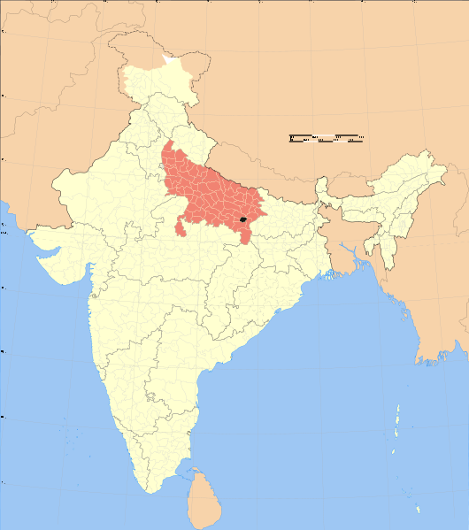
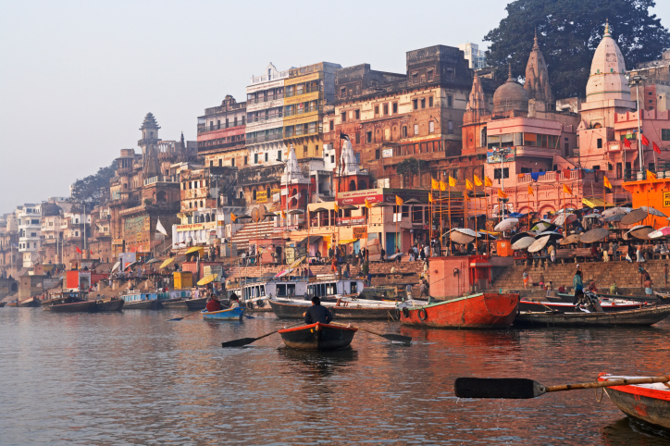
Varanasi, India

Slide 5
Yasa: the 6th Arhat
Yasa was the son of a rich merchant from Varanasi and, after a night of sleepless anxiety, he came across the Buddha who comforted him. The Buddha taught him a specialized version of the Dharma suitable for laypeople (i.e. the merits of generosity and virtue, and the drawbacks associated with sensual indulgences). Yasa immediately took refuge.
Yasa became the first lay Buddhsit devotee or Upāsaka (masculine) (Upāsikā is the feminine).
Soon Yasa’s father came looking for him and heard the Buddha speak and developed the Dharma-eye and he took refuge. Soon Yasa’s extended family and friends converted to Buddhism creating a total of 61 arhats in the world. At this time, the Buddha instructed 60 Awakened monks to go out and spread the Dharma.
Soon word spread far and wide and many came to Sarnath (near Varanasi) to take refuge. The monks were forbidden from showing off specialized powers (superknowledges) to the laity.

Slide 6
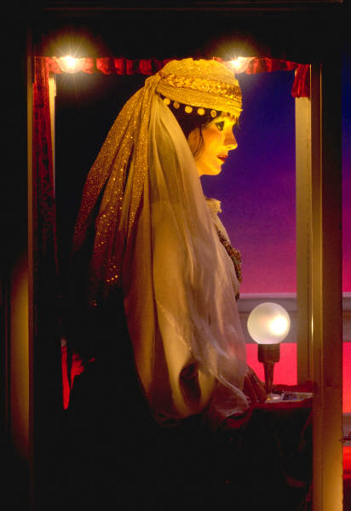
Abhijñā : The Six “Superknowledges”
These are knowledges that “Awakened ones” develop and the Siddhartha Gautama allegedly developed these during his Enlightenment under the Bodhi tree. The first five are mundane and will not help one achieve Nirvana, but the sixth abhijñā opens the mind to the deathlessness of Nirvana.
Psychic powers (levitation, walking on water)
The divine ear, or psychic hearing
Knowledge of other’s minds
Memory of one’s former lives
The divine eye, or clairvoyance
The ending of binding pollutants of the mind like sensual desire, becoming, ignorance.

Slide 7
The Middle Years
The Buddha used his special powers only when necessary and was said to have floated in the air, parted the waters of the sea, and disappear and re-appear in a different spot almost simultaneously.
Soon, the Buddha converted King Bimbisara in front of a large crowd and all of the people took refuge. During these conversions, the Buddha typically taught a variant of the Four Noble Truths and the Eightfold Path. After this moment, the Buddha spent some time with the original five monks in the capital of Magadha, when a wanderer overheard the Buddha and the five mendicants and suddenly attained the Dharma-eye. Śāriputra became one of the most famous monks in Buddhist literature, who seems to ask the most questions of the Buddha.

Slide 8
The Middle Years (cont’d)
The Buddha allowed members from any caste (including outcasts) to become Buddhists
He wandered around the Ganges area teaching and converting whomever sought refuge. He also converted members from his family. (In some Mahayana accounts, the Buddha had a son, named Rahula, who became an arhat. Also, Ananda his cousin become a crucial player in the Buddha’s entourage and, in some early Pāli sutras and most later Sanskrit sutras, the accounts given are considered to be from Ananda’s records of the Buddha’s Dharma talks. (“thus I have heard at one time…”)
Wealthy merchants, Kings and other prosperous converts helped to set up monasteries for monks and nuns in the area. In the Buddha’s own lifetime the sangha was extremely wealthy and

Slide 9
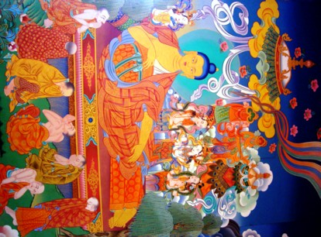
Parinirvana

Slide 10
Textual Archaeology of early Buddhism: Vinaya, Sutra, and Abhidharma Pitka or, The Three Baskets
Various sanghas and monasteries in Northern India began composing various narratives about the rules and roles of monks and nuns. These texts are called “Vinayas.” Stone inscriptions of Vinayas have been discovered but precise dating is impossible. Some think that the Vinaya texts are actually much later (between 1st and 4th Century C.E.). Current scholarship tries to piece together extant texts to fill in many of the gaps in tracing a reliable chronological and textual record. Nevertheless, our knowledge of early Buddhist texts is very limited mainly because of the thriving culture of oral transmission. Most Buddhist texts were not actually written down until 1st Century C.E.
*Vinaya texts are those concerned with monastic rules
*Sutras are the texts about the Dharma and usually entail the uddha himself as the protagonist/teacher.
*Abhidharma were later texts that further defined certain lineages from each other that tried to systematize various philosophies presented in the sutras. Abhidharma texts classify reality and clarify issues in the sutras and vinayas.

Slide 11
Early Councils
The vinayas tell of two councils held shortly after the Buddha’s death. The first council reportedly occcured immediately after the Buddha’s transition to parinirvana. It was led by Mahākāśyapa who asked Upali about the Buddha’s teachings of the vinaya, and he asked Ananda about the sutras. 500 monks in attendance of this discourse memorized the responses. Thus the standardization of the Dharma-Vinaya began.
A second council occurred 100 years later. Forest elders had noticed a laxity in the monks moral codes (albeit, minor aberrations such as storing salt to add flavour to bland alms). The wilderness monks viewed the city monks as unethical and unscrupulous with all kinds of shady financial dealings. Monks are not supposed to handle money. After long debates, the wilderness elders prevailed and the moral codes for monks and nuns were revised to be more austere to coincide with how the Buddha lived and taught.
What is crucial here, despite our hazy knowledge of these events, is that there existed splits in Buddhist communities (perhaps contributing to the development of Mahayana Buddhism around 200 B.C.E)

Slide 12
The Precepts (
Our updated Terms of Use will become effective on May 25, 2012. Find out more.
Śīla (moral discipline): The Precepts
Most Buddhists will recite (in unison the main five precepts):
“I undertake to observe the precept of abstaining
From destroying the life of living creatures
From taking things not given
From sexual misconduct
From false speech
From liquors that cause intoxication and heedlessness
On Holy days, pious Buddhists may undertake three more abstentions:
6. From eating after noon
7. From dancing, singing, music, garlands, perfumes, and other beautification adornments
8. From using high and luxurious seats (sleeping on high beds)
*Monks and Nuns are expected to follow all eight precepts, while lay Buddhists follow the first five.

Slide 13
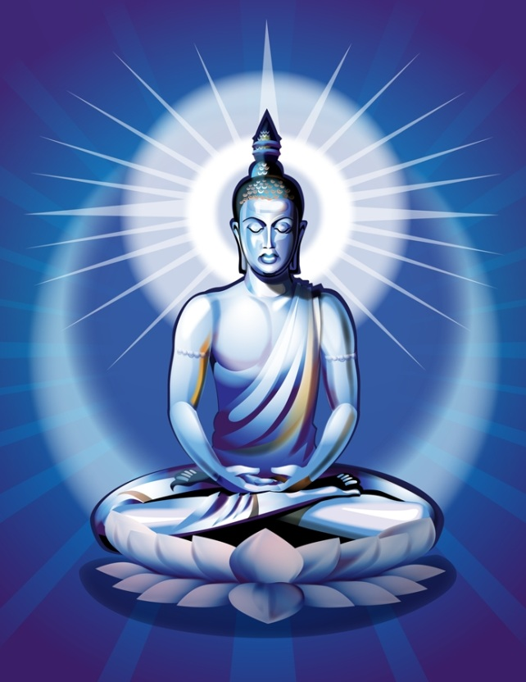
The Divine Virtues
Rather than the avoidances of the precepts, the divine virtues demonstrate Buddhist values in positive terms:
Loving-kindness—friendly towards other sentient beings (animals and humans)
Compassion—more than just caring when others suffer---compassion is to actively try to help another who is suffering
Altruistic Joy—to be truly happy (rather than envious or jealous) when good things happen to others.
Equanimity—being neither upset by criticism nor egotistical when praised.

Slide 14
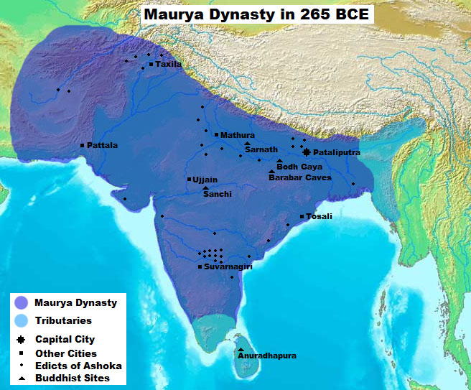
King Ashoka (304 B.C.E – 232 B.C.E)
The Maurya Dyansty: After conquering vast amounts of land through terrible slaughter, King Ashoka suddenly embraced Buddhism and used his influence to erect pillars at famous Buddhist sites.

Slide 15

As the legend goes, one day after the war was over, Ashoka ventured out to roam the city and all he could see were burnt houses and scattered corpses. This sight made him sick and he cried the famous monologue:
“What have I done? If this is a victory, what's a defeat then? Is this a victory or a defeat? Is this justice or injustice? Is it gallantry or a rout? Is it valor to kill innocent children and women? Do I do it to widen the empire and for prosperity or to destroy the other's kingdom and splendor? One has lost her husband, someone else a father, someone a child, someone an unborn infant.... What's this debris of the corpses? Are these marks of victory or defeat? Are these vultures, crows, eagles the messengers of death or evil?”
The famous Dharma Chakra of Ashoka

Slide 16
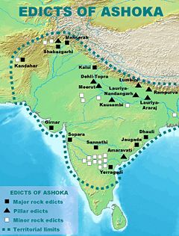
Edicts of Ashoka
Ashoka’s embrace of Buddhism greatly contributed to the spread of Buddhism almost three hundred years after the Buddha’s time. He erected rock carvings and stupas throughout the empire honouring the Buddha’s teachings.

Slide 17
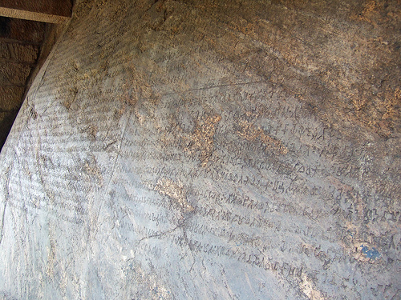

Slide 18
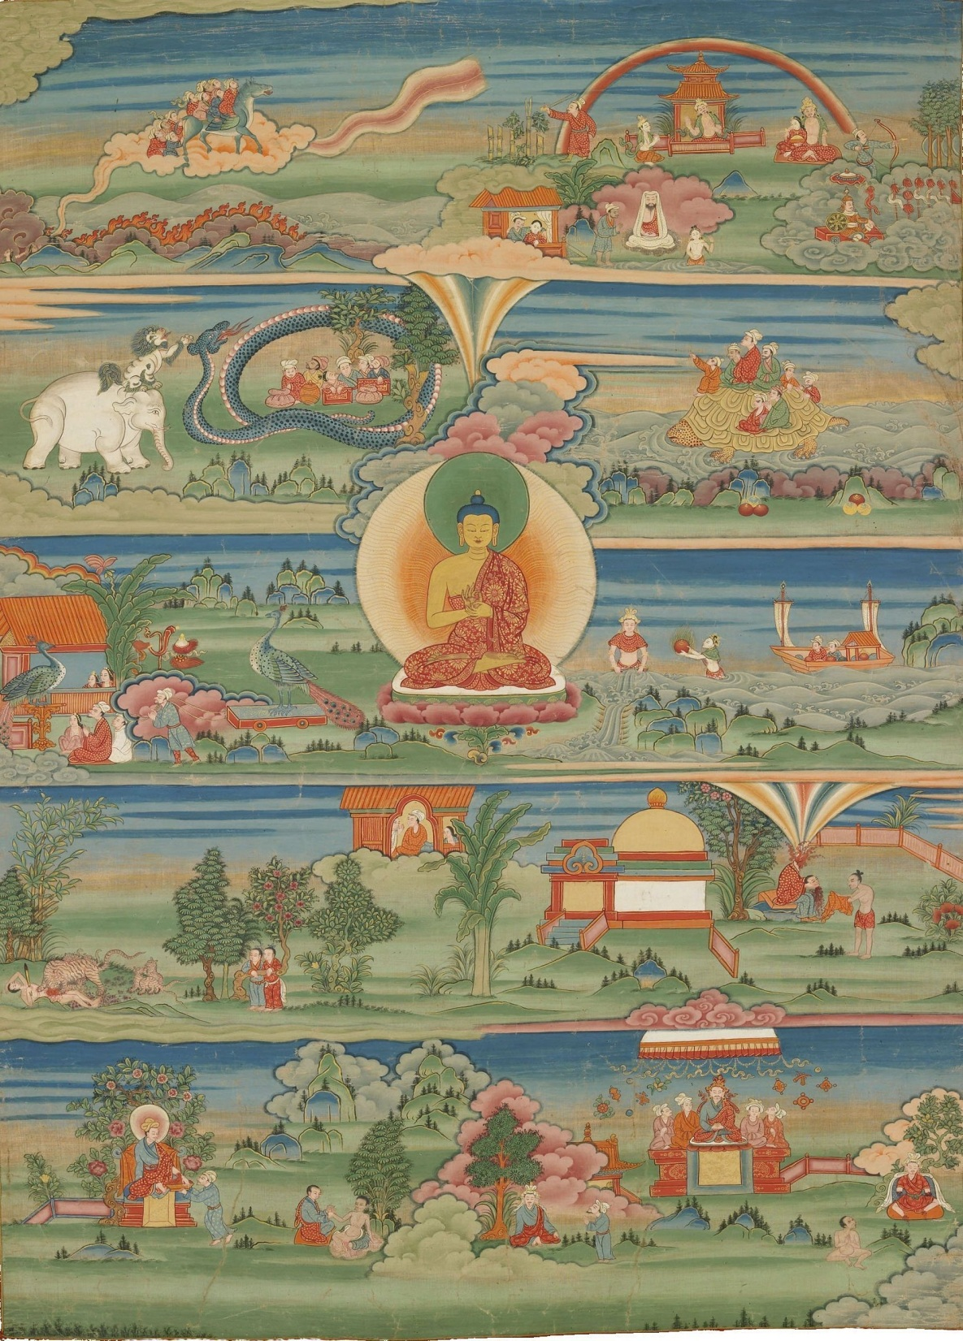
The Jātakas
Theravdin Abhidharma authors became more and more concerned about tales that began circulating about the Buddha’s previous lives. In the narratives, he was called “the Bodhisattva” (a term reserved specifically for the Buddha’s past life narratives until the development of Mahayana). These tales would depict the bodhisattva engaging in amazing acts of compassion earning him more and more merit that led him to his Awakening.
It is noteworthy that the early Theravadin jātakas depicted the bodhisattva as an animal, merchant, prince, ascetic, sometimes a deva, but never a God or woman.

