Slide 1
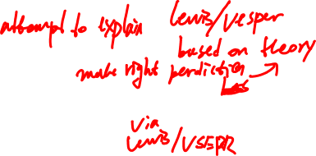
VALENCE BOND THEORY
Two atomic orbitals overlap so that the electrons are attracted to both nuclei.
  One electron in each orbital
  One orbital from each atom
It is useful for predicting:
  bond orders (Lewis diagrams are based on valence bond theory)
  molecular shapes (VSEPR diagrams are also based on valence bond theory)
Notes:
E of ONE PHOTON

Slide 2
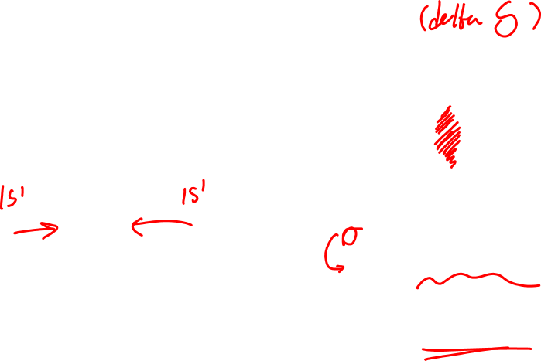
Two atomic orbitals overlap so that the electrons are attracted to both nuclei.
  One electron in each orbital
  One orbital from each atom
H
H
H
H
2 H atoms
H₂ molecule
σ bond (sigma bond):
The atomic orbitals overlap in a line between the two nuclei.
Notes:
E of ONE PHOTON

Slide 3
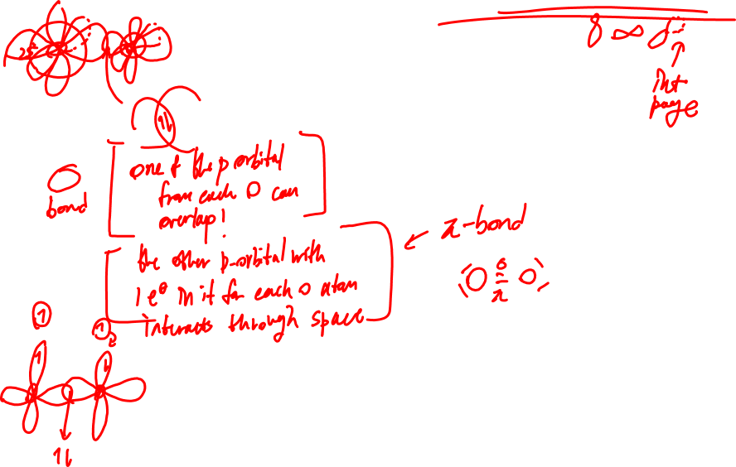
O₂
π bond (pi bond):
The atomic orbitals interact above and below the line between the two nuclei.
Notes:
E of ONE PHOTON

Slide 4
Limitations of Valence bond theory:
Valence bond theory is an atomic orbital theory; it is based on preserving the idea of the distinct orbitals on each atom in a molecule.
Valence bond theory FAILS to make useful predictions for:
  systems with an odd number of electrons
  the magnetic properties of molecules
Notes:
E of ONE PHOTON

Slide 5
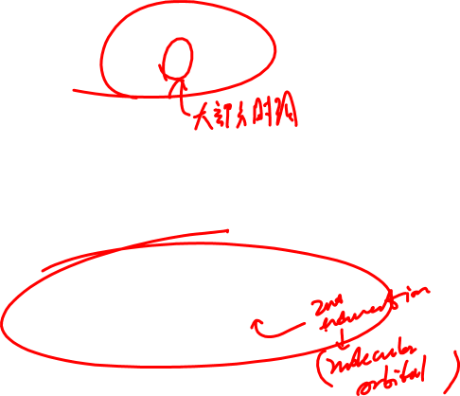
MOLECULAR ORBITAL THEORY – MO theory
M.O. theory says that atomic orbitals don’t just overlap – they actually blend together to produce completely new orbitals that belong to the molecule as a whole.
H
H
H
H
H₂ : atomic orbital picture
H₂ : M.O. picture
pictures of the rest of the types on pages 332 – 334 of the textbook.
Notes:
E of ONE PHOTON

Slide 6

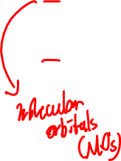
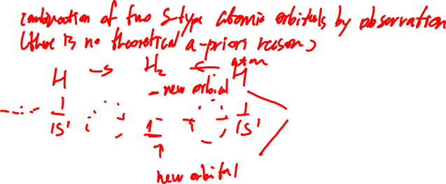
MOLECULAR ORBITAL THEORY – MO theory
When we want to know the atomic orbitals, we write up an electron configuration, then draw an orbital diagram.
When we want to know the molecular orbitals, we start with the atomic orbitals of the two atoms that are bonded, and work from there.
e.g. H₂
Notes:
E of ONE PHOTON

Slide 7
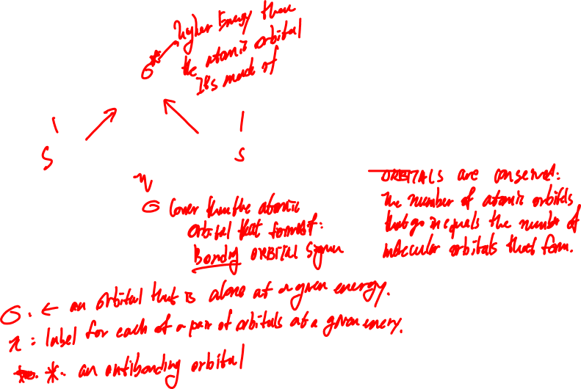
MOLECULAR ORBITAL THEORY – MO theory
This pattern forms any time two s-type atomic orbitals combine.
Notes:
E of ONE PHOTON

Slide 8
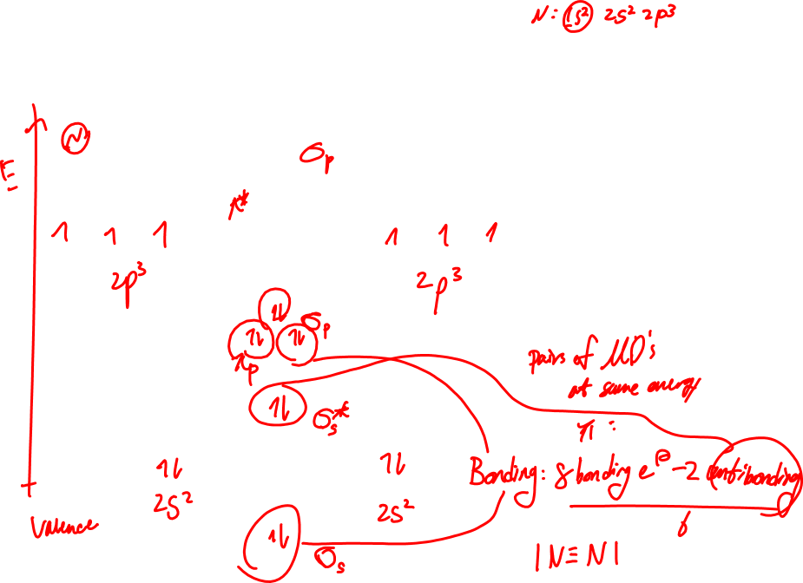
CORRECTED MOLECULAR ORBITAL THEORY – MO theory
Pattern for nitrogen molecules, and diatomic molecules containing elements in group V or left. “N-type” MO.
This is one pattern that can form when six p-type atomic orbitals combine (note – when you have a p subshell from each atom, you have to have six orbitals at a time!)
Notes:
E of ONE PHOTON

Slide 9
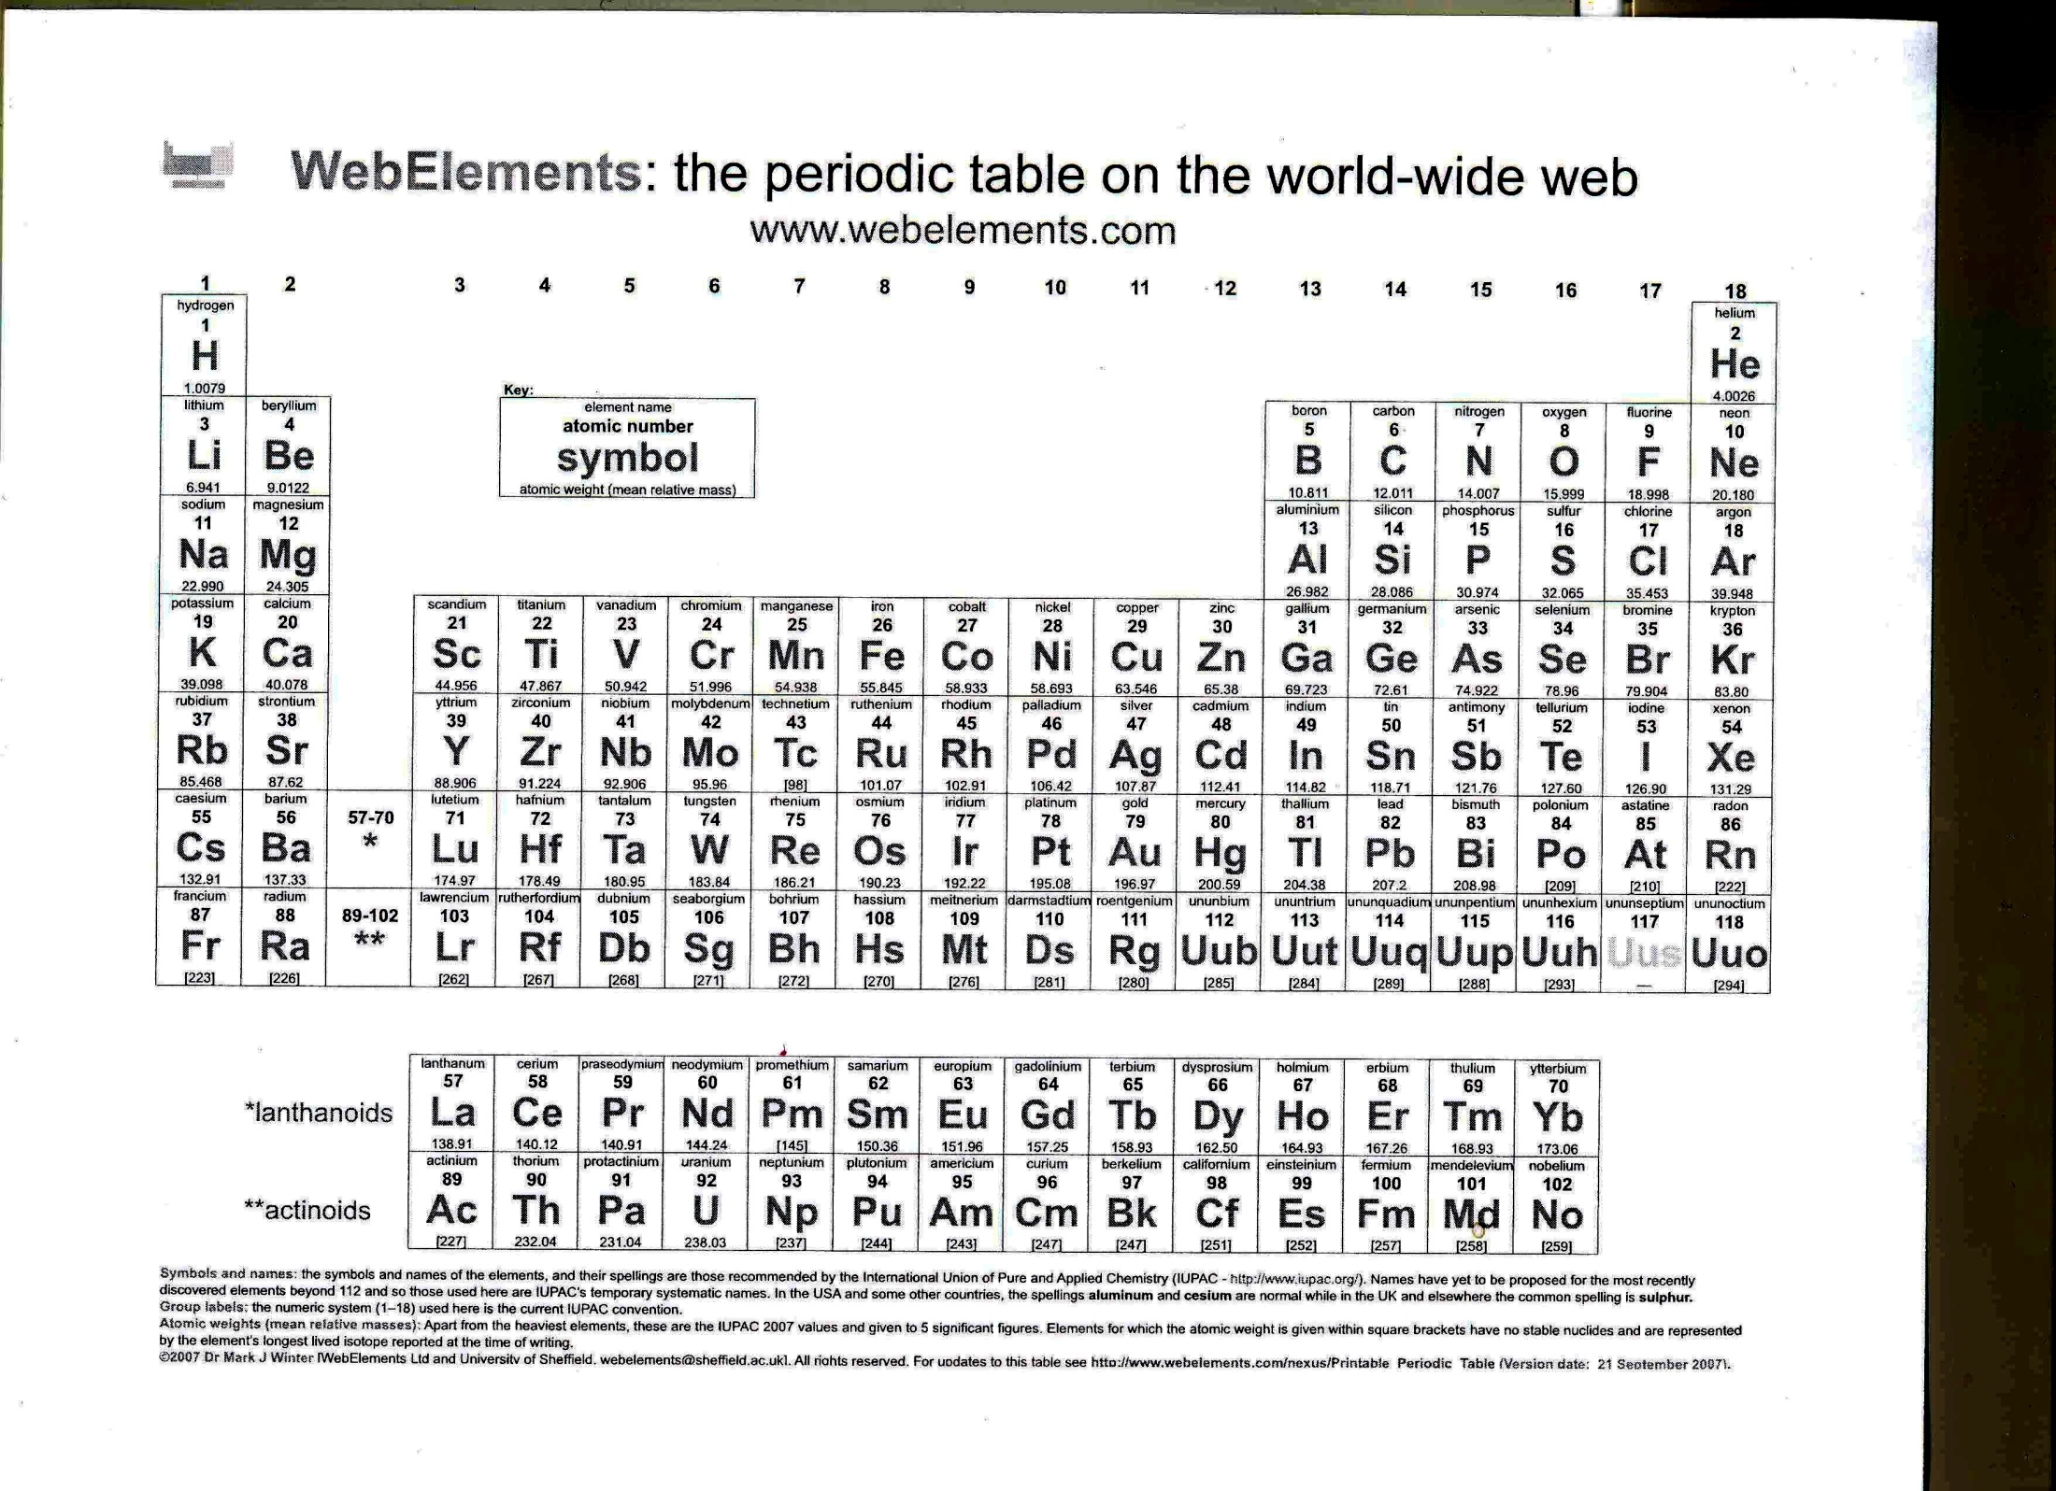
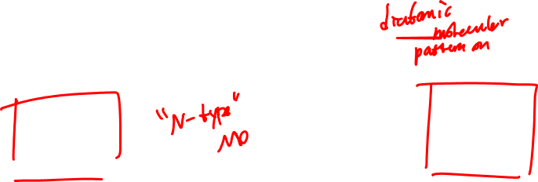

Slide 10
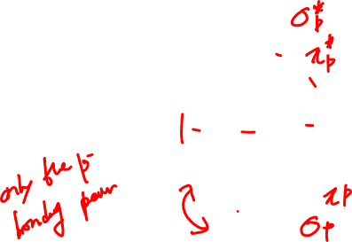
MOLECULAR ORBITAL THEORY – MO theory
Pattern for oxygen molecules, and diatomic molecules containing elements in group VI or right. “O-type” MO.
This is one pattern that can form when six p-type atomic orbitals combine (note – when you have a p subshell from each atom, you have to have six orbitals at a time!)
Notes:
E of ONE PHOTON

Slide 11
MOLECULAR ORBITAL THEORY – MO theory
Pattern for oxygen molecules, and diatomic molecules containing elements in group VI or right. “O-type” MO.
This is one pattern that can form when six p-type atomic orbitals combine (note – when you have a p subshell from each atom, you have to have six orbitals at a time!)
Notes:
E of ONE PHOTON

Slide 12


Slide 13
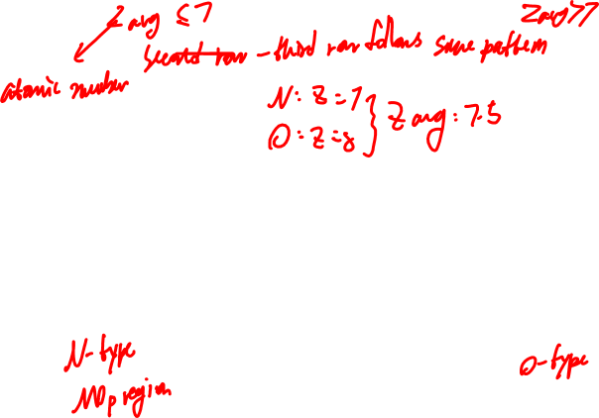
MOLECULAR ORBITAL THEORY – MO theory
Compare
Notes:
E of ONE PHOTON

Slide 14
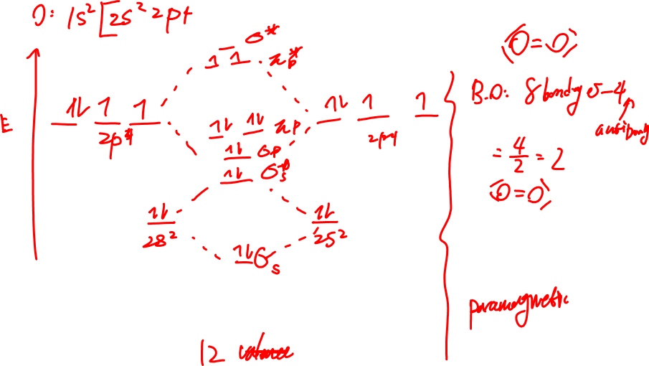
Draw and label a molecular orbital diagram for oxygen, O₂.
Give the bond order and the magnetism:
Notes:
E of ONE PHOTON

Slide 15
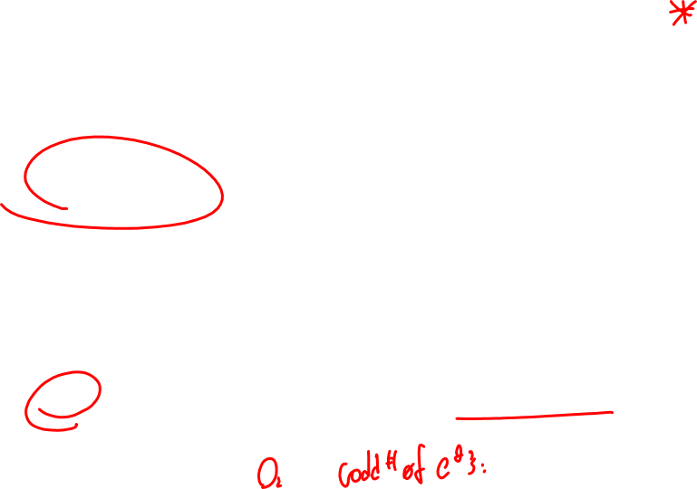
Bond orders:
B.O. = # bonding electrons - # antibonding electrons
2
Magnetism:
Diamagnetic: All electrons are paired
The molecule is not attracted to a magnetic field
Paramagnetic: There is at least one unpaired electron
The molecule is attracted to a magnetic field
Notes:
E of ONE PHOTON

Slide 16
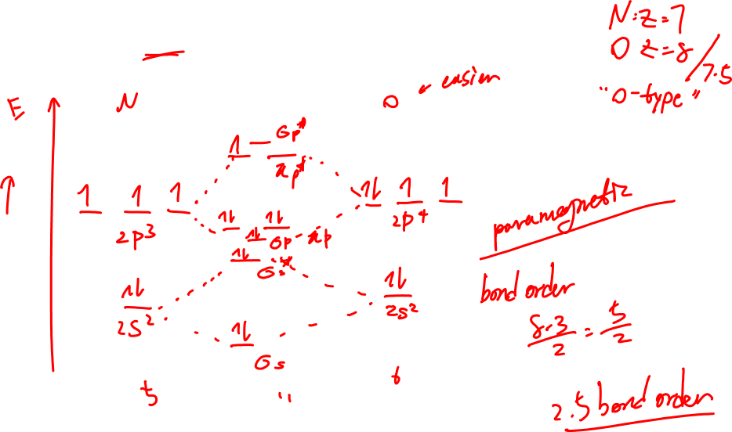
Draw and label a molecular orbital diagram for nitrogen monoxide, NO. Give the bond order and the magnetism:
Notes:
E of ONE PHOTON

Slide 17
Notes:
E of ONE PHOTON

Slide 18
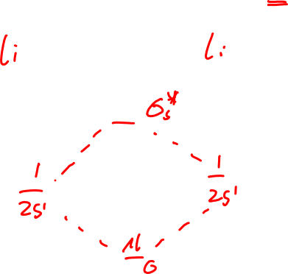
MO theory Band Diagrams
Give an MO diagram for Li₂ (Li: 1s² 2s¹)
Notes:
E of ONE PHOTON

Slide 19
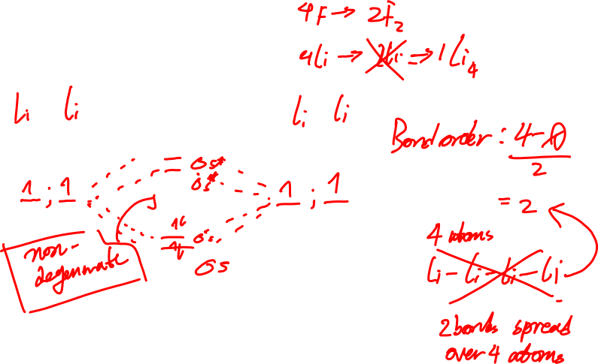
MO theory Band Diagrams
Give an MO diagram for Li₄
Notes:
E of ONE PHOTON

Slide 20
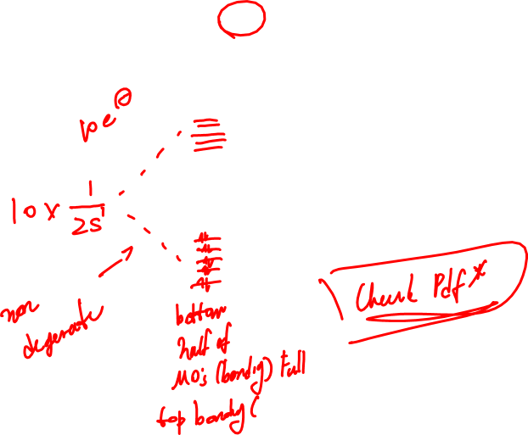
MO theory Band Diagrams
Give an MO diagram for Li₁₀
Notes:
E of ONE PHOTON

Slide 21
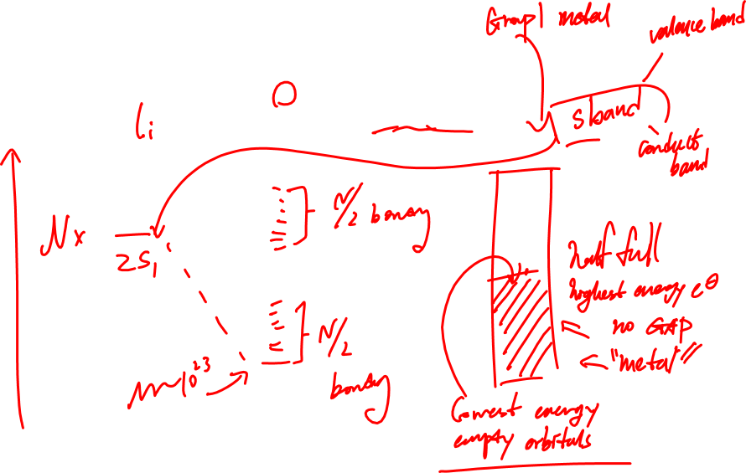
MO theory Band Diagrams
Give an MO diagram for Li_{N} (where N is a large number, like one mole…)
Notes:
E of ONE PHOTON

Slide 22
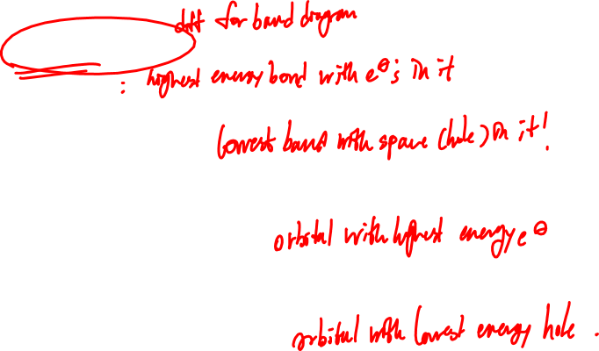
MO theory Band Diagrams
Give an MO diagram for Li_{N}
Valence band:
Conduction band:
Highest Occupied MO:
Lowest Unoccupied MO
Notes:
E of ONE PHOTON

Slide 23
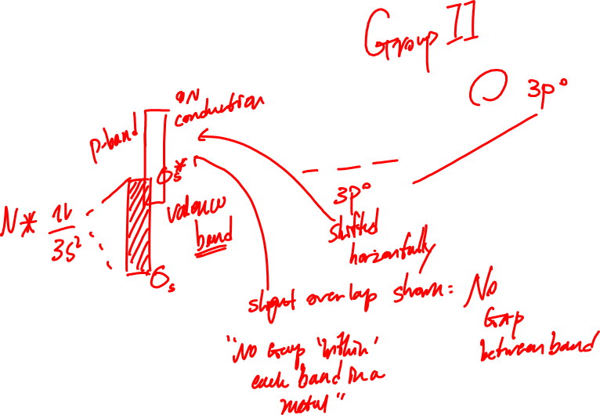
MO theory Band Diagrams
Now consider Mg₂ (Mg: 1s² 2s² 2p⁶ 3s²)
Notes:
E of ONE PHOTON

Slide 24
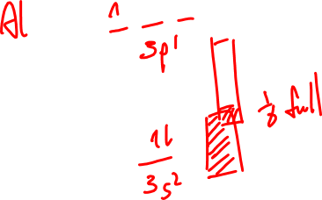
MO theory Band Diagrams
Now consider Mg_{N} (where N is a large number, like one mole…)
Notes:
E of ONE PHOTON

Slide 25
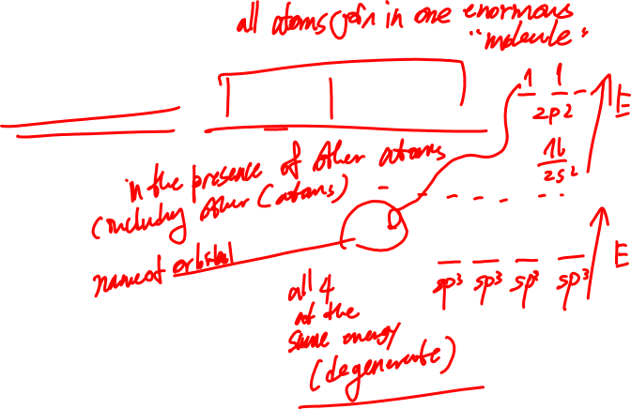
MO theory Band Diagrams
Non-metallic NETWORK SOLIDS:
e.g. Carbon – hybrid orbitals: C: 1s² 2s² 2p²
band gap ≈ 170 kJ/mol graphite
band gap ≈ 580 kJ/mol diamond
C*: 1s² (sp³)⁴
Notes:
E of ONE PHOTON

Slide 26
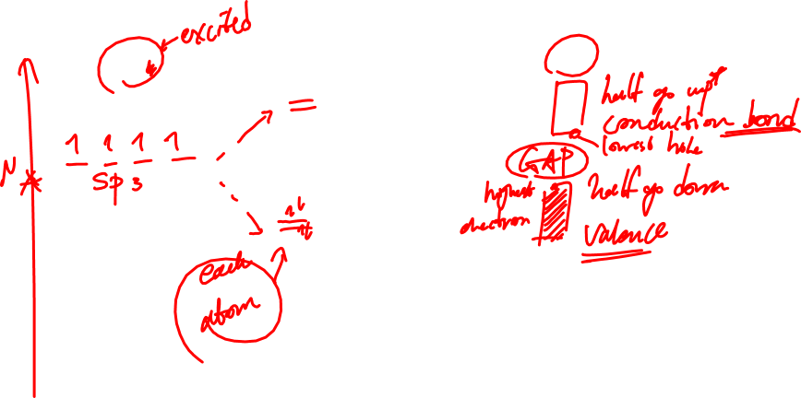
MO theory Band Diagrams: INTRINSIC semiconductors
Non-metallic NETWORK SOLIDS:
e.g. C₂ and C_{N}
Notes:
E of ONE PHOTON

Slide 27
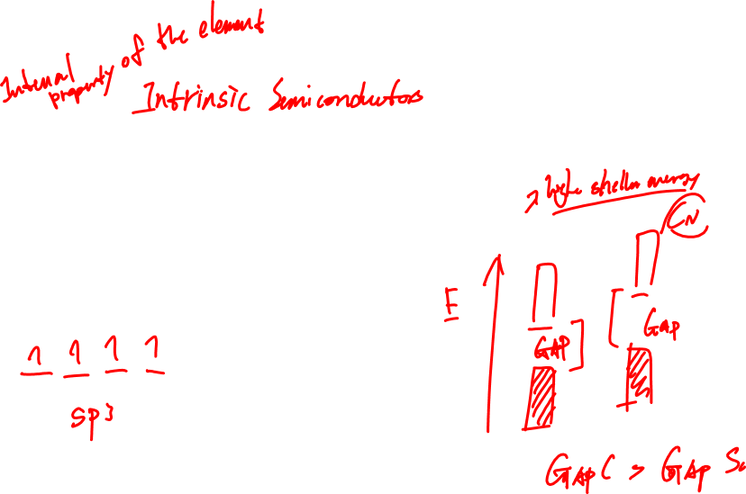
MO theory Band Diagrams: INTRINSIC semiconductors
Non-metallic NETWORK SOLIDS:
band gap ≈ 105 kJ/mol
e.g. Si₂ and Si_{N}
Notes:
E of ONE PHOTON

Slide 28

MO theory Band Diagrams: EXTRINSIC semiconductors
Doping: Imagine taking a large number of silicon atoms, and replacing one of them with a phosphorous atom
Si_{N}As_{n} N is a large number Si: [Ne] 3s² 3p²
n<<N (and right now, n=1) As: [Ar] 4s² 3d¹⁰ 4p³
(i.e. the phosphorous atoms only “see” silicon, and not other P atoms, so silicon drives the behaviour.)
Notes:
E of ONE PHOTON

Slide 29
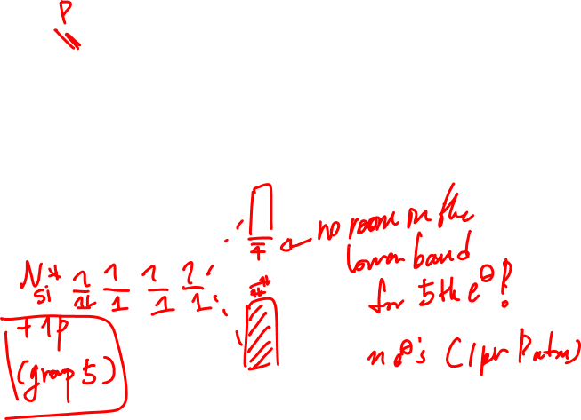
MO theory Band Diagrams: EXTRINSIC semiconductors
Si_{N}As_{n} N is a large number Si: [Ne] 3s² 3p²
n<<N (and right now, n=1) As: [Ar] 4s² 3d¹⁰ 4p³
Notes:
E of ONE PHOTON

Slide 30
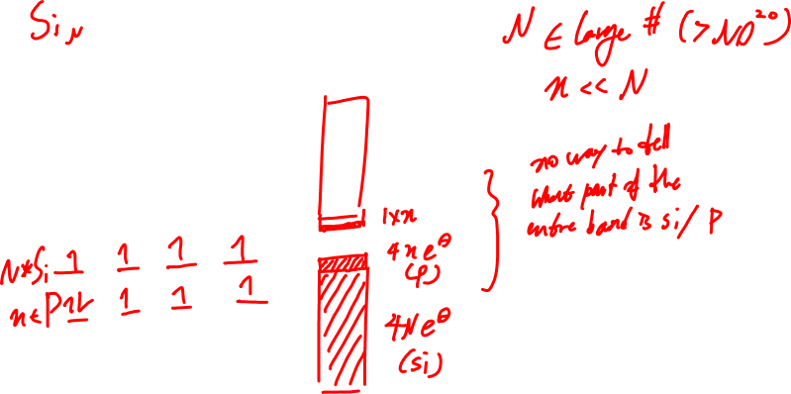
MO theory Band Diagrams: EXTRINSIC semiconductors
Notes:
E of ONE PHOTON

Slide 31
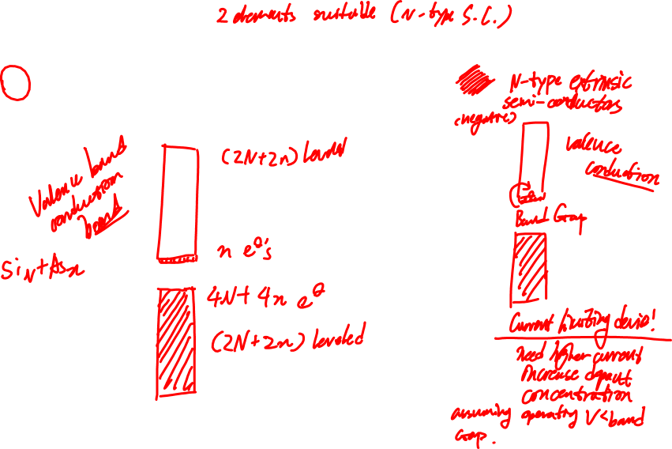
MO theory Band Diagrams: EXTRINSIC semiconductors
Compare the conductivity:
Si_{N}As_{n} N is a large number Li_{N}
n<<N
Notes:
E of ONE PHOTON

Slide 32
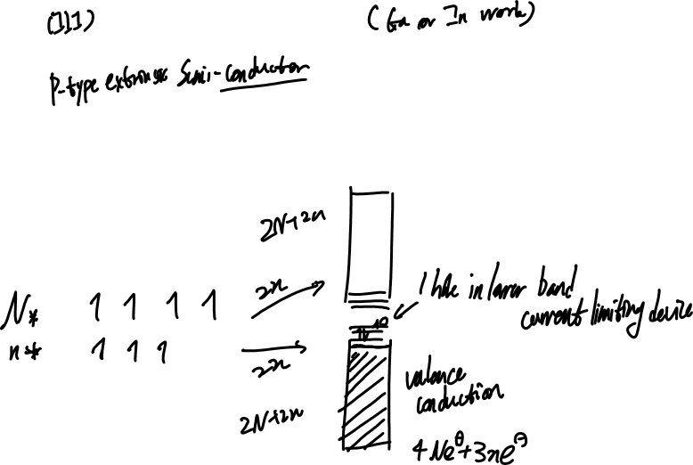
MO theory Band Diagrams: EXTRINSIC semiconductors
Si_{N}Ga_{n} N is a large number Si: [Ne] 3s² 3p²
n<<N (and right now, n=1) Ga: [Ar] 4s² 3d¹⁰ 4p¹
Valence band?
Conduction band?
Si:
Ga:
― ― ― ―
― ― ― ―
Notes:
E of ONE PHOTON

Slide 33
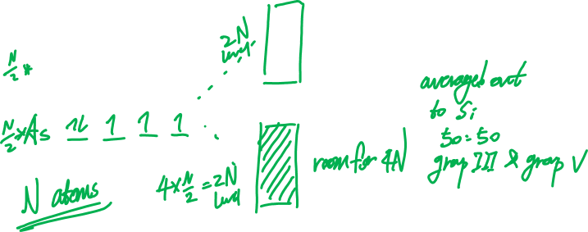
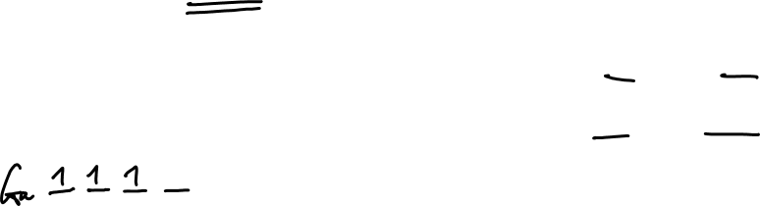
MO theory Band Diagrams: EXTRINSIC semiconductors
What about a 50:50 mixture of Ga and As?
Ga_{N}As_{N} N is a large number Ga: [Ar] 4s² 3d¹⁰ 4p¹
As: [Ar] 4s² 3d¹⁰ 4p³
Valence band?
Conduction band?
Notes:
E of ONE PHOTON

Slide 34
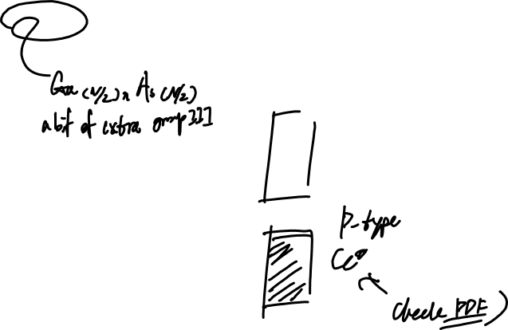
MO theory Band Diagrams: EXTRINSIC semiconductors
What about a mixture of Ga and As with a small excess of Ga?
Ga_{N+n}As_{N} N is a large number Ga: [Ar] 4s² 3d¹⁰ 4p¹
n<<N As: [Ar] 4s² 3d¹⁰ 4p³
Valence band?
Conduction band?
Ga:
As:
― ― ― ―
― ― ― ―
Notes:
E of ONE PHOTON

Slide 35
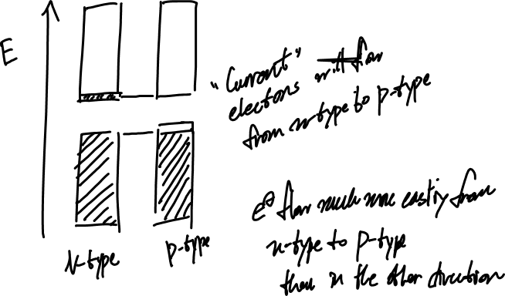
MO theory Band Diagrams
Notes:
E of ONE PHOTON

