Slide 1
THE MOLECULE: NOMENCLATURE
IONS AND IONIC COMPOUNDS
Atomic CATIONS: (positive ions)
Group IA, IIA and other main group cations where the charge is equal to the group number:
element name followed by the word "ion"
e.g. Li⁺ : Lithium ion
Al³⁺ (aluminum is in group IIIA): Aluminum ion
Pb⁴⁺ (lead is in group IVA): Lead ion
Notes:
E of ONE PHOTON

Slide 2
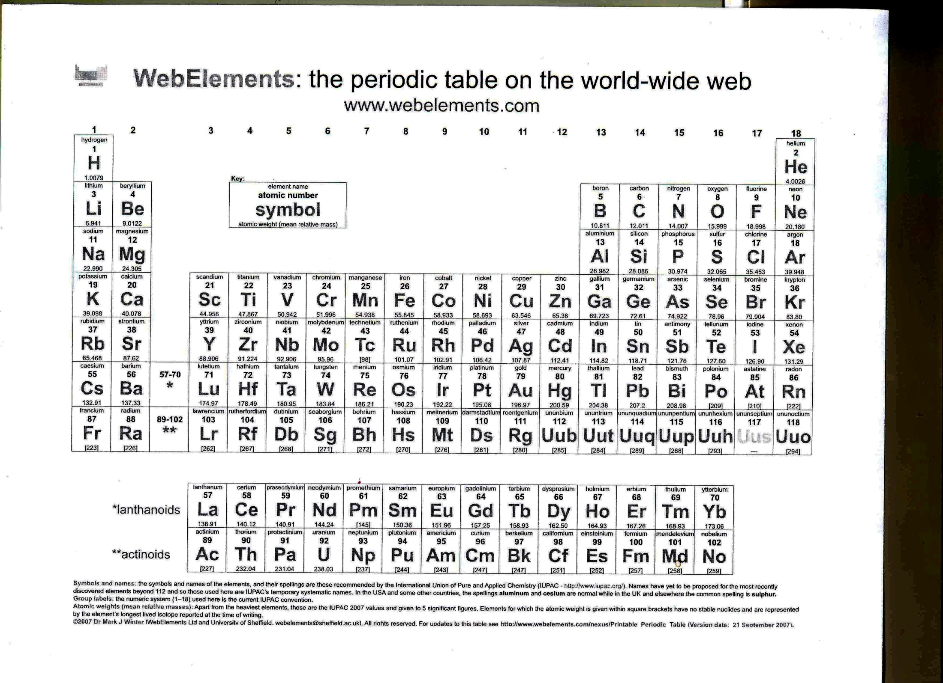

Slide 3
Other Main Group cations, and d-block and f-block cations:
element name
followed by the charge on the ion, in roman numerals, in round brackets
followed by the word "ion"
e.g. Mn²⁺ (d-block): Manganese (II) ion
Nd³⁺ (f-block): Neodymium (III) ion
Pb²⁺ (lead not in gr IIA: specify!): Lead (II) ion
The charge on the ion is specified for main group ions ONLY when it is not the same as the group number, and for d and f block cations at all times.
Notes:
E of ONE PHOTON

Slide 4
Molecular cations: (cations which consist of more than one atom; memorize!)
NH₄⁺ : Ammonium ion
There are many others, but if you need those, I’ll give you name and charge. The ammonium ion is common, and you need to know it.
Notes:
E of ONE PHOTON

Slide 5
Atomic ANIONS: (negative ions)
Drop the last syllable (or last 2 syllables) from the element name
Replace them with the syllable "ide"
Followed by the word "ion"
e.g. Cl: Chlorine
Cl⁻: Chloride ion
e.g. Te: Tellurium
Te²⁻: Telluride ion
The charge on an anion is never specified. No element can form more than one type of anion (although some will form one type of anion and one or more type of cation.)
Notes:
E of ONE PHOTON

Slide 6
Molecular anions: (memorize)
OH– hydroxide ion
CH₃COO – acetate ion
NO₃ – nitrate ion
CO₃^{2 –} carbonate ion
SO₄^{2 –} sulfate ion
PO₄^{3 –} phosphate ion
There are many others, but if you need those, I’ll give you name and charge. The ammonium ion is common, and you need to know it.
Notes:
E of ONE PHOTON

Slide 7
IONIC COMPOUNDS: (metal + non-metal or any combination of the molecular ions/elemental ions; Neutral by definition)
Name of the cation (with roman numeral included, if applicable) without the word "ion"
Followed by Name of anion without the word "ion"
e.g. NaCl is made up of Na⁺ and Cl⁻
or sodium ion and chloride ion
called: Sodium chloride
Notes:
E of ONE PHOTON

Slide 8
e.g. CrCl₃ is made up of:
the "Cl" must be Cl⁻ (no choice for the anion!)
therefore, to give a neutral compound, and "balance"
the 3 Cl⁻ , the "Cr" must be Cr³⁺.
The ions are therefore: Chromium (III) ion and Chloride ion
called: Chromium (III) chloride
Notes:
E of ONE PHOTON

Slide 9
e.g. Mn₂O₃
Notes:
E of ONE PHOTON

Slide 10
e.g. Cu₃(PO₄)₂
Notes:
E of ONE PHOTON

Slide 11
BINARY COVALENT COMPOUNDS: (2 non-metals)
You don't have electrical charges to dictate how many of each species may combine. Two elements may combine in several different ratios to form different covalent compounds.
The words used for the elements are the same as they were for ionic cpds :
  The less electronegative element is named first, using its element name
  The more electronegative is named second, with the last (or last 2) syllables replaced by "ide"
Notes:
E of ONE PHOTON

Slide 12
Prefixes are used to indicate how many of each element is used:
  Mono/mon 1
  di 2
  tri 3
  tetra/tetr 4
  penta /pent 5
  hexa/hex 6
  hepta /hept 7
  octa/oct 8
  nona/non 9
  deca/dec 10
Note: if only one of the less electronegative element (i.e. the first) is present, the prefix "mono" is left out. It is never left out for the more electronegative (second) however.
Notes:
E of ONE PHOTON

Slide 13
e.g.
  N₂O₅ : dinitrogen pentoxide
  N₂O₄ : dinitrogen tetroxide
  N₂O : dinitrogen monoxide (not dinitrogen oxide)
  CO₂ : carbon dioxide (not monocarbon dioxide!)
Notes:
E of ONE PHOTON

Slide 14
THE MOLECULE: LEWIS STRUCTURES
A moderately reliable way of predicting the bonding and bond orders of atoms in a molecule.
It is based on observation.
It is not a theory – it isn’t trying to explain anything
It is a model – within certain constraints, it makes accurate predictions
It does not work well on ions or molecules with an odd number of electrons (radicals)
It does not predict the magnetic properties of ions or molecules
Notes:
E of ONE PHOTON

Slide 15
THE MOLECULE: LEWIS STRUCTURES
“RECIPE”
1. Count the number of valence electrons on each atom.
Add 1 for each negative (-) charge
Subtract 1 for each positive (+) charge
2. Build the skeleton: Put the least electronegative element in the centre (never H in centre!)
If "acid", group all O and H into -O-H groups
If organic, you may have -CH2- groups or -CH3 groups
Link each atom (or group, as above) directly to the central atom with 1 link, or single bond (S.B.)
3. Count the number of electrons used in the skeleton (2 for each bond)
Subtract this from the number of valence electrons counted in step 1 to get the number left over.
4. Use leftover electrons in step 3. To try to complete all octets (ie fill the valence s and p orbitals) (NB. H only gets a total of 2 (NOT 8!) therefore it is satisfied with 1 single bond.)
Notes:
E of ONE PHOTON

Slide 16
There are now 3 possible outcomes:
O. EXACTLY ENOUGH ELECTRONS
Stop! (for now)
Notes:
E of ONE PHOTON

Slide 17
I. NOT ENOUGH ELECTRONS TO COMPLETE THE OCTETS:
"do what?"
• You need 1 double bond (DB) for each 1 pair (2 electrons) missing
• OR You need 1 triple bond (TB) for each 2 pair (4 electrons) missing
"do it where?"
• O atoms often form DB's
• C atoms often form DB's, quite often form TB's
• N atoms often form TB's, quite often form DB's
• NEVER to a H atom
• Rarely to a halogen, Never to F atom
• Never have more than 4 bonds on a second row (Li …Ne) atom
"do it how?"
• GO RIGHT BACK TO THE SKELETON!!!!
• Redraw skeleton with DB's/TB's as necessary
• Recalculate leftover electrons and re-do steps 3 and 4
Notes:
E of ONE PHOTON

Slide 18
II. YOU HAVE ELECTRONS LEFT OVER:
"expand the octet" of the central atom (as long as it is in row 3 or lower on the per. Table)
ie. Place the extra electrons, in pairs, on the central atom.
Notes:
E of ONE PHOTON

Slide 19
CORRECTING FOR FORMAL CHARGE
An atom, even in a molecule, has a "memory" of its original valence, and wants to maintain it.
1. Count the number of electrons "formally" assigned to each atom:
count all electrons in lone pairs
count 1 for each chemical bond touching the atom
2. Compare this against the original valence to get formal change, FC.
F.C. = {group #} - {(# lone electrons)+(# bonds)}
3. If, and only if:
  The central atom is in row 3 or below on the periodic table
  and
  there are both + and - formal chages present in the molecule
MOVE A LONE PAIR OF ELECTRONS OFF THE ELEMENT WITH THE NEGATIVE FORMAL CHARGE AND INTO THE BOND JOINING IT TO THE ELEMENT WITH THE POSITIVE FORMAL CHARGE.
Notes:
E of ONE PHOTON

Slide 20
The net effect is that the formal charge that was negative goes up by one (eg. from -1 to 0, or from -3 to -2) and the formal charge that was positive goes down by one (eg from +3 to +2, or from +1 to 0)
WHEN THERE ARE NO LONGER BOTH POSITIVE AND NEGATIVE FORMAL CHARGES PRESENT, YOU STOP ADJUSTING THE MOLECULE.
Notes:
E of ONE PHOTON

Slide 21
RESONANCE
When a Lewis structure has fewer multiple bonds than there were equivalent positions where you could have placed the multiple bond(s) THE MULTIPLE BONDS ARE SHARED AMONG THE EQUIVALENT POSITIONS.
Draw enough "resonance structures" to show every possible position having every possible bond order. You do not need to show "permutations and combinations".
For example, it only takes two resonance structures to show that SO₄²⁻ has two double bonds, shared among 4 equivalent S to O bonds.
Notes:
E of ONE PHOTON

Slide 22
e.g. Cl₂CO Carbonyl dichloride
Notes:
E of ONE PHOTON

Slide 23
Notes:
E of ONE PHOTON

Slide 24
e.g. ICl₄⁺
Notes:
E of ONE PHOTON

Slide 25
Notes:
E of ONE PHOTON

Slide 26
CORRECTING FOR FORMAL CHARGE
An atom, even in a molecule, has a "memory" of its original valence, and wants to maintain it.
1. Count the number of electrons "formally" assigned to each atom:
count all electrons in lone pairs
count 1 for each chemical bond touching the atom
2. Compare this against the original valence to get formal change, FC.
F.C. = {group #} - {(# lone electrons)+(# bonds)}
3. If, and only if:
  The central atom is in row 3 or below on the periodic table
  and
  there are both + and - formal chages present in the molecule
MOVE A LONE PAIR OF ELECTRONS OFF THE ELEMENT WITH THE NEGATIVE FORMAL CHARGE AND INTO THE BOND JOINING IT TO THE ELEMENT WITH THE POSITIVE FORMAL CHARGE.
Notes:
E of ONE PHOTON

Slide 27
e.g. H₂SO₃
Notes:
E of ONE PHOTON

Slide 28
e.g. SO₄^{2–}
Notes:
E of ONE PHOTON

Slide 29
e.g. SO₄^{2–}
Notes:
E of ONE PHOTON

Slide 30
RESONANCE
When a Lewis structure has fewer multiple bonds than there were equivalent positions where you could have placed the multiple bond(s) THE MULTIPLE BONDS ARE SHARED AMONG THE EQUIVALENT POSITIONS.
Draw enough "resonance structures" to show every possible position having every possible bond order. You do not need to show "permutations and combinations".
For example, it only takes two resonance structures to show that SO₄²⁻ has two double bonds, shared among 4 equivalent S to O bonds.
Notes:
E of ONE PHOTON

Slide 31
Notes:
E of ONE PHOTON

Slide 32
Valence Shell Electron Pair Repulsion: VSEPR
All the electrons in one individual chemical bond (2 in a single bond, 4 in a double bond, 6 in a triple bond) have to stay in the same region of space. Each of these is a “bonding region”.
Lone pair electrons and bonding electrons are each confined to their own “region of electron density”.
“Regions of electron density” want to get as far apart from each other as possible.
Notes:
E of ONE PHOTON

Slide 33

RECIPE: “VSEPR geometries” or “molecular geometries”
1. Draw a Lewis Diagram
2. On the central atom, count the number of regions of electron density
1 for each lone pair (or, if an odd number of electrons, 1 for the lone electron)
1 for each triple bond
1 for each double bond
1 for each single bond
Notes:
E of ONE PHOTON

Slide 34

RECIPE: “VSEPR geometries” or “molecular geometries”
3. Assign the "ideal shape" on which to base the geometry:
2 regions: LINEAR
3 regions: TRIANGULAR
4 regions: TETRAHEDRAL
5 regions: TRIGONAL BIPYRAMEDAL
6 regions: OCTAHEDRAL
4. Position the lone pairs (or, if applicable, the lone electron)
5. Position the bonds and the outer atoms
6. "Collapse" down the lone pairs (these dictate the shape, but are not part of the naming process)
7. Name and draw the resulting shape
Notes:
E of ONE PHOTON

Slide 35
2 regions: linear
4 regions: tetrahedral
3 regions: triangular
Notes:
E of ONE PHOTON

Slide 36
5 regions:
trigonal bipyramedal
6 regions: octahedral
Notes:
E of ONE PHOTON

Slide 37
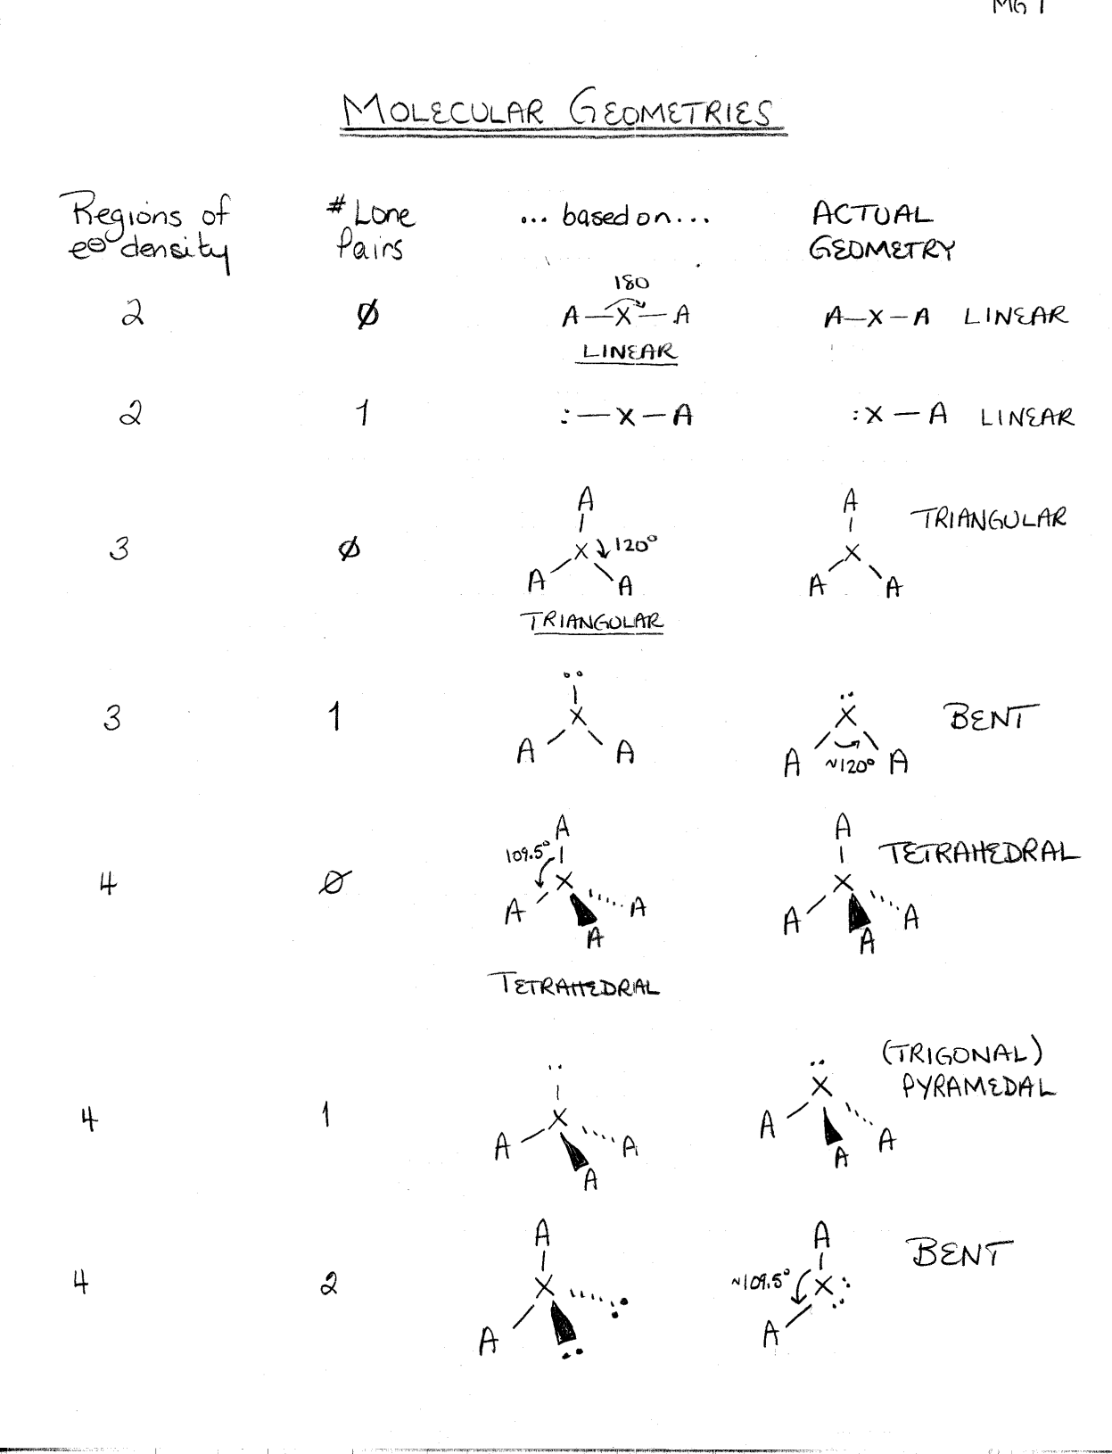
All the possible geometries up to six regions.
Reason them out rather than memorizing them!

Slide 38
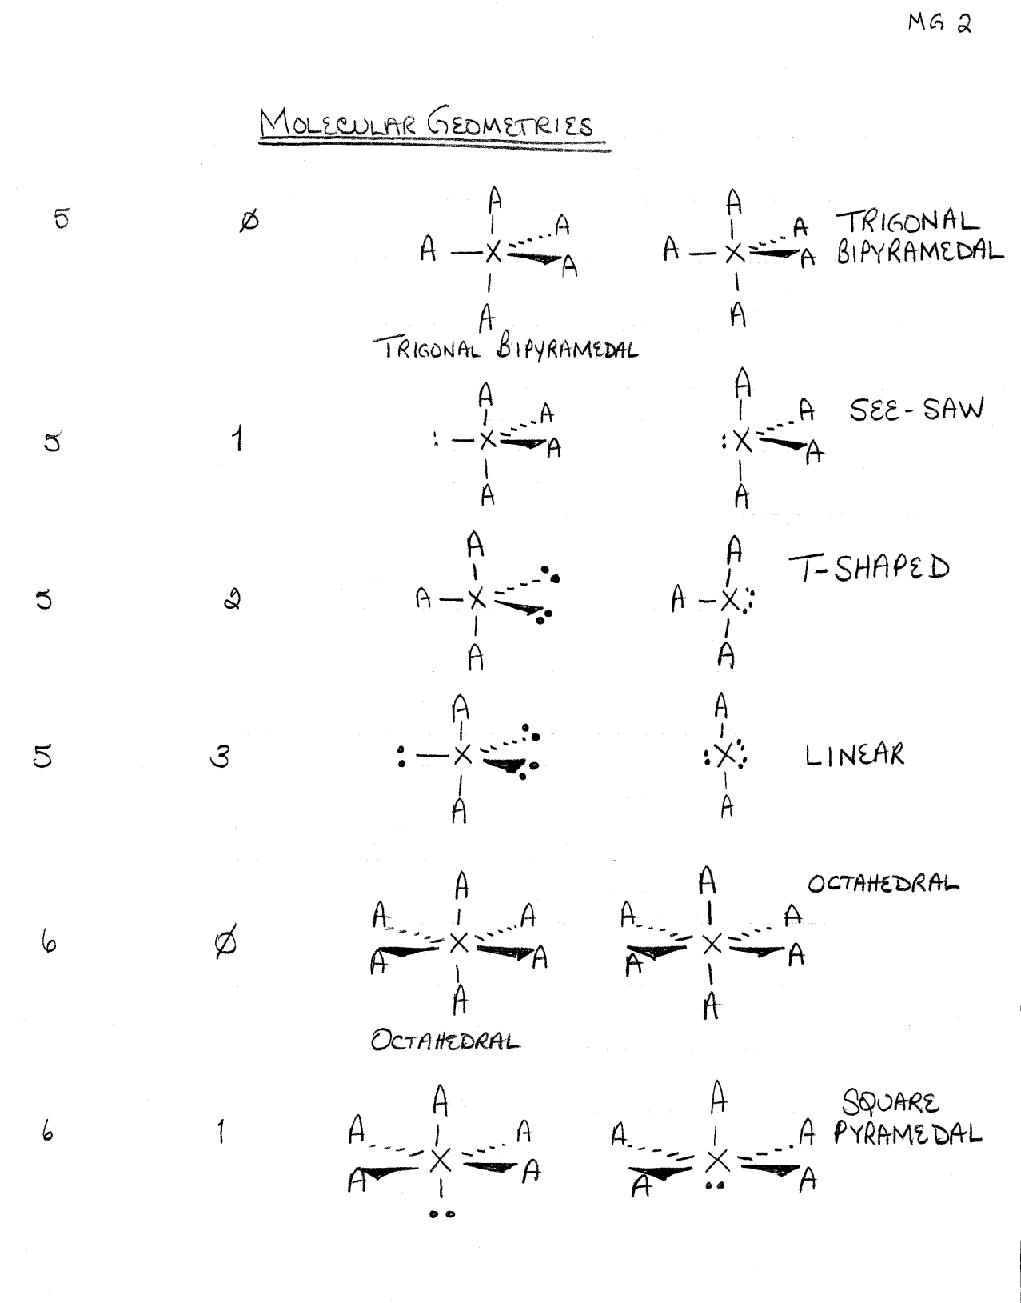

NOTE: lone pairs are always axial on the trigonal bipyramid
Notes:
E of ONE PHOTON

Slide 39
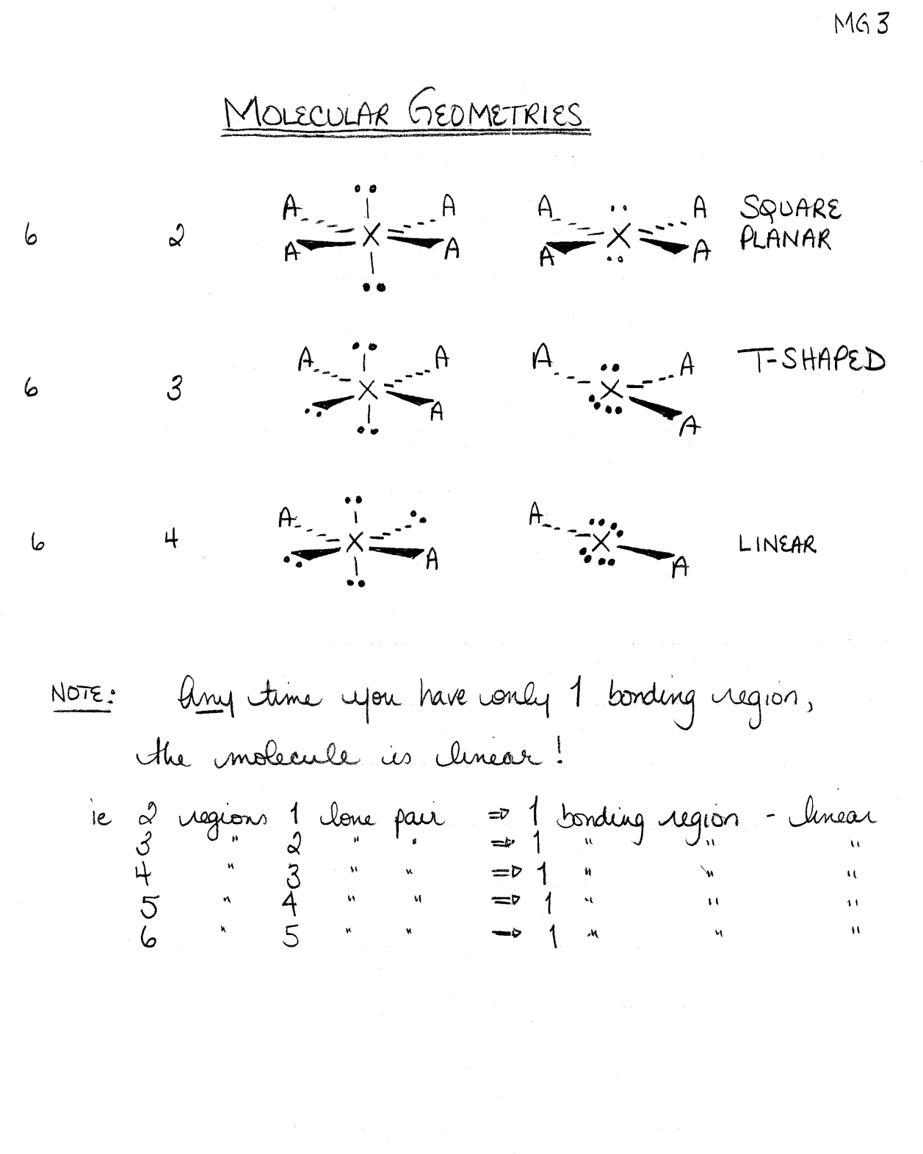
Notes:
E of ONE PHOTON

Slide 40
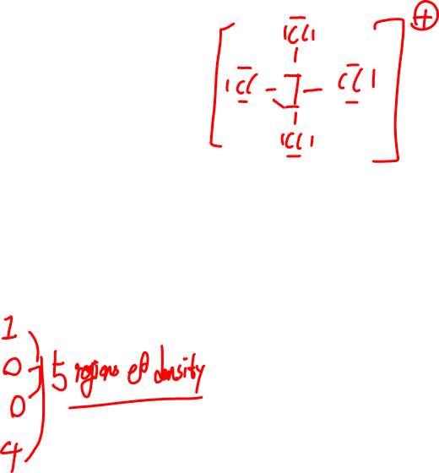
Remember ICl₄⁺
1. Draw a Lewis Diagram
On the central atom, count the number of regions of electron density
    L.P.:
    T.B.:
    D.B.:
    S.B.:
Notes:
E of ONE PHOTON

Slide 41
3. Assign the "ideal shape" on which to base the geometry:
2 regions: LINEAR
3 regions: TRIANGULAR
4 regions: TETRAHEDRAL
5 regions: TRIGONAL BIPYRAMEDAL
6 regions: OCTAHEDRAL
Notes:
E of ONE PHOTON

Slide 42
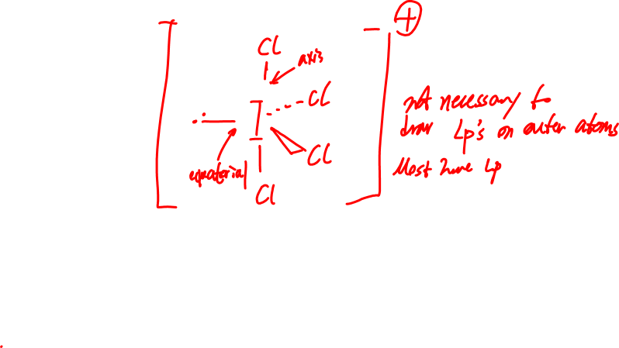
4. Position the lone pairs (or, if applicable, the lone electron)
5. Position the bonds and the outer atoms
Notes:
E of ONE PHOTON

Slide 43
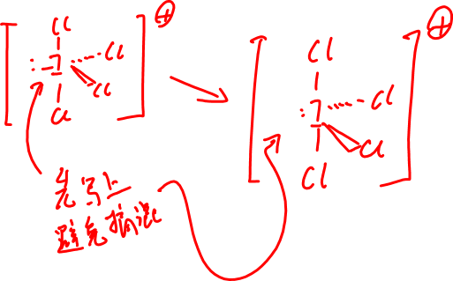
6. "Collapse" down the lone pairs (these dictate the shape, but are not part of the naming process)
7. Name and draw the resulting shape
Notes:
E of ONE PHOTON

Slide 44
Notes:
E of ONE PHOTON

Slide 45
Notes:
E of ONE PHOTON

