Slide 1
THE ATOM
Model: A nucleus: a dense central area made up of
      protons: p⁺
      neutrons: n⁰
A cloud of electrons around the nucleus: e–
CHEM 1101 lecture will start on slide 13; slides 1-12 are for background.

Slide 2
protons: p⁺
neutrons: n⁰

Slide 3
IT IS THE NUMBER OF PROTONS IN THE NUCLEUS THAT DETERMINES WHAT KIND OF ATOM WE HAVE – WHAT ELEMENT IT IS.
ATOMIC NUMBER: Symbol Z
  the number of protons in the nucleus
PERIODIC TABLE: An organized list of all known elements, arranged in order of atomic number
element names
behaviour
Z
SYMBOL
name
average mass

Slide 4
IT IS THE NUMBER OF PROTONS IN THE NUCLEUS THAT DETERMINES WHAT KIND OF ATOM WE HAVE – WHAT ELEMENT IT IS.
ATOMIC NUMBER: The atomic number is all you need to define the element
Every element with Z = 8 is oxygen. There are NO EXEPTIONS.
8
Every atom of oxygen has Z = 8. There are NO EXEPTIONS.
O
oxygen
15.999

Slide 5
ATOM: by definition is electrically neutral (sure we can charge them, but they’re not called atoms anymore!)
The protons are positively charged and the electrons are negatively charged (the neutrons are neutral)
so…there must be an equal number of protons (in the nucleus) and electrons (around it).
Z is defined as the number of protons, but for an atom (neutral, by def’n) it is also the number of electrons.
1
H
hydrogen
1.0079

Slide 6
ATOM: by definition is electrically neutral (sure we can charge them, but they’re not called atoms anymore!)
26
how many electrons are there in an atom of iron?
Fe
iron
55.845

Slide 7
http://www.webelements.com/nexus/sites/default/files/webelements_table_5sf_2012-06-07.pdf

Slide 8
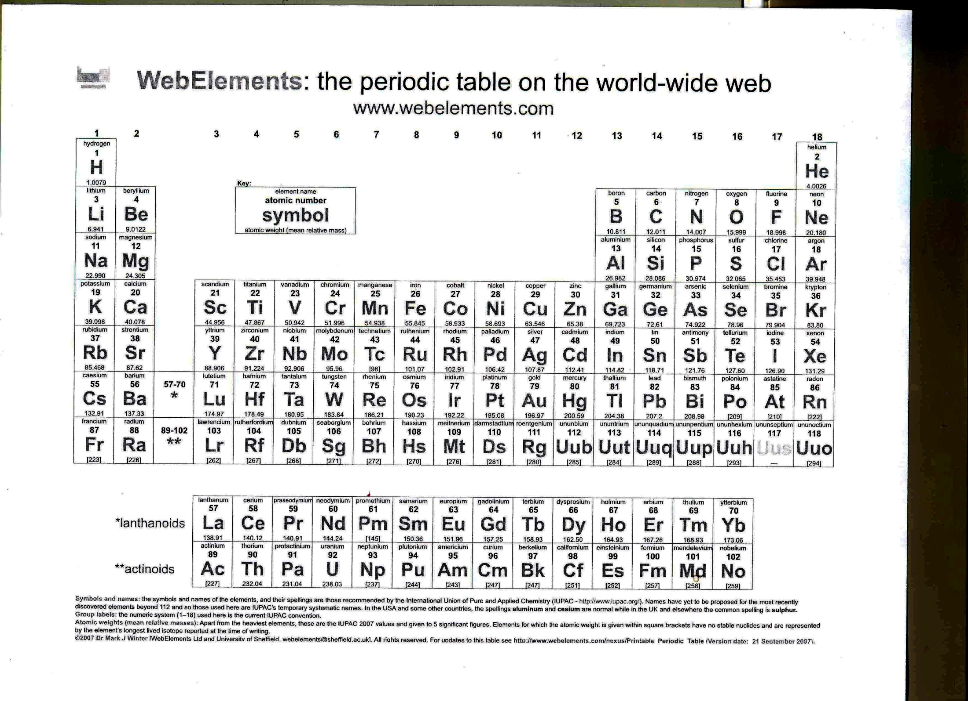

Slide 10
All atoms of a particular element have the same number of protons in the nucleus (Z).
Not all elements of a particular element have the same number of neutrons in the nucleus.
MASS NUMBER: Symbol A
  the total number of protons and neutrons in the nucleus
      A = (p⁺ + n⁰)
ISOTOPES: Atoms of the same element (same Z) with different masses (different A)
7
N
nitrogen
14.007

Slide 11
ISOTOPES: Atoms of the same element (same Z) with different masses (different A)
There are three isotopes of carbon found naturally, but only two are found in any significant amount:
C with 6 neutrons A =
C with 7 neutrons A =
Full atomic symbol:
X
6
C
A
carbon
Z
12.011

Slide 12
ISOTOPES: Atoms of the same element (same Z) with different masses (different A)
Full atomic symbol:
X
A
Full atomic symbol for carbon with 6 neutrons:
Z
can be written:
6
C
carbon
12.011

Slide 13
Studying the arrangement of the electrons in an atom – using ELECTROMAGNETIC RADIATION – EMR
EMR: Light and both the lower energy and higher energy non-visible parts of the spectrum
radio
microwave
I.R.
visible
U.V.
x-ray
gamma
> 1m
1 mm
10^{–7}m
10^{–8}m
10^{–11}m
10^{–12}m

Slide 14
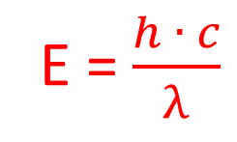

Particle model of EMR
NOTE: To model EMR as waves or particles is an oversimplification, but for our purposes in studying the atom, thinking of EMR as made up of particles describes the phenomena relatively well, so we do it!
Photons: “Particle” of light, whose energy depends on the frequency or wavelength of the radiation.
If there is only one wavelength present all photons will have the same energy.
E = $\frac{h ∙ c}{λ}$

Slide 15
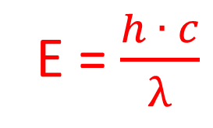
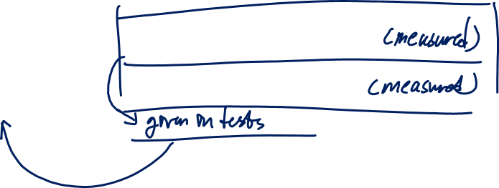
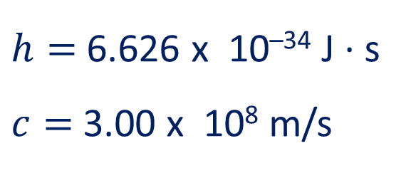
Particle model of EMR
If there is only one wavelength present all photons will have the same energy.
$h=$ 6.626 x 10^{–34} J ∙ s
$c=$3.00 x 10⁸ m/s
E = $\frac{h ∙ c}{λ}$
Notes:
E of ONE PHOTON

Slide 16
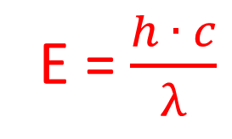

Studying the Atom, Using EMR:
Photons may interact with the electrons of atoms, depending on their energy.
For a gas phase hydrogen atom – the photons in the visible range that interact are:
  410 nm (violet)
  434 nm (indigo)
  486 nm (blue)
  656 nm (red-orange)
E = $\frac{h ∙ c}{λ}$
Notes:
E of ONE PHOTON

Slide 17
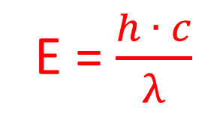
Studying the Atom, Using EMR:
Photons may interact with the electrons of atoms, depending on their energy.
The nuclear model of the atom was already known, but this observation led to the idea of electrons having:
Certain specific allowed energy states
The ability to: * Absorb energy to move to higher states
          * Release energy to fall to lower states
E = $\frac{h ∙ c}{λ}$
Notes:
E of ONE PHOTON

Slide 18
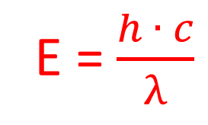

E = $\frac{h ∙ c}{λ}$
Studying the Atom, Using EMR:
Certain specific allowed energy states
The ability to: Absorb energy to move to higher states
          Release energy to fall to lower states
7
6
5
Note: the modern picture is much more complex.
This is a starting point for that, no more.
As a model, however, it works to predict energy levels.
4
3
2
1
Two-dimensional cut-away of a three-dimensional picture.
Notes:
E of ONE PHOTON

Slide 19
Studying the Atom, Using EMR:
4
5
6
Each successive level is closer to the one before. The difference between the energy of levels 1 and 2 is more than five times larger than the difference between levels 2 and 3…
3
increasing energy
2
1
Notes:
E of ONE PHOTON

Slide 20

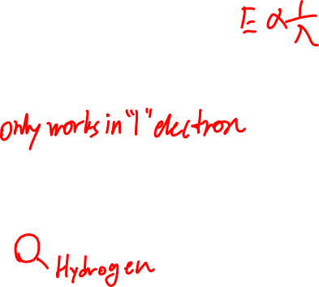

E = $\frac{h ∙ c}{λ}$
Studying the Atom, Using EMR: Rydberg Equation:
Certain specific allowed energy states
The ability to: Absorb energy to move to higher states
          Release energy to fall to lower states
7
The energy gap between the energy levels in a hydrogen atom can be described by an equation:
3
2
1
E_{gap} = R_{H} (1/n_{i}² – 1/n_{f}²)
R_{H} : Rydberg constant
2.18 x 10^{–18} J
n_{i}: electron’s initial level
n_{f}: electron’s final level
Note: you can relate the initial and final levels to wavelength (1/λ) and/or frequency (ν) as well as energy; you just use a different constant.
Notes:
E of ONE PHOTON

Slide 21

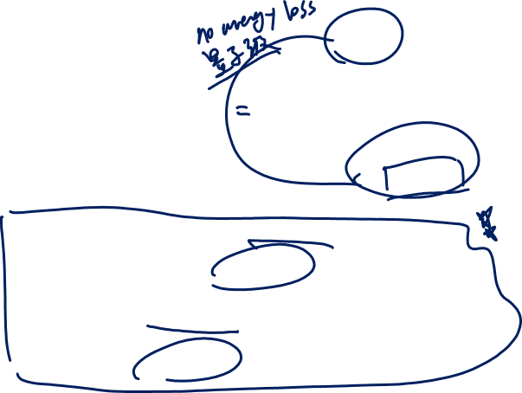
E = $\frac{h ∙ c}{λ}$
Studying the Atom, Using EMR: Rydberg Equation:
Certain specific allowed energy states
The ability to: Absorb energy to move to higher states
          Release energy to fall to lower states
7
3
E_{gap} = R_{H} (1/n_{i}² – 1/n_{f}²)
2
1
Since the energy of the photon involved must be equal to the energy of the gap, this can also be written:
E_{photon} = R_{H} (1/n_{i}² – 1/n_{f}²)
When the energy is positive, the photon is being absorbed by the atom.
When it is negative, the photon is being emitted (released) by the atom.
!
Notes:
E of ONE PHOTON

Slide 22
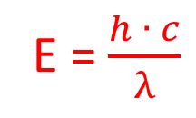
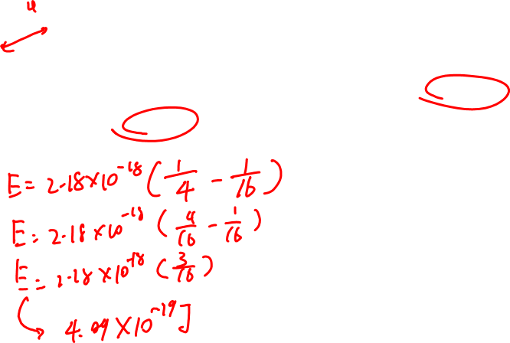
E = $\frac{h ∙ c}{λ}$
Studying the Atom, Using EMR: Rydberg Equation:
7
E = R_{H} (1/n_{i}² – 1/n_{f}²)
3
R_{H} : 2.18 x 10^{–18} J
2
1
Calculate the energy required for a photon to promote an electron from the second to the fourth energy level in hydrogen:
4.09 x 10⁻¹⁹ J
Notes:
E of ONE PHOTON

Slide 23
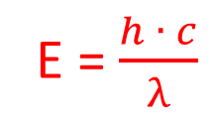
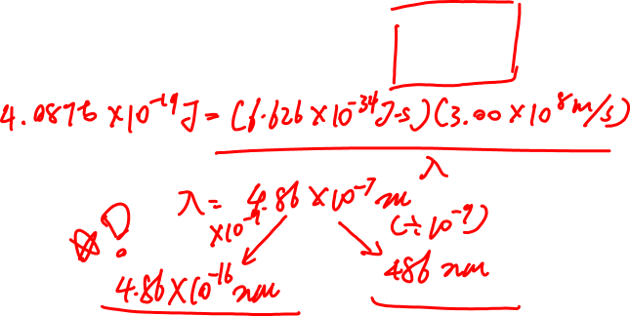
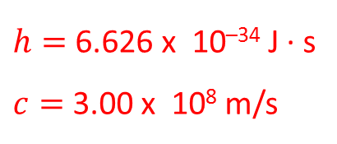
Studying the Atom, Using EMR: Rydberg Equation:
7
E = R_{H} (1/n_{i}² – 1/n_{f}²)
3
R_{H} : 2.18 x 10^{–18} J
2
1
What will be the wavelength of the photon in nanometers?
$h=$ 6.626 x 10^{–34} J ∙ s
$c=$3.00 x 10⁸ m/s
E = $\frac{h ∙ c}{λ}$
486 x 10⁻⁷ m
Notes:
E of ONE PHOTON

Slide 24
Studying the Atom, Using EMR: Atoms other than hydrogen:
Every atom has a characteristic emission/absorption spectrum.
Hydrogen is only unique in that we can build a mathematical equation to describe all of the emission levels.
For other atoms, we have not found a single relationship that describes the energy gaps.
Notes:
E of ONE PHOTON

Slide 25
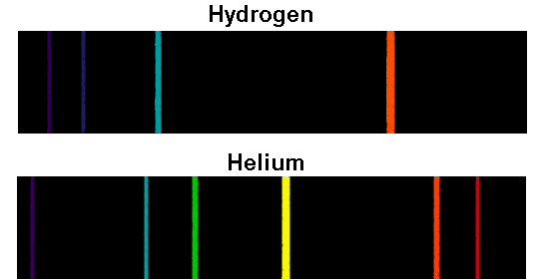
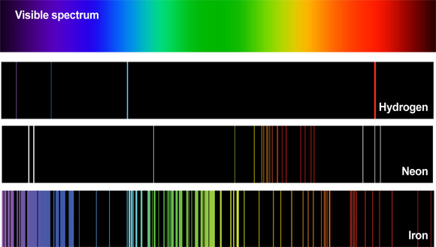

Studying the Atom, Using EMR: Atoms other than hydrogen:
Notes:
E of ONE PHOTON

Slide 26
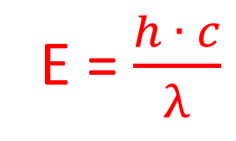
Photoelectric Effect:
When a beam of photons of sufficient energy strikes a collection of atoms of any element, electrons are emitted from the atoms.
From a chemical point of view:
  Take a gas-phase sample of an element
  shine EMR of relatively low energy into it
  increase the energy of the photons gradually
  note the point where electrons just start to appear
E = $\frac{h ∙ c}{λ}$
Notes:
E of ONE PHOTON

Slide 27
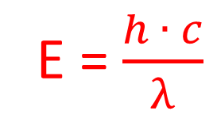
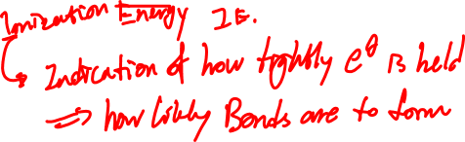
Photoelectric Effect:
E = $\frac{h ∙ c}{λ}$
  Take a gas-phase sample of an element
  shine EMR of relatively low energy into it
  increase the energy of the photons gradually
  note the point where electrons just start to appear
What useful knowledge about the atom can this give you?
Notes:
E of ONE PHOTON

Slide 28
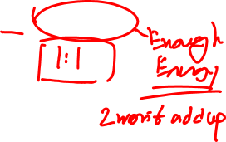
Photoelectric Effect:
E = $\frac{h ∙ c}{λ}$
The photoelectric effect involves the collision of ONE photon with ONE electron.
If you want to remove electrons from a dozen atoms – you’ll need a dozen photons
if you want to remove electrons from a mole of atoms – you’ll need a mole of photons
Notes:
E of ONE PHOTON

Slide 29

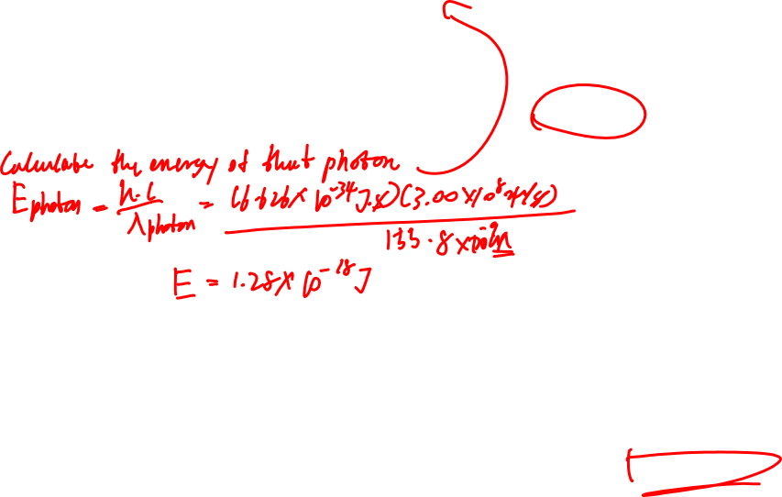
E = $\frac{h ∙ c}{λ}$
Photoelectric Effect:
  You find that EMR of wavelength of 155.8 nm is just sufficient to ionize silicon.
  a) What is the ionization of a silicon atom?
  b) What is the ionization energy of silicon, in kJ/mol?
1.28 x 10⁻¹⁸ J
Notes:
E of ONE PHOTON

Slide 30
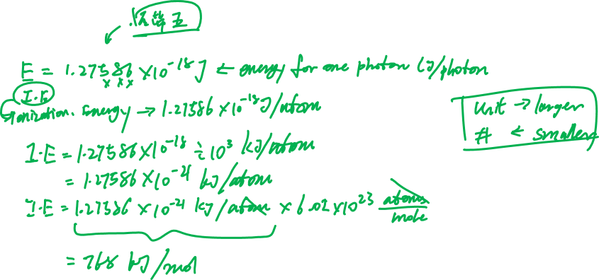
E = $\frac{h ∙ c}{λ}$
Photoelectric Effect:
  155.8 nm
768 kJ/mol
Notes:
E of ONE PHOTON

Slide 31


E = $\frac{h ∙ c}{λ}$
Photoelectric Effect – Work Function:
When a beam of photons of sufficient energy strikes a collection of atoms of any element, electrons are emitted from the atoms.
If a beam of photons strike a solid surface:
Work Function: The minimum energy required to remove an electron from a solid surface.
If you deliver this energy using photons, then if the incident photons have more energy than the work function of the material, the excess energy will be converted into kinetic energy of the ejected electrons. (Possible when the electron leaves the atom, but not when it moves from one state to another within an atom!)
(note: E_{photon} = W + K.E. is “not an equation”. It’s the definition of conservation of energy! It will not be “given”.)
Notes:
E of ONE PHOTON

Slide 32

E = $\frac{h ∙ c}{λ}$
Photoelectric Effect – work function:
  The work function of gallium metal is 417 kJ/mol.
  a) What is the maximum wavelength of electromagnetic radiation that will cause electrons to be ejected from the surface of gallium metal?
  b) If you use EMR of wavelength 225 nm, how much kinetic energy will the ejected electrons have?
Notes:
E of ONE PHOTON

Slide 33
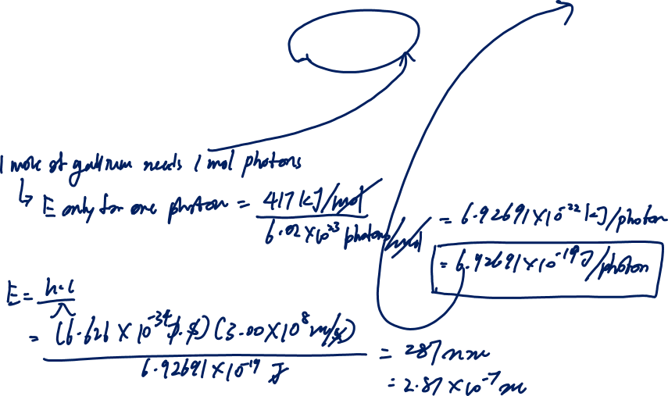
E = $\frac{h ∙ c}{λ}$
Photoelectric Effect – work function:
  The work function of gallium metal is 417 kJ/mol.
  a) What is the maximum wavelength of electromagnetic radiation that will cause electrons to be ejected from the surface of gallium metal?
6.9246097 x 10⁻¹⁹
287
Notes:
E of ONE PHOTON

Slide 34
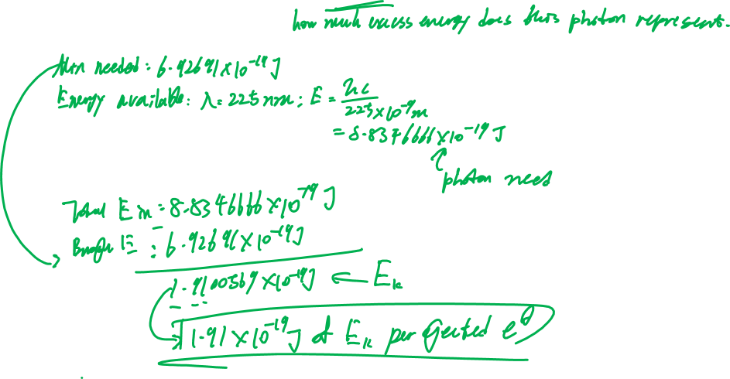
E = $\frac{h ∙ c}{λ}$
Photoelectric Effect – work function:
  The work function of gallium metal is 417 kJ/mol.
  b) If you use EMR of wavelength 225 nm, how much kinetic energy will the ejected electrons have?
8.8346666 x 10⁻¹⁹
1.9100569 x 10⁻¹⁹
Notes:
E of ONE PHOTON

Slide 35
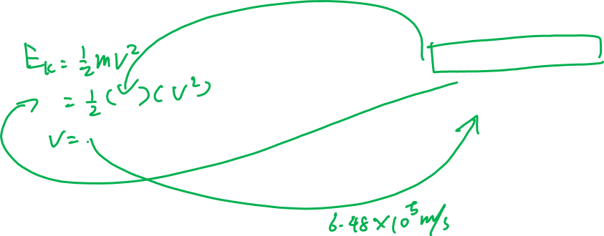
E = $\frac{h ∙ c}{λ}$
Photoelectric Effect – work function:
  The work function of gallium metal is 417 kJ/mol.
  bonus) How fast will the electrons be moving (assume they’re in a vacuum and not interacting)?
M_{e} = 9.109 x 10⁻³¹ kg
KE = 1.9100569 x 10⁻¹⁹
647 593.822 m/s
Notes:
E of ONE PHOTON

Slide 36
Multi-electron Atoms:
Recall the hydrogen atom: ONE descriptor, n, is enough to describe as much as we can know about the electron’s position and behaviour.
For a multi-electron atom (that means two or more electrons)
we still use the n value to describe the average size of the space that the electron occupies.
However… we need to describe more than that.
Notes:
E of ONE PHOTON

Slide 37
Multi-electron Atoms:
We need:
  three descriptors to describe the space in which the electron is most likely to be found
  one further descriptor to describe the behaviour of the electron in that space
Notes:
E of ONE PHOTON

Slide 38
Multi-electron Atoms:
We need:
  three descriptors to describe the space in which the electron is most likely to be found
    Size of the area
    Shape of the area
    “tilt” of the area
Notes:
E of ONE PHOTON

Slide 39
Multi-electron Atoms:
We need:
  one further descriptor to describe the behaviour of the electron in that space
    Spin of the electron (relative to the spin of the nucleus)
Notes:
E of ONE PHOTON

Slide 40
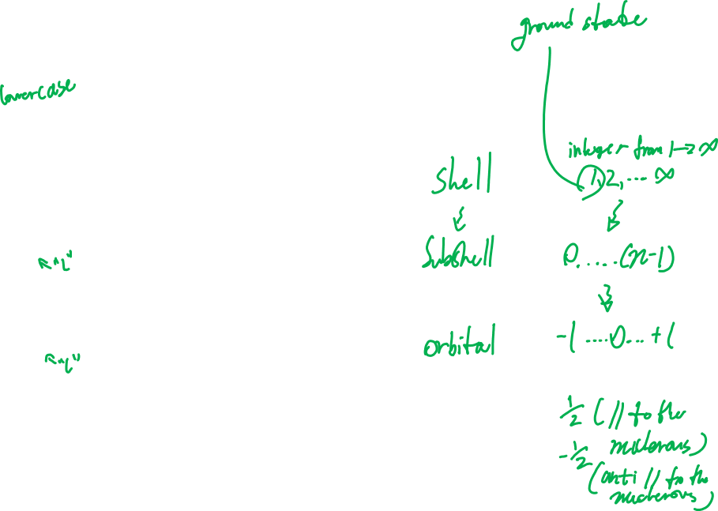
Multi-electron Atoms:
QUANTUM NUMBERS:
symbol | name | describes | area called | allowed values
n | Principal | Avg. size of area where the electron is most probably found
l | Angular | Shape of area where the electron is most probably found
m_{l} | Magnetic | Tilt of the area, relative to the areas where other electrons are most probably found
m_{s} | Spin | Direction of spin of the electron relative to the spin of the nucleus | -
Notes:
E of ONE PHOTON

Slide 41
Multi-electron Atoms:
QUANTUM NUMBERS:
In many cases, in the absence of an external magnetic field:
SHELL + SUBSHELL is enough information.
Although subshells have numerical designation, we also assign them letter codes:
Notes:
E of ONE PHOTON

Slide 42

Multi-electron Atoms:
QUANTUM NUMBERS:
Although subshells have numerical designation, we also assign them letter codes:
l-value | 0 | 1 | 2 | 3 | 4 | 5 | 6 | 7 | …
letter code:
Notes:
E of ONE PHOTON

Slide 43
Multi-electron Atoms:
QUANTUM NUMBERS:
Pauli Exclusion Principle: No two electrons in the same atom may have the same set of four quantum numbers.
“electrons can’t be in the same place with the same spin”
  This sets the maximum number of electrons that can occupy a given subshell (based on the available orbitals and spins for electrons in it)
Notes:
E of ONE PHOTON

Slide 44
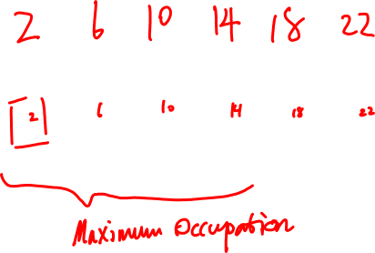
Multi-electron Atoms:
QUANTUM NUMBERS:
l-value | 0 | 1 | 2 | 3 | 4 | 5 | 6 | 7 | …
letter code: | s | p | d | f | g | h | i | j
Maximum occupation
…written… | s | p | d | f | g | h | i | j
Notes:
E of ONE PHOTON

Slide 45
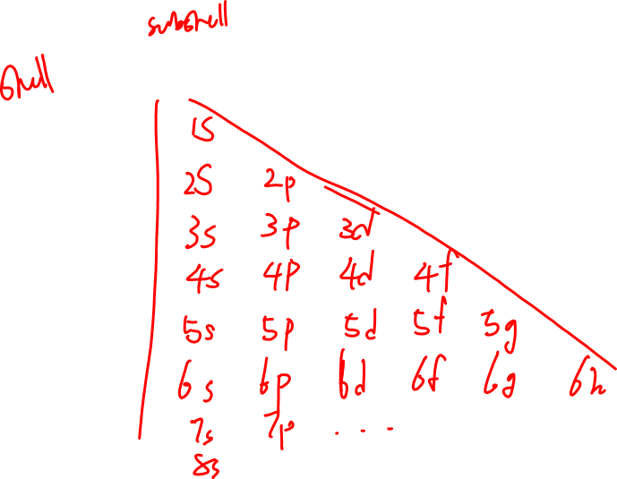
Multi-electron Atoms:
List of possible shell/subshell combinations:
 | 0 | 1 | 2 | 3 | 4 | 5 …
1
2
3
4
5
6
7…
l
n
Notes:
E of ONE PHOTON

Slide 46

Multi-electron Atoms:
Electron configurations for GROUND STATES of real atoms:
Electrons tend to occupy the lowest available electron states possible. Only as lower energy levels fill up will electrons enter higher energy levels.
When all electrons are in the lowest possible energy levels, the atom is in its GROUND STATE.
Notes:
E of ONE PHOTON

Slide 47
Multi-electron Atoms:
Electron configurations for GROUND STATES of real atoms:
Energy: Electromagnetic potential energy relative to the nucleus.
depends on: * Avg. distance from the nucleus
* Electrical and magnetic interactions with other electrons
Shells do NOT fill up in numerical order. Some subshells are lower energy than others, even though others closer to the nucleus.
Notes:
E of ONE PHOTON

Slide 48
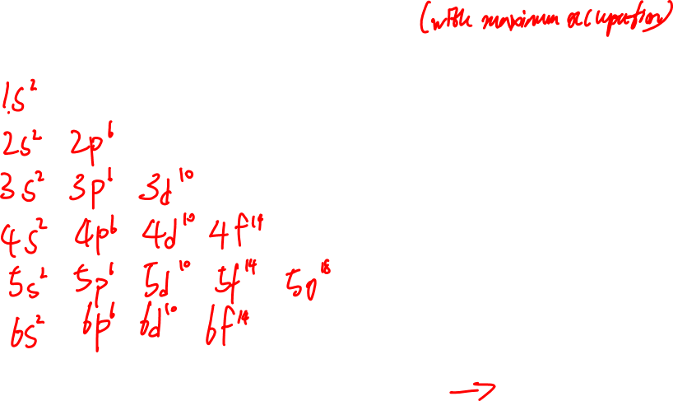
Multi-electron Atoms:
List of possible shell/subshell combinations:
Notes:
E of ONE PHOTON

Slide 49
Multi-electron Atoms:
List of possible shell/subshell combinations:
1s²
2s² | 2p⁶
3s² | 3p⁶ | 3d¹⁰
4s² | 4p⁶ | 4d¹⁰ | 4f¹⁴
5s² | 5p⁶ | 5d¹⁰ | 5f¹⁴ | 5g¹⁸
6s² | 6p⁶ | 6d¹⁰ | 6f¹⁴ | 6g¹⁸ | 6h²²
7s² | 7p⁶ | …
Notes:
E of ONE PHOTON

Slide 50
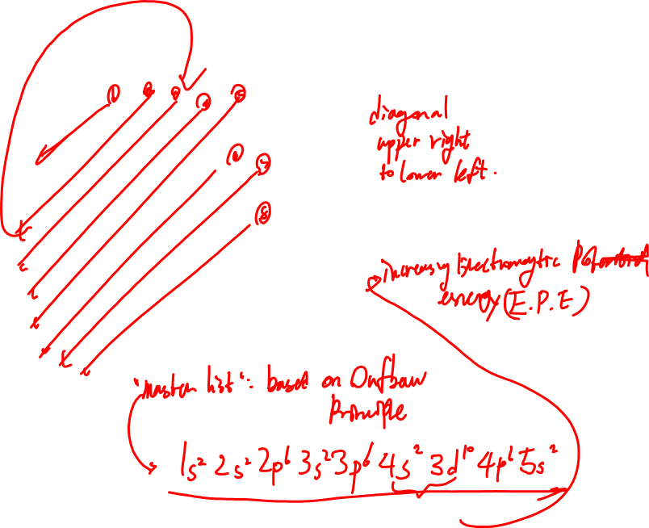
Multi-electron Atoms:
Use the diagonals to get the usual order of subshells:
1s²
2s² | 2p⁶
3s² | 3p⁶ | 3d¹⁰
4s² | 4p⁶ | 4d¹⁰ | 4f¹⁴
5s² | 5p⁶ | 5d¹⁰ | 5f¹⁴ | 5g¹⁸
6s² | 6p⁶ | 6d¹⁰ | 6f¹⁴ | 6g¹⁸ | 6h²²
7s² | 7p⁶ | …
Notes:
E of ONE PHOTON

Slide 51

Multi-electron Atoms:
The “master list” of subshells:
1s² , 2s², 2p⁶, 3s², 3p⁶, 4s², 3d¹⁰, 4p⁶, 5s², 4d¹⁰, 5p⁶, 6s², 4f¹⁴, 5d¹⁰, 6p⁶, 7s², 5f¹⁴, 6d¹⁰, 7p⁶…
with running sub-totals for total electrons described:
1s² ₂, 2s², 2p⁶ ₁₀, 3s², 3p⁶ ₁₈, 4s², 3d¹⁰, 4p⁶ ₃₆, 5s², 4d¹⁰, 5p⁶ ₅₄, 6s², 4f¹⁴, 5d¹⁰, 6p⁶ ₈₆, 7s², 5f¹⁴, 6d¹⁰, 7p⁶ ₁₁₈ …
Notes:
E of ONE PHOTON

Slide 52
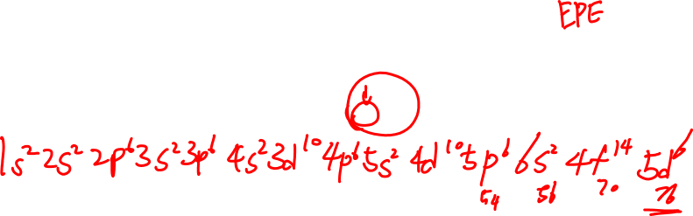

Multi-electron Atoms:
This list gives the order of increasing energy of electrons in subshells for about 80% of the elements on the periodic table:
1s² ₂, 2s², 2p⁶ ₁₀, 3s², 3p⁶ ₁₈, 4s², 3d¹⁰, 4p⁶ ₃₆, 5s², 4d¹⁰, 5p⁶ ₅₄, 6s², 4f¹⁴, 5d¹⁰, 6p⁶ ₈₆, 7s², 5f¹⁴, 6d¹⁰, 7p⁶ ₁₁₈ …
Give the electron configuration for ₇₆Os
Notes:
E of ONE PHOTON

Slide 53

Multi-electron Atoms:
1s² ₂, 2s², 2p⁶ ₁₀, 3s², 3p⁶ ₁₈, 4s², 3d¹⁰, 4p⁶ ₃₆, 5s², 4d¹⁰, 5p⁶ ₅₄, 6s², 4f¹⁴, 5d¹⁰, 6p⁶ ₈₆, 7s², 5f¹⁴, 6d¹⁰, 7p⁶ ₁₁₈ …
Valence shell: The shell that is furthest from the nucleus (on avg.)
(note: there is some argument over this… whether to include d and f subshells from smaller shells. We’ll go with this simplest definition.)
Valence subshells: Any and all subshell(s) of the valence shell that have at least one electron in it/them
Highest energy subshell:
Notes:
E of ONE PHOTON

Slide 54
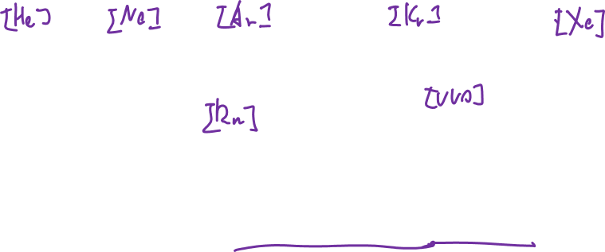
Multi-electron Atoms:
This list gives the order of increasing energy of electrons in subshells for about 80% of the elements on the periodic table:
1s² ₂, 2s², 2p⁶ ₁₀, 3s², 3p⁶ ₁₈, 4s², 3d¹⁰, 4p⁶ ₃₆, 5s², 4d¹⁰, 5p⁶ ₅₄, 6s², 4f¹⁴, 5d¹⁰, 6p⁶ ₈₆, 7s², 5f¹⁴, 6d¹⁰, 7p⁶ ₁₁₈ …
increasing E
The subtotals after each p subshell correspond to the number of electrons in each of the Noble Gases (column VIII):
Notes:
E of ONE PHOTON

Slide 56
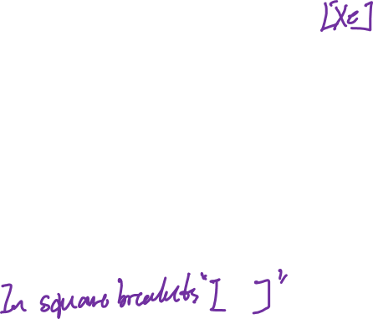
Multi-electron Atoms:
1s² ₂, 2s², 2p⁶ ₁₀, 3s², 3p⁶ ₁₈, 4s², 3d¹⁰, 4p⁶ ₃₆, 5s², 4d¹⁰, 5p⁶ ₅₄, 6s², 4f¹⁴, 5d¹⁰, 6p⁶ ₈₆, 7s², 5f¹⁴, 6d¹⁰, 7p⁶ ₁₁₈ …
We can take advantage of this pattern.
NOBLE GAS SHORTHAND:
Write the closest Noble Gas having fewer or equal number of electrons
Write the remaining electron shell/subshell positions
Notes:
E of ONE PHOTON

Slide 57
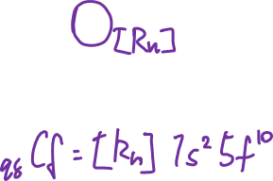
Multi-electron Atoms:
1s² ₂, 2s², 2p⁶ ₁₀, 3s², 3p⁶ ₁₈, 4s², 3d¹⁰, 4p⁶ ₃₆, 5s², 4d¹⁰, 5p⁶ ₅₄, 6s², 4f¹⁴, 5d¹⁰, 6p⁶ ₈₆, 7s², 5f¹⁴, 6d¹⁰, 7p⁶ ₁₁₈ …
Give the electron configuration for ₉₈Cf
Notes:
E of ONE PHOTON

Slide 58
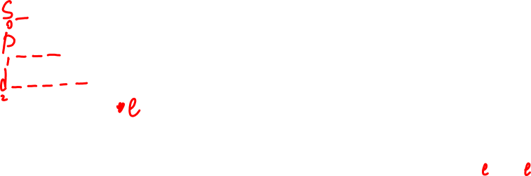
When we need all of the quantum numbers:
e.g. ₆₃Eu : 1s² ₂, 2s², 2p⁶ ₁₀, 3s², 3p⁶ ₁₈, 4s², 3d¹⁰, 4p⁶ ₃₆, 5s², 4d¹⁰, 5p⁶ ₅₄, 6s², 4f⁷
Think back to the sets of possible values for the four Q#’s:
symbol | name | describes | area called | allowed values
n | Principal | Avg. size of area where the electron is most probably found | SHELL | 1,2,3…∞
l | Angular | Shape of area where the electron is most probably found | SUBSHELL | 0,1,2,… (n-1)
m_{l} | Magnetic | Tilt of the area, relative to the areas where other electrons are most probably found | ORBITAL | –l,…0,…+l
m_{s} | Spin | Direction of spin of the electron relative to the spin of the nucleus | - | +1/2, –1/2
Notes:
E of ONE PHOTON

Slide 59
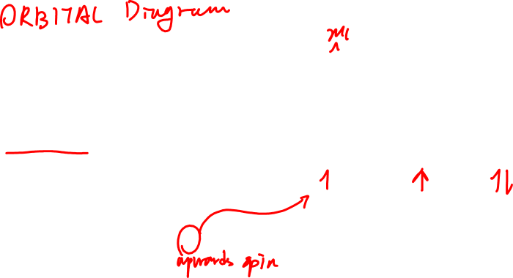
When we need all of the quantum numbers:
e.g. ₆₃Eu : 1s² ₂, 2s², 2p⁶ ₁₀, 3s², 3p⁶ ₁₈, 4s², 3d¹⁰, 4p⁶ ₃₆, 5s², 4d¹⁰, 5p⁶ ₅₄, 6s², 4f⁷
Think back to the sets of possible values for the four Q#’s:
Connect the possible ORBITAL numbers to real subshells:
Draw a pictogram for all the orbitals of a given subshell
use a line for each orbital: ____
use an arrow for each electron: ____ or ____ or ____
(remember, electrons can have + or – spin; + means parallel to the nucleus and favourable)
Notes:
E of ONE PHOTON

Slide 60
When we need all of the quantum numbers:
e.g. ₆₃Eu : 1s² ₂, 2s², 2p⁶ ₁₀, 3s², 3p⁶ ₁₈, 4s², 3d¹⁰, 4p⁶ ₃₆, 5s², 4d¹⁰, 5p⁶ ₅₄, 6s², 4f⁷
? Shell?
? subshell?
? orbital??
? spin??
Notes:
E of ONE PHOTON

Slide 61
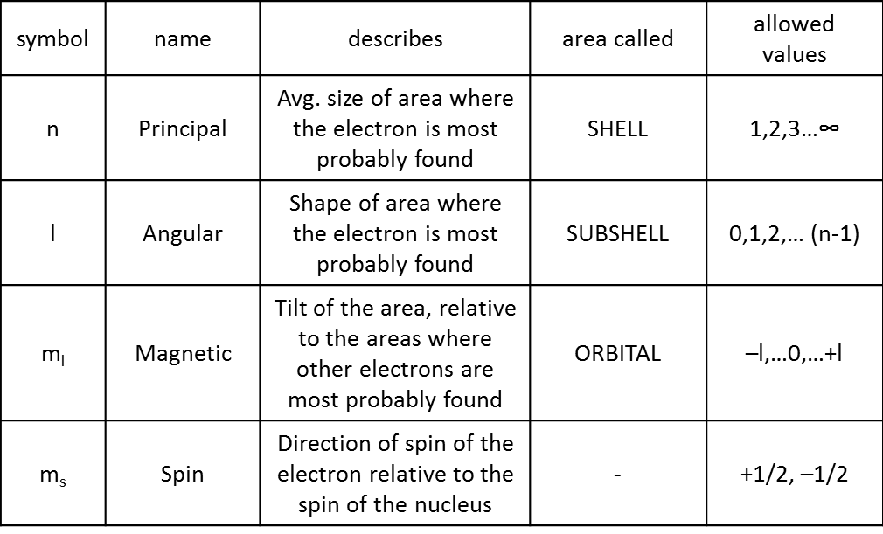
When we need all of the quantum numbers:
e.g. ₆₃Eu : 1s² ₂, 2s², 2p⁶ ₁₀, 3s², 3p⁶ ₁₈, 4s², 3d¹⁰, 4p⁶ ₃₆, 5s², 4d¹⁰, 5p⁶ ₅₄, 6s², 4f⁷
Think back to the sets of possible values for the four Q#’s:
Notes:
E of ONE PHOTON

Slide 62
When we need all of the quantum numbers:
e.g. ₆₃Eu : 1s² ₂, 2s², 2p⁶ ₁₀, 3s², 3p⁶ ₁₈, 4s², 3d¹⁰, 4p⁶ ₃₆, 5s², 4d¹⁰, 5p⁶ ₅₄, 6s², 4f⁷
Orbital Diagram: Pictogram of the orbitals, showing all orbitals
any electrons that are present*
We can figure out how many orbitals there are from the list of possible orbital (ml) values
To figure out how the electrons position themselves, we need to know two “rules”
Pauli Exclusion Principle: No two electrons in the same atom can have the same set of four quantum numbers, which means that two electrons in the same orbital MUST have opposite spin
Hund’s Rule: Electrons will always have spins parallel to the nucleus (+½; ↑) if possible. See Pauli exclusion principle for whether it is possible or not!
Notes:
E of ONE PHOTON

Slide 63
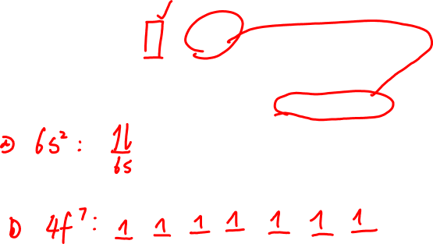
When we need all of the quantum numbers:
e.g. ₆₃Eu : 1s² ₂, 2s², 2p⁶ ₁₀, 3s², 3p⁶ ₁₈, 4s², 3d¹⁰, 4p⁶ ₃₆, 5s², 4d¹⁰, 5p⁶ ₅₄, 6s², 4f⁷
Give an orbital diagram for: a) The valence subshell(s) of Eu
b) The highest energy subshell of Eu
Notes:
E of ONE PHOTON

Slide 64
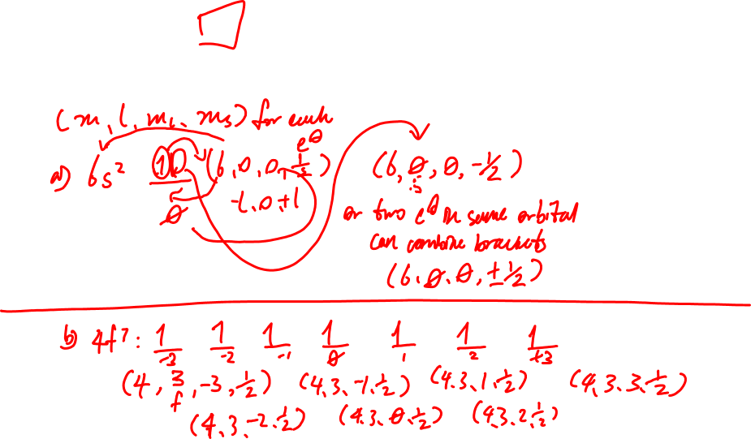
When we need all of the quantum numbers:
e.g. ₆₃Eu : 1s² ₂, 2s², 2p⁶ ₁₀, 3s², 3p⁶ ₁₈, 4s², 3d¹⁰, 4p⁶ ₃₆, 5s², 4d¹⁰, 5p⁶ ₅₄, 6s², 4f⁷
Give full sets of quantum numbers for a) The valence subshell(s) of Eu
b) The highest energy subshell of Eu
Notes:
E of ONE PHOTON

Slide 65

Exceptions to the pattern:
1s² ₂, 2s², 2p⁶ ₁₀, 3s², 3p⁶ ₁₈, 4s², 3d¹⁰, 4p⁶ ₃₆, 5s², 4d¹⁰, 5p⁶ ₅₄, 6s², 4f¹⁴, 5d¹⁰, 6p⁶ ₈₆, 7s², 5f¹⁴, 6d¹⁰, 7p⁶ ₁₁₈ …
There are two main categories of exception:
  If one level does not completely fill, but another level – higher on the list - is occupied
  If a level that is normally lower in energy is higher in energy for some configurations
Notes:
E of ONE PHOTON

Slide 66
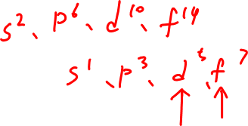
Exceptions to the pattern:
1s² ₂, 2s², 2p⁶ ₁₀, 3s², 3p⁶ ₁₈, 4s², 3d¹⁰, 4p⁶ ₃₆, 5s², 4d¹⁰, 5p⁶ ₅₄, 6s², 4f¹⁴, 5d¹⁰, 6p⁶ ₈₆, 7s², 5f¹⁴, 6d¹⁰, 7p⁶ ₁₁₈ …
  If one level does not completely fill, but another level – higher on the list - is occupied
  Note: the actual configuration, not our “expected” one, is lower in energy!
It has been observed that there is an extra stability to:
  fully filled subshells
  exactly half filled subshells
Notes:
E of ONE PHOTON

Slide 67
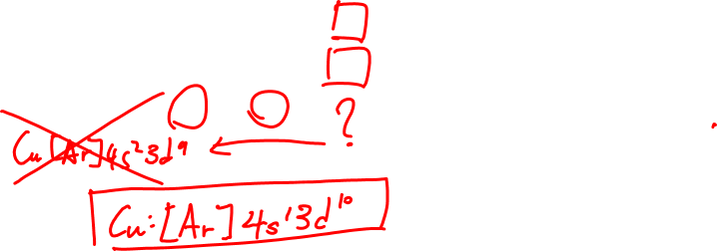

Slide 68
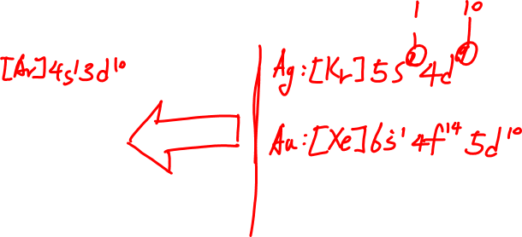
Exceptions to the pattern:
1s² ₂, 2s², 2p⁶ ₁₀, 3s², 3p⁶ ₁₈, 4s², 3d¹⁰, 4p⁶ ₃₆, 5s², 4d¹⁰, 5p⁶ ₅₄, 6s², 4f¹⁴, 5d¹⁰, 6p⁶ ₈₆, 7s², 5f¹⁴, 6d¹⁰, 7p⁶ ₁₁₈ …
  If one level does not completely fill, but another level – higher on the list - is occupied
It has been observed that there is an extra stability to:
  fully filled subshells
  exactly half filled subshells
expected for Cu:
actual for Cu:
Notes:
E of ONE PHOTON

Slide 69


Slide 70
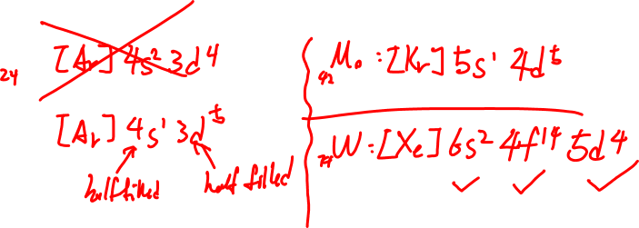
Exceptions to the pattern:
1s² ₂, 2s², 2p⁶ ₁₀, 3s², 3p⁶ ₁₈, 4s², 3d¹⁰, 4p⁶ ₃₆, 5s², 4d¹⁰, 5p⁶ ₅₄, 6s², 4f¹⁴, 5d¹⁰, 6p⁶ ₈₆, 7s², 5f¹⁴, 6d¹⁰, 7p⁶ ₁₁₈ …
  If one level does not completely fill, but another level – higher on the list - is occupied
It has been observed that there is an extra stability to:
  fully filled subshells
  exactly half filled subshells
expected for Cr:
actual for Cr:
Notes:
E of ONE PHOTON

Slide 71
Exceptions to the pattern:
1s² ₂, 2s², 2p⁶ ₁₀, 3s², 3p⁶ ₁₈, 4s², 3d¹⁰, 4p⁶ ₃₆, 5s², 4d¹⁰, 5p⁶ ₅₄, 6s², 4f¹⁴, 5d¹⁰, 6p⁶ ₈₆, 7s², 5f¹⁴, 6d¹⁰, 7p⁶ ₁₁₈ …
  If a subshell that is normally higher in energy is lower in energy for some configurations
Notes:
E of ONE PHOTON

Slide 72
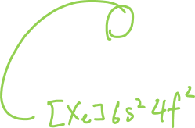

Slide 73
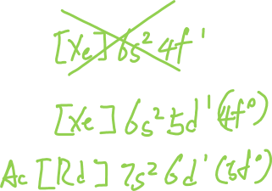
Exceptions to the pattern:
1s² ₂, 2s², 2p⁶ ₁₀, 3s², 3p⁶ ₁₈, 4s², 3d¹⁰, 4p⁶ ₃₆, 5s², 4d¹⁰, 5p⁶ ₅₄, 6s², 4f¹⁴, 5d¹⁰, 6p⁶ ₈₆, 7s², 5f¹⁴, 6d¹⁰, 7p⁶ ₁₁₈ …
  If a level that is normally lower in energy is higher in energy for some configurations
expected for La:
actual for La:
Notes:
E of ONE PHOTON

Slide 74
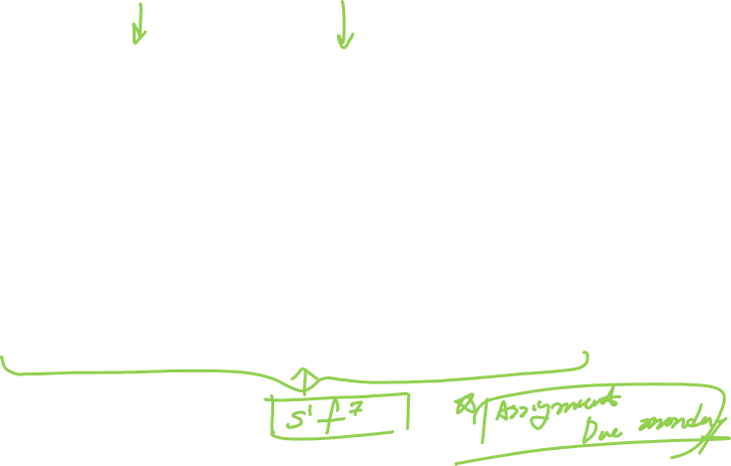
The exceptions:

Slide 75
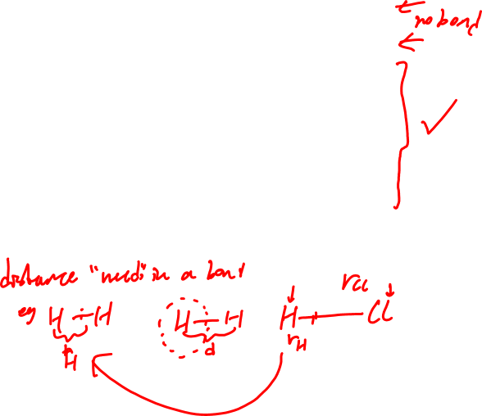
PERIODIC PROPERTIES – ATOMIC SIZE:
ATOMIC SIZE:

Slide 76
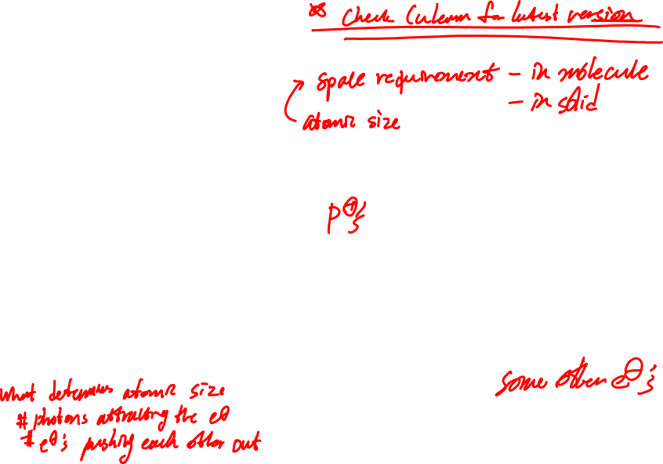
PERIODIC PROPERTIES – ATOMIC SIZE:
What dictates size?
What pulls inwards?
What pushes outwards?
₃Li: 1s², 2s¹
₄Be: 1s², 2s²
₅B: 1s², 2s², 2p¹
₆C: 1s², 2s², 2p²
₇N: 1s², 2s², 2p³
₈O: 1s², 2s², 2p⁴
₉F: 1s², 2s², 2p⁵
₁₀Ne: 1s², 2s², 2p⁶
₁₁Na: 1s², 2s², 2p⁶, 3s¹
Notes:
E of ONE PHOTON

Slide 77
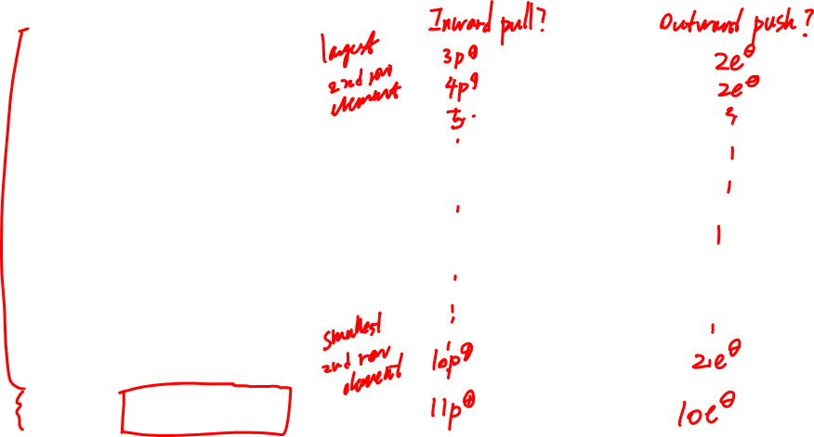
PERIODIC PROPERTIES – ATOMIC SIZE:
₃Li: 1s², 2s¹
₄Be: 1s², 2s²
₅B: 1s², 2s², 2p¹
₆C: 1s², 2s², 2p²
₇N: 1s², 2s², 2p³
₈O: 1s², 2s², 2p⁴
₉F: 1s², 2s², 2p⁵
₁₀Ne: 1s², 2s², 2p⁶
₁₁Na: 1s², 2s², 2p⁶, 3s¹
Notes:
E of ONE PHOTON

Slide 78

PERIODIC PROPERTIES – ATOMIC SIZE:

Slide 79

PERIODIC PROPERTIES – IONIZATION ENERGY (I.E.):
IONIZATION:

Slide 80

PERIODIC PROPERTIES – IONIZATION ENERGY:
What would be expected to influence the amount of energy needed to remove an electron?
What could also influence this?
₃Li: 1s², 2s¹
₄Be: 1s², 2s²
₅B: 1s², 2s², 2p¹
₆C: 1s², 2s², 2p²
₇N: 1s², 2s², 2p³
₈O: 1s², 2s², 2p⁴
₉F: 1s², 2s², 2p⁵
₁₀Ne: 1s², 2s², 2p⁶
Notes:
E of ONE PHOTON

Slide 81

PERIODIC PROPERTIES – IONIZATION ENERGY:
₃Li: 1s², 2s¹
₄Be: 1s², 2s²
₅B: 1s², 2s², 2p¹
₆C: 1s², 2s², 2p²
₇N: 1s², 2s², 2p³
₈O: 1s², 2s², 2p⁴
₉F: 1s², 2s², 2p⁵
₁₀Ne: 1s², 2s², 2p⁶
I.E vs atomic number:
Notes:
E of ONE PHOTON

Slide 82
PERIODIC PROPERTIES – IONIZATION ENERGY:
₃Li: 1s², 2s¹
₄Be: 1s², 2s²
₅B: 1s², 2s², 2p¹
₆C: 1s², 2s², 2p²
₇N: 1s², 2s², 2p³
₈O: 1s², 2s², 2p⁴
₉F: 1s², 2s², 2p⁵
₁₀Ne: 1s², 2s², 2p⁶
Notes:
E of ONE PHOTON

Slide 83
PERIODIC PROPERTIES – IONIZATION ENERGY:
The atom (2) – Periodic properties – IONIZATION ENERGY

Slide 84

PERIODIC PROPERTIES – HIGHER ORDER IONIZATIONS:
1st Ionization of F:
2nd Ionization of F:
3rd Ionization of F:
Notes:
E of ONE PHOTON

Slide 85

PERIODIC PROPERTIES – ELECTRON AFFINITY:
Notes:
E of ONE PHOTON

Slide 86

PERIODIC PROPERTIES – Higher order electron affinities:
1st E.A. of N:
2nd E.A. of N:
3rd E.A. of N:
Notes:
E of ONE PHOTON

Slide 87

PERIODIC PROPERTIES – Electronegativity:
The tendency of an atom to pull electrons in a chemical bond towards itself.
(not relevant for an atom in isolation!)
Notes:
E of ONE PHOTON

Slide 88


PERIODIC PROPERTIES – ELECTRONEGATIVITY:

Slide 89

PERIODIC PROPERTIES – ION FORMATION:
ION FORMATION:
NOTE: not oxidation state!

Slide 90

PERIODIC PROPERTIES – ION FORMATION:
Move electrons onto or off of the atom in order to:
  Fill the entire valence s and p subshells
  Empty the entire valence s and p subshells
  Empty the valence p subshell – only if n ≥ 4
NEVER add more than 3 electrons
NEVER remove more than: 3 electrons from small atoms
4 electrons from large atoms
Metals NEVER form negative ions

Slide 91

ION FORMATION:
B: 1s² , 2s², 2p¹
Ga: [Ar] 4s², 3d¹⁰, 4p¹
Fill the entire valence s and p subshells
Empty the entire valence s and p subshells
Empty the valence p subshell – only if n ≥ 4
NEVER add more than 3 electrons
NEVER remove more than: 3 or 4
Metals NEVER negative
Notes:
E of ONE PHOTON

Slide 92

ION FORMATION:
C: 1s² , 2s², 2p²
Pb: [Xe] 6s², 5d¹⁰, 4f¹⁴, 6p²
Fill the entire valence s and p subshells
Empty the entire valence s and p subshells
Empty the valence p subshell – only if n ≥ 4
NEVER add more than 3 electrons
NEVER remove more than: 3 or 4
Metals NEVER negative
Notes:
E of ONE PHOTON

Slide 93

ION FORMATION:
O: 1s² , 2s², 2p⁴
*Po: [Xe] 6s², 5d¹⁰, 4f¹⁴, 6p²
Fill the entire valence s and p subshells
Empty the entire valence s and p subshells
Empty the valence p subshell – only if n ≥ 4
NEVER add more than 3 electrons
NEVER remove more than: 3 or 4
Metals NEVER negative
Notes:
E of ONE PHOTON

Slide 94


PERIODIC PROPERTIES – ION FORMATION:

Slide 95

When forming cations, electrons are always lost first from the VALENCE subshells, and only then will they be lost from what were originally inner subshells.
Transition metals (d block elements) do not always follow predictable patterns in their ion formation (note again, this is NOT oxidation state).
  Most will form +2 ions M²⁺ or M(II)
  Some will form +1 ions M¹⁺ or M(I)
  Some will form +3 ions M³⁺ or M(III)
e.g. ₂₃V: [Ar] 4s², 3d³
  ₂₃V(III):
Notes:
E of ONE PHOTON

