Slide 1
TOPIC 1. MATH and MEASUREMENT
For my CHEM 1101 students: I am assuming that you know much of this material. You will need to be able to work in scientific and exponential notation. If it is new to you, see me ASAP. The class will start at slide 12 (the early ones are for you to review), and go quite quickly. I will slow down a bit at slide 24; that material may be entirely new to many of you.
1.1 Exponential and Scientific notation
The (rest) mass of an electron (m_{e}):
The speed of light in a vacuum (c):

Slide 2
The (rest) mass of an electron:
0.000 000 000 000 000 000 000 000 000 000 910 9 kg
The speed of light in a vacuum:
299 800 000 m/s (or about 300 000 000 m/s)
The significand (mantissa):
The non-zero portion of the value
The exponent:
The power of ten you have to multiply the significand by in order to give the true magnitude (size) of the value.

Slide 3
Exponential notation:
The speed of light in a vacuum:
299 800 000 m/s (or about 300 000 000 m/s)
The significand (mantissa):
The non-zero portion of the value

Slide 4
Exponential notation:
The speed of light in a vacuum:
299 800 000 m/s (or about 300 000 000 m/s)
The exponent:
The power of ten you have to multiply the significand by in order to give the true magnitude (size) of the value.

Slide 5
Scientific notation:
The significand is set to be: ≥ 1 and < 10
“between 1 and 9.99999999999999 (as many decimals as required)”
practically speaking, this means that you insert a decimal after the first non-zero digit.
c = 2 9 9 8 0 0 0 0 0

Slide 6
Scientific notation:
To determine the exponent, count the number of times you “bounced” the decimal place (remember, if there was no decimal in the original, it’s actual position was at the end!)
if the true value is larger than the significand: +ve exponent
if the true value is smaller than the significand: –ve exponent
c = 2 9 9 8 0 0 0 0 0

Slide 7
Scientific notation:
if the true value is larger than the significand: +ve exponent
if the true value is smaller than the significand: –ve exponent
m_{e} = 0 . 000 000 000 000 000 000 000 000 000 000 910 9

Slide 8
Scientific notation:
So, when you see:
  a negative exponent: it’s a message that “reality” is _______
  a positive exponent: it’s a message that “reality” is _______
compared to the scientific notation

Slide 9
Converting from scientific to standard notation:
Remember: the exponent tells you
how many positions to move the decimal
which way (+ve means “make it bigger”; –ve means “make it smaller”)
h = 6.626 x 10 ^{–34} J∙s

Slide 10
Converting from scientific to standard notation:
Remember: the exponent tells you
how many positions to move the decimal
which way (+ve means “make it bigger”; –ve means “make it smaller”)
N_{A} = 6.02 x 10 ²³

Slide 11
Scientific notation:
Scientific notation is extremely useful for very large and very small numbers (I hope I never have to write Plank’s constant or Avogadro’s number in standard notation again, at least not until next year’s CHEM 1005 class) but…
It is also extremely important in allowing us to indicate significant figures in a clear and unambiguous way.

Slide 12
1.2 Significant Figures:
So, this tourist walks into a dinosaur museum in Drumheller, Alberta…
Significant figures (or significant digits) allow you to tell how precisely a measured value is known.
They don’t tell you anything about accuracy. (how closely a measured value is to the true value)
They only have meaning for measured values. If a value is counted or defined, there is no meaning to significant figures (we treat counted and defined values as if they have an infinite number of significant figures – more later.)

Slide 13





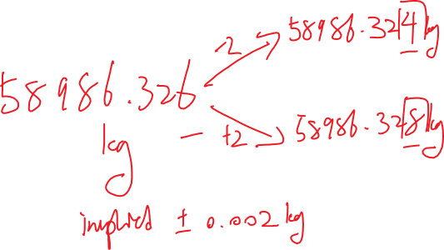
Unless something is otherwise specified, you assume that you know that the true value is plus or minus 2 ($±$ 2) in the last significant digit
e.g. if I say “the mass of this 747 aircraft is 58 986.326 kg”, what am I (almost certainly falsely) implying?

Slide 14
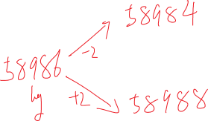
On the other hand, if I say “the mass of a 747 aircraft is 58 986 kg”, I’m implying that all I know is…
With modern technology and a well calibrated roll-on scale (research grade, at the Boing development facility) this one is at least possible.

Slide 15


1.2 a
Determining the number of significant figures/digits in a given measured value
(there will be a subtle difference when it comes to calculated values – well get to that later):
All non-zero digits are significant.
Any zeros between two significant digits are significant.
Any terminal (end; right hand) zeros are significant ONLY if the number contains a decimal place. (3-b) Otherwise they are ambiguous, and you must assume they are non-significant.
Leading (beginning; left hand) zeros are NEVER significant.

Slide 16
Number of significant figures/digits
All non-zero digits are significant.
348 mm:
26.952 mm:

Slide 17
Number of significant figures/digits
All non-zero digits are significant.
Any zeros between two significant digits are significant.
2051 mm:
103.6008 mm:
8000.002 mm:

Slide 18



Number of significant figures/digits
All non-zero digits are significant.
Any zeros between two significant digits are significant.
Any terminal (end; right hand) zeros are significant ONLY if the number contains a decimal place. (3-b) Otherwise they are ambiguous, and you must assume they are non-significant.
23.00 mm:
230. mm:
230 mm:
103.6080 mm:
9 000 000 mm:
8 000.00 mm:
.900 mm:

Slide 19
Number of significant figures/digits
All non-zero digits are significant.
Any zeros between two significant digits are significant.
Any terminal (end; right hand) zeros are significant ONLY if the number contains a decimal place. (3-b) Otherwise they are ambiguous, and you must assume they are non-significant.
Leading (beginning; left hand) zeros are NEVER significant.
0.97 mm:
0042 mm:
0.000 804 mm:
I admit I can’t think of a reason that someone would write this number this way, but if they did…
0.907 00 mm:

Slide 20
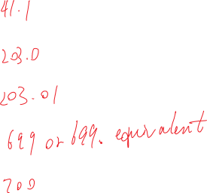


A Note on Rounding
It’s as simple as it gets.
  if the first digit you reject is: 0, 1, 2, 3, or 4: do not change
  if the first digit you reject is: 5, 6, 7, 8, or 9: round up
You never make any changes based on any other digits you reject!
41.14482 rounded to 3 sig figs:
203.0098 rounded to 4 sig figs:
203.0098 rounded to 5 sig figs:
699.4999 rounded to 3 sig figs:
699.5111 rounded to 3 sig figs:

Slide 21

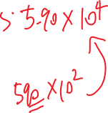


A Note on Rounding
It’s as simple as it gets.
  if the first digit you reject is: 0, 1, 2, 3, or 4: do not change
  if the first digit you reject is: 5, 6, 7, 8, or 9: round up
You never make any changes based on any other digits you reject!
58 986.326 kg rounded to 3 sig figs:

Slide 22
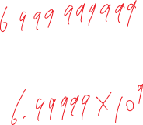

A Note on Rounding
NEVER ROUND IN THE MIDDLE OF A CALCULATION. KEEP TRACK OF THE SIGNIFICANT FIGURES AS YOU GO ALONG (I UNDERLINE THEM, MYSELF) BUT DON’T ROUND UNTIL THE VERY END RESULT.

Slide 23


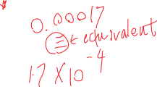
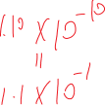
Calculating with measured values:
1.2 b
1.2 b1 Multiplication and Division
The result of multiplication and/or division will have the same number of significant digits as the input value with the fewest significant digits.
(47)(0.0802)/(208)(109)
[ = 0.000 166 257 939 ]
=
or
=
(3.905 x 10^{–5})/(4.00)(8.90 x 10⁴)
[ = 1.096 101 12 x 10^{–10}]
=

Slide 24

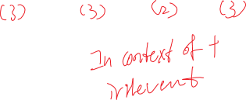


Calculating with measured values:
1.2 b
1.2 b2 Addition and subtraction
The rules are NOT the same as multiplication / division!
This one is more complex to apply:
Think of adding up floor tiles to make a pattern:
47.8 cm + 28.2 cm + 5.7 cm + 34.0 cm = [115.7 cm ]
=
If we used the multiplication – division rules, we’d have to round to only two sig. figs.:
WE DON’T DO THAT!

Slide 25
Calculating with measured values:
1.2 b
1.2 b2 Addition and subtraction
47.8 cm + 28.2 cm + 5.7 cm + 34.0 cm = [115.7 cm ]
=
THINK!! – Why doesn’t it make sense to give the answer as (120 cm) or, unambiguously: 1.2 x 10² cm?

Slide 26





1.2 b2 Addition and subtraction
The rules depend on the position of the significant digits:
What is the last position where there is a significant digit in all positions?
4 7 . 8 cm
+ 2 8 . 2 cm
+ 5 . 7 cm
+ 3 4 . 0 cm
[ 1 1 5 .7 cm ]
4 7 . 8 cm
+ 2 8 . 2 cm
+ 5 . 7 cm
+ 3 4 . 0 cm
[ 1 1 5 .7 cm ]

Slide 27

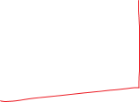

1.2 b2 Addition and subtraction
Now let’s say you had a different measuring tool for each tile, and the measurements are:
    47. 8 4 3 cm
    28. 2 cm
    5. 6 9 cm
    34. cm
    [115.7 3 3 cm ]
    47. 8 4 3 cm
    28. 2 cm
    5. 6 9 cm
    34. cm
    [115.7 3 3 cm ]

Slide 28

1.2 b2 Addition and subtraction
When the numbers:
are all in standard notation
are each significant at least to the units (ones) position:
The rule can be stated fairly simply:
“round off the result to the same number of decimal places as the input value with the fewest decimal places”

Slide 29




1.2 b2 Addition and subtraction
When the numbers:
are NOT all in standard notation
or
are NOT each significant at least to the units (ones) position:
1.5 3 8 8 1 3 x 10 ^{–25} kg
3.9 6 9 5 8 x 10 ^{–25} kg
8.3 8 0 x 10 ^{–29} kg
[5.5 0 9 2 3 1 x 10 ^{–25} kg]

Slide 30
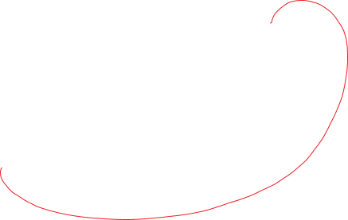

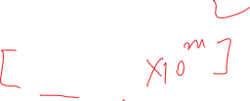
1.2 b2 Addition and subtraction
You have to modify the scientific notation as needed so that all the exponents have the same value (you don’t need to convert them into standard notation!)
The simplest strategy:
Add them up on a calculator
Convert all of the values into the same exponent as the exponent in the answer you get
If you make the exponent larger, the significand gets smaller;
If you make the exponent smaller, the significand gets larger.

Slide 31
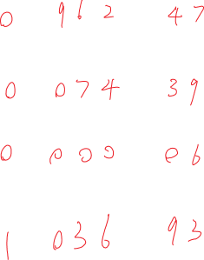
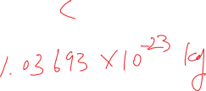

1.2 b2 Addition and subtraction
9.624793 x 10 ^{–24} kg
7.439 x 10 ^{–25} kg
6.2 x 10 ^{–28} kg
[1.0369313 x 10 ^{–23} ] kg
x 10 ^{–23}

Slide 32
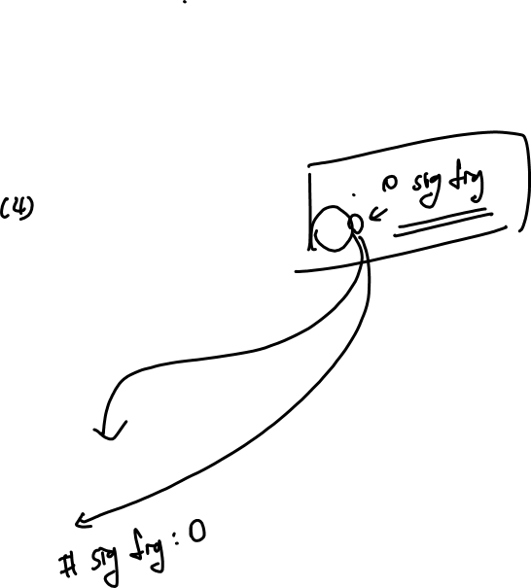
1.2 b3 Logarithms/Natural logarithms (log & ln)
Logarithm: The power to which 10 must be raised to restore the original value.
e.g. 1000. ( = 10 x 10 x 10 ) = 10³
Since you have to raise 10 to the power of 3 to get your “1000.” back,
The log of 1000. is 3
log (1000.) = 3

Slide 33

1.2 b3 Logarithms/Natural logarithms (log & ln)
e.g. 1000. ( = 10 x 10 x 10 ) = 10³
log (1000.) = 3
What about the sig figs?
Where does the 3 come from?
was it part of the sig figs originally (before the log was taken)?
How many sig figs were there originally (before the log)?

Slide 34

1.2 b3 Logarithms/Natural logarithms (log & ln)
log (1000.) = 3
What about the sig figs?
How many sig figs were there originally (before the log)?
These sig figs need to be preserved –
How can you
keep the numerical value of three…
and
have the correct number of sig figs?

Slide 35

1.2 b3 Logarithms/Natural logarithms (log & ln)
Significant figure rule for logs and ln’s:
  Determine the number of sig figs in the original value
  Keep this many decimal places in the calculated log or ln.
    Keep any digits in front of the decimal place, but don’t count them as sig figs. They are analogous to leading zeros in this context
    Add zeros on the end of the value if you don’t have enough sig figs already

Slide 36
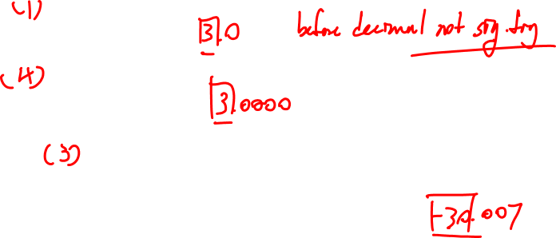
1.2 b3 Logarithms/Natural logarithms (log & ln)
Significant figure rule for logs and ln’s:
  Determine the number of sig figs in the original value
  Keep this many decimal places in the calculated log or ln.
    Keep any digits in front of the decimal place, but don’t count them as sig figs
    Add zeros on the end of the value if you don’t have enough sig figs already
log (1 0 0 0 ) = [ 3 ] =
log (1 0 0 0.) = [ 3 ] =
log ( 9. 8 5 x 10^{–31}) = [ – 30.00656377] =

Slide 37
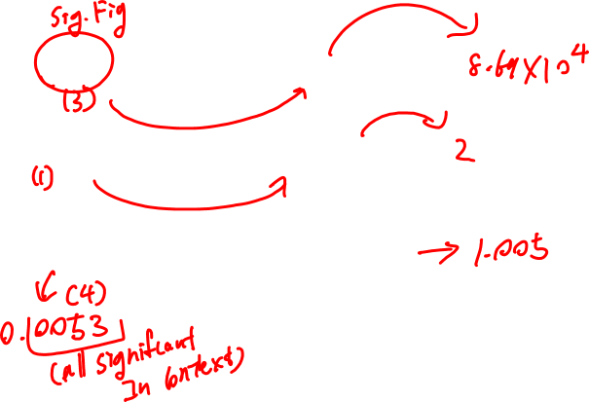
1.2 b3 Logarithms/Natural logarithms (log & ln)
Taking antilogs & antilns:
  The number of sig figs after the decimal place represents the total number of sig figs in the calculated result.
log x = 4.939 ; x = [ 86 896.024293 ]
ln x = 0.6 ; x = [ 1.8221188 ]
**ln x = 5.3 x 10^{–3} ; x = [ 1.00531407 ]

Slide 38

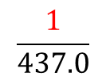
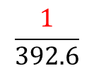
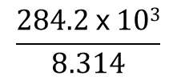
1.2 c Exact Numbers
Numbers that are counted:
  e.g. the number of students in the room
  the number of steps in a staircase
Numbers that serve as mathematical operators:
(
$$\frac{1}{437.0}$$
(
$$\frac{284.2 x 103}{8.314}$$
$$\frac{1}{392.6}$$
(
ln
$$\frac{x}{1.86}$$
(
=
–
  e.g. in the equation :
  the 1’s mean “invert” and are interchangeable with (392.6)^{–1} and (437.0)^{–1} .

Slide 39
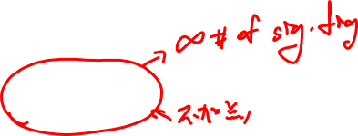
1.2 c Exact Numbers
Numbers that are defined:
  e.g. by convention, there are exactly 2.54 cm in an inch.
Unit prefix conversions:
  e.g. k (as in kilometer) is exactly 1000
  p (as in picometer) is exactly 10^{–12}

Slide 40

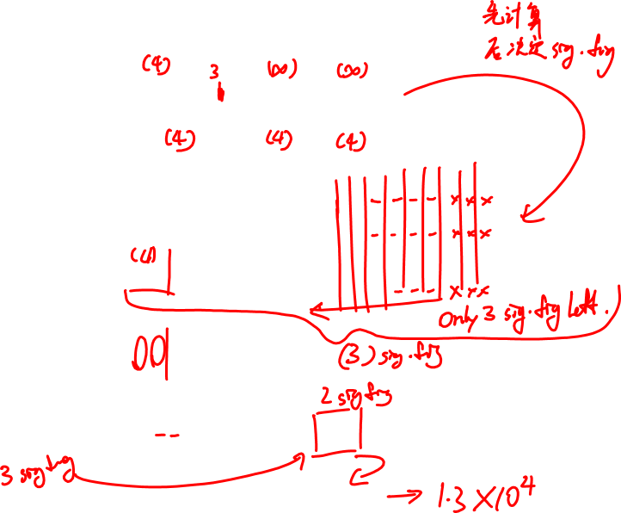

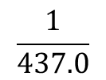

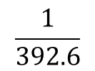

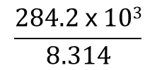

1.2 d Multi-step Calculations
(
$$\frac{1}{437.0}$$
(
$$\frac{284.2 x 103}{8.314}$$
$$\frac{1}{392.6}$$
(
ln
$$\frac{x}{1.86}$$
(
=
–
(
(
0.0 0 2 5 4 7 1 2 1
(
ln
$$\frac{x}{1.86}$$
(
=
(34 183.30527)
–
0.0 0 2 2 8 8 3 2 9
ln
(
$$\frac{x}{1.86}$$
(
=
(34 183.30527)
(
0.0 0 0 2 5 8 7 9 2
)
ln
(
$$\frac{x}{1.86}$$
(
=
(8.8 4 6 3 7 3 9)
(8.846 373 9)
(
$$\frac{x}{1.86}$$
(
=
e
=
(6 9 4 9 . 1 4 4 9 3 7)
$$x$$
=
(1 2 9 2 5 . 4 0 9 5 8)
=

