Slide 1

PowerPoint Presentations for
Principles of Microeconomics
Sixth Canadian Edition
by Mankiw/Kneebone/McKenzie
Adapted for the
Sixth Canadian Edition by
Marc Prud’homme
University of Ottawa

Slide 2

Frontiers of microeconomics
Chapter 22

Slide 3
Frontiers of microeconomics
This final chapter on microeconomics offers an assortment of three topics at the discipline’s frontier
to see how economists are trying to expand their
under- standing of human behaviour and society.
  Asymmetric information
  Political economy
  Behavioural economics

Slide 4
Asymmetric Information
Because asymmetric information is so prevalent, economists have devoted much effort in recent
decades to studying its effects.
Many times in life, one person knows more about
what is going on than another.
A difference in access to relevant knowledge is called an information asymmetry.

Slide 5
Hidden Actions:
Principals, Agents, and Moral Hazard
Moral hazard: the tendency of a person who is imperfectly monitored to engage in dishonest or otherwise undesirable behaviour
Agent: a person who is performing an act for another person, called the principal
Principal: A person for whom another person, called the agent, is performing some act
Notes:
If the principal cannot perfectly monitor the agent’s behaviour, the agent tends to undertake less effort than the principal considers desirable. The phrase moral hazard refers to the risk, or “hazard,” of inappropriate or otherwise “immoral” behaviour by the agent. In such a situation, the principal tries various ways to encourage the agent to act more responsibly. The employment relationship is the classic example. The employer is the principal, and the worker is the agent. The moral-hazard problem is the temptation of imperfectly monitored workers to shirk their responsibilities. Employers can respond to this problem in various ways:
• Better monitoring: Parents hiring nannies have been known to plant hidden video cameras in their homes to record the nanny’s behaviour when the parents are away. The aim is to catch irresponsible behaviour.
• High wages: According to efficiency-wage theories (discussed in Chapter 19), some employers may choose to pay their workers a wage above the level that balances supply and demand in the labour market. A worker who earns an above-equilibrium wage is less likely to shirk, because if she is caught and fired, she might not be able to find another high-paying job.
• Delayed payment: Firms can delay part of a worker’s compensation, So if the worker is caught shirking and is fired, he suffers a larger penalty. One example of delayed compensation is the year-end bonus. Similarly, a firm may choose to pay its workers more later in their lives. Thus, the wage increases that workers get as they age may reflect not just the benefits of experience but also a response to moral hazard.
Employers can use any combination of these various mechanisms to reduce the problem of moral hazard.

Slide 6
Hidden Characteristics:
Adverse Selection and the Lemons Problem
Adverse selection: the tendency for the mix of unobserved attributes to become undesirable from the standpoint of an uninformed party

Slide 7
Hidden Characteristics:
Adverse Selection and the Lemons Problem
Adverse selection is a problem that arises in markets where the seller knows more about the attributes of the good being sold than the buyer does.
As a result, the buyer runs the risk of being sold a good of low quality.
That is, the “selection” of goods being sold may be “adverse” from the standpoint of the uninformed buyer.
The classic example of adverse selection is the market for used cars.

Slide 8
Signalling to Convey Private Information
Markets respond to problems of asymmetric information in many ways.
One of them is signalling.
Signalling: an action taken by an informed party to reveal private information to an uninformed party
Notes:
We have seen examples of signalling in previous chapters. As we saw in Chapter 16, firms may spend money on advertising to signal to potential customers that they have high-quality products. As we saw in Chapter 19, students may earn postsecondary and postgraduate degrees to signal to potential employers that they are high-ability individuals. Recall that the signalling theory of education contrasts with the human-capital theory, which asserts that education increases a person’s productivity, rather than merely conveying information about innate talent. These two examples of signalling (advertising, education) may seem very different, but below the surface they are much the same: In both cases, the informed party (the firm, the student) uses the signal to convince the uninformed party (the customer, the employer) that the informed party is offering something of high quality. What does it take for an action to be an effective signal? Obviously, it must be costly. If a signal were free, everyone would use it, and it would convey no information. For the same reason, there is another requirement: The signal must be less costly, or more beneficial, to the person with the higher-quality product. Otherwise, everyone would have the same incentive to use the signal, and the signal would reveal nothing.

Slide 9
Screening to Uncover Private Information
When an informed party takes actions to reveal his private information, the phenomenon is called signalling.
When an uninformed party takes actions to induce the informed party to reveal private information, the phenomenon is called screening.
Screening: an action taken by an uninformed party to induce an informed party to reveal information

Slide 10
Asymmetric Information and Public Policy
Asymmetric information may call for government action
in some cases, but three facts complicate the issue.
  The private market can sometimes deal with information asymmetries on its own, using a combination of signalling and screening.
  The government rarely has more information than
  the private parties.
  The government is itself an imperfect institution.

Slide 11
A person who buys a life insurance policy pays a certain amount per year and receives for his family a much larger payment in the event of his death.
Would you expect buyers of life insurance to have higher or lower death rates than the average person?
How might this be an example of moral hazard?
Of adverse selection?
How might a life insurance company deal with
these problems?

Slide 12
POLITICAL ECONOMY
The field of political economy (sometimes called the field of public choice) applies the methods of economics to study how government works.

Slide 13
The Condorcet Voting Paradox
Condorcet paradox: the failure of majority rule to produce transitive preferences for society
Notes:
Most advanced societies rely on democratic principles to set government policy. When a city is deciding between two locations to build a new park, for example, we have a simple way to choose: The majority gets its way. Yet, for most policy issues, the number of possible outcomes far exceeds two. A new park, for instance, could be placed in many possible locations. In this case, as the eighteenth-century French political theorist Marquis de Condorcet famously noted, democracy might run into some problems trying to choose one of the outcomes.

Slide 14
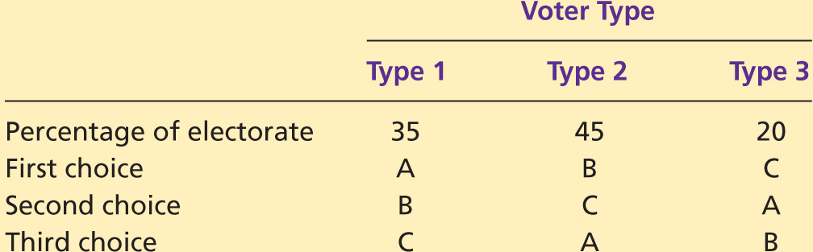
TABLE 22.1:
The Condorcet Paradox

Slide 15
Arrow’s Impossibility Theorem
Arrow’s impossibility theorem: a mathematical result showing that, under certain assumed conditions, there is no scheme for aggregating individual preferences into a valid set of social preferences

Slide 16
The Median Voter Is King
Median voter theorem: a mathematical result showing that if voters are choosing a point along a line and each voter wants the point closest to his most preferred point, then majority rule will pick the most preferred point of the median voter

Slide 17
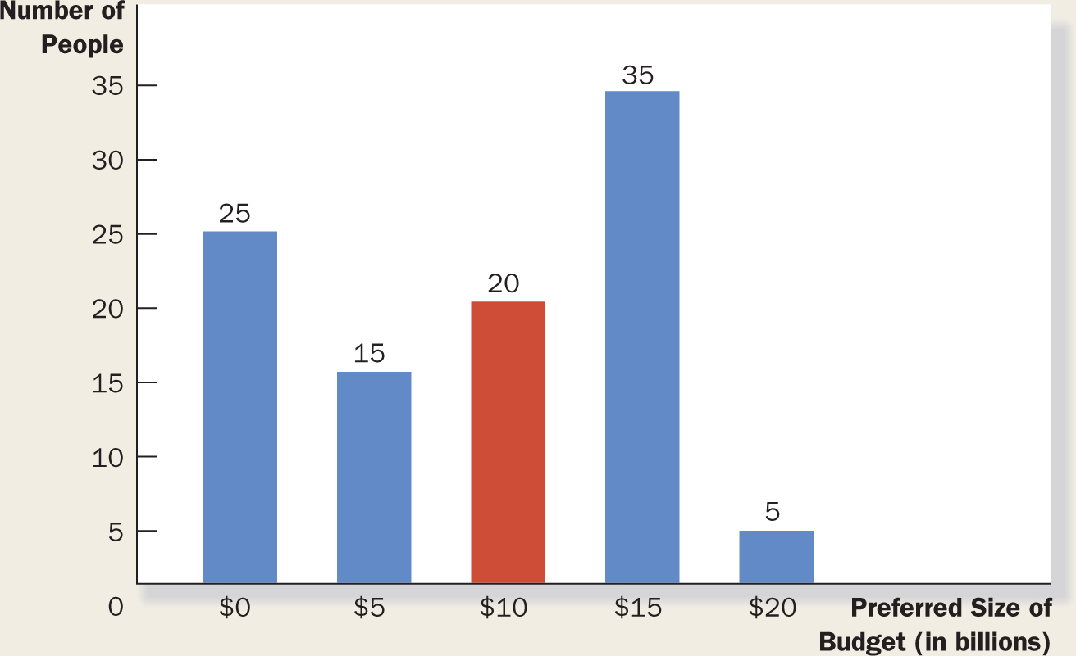
FIGURE 22.1:
The Median Voter Theorem: An Example
Notes:
This bar chart shows how 100 voters’ most-preferred budget is distributed over five options, ranging from zero to $20 billion. If society makes its choice by majority rule, the median voter (who here prefers $10 billion) determines the outcome.

Slide 18
Politicians Are People, Too
Politicians also have objectives.
Self-interest is as powerful a motive for political actors as it is for consumers and firm owners.
Some politicians, motivated by desire for reelection, are willing to sacrifice the national interest to solidify their base of voters.
Other politicians are motivated by simple greed.

Slide 19
A school district is voting on the school budget and the resulting student–teacher ratio. A poll finds that 35 percent of the voters want a ratio of 9:1, 25 percent want a ratio of 10:1, and 40 percent want a ratio of 12:1.
What outcome would you expect the district to end up with?

Slide 20
BEHAVIOURAL ECONOMICS
The fields of economics and psychology usually proceed independently, in part because they address a different range of questions.
But recently a field called behavioural economics has emerged in which economists are making use of basic psychological insights.
Let’s consider some of these insights here.

Slide 21
People Aren’t Always Rational
Herbert Simon, one of the first social scientists to work at the boundary of economics and psychology, suggested that humans should be viewed not as rational maximizers but as satisficers.
Rather than always choosing the best course of action, they make decisions that are merely good enough.
Similarly, other economists have suggested that
humans are only “near rational” or that they exhibit “bounded rationality.”

Slide 22
People Aren’t Always Rational
Studies of human decision making have tried to detect systematic mistakes that people make.
  People are overconfident.
  People give too much weight to a small number of vivid observations.
  People are reluctant to change their minds.

Slide 23
People Care About Fairness
Another insight about human behaviour is
best illustrated with an experiment called
the ultimatum game.
The natural interpretation is that people are
driven in part by some innate sense of fairness.

Slide 24
People Are Inconsistent over Time
Imagine some dreary task, such as doing your laundry, shovelling snow off your driveway, or filling out your income tax forms. Now consider the following questions:
  Would you prefer (A) to spend 50 minutes doing the task immediately or (B) to spend 60 minutes doing the task tomorrow?
  Would you prefer (A) to spend 50 minutes doing the task in 90 days or (B) to spend 60 minutes doing the task in 91 days?
  When asked questions like these, many people choose B to question 1 and A to question 2.

Slide 25
Describe at least three ways in which human decision making differs from that of the rational individual of conventional economic theory.

Slide 26

The end
Chapter 22

