Slide 1
MAAE 2001
Engineering Graphical Design
Sections A and B
Lecture 4
Freehand Sketching; Orthographic Projection
(Chapters 6, 7)
Professors M.J.D. Hayes and A.V. Artemev
Department of Mechanical and
Aerospace Engineering

Slide 2
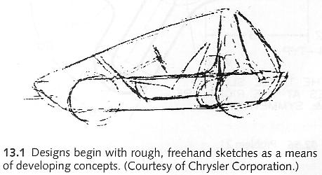
Freehand Sketching
Sketching is a fast, efficient way to draw without the use of drafting instruments, or computer.
It is as important to design thinking and problem solving as it is to communication.
Many freehand sketches are made while developing ideas and solutions.
Many new products began as sketches made on the back of an envelope, or a napkin at lunch.
Read Chapter 6 for useful techniques.

Slide 3
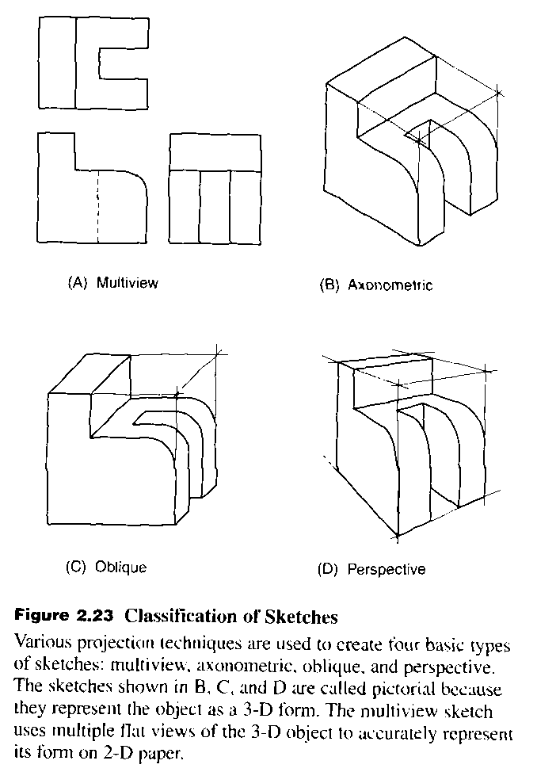
Types of Sketches
Bertoline, Introduction to Graphics Communications for Engineers

Slide 4
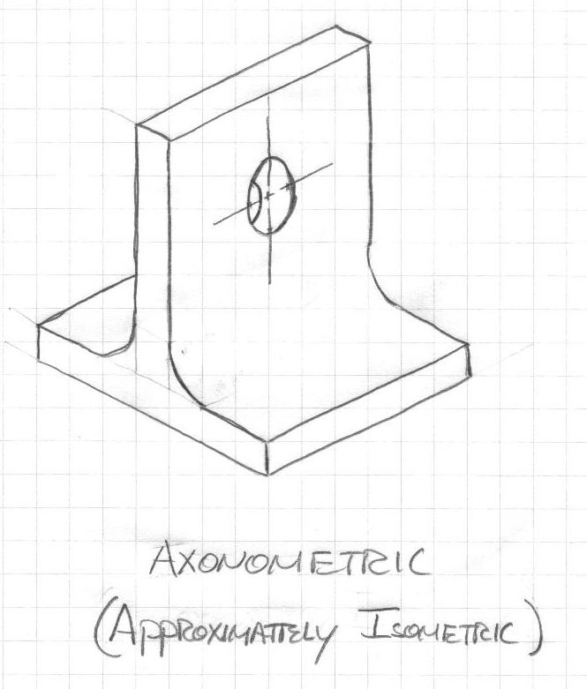
Axonometric Sketching
Axonometric projection uses parallel projectors (orthogonal projection), but it shows more than one face of the object.
The scale in the directions of the 3 principle axes are all different.

Slide 5
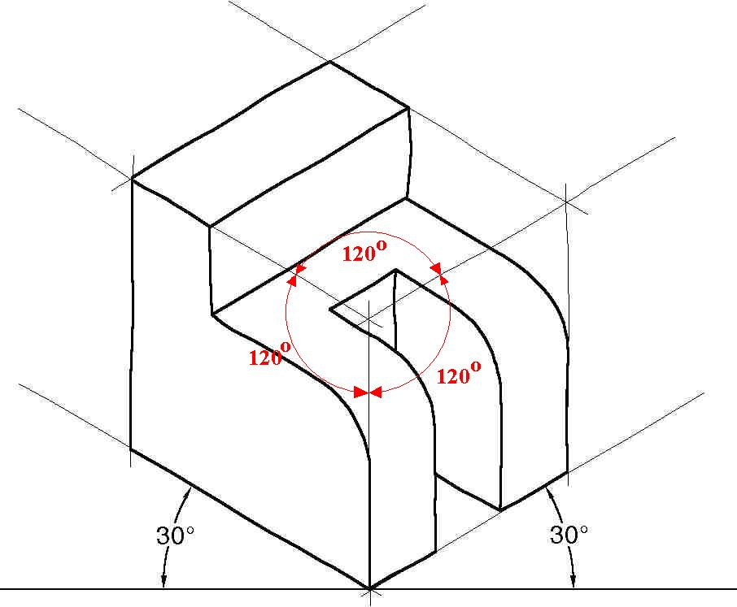
Isometric Sketching
The x-, y- and z-axes have the same metric: a unit (say, a centimetre) along the x-axis is equally long along the y- and z-axes.
In a rendered wire frame cube, all edges in the 2D picture are equally long.
The projected cube is also symmetric. All sides are rhombuses (a rhombus is a parallelogram with sides that are equal in length).

Slide 6
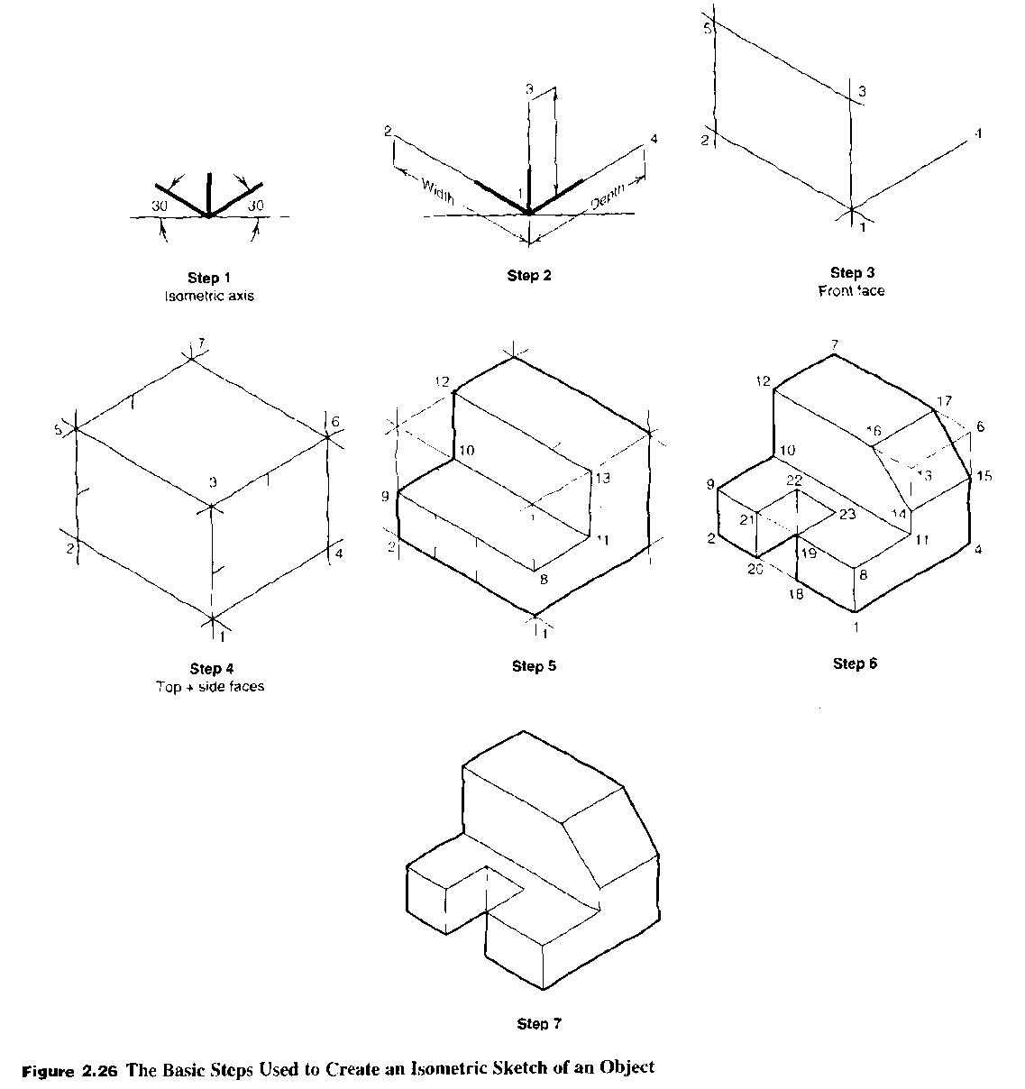
Isometric Sketching
Bertoline, Introduction to Graphics Communications for Engineers

Slide 7
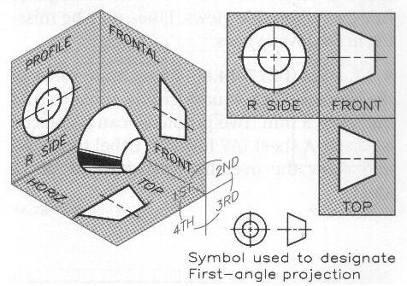
First-Angle Orthographic Projection
First-Angle Projection
The object is placed in the first quadrant and viewed from the first.
The object is between the observer and projection planes.
Used in most of the world.
The top view is placed below the front view. The right-side view is to the left of the front view.

Slide 8
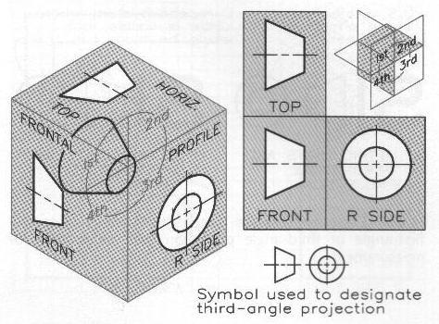
Orthographic Projection
We use third-angle projection.

Slide 9
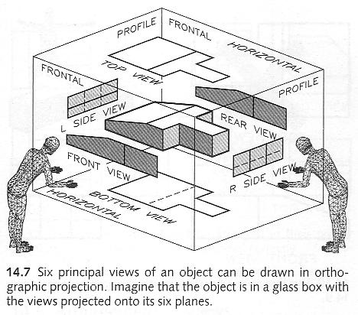
Orthographic Projection
Six principal views can be drawn in orthographic projection.
Imagine a glass box with the views projected onto its six planes.

Slide 10
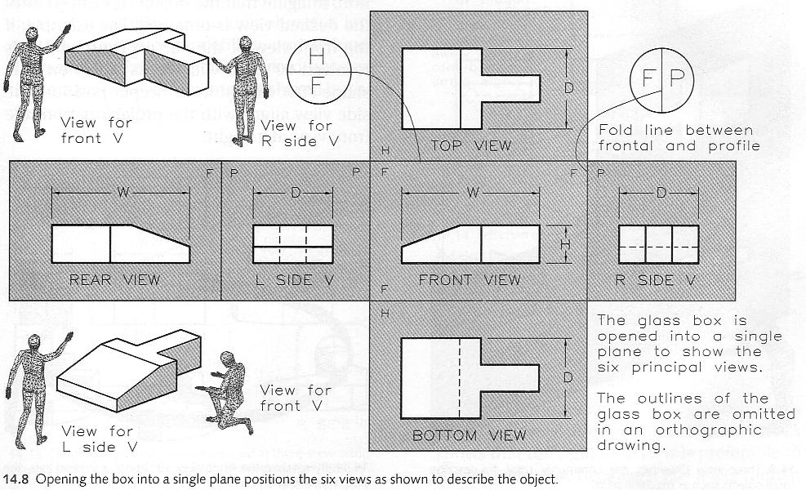
Orthographic Projection
Opening the box into a single plane (the front plane) gives the six views.

Slide 11
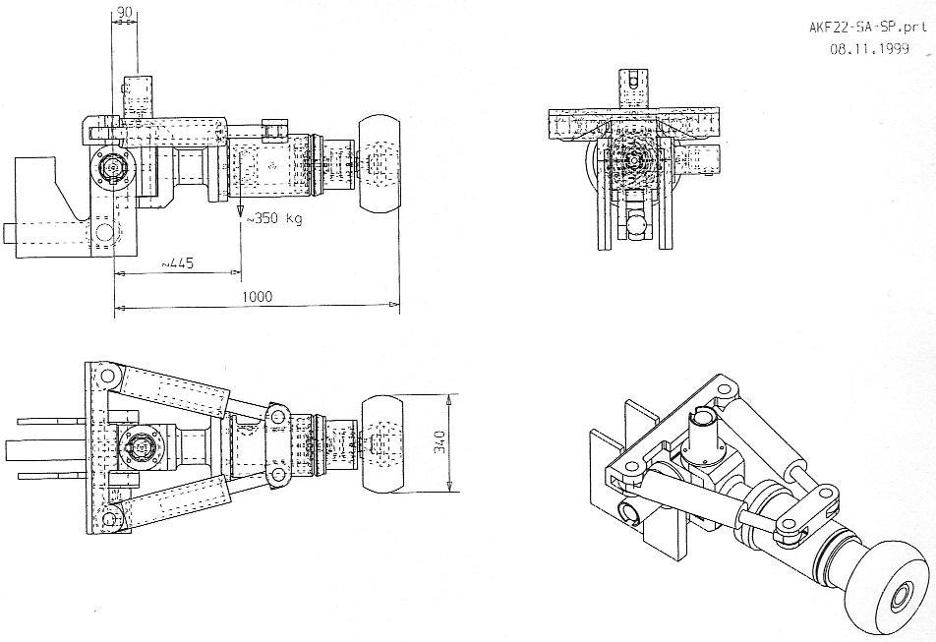
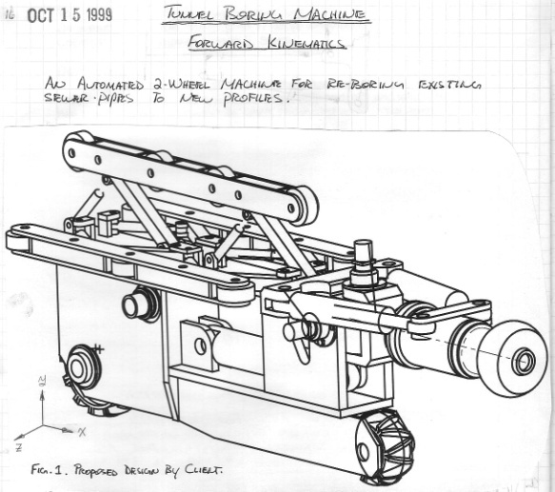
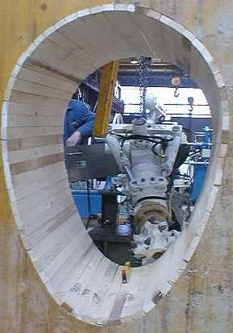
Orthographic Projection
The principal plane folding lines are generally not shown in a multi-view technical drawing, unlike a DG drawing.
Note: this drawing is in
first-angle projection.
Front view
Left view
Top view

Slide 12
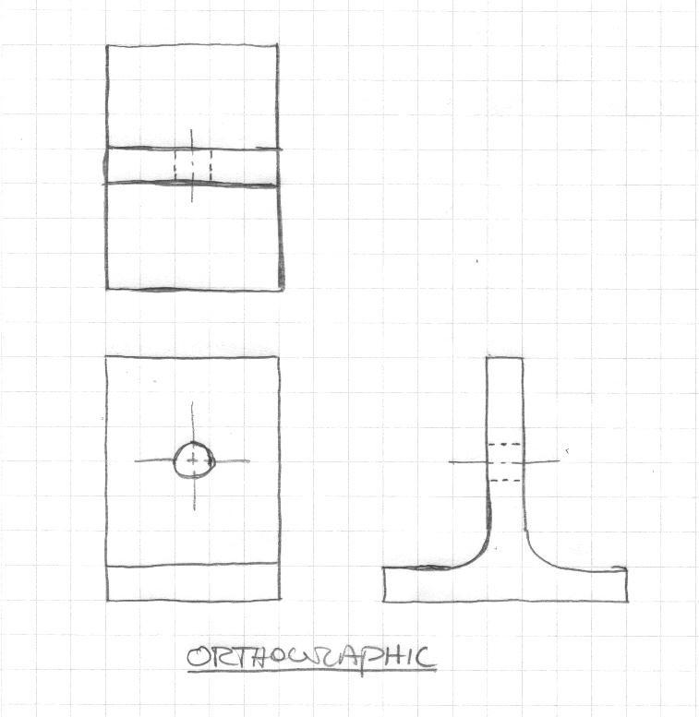
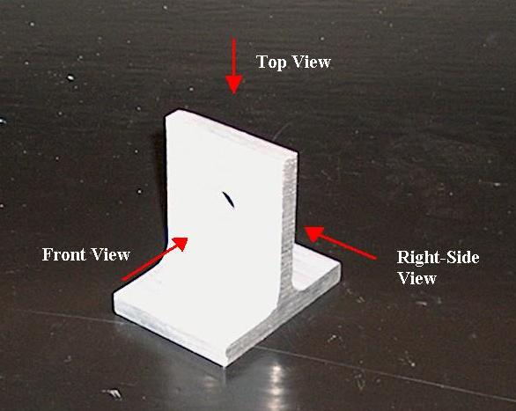
Orthographic Sketching

Slide 13
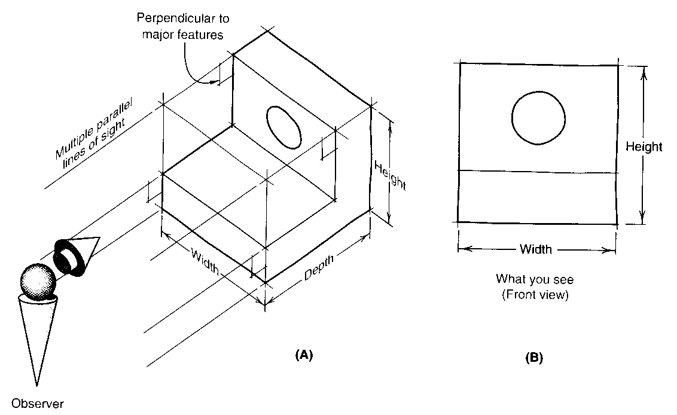
Orthographic Sketching
Bertoline, Introduction to Graphics Communications for Engineers

Slide 14
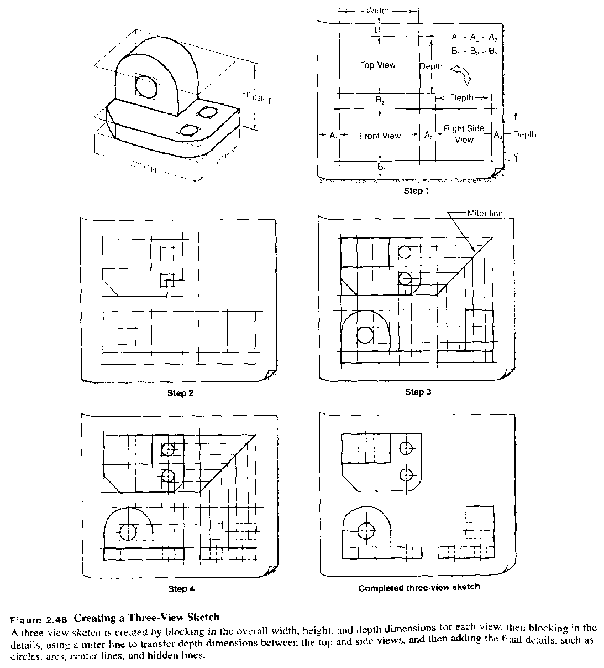
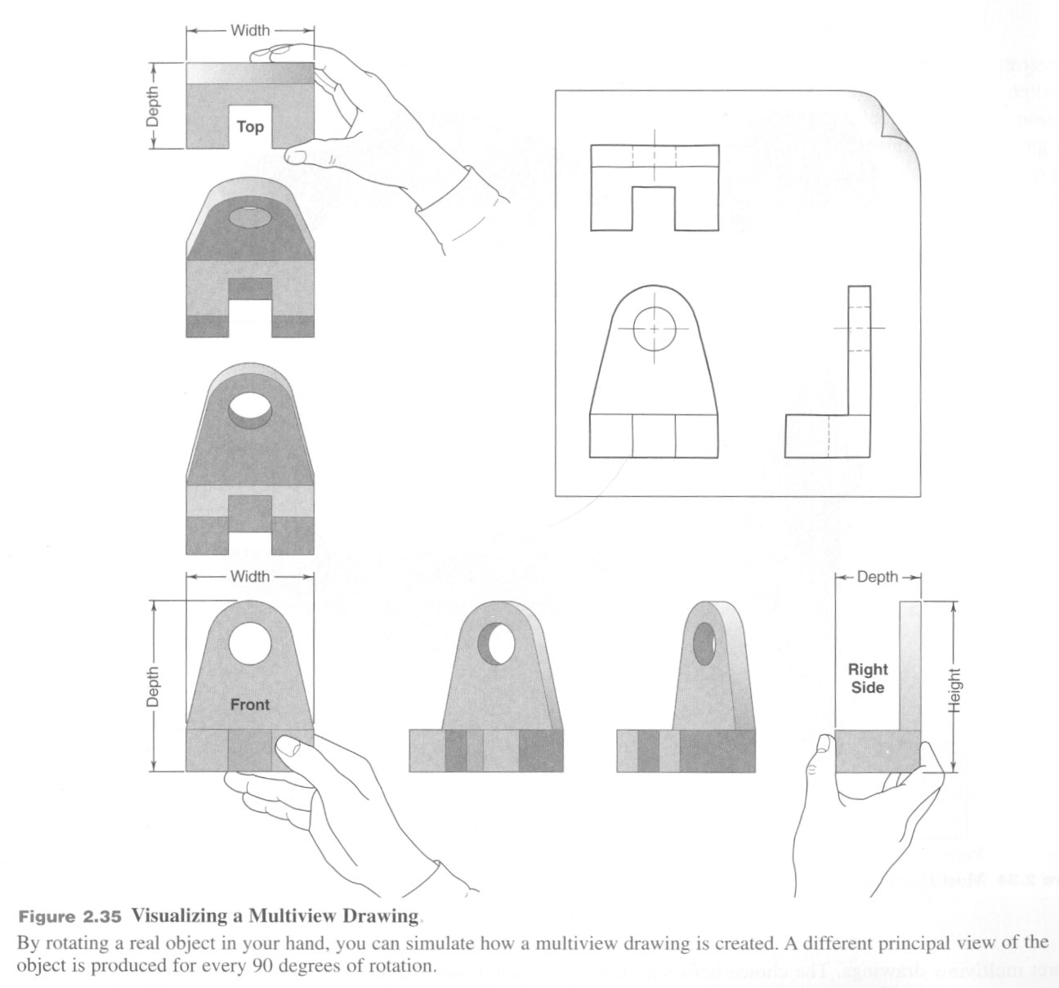
Orthographic Sketching
Bertoline, Introduction to Graphics Communications for Engineers
Bertoline, Introduction to Graphics Communications for Engineers

Slide 15
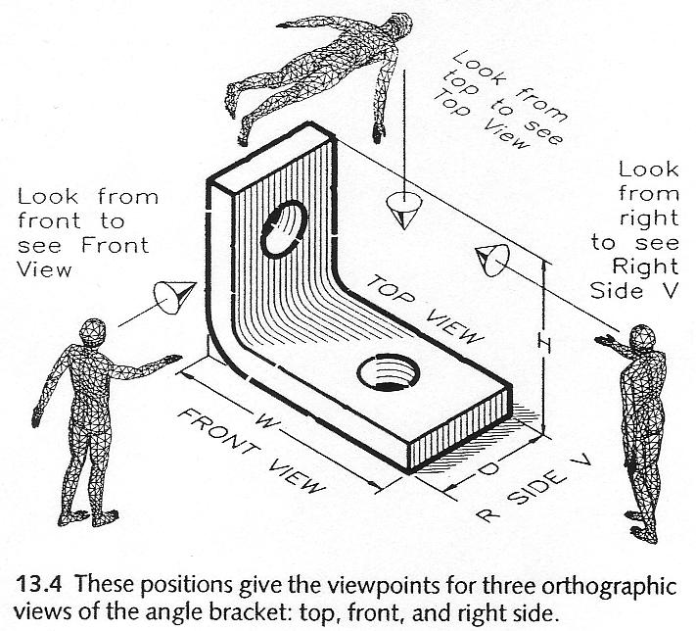
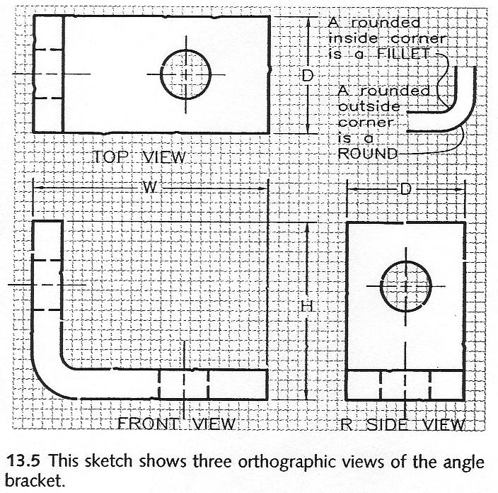
Shape Description
An angle mounting bracket is a simple 3D object, until you try to describe it in an unambiguous way.
Using words, the task approaches impossible.
Using descriptive geometry it is trivial.
However, for engineering drawings some more conventions must be used.

Slide 16
Shape Description
Technical drawings are a specialized way of communicating information graphically.
Technical drawings are fundamental to engineering.
Provide the link between imagination and creation.
Like any form of communication, a basic grammar must be adhered to, or else misunderstandings will result.
It is crucial that the graphical representation be clear and unambiguous.
The image must be precise and exact...

Slide 17
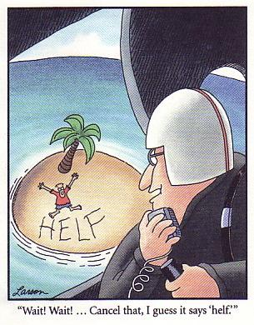
Graphical Communication

Slide 18




Grammar: Line Types
Object Lines: indicate all visible edges of an object. They should stand out so the shape of an object is apparent to the eye.
Hidden Lines: shows object lines that are hidden from view.
Cutting Plane Lines: indicates edge view of an imaginary cutting plane.
Centre Lines: indicates centres of holes and symmetrical features.

Slide 19
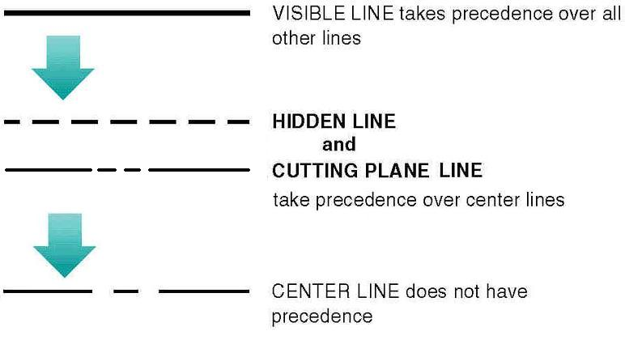
Line Type Precedence

Slide 20
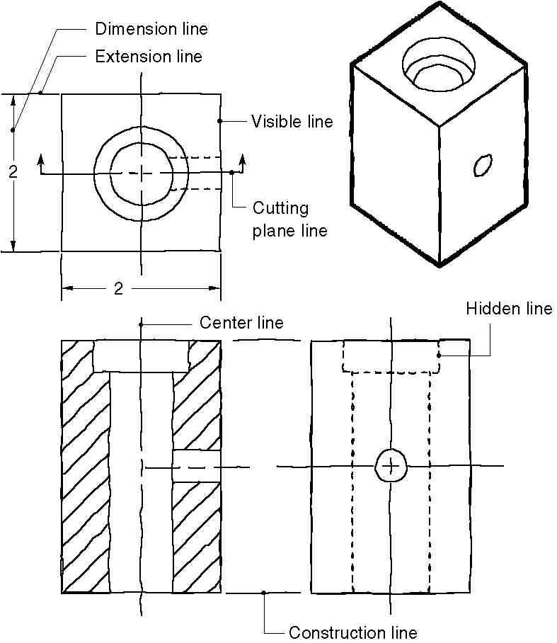
Example

Slide 21
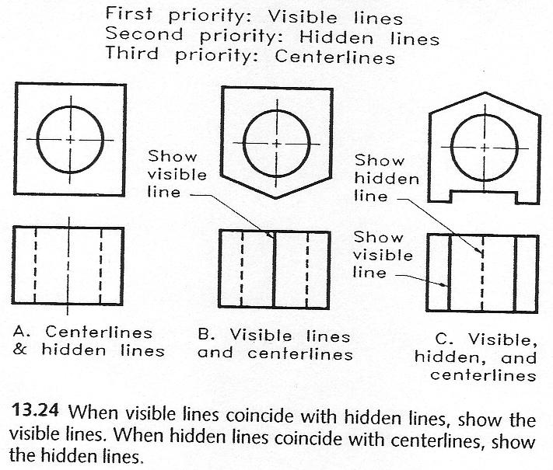
Line Precedence

Slide 22
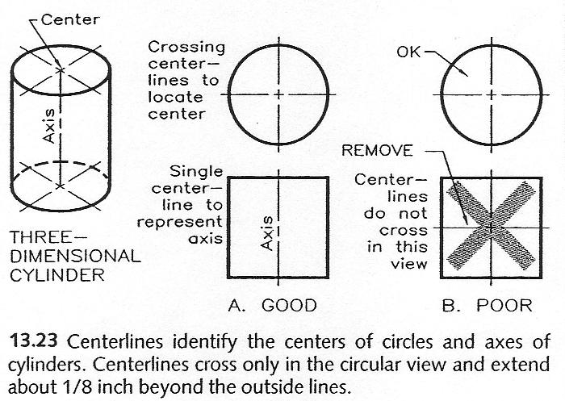
Centre Lines

Slide 23
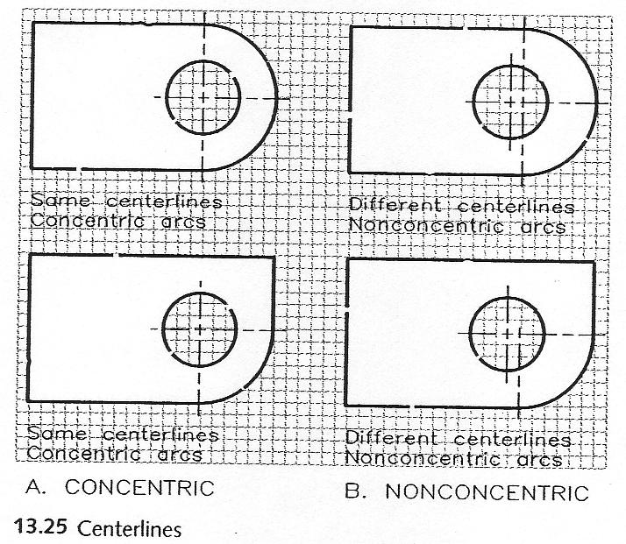
Centre Lines

Slide 24
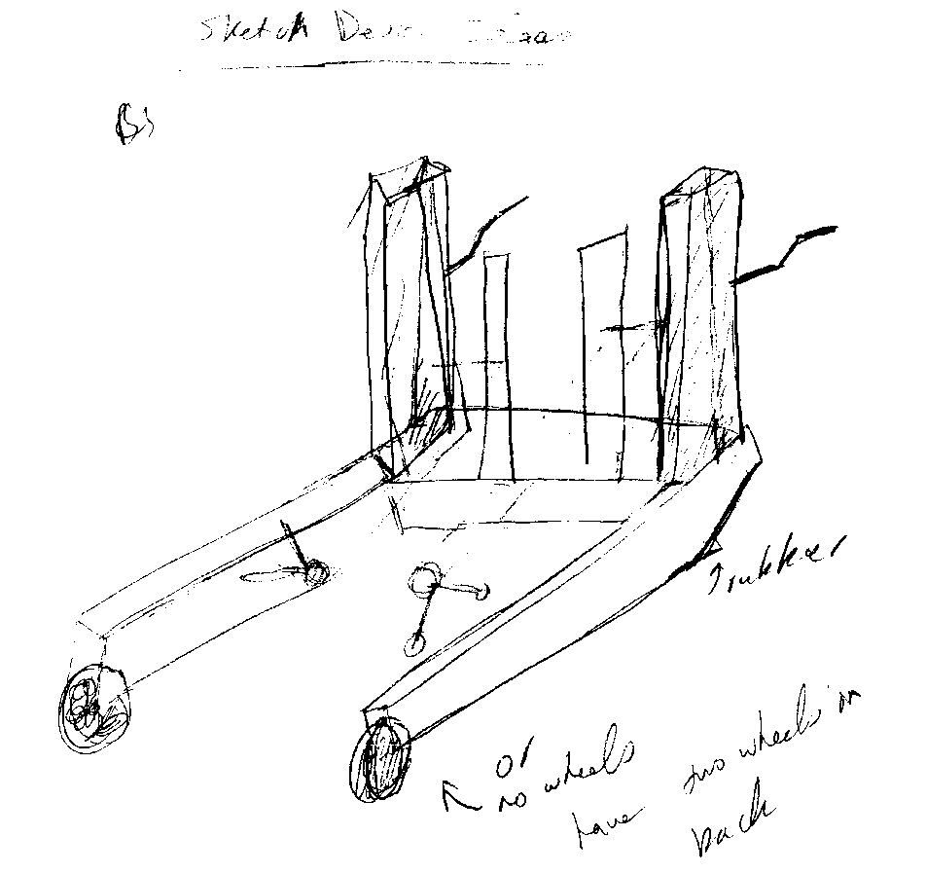
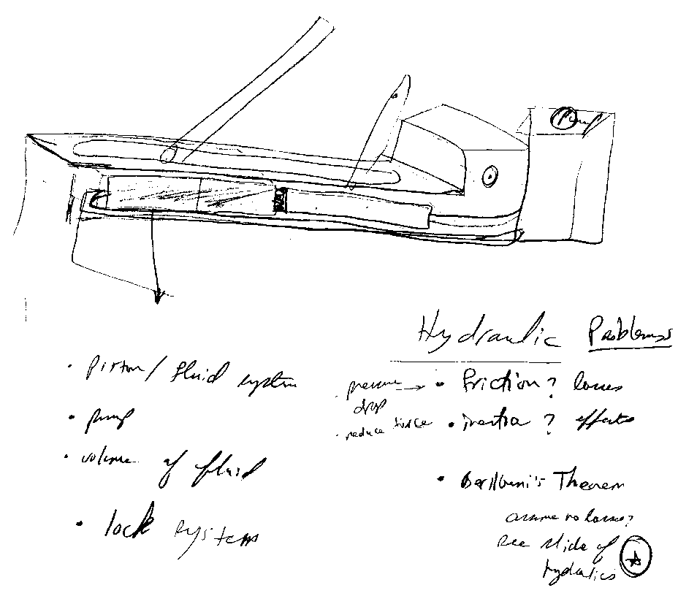
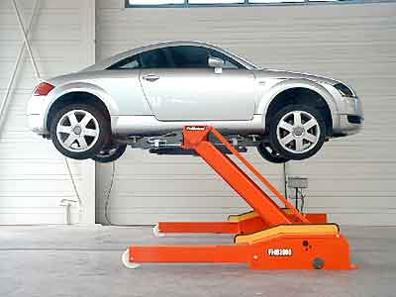
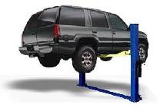
Sketching Examples – Vehicle Lift

Slide 25
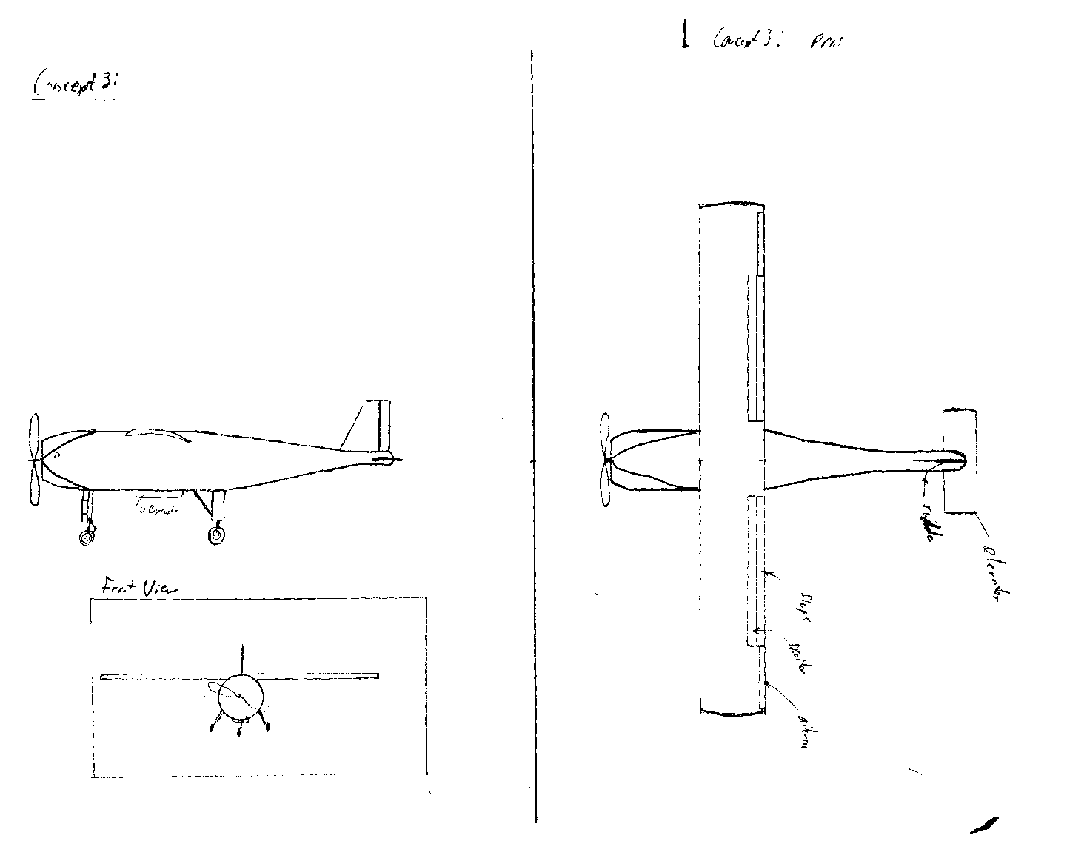
Sketching Examples – a/c Conceptual Design

Slide 26
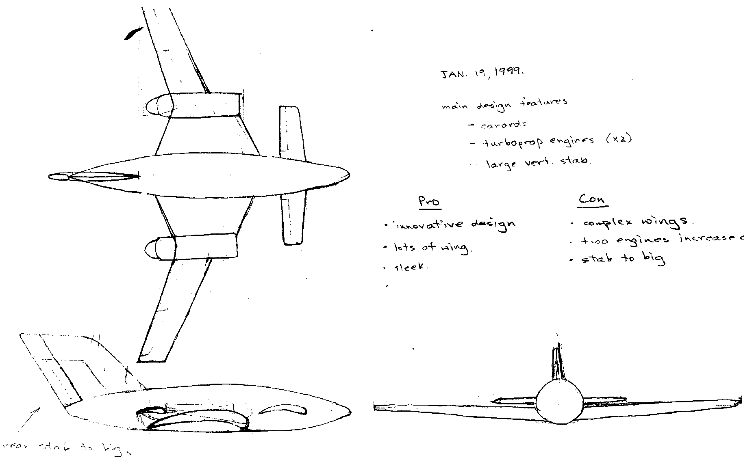
Sketching Examples – a/c Conceptual Design

Slide 27
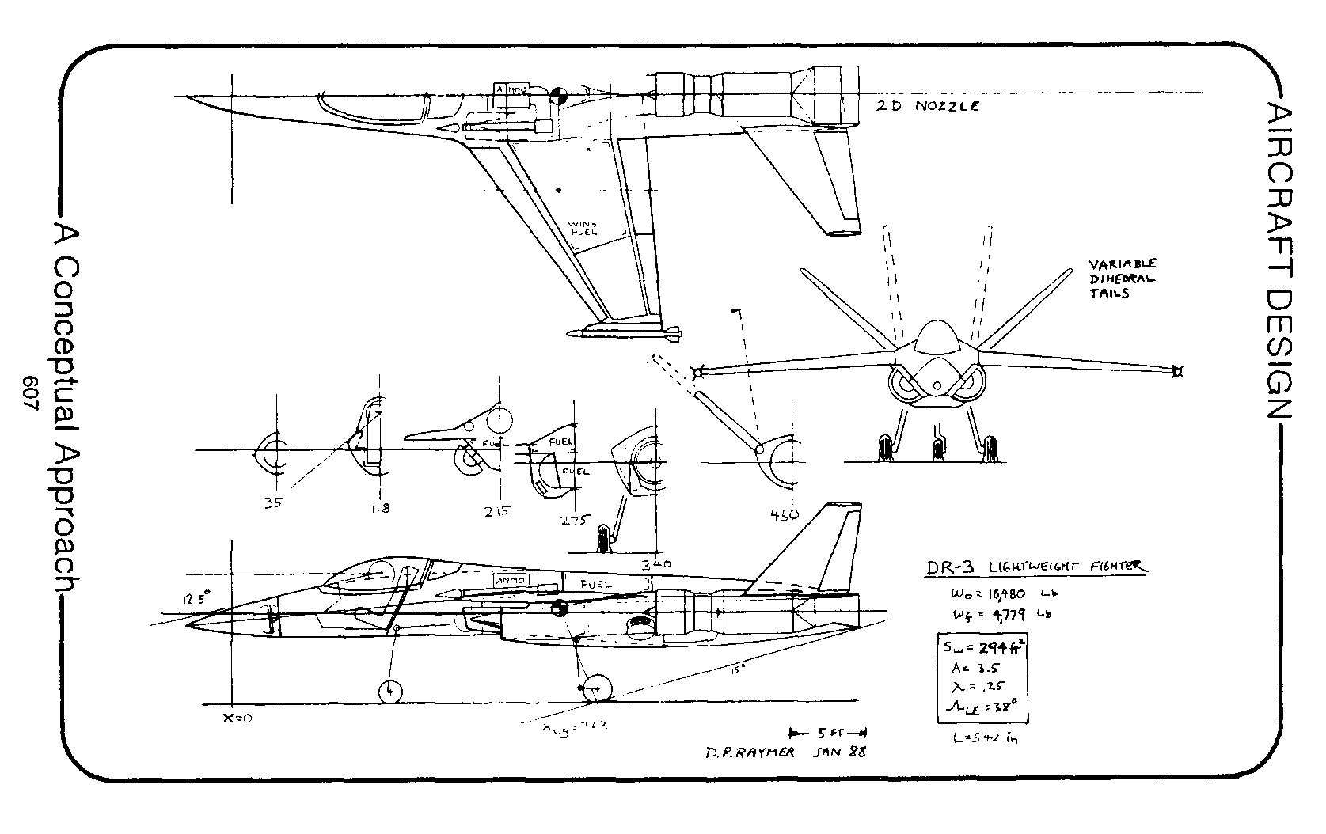
Sketching Examples – a/c Conceptual Design
Raymer, Aircraft Design: A Conceptual Approach

Slide 28
Questions??

