Slide 1
Chapter 11
Channels
Review all chapter slides but if time is short focus on these concepts…

Slide 2
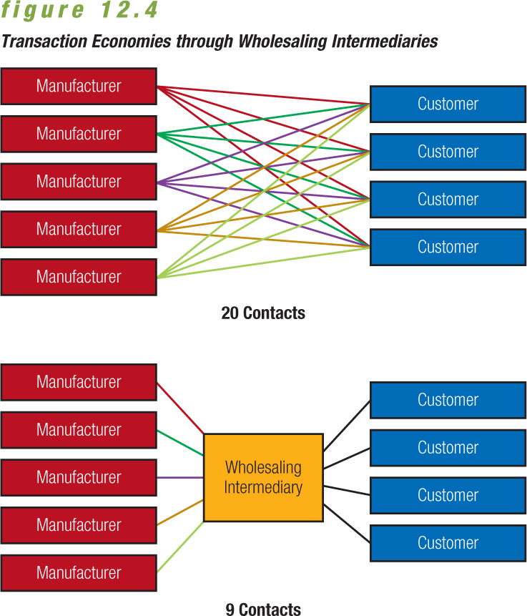
Lowering Costs by Limiting Contacts
0

Slide 3
Tons of Definitions…
0
Distribution – Movement of goods and services from producers to customers
Marketing (distribution) channel – System of marketing institutions that enhances the physical flow of goods and services, along with ownership title, from producer to customer
Logistics – Coordinating the flow of information, goods, and services among members of the distribution channel
Supply-chain management – Control of the activities of purchasing, processing, and delivery through which raw materials are transformed into products and made available to final consumers
Physical distribution – Broad range of activities aimed at efficient movement of finished goods from the end of the production line to the consumer

Slide 4
The Role of Marketing Channels in Marketing Strategy
0
Four functions of marketing channels:
  Facilitating the exchange process by reducing the number of marketplace contacts necessary to make a sale
  Adjusting for discrepancies in the market’s assortment of goods and services via sorting
  Standardizing exchange transactions by setting expectations for products
  Facilitating searches by both buyers and sellers
This doesn’t mean there aren’t conflicts…

Slide 5
Direct Channel
Producer
Consumer
Retail Channel
Producer
Consumer
Retailer
Wholesale Channel
Producer
Wholesaler
Consumer
Retailer
Agent/Broker Channel
Producer
Agent
Wholesaler
Consumer
Retailer

Slide 6
Wholesale
0
Producer to wholesaler to retailer to consumer
  The traditional channel for consumer goods
  Many wholesalers participate in warehousing
  Gives small producers access to hundreds of retailers
    Apple Farmer sells to Lococco wholesale who stock the produce isles of most Niagara Grocery stores
  Gives small retailers access to wholesaler’s specialized distribution skills
    Little corner grocery store can purchase anything they want without entering into buying agreements with every supplier
Channel

Slide 7
Agent/Brokers
0
Producer to agent to wholesaler to retailer to consumer
  Common in markets served by small companies
  Agent may or may not take possession of goods but does not take title
    Food brokers
    Insurance industry
Channel

Slide 8
Determining Distribution Intensity
0
Intensive distribution – Distribution of a product through all available channels
  Eg. Campbell’s Soup – you can buy it anywhere
Selective distribution – Distribution of a product through a limited number of channels
  Eg. Luxury goods
Exclusive distribution – Distribution of a product through a single wholesaler or retailer in a specific geographic region
  Eg. Automotive Dealerships
Channel

Slide 9
Vertical Marketing Systems
0
Planned channel system designed to improve distribution efficiency and cost-effectiveness by integrating various functions throughout the distribution chain.
  One owner owns multiple pieces of the channel
Rely on forward or backward integration
  Forward integration – Firm attempts to control downstream distribution
  Backward integration – Manufacturer attempts to gain greater control over inputs to production process
Channel

Slide 10
Horizontal Marketing Systems
When two or more companies at one level join together for a new marketing opportunity
  Companies need to gain economies of scale so by joining together they could address financial, productions or marketing resources
    Walmart with PepsiCo’s Frito Lays
    Walmart with McDonald’s
    Target with Starbucks
    Microsoft and Yahoo!

Slide 11
Chapter 12
Retail Strategy
Review all chapter slides but if time is short focus on these concepts…

Slide 12
Retailing Strategy
0
Retailers base key decisions on two fundamental steps in the marketing strategy process:
  Selecting a target market
  Developing a retailing mix to satisfy the chosen market
    4Ps +

Slide 13
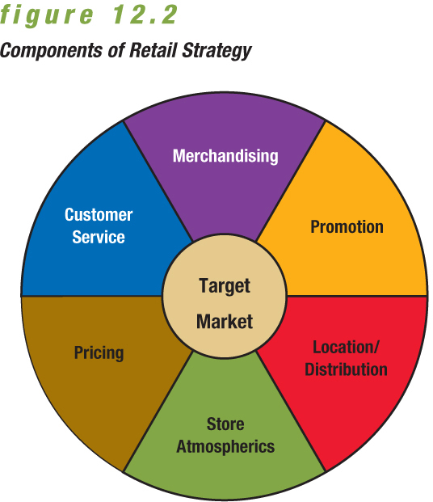
Retailing Strategy
0

Slide 14
Creating a Retail Strategy:
Selecting a Target Market
0
Consider size and profit potential of the market and the level of competition
  Example: Walmart draws customers away from traditional department stores with trendy but affordable lines of clothing.

Slide 15
Creating a Retail Strategy:
Product Merchandising Strategy
0
Guides retailer’s decisions on the items it will offer
While developing the merchandise mix, retailers should consider:
  Needs and preferences of its target market
  Competitive environment influencing choices
  Overall profitability of each product line and category

Slide 16
Creating a Retail Strategy:
Product Category Management
0
Seeks to improve retailer’s product performance through coordinated buying, merchandising, and pricing
Category management evaluates performance according to each product category.
Categories that underperform may be dropped even if they are strong brands.

Slide 17
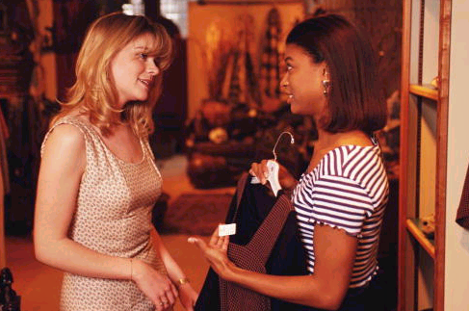
Creating a Retail Strategy:
Price
LO3
Prices reflect a retailer’s marketing objectives and policies.
Price defines the value of both the merchandise and the service provided
They affect consumer perceptions.

Slide 18
Creating a Retail Strategy:
Price Markups and Markdowns
0
Markup – Amount a retailer adds to the cost of a product to determine its selling price
Markup is influenced by two factors:
  Services performed by the retailer
  Inventory turnover rate
Markdown – Amount by which a retailer reduces the original selling price of a product

Slide 19
Customer-Service Strategy
0
Heightened customer service is one possible retailing strategy.
The goal is to attract and retain target customers to increase sales and profits.
Some services that retailers could provide:
  Enhanced comfort through lounges, complimentary coffee, convenient restrooms
  Child-care services for customers
  Virtual assistance programs

Slide 20
Creating a Retail Strategy: Location/Distribution Strategy
0
Location depends on many factors, including the type of merchandise, the retailer’s financial resources, characteristics of the target market, and site availability.
Planned shopping centre – Group of retail stores planned, coordinated, and marketed as a unit. Includes five main types:
  Neighbourhood shopping centre
  Community shopping centre
  Regional shopping centre
  Power centre
  Lifestyle centre

Slide 21
Creating a Retail Strategy:
Promotional Strategy
0
Promotion informs customers about locations, merchandise selections, hours of operation, and prices.
Helps retailers attract shoppers and build customer loyalty
National chains purchase advertising in print and broadcast media.
Atmospherics – Combination of physical characteristics and amenities that contribute to a store’s image
Atmospherics includes: exterior and interior decor
  Exterior should help identify the retailer and attract target market shoppers
  Interior should compliment retailer’s image, respond to customers’ interests, and induce shoppers to buy

Slide 22
Categorizing Retailers
LO2
Department Stores
Full-line Discount
Broad variety and deep assortment
Broad variety at low prices
Specialty
Limited merchandise with service in small store
Drugstores
Specialty for pharmaceutical and heath
Category Specialist
Discount with narrow but deep assortment
Extreme value
Full line, limited, very low prices
Off-Price
Inconsistent assortment of brand name at low prices

Slide 23
Channels for Selling to Consumers
LO4
Store Channel
Kiosk Channel
Catalogue Channel
Internet Channel
Direct Channel

Slide 24
Chapter 13
IMC
Review all chapter slides but if time is short focus on these concepts…

Slide 25
IMC
A company’s combined total effort to
    inform
    persuade or
    remind
customers directly – Personal Selling
or indirectly –Advertising, Product Placement, Sales Promos, Direct Marketing PR, Guerrilla Marketing
about their products or services

Slide 26
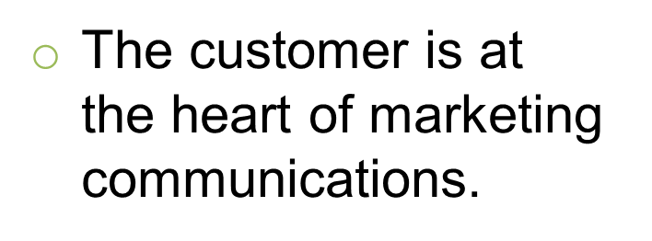
0
Integrated Marketing Communication
Public Relations
Promotion
Direct Marketing
Personal Selling
Advertising
Sponsorship
Ikea

Slide 27
Objectives of Promotion
0
Promotion has five basic objectives:
1. Provide information.
  Goal is to inform the market about the availability of a
  product
2. Increase demand.
  May increase primary demand or desire for a particular product category
  May increase selective demand or desire for a specific brand

Slide 28
Objectives of Promotion
0
3. Differentiate the product.
  Differentiation provides
  firms more control over
  marketing variables such
  as price.
4. Accentuate the product’s value.
  Greater value helps justify
  a higher price in the
  marketplace.
5. Stabilize sales.
  Can stabilize variations in
  demand

Slide 29
Public Relations
Public relations — Firm’s communications and
relationships with its various publics
  Marketing public relations
  Nonmarketing public relations
Publicity — Nonpersonal stimulation of demand through unpaid placement of news in published medium or a favourable presentation of it on the radio or television
  Product placement — The marketer pays a motion picture or television program owner a fee to display his or her product prominently in the film or show
Sponsorship

Slide 30

Sponsorships
0
Relationship in which an organization
provides funds or in-kind resources
to an event
What they get for the $$
Access to the activity’s audience
The image boost associated with the activity
Several companies come together to sponsor Movies for Mommies.

Slide 31
Direct Marketing
LO2
Direct communications, other than personal sales
contacts, between buyer and seller, designed to
generate sales, information requests, or store or website visits
Forms of Direct Marketing
Direct Mail
Catalogue
Kiosk
Direct Response TV
Electronic media
Telephone

Slide 32
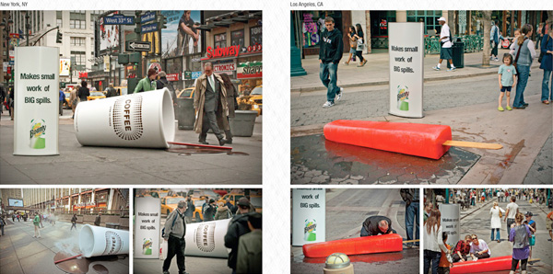
Direct Marketing
Guerrilla marketing — Unconventional, innovative, and low-cost marketing techniques designed to get consumers’ attention in unusual ways
Types of guerilla marketing:
    Buzz marketing
    Viral marketing

Slide 33
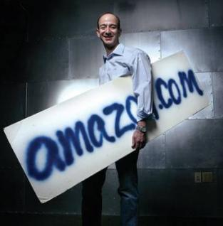
Direct Marketing
LO2
Annual growth rates outstrip
retail sales
One of the fastest-growing
forms of retailing with $51 billion
in annual sales
Four defining characteristics:
  targeted
  motivates an action
  measurable
  can provide information for a
  marketing database

Slide 34
Forms of Direct Marketing
LO2
Direct Mail
Targeted, printed communication sent to a prospective consumer’s mailbox
Catalogues
hard copy and online
welcomed in 80% of Canadian homes
DRTV
short television commercials and/or infomercials
strong call to action via 1-800 number, mail or website
Kiosks
Facilitate service delivery, e.g. airline ticket printing
Sell services and products to consumers,

Slide 35
0
Direct Marketing
Is one of the fastest-growing elements of the promotional mix
Pursues goals beyond creating awareness
  Persuade people to take action
  Personalization
  Measurement is easier
  Win new customers, enhances relationships with existing
Databases are a big part of direct marketing.
Notes:
Direct marketing is one of the fastest growing elements of the promotional mix.
Both B2C and B2B marketers rely on direct marketing to generate orders, or the sales leads that may result in future orders.
Direct marketing helps increase store traffic—visits to the store or office to evaluate or purchase the goods.
Direct market communications pursue goals beyond creating product awareness:
To persuade people to take action
To tailor individual responses to meet consumers’ needs in an interactive way
To measure effectiveness of their efforts more easily than with advertising or other forms of promotion
To win new customers and enhance relationships with existing ones
The growth of direct marketing parallels the move toward IMC in many ways:
Fragmented media markets and audiences
Growth in customized products
Shrinking network broadcasting audiences
Increasing use of databases to target markets
Lifestyles of consumers as a main focus
Databases are a big part of direct marketing.

Slide 36
Chapter 14
Advertising and Digital Communications
Review all chapter slides but if time is short focus on these concepts…

Slide 37
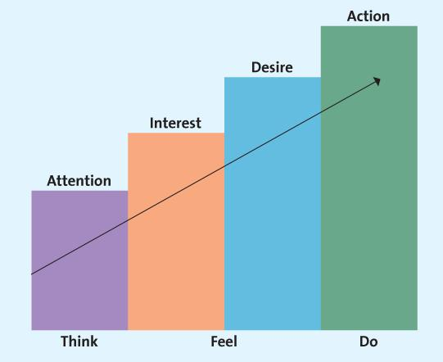
The AIDA Model
LO1

Slide 38
Objectives of Advertising
Informative advertising
  Building brand of company image
  New product launch
  Product explanation
Persuasive advertising
  Building brand preference
  Encourage brand switching
  Convincing customers to tell others about the brand
Reminder advertising
  Maintaining customer relationships
  Reminding Where the product can be purchased
Notes:
It’s common in the latter maturity stage and through the decline stage of the product life cycle.

Slide 39
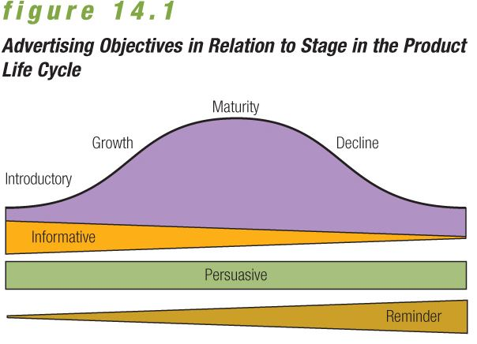
0

Slide 40
Advertising Strategies
0
Comparative advertising
  Advertising strategy that emphasizes messages with direct
  or indirect promotional comparisons between competing brands.
Retail advertising
  Includes all advertising by retail stores that sell goods or services directly to the consuming public
  Cooperative advertising
Interactive advertising
  Involves two-way promotional messages transmitted through communication channels that induce message recipients to participate actively in the promotional effort
Cross promotion
  A technique in which marketing partners share the cost of a promotional campaign that meets their mutual needs
Celebrity advertising

Slide 41
0
Advertising Messages
    Advertising campaign — Series of different but related ads that use a single theme and appear in different media within a specified time period Emotional appeal is VITAL
  Fear appeals
  Humour in advertising messages
  Ads based on sex

Slide 42
Developing/Creating Ads
After idea conception, ad must be refined from rough sketch to finished layout.
Use of advertising in games, or advergames
Banners and pop-ups
Social networking advertising is a new form of online advertising.

Slide 43
Media/Digital Scheduling
0
Digital
    Email
    Online communities and social networks
    Blogs and podcasts
    Other digital communications — mobile
Scheduling
  After selecting media, marketers determine the most effective timing and sequence for a series of advertisements.
  Influenced by a variety of factors:
    Seasonal sales patterns
    Repurchase cycles
    Competitors’ activities

Slide 44
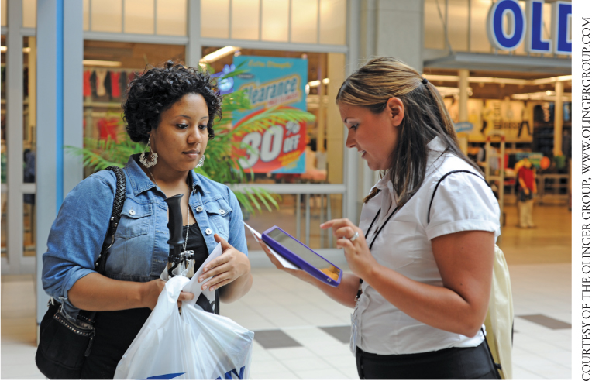
Measuring Advertising Effectiveness
Media research —
Assesses how well
particular medium
delivers message,
where and when to
place the message,
and the size of the
audience
Message research — Tests consumer reactions to an advertisement’s creative message through pretesting and post-testing
Focus groups and personal interviews can be used to pretest ads.

Slide 45
Chapter 16
Price
Review all chapter slides but if time is short focus on these concepts…

Slide 46
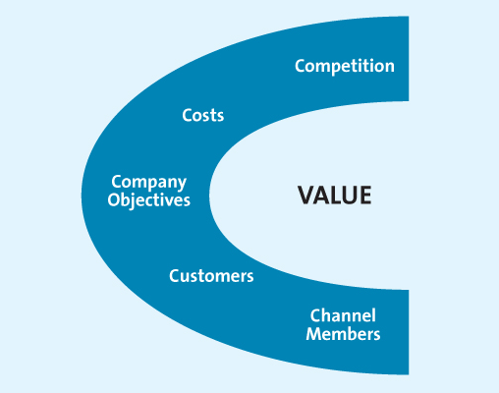
The 5 Cs of Pricing
LO2

Slide 47
Company Objective
0
Profitability
  Profit Maximization
  Consumers must be convinced they are receiving good value for their money.
Volume
  Sales Maximization
  Belief that increased sales volume is more important in the long run than immediate profits
  Can maximize sales through pricing and nonprice factors such as service and quality
Meeting Competitor’s Price
  Firms sometimes set prices to match established industry price leaders.
  Shifts marketing mix to focus on nonprice factors
  Pricing strategy emphasizing benefits derived from a product in comparison to the price and quality levels of competing offerings
Prestige
  Lifestyle and image is the target
  Establishing a relatively high price to develop and maintain an image of quality and exclusiveness that appeals to status-conscious consumers

Slide 48
New-Product Pricing
For use when:
Product’s quality and image support a high price; costs of low volume do not cancel the benefit of higher price; competitors cannot easily enter the market and undercut price
Market Skimming
High initial price to skim revenue from those willing to pay
Market Penetration
Low initial price to penetrate market and gain market share due to price sensitivity
For use when:
Market is price sensitive; costs fall as volume increases; competition can be kept out of market

Slide 49
0
Pricing Strategies:
Skimming Pricing Strategy
Pricing strategy involving the use of a high price relative to competitive offerings
Commonly used as a market entry price for distinctive goods or services with little or no initial competition
Sometimes used throughout the life of the product, as with luxury goods
Permits marketers to control demand but also attracts competitors

Slide 50
Penetration Pricing Strategy
0
Use of a relatively low-entry price compared with competitive offerings, based on the theory that this initial low price will help market acceptance
Price level may increase to match competitors, once the product has recognition in the market
Works best for goods and services that have:
  Highly elastic demand
  Low production and marketing costs
  A high likelihood of attracting strong competitors

