Slide 1
Roots of World War II
Roots of World Conflict
Weeks 8 and 9

Slide 2
A hint of things to come…
All nations were equal, but some were more equal than others…
  The Japanese (who fought with the Allies in WWI) wanted the League’s Covenant to affirm the principle of racial equality, but the Western governments rejected this proposal at the 1919 peace talks.
  The US passed laws in the 1920s excluding Japanese immigrants.
  Britain ended its bilateral treaty with Japan at the urging of the Canadian government which was afraid that renewal would alienate the United States.
    (Nye, Understanding Global Conflict and Cooperation, 2011, p.130)

Slide 3
Two League failures…
One: Japan takes Manchuria (part of China), and installs a puppet government.
A League report condemns Japan’s actions, but the League does not invoke Article 16.
Japan withdraws from the League because of the negative report, but stays in Manchuria.

Slide 4
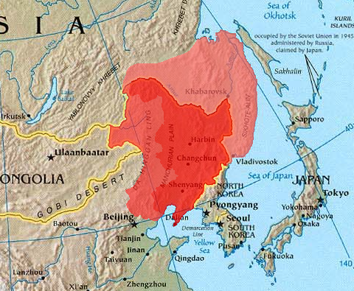

Slide 5
Two League failures…
Two: Italy takes Ethiopia because (get this…) the Ethiopians had defeated Italian efforts to colonize them in the 19th century, and Mussolini’s fascist government saw this as a wrong to be righted.
Ideology, not balance-of-power was the root cause here.
The League applied sanctions
  An embargo on the sale of military goods to Italy; a prohibition on loans to Italy; cessation of imports from Italy; a refusal to sell hard-to-find goods to Italy
  Italy could still buy steel, coal, and oil; Diplomatic relations were maintained; The Suez Canal was left open, leaving Eritrea accessible to Italy.
The sanctions were not enough to sway Mussolini
Britain and France wanted Italy on their side against Germany (which was growing powerful under Hitler).
Balance-of-power was the root cause of the League’s failure.
Does the Prisoners’ Dilemma help explain why the collective security model of the League of Nations collapsed in the face of balance-of-power concerns?

Slide 6
http://www.britannica.com/EBchecked/topic/202210/fascism

Slide 7
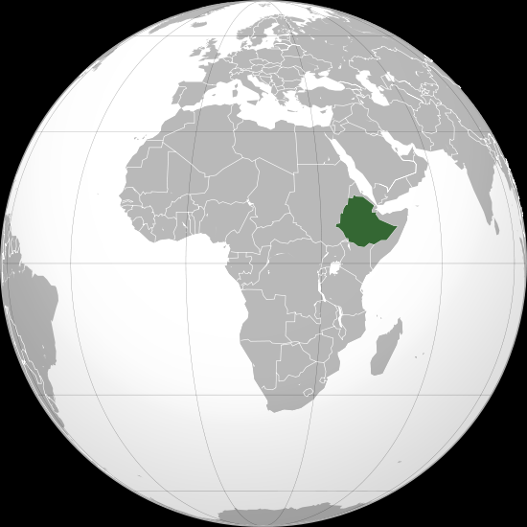

Slide 8
So, what caused WWII?
1: The Treaty of Versailles was:
Too harsh, undermining Germany’s economy and stirring up nationalism, and
Too lenient, because it left Germany with the ability to do something about it.

Slide 9
So, what caused WWII?
2: What Germany does is:
Elect a divided government whose president makes Hitler Chancellor in 1933.
That same year Hitler passes an act creating the Nazi dictatorship.

Slide 10
So, what caused WWII?
3: In 1933 he withdraws Germany from the League of Nations (Germany had been granted membership in 1925), arguing that because France was not willing to cut its forces at a disarmament conference, Germany could not remain a member.
4: In 1935 he announces that Germany will be tripling the size of its army and building an air force.
5: In 1936 he signs the Axis Pact with Italy, and the Anti-Comintern Pact with Japan.
6: In 1938 he takes Austria by force, before Austrian leader Chancellor Kurt von Schuschnigg could hold a plebiscite on whether or not Austria should join Germany.

Slide 11
So, what caused WWII?
6: Also in 1938, Hitler demands that the Sudetenland, which was part of Germany until the post-World War I settlement made it part of Czechoslovakia, be returned to Germany.
(He claimed it was an affront to the right of German speaking peoples to self-determine; however, the Bohemian Mountains were also a good defensive position for the Czechs should the Germans try to invade.)
Czechoslovakia mobilizes some troops in response, and Hitler goes ballistic, threatening to crush Czechoslovakia.
Britain becomes worried, not wanting war to break out, and knowing they were not prepared for war. Neville Chamberlin, Britain’s prime minister, met with Hitler in Munich in September 1938, and gave him the Sudetenland in return for a promise that Hitler would leave the rest of Czechoslovakia alone.
Chamberlin declares, “Peace in our time!”
Hitler invades Czechoslovakia (in March, 1939).

Slide 12
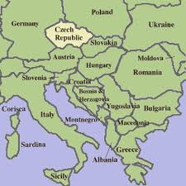

Slide 13
So, what caused WWII?
Hitler then claims that part of Poland belongs to Germany because Germans live there, then takes it.
He then lands troops in Norway, and rolls through Holland, Belgium, and France, while Britain mobilizes.

Slide 14
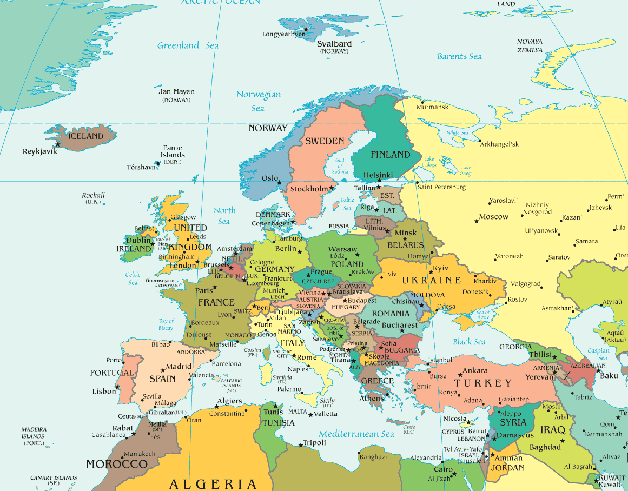

Slide 15
Other important factors:
The ideologies of Fascism and Communism divided people, hindering communication between nations, thus giving Hitler greater opportunity to manipulate them.
The US and the USSR were absent until late in the game, leaving Germany more freedom to act.
The stock market collapse on October 29, 1929, and the resulting Great Depression worsened the effects of Germany’s reparations payments.

Slide 16
Why did Japan attack the US?
Because they thought they could.
They had expansionist plans in Asia.
They took China, and French Indochina (now Vietnam, Cambodia, and Laos).
The US restricted their oil supplies in response.
Japan decided to take Indonesia for its oil. But they were worried that the US might attack, so they attacked Pearl Harbour at the same time.

Slide 17
How did it become a global war?
Hitler declared war on the US after Japan had attacked Pearl Harbour (possibly to keep Japan locked into the war since he’d been urging Japan to join him).

Slide 18
Is appeasement always a bad approach?
Appeasement may have helped prevent WWI. Certainly confrontation only added to the spiral of hostility.
Confrontation may have helped prevent WWII. Certainly appeasement only gave Hitler room to manoeuvre.
Generals are said to be always fighting the last war. It seems the same can be said of politicians.
If history isn’t, by itself, a dependable way of preventing future conflicts, what else is needed?

