Slide 1
Canada’s Rivers

Slide 2
Lecture outline
Drainage basins: features of 8 major rivers
Hydrology: run-off regimes, flooding
Glacial legacy: effect on drainage basins, on drainage patterns
Equilibrium: long profiles, base level, legacy of old deposits, response to global warming
5. Interaction with biology
Canada’s rivers are abnormal in many respects!

Slide 3
1. Drainage Basins
Features of 8 major Canadian Rivers
Major Ocean drainage basins of Canada
the Pacific
the Arctic
Hudson Bay
the Atlantic ocean
the Gulf of Mexico
http://atlas.nrcan.gc.ca/auth/english/maps/environment/hydrology/watershed
http://atlas.nrcan.gc.ca/auth/english/maps/environment/hydrology/drainagebasins
http://www.aquatic.uoguelph.ca/rivers/cnrvintr.htm

Slide 4
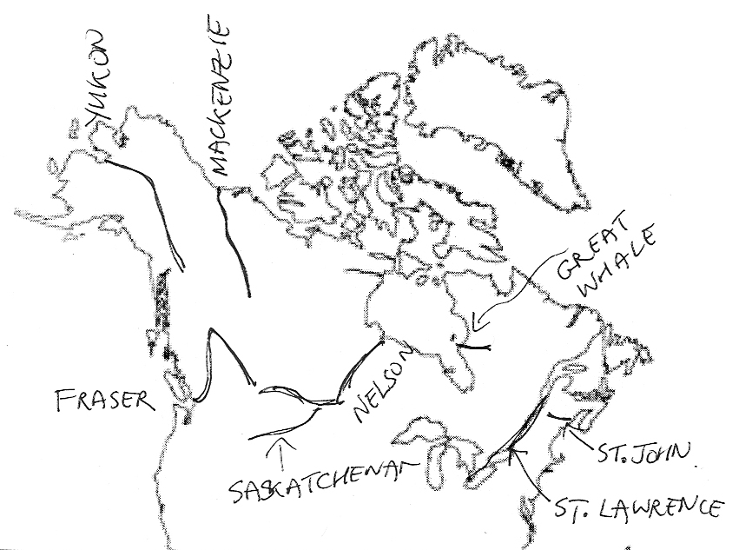
Major watersheds of Canada
Mackenzie R.
Yukon R.
Fraser R.
Great Whale R.
Nelson R.
Saskatchewan R.
St. Lawrence R.
St. John R.
All different!

Slide 5
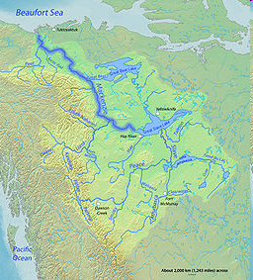
Mackenzie River
Longest river in Canada
Arctic river, through permafrost region
Ends in huge delta, 12th largest in world
Famous for pingoes (eg, 1350 in delta).
Huge discharge! highest in Canada
en.wikipedia.org

Slide 6
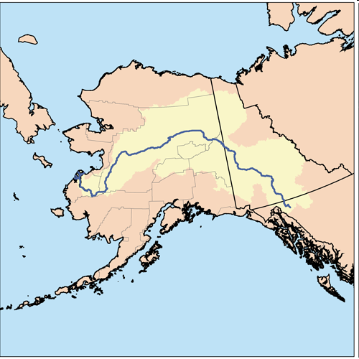
Yukon River
slow-moving, braided stream, and is shallow except when swollen by spring waters
gradient is even and there are few rapids
Transportation for Klondike Gold Rush ...
http://en.wikipedia.org/
Whitehorse
  “The most dangerous area on the trip down the Yukon River was the White Horse Rapids. Many stampeders lost everything as their boats smashed on the rocks”.
  1898: small boat on the White Horse Rapids.
Yukon River, upstream of Whitehorse: spawning grounds of Chinook salmon
300 km from Bering Sea = longest migration route of any salmon

Slide 7
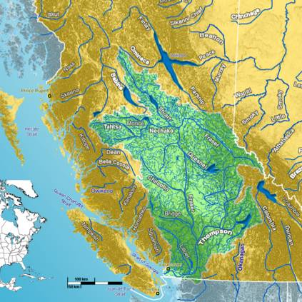
Fraser River
mountainous headwaters, emerges through fault-guided Fraser Canyon, that is v. windy!
Fed by rain + glacial meltwater
Huge amounts of sediment (glacial legacy)
Delta + premier bird habitat
Huge biodiversity: Roberts Bank tidal flat
Designated Site of Hemisphere Importance for shorebirds
Internationally sig pop of migratory birds
http://en.wikipedia.org/

Slide 8
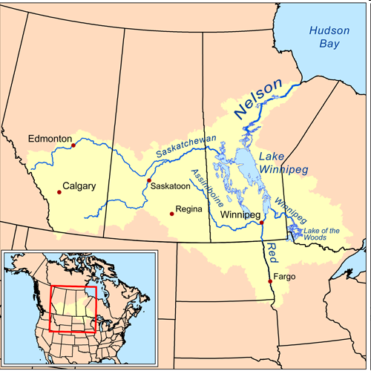
Nelson River
Steep gradient
Lots of hydroelectric dams
Drains the Saskatchewan and Assiniboine Rivers and Lake Winnipeg
http://en.wikipedia.org/
Series of glacial lakes connected by river
From Precambrian Shield rocks to Palaeozoic Hudson Platform

Slide 9
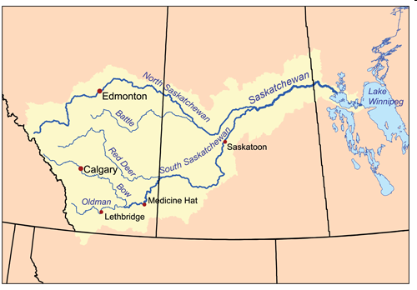
Saskatchewan River
Big range of environments and geology
From foothills Cordillera (folded sed rocks) to Interior Platform (flat sed rocks) through PreCambrian Shield
From montane forest to grassland to boreal forest
http://en.wikipedia.org/
From foothills of Rockies, glacier-fed
Drains the prairies
V low gradient over prairies
Delta at Lake Winnipeg

Slide 10
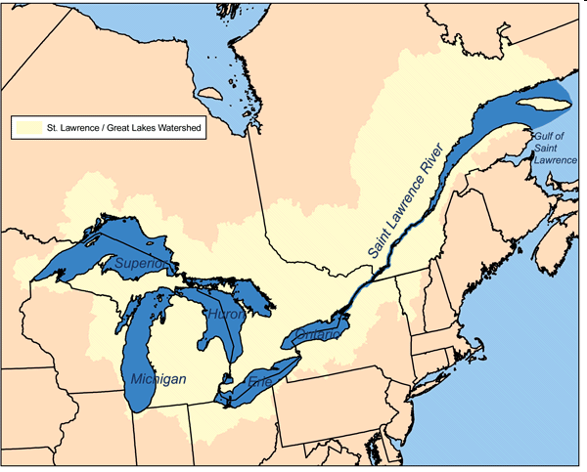
St. Lawrence River
Includes Great lakes (world’s largest system of freshwater lakes)
Most densely populated drainage basin
2nd largest discharge in Canada
Includes PreCambrian Shield
Ottawa-St. Lawrence Platform
Edge of Appalachians
Huge lakes
Huge estuary
http://en.wikipedia.org/
Also huge variety of ecosystems, wild + human-modified

Slide 11
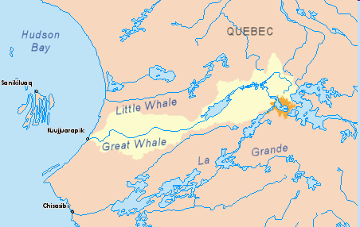
Great Whale River
Many waterfalls, powerful currents
Part of James Bay Project (Hydro-Quebec planned 3 hydroelectric stations – strongly opposed, plan died in 1994)
James Bay I (La Grande Complex) already hugely dammed.
http://en.wikipedia.org/
PreCambrian
Deranged drainage
Boreal forest-tundra

Slide 12
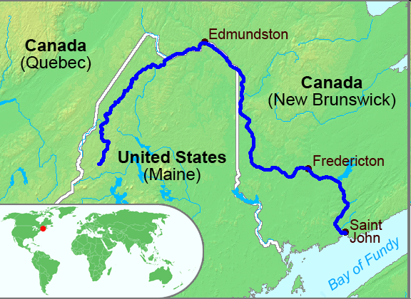
St. John River
Drains to Bay of Fundy
Mouth has unique “Reversing Falls” where tides cause river flow to reverse
Part of Appalachians
http://en.wikipedia.org/

Slide 13
2. Hydrology
Discharge, River Regimes, Flooding.
Water Balance
Inflow – Outflow = Change in Storage
Outflow = Inflow - Change in Storage
Components of Water Balance:
Precipitation (P), Evaporation (E), Runoff (R), Storage (S)
R = P – E - ΔS
ΔS = P – E – R
Considering potential flooding
Considering stored water availability

Slide 14
Storage
i.e. infiltration to groundwater
Infiltration rate: rate at which soil can absorb water
  relates to surface properties (porosity, permeability, and capillary action)
  relates to rainfall characteristics (rainfall intensity)
Infiltration capacity: total amount that can be absorbed
relates to size of storage available
Depression Storage: ability of land to retain water in surface puddles and depressions
relates to surface roughness
contributes to evaporation and infiltration

Slide 15
Run-off
Surface Run-off = overland flow (i.e., surface flow)
(Only occurs with EXCESS water)
Source: Precipitation, snow melt, glacier melt
Snow:
1/3rd of annual precipitation in Canada falls as snow, and typically over half of the days with precipitation have snowfall
Areas where more that half of the annual runoff is derived from snowmelt

Slide 16
Balance of precipitation rate and infiltration rate?
Run-off occurs only when infiltration rate too slow + when depression storage full
Ground NOT necessarily saturated
Evaporation rate also imp
Case study: Saskatchewan

Slide 17
Mean annual precipitation
Mean annual runoff
Northern Sask: ~400 mm precip
Northern Sask: 200-225 mm runoff
Southern Sask: ~350 mm precip
Southern Sask: 0-10 mm runoff
Similar precip, but v diff runoff. Why?

Slide 18
Run-off in Canada
Large seasonal variation in runoff due to storage in the snow cover
Runoff peaks mostly in spring – called “FRESHET”
Peak runoff later in the year further north
Maximum runoff where
precipitation is greatest &
topography is rugged and
steep - west and east coasts
Minimum runoff where “effective rainfall” lowest
“Effective Rainfall” = surplus available for run-off after evaporation

Slide 19
Runoff/River Regimes: changes in discharge over year
Hydrograph = A plot of streamflow vs. time
Annual hydrograph = average stream flow over year
Storm hydrograph = streamflow for a single storm event
In Canada, three runoff regimes most common:
NIVAL
PRO-GLACIAL
PLUVIAL-TEMPERATE

Slide 20
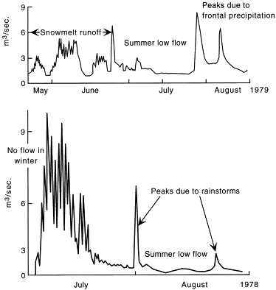
Nival Regimes: Streamflow hydrograph dominated by snowmelt inputs.
Little/no winter flow
Low summer flow
Eg, A Subarctic Nival regime from Alaska (summer record only)
Eg, An Arctic Nival regime from Cornwallis Island, NWT, Canada (even shorter record)
Arctic monitoring and assessment program

Slide 21
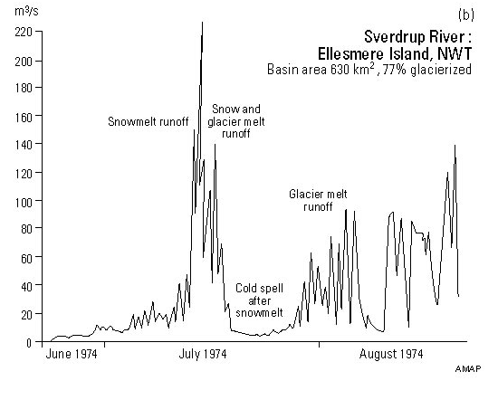
Little/no winter flow
Summer flow rel. to temp.
Obvious diurnal pattern
Proglacial Regime: Streamflow hydrograph dominated by glacial meltwater
Arctic monitoring and assessment program

Slide 22
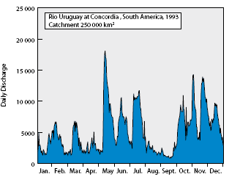
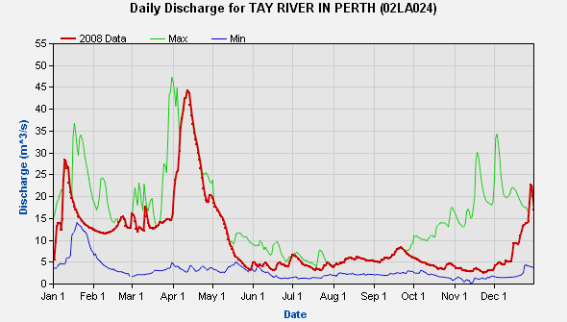
Pluvial/Temperate Regime: Streamflow hydrograph dominated by frequent rainfall events
mrcmekong.org
Environment Canada
Canaan River, Newfoundland, Atlas of Canada,
Tay River, Ontario

Slide 23
Flooding: How does a river respond to any one storm?
i.e., What is the typical “Storm Hydrograph” for a river?
Balance between Overland Flow and Infiltration affects storm response
Run-off occurs only when infiltration rate too slow + when depression storage full
Ground NOT necessarily saturated
Evaporation rate also imp
Important controls on the balance: material type, size and shape of basin, number of channels available to drain water, previous rainfall

Slide 24
Infiltration Rate governed by soil type, rock type, slope, etc.
Eg, Alberta, badlands south of Red Deer.
- Non-permeable sandstone
No infiltration
Instant run-off
Floods + erosion into “Badlands”!

Slide 25
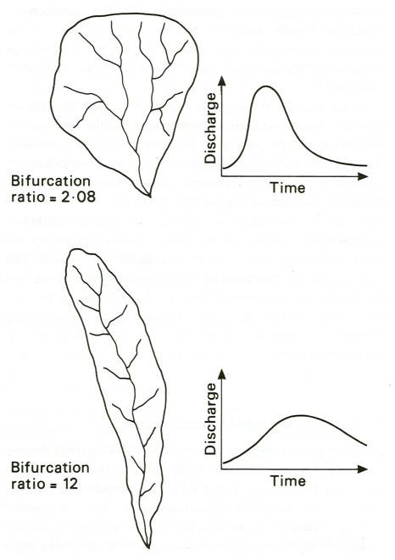
Basin shape
e.g. round shape: all water reaches mouth at same time
Gives peaked or “flashy” hydrograph
e.g. elongate shape: water reaches mouth at different times
Gives less peaked or “sluggish” hydrograph
Fig. 9.3, Global Geomorphology, Michael A. Summerfield, 1991

Slide 26
Number of channels available
Drainage density = length channel/unit area
More channels = faster/bigger flood
Basin size
Small basin = rapid water rise
Bigger basin = slower water rise
Relief/Slope
Steep slope = rapid water rise
Gentle slope = slower water rise
Thickness of soil
Thin soil = no storage = rapid water rise
Thick soil = more storage = slower water rise
Vegetation cover
Little vegetation = rapid water rise
Lots of vegetation = slower water rise

Slide 27
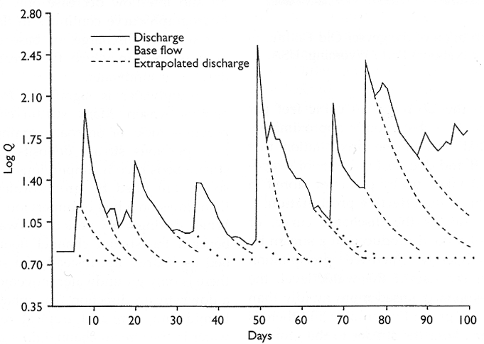
Antecedent Rainfall
Previous rain = ground already soaked = rapid water rise
Discharge in a small stream (Pennsylvania, USA) during successive rainfalls. Discharge Q in cubic metres per minute
Fig. 10.6, Introduction to Geomorphology, Frank Ahnert, 1998.

Slide 28
When will a river flood?
Need to know ...
How often it has flooded in the past, especially extreme events
Measure discharge for many storms
Graph maximum discharge against recurrence interval
Assess probability of future floods!

Slide 29
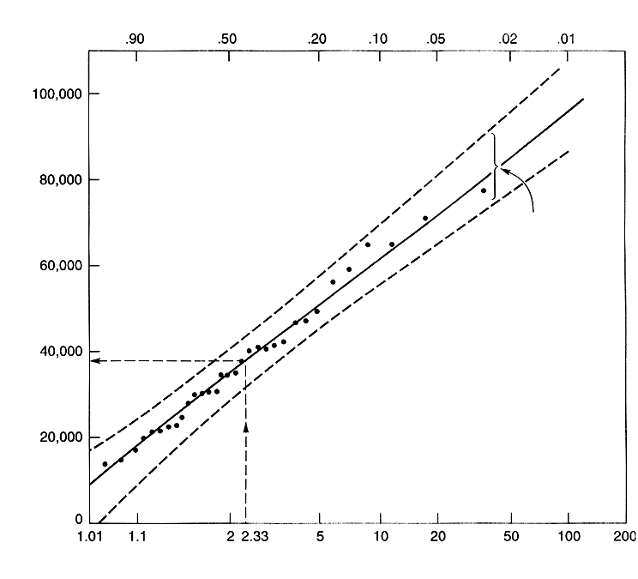
Basis for flood prediction
Regression line and confidence interval
Annual maximum discharge (cfs)
Note: Log scale
Recurrence interval (yr)
Fig. 5-9, Surface Processes And Landforms, Don J. Easterbrook, 2nd Ed. 1999.

Slide 30
Discharge can vary considerably temporally
News Release - June 13, 1995
HIGH WATER LEVEL WARNING FOR SOUTH SASKATCHEWAN RIVER
High water levels have been forecast by Sask Water for the South
Saskatchewan River, both above and below Lake Diefenbaker, due to
extreme rainfall conditions in Alberta.
Water levels through Saskatoon are expected to rise 1.5 to 2 metres in
the next 48 hours, causing conditions comparable to those experienced
in 1993. Very high flow velocities will also make the river dangerous
to recreation users.
The South Saskatchewan River runs dry
The river is the lifeblood of the prairies, but its future flow will be determined by a supply-demand equation — and the math doesn’t look promising
6th Nov 2010 Canadian Geographic Report
In the last century the flow of the river has dropped by 12%

Slide 31
3. Glacial Legacy
Effect on Drainage basins and Drainage patterns
Erosion
Deposition
Isostatic depression and uplift
Ice-dammed lakes

Slide 32
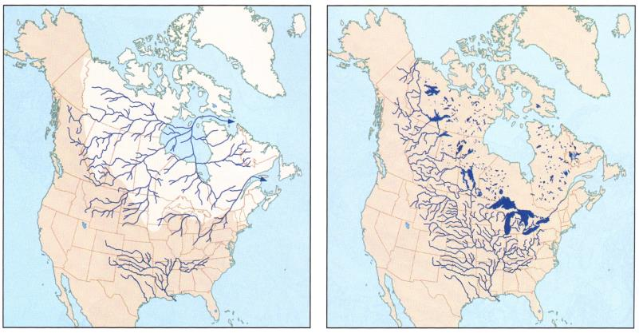
Effect of glacial legacy on drainage basins
Pre- and post-glacial drainage systems of North America
Fig 14.28 Hamblin and Christiansen 2001 Earth’s Dynamic Systems
Before: mainly to NE, Hudson Bay, small Mississippi, no Mackenzie, no Gt. Lakes, no Gulf of St. Lawrence
After: Mackenzie, Mississippi-Missouri, St. Lawrence, Gt. Lakes, no Hudson Bay drainage, Deranged drainage of Shield

Slide 33
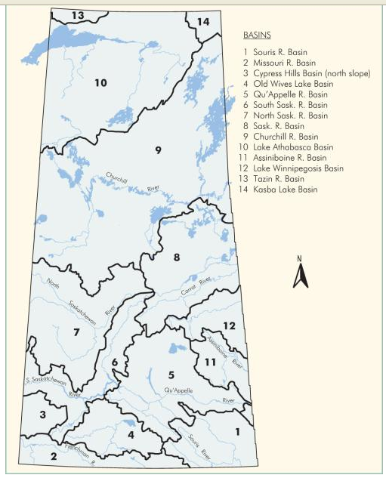
Effect on river junctions: cf normal watersheds, river junctions
Effect of repeated shifts in drainage? Barely integrated network ... Irregular junctions, illogical watersheds!
Churchill basin
Major Drainage divide
Saskatchewan basin
Qu’Appelle
Churchill basin
South Sask
Saskatchewan basin
Old Wives Lake
Souris
SASKATCHEWAN drainage
Canadian plain Research Centre Mapping Division
Missouri

Slide 34
Effect of glacial legacy on drainage patterns
Drainage patterns reflect topography and geology (tributary angle, frequency, etc.)
dendritic (most common)
parallel (strongly influenced by slope)
trellis (strongly influenced by structure)
radial (dome or cone)
centripetal (basin)
distributary (splay)
deranged (no pattern)

Slide 35
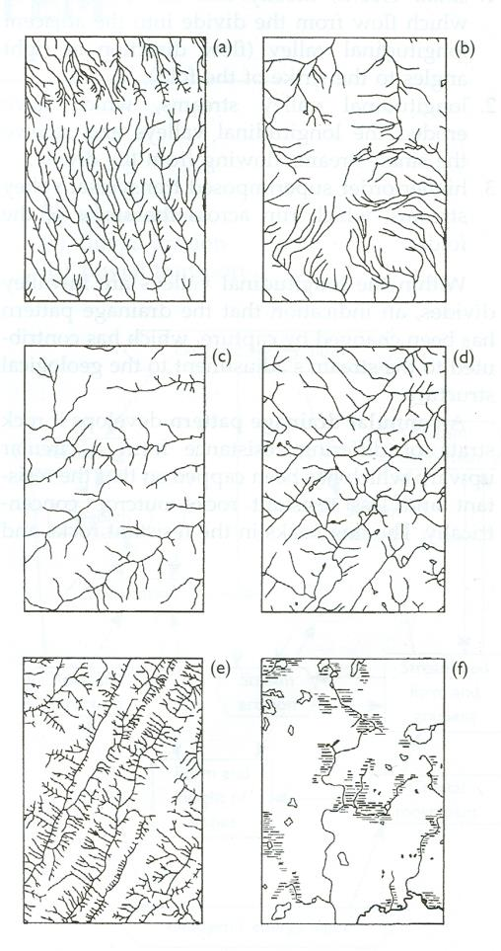
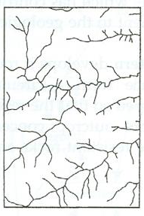
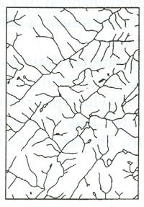
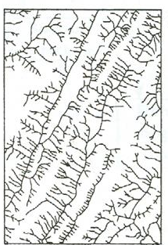
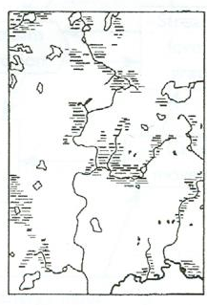
Stream and Valley Network Patterns
Parallel
b) Radial
c) Dendritic
d) Rectangular
e) Trellis
f) Deranged
Fig. 17.8, Introduction to Geomorphology, Frank Ahnert, 1998.

Slide 36
Drainage Patterns in Canada?
Dendritic: Clarington, Ontario, former lake deposits; ie, drainage pattern governed by surficial geology
Parallel: Badlands Rock Layer and Drainage Patterns in Dinosaur Park, Southeast of Drumheller, AB; drainage pattern governed by geology (rock type) and slope
Parallel : Straight slopes, straight-sided fault scarps, straight sides of glacial U-shaped valleys.
Eg, Sparwood BC (nr Crowsnest Pass)
Deranged: Labrador Fold Belt. Drainage pattern governed by geological structure, glacial legacy, and time

Slide 37
Deranged: Waldsea Lake, Sask. (salt lake) Internal drainage
Drainage pattern governed by geological structure (flat beds), geology (salt beds), glacial deposits (hummocky moraine)
Trellis: Peterborough drumlin field (ie, drainage pattern governed by surficial geology)
Dasent Peak, AB, trellis drainage, Jasper Nat Pk.
(+ Saskatchewan River Crossing and Bighorn Dam)
Regions of folded sedimentary rocks such Cordilleran and Innuitian orogenies : ie, drainage pattern governed by geological structure
Ellesmere island, trellis structure
Distributary: The Saskatchewan River flowing into Lake Manitoba; ie, drainage pattern governed by base level and sedimentary load.

Slide 38
3. Equilibrium
Long profiles, base level, legacy of old deposits, response to global warming

Slide 39
River Equilibrium: Relationship of modern river to modern conditions
Most of the moderate to large rivers in Canada are NOT in equilibrium with present conditions
Reason? Rivers adapted to conditions in the past (eg, post-glacial high discharge) or conditions changing too rapidly (eg, climate warming)
Response rate depends on
materials – eg, hard rock v soft rock; eg, rock v sediments
time available since last major change – eg, time since sea level change; eg, time since ice retreat

Slide 40
Evidence that rivers are not in equilibrium?
Poorly integrated channels
Variations in channel width
Irregular long profile (e.g, rapids)
Misfit rivers: eg, underfit rivers relict from time of glacial meltwaters

Slide 41
Response rate depends on materials – eg, hard rock v soft rock; eg, rock v sediments
River at equilibrium: South Nation River, near Casselman, Ontario. Champlain Sea deposits.
What features does this river show?
No sudden changes, parallel banks, even long profile
River not at equilibrium Ottawa River
Many sudden changes, non-parallel banks, bumpy long profile
Another example of constricted parts of profile (also caused by rock barriers)
Fraser River Canyon at Pavilion BC

Slide 42
Long Profile of river in equilibrium (+ base level)
Base Level = level below which a river will not erode
Ultimate base level: Sea level
Local base level: Lake level, or larger river level, or resistant rock unit
Longitudinal profile: graded river profile is hyperbolic to base level; upper steep reaches, middle moderate reaches, lower flat reaches.
Sea level
Equilibrium Longitudinal profile

Slide 43
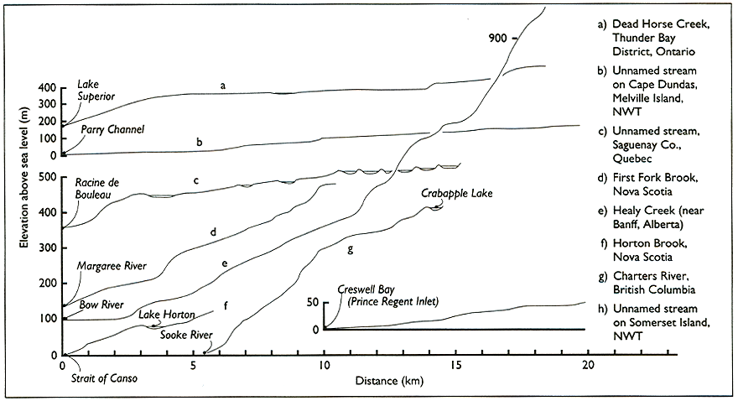
Examples of Canadian stream profiles
Do they fit the hyperbolic long profile?
What profile do they have?
Mostly flatter at headwaters and steeper towards mouth!
Fig 10.16, Alan S. Trenhaile, Geomorphology (A Canadian Perspective), 1998

Slide 44
Many nick points in long profile:
Causes?
Geological control (e.g., resistant rock bed)
Base level changes (local or ultimate) (e.g., former lake, glacial sea level lowering)
Alexandra Falls, Hay River NWT
Rapids in Ottawa River, north of Britannia Bay

Slide 45
Misfit (usually underfit) streams
Caused by changes in discharge
  e.g., from river capture
  Glacial meltwater
  Lake drainage
  Etc.
Post-glacial changes in discharge: underfit streams.
The Assiniboine and Qu’Appelle Valleys, Manitoba, formed as spillways from meltwater.
Other features of former fluvial activity
Algonquin. Ontario, near Barron Gorge. Huge scale scour marks in bedrock channel. Route of former L. Aggassiz outflow.
Giant potholes (>300) at Pothole Trail at Rockwood Conservation Area (Eramosa River, Guelph) from glacial ice melt or even sub-glacial water, ~ 12 ka

Slide 46
Legacy of old deposits
Affects balance of discharge and carrying capacity
Capacity: the total possible load a stream can transport
Balance between energy in stream and sedimentary load to be carried → graded stream, degrading or aggrading streams
Equilibrium stream: where the sediment load is balanced to the stream's capacity
Degrading stream: When load is below capacity, erosion occurs
Aggrading stream: When load exceeds capacity, deposition occurs

Slide 47
Legacy of old deposits: glacial deposits
Balance of discharge and carrying capacity? What happens?
Post-glacial alluvial fans in Bow Valley, Banff
Formed post-glacially, ended ~ 5 ka
Now being dissected by rivers
Legacy of old deposits: pre-glacial deposits
Yukon, Yukon River and Bonanza Creek, Klondike junction.
Triassic river gravels filled valley, incised again.

Slide 48
Response to climate warming?
2009 WWF study reported that South Saskatchewan River is most at risk (cf 10 major rivers in Canada). Climate change, agricultural and urban infrastructure water use, and dams producing Hydroelectricity, have all combined to reduce the flow of the South Saskatchewan River by 70%.

Slide 49
4. Interaction with biology
Impact of beavers v. imp in Canada
Beaver is one of our “keystone” species (affects whole ecosystem significantly)
One of the primary means of lake/wetland formation

Slide 50
Eg, Beaver Dams in Riding Park National Park, Manitoba
What impact have the beavers had on the river channel morphology?
What impact have the beavers had on the river valley morphology?
Aside: What impact do beavers have on biodiversity?

Slide 51
Impact of beavers?
  Moderate flooding
  Stabilize water supply
  Recharge groundwater
  Improve water quality
  Reduce erosion
  Develop new wetlands
  Increase biodiversity
  Improve fertility
+ Great for canoeing!
So ... what would happen if beavers disappear?
Ravines, badlands, deltas, floods, etc.

Slide 52
Sample test questions on rivers and hydrology
Which of these five floods of the Red River was the biggest (circle the correct one)? 1 mk
1826, 1852, 1950, 1997, 2006
1826 is correct
Describe the preventative measures that are taken to mitigate the impacts of flooding in the Red River Valley. 5 mks
Emergency dykes (in areas that are outside of the main dykes)
Ring dykes around houses/buildings
Ringed towns, dykes around towns
Building on pads/gravel mounds
Red River floodway – a diversion canal that protects Winnipeg
(+ Expansion of floodway underway)

Slide 53
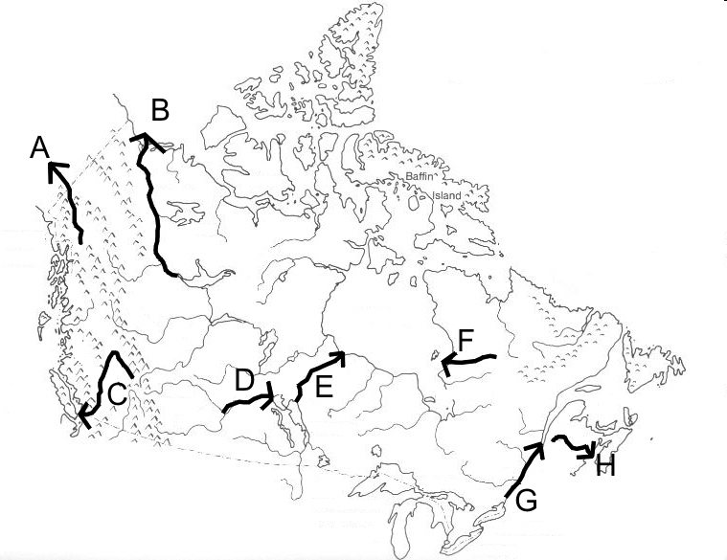
Name the rivers shown on this map. For each give one of the features discussed in the lecture that makes it unique/interesting. 8 mks
Under what conditions will surface runoff occur? 2 mks
When infiltration rate is too slow to accommodate rate of input, and when depression storage is full
Also when precip greater than evaporation + storage full, Or when ground already saturated so no storage left.

Slide 54
What is the evidence for this, and why are so many of Canada’s river not in equilibrium with the conditions of today? 10 mks
EVIDENCE? Poorly integrated channels, rapids, nickpoints, variations in channel width; Misfit rivers; Deranged drainage; Long profile not the hyperbolic profile of the equilibrium form
WHY? Adapted to conditions in the past, not the present. eg, many formed by post-glacial high discharge
Legacy from past has to be removed first; eg, large amounts of glacial deposits in BC
Conditions changing too rapidly eg, global warming/increased aridity
Not enough time to adapt to changes, eg time since ice retreat, eg, sea level rise since last glacial period.
Materials too resistant to erosion to change rapidly; eg, rock basins over much of the Shield.
Size of river too large … smaller rivers more likely to be in equilibrium.

