Slide 1

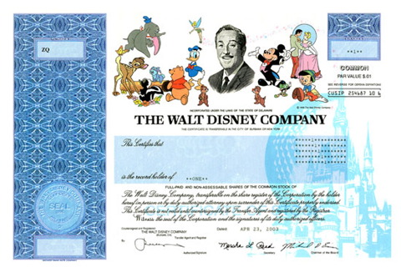

BUSI 2504 – Essentials of Business Finance
Lecture 5 – Chapter 8 Stocks
Paul Wefers Bettink, MA, MBA
paul.wefersbettink@carleton.ca

Slide 2
Lecture Outline
Stocks – Chapter 8
  Common Stock Valuation
  Common Stock Features
  Preferred Stock Features
  Stock Market Reporting

Slide 3
Key Concepts and Skills
Understand how stock prices depend on future dividends and dividend growth
Be able to compute stock prices using the dividend growth model
Understand how corporate directors are elected
Understand how stock markets work
Understand how stock prices are quoted

Slide 4
Cash Flows for Shareholders 8.1
If you buy a share of stock, you can receive cash in two ways
  The company pays dividends
  You sell your shares, either to another investor in the market or back to the company = Capital Gains
As with bonds, the price of the stock is the present value of these expected cash flows

Slide 5
One Period Example
Suppose you are thinking of purchasing the stock of Moore Oil, Inc. and you expect it to pay a $2 dividend in one year and you believe that you can sell the stock for $14 at that time. If you require a return of 20% on investments of this risk, what is the maximum you would be willing to pay?
  Compute the PV of the expected cash flows
  Price = (14 + 2) / (1.2) = $13.33
  Or FV = 16; I/Y = 20; N = 1; CPT PV = -13.33

Slide 6
Two Period Example
Now what if you decide to hold the stock for two years? In addition to the $2 dividend in one year, you expect a dividend of $2.10 in two years and a stock price of $14.70 at the end of year 2. Now how much would you be willing to pay now?
  PV = 2 / (1.2) + (2.10 + 14.70) / (1.2)² = 13.33
  Or CF₀ = 0; C01 = 2; F01 = 1; C02 = 16.80; F02 = 1; NPV; I = 20; CPT NPV = 13.33

Slide 7
Three Period Example
Finally, what if you decide to hold the stock for three periods? In addition to the dividends at the end of years 1 and 2, you expect to receive a dividend of $2.205 at the end of year 3 and a stock price of $15.435. Now how much would you be willing to pay?
  PV = 2 / 1.2 + 2.10 / (1.2)² + (2.205 + 15.435) / (1.2)³ = 13.33
  Or CF₀ = 0; C01 = 2; F01 = 1; C02 = 2.10; F02 = 1; C03 = 17.64; F03 = 1; NPV; I = 20; CPT NPV = 13.33

Slide 8
Developing The Model
You could continue to push back the date when you would sell the stock
You would find that the price of the stock is really just the present value of all expected future dividends
So, how can we estimate all future dividend payments?

Slide 9
Estimating Dividends: Special Cases
Constant dividend
  The firm will pay a constant dividend forever
  This is like preferred stock
  The price is computed using the perpetuity formula
Constant dividend growth
  The firm will increase the dividend by a constant percent every period
Supernormal growth
  Dividend growth is not consistent initially, but settles down to constant growth eventually

Slide 10
Zero Growth
If dividends are expected at regular intervals forever, then this is like a preferred stock and is valued as a perpetuity
P₀ = D / R
Suppose stock is expected to pay a $0.50 dividend every quarter and the required return is 10% with quarterly compounding. What is the price?
  P₀ = .50 / (.1 / 4) = $20

Slide 11
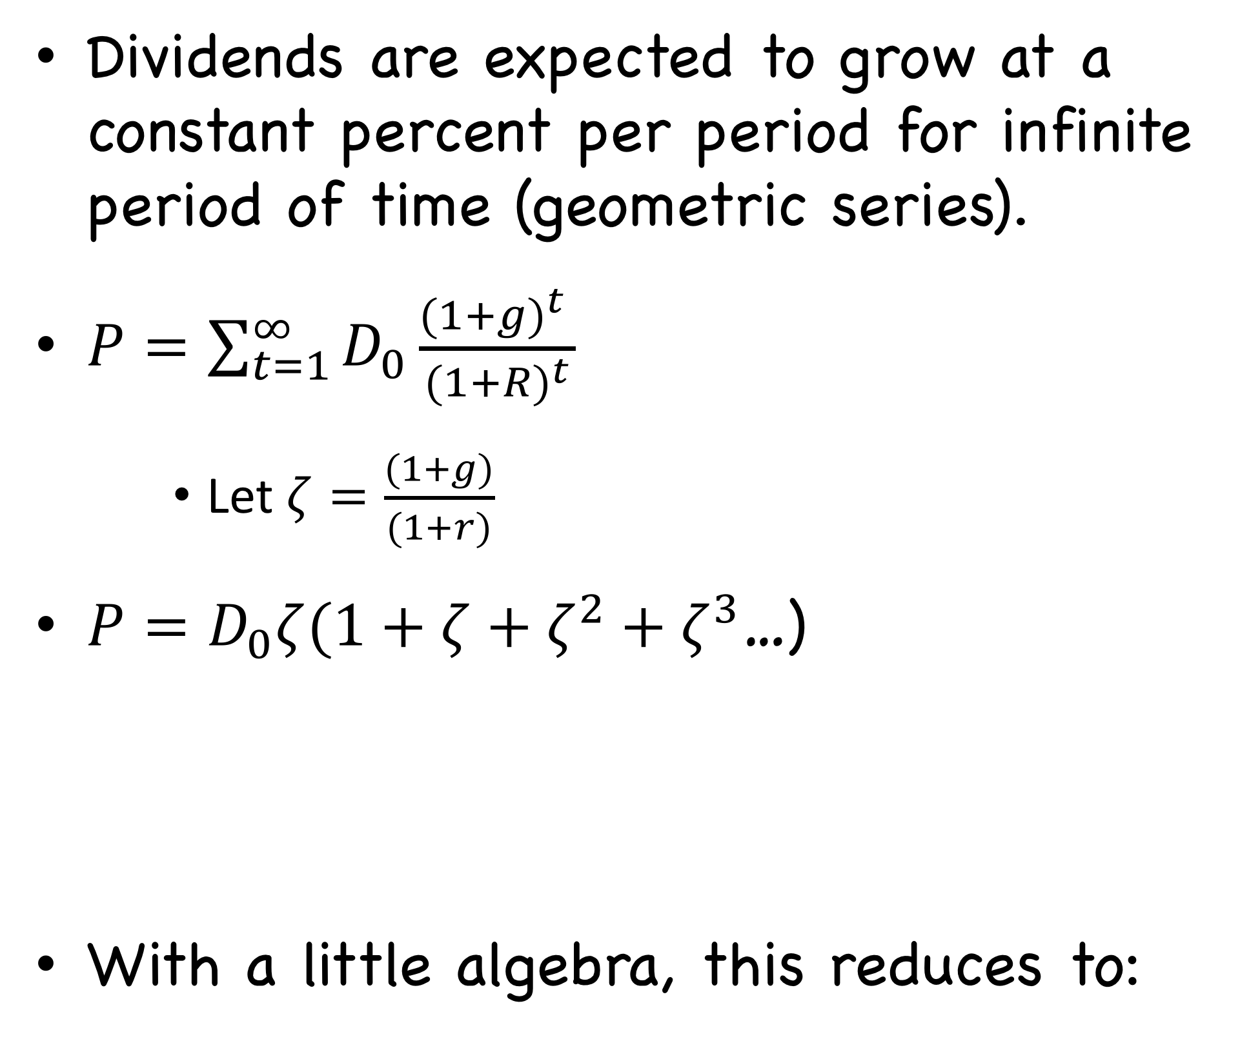
Dividend Growth Model
Dividends are expected to grow at a constant percent per period for infinite period of time (geometric series).
$P=\sum_{t=1}^{∞}{D_{0}\frac{(1+g)^{t} }{(1+R)^{t}}}$
    Let $ζ=\frac{(1+g)}{(1+r)}$
$P=D_{0}ζ(1+ζ+ζ^{2}+ζ^{3}$…)
With a little algebra, this reduces to:

Slide 12
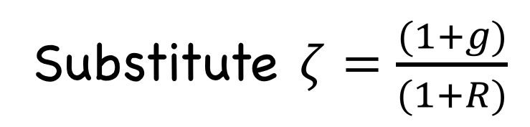
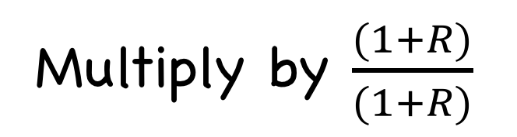
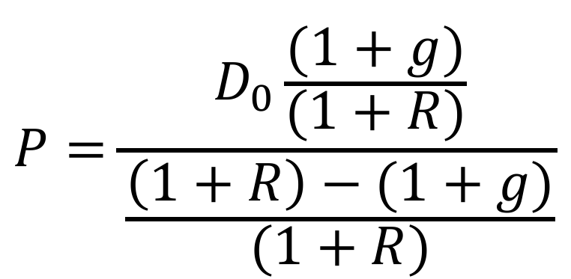
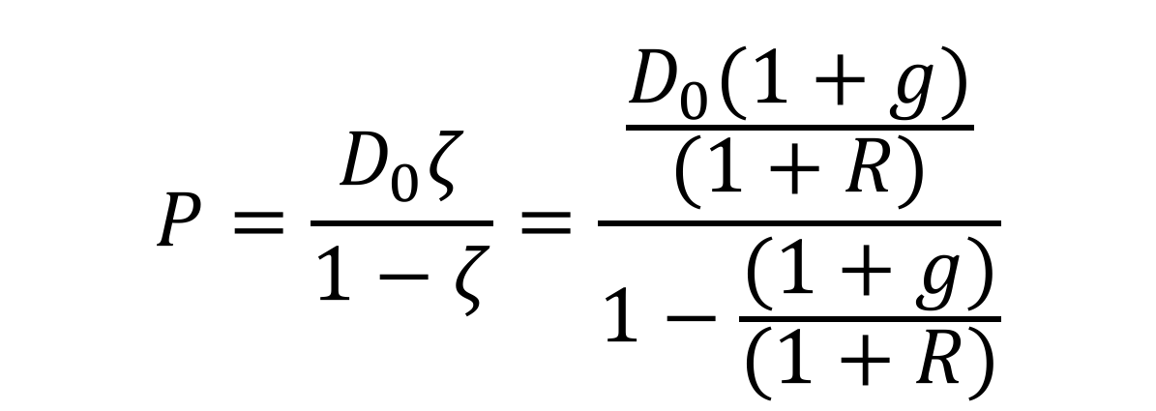
Dividend Growth Model (Continued)
$$P=\frac{D_{0}ζ}{1−ζ}=\frac{\frac{D_{0}(1+g)}{(1+R)}}{1−\frac{(1+g)}{(1+R)}}$$
Substitute $ζ=\frac{(1+g)}{(1+R)}$
$$P=\frac{D_{0}\frac{(1+g)}{(1+R)}}{\frac{\left(1+R\right)−(1+g)}{(1+R)}}$$
Multiply by $\frac{(1+R)}{(1+R)}$

Slide 13
DGM – Example 1
Suppose Big D, Inc. just paid a dividend of $.50. It is expected to increase its dividend by 2% per year. If the market requires a return of 15% on assets of this risk, how much should the stock be selling for?
P₀ = .50(1+.02) / (.15 - .02) = $3.92
  Where g=2% or 0.02, R= 15% or 0.15, D₀=$0.50

Slide 14
DGM – Example 2
Suppose TB Pirates, Inc. is expected to pay a $2 dividend in one year. If the dividend is expected to grow at 5% per year and the required return is 20%, what is the price?
  P₀ = 2 / (.2 - .05) = $13.33
  Why isn’t the $2 in the numerator multiplied by (1.05) in this example? Because it is the expected dividend (the next period) – D₁

Slide 15
Stock Price Sensitivity to Dividend Growth, g
D₁ = $2; R = 20%

Slide 16
Stock Price Sensitivity to Required Return, R
D₁ = $2; g = 5%

Slide 17
Gordon Growth Company – Example 1
Gordon Growth Company is expected to pay a dividend of $4 next period and dividends are expected to grow at 6% per year. The required return is 16%.
What is the current price?
  P₀ = 4 / (.16 - .06) = $40
  Remember that we already have the dividend expected next year, so we don’t multiply the dividend by 1+g

Slide 18
Gordon Growth Company – Example 2
What is the price expected to be in year 4?
  P₄ = D₄(1 + g) / (R – g) = D₅ / (R – g)
  P₄ = 4(1+.06)⁴ / (.16 - .06) = 50.50
What is the implied return given the change in price during the four year period?
  50.50 = 40(1+return)⁴; return = 6%
  PV = -40; FV = 50.50; N = 4; CPT I/Y = 6%
The price grows at the same rate as the dividends

Slide 19
Example – Non-constant Dividend Growth
Suppose a firm is expected to increase dividends by 20% in one year and by 15% in two years. After that dividends will increase at a rate of 5% per year indefinitely. If the last dividend was $1 and the required return is 20%, what is the price of the stock?
Remember that we have to find the PV of all expected future dividends.

Slide 20
Example – Non-constant Dividend Growth Continued
Compute the dividends until growth levels off
  D₁ = 1(1.2) = $1.20
  D₂ = 1.20(1.15) = $1.38
  D₃ = 1.38(1.05) = $1.449
Find the expected future price
  P₂ = D₃ / (R – g) = 1.449 / (.2 - .05) = 9.66
Find the present value of the expected future cash flows
  P₀ = 1.20 / (1.2) + (1.38 + 9.66) / (1.2)² = 8.67

Slide 21
Quick Quiz – Part I
What is the value of a stock that is expected to pay a constant dividend of $2 per year if the required return is 15%?
What if the company starts increasing dividends by 3% per year, beginning with the next dividend? Assume that the required return stays at 15%.

Slide 22
Using the Constant Dividend Growth Model (DGM) to Find R
Start with the constant DGM:
This shows the components of the required return
  D₁ / P₀ is the dividend yield and g is the capital gains yield

Slide 23
Example – Finding the Required Return
Suppose a firm’s stock is selling for $10.50. They just paid a $1 dividend and dividends are expected to grow at 5% per year. What is the required return?
  R = [1(1.05)/10.50] + .05 = 15%
What is the dividend yield?
  1(1.05) / 10.50 = 10%
What is the capital gains yield?
  g =5%

Slide 24
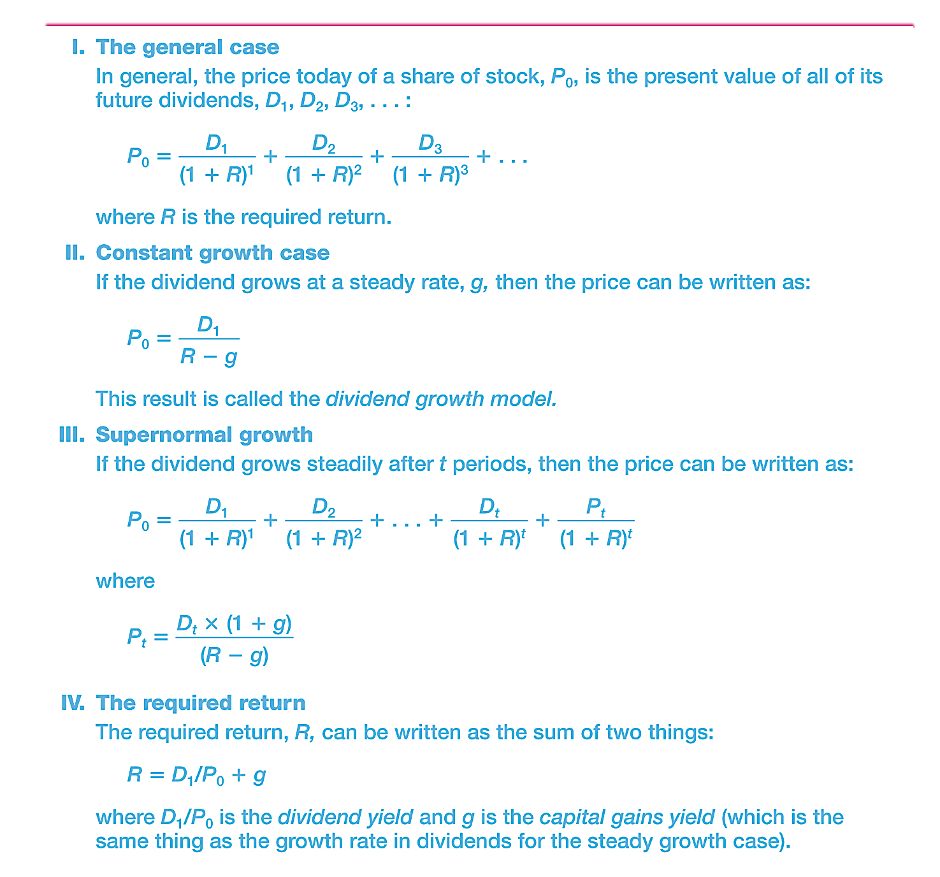
Table 8.1 - Summary of Stock Valuation

Slide 25
Common Stock Features 8.2
Shareholders’ Rights
Other Rights
  Share proportionally in declared dividends
  Share proportionally in remaining assets during liquidation
  Preemptive right – first shot at new stock issue to maintain proportional ownership if desired
Classes of stock
  Unequal voting rights
  Control of firm
  Coattail provision

Slide 26

Example of a Stock Certificate

Slide 27
Dividend Characteristics
Dividends are not a liability of the firm until a dividend has been declared by the Board
Consequently, a firm cannot go bankrupt for not declaring dividends
Dividends and Taxes
  Dividend payments are not considered a business expense and are not tax deductible
  Dividends received by individual shareholders are partially sheltered by the dividend tax credit
  Dividends received by corporate shareholders are not taxed
  This prevents double taxation of dividends

Slide 28
Example – Keyera Corp.
USE OF PROCEEDS
The net proceeds to the Corporation from the Offering will be approximately $169,248,000 after deducting the Underwriters’ Fee of $7,052,000 and before deducting expenses of the Offering. If the Underwriters exercise the Over- Allotment Option in full, the net proceeds from the Offering will be approximately $194,635,200 after deducting the Underwriters’ Fee of $8,109,800 and before deducting expenses of the Offering. The expenses of the Offering and the Underwriters’ Fee will be paid from the general funds of the Corporation. The whole of the net proceeds of the Offering will be used to repay a portion of aggregate indebtedness of approximately $275.9 million, representing indebtedness of approximately $239 million incurred in connection with the AEF Acquisition as described under “Recent Developments”, and indebtedness of approximately $36.9 million incurred in 2011 in connection with the G&P Acquisitions.

Slide 29
Preferred Stock Features 8.3
Dividends
  Most preferred shares have a stated dividend that must be paid before common dividends can be paid
  Dividends are not a liability of the firm and preferred dividends can be deferred indefinitely
  Most preferred dividends are cumulative – any missed preferred dividends have to be paid before common dividends can be paid
Preferred stock generally does not carry voting rights

Slide 30
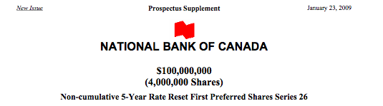

Example – National Bank
Issue of New Preferred Shares

Slide 31
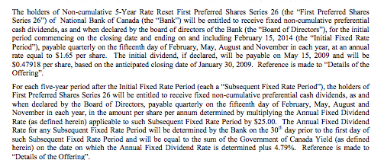
National Bank of Canada
First 5 years – Dividends = $1.65/$25 = 6.60%
Afterwards (after February 15, 2014) – Dividends = 5 year Canada Bond rate + 4.79%

Slide 32
Stock Market Reporting 8.4
Stock market quotations are published in the newspapers and are also available on-line (usually with 15-minute delays)
In Canada, large cap stocks trade on the TSE (www.tsx.com)
Quotes and corporate information on stocks that trade on the TSE can be found at the exchange’s website

Slide 33
Work the Web Example
Information on a large number of stocks in several different markets can also be found at the Globe & Mail and Financial Post websites
www.globeinvestor.com
www.financialpost.com
Also, publicly traded companies usually have an investor relations section on their WebPages

Slide 34
Quick Quiz – Part II
You observe a stock price of $18.75. You expect a dividend growth rate of 5% and the most recent dividend was $1.50. What is the required return?
What are some of the major characteristics of common stock?
What are some of the major characteristics of preferred stock?

Slide 35
Summary 8.5
You should know:
  The price of a stock is the present value of all future expected dividends
  There are three approaches to valuing the stock price, depending on the growth rate(s) of the dividends
  The rights of common and preferred shareholders
  How to read a stock market quotation from the newspaper

Slide 36
Appendix A – Corporate Voting
Cumulative Voting
  Designed for minority shareholders
  Directors are elected all at once
  A shareholder may cast all votes for one member of the board of directors
Straight Voting
  Directors are elected one at a time
  Majority shareholders can control the board
Proxy Voting
  Shareholder grants someone else authority to vote on their behalf

