Slide 1

Flow of litigation and
Morality
Murder, Porn and Necessity

Slide 2
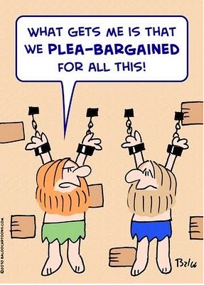
Flow of litigation
Discretion, Calculability, Plea bargain and Proportionality

Slide 3
The Flow of litigation (1)
  ***A high degree of “discretion” about the prosecution of crime:
    From a search warrant, judge of peace must decide from reasonable causes
    Police officer’s discretion to arrest
    At preliminary inquiry, judge must decide if sufficient evidences to go to trial or discharge
    The judge/jury must decide whether if Crown has proven case beyond reasonable doubt
  Hence a high degree of contingency in the process…

Slide 4
Discretion v. transparency?
In R. v. Jolivet (2000), the Supreme Court of Canada enthusiastically approved the statement that "(a)s a general principle, we have recognized that for our system of criminal justice to function well, the Crown must possess a fair deal of discretion." (para. 16).
Are we at risk of secrecy?
  https://www.youtube.com/watch?v=sIzwueCR65g
Notes:
https://www.youtube.com/watch?v=sIzwueCR65g

Slide 5
The Flow of litigation (2)
Plea Bargains: as a mean to control such contingency, when it comes to sentencing and outcomes…
When? Before the trial, or during trial, often when new evidence change the previous balance of power between Crown and Council
Definition: p. 74, Law Reform Commission of Canada:
  an agreement by the accused to plead guilty in return for the persecutor's agreeing to take or refrain from taking a particular course of action

Slide 6
The Flow of litigation (3)
Subcategories of plea bargaining:
  Charge bargaining:
    promises on the nature of the charges
  Sentence bargaining:
    promises related to the ultimate sentence that may be meted by the court
  Fact bargaining
    promises on the fact that the Crown might bring to the attention of the judges
Crown or Police cannot enter a plea bargain without council, except if waived (R v. Burlingham (1994)),
  a right extended by the Charter of Rights and Freedoms, of accused having the right to retain and instruct council without delay

Slide 7
The Flow of litigation (4)
Plea bargaining
Pros:
  Increase certainty for both Crown and Council
  Save the court time and costs, especially in lengthy trial
  Eliminates the need to call a jury and traumatized victim(s) or witness(es) to testify

Slide 8
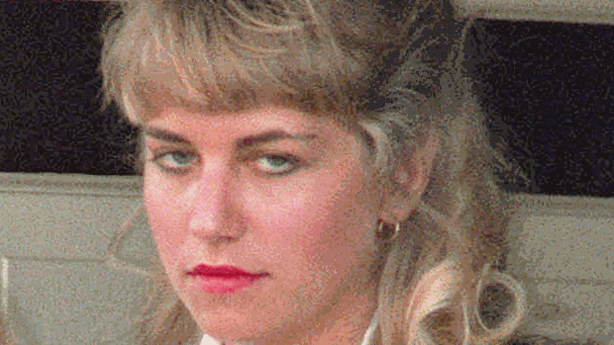
The Flow of litigation (5)
Plea bargaining.
Cons/critiques:
  The judge can overlook recomm. made in sentencing by Crown…
  The Crown is divisible: a bargain at a lower court is not binding on appeal…
  Potential to undermine the credibility of the court by not disclosing how and why bargains are struck
  The critique of offering cheap sentences to secure a win…
    Homolka: https://www.youtube.com/watch?v=nAKvY1L6I8E
  Turn the adversarial procedures into a merely administrative one…
Notes:
https://www.youtube.com/watch?v=Mcoed_LkuS0
Homolka free:
https://www.youtube.com/watch?v=nAKvY1L6I8E

Slide 9
The Flow of litigation: proportionality in sentencing
Bill C-41 and the issue of discretionary power
  In 1994: the Parliament introduced Bill to address the disparity in sentencing (see p. 76). In line with the article 718 of the Code:
    “A sentence must be proportionate to the gravity of the offence and the responsibility of the offender” p. 76
Conditional Sentence: serving the sentence in the community at certain conditions.
  The original sentence must have been less than 2 years
  Doesn’t represent a danger for the safety of the community

Slide 10

Law and morality
Morality, Tragic choices, Pornography

Slide 11
Friedrich Nietzsche
“There is no such thing as moral phenomena, but only a moral interpretation of phenomena”,
“All things are subject to interpretation whichever interpretation prevails at a given time is a function of power and not truth.”
“What are man's truths ultimately? Merely his irrefutable errors.”
“In heaven, all the interesting people are missing.”

Slide 12
Introduction to Legal Studies
Law, Morality and Justice
Today: Law, Morality and Justice:
Law reflects the dominant normative positions in society… (Homolka depicted as women, the passive player in crime?)
Normative positions about “right” & “wrong” reflect moral positions in society

Slide 13
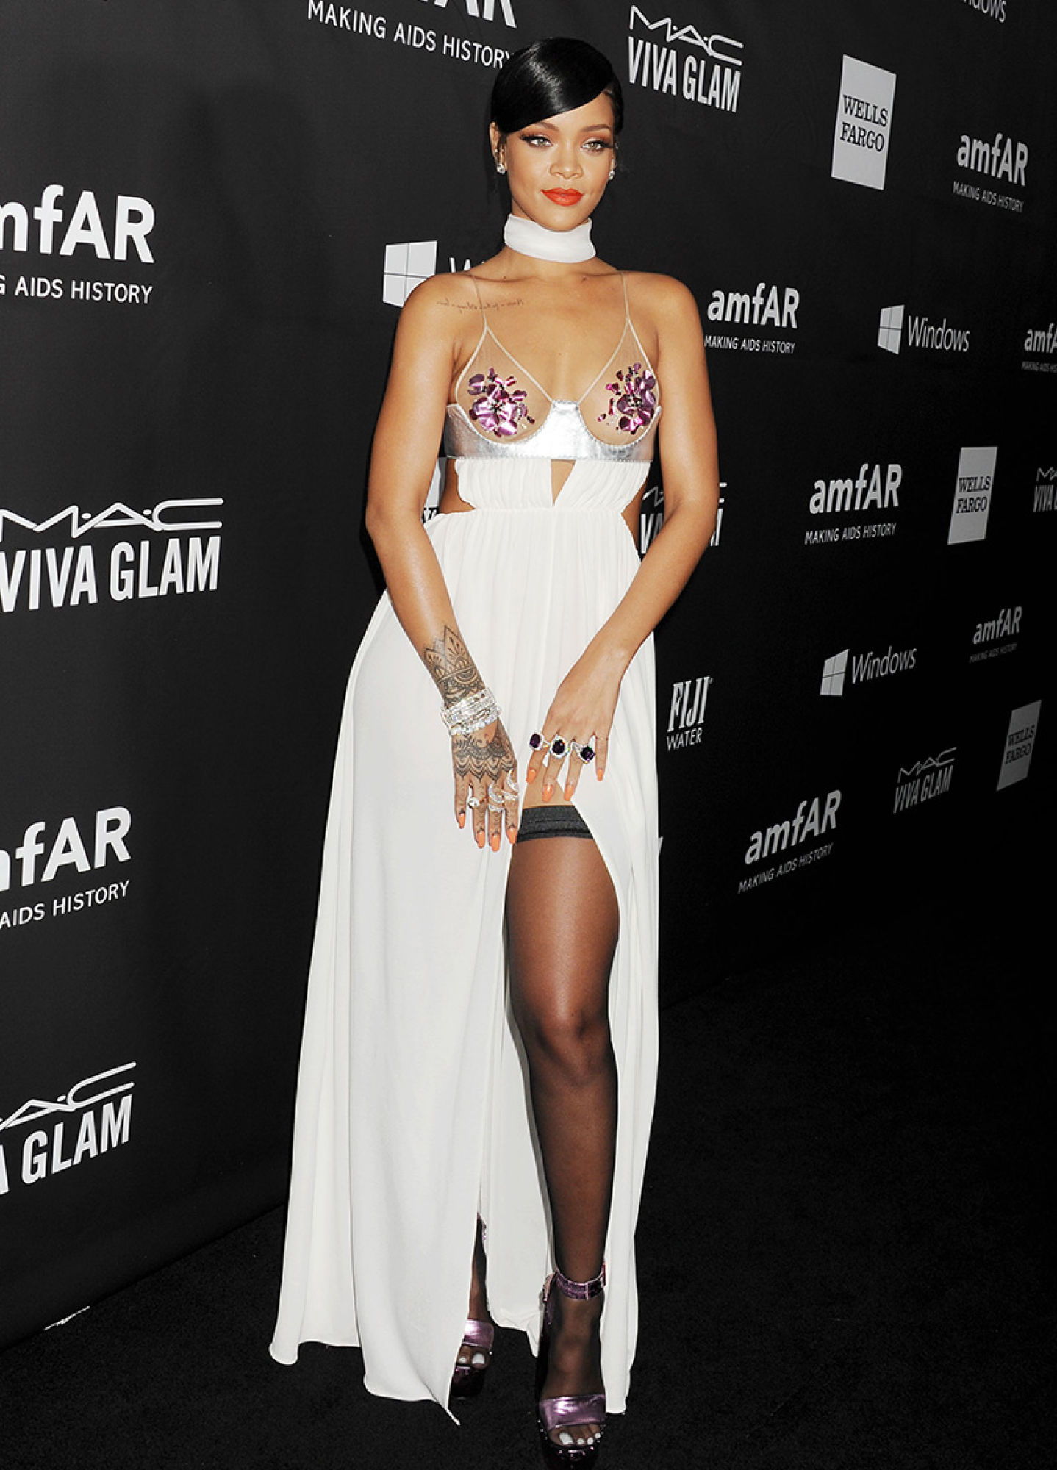
Does Rihanna went to far?

Slide 14
The “Moral” reaction
On MTV: enter your comment here. Choose a reaction
Sickk: 37
Adorbs: 61
Wtf: 110
Lmao: 29
feel that: 16
i can't even: 77
Sad: 32

Slide 15
The legal question
Should Rihanna get sued over this?
Or get punished?
If so, how would you formulate the accusation?
What would be the ground of your accusation?
  Your feelings (subjective?)
  Your religion (dogmas?)
  Adherence to the majority (what about slavery, rights of women to vote?)

Slide 16
Homosexuality and the “truth” of medicine, of Law
In 1952, the APA listed homosexuality in the DSM as a sociopathic personality disturbance…
The seventh printing of the DSM-II, in 1974, no longer listed homosexuality as a category of disorder.
  After a vote by the APA trustees in 1973, and confirmed by the wider APA membership in 1974, the diagnosis was replaced with the category of “sexual orientation disturbance”.
Notes:
https://www.youtube.com/watch?v=PAX33MFATMs

Slide 17
Knowledge production: Truth, Freedom, Power
We often assume that knowledge production appeals to our access to OBJECTIVITY.
A “fact” needs to be confirmed, verified.
But moreover a fact needs to be understood as “true.” Independent from bias? Not tainted by personal preferences? By relations of power?
It often gets blurry when two competitive interpretations of a “fact” is occurring.
LAW: it get often dramatic when this fact is associated with a “wrong” in need of redress:
  is the truth lying with observable effects of that “wrong”
  or the intent of the person causing it?

Slide 18
Social Facts and “norms”
“Social facts” and “norms” are more readily recognized as “social constructions”
Meaning that they are dynamic, negotiated, not-divisible from relations of power (this not objective per se), no amenable to “God’s point of view…”
In sum: we would always be within our own set of conditioning when voicing our understanding)…
A lingering philosophical tension between:
  Freedom of consciousness (soul, consciousness, choice)
  and the understanding of human beings as determined by overarching “social facts” (your education, religions, political contexts, etc.)

Slide 19
Introduction to Legal Studies
Law, Morality and Justice
But should the law be used to address moral issues—derived from “social facts”?
Can the law avoid moral issues?
  Family Law?
    No fault divorce?
  Criminal Law?
    Wrongful killing?

Slide 20
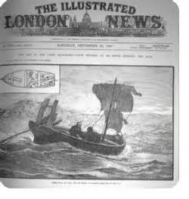
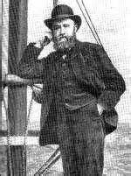
Introduction to Legal Studies
Law, Morality and Justice
Law. Morality & “Tragic Choices”
The Case: R. v. Dudley & Stephens
  The facts of the case
  The dilemma
  The Court’s decision
Notes:
The clip: https://www.youtube.com/watch?v=A03p_egwaSg
The explanation: https://www.youtube.com/watch?v=_FNp_-Ytcjc

Slide 21
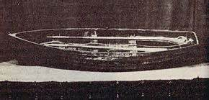
Introduction to Legal Studies
Law, Morality and Justice
Law, morality and necessity
  When is unlawful behavior justifiable?

Slide 22
Introduction to Legal Studies
Law, Morality and Justice
  R. v. Latimer & the defense of ‘necessity’
  The facts:
  The defense of necessity:
      as an ‘excuse’ (Perka v. The Queen)
      Involuntary acts & the absence of choice…
      Requirement of imminent peril & “demonstrably impossible compliance”: Was there a legal way out?
      In sum, legal option=
        choice=voluntariness=criminal act

Slide 23
Introduction to Legal Studies
Law, Morality and Justice
Law, Morality & Freedom
  Text: Devlin, “Law and Morality”
  Subject: Valid motivations for limiting freedom:
    For Mill: only “to prevent harm to others”
    Harm?
      Physical or more extreme psychological harm
    The importance of the possibility of fallibility
      knowing that we can be wrong

Slide 24
Introduction to Legal Studies
Law, Morality and Justice
Versus Devlin and “legal moralism”
  Legal moralism: law can be legitimately used to reinforce society’s “collective moral judgments”
  But whose moral judgments should rule the day?
  The law may be bound up with moral questions, but is the answer to impose the majority’s morality on just everyone?

Slide 25
Law, Morality and Justice:
A Test?
R. v. Butler & the regulation of obscenity
  “Community Standard Tolerance Test”:
    A test not concerned with what Canadians would tolerate per se, but what they would not tolerate other Canadians to be exposed to (p. 109)
    The “national community standard of tolerance”: by which pornographic material can be subject of regulatory control
  Degradation Test:
    Now about the “evolving” standards…
    Community standards must be contemporary. Time change and ideas change accordingly.

Slide 26
Introduction to Legal Studies
Law, Morality and Justice
R. v. Butler:
  Degradation or Dehumanization test
    Notion of Harm: Materials which portray people in positions of subordination, servile submission or humiliation run against equality and dignity of all persons—even with consent
    3 Categories: Violence, degrading, neither
    The arbiter is the “community” as a whole (p. 99)

Slide 27
Introduction to Legal Studies
Law, Morality and Justice
  R. v. Butler:
    Moral disapprobation versus avoidance of harm to society
    The importance of context:
      the “artistic defense” versus “internal necessities”
        The question: is undue exploitation of sex the main object of the work?
        Artistic rests on Freedom of expression, and must be upheld

Slide 28
“Good” pornography?
The case of good pornography, according to the BC Civil liberties Association (p. 115):
“Good pornography has value because it validates women’s will to pleasure […] It celebrates a range of female sexuality that is wider and truer than legitimated by the non-pornographic culture”
In R. v. Wagner: “Women, particularly, are deprived of unique human character or identity and are depicted as sexual playthings, hysterically and instantly responsive to male sexual demands.” Also video.
Notes:
Against:
http://www.makers.com/moments/pornography-phenomenon
For:
https://www.youtube.com/watch?v=q6agt8ACu9o

Slide 29



About Liberty…
“The only freedom which deserves the name, is that of pursuing our own good in our own way, so long as we do not attempt to deprive others of theirs, or impede their efforts to obtain it.”
― John Stuart Mill, On Liberty

Slide 30
Introduction to Legal Studies
Law, Morality and Justice
Law, Morality and ‘Victim-less Crimes’
  Do we need a victim for a crime to be considered
  Is there such a thing as a ‘victim-less crime’?
    Prohibitions on drug use…

Slide 31
Questions/Discussion

