Slide 1

BUSI 2400
Digital
Products
Crew Challenge # 3 – Class #4

Slide 2
Why are digital products so profitable?
If you think about it, digital products don’t exist anywhere except in a warehouse
There’s only ever one of them
  And they take up almost no physical space
Every one that’s sold is a brand new copy of the original
  And the customer pays for shipping as usual!
What does ordinary commerce look like?

Slide 3
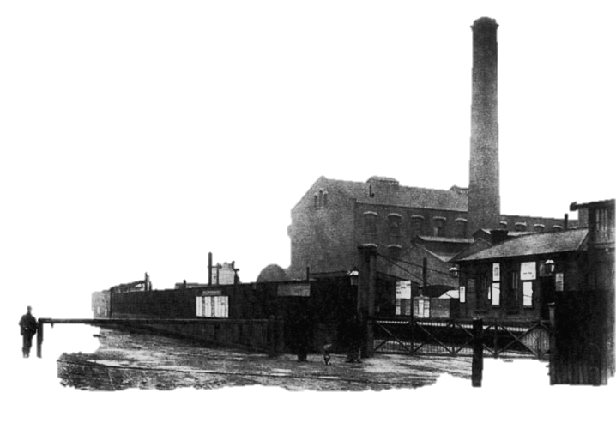
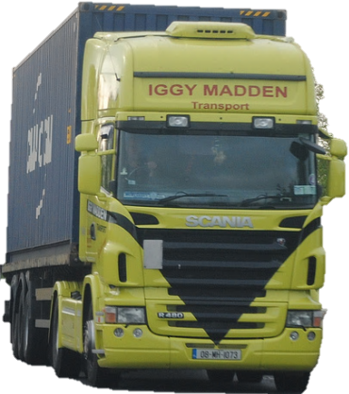
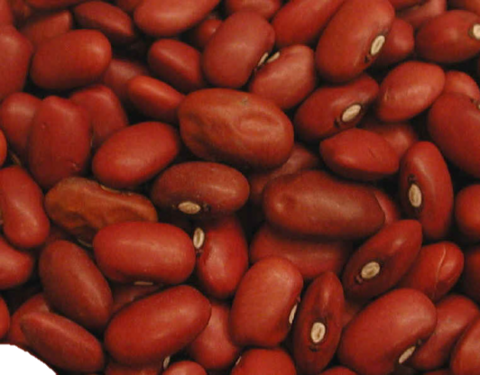


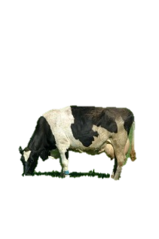



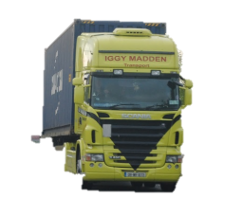

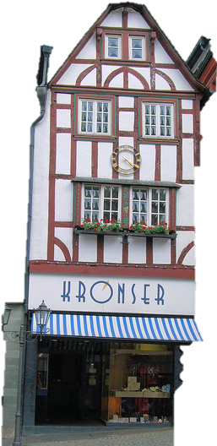
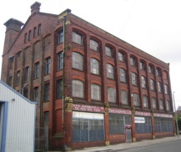
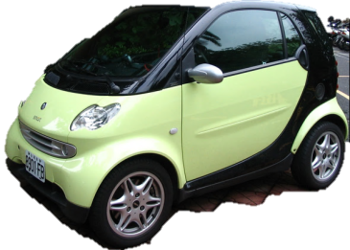



Broad Elements
Traditional commerce
Raw materials
Production
Finished goods
Recycle
Warehouse
Customer
Transaction
Retailer

Slide 4
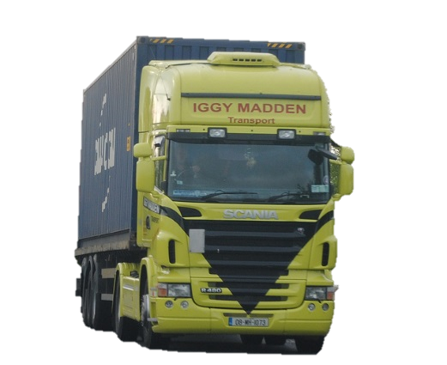

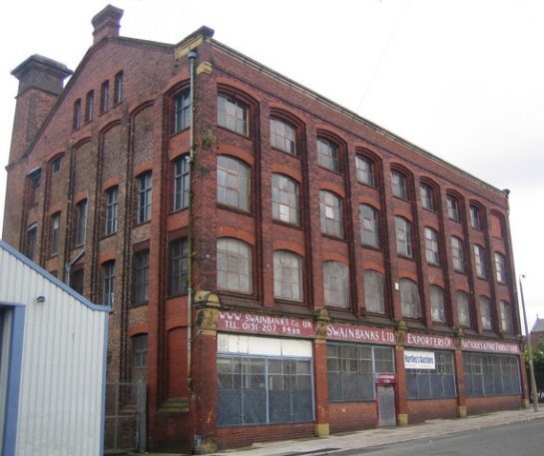
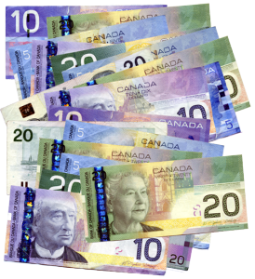

Broad Elements
E-commerce (physical goods)
Raw materials
Production
Finished goods
Recycle
Customer
Transaction
Warehouse

Slide 5

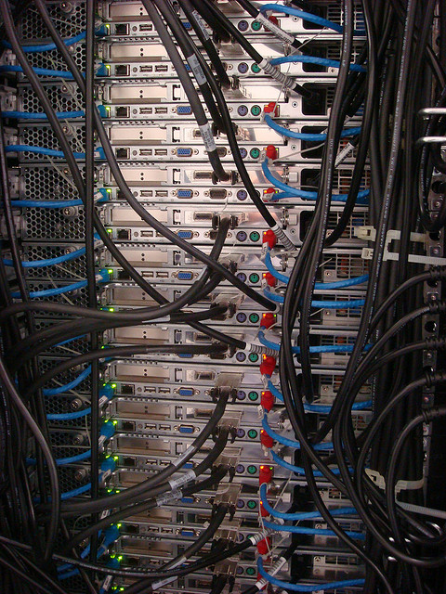


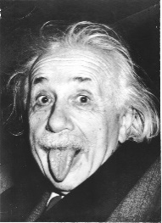
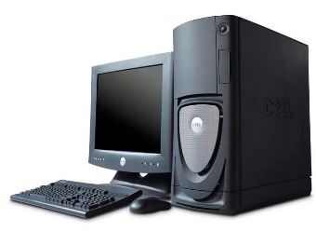











Broad Elements E-commerce (digital)
Raw materials
Production
Finished goods (digital storage)
petGRO
Digital Distribution Channels
Customer
Transaction

Slide 6


CCR3 - This one counts ☺
15 min
7 X 2 min
Beans4All needs to decide on a digital
product portfolio for our client petGRO…
  Given petGRO’s core competencies and brand recognition, list 6 digital products that petGRO could sell?
Pick 1 digital product listed above to answer the following questions:
  To whom should they sell it to?
  What distribution channel(s) should they use?
  What value would customers derive from it?
  What other digital products might be bundled with this product?
    petGRO's or other firms digital products
  Describe what new revenue stream(s) would be created from this digital bundle?
  What threats from competition may threaten this digital bundle revenue?

