Slide 1

BUSI 2400
CC2 – Big Data
Big Data
1:36 sec (first 60 seconds)

Slide 2

Is the word data a collective singular or is it plural?
So is/are data like milk or like dogs?
Do we say “Data is…” or “Data are…”?
  As in “Milk is great tasting when cold…” as opposed to “Dogs are likely to bite when provoked...”
There is some debate about this… yup it’s true
We are persuaded that the term data is collective singular…
So we say “Data is…” and not “Data are…”
And it’s pronounced DAY-TA and not DAT-AH

Slide 3
What does data look like?
Data comes in various forms:
  Digital (numbers only; including binary, decimal and others)
  Textual (letters and numbers – alphanumeric)
  Visual
  Aural
  Other sensory (touch, smell)
All can be represented, with varying degrees of accuracy and fidelity, in digital form = as numbers

Slide 4
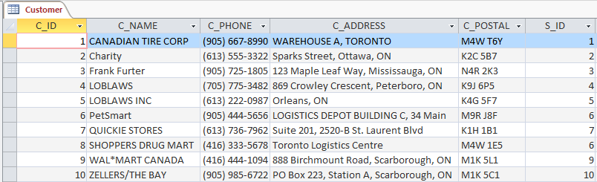
What does data look like?
When data are nicely structured, as in a database, we have a predictable row by column format as in:
<---- Fields ---->
Records

Slide 5
What does data look like?
But what about when data are unstructured, as in:
UnWhy isn't there more vitamin D in the pet food? Why doesn't petGRO offer food for other animals? Why don't more stores sell petGRO brand? Why aren't bags labeled what breed of dog is best fit for the food? Can there be diseases caused by petGRO food?
Other pet foods i.e hamsters Portioned Controlled Bags
Further the Protect and Perform lines by offering canned foods which will benefit to the dogs and cats with lost teeth or preference. A product line that will focuses on puppies and kittens into growing healthy (including the proper nutrition to influence a proper development) Provide treats for cats and dogs, again this can further the Protect and Perform lines, by providing the same benefits. A product line designed to focus on weight control of pets, this could be an advantage since humans can relate to their pets. Also since value and quality is the main draw of PetGRO, they can benefit by implementing a more luxurious/health conscious line. (With attractive packaging to draw attention)
Why is there not food offered for a wider variety of pets? Why is every line of pet food not offered in custom bulk size? How can I be sure the good will meet the needs of a specific breed of animal? Why is animal clothing (boots, sweaters, etc.) not offered in the pet accessories line? Why is there not a product line of wet food which cats seem to prefer most of the time over dry food?
A vegetarian product line for cat and dog food. Dental bone or treat for dogs. Dental care is hard to maintain and these types of treats are essential. An organic product line using only organic materials and using animal products from free range farms that use only natural feed and no chemicals or hormones in their animals. A high calorie and protein product line for really active dogs that need the extra energy such as racing dogs or working dogs. A gourmet wet pet food line for the owners who like to spoil their pets and feed them food that looks like something the owner would eat themselves.
Why didn't they have various flavoured snacks (chicken, beef, bacon, milk) for dogs and cats? why didn't they provide vitamins or supplements for dogs and cats? Why didn't they have moist or canned dog foods? Why didn't they have grain free/low carb products for dogs and cats? Why didn't they have organic and homemade products?
Will you offer wet food for cats and dogs? Are all ingredients used to make your pet food organic? On average how long does the food last before it expires? What is the best type of food for a picky eater or to stimulate fussy appetites? Do you provide essential vitamin within each product line you offer?
Mailed advertisements with subscriptions attached? Downloadable software to help for the old lady? Make a 16 Kg bag of cat food, sell at bulk price. Simplify Make a 2 Kg bag of dog food, limited time offer! Iphone/smartphone ap? "order from your phone"
petGRO Rawhide Bone petGRO Kong petGRO Hair Clippers petGRO Shampoo & Conditioner petGRO Nail Clippers
Have you ever considered adding a fiber based food product to aid in the bowel movement for older cats and dogs?
A food line that cures cats and dogs of illnesses A food line that is rich in vitamins to heal cats and dogs from wounds Scented foods that makes it more appealing for cats and dogs to want to eat A food line that makes the cat or dog more disciplined and relaxed A food line that makes the cat or dog more intelligent
Are there any pet food that are good for competitive racing for my dogs? Are there any blueberry flavoured pet food for my cat? Do you have any pet food that can dye my dog blue after eaten? Is there any pet food that can make my dog/cat's fur softer ? Is there any pet food that can make my dog/cat fur longer?
Proportioned controlled bags Cater commercial for PetGRO Steak/ hamburger looking dog food Dog/cat special food product for cleaning teeth and eliminating bad breath Medicine-given treats for dogs and cats
Could petGRO introduce a wet dog food product? My schnauzer is a princess and won't touch dry food. Could petGRO make a product with a longer shelf life, so that I can place a bigger order and reduce shipping costs? Could petGRO make treats for my dog? Could petGRO make catnip? Sometimes whiskers gets boring. Could petGRO make a weight loss food for my fat cat?
Organic Gluten-Free Freeze-Dried Omega 3 Oral Care
My cat is allergic to peanuts; why do you not have a â€œpeanut freeâ€ certified food? My dog is obese; why do you not offer a weight control formula? Why can I not order your PROTECT line in bulk? Why do you not have a formula for pregnant dogs? Why does your petPRO line not include animal clothing?
Why does petGRO not manufacture their own pet accessories to ensure optimum quality and utility? Does petGRO offer food for animals with special dietary needs? ex. diabetic cats and dogs Do they provide accessories for more than just cats and dogs? What food should a pet owner buy for their average pet? That is neither old nor a puppy and already has protection against fleas, ticks, and heartowrms. Is it safe to have the same types of food for both cats and dogs? Why are there not separate lines for both cats and dogs?
add dog coats to the accessory line. edible protection against fleas, ticks and heatworm should also be made available for cats in PROTECT 2kg bags of perFORM, nutriVAL and PROTECT should be made available for canines. 16kg bags of perFORM, nutriVAL and PROTECT should be made available for felines. make bulk orders also available for PROTECT and perFORM
New organic cat and dog food products. A new food product for cats that boosts dental health. A new feature for the Protect line for outside cats that protects against fleas, ticks and heart worms. A new feature for the perFORM line that promotes heart health. A new product or line for specific dietary needs for cats and dogs. Food would only contain one kind of meat.
Yammer crew challenge Quiz Group work Data
Are there any regional offices for regional sales staff? Does all Corporate Staff work out of Corporate HQ in Sask? Do the corporate employees have the ability to remote into the Corporate Network via VPN? Has PetGRO adopted any of the latest Microsoft OS's and Office software (ie: Office 365) Does PetGRO have any veterinarians on staff, or as part of their payroll?
fur-ball control cat food organic cat food product fast-growing dog food special food for pet illness (like help cure the illness) vegetarian pet food
Do you have any plans to introduce gluten-free pet food?
Create a line of food for cats and dogs that have a natural ingredient that makes the animalsâ€™ feces glow in the dark. Revamp the food packaging (all sizes) to have a resealable feature (ziplock-like) so that the food can keep itâ€™s freshness. Bring in a new line of vegetarian food for cats and dogs. Create a dog safe peanut butter as a treat. On the packaging for cat/dog food have a healthy DIY (do it yourself) recipe for treats.
Do you supply live food for my super slithering snakes? Fedex doesn't ship to my area is there any way i can still order? Is there a way to come to a warehouse with your own truck to pick up the goods? Is the food here exclusive to the site or can i buy it at petsmart do you offer discounts for extremely large orders?
Dental food (bigger kibble) Different food for different size dogs/cats Gastrointestinal food High protein/carb food for athletic/show dogs Low calorie food
Create a line of dog/cat treats for pet owners to use for training, rewarding good behavior, etc. Add extra fats to nutriVAL brand for dogs, such as seed oils from various plants, which helps create a shiny coat and healthy skin (plays role in cell structure). Add extra carbohydrates such as wheat, corn meal, etc. in nutriVAL brand for dogs to help with the building of body tissue. For dogs/cats that are allergic to carbohydrates or suffering from obesity, create brand without carbohydrates and add extra protein (the building block for body tissue). Create new organic brand of cat/dog food for owners who choose to provide 'all-natural', healthy meals for their pets.
Organic and GMO free product line Product line with fertility enhancements/hormones (for breeding purposes) Product line of treats made specifically for dental care and bad breath (halitosis) Additional vitamins in the food to strengthen cat/dog fur coats (for show/competition purposes) Additional protein supplements in the food for agility/performance dogs
"2. Why not add new flavors (product lines) such as lamb or other natural meat flavors that are not yet available?" "1. Why not create a pet food that would address the needs of each life stages of cats and dogs instead of customizing it?" "3. Why not introduce a wet food mixture since there is a growing preference for this type of texture and form?" "4. Why not introduce packages that are innovative and will help prolong the â€œfreshnessâ€ of the pet food and that are eco-friendly? In connection to this, why not create small individual sachets of pet food that are inside the usual package to address the needs of pet owners who needs to travel and may want to take small amount of food for their pet?" "5. Why not try to create fruit or vegetable extract/juice to supplement for water consumption of cats and dogs? "
Add a new product that is canned dog and cat food that is moist Add a feature to the food for cats and dogs trying to lose weight add a new product that is semi-moist that are in packets and are vacuum-sealed Add a feature to the food where it will keep clean the dogs and cats mouth add a product that could would be natural and organic
Fresh pet foods for dogs with sensitive stomachs Organic and natural pet food Fresh pet treats Fresh pet foods for weight control Fresh pet foods for different sizes of dogs and cats
shell> mysql pet-central
Can you include an added feature to your "Protect Pet Foods" product that protects teeth (from plaque and bacteria) of cats and dogs as well? Do you have a food product or snack that can give boost a dog or cat's energy level to promote extreme activeness? Is it possible to create a product that can calm down very active pets, for example liquid drops that could be added to pets' water or food? Do you have a product that reduces shedding of fur of cats and dogs (e.g. similar to hair loss treatment products for humans) Can you include an added feature to your "NutriVAL" product that also improves cognitive functions in pets?

Slide 6
What is Big Data?
Big data is a broad term for data sets so large or complex that traditional data processing applications are inadequate.
  Challenges include:
    analysis, capture, data curation, search, sharing, storage, transfer, visualization, and information privacy
    Retrieved May 11, 2015 from http://en.wikipedia.org/wiki/Big_data

Slide 7
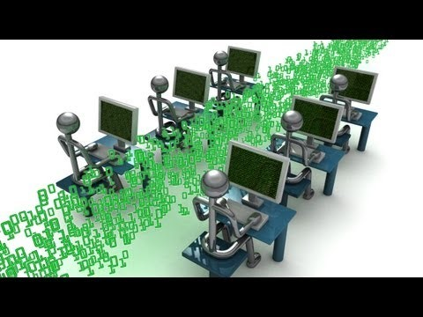
Explaining Big Data
https://www.youtube.com/watch?v=7D1CQ_LOizA 8:32 (first 4:10)

Slide 8
From informationweek.com
  Top IT jobs for 2014 (read here)
1. Big Data experts. Yesterday's buzzword is tomorrow's hot job market.
2. Business intelligence (BI) designers. The ability to turn all of that [big data] information into stuff the executive suite, marketing, and other non-technical business units can actually understand and use. (PowerPoint achieved popularity for a reason, people.) Enter BI designers.

Slide 9
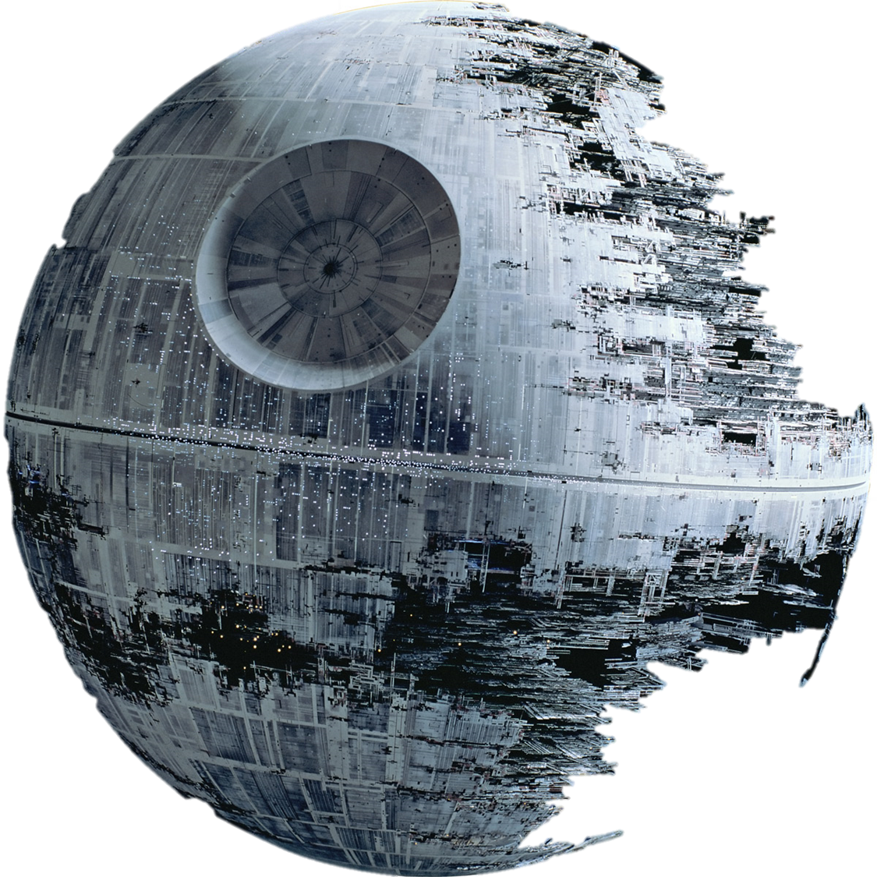
Big Data is often described using the Three Vs
  Volume – the sheer amount of Big Data is almost unfathomable – the total collected amount from big bang to 2003 is now created every two days (see week 1 slides)
  Variety – the sources of Big Data are broad and growing every day – and so is data exhaust, which we’ll explain in a subsequent slide
  Velocity – the speed with which it is generated, and thus must be consumed, is phenomenal. Big data can quickly go stale
    IBM suggests adding Viability (the inherent ability of the data to provide the information we seek – feasible to obtain and to sustain) and Value (does the analysis of the data actually lead to “needle-moving” information? Correlation <> causation).
    Read the article here.

Slide 10
“If you know what questions to ask of your transactional cash register data, which fits nicely into a relational database, you probably don't have a Big Data problem.
If you're storing this same data and also an array of weather, social and other data to try to find trends that might impact sales, you probably do.”
Matt Assay, readwrite.com

Slide 11
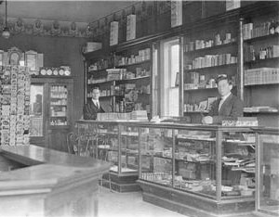
And what about context… ?
Imagine a retail
environment in 1867
A small store in a small
community where travel
took days instead of hours;
families were big and
depended on each other
(the community) much more than today
Think of walking into the general store… and being greeted personally by someone who knew all about you, your credit history, your education, your job and all your brothers and sisters and all about the community and your complex place in it and could assemble the context of your visit in a matter of seconds…

Slide 12



Context…
Now think of you walking into Banana Republic to shop
What if, as you walked in the door, sensors recognised you (name, age, gender, …), linked your purchase history, scanned your physical dimensions, knew the season… and thus had a rudimentary context for your visit
What if it then mined your FB, Twitter, Pinterest, etc. networks to determine what your friends (your community) like or dislike… what they are wearing and whether you, based on comments or video evidence, like to be similar to your group, or go it alone…
What if it then simply suggested stuff to you… or flashed you wearing it in an interactive mirror…
And guess what? BR is owned by same folks as GAP, Old Navy, etc.
What if you’re there to buy a gift…?
This is context… and there are no limits to it.

Slide 13
Big Data for Smarter Customer Experiences
5:23 mins
  Everything in this video is possible with the data and technology that exists today

Slide 14
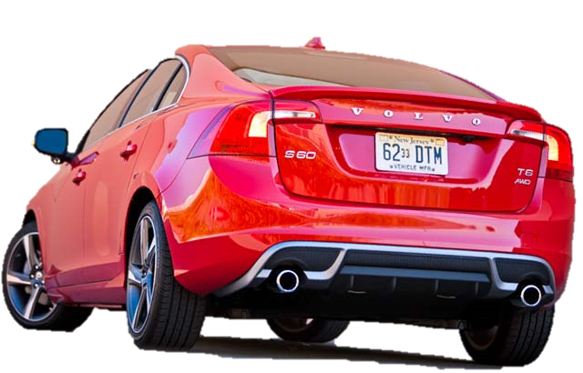
Data Exhaust
Much produced data is ignored (and represents untapped opportunities)
For example Volvo’s Pedestrian and Cyclist Detection System can detect the presence of either or both as they enter its field of vision
Purpose is pedestrian and cycling
accident avoidance…
Exhaust is count of pedestrians
and cyclists by GPS location…Etc.
  Could there be other uses for this data?

Slide 15


So much Big Data is thrown away
Real-time monitoring of patients in hospitals looking only for outliers that will trigger an alarm
  What if the pattern of data preceding the alarm can predict the event?
Airports using radar to monitor weather patterns and air traffic pick up voluminous data on birds, bats and insects
  There’s tremendous value in that data for scientists studying any and all of these creatures

Slide 16
Benefits of Big Data
Small/Little data is expensive – it needs to be managed – data like your credit card statement or your phone bill
Big data is almost free if you consider the volume
Sometimes you need small data, and sometimes tons of big data will do instead
  For example if your bank tells you that you have “Approximately $4,000 in your account…” that’s not good enough small data information. This is transaction data and must be accurate.
  But if a GPS tells you that at your current rate of speed in the current traffic conditions “You will arrive at your destination in approximately 40 minutes…” that’s good enough big data approximation – to know exactly would be nearly impossible (predicting the future) but in this case, an approximation is adequate

Slide 17

Big Data and art…
Big Data is like an impressionist painting… the farther away you get, the more information on the whole is afforded
You see the big picture
And sometimes that has value that small data just can’t provide…

Slide 18
Big Data and health
The app ginger.io uses data on frequency of app usage on iPhone and Android devices to predict when self-described depressives are entering a down cycle…
Alerts caregivers that a person might need intervention

Slide 19
Other examples…
Netflix uses information to shape personal recommendations from customers and predict what they may be interested in.
  It’s not perfect, how could it? We always have a different mood, or preference… but it is still pretty useful!
Google tracks the movement of cell phones in order to determine traffic patterns (crowdsourcing data to create a image of traffic).
  The “data exhaust” of GPS tracking is captured and put to good use.

Slide 20
Even more examples…
CDC developed information systems to track influenza, their methods resulted in a process that presented an view that was two weeks behind.
Google joined to help… they used google search patterns to create a new real-time view, in aggregate though it was not perfect, but good enough to direct planning and action.

Slide 21
Big Data creates opportunity
In all these cases, a “small data” approach would be a) too costly, b) too slow, c) or unfeasible.
CDC – too slow
  With all the resource they have, they could only produce views that were 2 weeks behind.
Netflix – infeasible
  They would put customers off if they attempted to survey customers completely enough.
Ginger.io – to expensive
  the benefits, though there, would not be enough to justify a “small data” approach

Slide 22
Correlation vs. causation
Big Data can tell you THAT but not WHY
Big Data provides correlation with no guarantee of causation – but often that’s good enough
  Walmart data shows a spike in Pop Tart sales (7x) within regions where a hurricane is predicted – it seems that people stock up on Pop Tarts before a natural disaster, why?
  Big data can tell you that… and it tells Walmart and other retailers how to alter their purchasing and supply chain to take advantage
  Who knows why and, for retailers, who cares? It’s just a correlation that represents a fact THAT people seem to behave this way…
http://www.nytimes.com/2004/11/14/business/yourmoney/14wal.html?_r=0

Slide 23
Ownership
Who owns the data?
  Can I have and use my own (what would be) small data from the Big Data that is collected on me?
  How do I get that data?
Big data has value!
  A heart patient named Hugo wanted to have the data generated by his pacemaker but was denied access to it
    Physicians and manufacturer were worried about liability if something went wrong with the medical response to a possible cardiac event

Slide 24
The Data Barons
Zuckerberg, Brin, Bezos, etc. are the new oil barons –> the Data Barons
They and others are amassing enormous wealth from our giving them our data for free
If we could instead have centralised yet distributed, free and supported access by all to the collected Big Data , we would have a democratic society

Slide 25
Data Brokers
Remember the Video I showed you last week?
Data brokering is becoming big business… as more and more data - mined, aggregated, and contrasted – can generate insights that were never before possible.
“Data brokers collect and sell information for a variety of purposes including for fraud prevention, credit risk assessment, and marketing. Their customer base encompasses virtually all major industry sectors in the country in addition to many individual small businesses.”
Source: A Review of the Data Broker Industry: Collection, Use, and Sale of Consumer Data for Marketing Purposes

Slide 26


CCR2
15 min
Beans4All needs to scope out a Big Data
strategy for our client (petGRO)
  List at least 6 Big Data sources that petGRO should consider collecting?
Pick 3 sources that you identified and use these 3 sources to answer the following questions
  Describe the following attributes for each source?
    Structured or unstructured data
    Volume, velocity and veracity
  What business utility can petGRO derive from each data source?
  What utility will customers gain from petGRO using this data?
  When Big Data is collected, a lot of data is ignored. List untapped opportunities petGRO could use with the Data Exhaust from each source?
7 X 2 min

