Slide 1

BUSI 2400
Crew Challenge #1 ---
Privacy and Business Utility

Slide 2
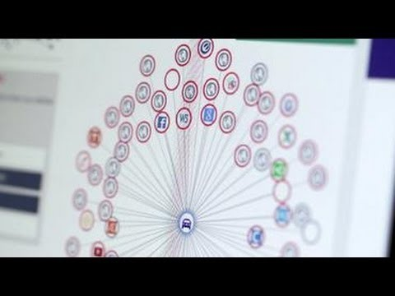
Data Brokers
https://www.youtube.com/watch?v=_Cty7ctycsI

Slide 3

What does this data communicate?
Let’s use the 6 communication questions as a framework to analyze 6 areas of data and think about what data “communicates”:

Slide 4

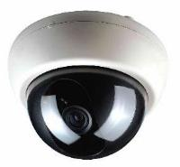


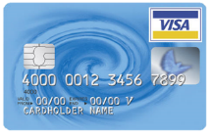
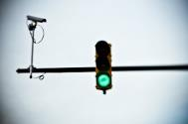
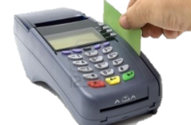


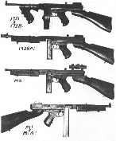

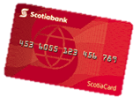







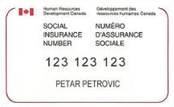




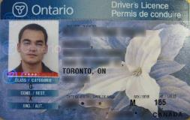
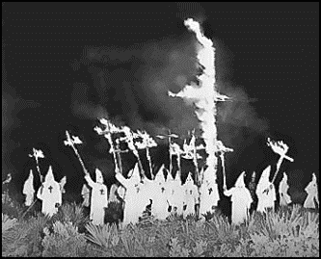
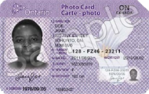


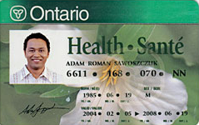
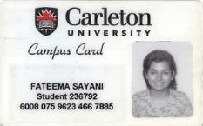
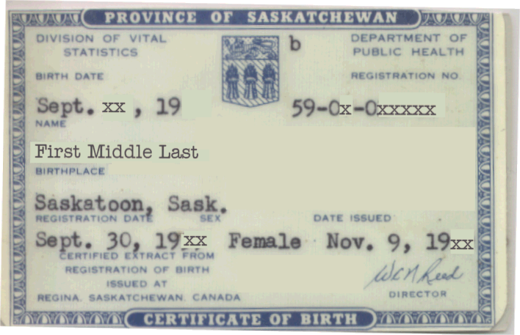


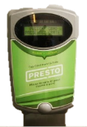




6 Areas of data
3. Personal
communication
IM
Private Msg
Skype
Where, when, who & how?
Phone
Who, when & where?
Text
Email
2. Commercial,
personal and
government
surveillance
Voice
4. Commercial
transactions
Where, who, how & what?
5. Social media
Where, when, who & what?
Where, when, who, how & what?
Employment
6. Personal
browsing
Charity & volunteer
work
Political
affiliation
Who, what, when & where?
Travel
1. Administrative

Slide 5
Re-cap: 6 Areas of Data
Administrative
  Who, what, when & where
    Birth certificate; driver’s licence; SIN card; CU Card; Bus pass; Health card…
Commercial, personal & government surveillance
  Who, when & where
    Traffic cameras; video in stores, casinos, government offices; satellite; police scanners; GPS on phone (crosses boundary into personal comm below)…
Personal communication
  Where, when, who & how
    GPS on phone; text messaging; cell phone calls; wi-fi connection; Bluetooth; NFC; email
Commercial transactions
  Where, who, how & what
    Trip booking online (Via; Porter; taxi…) purchases using Interac or credit card; funds e-transfer; using reward cards (Air Miles; Shoppers; etc…)
Social media
  Where, when, who & what
    LinkedIn; FB; Twitter; Pinterest – you know them all!
Personal browsing
  Where, when, who, how & what
    URLs of site to which you browse hoping that it’s private but it’s not… ever…

Slide 6


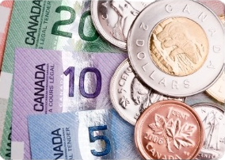
The privacy – utility tug-of-war

Slide 7
Business Utility
Utility: An economic term referring to the total satisfaction received from consuming a good or service.
Business Utility – is the total business value that can be derived from possessing, or consuming, a good or service.

Slide 8
A tug of war?
25
75
0
Individual Privacy
100
100
Business Utility
0
75
25
Σ = 100
Σ = 100

Slide 9

Who owns your personal data?
  You?
  The firms that collect, store and analyse it? FB?
  The network that carries it?
  The government? The privacy commissioner?

Slide 10
Google Apps for Education finds place in Nova Scotia classrooms
    By Jack Julian, CBC News Posted: Sep 14, 2015 7:11 AM AT Last Updated: Sep 14, 2015 11:03 AM AT
Twenty thousand Nova Scotia students are now using free computer software from Google as part of their classroom activities
The cloud-based suite of programs can be accessed on any electronic device with an internet connection and a web browser
It includes email, word processing and assignment management software
Every student requires a Google Account
  First and last name, their email address and encrypted password

Slide 11
That's all that is required to share
While student work is stored on Google's servers, it remains student property
"Google Apps for Education users own their own data, not Google. And the data that schools put into our system is theirs, and we believe it should stay that way,” spokesperson for Google Canada
Google Apps for Education is free of advertising

Slide 12
"They cannot use our students' information and share that for advertising purposes"
They do collect information based on such things as what device you may be using, or your language, or your search history
But mostly it's just to provide the service in a better way to users
But it's very basic information that's being used in that respect"

Slide 13
Does increasing privacy really mean less business utility from data?
  If you have complete control over your data (its ability to identify you), does it mean that it has less value to business/government? Since even “anonymous data” can be combined to profile you, is anonymity achievable?
Should firms pay you for access to your data?

Slide 14


CCR1
15 min
7 X 2 min
List the 6 areas of data discussed in the preamble?
What value will petGRO derive from collecting data?
Why should petGRO want the data?
What value will petGRO customers derive from allowing petGRO to collect their data?
What’s in it for petGRO customer?

