Slide 1
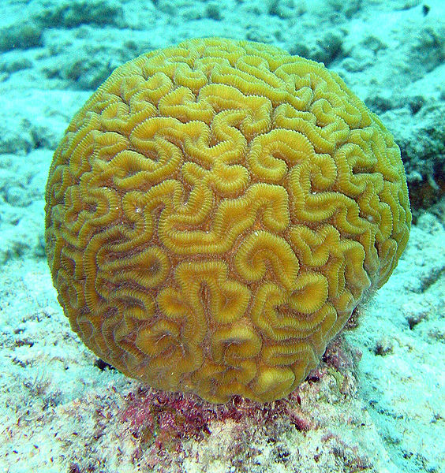
Introduction to Course
CGSC 1001
Mysteries of the Mind
by Jim Davies
jim@jimdavies.org
Notes:
Pictured: Brain coral (Diploria labyrinthiformis)
This work has been released into the public domain by its author, Janderk at the English Wikipedia project. This applies worldwide.

Slide 2
The Point of the Course
To fascinate you with minds, how they work, and how they are studied with the various methods in cognitive science.
The course is supposed to make you want to learn more. Hopefully,
this course will make you
look differently at almost
everything.
Features TED talks and
demonstrations.
It’s fun.

Slide 3
Comments and Discussion Welcome!
Twitter hashtag #CGSC1001 , you can link to me @drjimdavies
Discussion board: Please post questions to the discussion board on cuLearn.
There are too many students to handle questions through email.
Other students are also
encouraged to answer
questions.
If you want video on demand of
these lectures, you can pay $50
for all of them or a few dollars
per lecture. See the syllabus
for details.

Slide 4
Carleton University Online (CUOL)
Students in the A or B section are in the classroom, and students in the T or V section are the online students.
Section A or B students can
watch videos free at the
CUOL centre (D299 Loeb)
or purchase videos from
http://carleton.ca/cuol/access-your-courses/

Slide 5
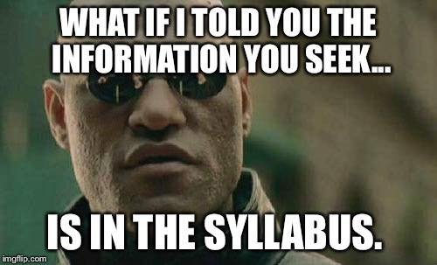

Slide 6
Why I Love Cognitive Science
Multiple disciplines
Likely to see a revolution in our lifetimes

Slide 7
The Cognitive Science Major
http://www.carleton.ca/ics/
Smaller classes
Broad approaches
Young faculty with great teaching evaluations

Slide 8
Evaluation
As you can see, this class size is BIG.
As such, the grades will be based on multiple-choice tests.
Grades Break Down
  Exam one: 25%
  Exam two: 25%
  Essay: 15%
  Final Exam: 35%

Slide 9
The Two Midterms and One Final
The final will cover all the material in the course, 2nd midterm is not cumulative.
The readings are only there to help you understand the lectures.
Questions will be from the
lectures and videos linked
to in the lectures.
So though I do not take
attendance, you are likely to
miss most of the test
information if you don’t
watch the lectures.

Slide 10
Essay
Explain something in the lecture with help from a book, or something in a book with help from a lecture.
Between 800 and 1200 words long.
Paste directly into cuLearn
  That is, you will not
  attach a document.

Slide 11


Slide 12


Slide 13
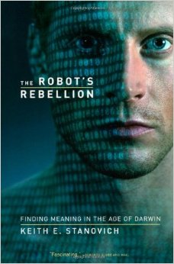

Slide 14
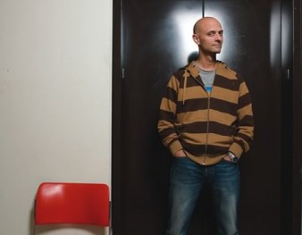
The Instructor
Jim Davies
2205 Dunton Tower
613-520-2600 x1109
Interested in human imagination and how we can replicate that on computers.
Watch the TEDx CarletonU talk at http://youtu.be/caBIboOGSe4
Or an interview with me:
http://nautil.us/issue/4/the-unlikely/ingenious-jim-davies
You can follow me on twitter @drjimdavies , where I post things about cognitive science and one-liners

Slide 15
There is No Textbook
Why?
You will read articles mostly from the web.
Scholarpedia when I can get one, Wikipedia and other online sources sometimes.
Occasionally I will ask you
to read an article you must
download through the
library. Search for the
journal title in the catalog;
it will lead you to a webpage
where you can browse to the
article assigned. I am not
allowed to put it on CULearn
because of the new copyright
laws.

Slide 16
Online Syllabus and Lecture Slides
Available at: https://www.dropbox.com/sh/6kg5bn2i3j6dym9/PA3QtfKpPY
Unfortunately the school does not support printing of the
syllabus for classes this
big.
Can I get a volunteer
notetaker?
Polleverywhere

Slide 17
Let’s Watch a Talk!
http://www.polleverywhere.com/multiple_choice_polls/LTE3OTEwNDA3MjQ

Slide 18
Links to the Talks to Watch in Class
Pinker on Swearing: http://youtu.be/1BcdY_wSklo
Markman on similarityhttp://thesciencenetwork.org/programs/cogsci-2011/arthur-markman
Waterloo’s Chris Eliasmith on neural computer modeling
(You can enjoy the
others on your own)
http://thesciencenetwork.org/programs/cogsci-2011/chris-eliasmith

