Slide 1
MAAE 2001
Engineering Graphical Design
Sections A and B
Lecture 1
Introduction
Professors M.J.D. Hayes and A. de Ruiter
Department of Mechanical and
Aerospace Engineering

Slide 2
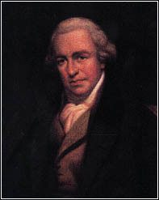
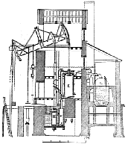
Mechanical Engineering
The modern definition of ME:
design, implementation, control, and maintenance of mechanical systems that transfer energy and/or power
Examples:
  robot mechanical systems (industrial robots, vehicle simulators, etc.);
  vehicles (land, air, marine);
  power generation (hydro, chemical, bio, etc.);
  (automated) manufacturing and production systems...
Started in the 1700’s when steam was harnessed with the work of James Watt, among others.
James Watt: 1739-1819

Slide 3
Mechanical Engineering
Historically ME
  Started as a hands-on job shop profession;
  Developed into a profession focused on problem solving and analysis;
  Currently the professional focus is on balance: design analysis-synthesis cycle.
Hence, there is strong emphasis placed on design in each year of the MECH and AERO programmes:
  MAAE 2001;
  MECH/AERO 3002;
  MAAE 3901;
  MECH/AERO 4003;
  MECH/AERO 4907 (final project).

Slide 4
MAAE 2001 Course Outline
Instructors:
  Section A: Prof. A. de Ruiter, 3246ME
  Section B: Prof. M.J.D. Hayes, 2184ME
  Office Hours: TBA
Goals:
  To teach the fundamentals of Descriptive Geometry (DG) and graphical solution techniques for standard problems in 3D Euclidean space;
  development of spatial visualization skills;
  fundamental principles and practices of Engineering Drawing;
  development of CAD skills using IntelliCAD (AutoCAD) and Pro/E;
  introduction to rapid prototyping/3D printing technology
  to apply the above skills to the Engineering Design Process.

Slide 5
MAAE 2001 Outline
Topics:
  the design process
  basic manual drafting skill using instruments, sketching
  intro to descriptive geometry (DG)
    orthographic projection
    points, lines, planes
    graphical mechanics
    intersections and developments
  engineering drawing
    drawings
    dimensioning
    fits and tolerances
    threads, fasteners, welding
    gears and cams
    materials and manufacturing

Slide 6
MAAE 2001 Outline
Texts (required):
Graphics Technology, 2nd Ed., James H. Earle, Pearson Prentice Hall, 2005.
Pro/ENGINEER WILDFIRE 5.0 Tutorial, R. Toogood and J. Zecher, SDC publications, 2009.
Both books are available at the University Bookstore (any edition of Earle will suffice, including any edition of Engineering Design Graphics).

Slide 7
MAAE 2001 Outline
Drafting instruments (required):
  You require the following instruments for manual drawing assignment and test problems. These items can be purchased at the bookstore or at any stationary supply store:
    30º-60º and 45º-90º triangles.
    Protractor.
    Compass.
    Straight edge scale.
    White vinyl eraser.
    Pencils.

Slide 8
MAAE 2001 Outline
Course Management:
  WebCT – course info, lectures, assignments, and grades will be posted on the MAAE 2001 site
Structure:
  two 1-hour lectures per week – cover course material.
  two 2-hour lab periods per week.
    One devoted to DG using freehand sketching, drafting instruments, and IntelliCAD.
    Second devoted to Engineering Drawing and Design using freehand sketching and Pro/E.
  both labs support the development of your design skills.
  labs start the week of Jan. 16th (more details to follow)
All assignments (DG, Pro/E, and the project) must be submitted. Failure to do so will result in a grade of “FND” for the course.

Slide 9
MAAE 2001 Outline
Examinations:
  1-hour DG closed-book mid-term examination tentatively scheduled for Monday, March 5, 2012
    in classroom
    a number of multiple-choice questions
    several DG constructions, some with more than one component.
  3-hour closed book final examination during exam period at end of term
    covers all lecture material and assigned readings
    a number of multiple-choice questions
    several DG constructions, some with more than one component
Absolutely no test scheduling accommodations will be made for other than certified health reasons.

Slide 10
MAAE 2001 Outline
Grading:
  6 DG Lab Assignments: 10%
  7 Pro/E exercises: 10%
  1 Design Project: 20% in total
    Project Selection Proposal: 0%
    Concept Sketches: 2%
    Proof-of-Concept Working Model: 3%;
    ABS Working Prototype: 5%;
    Design Drawings and Report: 10%
  1 DG Mid-Term (closed-book): 10%
  1 Final Exam (closed-book): 50%

Slide 11
MAAE 2001 Outline
Labs start the week of January 16.

Slide 12
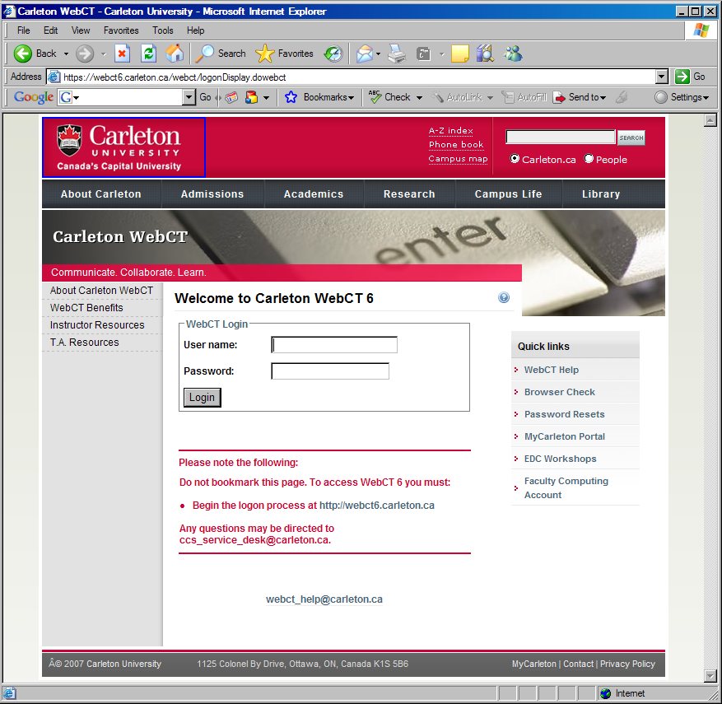
WebCT

Slide 13
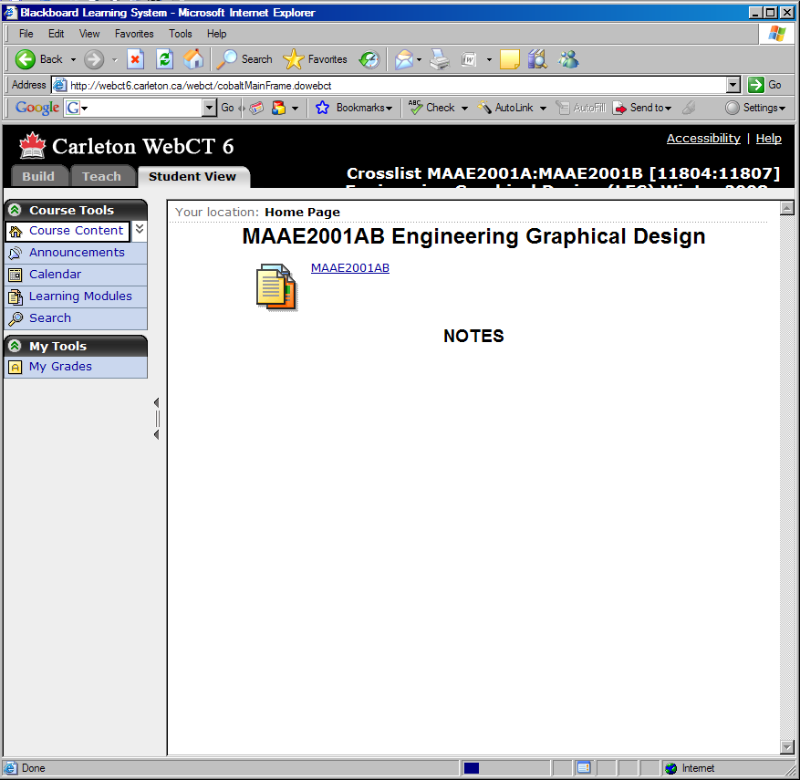
WebCT

Slide 14
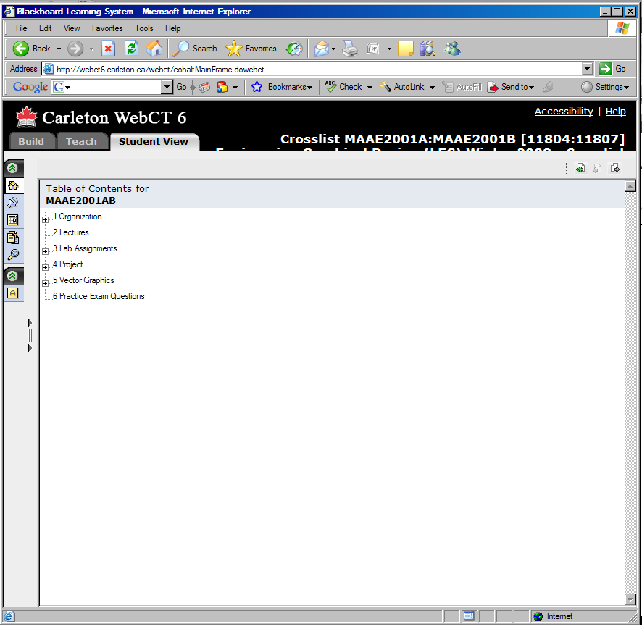
WebCT

Slide 15
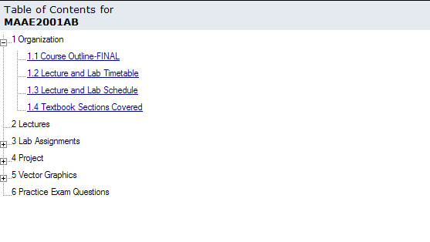
WebCT

Slide 16
WebCT
MAAE 2001, Section A, Winter 2012 - Lecture and Lab Timetable
Prof. A. de Ruiter
 | Monday | Tuesday | Wednesday | Thursday | Friday
8:30 | Lecture - Sect A/B 5050MC/101AT |  | Lecture - Sect A/B 5050MC/C164LA
9:00
9:30 |  | Lab A2 DG 9:30-11:30 2256ME |  | Lab A2 Pro/E 9:30-11:30 2256ME
10:00
10:30
11:00
11:30 | Lab A3 DG 11:30-1:30 2256ME | Lab A1 DG 11:30-1:30 2256ME | Lab A3 Pro/E 11:30-1:30 2256ME | Lab A1 Pro/E 11:30-1:30 2256ME
12:00
12:30
1:00
1:30
2:00
2:30
3:00
3:30
4:00
4:30
5:00
5:30

Slide 17
WebCT
MAAE 2001, Section B, Winter 2012 - Lecture and Lab Timetable
Prof. M.J.D. Hayes
 | Monday | Tuesday | Wednesday | Thursday | Friday
8:30 | Lecture - Sect A/B 5050MC/101AT |  | Lecture - Sect A/B 5050MC/C164LA
9:00
9:30 | Lab B2 DG 9:30-11:30 2256ME |  | Lab B2 Pro/E 9:30-11:30 2256ME
10:00
10:30
11:00
11:30
12:00
12:30
1:00
1:30
2:00
2:30 | Lab B3 DG 2:30-4:30 2256ME | Lab B1 DG 2:30-4:30 2256ME | Lab B3 Pro/E 2:30-4:30 2256ME | Lab B1 Pro/E 2:30-4:30 2256ME
3:00
3:30
4:00
4:30
5:00
5:30

Slide 18
IMPORTANT FOR SECTION B
Room for Monday Lectures: 101AT
Room for Wednesday Lectures: C164LB

Slide 19
WebCT

Slide 20
WebCT
MAAE 2001 A/B Winter 2012 Schedule
Lect | Date | Lecture Subject |  | Week of | Lab - Graphics Principles | Lab - Pro/E
1 | Jan. 04 | Introduction - Project assigned |  | Jan. 04 | no labs | no labs
2 | 09 | The Design Process; 3D Printing (Chapter 2+lectures) |  | Jan. 09 | no labs
3 | 11 | Mech. Drawing Techniques (Chapters 3 and 5) |  |  |  | no labs
4 | 16 | Sketching, multiple views, orthographic projection (Chapters 6,7) |  | Jan. 16 | IntelliCAD: Drawing Basics
5 | 18 | Working/assembly drawings (Chapter 15) |  |  |  | Pro/E Project Groups
6 | 23 | DG - points, lines and planes (Chapters 7, 18, 19) |  | Jan. 23 | IntelliCAD: Drawing Basics
7 | 25 | DG - primary auxiliary views (Chapter 19) (DG1) |  |  |  | Pro/E Lab 1: Lessons 1/2 Proposal due
8 | 30 | DG - primary auxiliary views (Chapter 19) |  | Jan. 30 | DG 1 - Coordinates and Lines
9 | Feb. 01 | DG - plane intersections (Chapter 19) |  |  |  | Pro/E Lab 2: Lesson 3/4 ( holes and cuts; rotation)
10 | 06 | DG - visibility (Chapter 19) (DG2) |  | Feb. 06 | DG 2 - Intersections
11 | 08 | DG - successive auxiliary views (Chapter 20) (DG3) |  |  |  | Pro/E Lab 3: Lesson 5/6 (Utilities/datum planes)
12 | 13 | DG - connecting line segments (Chapter 20) (DG4) |  | Feb. 13 | DG 3 - Planar true view
13 | 15 | DG - vector graphics I (Chapter 22) |  |  |  | Pro/E Lab 4: Lessons 7/8 (copies, drawings) Conceptual sketches and proof-of-concept working model due.
- | Feb. 20-24 | Winter Break |  | Feb. 20-24 | Winter Break
14 | 27 | DG - vector graphics II (Chapter 22) |  | Feb. 27 | DG 4 - Shortest distance between skewed lines
15 | 29 | DG - intersections and developments I (Ch. 23) |  |  |  | Pro/E Lab 5: Lesson 9 (Assembly) STL Files due 16:30, Fri. March 09
- | Mar. 05 | mid-term exam (to L10, DG2) |  | Mar. 05 | DG Mid-Term Exam, Monday, March 5
16 | 07 | DG - intersections and developments II (Ch. 23)(DG6)
17 | 12 | Dimensions, Fits and Tolerances (Chapter 12,13) |  | Mar. 12 | DG 5 - Force systems
18 | 14 | Dimensions, Fits and Tolerances (Chapter 12,13) |  |  |  | Pro/E Lab 6: Lesson 10 (Assembly)
19 | 16 | More on engineering drawings (Chapters 5,8,9,15) |  | Mar. 19 | DG 6 - Developments
20 | 21 | Threads, fasteners, and welding (Ch. 10 and 14) |  |  |  | Pro/E Lab 7: Lesson 11 (Sweeps/Blends)
21 | 23 | Gears and cams (lectures) |  | Mar. 26 | Project Final Design Report due 16:30, Wed. April 4 in the orange steel file cabinet in front of 3135ME. ABS Working Prototypes graded in Pro/E Lab.
22 | 28 | Materials and Processes (Chapter 11)
23 | Apr. 02 | Summary/Wrap-up |  | Apr. 02 | Project Final Design Report due 16:30, Tue. April 5 in the orange steel file cabinet in front of 3135ME.
- | 04 | No Lecture

Slide 21
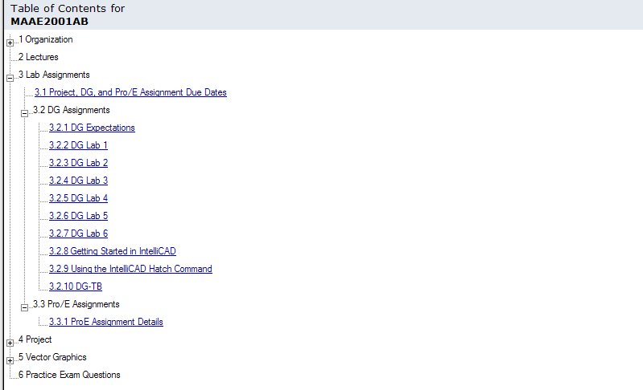
WebCT

Slide 22
WebCT
MAAE 2001 Engineering Graphical Design Winter 2012 - Due Dates
 | Section A1 |  | Section A2 |  | Section A3 |  | Section B1 |  | Section B2 |  | Section B3
Deliverable | Assigned | Due | Assigned | Due | Assigned | Due | Assigned | Due | Assigned | Due | Assigned | Due
Project:
Project Groups | Jan. 04 | Jan. 19 | Jan. 04 | Jan. 19 | Jan. 04 | Jan. 18 | Jan. 04 | Jan. 19 | Jan. 04 | Jan. 18 | Jan. 04 | Jan. 18
Project Selection Proposal | Jan. 04 | Jan. 26 | Jan. 04 | Jan. 26 | Jan. 04 | Jan. 25 | Jan. 04 | Jan. 26 | Jan. 04 | Jan. 25 | Jan. 04 | Jan. 25
Concept Sketches | Jan. 04 | Feb. 16 | Jan. 04 | Feb. 16 | Jan. 04 | Feb. 15 | Jan. 04 | Feb. 16 | Jan. 04 | Feb. 15 | Jan. 04 | Feb. 15
Proof-of-Concept Model | Jan. 04 | Feb. 16 | Jan. 04 | Feb. 16 | Jan. 04 | Feb. 15 | Jan. 04 | Feb. 16 | Jan. 04 | Feb. 15 | Jan. 04 | Feb. 15
STL File | Jan. 04 | Mar. 09 | Jan. 04 | Mar. 09 | Jan. 04 | Mar. 09 | Jan. 04 | Mar. 09 | Jan. 04 | Mar. 09 | Jan. 04 | Mar. 09
ABS Prototype | Jan. 04 | Mar. 29 | Jan. 04 | Mar. 29 | Jan. 04 | Mar. 28 | Jan. 04 | Mar. 29 | Jan. 04 | Mar. 28 | Jan. 04 | Mar. 28
Design Drawings and Report | Jan. 04 | Apr. 04 | Jan. 04 | Apr. 04 | Jan. 04 | Apr. 04 | Jan. 04 | Apr. 04 | Jan. 04 | Apr. 04 | Jan. 04 | Apr. 04
Lab. Assignments:
DG 1 | Jan. 31 | Feb. 07 | Jan. 31 | Feb. 07 | Jan. 30 | Feb. 06 | Jan. 31 | Feb. 07 | Jan. 30 | Feb. 06 | Jan. 30 | Feb. 06
DG 2 | Feb. 07 | Feb. 14 | Feb. 07 | Feb. 14 | Feb. 06 | Feb. 13 | Feb. 07 | Feb. 14 | Feb. 06 | Feb. 13 | Feb. 06 | Feb. 13
DG 3 | Feb. 14 | Feb. 28 | Feb. 14 | Feb. 28 | Feb. 13 | Feb. 27 | Feb. 14 | Feb. 28 | Feb. 13 | Feb. 27 | Feb. 13 | Feb. 27
DG 4 | Feb. 28 | Mar. 13 | Feb. 28 | Mar. 13 | Feb. 27 | Mar. 12 | Feb. 28 | Mar. 13 | Feb. 27 | Mar. 12 | Feb. 27 | Mar. 12
DG 5 | Mar. 13 | Mar. 20 | Mar. 13 | Mar. 20 | Mar. 12 | Mar. 19 | Mar. 13 | Mar. 20 | Mar. 12 | Mar. 19 | Mar. 12 | Mar. 19
DG 6 | Mar. 20 | Mar. 27 | Mar. 20 | Mar. 27 | Mar. 19 | Mar. 26 | Mar. 20 | Mar. 27 | Mar. 19 | Mar. 26 | Mar. 19 | Mar. 26
Pro/E 1 | Jan. 26 | Feb. 02 | Jan. 26 | Feb. 02 | Jan. 25 | Feb. 01 | Jan. 26 | Feb. 02 | Jan. 25 | Feb. 01 | Jan. 25 | Feb. 01
Pro/E 2 | Feb. 02 | Feb. 09 | Feb. 02 | Feb. 09 | Feb. 01 | Feb. 08 | Feb. 02 | Feb. 09 | Feb. 01 | Feb. 08 | Feb. 01 | Feb. 08
Pro/E 3 | Feb. 09 | Feb. 16 | Feb. 09 | Feb. 16 | Feb. 08 | Feb. 15 | Feb. 09 | Feb. 16 | Feb. 08 | Feb. 15 | Feb. 08 | Feb. 15
Pro/E 4 | Feb. 16 | Mar. 01 | Feb. 16 | Mar. 01 | Feb. 15 | Feb. 29 | Feb. 16 | Mar. 01 | Feb. 15 | Feb. 29 | Feb. 15 | Feb. 29
Pro/E 5 | Mar. 01 | Mar. 15 | Mar. 01 | Mar. 15 | Feb. 29 | Mar. 14 | Mar. 01 | Mar. 15 | Feb. 29 | Mar. 14 | Feb. 29 | Mar. 14
Pro/E 6 | Mar. 15 | Mar. 22 | Mar. 15 | Mar. 22 | Mar. 14 | Mar. 21 | Mar. 15 | Mar. 22 | Mar. 14 | Mar. 21 | Mar. 14 | Mar. 21
Pro/E 7 | Mar. 22 | Mar. 29 | Mar. 22 | Mar. 29 | Mar. 21 | Mar. 28 | Mar. 22 | Mar. 29 | Mar. 21 | Mar. 28 | Mar. 21 | Mar. 28

Slide 23
WebCT

Slide 24
WebCT

Slide 25
DG Assignment Expectations
To be awarded perfect marks for a DG Laboratory Assignment the following expectations must be fulfilled, in addition to providing a correct solution.
  Where numerical solutions are required, they must be in the appropriate form (i.e. compass bearing of a line, slope ratio of a line, etc.), and units must be included. Unless otherwise specified, always use two-decimal-place accuracy.
  Leave all construction lines. For freehand sketches and manual drawings the construction lines are lighter and finer than object lines. For IntelliCAD drawings, construction lines must be changed to the DOT line type (see the file Getting Started in IntelliCAD that is posted in the DG Assignment folder in WebCT).
  Where it is required to extract dimensions in order to compute answers, leave the dimensions and extension lines in the drawing.
  Show and label all folding lines.
  Identify all projections of all points.
  Insert and completely fill out the title block.

Slide 26
WebCT

Slide 27
WebCT
Pro/E Exercises MAAE 2001- Winter 2012 - A. de Ruiter (Section A1)
Assigned | Due | Lab - Pro/E | Assignment Figure | Page
Jan 26 | Feb 02 | Lab 1: Pro/E Network Organization, Demo and Lessons 1/2 | Figure 39 | page 2-31
Feb 02 | Feb 09 | Lab 2: Pro/E -Lesson 3/4 ( holes and cuts; revolution) | Figure 43; Figure 24 | pages 3-28; 4-17
Feb 09 | Feb 16 | Lab 3: Pro/E - Lesson 5/6 (Utilities/datum planes) | Figure 27 | page 6-17
Feb 16 | Mar 01 | Lab 4: Pro/E - Lessons 7/8 (copies, drawings) | Figures 21,22,29,34,35,55, and 58; Figures 22 and 40 | Pages 7-11,7-12,7-16,7-19,7-21,7-30, 7-32; Pages 8-21,8-39
Mar 01 | Mar 15 | Lab 5: Pro/E - Lesson 9 (Assembly) | Figure 40 | Page 9-25
Mar 15 | Mar 22 | Lab 6: Pro/E - Lesson 10 (Assembly) | Figures 17 and 26 | Pages 10-17 and 10-25
Mar 22 | Mar 29 | Lab 7: Pro/E - Lesson 11 (Sweeps/Blends) | Figure 31 | Page 11-19
Pro/E Exercises MAAE 2001- Winter 2012 - M.J.D. Hayes (Section B1)
Assigned | Due | Lab - Pro/E | Assignment Figure | Page
Jan 26 | Feb 02 | Lab 1: Pro/E Network Organization, Demo and Lessons 1/2 | Figure 39 | page 2-31
Feb 02 | Feb 09 | Lab 2: Pro/E -Lesson 3/4 ( holes and cuts; revolution) | Figure 43; Figure 24 | pages 3-28; 4-17
Feb 09 | Feb 16 | Lab 3: Pro/E - Lesson 5/6 (Utilities/datum planes) | Figure 27 | page 6-17
Feb 16 | Mar 01 | Lab 4: Pro/E - Lessons 7/8 (copies, drawings) | Figures 21,22,29,34,35,55, and 58; Figures 22 and 40 | Pages 7-11,7-12,7-16,7-19,7-21,7-30, 7-32; Pages 8-21,8-39
Mar 01 | Mar 15 | Lab 5: Pro/E - Lesson 9 (Assembly) | Figure 40 | Page 9-25
Mar 15 | Mar 22 | Lab 6: Pro/E - Lesson 10 (Assembly) | Figures 17 and 26 | Pages 10-17 and 10-25
Mar 22 | Mar 29 | Lab 7: Pro/E - Lesson 11 (Sweeps/Blends) | Figure 31 | Page 11-19

Slide 28
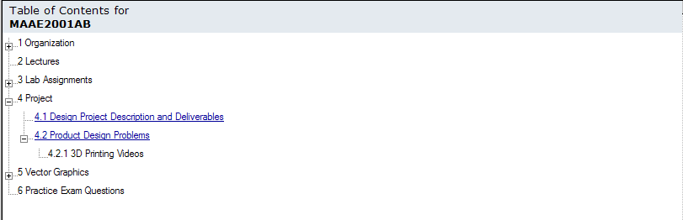
WebCT

Slide 29
Project - Mechanical Design
This project requires solving a design problem where a mechanism consisting of multiple components is necessary.
The project is to be done in groups of at least 2 and at most 3.
Group members MUST BE IN THE SAME LAB SECTION.
Group formation is to be done in or before the first Pro/E Lab (week of Jan. 16).
Your Section TA will assign you a GROUP NUMBER, eg. A1-7 (Group 7 in Lab Section A1). USE THIS GROUP NUMBER ON ALL REPORTS.
Your project proposal is due the next lab. The time to start planning is NOW!
The design problem can be selected from those shown in the document “Product Design Problems” in the Project section on the WebCT site.
While there are many suggested problems, you will have to select the problem you want to solve carefully, considering constraints that you should be able to identify, based on what follows.
Alternately, you can develop your own design problem
  landing gear mechanism, components of an automobile system

Slide 30
Project - Mechanical Design
The mechanism assembly MUST have a minimum of four different independent parts and exhibit some relative motion between components.
  For example, four identical wheels on a vehicle design represent only one part.
At the same time you should be reminded that we are asking for only shape design, rather than a design that includes detailed engineering analyses.

Slide 31
Project - Mechanical Design
Project Deliverables and Due Dates
Project Deliverables | Due Date | Grade
1. Project Selection Proposal | Submit to TA in scheduled Pro/E Lab week of January 23, 2012. | 0%
2. Concept Sketches | Submit to TA in scheduled Pro/E Lab week of February 13, 2012. | 10% of project (2% of final mark)
3. Proof-of-Concept Model | Present to TA in scheduled Pro/E Lab week of February 13, 2012. | 15% of project (3% of final mark)
4. ABS Working Prototype | STL files due 16:30 March 09, 2012. Present models to TA in Pro/E Lab week of March 26, 2012. | 25% of project (5% of final mark)
5. Design Drawings & Report | 16:30 Wed. April 4, 2012: deposit in the steel cabinet MAAE 2001 slot outside room 3135ME. | 50% of project (10% of final mark)
details available on WebCT
will be discussed in future lectures

Slide 32
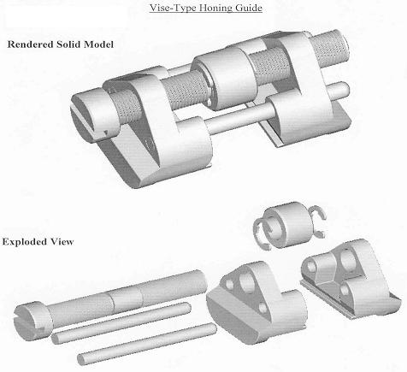
Project Example 1

Slide 33
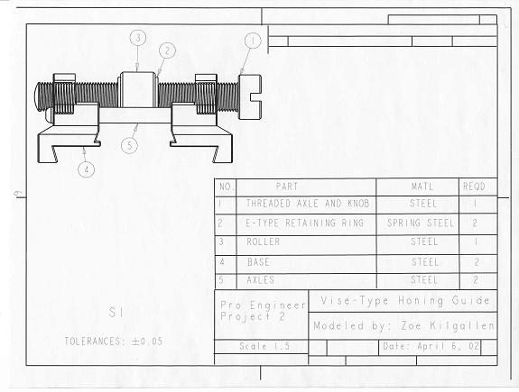
Project Example 1

Slide 34
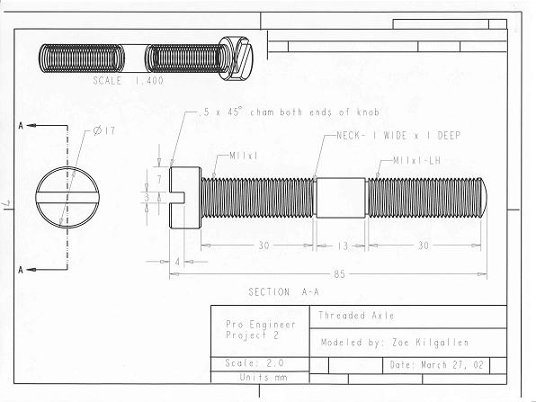
Project Example 1

Slide 35
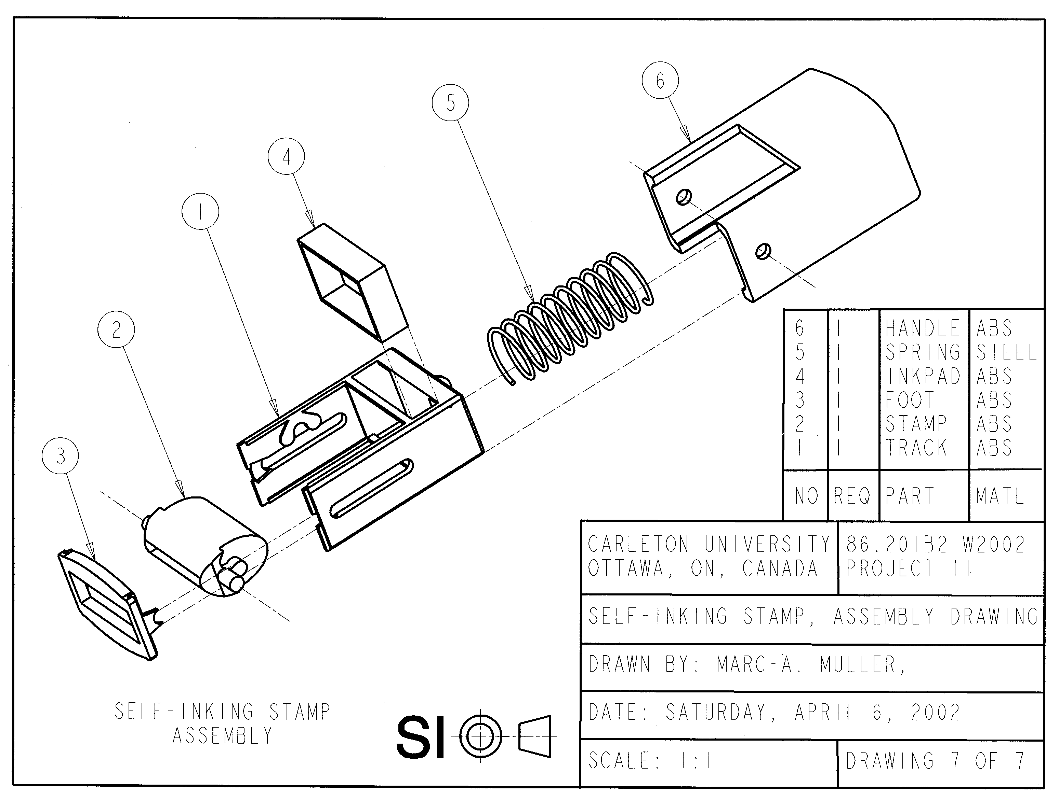
Project Example 2

Slide 36
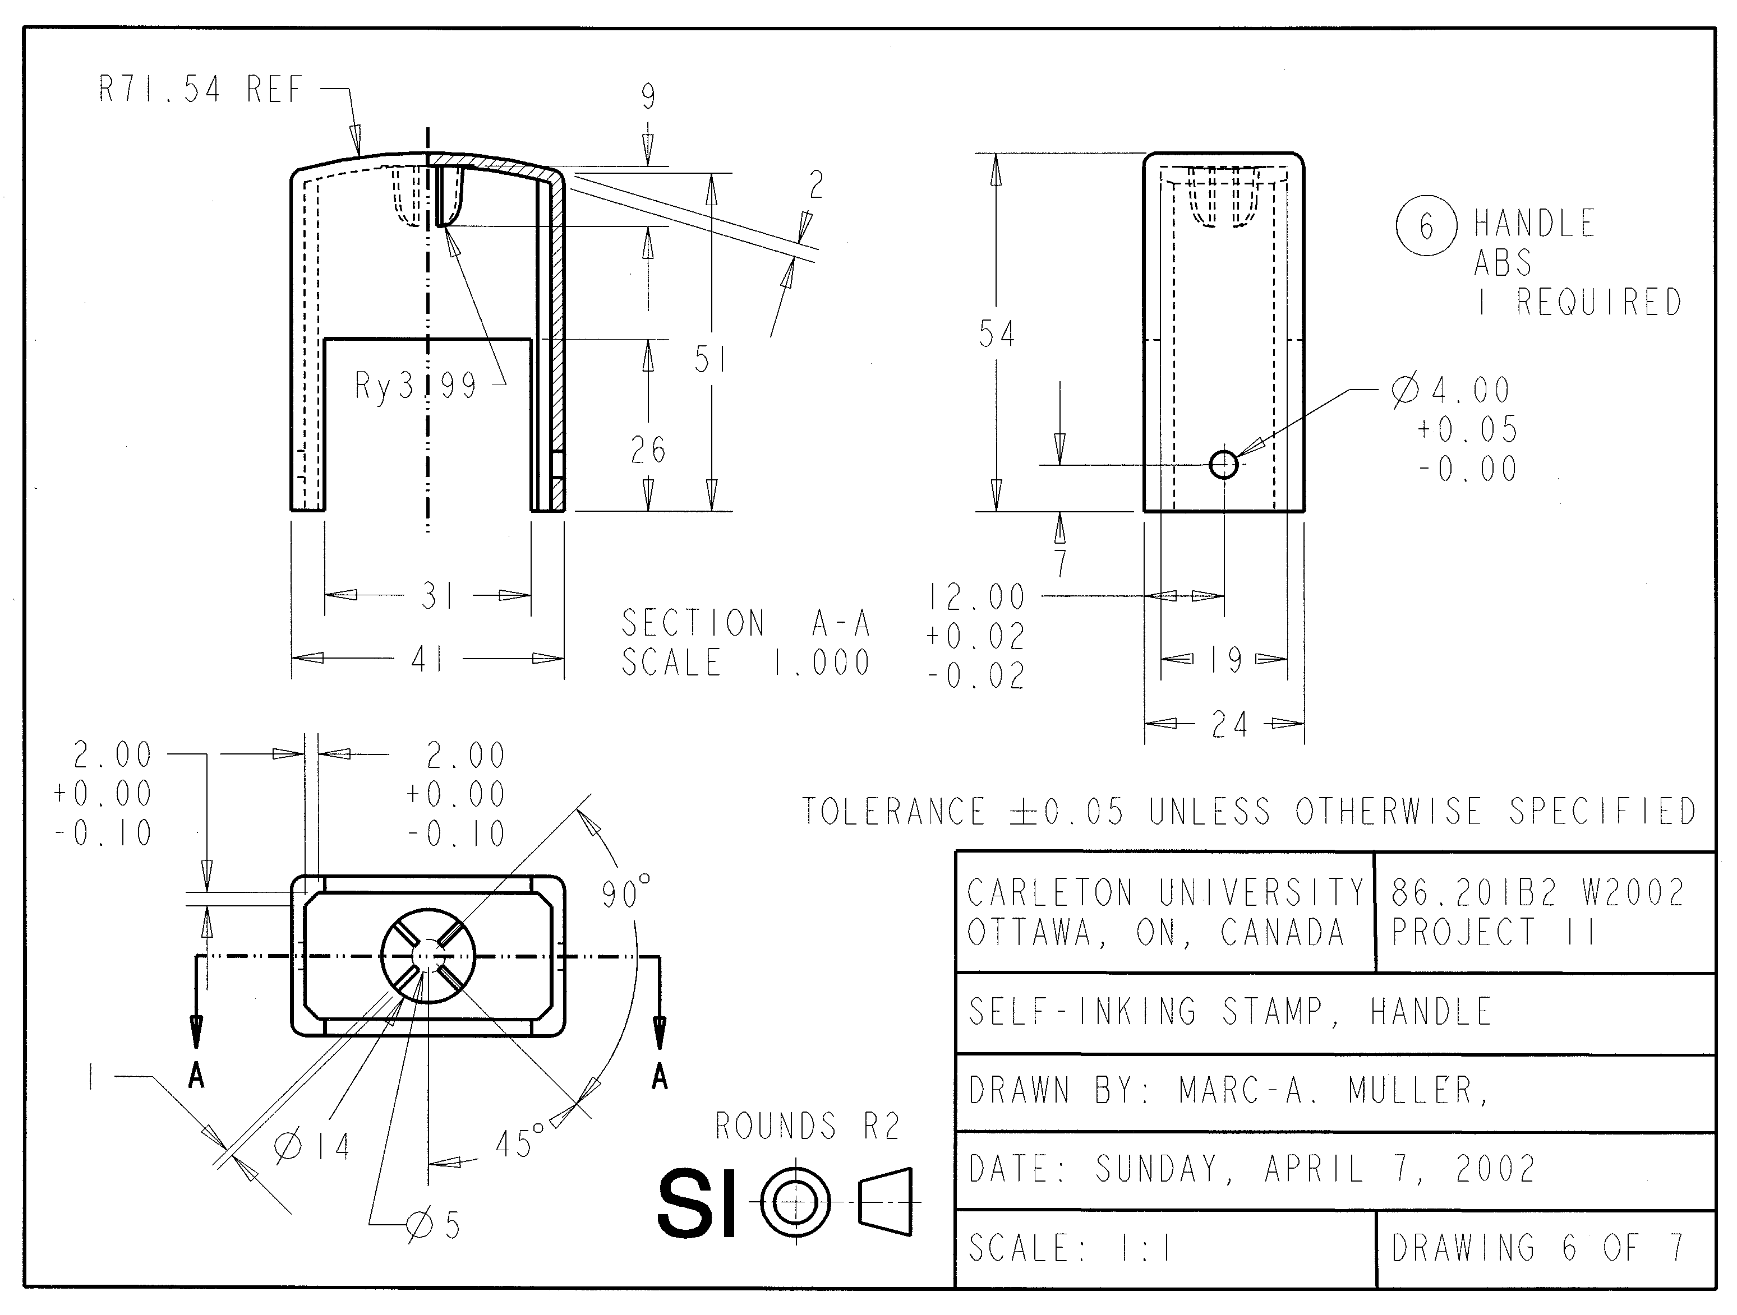
Project Example 2

Slide 37
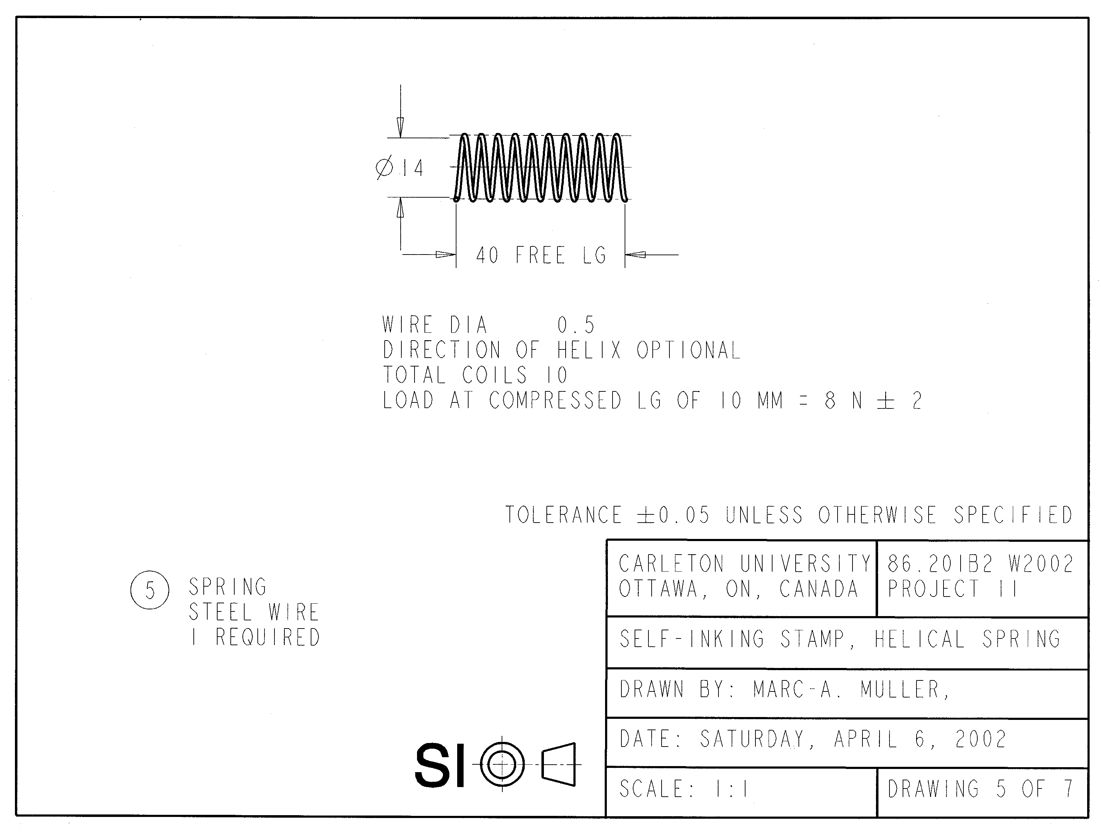
Project Example 2

Slide 38
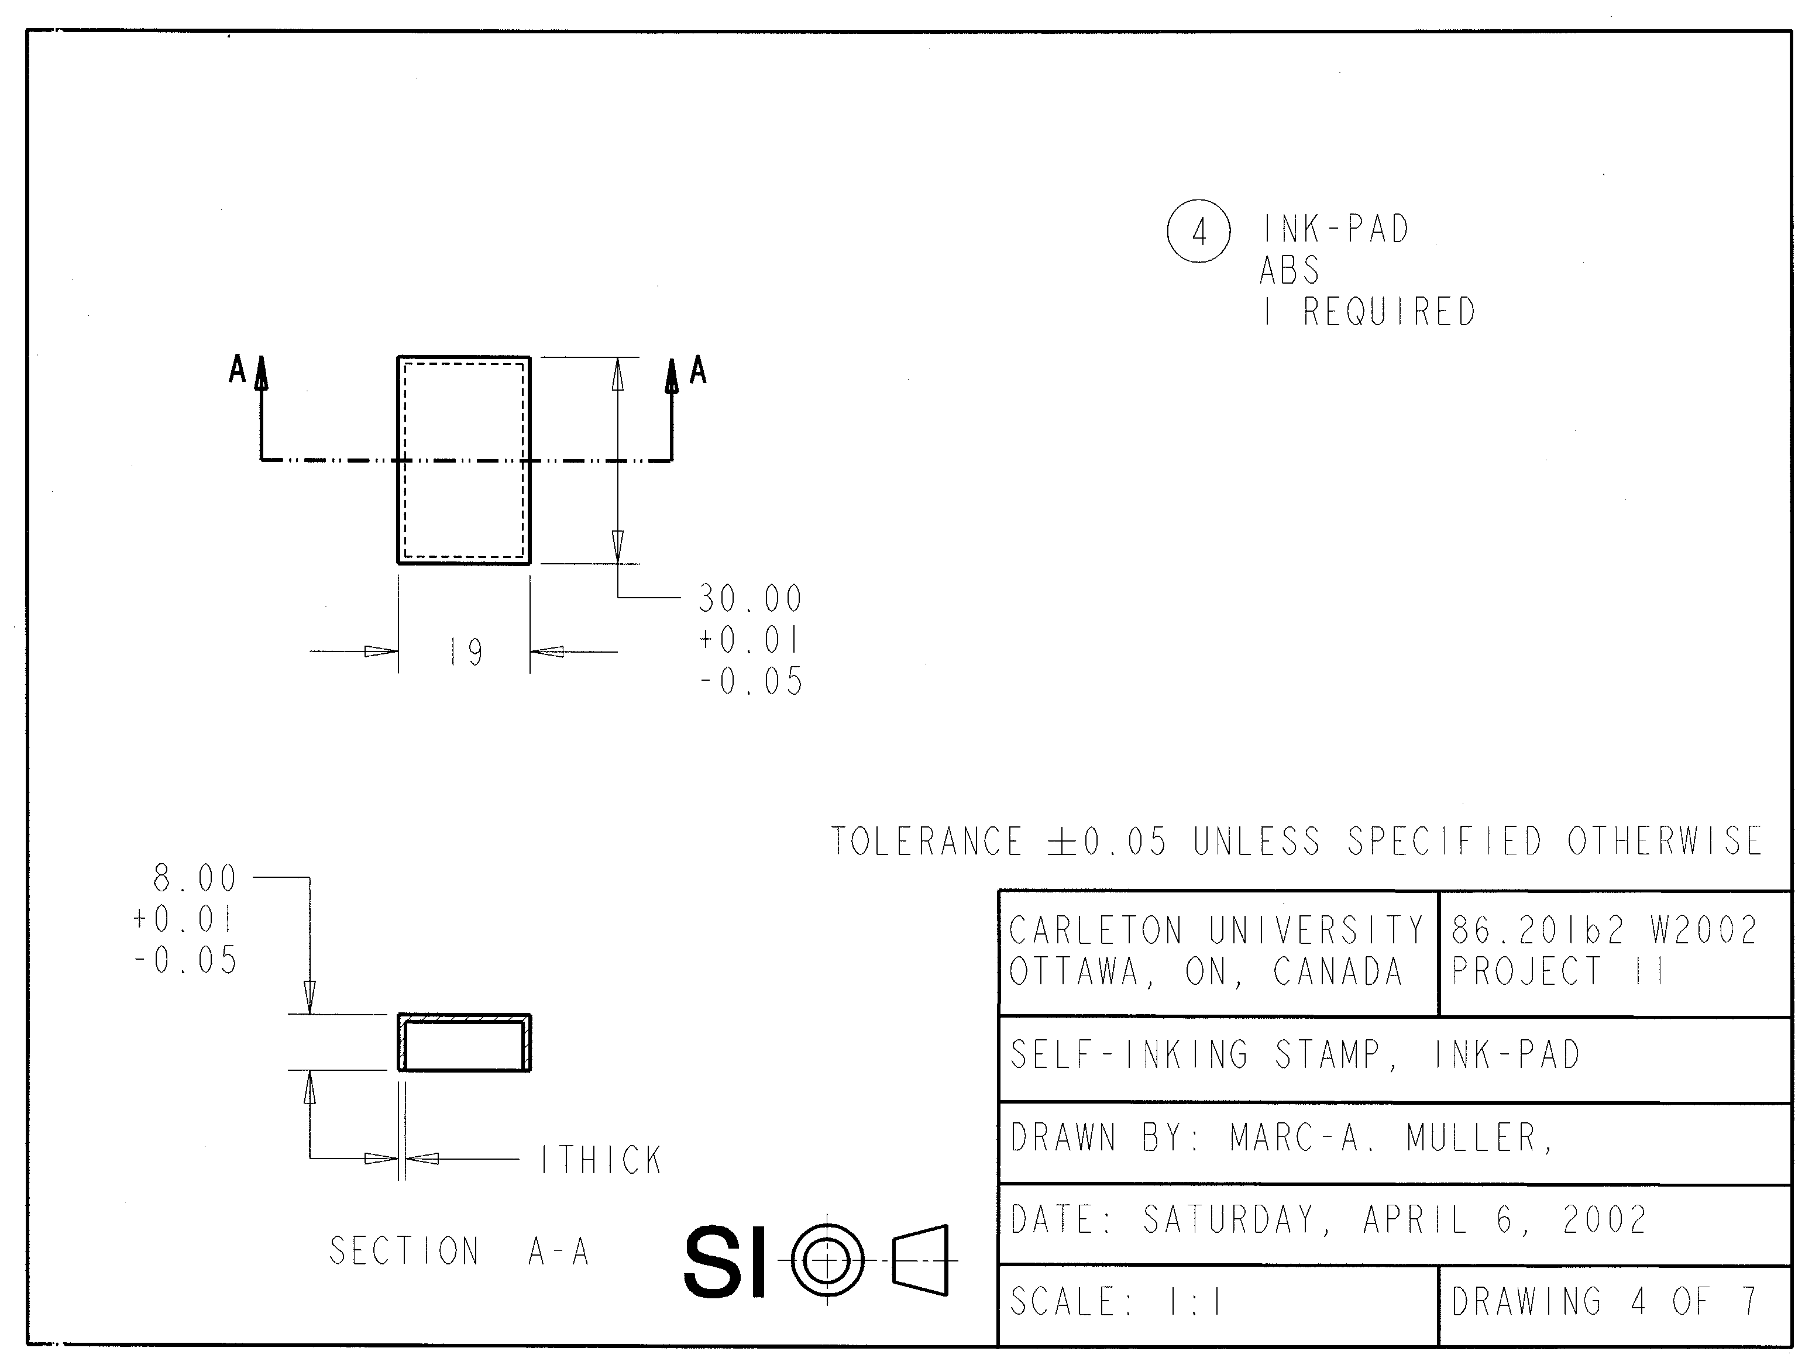
Project Example 2

Slide 39
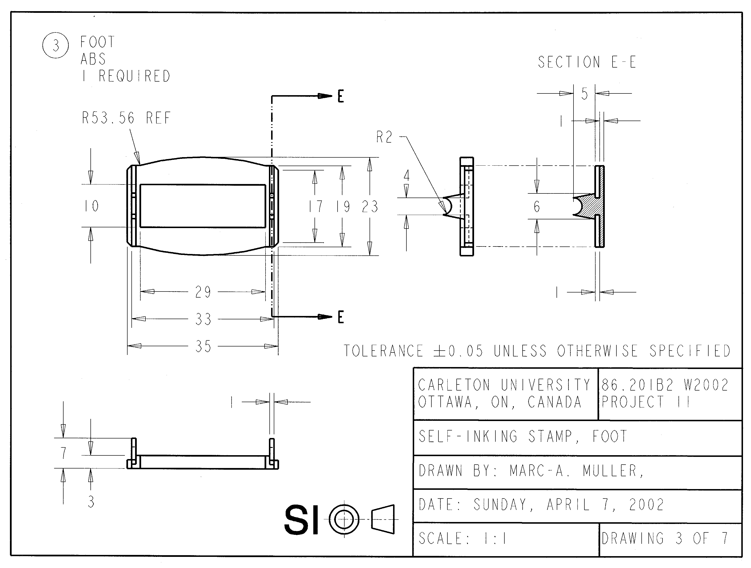
Project Example 2

Slide 40
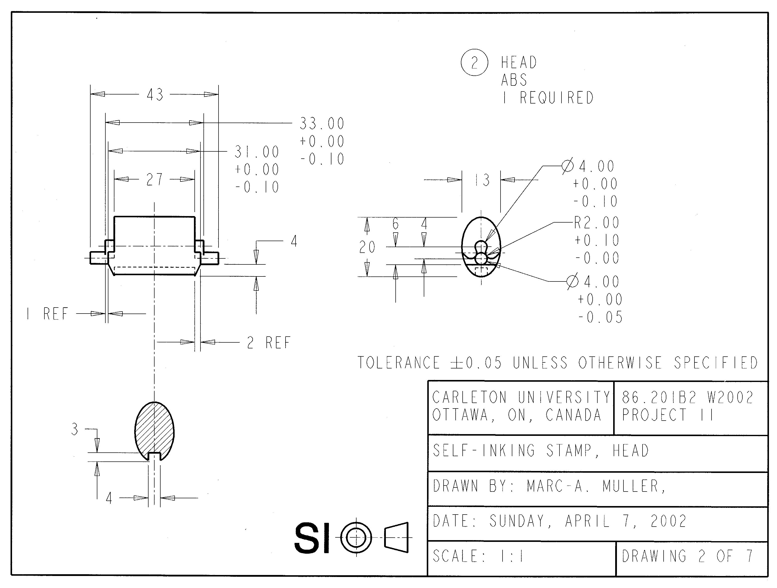
Project Example 2

Slide 41
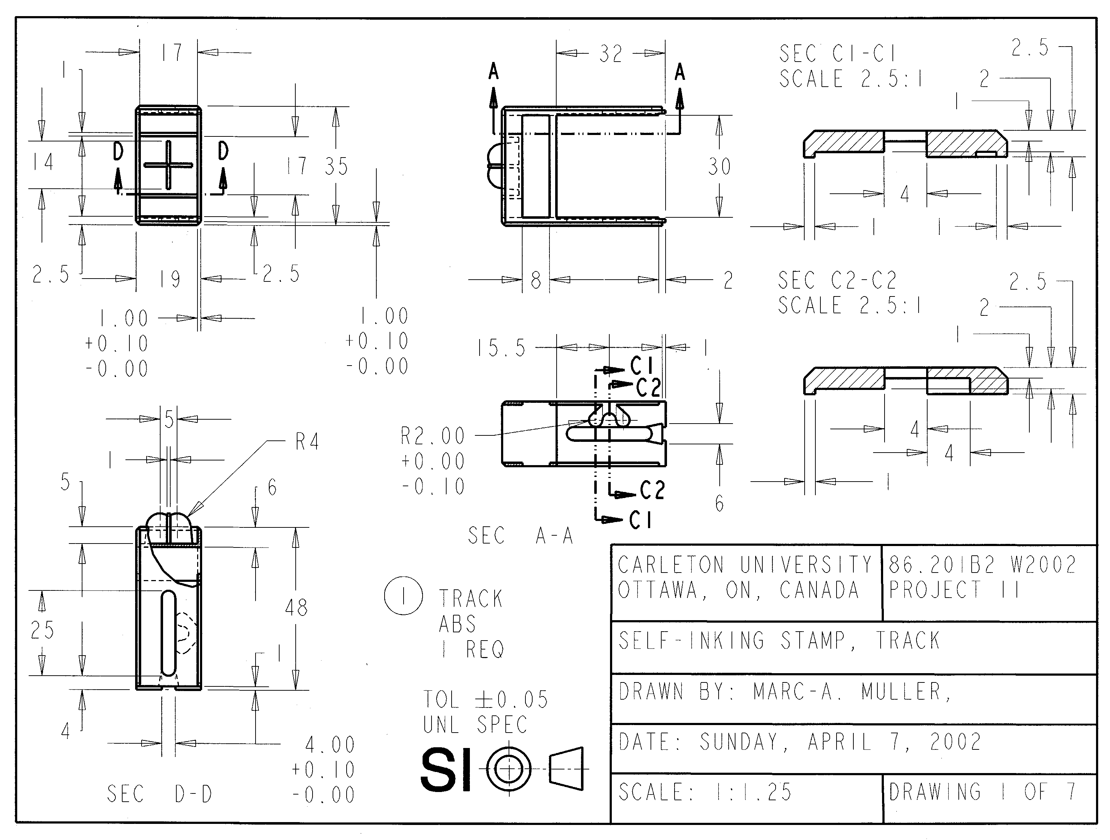
Project Example 2

Slide 42
Reading Assignment
Read in Earle:
  Chapter 2: The Design Process;
  Chapter 3: Drawing Instruments;
  Chapter 5: Geometric Construction.

Slide 43
Questions??

