Slide 1


How you will learn about Personality
Lecture/Discussion & Reading | Self Assessment
Ppt Chapter 2 text | NEO Personality Inventory

Slide 2
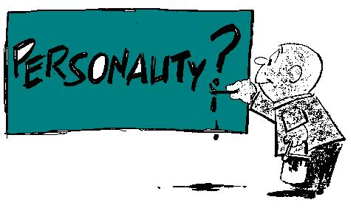
Topics in Personality
What is Personality?
  Contrast with other concepts
Research on Personality

Slide 3
Personality
The relatively stable set of psychological characteristics that influences the way an individual interacts with his or her environment.
Notes:
Stable because when measured over decades research has found people respond similarly to personality inventories. Therefore these reliable responses to valid measures of personality suggest that people’s personality characteristics do not change throughout adulthood.

Slide 4
What Creates a Personality?
Genetics
Personality
Environment
Notes:
Your inherited traits contribute to your personality as does your upbringing. Your family environment, your schools, friends, teachers etc. all contribute to the formation of your personality
again neither is necessarily more important
people may say you are just like your mom or dad, but chances are in other respects you are quite different….

Slide 5
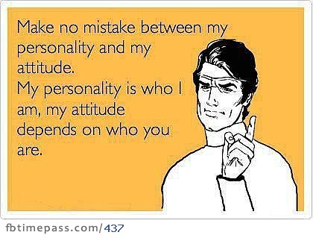
Attitude vs. Personality

Slide 6
Why study Personality?
Employee selection
  Job Performance
  Career Success
  Fit with job/organization
Leadership development
  Self and other awareness (next class)

Slide 7
Five Factor Model of Personality
  Extraversion
  Openness to Experience
  Conscientiousness
  Agreeableness
  Emotional Stability
Notes:
The most prominent model of personality in organizational behaviour today is called the big five model of personality. according to this model, there are five broad traits that can be used to describe people’s personality. These traits are called dimensions because each dimension is comprised of several small traits. According to the model, each dimension is a continuum, ranging from low to high, and every person has some level of each of these five dimensions. So people can be high, moderate, or low on conscientiousness, high, moderate, or low on agreeableness, high, moderate, or low on agreeableness, etc. An important point about this model is that people cannot be both high and low on a dimension. So you cannot be both low in emotional stability and high in emotional stability.
Conscientiousness. People who are high on conscientiousness are careful, and dependable. They tend to be responsible, organized, and persistent. They also tend to have a high need for achievement. People who are low on conscientiousness are disorganized, and easily distracted. They tend to be careless and unreliable. They also have a lower need for achievement.
Emotional Stability. People who are high on emotional stability tend to be poised and secure. They are calm and self-confident. People who are low in emotional stability are often described as neurotic. They are anxious and indecisive. They tend to have mood swings and can often be depressed.
Openness to experience. People who are high on openness to experience are curious about the world, are fascinated by novelty and are open to new experiences. They also tend to enjoy experiences different cultures and tend to be creative and artistic. People who are low on openness to experience tend to resist change and be fixed in their ways. They tend to be more conventional and find comfort in things that are familiar.
People who are high on agreeableness tend to be courteous and empathic. they are good natured, friendly, and easy to get along with. people who are low on agreeableness tend to be uncooperative and irritable. They tend to be antagonistic and difficult to get along with.
Finally, extraversion. people who are high on extroversion tend to be outgoing and talkative, they like to socialize and tend to quite assertive. people who are low on extraversion tend to be introverted. they are shy, quiet and often prefer to be alone, rather than in a group.
Links to work behaviour:
Conscientiousness:
relates positively to job performance, attendance, motivation,
negative relation with counterproductive behaviours
Career success is predicted by emotional stability, conscientiousness and agreableness

Slide 8
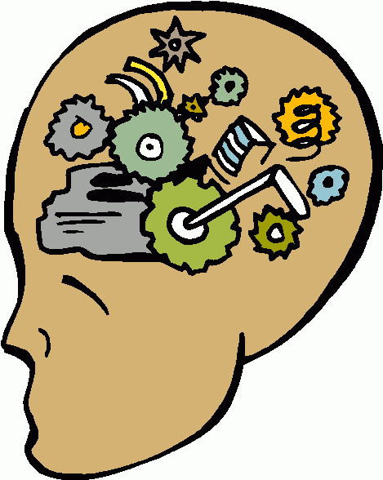

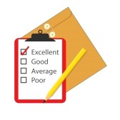
Complete Your Personality Survey
Download from portal
Notes:
Complete the following measures of your personality
These give you an idea of what personality measures look like
In a job interview you might be required to complete a personality measure, they are also often used for coaching purposes

Slide 9

Extraversion
Facets:
  Warmth,
  Gregariousness
  Assertiveness
  Activity Level
  Excitement-Seeking
  Positive Emotions
Notes:
- Joey (from Friends)

Slide 10
Extraversion
Outgoing, talkative
Quiet, prefer to be alone
Extraversion
Extraversion
Sociable, assertive, energetic
Effective Interpersonal interaction
Notes:
A study shows that extraversion is positively correlated to absenteeism, i.e. extroverted people tend to be absent in more occasions than introverts
It predicts managerial and sales performance

Slide 11
Behavior vs. Personality
Behavior
  Can be observed/measured all the time
    E.g., Talkativeness in social situations is extraversion vs. talkativeness in non social situations is not
  Is influenced by personality & other factors
    E.g., Talking in class is determined by personality and reinforcement for class participation (e.g., class participation marks) whereas talking across different social situations is determined by personality

Slide 12

Conscientiousness
Facets:
  Sense of Competence
  Orderliness
  Sense of Responsibility
  Achievement Striving
  Self-Discipline
  Deliberateness
Notes:
Harvey Specter (from Suits) – Overachiever and sense of competence

Slide 13
Conscientiousness
Disorganized, Unreliable
Conscientiousness
Careful, dependable
Conscientiousness
Motivation, goal setting, attendance, discipline, achievement oriented
Higher job performance
Notes:
According to studies, conscientiousness is the biggest predictor of job success

Slide 14
Intelligence vs. Personality
General Mental Abilities (estimate of IQ) is 59% more accurate than Conscientiousness in predicting job success
 | Occupational Level | Income
GMA | .51 | .53
Conscientiousness | .49 | .41

Slide 15
Why does Conscientiousness predict job success
Conscientiousness
Motivation, goal setting, attendance, discipline, achievement oriented
Higher job success
Notes:
According to studies, conscientiousness is the biggest predictor of job success

Slide 16
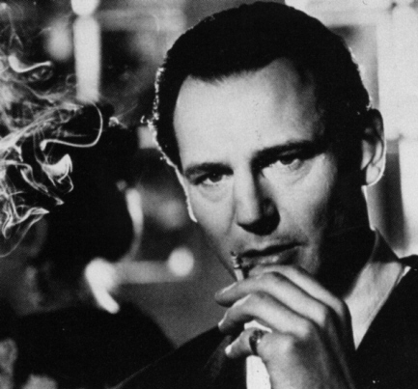
Agreeableness
Facets:
  Trust in others
  Sincerity
  Altruism
  Compliance
  Modesty
  Sympathy
Notes:
Oscar Schindler – Schindlers List (based on a true story)

Slide 17
Agreeableness
Courteous, empathic
Uncooperative, irritable
Agreeableness
Agreeableness
Cooperative, helpful and nurturing others
Better interaction and teamwork
Notes:
Agreeableness predicts job performance in jobs that require working in teams

Slide 18

Emotional stability/neuroticism
Facets (Neuroticism):
  Anxiety
  Angry Hostility
  Moodiness/Contentment
  Self-Consciousness
  Self-Indulgence
  Sensitivity to Stress
Notes:
Joffrey (Game of Thrones) – for neurotic

Slide 19
Emotional Stability
Poised, secure
Anxious, indecisive
Emotional Stability
Emotional Stability
Calm and secure
Effective interaction and teamwork

Slide 20

Openness to Experience
Facets:
  Imagination,
  Artistic Interests,
  Depth of Emotions,
  Willingness to Experiment,
  Intellectual Curiosity,
  Tolerance for Diversity
Notes:
- Sheldon Cooper (Big Bang Theory) – for his intellectual curiousity. Do you have anyone better in mind?

Slide 21
Openness to Experience
Resist change, fixed in their ways
Sensitive, flexible
Openness to Experience
Openness to experience
Creative, intellectual, curious and broad interests
Creative and effective learning

Slide 22
Why Study Personality
Research shows Big Five Personality Dimensions are related to
  job performance and organizational citizenship behaviours
  work motivation, job satisfaction, and life satisfaction
  job search and career success

Slide 23
What we learned about Personality:
Sample Exam Questions
What is personality
  Compare and contrast to behavior, IQ, attitudes
Why is personality related to job performance
  Compare to IQ

Slide 24
What we learned about Personality:
Sample Exam Questions
What is the difference between Openness to Experience and Intelligence (IQ)?
Can a person score high in both neuroticism and extraversion?
Which personality trait is the best predictor of career success? Why?
Notes:
Extraversion is rooted in positive emotions, while neuroticism is rooted in negative emotions
- Highlight difference between

