Slide 1
Individual Members Generate As Many Hypotheses as you can
Given your team topic…
How to generate hypotheses
  Use the textbook, psychinfo and other research sources to generate as many hypotheses on the topic
    e.g. , Topic = “Job Satisfaction” then potential Hypotheses are
      People who are more satisfied are more productive
      People who are more satisfied with their jobs set higher goals for performance
      People who are more satisfied with their jobs are more helpful to others in the company

Slide 2
How to generate plausible hypotheses in your topic area with Psycinfo

Slide 3
Learning to Use Psycinfo
Find articles reviewing the literature on your topic
  Generate and Identify ‘technical’ subject terms
  Search for “overview” article on subject terms
    Theoretical literature reviews
      theoretical explanations
    Articles with Meta-analyses
      empirical studies

Slide 4
How you will learn psycinfo today
Instructor will demonstrate with her topic, student will EXPLORE with own topic
  Instructor’s demonstration Topic:
    Happiness on the job
  Student’s chosen topic
    Picked from box!

Slide 5
1. Generate as many terms for topic as you can!
Instructor’s topic “Happiness on the job” (lay term)
Students EXPLORE with own topic

Slide 6
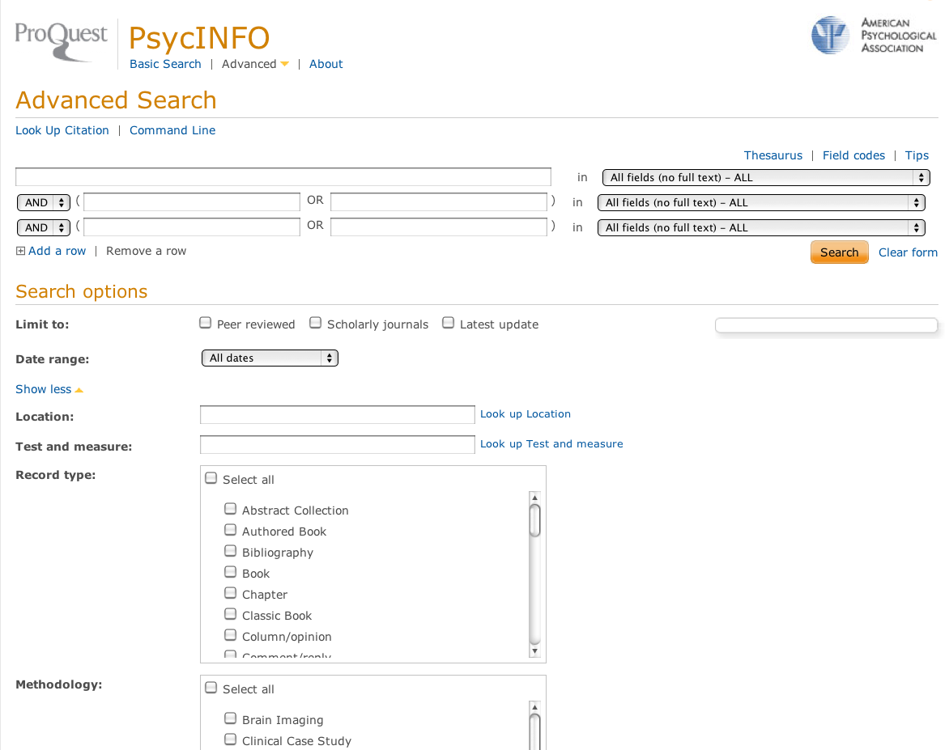
Generate topic terms with PsycInfo
Login to psycinfo
Notes:
Besides of thinking of our own key words, we can also make use of the key word index.

Slide 7
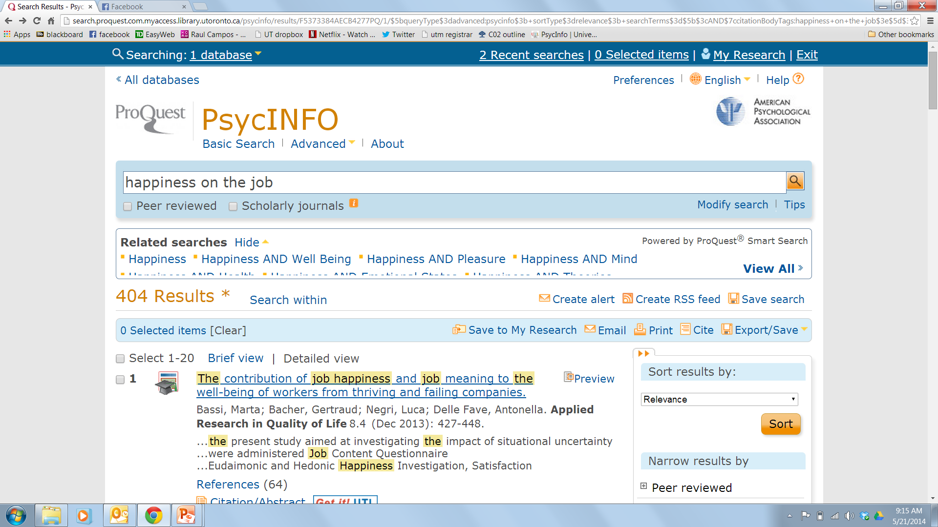
Instructor’s first Psycinfo Search with lay-term “happiness on the job”

Slide 8
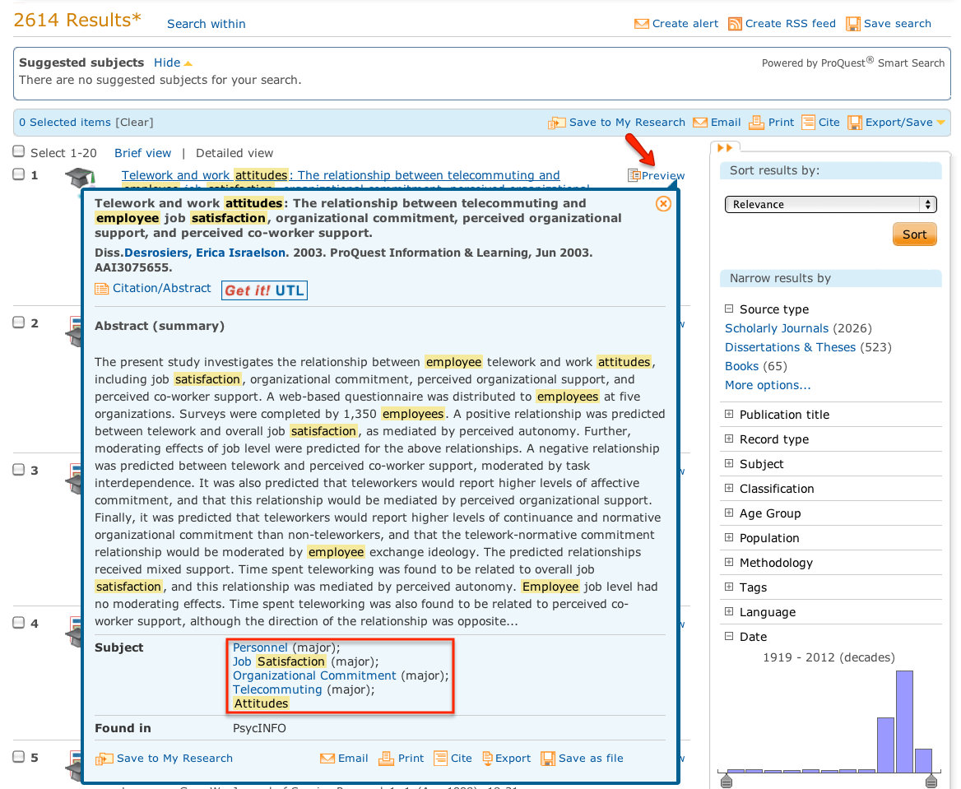
Examine an abstract from first search with lay term to identify technical subject terms
“Subjects” at the bottom of the abstract help to identify relevant subject terms/headings/keywords

Slide 9
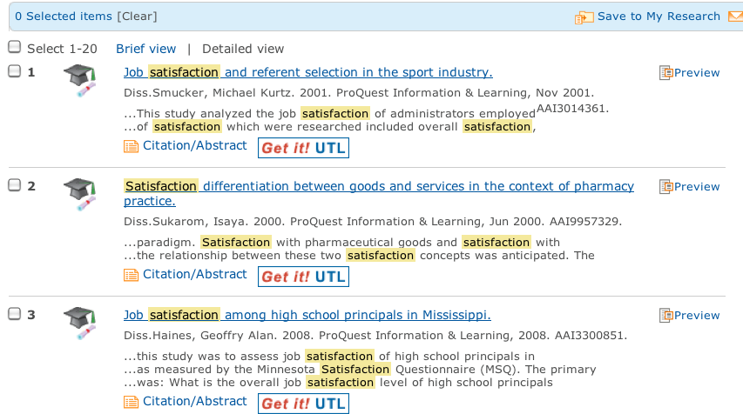
Using technical terms removes misleading subject terms and reduces ‘hits’ with un-necessary terms
Article examining customer satisfaction

Slide 10
Students do a preliminary search!
Instructor’s lay term: “Happiness on the job”
Technical term / subject heading identified from abstract evaluation: “Job Satisfaction”
Students Explore with lay term and discover subject terms
  Make notes!

Slide 11
Another way to generate as many technical terms on the topic as you can!
Explore Thesaurus Function with Technical term / subject heading identified from evaluating abstract :
  Instructor Term: Job Satisfaction
Students Explore the Thesaurus function to get more

Slide 12
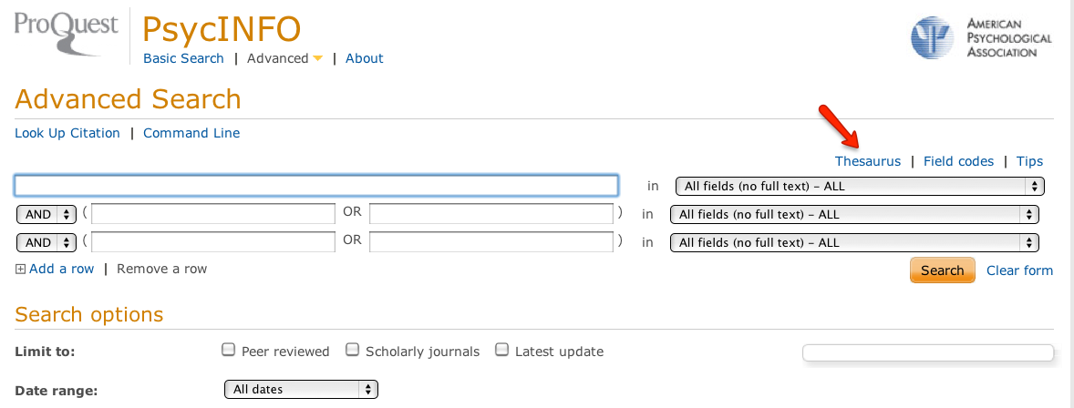
Go to the Thesaurus by clicking on the Thesaurus link

Slide 13
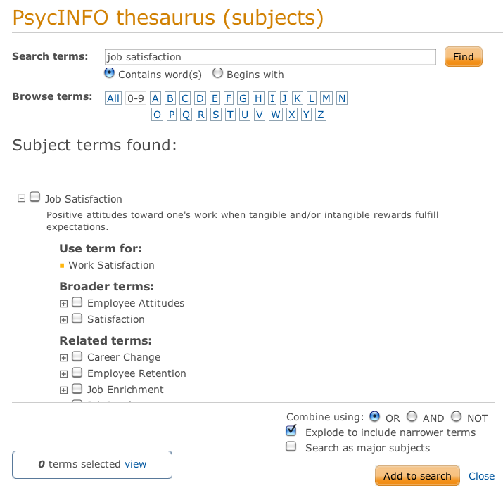
Screen after typing in “technical term” in Thesaurus
Click on the subject headings with [+] to show more related subject terms
  Note down useful subject headings
Notes:
e.g. click on “employee attitudes”

Slide 14
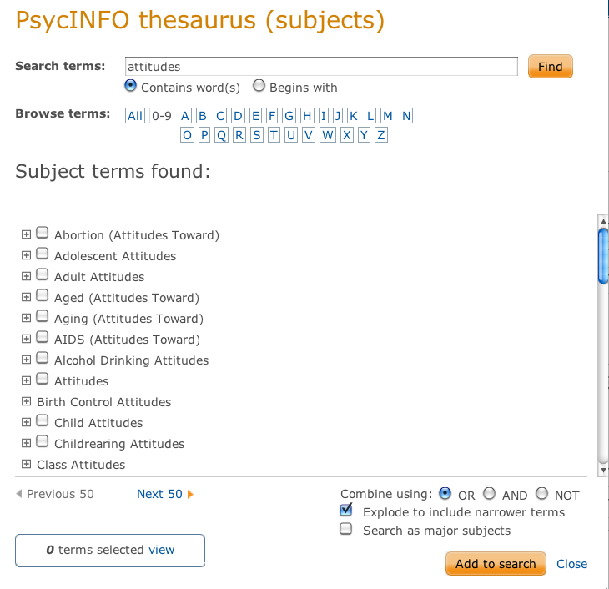
Exploring the results of your search in Thesaurus to get more Technical Terms
E.g. click on “attitude”
Scroll down and see “Employee attitude” and “Employer attitude”

Slide 15
Other ways of identifying Useful Technical Terms/Subject Headings with Thesaurus
Use alternative “display options" to display results in a different way
  Choosing “Begins With” display option gives us related subject headings organized alphabetically
  Choosing “Contains” displays any subject headings which contain the search words

Slide 16
Final list of multiple technical terms to use in database
Instructor’s topic “Happiness on the job”
  Job Satisfaction
  Employee happiness
  Employee satisfaction
  Employee well-being
  Attitudes of employees

Slide 17
Students Practice using Thesaurus & Generate as many subject terms you can
Use the thesaurus to identify useful subject headings for your topic
Familiarize yourself with the thesaurus option
  EXPLORE!!!
Generate as many subject terms as you can!

Slide 18
Examine “literature reviews” or Meta-analyses for potential Hypotheses
Generate a set of possible dependent variables
  E.g., Instructor topic: job satisfaction
  Instructor Hypotheses with subject terms
Hypotheses | Search Terms
People who are more satisfied are more productive People who are more satisfied with their jobs set higher goals for performance People who are more satisfied with their jobs are more helpful to others in the company | Job satisfaction and performance or productivity Job satisfaction and goal difficulty Job satisfaction and organizational citizenship

Slide 19
Why search for literature reviews or meta analyses
Recall….
  Theoretical literature reviews
      theoretical explanations
  Articles with Meta-analyses
      empirical studies

Slide 20
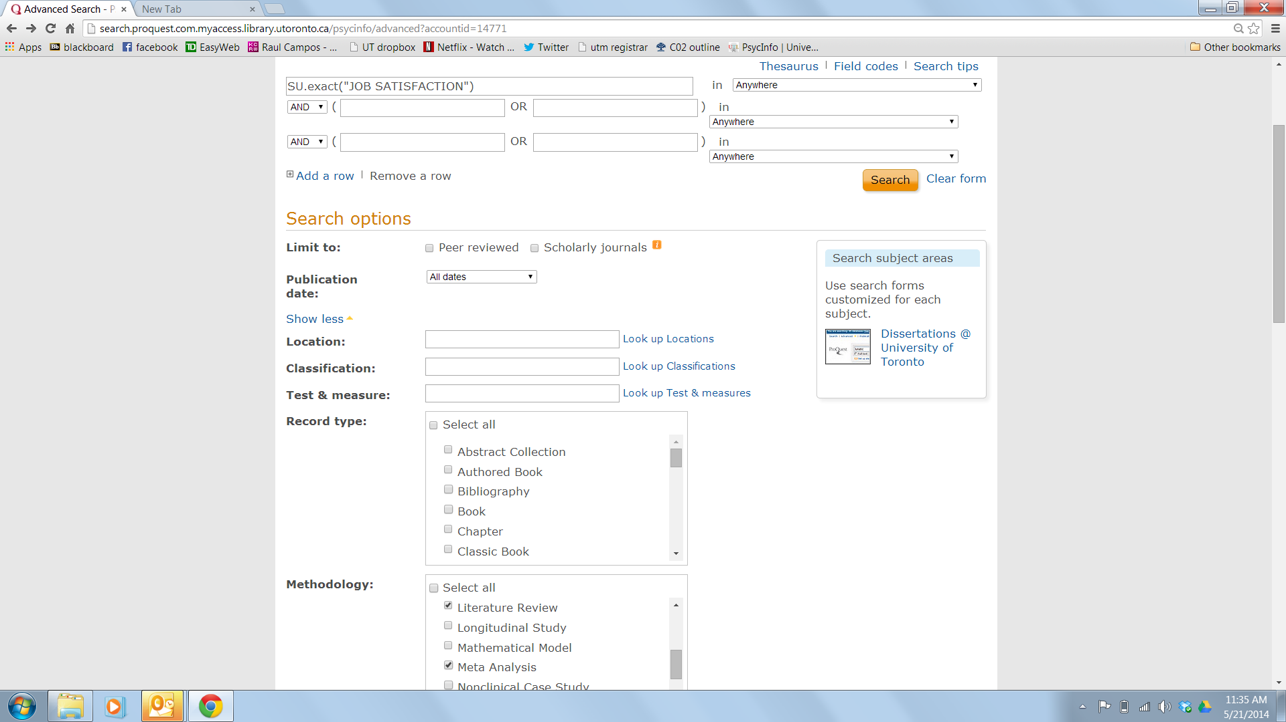
How to find Literature Reviews or Meta-analyses on topic
Use exact subject term generated from database in Advanced Search window
Scroll down & select appropriate methodology

Slide 21
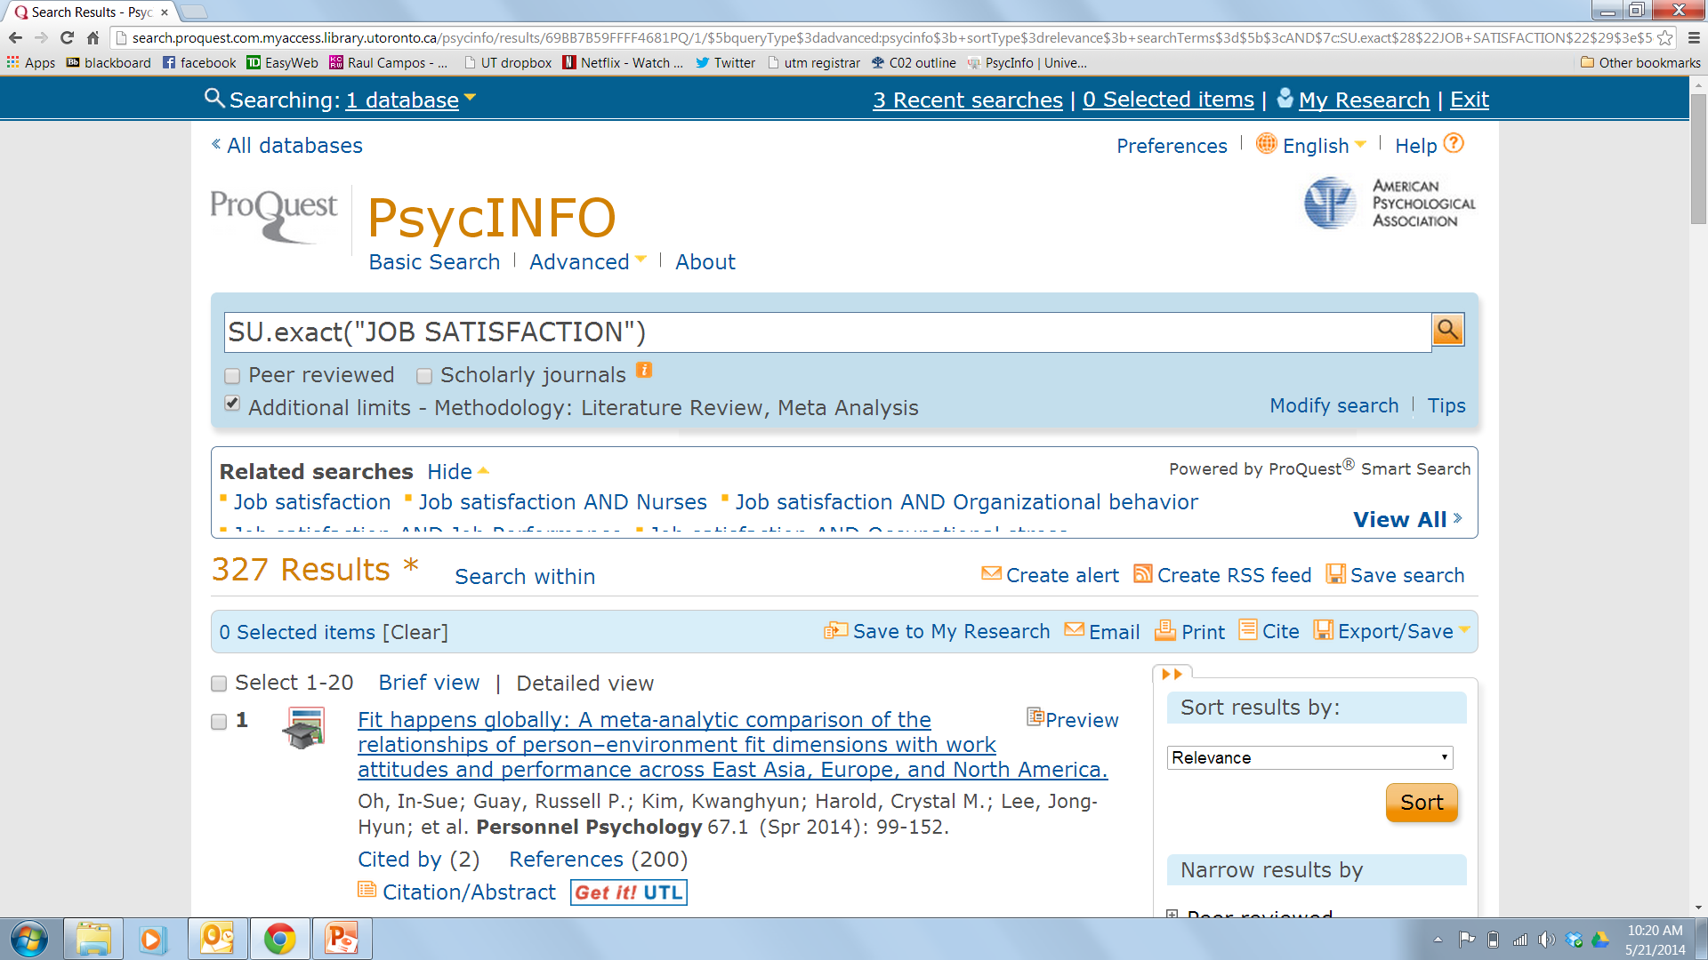
Check if search engine is applying the limits you specified
Limits applied

Slide 22
Students individually generate as many hypotheses as you can after verifying data exists on that hypothesis and then go to tutorial rooms!

