Slide 1
How to Research for Assignment 1:
Measurement
leadership performance
Skill
Definition
Measurement

Slide 2
Recall requirement of Assignment 1
Justify why you chose this skill
Justify why you trust the scores on the questionnaire assessing the skill you chose to improve on Use academic references
  Validity and reliability of questionnaire

Slide 3
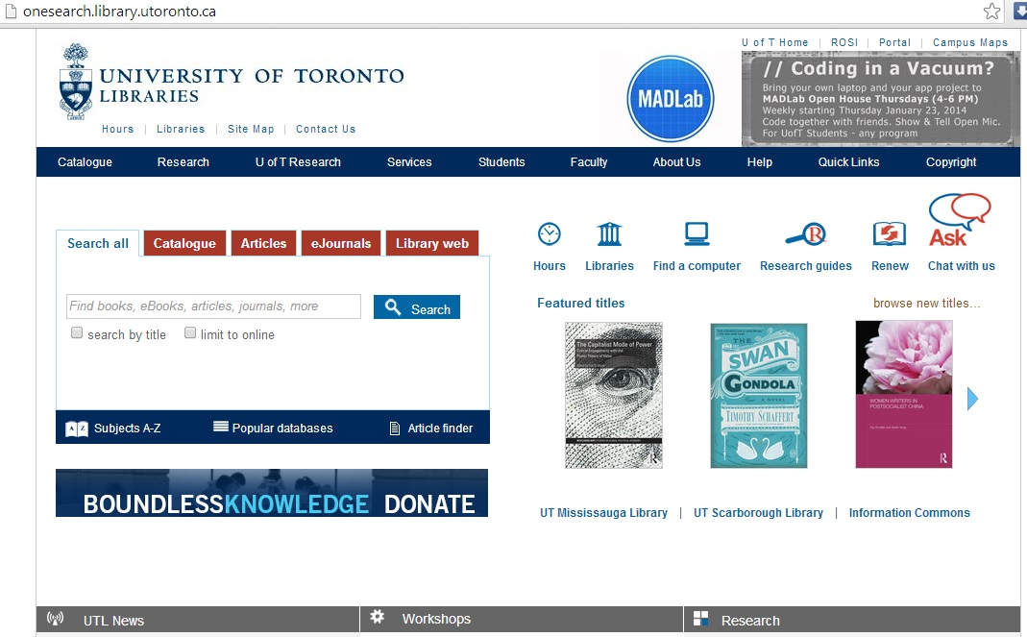
UofT’s Library Website
Step 1: Click on ‘Popular databases’

Slide 4
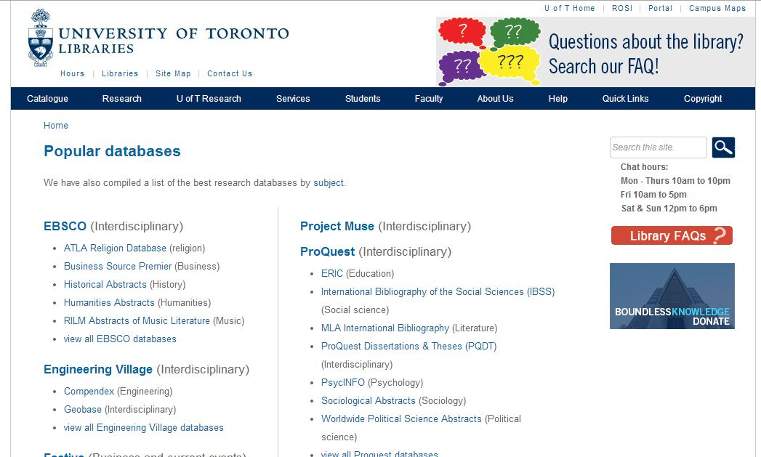
Under ‘Popular databases’
Step 2: Click on PsycInfo under ‘ProQuest’

Slide 5
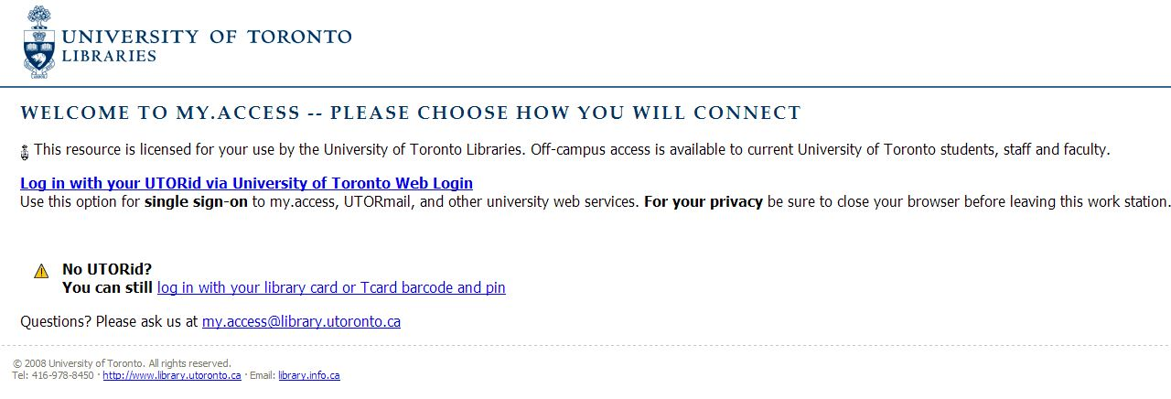
When Connecting Off-Campus: Access Page
Step 2: Select one of two options

Slide 6
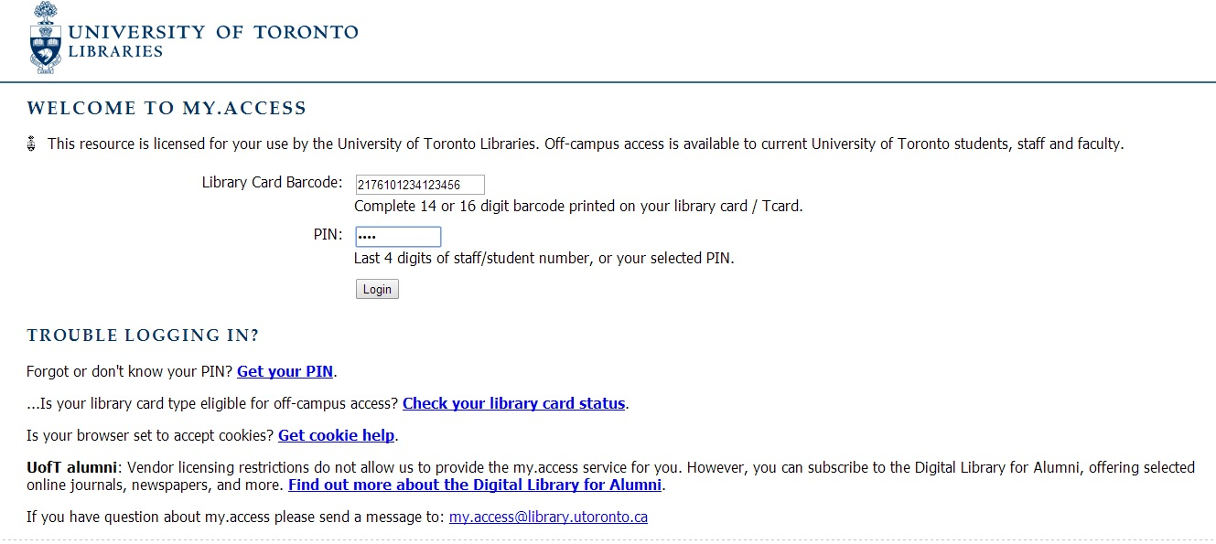
Logging with your Library # and PIN
To login use your Library # on your T-Card and the last four numbers of your Student Number (as PIN)

Slide 7
Summary of what we did so far:
From the UofT library website:
http://http://onesearch.library.utoronto.ca/
Under Search for ‘Popular Databases’ tab, select ‘PsycInfo’ under the topic “Psychology”,
Differences between on-campus vs. off- campus access

Slide 8
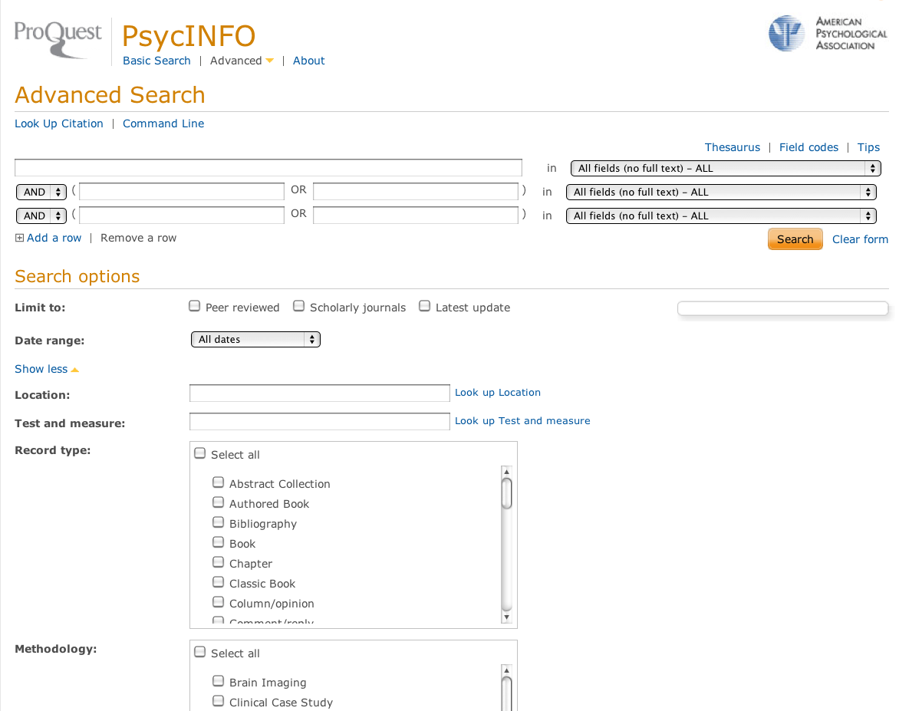
Screen when logged into PsycInfo
Notes:
Besides of thinking of our own key words, we can also make use of the key word index.

Slide 9
Students Exercise
Search for a measure:
“Satisfaction with Life Scale”, by Ed Diener, et al published in 1985

Slide 10
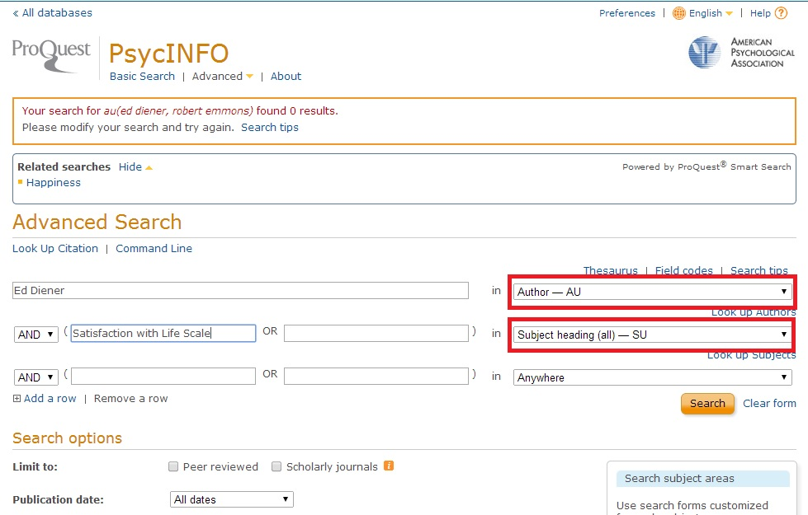
Change the Search categories to Author and Subject Heading
Notes:
Search for the original article by “Satisfaction with Life Scale”, by Ed Diener, et al published in 1985

Slide 11
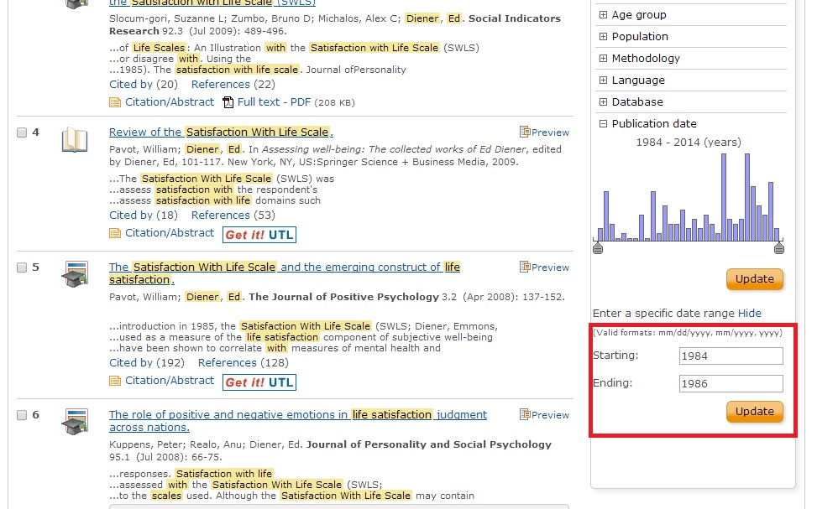
Change the year to include 1985

Slide 12
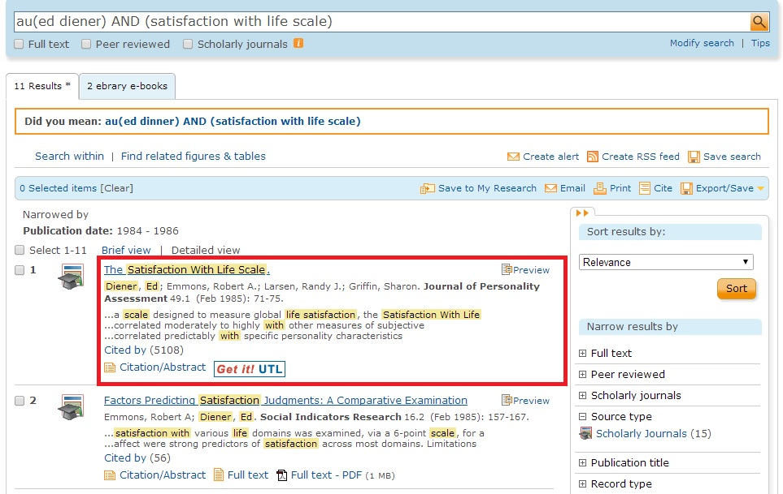
Click on the Original Article “Satisfaction with Life Scale”

Slide 13
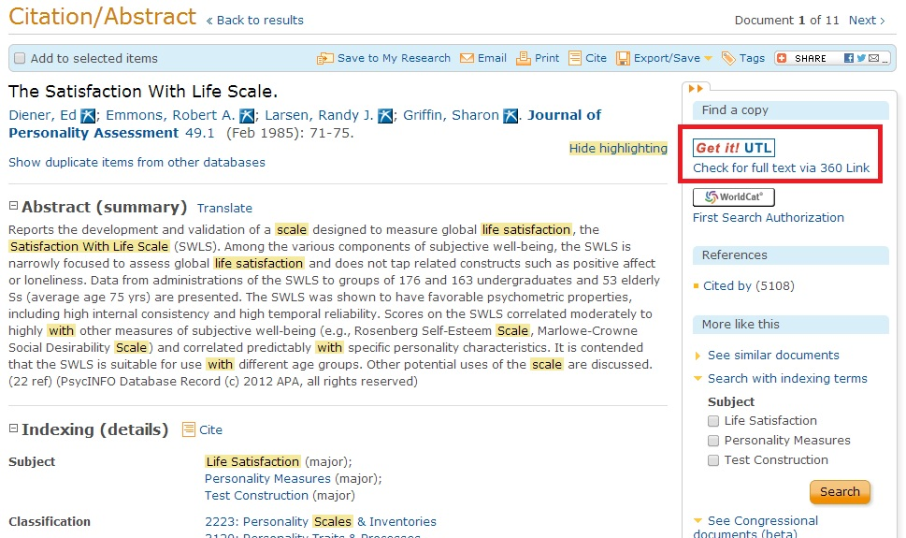
Main Article Abstract Summary
Notes:
Click on the Get it! UTL box to redirect to the original Article

Slide 14
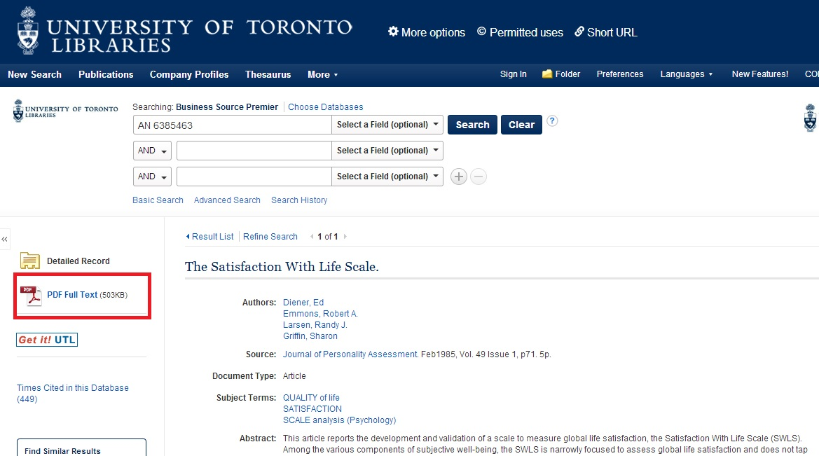
Click on PDF (full text) for the Article

Slide 15
Recall requirement of Assignment 1
Justify why you chose this skill
Justify why you trust the scores on the questionnaire assessing the skill you chose to improve on Use academic references
  Validity and reliability of questionnaire

Slide 16
Find Reliability and Validity Information of Scale
In the context of Satisfaction with Life Scale

Slide 17
The Satisfaction with Life Scale (SWLS)
1. In most ways my life is close to ideal.
2. The conditions of my life are excellent.
3. I am satisfied with my life.
4. So far I have gotten the important things I want in my life.
5. If I could live my life over, I would change almost nothing.
1 2 3 4 5 6 7
Strongly Strongly
Disagree Agree

Slide 18
What is Reliability and Validity
• Reliability index of consistency of measurement
Validity index of usefulness of the measure

Slide 19
What is reliability
Reliability assesses the consistency of multiple measurements
  Increases with the number of measurements
    Across time: test-retest
    Across evaluators judging the same thing: inter-rater
    Across items -internal
  It is the “average” of the measurements

Slide 20
Development of SWLS
  3 Studies
    Test-retest Reliability
    Internal Reliability
    Inter-rater reliability

Slide 21
Development of SWLS –
Test-retest Reliability
176 university students using experimental set of 48 items
Two month test retest reliability for the SWLS = 0.82

Slide 22
Test-retest reliability/Temporal Reliability
  Assumes no / random effects of memory/learning within the two time intervals
Useful for constructs assumed to be stable
Test-retest reliability is not applicable to some measures
  E.g. ,current mood (e.g., how you feel right now) will show low-retest correlations,

Slide 23
Inter rater Reliability in SWLS
53 elderly persons
    Completed 2 measures of satisfaction
    Interviewed and rated on two measures of satisfaction by 2 trained interviewers
Correlation between
  Ratings between the two interviewers = 0.73
  LSI and SWLS correlated 0.46.
  LSI and interviewer score correlated to 0.68

Slide 24
Development of SWLS –
Internal Reliability & Validity
176 S1 subjects
163 additional students took refined set of items
All took additional previously validated subjective well-being measures.

Slide 25
Internal Reliability of SWLS
Satisfactory (if above .70)
  Means that participants respond similarly to items that are supposed to measure the same thing
r = .70; r² = 49%

Slide 26
What is validity
Definition of Concept
Validity
Measure of Concept
Measure of eadership performance
Validity

Slide 27
Validity Data

Slide 28
What you learned
How to do Assignment 1 requirements
  Measurement
    Learn to find article which developed the measure of the skill
    Learn to locate information about reliability of measure
  Learn to locate information about definition of measure
    Clue: sources listed in measurement artilcle
  Learn to locate information about validity of measure
    May need additional articles – clue: sources listed in reading by Hogan & Warrenfeltz

