Slide 1
OUTLINE of this section
Canadian Soil Classification System
Podzolization – Podzolic soils
Calcification – Chernozemic soils, Solonetzic soils.
Brunisolic soils
Luvisolic soils
Cryosolic soils
Organic soils
Gleysolic soils
Regosolic soils
Soil Fertility in Canada

Slide 2
Canadian Soil Classification
Canadian System of Soil Classification = CSSC
The Ten Soil Orders of the CSSC
Brunisolic Order
Chernozemic Order
Cryosolic Order
Gleysolic Order
Luvisolic Order
Organic Order
Podzolic Order
Regosolic Order
Solonetzic Order
Vertisolic Order
http://www.soilsofcanada.ca/
http://sis.agr.gc.ca/cansis/nsdb/slc/intro.html
http://atlas.nrcan.gc.ca/site/english/maps/archives/4thedition/environment/land/041_42

Slide 3
General Scheme: Climate Conditions
i.e. Temperature and Precipitation
Brunisolic Order
Chernozemic Order
Cryosolic Order
Gleysolic Order
Luvisolic Order
Organic Order
Podzolic Order
Regosolic Order
Solonetzic Order
Vertisolic Order
COLD & DRY
Cryosoli
soils
Brunisolic soils
COLD & WET
Podzolic soils
Chernozemic
soils
Luvisolic soils
Temp gradient
Solonetzic
soils
Luvisolic
soils
HOT & DRY
HOT & WET
Precip gradient

Slide 4
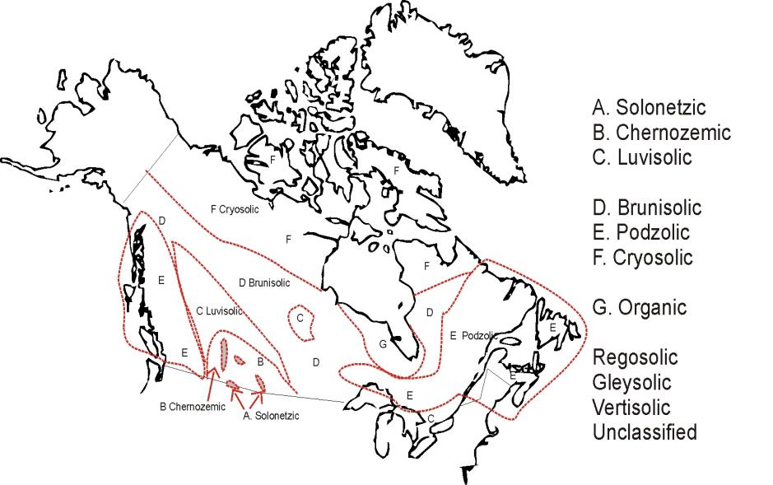

Slide 5
Two important soil processes:
Podzolization, Calcification
Podzolic Soils
Chernozemic Soils
Solonetzic Soils

Slide 6
Podzolic Order (US: Spodosols)
Organic horizon
Podzolization:
cool, moist soils
A f, h horizon
Remember! PODZOLS & LEACHING
Important in boreal forest
Mineral horizons
Ae grey, bleached
Conferous forest
Igneous-rock derived parent materials
High acidity in the A horizon
Bleached Ae horizon
Deposition of iron and aluminum in the B horizon
B h horizon – accumulated organic matter, oxidized iron = “spodic horizon”
C Impermeable layer, accumulated material packs pores

Slide 7
What are the key features of a podzol?
2 main areas of Podzolic soils: Eastern Shield, Cordillera/BC
B horizon enriched with humus or iron (Bh or Bf)
Bh horizon, with organic coating on particles in spodic horizon
White, eluviated, bleached, ashy Ae
Sandy substrate and Mean annual precip >700 mm
Eg, Boreal Shield podzol with very clear Ae and spodic B
Not always such a clear Ae horizon, but still has the spodic B horizon

Slide 8
Hypothetical question ...
Site 1: parent material is lacustrine clay
Site 2: parent material is sand dunes
Both are in a podzolic soil regime.
Given the same climate and same vegetation and same amount of time for pedogenesis ...
How might the soil profiles differ?

Slide 9
Limitations of podzols
Often waterlogged (impermeable C) Gives grey mottles, reddish in oxidizing patches.
Little water retention in summer (lack of clay/silt)
Poor nutrient status (not retained on sand + little organic matter), N most limiting nutrient
Acidity: ~ 3.5 close to surface. Low biodiversity. No earthworms, few bacteria. Decomposition mainly by fungi. Mycorrhiza v imp for N and P (most crucial) nutrient supply.
Symbiotic fungi in root nodules

Slide 10
Human concerns?
Mainly used for logging
Easy to work with, stable mechanically, heavy machinery causes no problems
  Implications of intensive logging, thinning of young trees, and slash burning on soil?
    Growth often good in short term after burning
    ... but long-term loss of nutrients

Slide 11
Chernozemic Order (US: Mollisols)
Calcification:
dry soils
A h horizon
Dense sod of grasses and roots
Dark colour, high in bases
Important in prairies,
Chernozemic soils
Grassland
High levels of organic matter additions from the roots of grasses
Accumulation of excess calcium carbonate
B Calcic horizon
Leaching of carbonate salts to average depth of moisture penetration

Slide 12
What are the key features of a chernozem?
1 main area for Chernozemic soils: Prairies
Grassland soil
A horizon enriched with humus (Ah)
B horizon calcic
Eg, Profile of black chernozem, East Prairie region

Slide 13
Eg, Brown v. Black Chernozem soils
Dark Ah horizon
Calcic B horizon
Brown chernozem, southern prairies
Black chernozem, BC
Organic matter in A
LESS MORE
Depth of CaCO₃ layer
SHALLOW DEEP
typical parent materials for chernozems of prairies
Glacial till, loess, kames

Slide 14
Transitions over space:
responce to effective rainfall
(eg, west-east – higher effective rainfall to east of prairies)
(eg, altitudinal – higher effective rainfall in highlands)
in colour
organic content
depth of calcic horizon
pH at surface
Notes:
Material often ... Glacial or loess.
Basal till left from ice. Gravelly-sandy eskers and kames on top of till. Winds eaolian loess.
Low precip. Annual drought in later summer.
Decomposition of grass roots = humus – black upper horizon
Blue bunch wheat grass most imp. species. V tough grass. New roots produced every year. BUT evolved without cattle grazing.
Small blue grass – annual, v little biomass.
Biological activity not v high. Decomposition in the wetter season.
Black chernozem ... Intensive accumulation of organic matter in surface horizon. Ah horizon ... Up to 10% organic content. Cooler, moiture effecitevness higher ... Carbonates leached to deeper depths than brown soils.
Leaching of carbonate salts to average depth of moisture penetration. Carbonate acts as buffer, improves nutrient supply
Transition in prairies over long distance ... West-east transect ... 100s km
In BC it is altitudinal change, over only short distance.
Heavy grazing pressure kills blue grass.
Regions far from ponds have less grazing ... Blue brunch grass can survive.
Increase in elevation = cooler and wetter (same pattern as west to east transition): change brown to black at high elevation. More ogranic ... More aspens, forbs, grasses ... esp rough fescue. Greater diversity.
Management: graze to avoid blooming period for Blue grass.

Slide 15
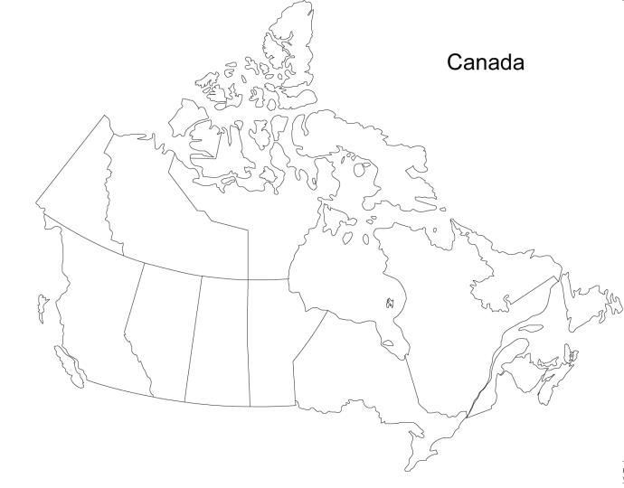
Chernozemic Soils of the Prairies
Depth of CaCO₃
WEST
EAST
Brown Chernozem
Dark Brown Chernozem
Black Chernozem
Short grasses
Mixed grasses
Tall grasses
pH 7.0-8.0
pH 5.5-7.0
Christopherson and Bryne 2009

Slide 16
Brown Chernozem: less organic matter in A, lighter in colour. Carbonates not leached deeply, mean annual water deficit of 19-38 m. pH 7-8 at surface
Dark Brown Chernozem: darker colour, mean annual water deficit 13-19 cm
Black Chernozem: More organic matter in A, darkest colour. Ah horizon ... Up to 10% organic content. Carbonates leached more deeply, water deficit 6.5-13 cm. pH 5.5-7.0 at surface

Slide 17
Human concerns?
Excellent nutrient status – carbonates buffer soil, leaching reduced
Annual drought stress
Used intensively for grazing ... but ecosystem did not evolve with cattle grazing. Blue Grass killed, especially close to ponds (grazing more intense) + prevented from seeding
Solution: Management of grazing to avoid Blue Grass flowering time.

Slide 18
Solonetzic Order
Columnar structure develops when soil dries out
What are the key features of a solonetzic soil?
Desert soil
B horizon enriched with calcium/sodium (Bn)
n = “natric” – high sodium (calcium to sodium ratio <10)
Eg, Solonetzic soil from Alberta

Slide 19
3 main horizons
Conditions for formation of solonetzic soild?
Parent materials rich in Na, + Must have some clay to bind to Na⁺
Climate: dry + evaporation
- ground water evaporation (eg, Prairies)
Topography (+ climate):
- internal-drainage basin (eg, in BC)
Ahs on top (organic + salt)
Ae: Clay depletion
Bn Salt-accumulation
Properties:
When moist, the clay swells + is malleable (called `Gumbo`!), but impermeable
Dries out to a columnar structure develops, very hard + salt crystals = `hard pan`
1 main area for Solonetzic soils: driest parts of prairies
sis.agr.gc.ca

Slide 20
Typical locations, driest parts of prairies,
Grasslands but with desert plants (eg, succulents)
Issues for humans?
Problems for plants - water supply limited by salt (salt in the root zone kill roots, cannot grow deeper to access deeper water)
Soils cannot easily be treated to counteract salt content
Corrosive to pipes, problems for buildings

Slide 21
Brunisolic Order (US: Inceptisols)
Have the beginning of a B horizon which is weakly developed and noted for its reddish coloration
Lacks strong clay development and accumulation of other compounds
Most frequently found under forests, but also under tundra and grass.
What are the key features of a brunisol?
Only slight horizon development
Brown Bm horizon
m = slightly changed by chemical weathering (eg, oxidation)

Slide 22
Main areas for Brunisolic Soils: Cordilleran and Shield regions that are drier/colder than podzols
Same sandy parent materials as podzols
Not as well-developed as podzols or luvisols, more developed than regosols

Slide 23
Properties
A horizon slightly darker colour
B horizon, changed little
Bm (uniform brown from oxidation of iron) horizon ... Diagnostic for brunisol.
Issues for humans?
Problems with drying out
Absence of clays/silts = not v fertile.
Geographic variation: wetter regions – grade to podzols; drier regions – become more calcic.

Slide 24
Luvisolic Order (US: Alfisols)
Found in moist, less continental climates than chernozems. Warmer than podzols, usually on glacial deposits.
High in mineral content and usually moist
Lacks the dark brown surface horizon of chernozems, but do have significant clay accumulation in the B horizons
Found under high latitude mixed forests or mid-latitude deciduous forests (eg, Ottawa-St. Lawrence Lowlands)
Areas known for most intensive agriculture in North America
Eg, Luvisol of Atlantic Canada

Slide 25
Not much leaf litter. Thin Ah horizon. Not much biological activity, confined to A horizon.
Luvisols
What are the key features of a luvisolic soil?
Greyish Ae, removal of clay, moderately acidic
Bt horizon = enrichment of clay (from glacial materials), fairly dense, barrier to root penetration
Eluviation-illuviation important
Pale Ae horizon
Clay-rich Bt horizon
Colour change to C horizon ... Some CaCO₂ coating pebbles. ie, not acid here
Sounds like a podzol that failed! (diff climate + parent material)
Half way between podzol and chernozem

Slide 26
 | Chernozem | Luvisol | Podzol
Parent material | glacial | glacial | Shield rock
Climate | Hot/cold Dry | Mod. | Cold Wet
Eluviation | Not much | Lots | Extreme
Illuviation | Calcic shallow B | Clay-rich B | Iron-rich spodic B
Main areas for Luvisolic soils: Southern Cordillera, Northern Interior platform, South-western Ontario

Slide 27
Human concerns?
Holds water well, so good for agriculture/trees
But can be poorly-drained. Infiltration limited by clay-rich horizon
Needs caution ... Damaged by traffic when moist. Compacted easily.
Not so much organic matter, easily destroyed.
Thin silt-rich A horizon prone to crusting. Nutrient limited.

Slide 28
Cryosolic Order (US: Gelisols)
High-latitude or High-altitude soils that have:
Permafrost within 1 m of the surface or
Gelic materials within 1 m of the surface and permafrost within 2 m
Gelic materials are mineral or organic soil materials that show evidence of cryoturbation (frost churning) and/or ice segregation

Slide 29
Cryosols
Most extensive soils in Canada
Permafrost within 1-2 m of surface
Mean annual soil temp < 0ºC
Latitude (northern) and altitudinal (alpine) distribution
What are the key features of a cryosol?
Thin organic A horizon
Frost heaving and mixing
Patterned ground

Slide 30
Effects of ice on cryosols:
Frost churning – horizons highly disrupted.
Ground ice, ice lenses
Pockets of organic material mixed into soil by frost churning.
Earth hummocks, eg. patterned ground
Active layer

Slide 31
Local variations
Soils without cryoturbation ... Too dry, too coarse texture.
Organic cryosols in waterlogged depressions
Discontinuous pfrost zone ... Aspect, slope imp.
Human concerns?
V easily disturbed. eg, by fire, traffic, clearing.
Thermokarst easily triggered
Main areas for Cryosolic soils: Arctic, Northern Manitoba, Northern Quebec
Note: Cryosol = Regosol (on some maps)

Slide 32
Organic Order
Often water saturated for most of the year
Occur in muskeg, bogs, fens, and other wetlands
Organic material (must have > 30% by weight) tends to dominate the O horizon and clay in the C horizon
Eg, Horizontal fen, Atlantic Canada
Eg, Slope bog, Atlantic Canada
Eg, Ribbed fen, Atlantic Canada
Eg, Organic soil in Southern Ontario
Main area for Organic soils: Hudson Bay lowlands

Slide 33
Gleysolic Order
Form in waterlogged and cool or cold environments
Thick organic layer includes decomposing and decomposed vegetation that remains because of slow rot by anaerobic micro-organisms
Often found in lowland areas where water collects – can occur in many Canadian environments
Eg, Northern BC, typical gleysol site, river floodplain

Slide 34
Gleysols
What are the key features of a gleysol?
Organic matter on top
Grey-blue reduced layers in B horizon
Mottling

Slide 35
Regosolic Order
Soils that fit in no other category: basically very poor soil development (Why might this be?)
Recent origin (with more time will change to another soil type) eg, unconsolidated material, bedrock
Slow pedogenesis, eg, dry, cold climates
Unstable materials, eg, landslides, alluvial floodplains, sand dunes
What are the key features of a regosolic soil?
Not much!
  No B horizon
  Thin A horizon overlying a C or R horizon (not much development though)
  Some places have buried soil horizons
Beware! Just because it is a regosol doesn’t always mean it is infertile (think of the alluvial Nile valley)

Slide 36
Canadian soils ranked according to
        Humidity (evaporation:precipitation balance)
        Level of maturity (extent of pedogenesis – climate/time)

Slide 37
Rainfall: low to high
Evap: high to low
1. Arid: Solonetzic Soil
2. Grassland: Chernozemic Soil
3. Moderately wet, mixed forest: Brunisolic Soil
4. Wet, mixed forest: Luvisolic Soil
5. Wet cold, coniferous forest: Podzolic Soil

Slide 38
State of development: Immature to mature
1. Very poorly developed: Regosolic Soil
2. Poorly developed: Cryosolic Soil
3. Poorly developed: Brunisolic Soil
4. Moderately well developed: Luvisolic Soil
5. Well developed: Podzolic Soil, Chernozemic Soil, Solonetzic Soil

Slide 39
Soil Fertility in Canada
What governs fertility?
Soil properties
  Thickness, nutrients, pH
Climate
  Temperature, precipitation
Topography
  Drainage, relief
Soil Fertility
High: Chernozems
Medium: Luvisols, Organic
Low-Medium: Podzols, Brunisols
Low: Cryosols

Slide 40

Agriculture in Canada: 5% of land area is arable.
¾ is pasture
Agricultural regions:
Canadian Prairies
Lower Mainland + Interior plateau of BC
St. Lawrence Basin + Maritimes

