Slide 1

Canada’s Soil
Useful videos on Canadian Soils (but they are a bit long)
http://www.youtube.com/playlist?list=PLB6237C1C6302E5A6

Slide 2
What good is soil to us?
Supports Life (eg, food!)
2. Cleans Air and Water
(3. Supports Human Infrastructures)

Slide 3
OUTLINE of this section
Soil composition
Particles: Mineral matter, Organic matter
Pores: air/water
Soil Properties
Texture: mineral component, grain size
Acidity: pH
Cation exchange:
Soil formation from parent material
4 processes: additions, transformations, translocations, losses
Horizons: Organic, Mineral
5 controlling factors:
Parent materials: mineral; organic .. eg from Canada
Climate …eg from Canada, temp, precip, freezing
Biology … eg from Canada, regional scale, local scale
Relief
Time …+ effect in Canada

Slide 4
Soil composition
SOIL COMPOSITION
MINERAL MATTER ~45% by volume
= SOIL SKELETON
ORGANIC MATTER ~5%
WATER and AIR ~50%
= PORE SPACES
Particles
Pores
Organic Material – small % but v imp component
forms from living matter

Slide 5
Soil Properties
Texture
Texture: (of the mineral fraction)
= proportions of sand/silt/clay (soil skeleton)
Particle size:
Non-soil | Soil
 | Non-cohesive fraction |  | Cohesive fraction
Gravel | Sand sized | Silt sized | Clay sized
> 2 mm | 0.05-2 mm | 0.002-0.05 mm | < 0.002 mm

Slide 6
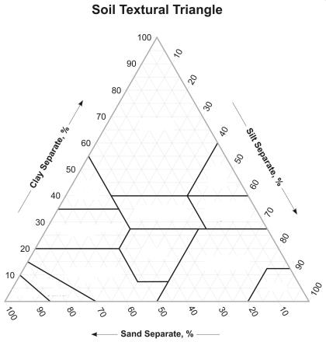
Texture governs porosity, moisture-holding capacity, chemistry and thus ...
Soil Texture triangular diagram:
Soil Quality:
< 30 % Clay – Loamy Soil
- Higher Soil Fertility
clay
Clay loam
loam
Silty loam
Sandy loam
silt
silt
Texture also facilitates what Chemical and Physical Processes might occur within and between different soil horizons
Parent Material and Climate are particularly important in determining Soil Texture and initial Soil Quality

Slide 7
Acidity
pH (acidity) function of number of hydrogen ions H+
(0=acid, 14=alkaline,7=neutral)
<6 usually too acid for good growth
Cation exchange Capacity
Imp for fertility
Property of clays and humus
High CEC?: fertile but high clay content, can be acidic, can be poorly drained
Low CEC?: infertile, high sand content; easily leached, poor water-holding capacity

Slide 8
Soil Formation
What happens to parent material to create soil?
→ 4 soil formation processes (create horizons): additions, transformations, translocations, losses
→ 5 soil controlling (forming) factors (govern type of soil): parent material, climate, biology, relief, time
8

Slide 9
The 4 Soil Forming Processes:
Additions
-precip + OM
-nutrients (weathering)
2. Transformations
-OM → humus
-1^{ry} → 2^{ry} minerals
3. Translocations
-eluviation & illuviation
-humus, clay, ions
4. Losses
-leaching
-erosion
9
Notes:
9

Slide 10
The 4 soil forming processes create horizons
O = Leaf litter, loose organic debris
(Ah = Humus layer, top of A horizon)
A = Topsoil, Zone of Eluviation (or Depletion) (Ae) of clays, humus, Fe/Al oxides
B = Subsoil, Zone of Illuviation (or Accumulation), enriched in organic matter, humus, clays, Fe/Al oxides (ie, from the Ae horizon)
C = Weathered Parent Material, unaffected by pedogenic processes
R = Bedrock/regolith

Slide 11
The 5 soil controlling/forming factors:
Parent materials (local factor)
Climate (regional factor)
Biology (regional or local factor)
Relief (local factor)
Time

Slide 12
Soil-forming factors 1: parent materials
  Residual (sedentary) material: eg, weathered bedrock
  Transported material: eg, glacial till, alluvium, hillwash, loess, coastal deps.
  Accumulated organic material: eg, leaf litter
Eg, sandstone, Alberta
Eg, residuum from weathered rock
Eg, Alluvial deposits, Yukon
eg, glacial till, sand dunes
Key factors of parent material:
Susceptibility to weathering
Type of chemistry
e.g. soils formed over limestone more alkaline than those over granite

Slide 13
Mineral material: glacial and non-glacial
Parent materials in Canada
  Non-Glacial:
    Exposed bedrock
    Colluvium – hillslope sediments (from physical erosion; eg, talus, periglacial solifluction, landslides)
    Alluvium – fluvial/lacustrine/marine sediments (deposited by water)
  Glacial: Both continental and alpine (somewhat different deposits)
    Glacial till + moraine
    Glacio-fluvial/lacustrine
    Glacio-marine sediments

Slide 14
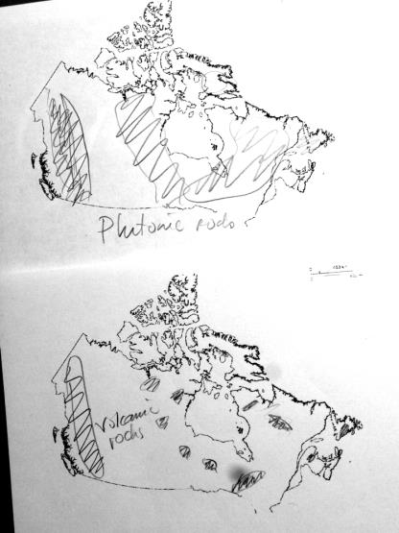
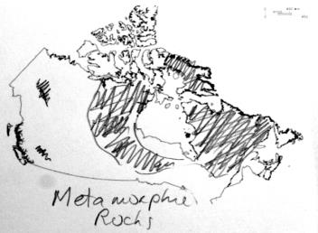
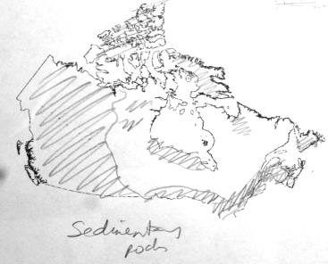
Recall rocks in Canada and geological provinces

Slide 15
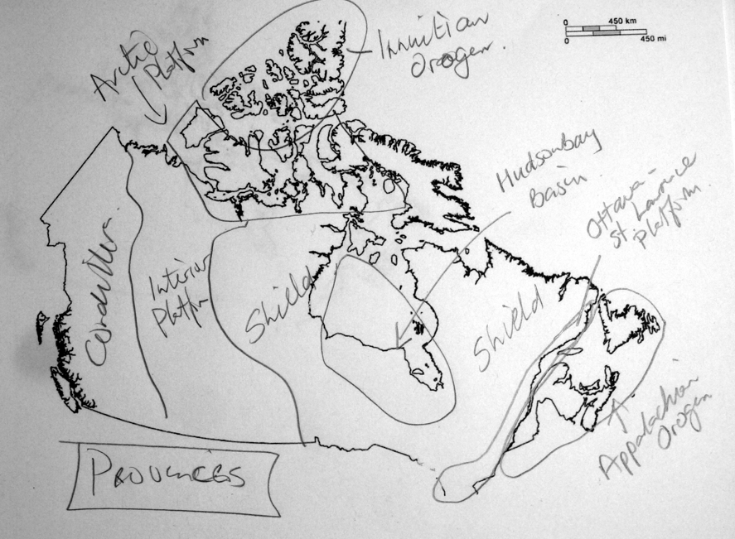

Slide 16
Parent Material: Bedrock
Shield: Metamorphic and Igneous rock; difficult to erode; minerals do not weather as easily as sedimentary rock; also, consider relief, poor drainage
Arctic Region: Sedimentary rock; easier to erode, but poor climate conditions (cold and dry)
Cordillera: mixed rock types, alpine glacial erosion, physiography a bigger factor; also, variable climate conditions
Appalachians: Mixed rock; mountainous to variable topography and climate; mixed environments (low to high favourability)
Interior Platform: Sedimentary rock; easily eroded; undulating topography and climate more favourable for soil development
Lowlands: Sedimentary rock; easily eroded; undulating topography and climate more favourable for soil development (as with Platform)

Slide 17
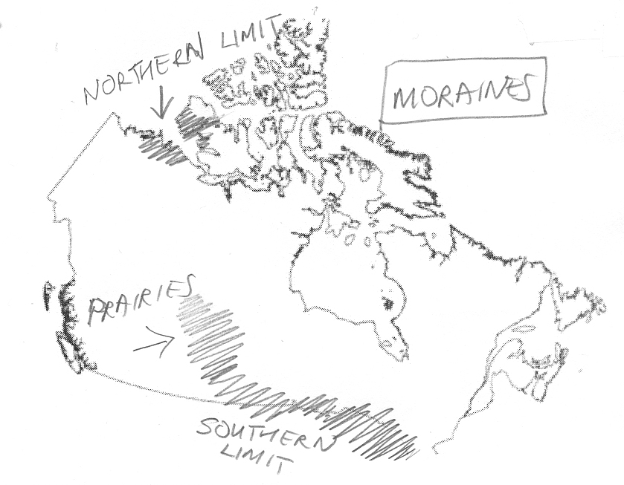
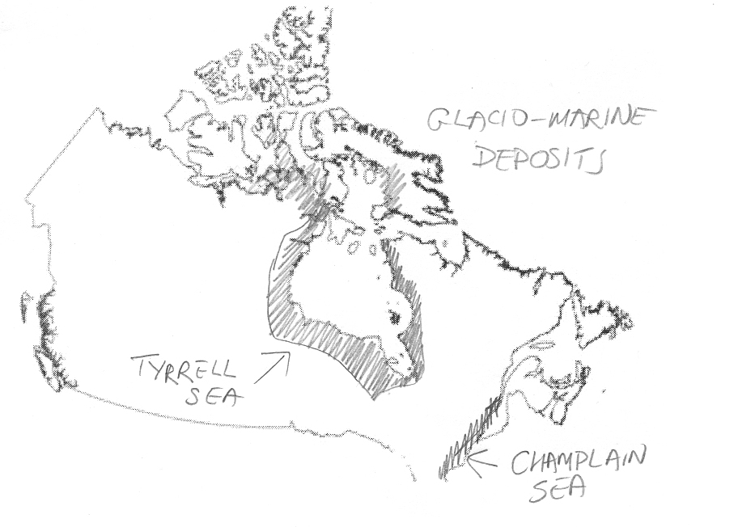
Parent material: glacial deposits
Recall glacial deposits map
Vast areas of Canada covered by
glacial till (sub-glacial, end/terminal moraine)
Glacio-marine deposits; result of marine inundation prior to isostatic rebound. (e.g. Hudson Bay – Tyrell Sea, St. Lawrence Lowlands – Champlain Sea)
Glacio-lacustrine deposits also quite extensive throughout northern Ontario, Manitoba, and Saskatchewan

Slide 18
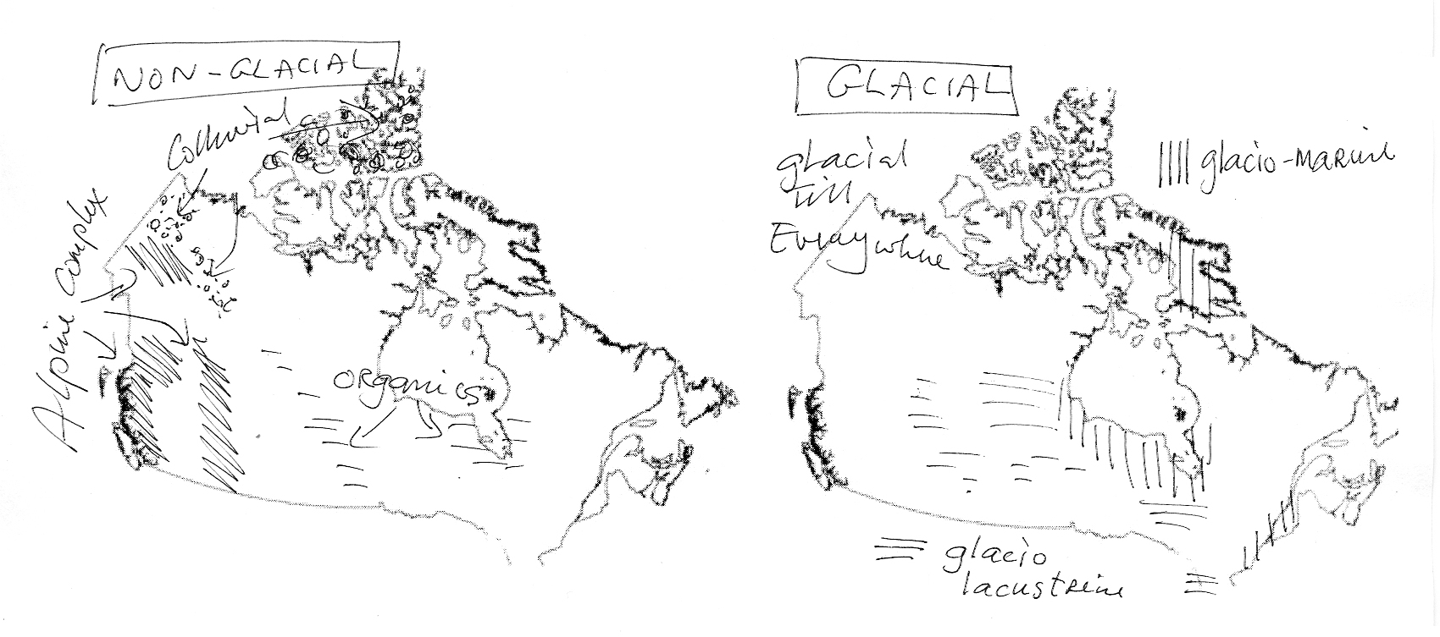
Parent material: non-glacial deposits
Alpine Complex deposits (mix of past glacial and post-glacial erosion/deposition in Cordillera)
Alluvial deposits: (e.g. MacKenzie River Delta)
Colluvial: Yukon and High Arctic
Organics – MB and James Bay regions

Slide 19
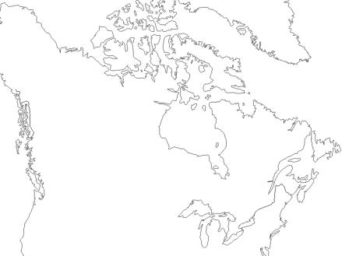
Soil-forming factors 2: Climatic conditions
Temperature
Precipitation
Low
Medium
High
Long term climate patterns act upon the available parent material at surface to
develop Canada’s soil types and regions over long periods of time.

Slide 20
Climate + Biology
Temperature + Precipitation
Absolute values, ranges, variability
Macro-biology (Vegetation, Fauna)
Micro-biology (Bacteria, Cyanobacteria, Fungi)

Slide 21
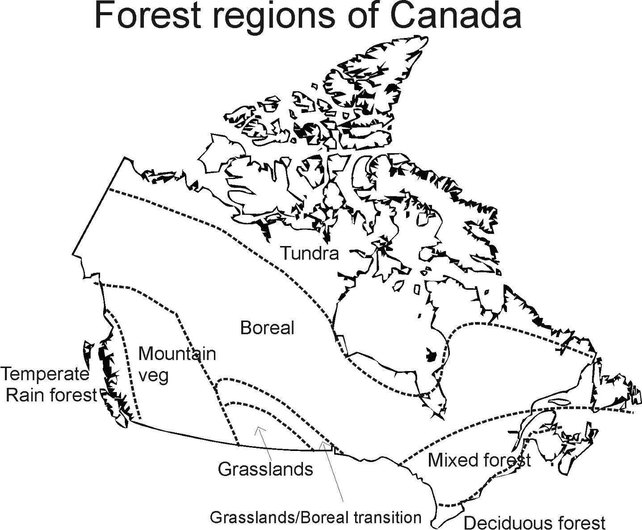
Soil-forming factors 3: Biology (regional + local)

Slide 22
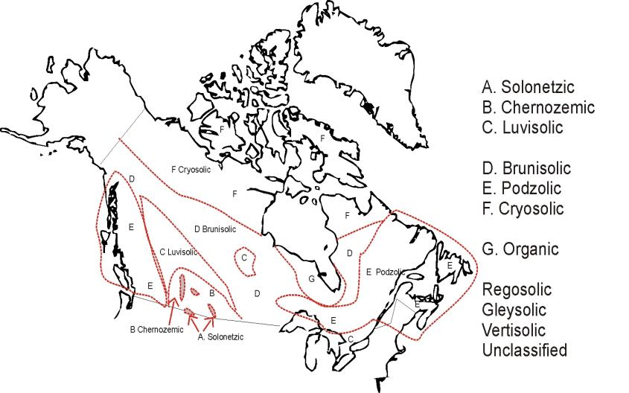
Soil Orders
of Canada
Agriculture and Agri-foods Canada, 2012

Slide 23
Influence of Biology: regional scale
Matching patterns of forests and soils
Influence of Biology: local scale
Soil Profile of black spruce stand, Alaska
Soil Profile of aspen stand, Alaska

Slide 24
Soil-forming factors 4: Relief (local)
Topography
Drainage
Erosion
Examples of where these might be important?

Slide 25
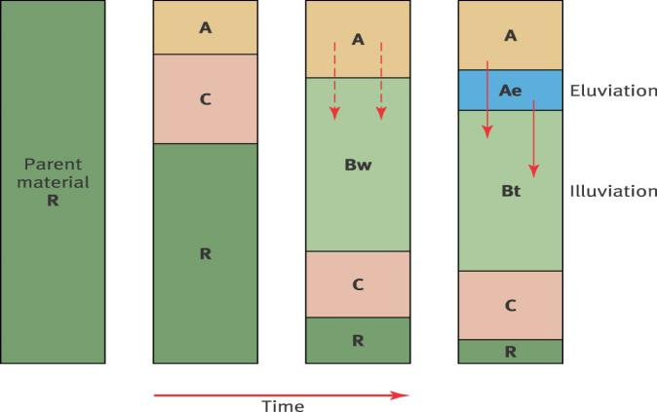
Soil-forming factors 5: Time
How long has Canada had?
... creation of ...
  Primary minerals
  Secondary minerals
  Horizons
When did the ice melt?
w = white
t = clay
e = eluviated

Slide 26
Age of soil depends where you are!
~6 ka for Labrador
~10 ka for Shield
~12 ka for Prairies and Cordillera
~14 ka for ice-free corridor

