Slide 1
Canada’s Periglacial Regions
Periglacial landscapes:
regions where frost action is dominant and freeze-thaw action drastically modifies the ground surface
too dry for glaciers
1/3 Earth’s terrestrial surface
unique landforms
permafrost common

Slide 2
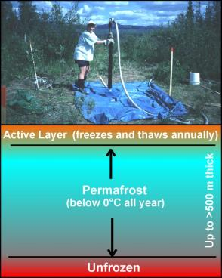
Permafrost:
where earth materials (e.g., soil, rock, sediment) are cryotic (below 0ºC) for longer than a year
ground temperature will range between 0º and -20º C
~25% of Earth’s non-glaciated terrestrial surfaces
Features of permafrost:
Active Layer (summer thaw layer, 1-3 m deep)
Permafrost table (top of frozen layer)
Permafrost (frozen layer; usually up to ~500 m deep, can be up to 1500 m)
Unfrozen sub-permafrost
Smith, GSC

Slide 3
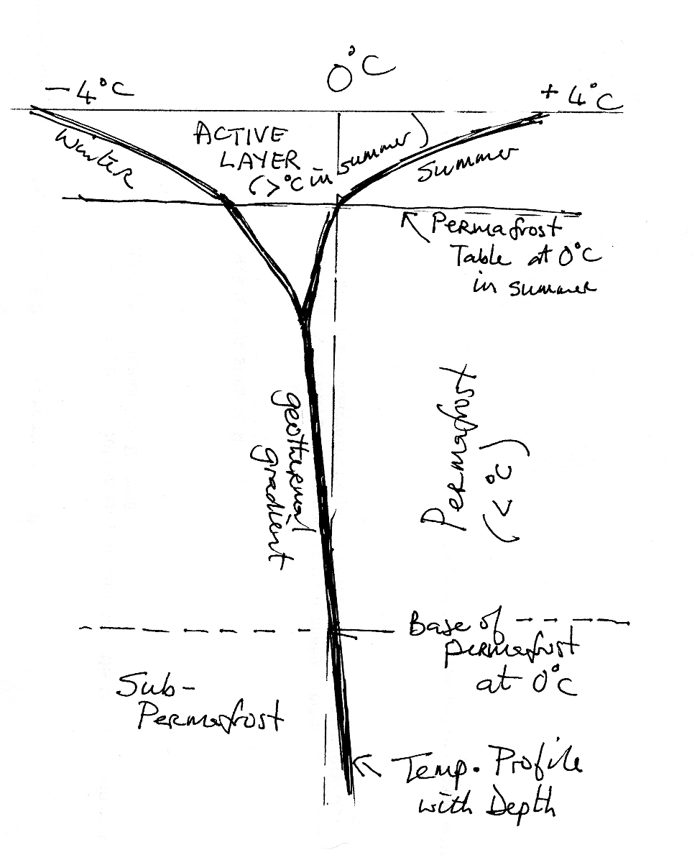
Active Layer
Permafrost table (at 0 C in summer
Permafrost (< 0 C)
Sub-Permafrost (> 0 C)
Active Layer goes through an annual ‘Freeze/Thaw’ cycle
Temp. profile with depth
How does permafrost develop?
Energy balance: in balances out
In = solar from above, geothermal from below
Out = longwave radiation to space
At equilibium pfrost base is where geothermal heat = loss to atmosphere

Slide 4
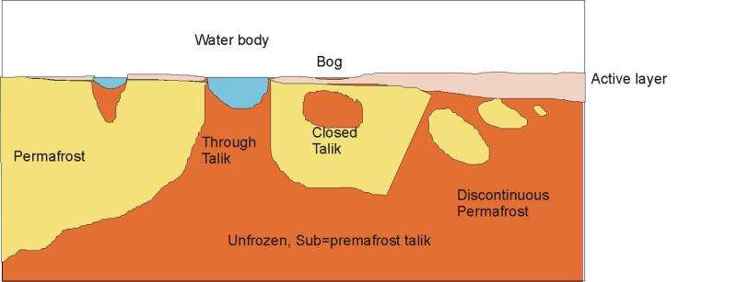
Change in thickness with latitude, N →S transect
N →S permafrost gets shallower
N →S active layer gets thicker
N →S continuous in north, discontinuous in south
Drained lake bed
Active layer only ~10 cm in Ellesmere Island
Active layer ~200 cm in south
Talik = unfrozen zone within permafrost

Slide 5
Types of permafrost:
Continuous (no major breaks)
Discontinuous (many breaks)
Sporadic (small islands of permafrost in unfrozen region)
Isolated
Alpine (high elevation)
Subsea (frozen sediments beneath seawater)
How does permafrost develop?
How does subsea permafrost develop?
Energy balance: in balances out
In = solar from above, geothermal from below
Out = longwave radiation to space
Not in equilibrium with conditions of today! (under water cannot be <0º)
Developed when coastal plain was exposed
At equilibium pfrost base is where geothermal heat = loss to atmosphere

Slide 6
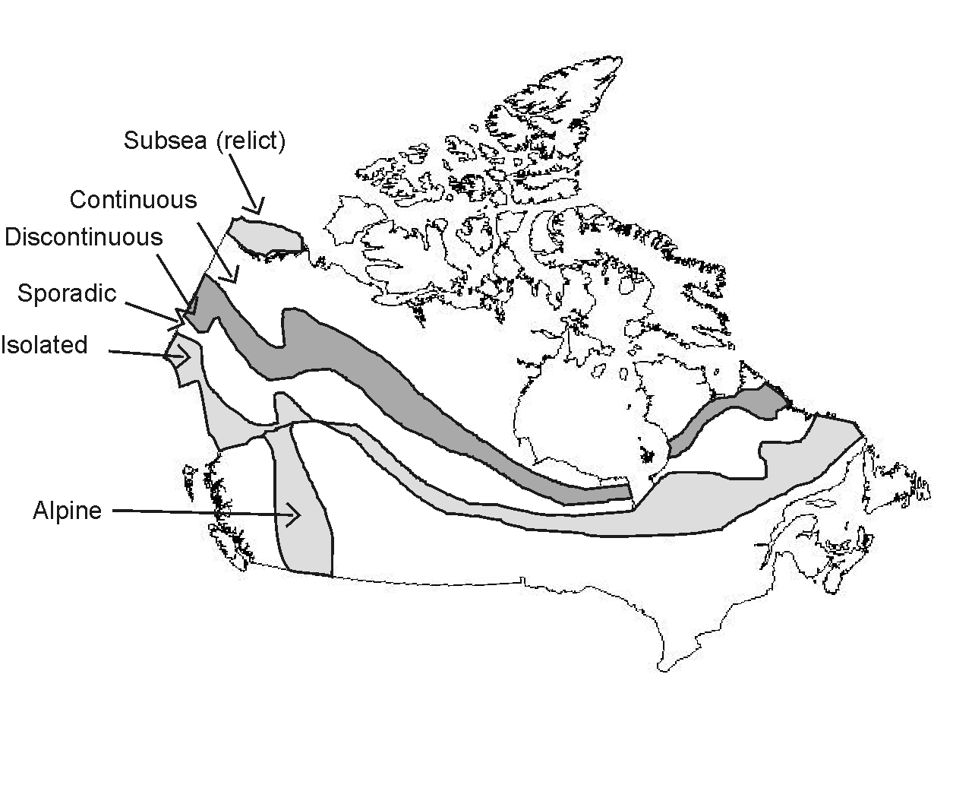
Permafrost distribution in Canada
permafrost covers >50% of the Canadian landmass
southern limit of continuous at mean annual surface air temp of ~-7ºC
southern limit of discontinuous at mean annual surface air temp of ~-2ºC

Slide 7
Features of permafrost landscapes
1. Frost shattering ( Critical temp for frost shattering -4 to -15ºC, slowest cooling rate best)
- creates blockfields (felsenmeer)
2. Ground ice
- pore ice (disseminated in soil)
- ice wedges (in vertical cracks)
- segregated ice (in horizontal layers of pure ice)

Slide 8
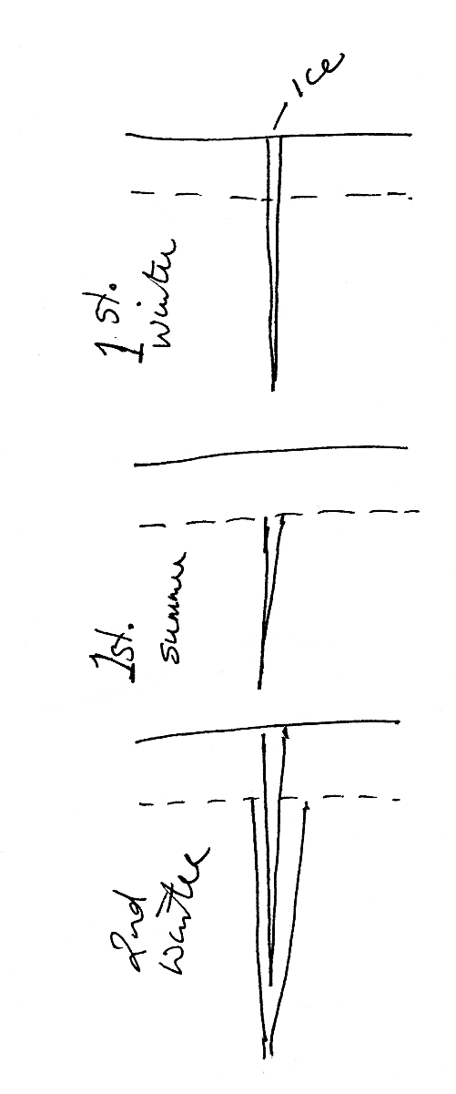
Ice Wedges
- underlie patterned ground (ice-wedge polygons)
Ice wedge cast, Norfolk, UK, evidence for former periglacial climate

Slide 9
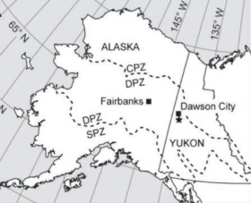
Interesting discovery in Canada about wedge ice!
Ice wedges preserved under several metres of volcanic ash
Date on ash 700,000 years old
Oldest known piece of ice in North America
Survived many warm stages (eg, two interglacial ages: 125,000 and 430,000 years ago)
Dominion Creek, Yukon
This is being used as evidence that global warming will not cause big impacts. What is wrong with this argument?
Science 19 September 2008

Slide 10
2. Ground ice (contd.)
Segregated ice (and heave)
Eg, Segregated ice lens exposed by slumping, Tuktoyaktuk, NWT
- lenses of almost pure ice, grow by capillary attraction of soil water to freezing front.

Slide 11
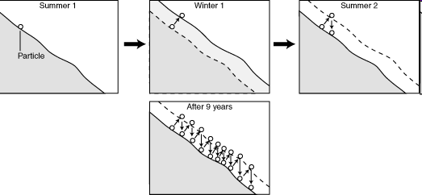
Features of permafrost landscapes
3. Mass movement
- frost creep
geol.umd.edu

Slide 12
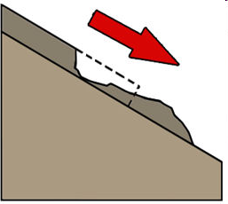
3. Mass movement
- solifluction
Downward movement of saturated active layer
Requires only ~2º slopes!
5-100 cm per year
Creates step-like lobes and terraces
Risers ~0.5 – 15 m high
Treads ~10 – 500 m long
myfundi.co.za
Eg, Solifluction lobes near Valdez, Alaska

Slide 13
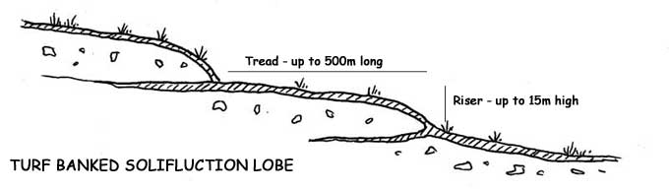
Vegetation controls type and rate of movement
1. Continuous mat of vegetation makes “turf-banked” solifluction lobe
Veg + soil rolled under
2. More veg = less movement
Greatest movement on N- and E-facing slopes
http://cgz.e2bn.net/e2bn/leas/c99/schools/cgz

Slide 14
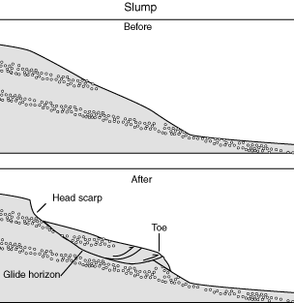
3. Mass movement
thaw slumping (often retrogressive)
Eg, Retrogressive thaw slump on Selawik River, Alaska
geol.umd.edu
Retrogressive thaw slump in action, Herschel Island, Yukon
http://www.youtube.com/watch?v=4ncJLCaIGEg
http://www.youtube.com/watch?v=drodbH7L8b0
Eg, Large retrogressive thaw slump, Peel River Canyon, Yukon

Slide 15
3. Mass movement
- active layer failure (exposes permafrost table)
Eg, Active layer detachment, nr Whitehorse
3. Mass movement
rock glaciers (not enough snow to create ice glaciers, often on rain shadow side of mts.)
Rock Glacier Trail
Yukon, south of Haines Junction, Kluane National Park
Eg, Atlin rock glacier, Alaska
Selwyn Mts, Yukon: mean velocity of 9 rock glaciers: 0.20 m/yr

Slide 16
Features of permafrost landscapes
4. Unique landforms
- patterned ground
- various ice-cored mounds (eg, palsas)
- pingos
Eg, Stone circles on Melville Island, Northwest Territories
Eg, Pingos near Tuktoyaktuk
Eg, Emerging palsa in a fen bog near Churchill, Manitoba

Slide 17
Permafrost
... and northern communities
... and global warming
Permafrost is an important feature of the northern landscape

Slide 18
Presence of permafrost and ground ice presents challenges to northern development
presence of permafrost and thaw settlement/frost heave considered in design of infrastructure
Foundation design for permafrost environments
Utilidors
Warming and thawing of permafrost can lead to instabilities in the landscape that can have implications for ecosystems and northern development
Ice-rich soil
Unstable ground
Frost heave
Thawing of massive
ice
Thawing of ground ice and thermokarst terrain
techniques used to preserve infrastructure integrity
Adaptation techniques required to preserve frozen ground

Slide 19
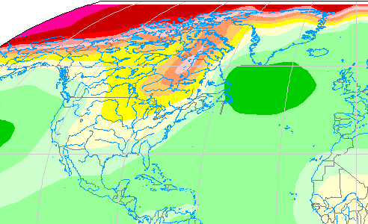
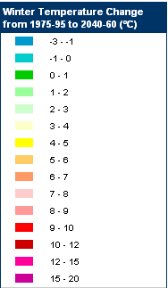
Climate Change: predicted temperature at ~ 2050
Impact of global warming on permafrost?
Northern coast: Winter temp 9-10 ºC higher!
Gt. Lakes: Winter temp 4-5 ºC higher!
Images from Sharon Smith, GSC

Slide 20
A significant portion of the permafrost region of Canada is underlain by permafrost warmer than -2°C
so v sensitive to small changes
Impact of global warming?
much of this warmer (>-2°C) and thinner permafrost may ultimately disappear in response to climate warming
where permafrost is thicker and colder
  active layers may thicken
  permafrost may become thinner

Slide 21
Canadian Permafrost Monitoring Network (1995)
Provides long-term field observations
Key variables:
  permafrost thermal state
  active layer thickness
Mainly Mackenzie Valley
http://gsc.nrcan.gc.ca/permafrost/pdf/pf_indicators.pdf
GSC

Slide 22
Trends in Permafrost Temperature
0.1°C per decade
0.3°C per decade
Source: S Smith, GSC

Slide 23
Net temperature change over 18 years at 10 m depth
Mackenzie Valley South of Norman Wells
Average increase 0.45°C
From Smith et al. 2005

Slide 24
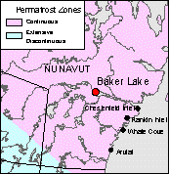
Baker Lake Thaw Depth
General increase in thaw depth since 1997
Images from Sharon Smith, GSC

Slide 25
What happens as a result of these temperature rises?
Ground settlement
Positive feedback temp rise
Ground instability
Exacerbated by fire

Slide 26
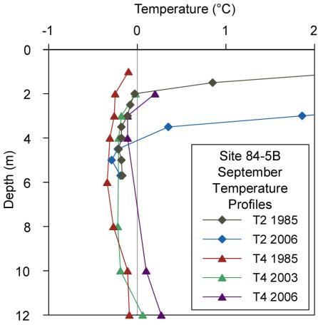
Effect of clearing a pipeline right-of-way on ground temperature?
Thawing beneath ROW related to clearing during pipeline construction
Recent thawing off-ROW due to burning of vegetation and organic layer
T4
T2
Sept. 2007
Images from Sharon Smith, GSC

Slide 27
Effect of pipeline right-of-way on settlement?
ongoing settlement on-ROW
may have settlement off-ROW following fire
Source: S. Smith, GSC

Slide 28
Effects of slope instability?
Tundra sites – Parsons Lake
Slump
Slumping leads to disturbance of surface and vegetation
Change in surface conditions results in warming
Upland
Source: S. Smith, GSC

Slide 29
Effects of fire?
Removal of vegetation removes insulation → warming
Burning of surface → destruction of organic material/topsoil
84-5B Sept. 2003

Slide 30
Implications: Now, Short and Long Term
Now: many permafrost
terrains are already affected
(eg, landslides in NWT)
Short-term (decades): will
likely see significant
structural instability of
terrain throughout
the current permafrost
regions of Canada
Long-term (centuries):
recall ‘TIME’ factor in soil development – changes in soil type will not occur overnight
  Inuit will not be farming wheat any time soon
  However, significant habitat changes are likely to occur

Slide 31
Relative changes in active-layer thickness predicted for 2050
Northern coast & Arctic Islands: > 50% thicker
Discontinuous pfrost: . 20-30% thicker

Slide 32
Why is permafrost important?
Frozen ground and the ground ice it contains influences surface and subsurface hydrology, ecosystems and human activity
  its behaviour depends on physical properties including ground ice content and thermal condition
Northern development and land use decisions require knowledge of permafrost conditions
  engineering design
  environmental impact assessment and development of mitigation strategies
Assessments of impacts of climate change on natural and human systems
  development of adaptation strategies
  improve models leading to better prediction of future conditions
  assessment of changes in carbon cycle and feedbacks to climate system

Slide 33
Finally ...
Focus topic for Canada’s Periglacial regions.
Clathrates!
Methane deposits trapped under permafrost

Slide 34
What is a “clathrate”?
Molecular lattice of one material (eg, H₂O) enclosing molecule of second type of material (eg, methane, CH₄)
Conditions for creation?
Methane and water form crystals under ...
1. High compression ... Eg, in deep ocean
2. Cold temps ... Eg, frozen water-ice-methane beneath permafrost
Properties?
Looks like ice
Floats on water
Melts easily
Burns!
Methane clathrate (“methane hydrate”): methane molecule in centre of “cage” of water molecules

Slide 35
Clathrates in Canada?
Methane hydrates: Mallik gas hydrate field in Mackenzie Delta.

Slide 36
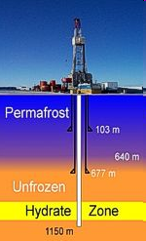
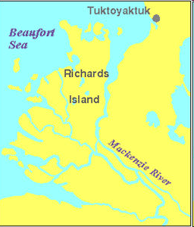
Mallik methane hydrate field, Mackenzie delta
Frozen methane trapped in crystal structure, in 10 layers of Tertiary sands, under 600 m of permafrost
Site of extensive research and technical development on permafrost gas hydrates
1971-72: discovered
1998: research well drilled
2002: first production test 1200 m deep well (released methane with heat)
2008: test project (released methane by lowering pressure
http://en.wikipedia.org

Slide 37
Sample test questions on periglacial
Why is Canada’s permafrost so susceptible to the effects of global warming and what are the likely effects? 6 mks
Much of the permafrost is warmer than -2°C which is the southern limit for discontinuous permafrost … so already it is very close to edge of ability to maintain pfrost.
Active layers will get thicker
Thin pfrost may disappear in southern regions
Thick pfrost may get thinner
Ground settlement – more thaw lakes
Ground instability – more mass movement
Positive feedback temperature rise
One effect is that plants will grow better!
Possibly more fire because of the greater biomass available.

Slide 38
What are the types of ground ice in permafrost regions? 3 mks
Pore ice
Wedge ice
Segregated ice
What techniques have been used to mitigate permafrost damage in human development projects in the Canadian arctic? 3 mks
designing foundations eg on stilts, to preserve pfrost,
above-ground utilidors to carry services
oil pipeline on stilts/racks to keep it above pfrost + heat conductors to dissipate heat of flowing oil to air, rather than to ground

Slide 39
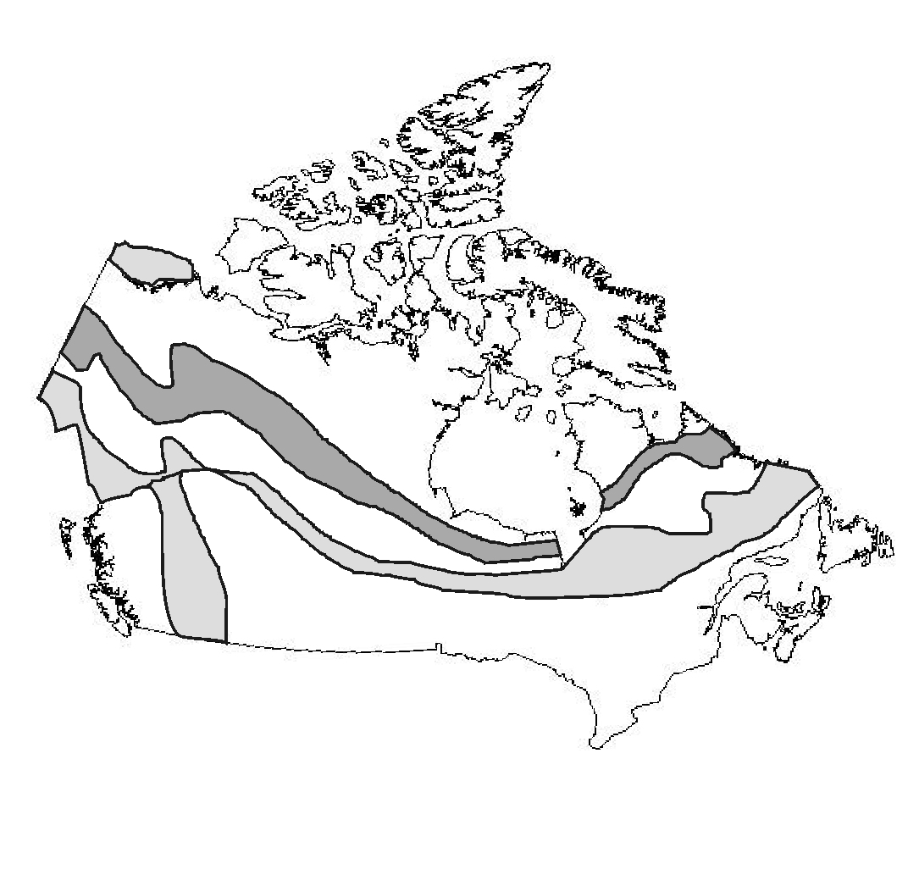
Fill in this table listing the types of permafrost shown on the map of Canada. 5 mks
D
A Alpine
B Discontinuous
C Continuous
D Sub-sea (relict)
E Sporadic
F Isolated
B
C
E
A
F

