Slide 1
Glacial deposits
A. Till (characteristics)
B. Moraines (eg, Ground moraine, End moraine)
C. Drumlins (sub-glacial flood theory of formation)
Glaciofluvial deposits
Outwash plain
Esker
Outwash delta/fan
Glaciomarine deposits
Glaciomarine clays

Slide 2
Terms used for glacial deposits
  Till: glacial material deposited directly from ice
  Erratic: single clast of glacial origin
  Moraine: landform made of till (may contain glacio-fluvial)
A. Glacial Till
Characteristics of glacial till
Unsorted (‘boulder clay’)
Non-laminated
Often angular
Clasts of non-local origin

Slide 3
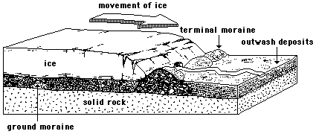
B. Moraines (eg, Ground moraine, End moraine)
Ground moraine
Often called “Till Plain” or “Hummocky moraine/ground” or “Hummocky Disintegration Moraine”
small rolling hills
boulders
kettle lakes (prairie “potholes” )
geographyhigh.connectfree.co.uk
Ground moraine: undulating plain of material laid down under ice (“lodgement”) & melted from top of ice (“ablation”)
Disintegration moraine: hummocky chaotic topography made up of ground moraine from stagnant ice

Slide 4
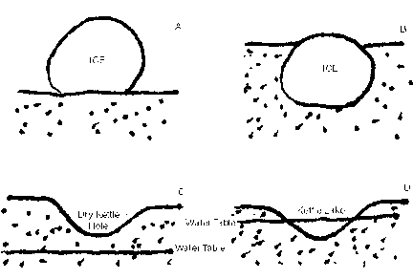
Eg, Ground moraine, Newfoundland
Bouldery ground moraine,
Topsails Plateau, Newfoundland.
Eg Hummocky Ground/Disintegration moraine, Duck Mountain, Manitoba
Kettle holes/lakes
geo.sunysb.edu
Notes:
4

Slide 5
Hummocky disintegration moraine, Saskatchewan, Alberta
Eg, Hummocky moraine, south of Cypress Hills, SW Saskatchewan, made up of “knob-and-kettle” topography
Eg, Hummocky moraine topography: kettle holes and irregular hills (hummocks) near Lethbridge, Alberta

Slide 6
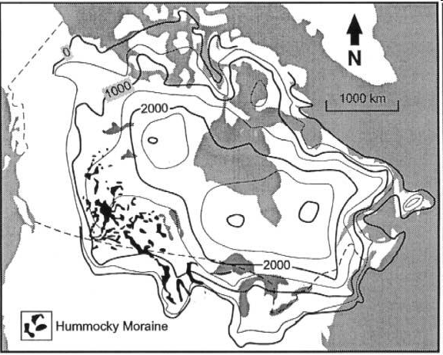
Hummocky moraine distribution in Canada
Mainly the Prairies
libwiki.mcmaster.ca

Slide 7
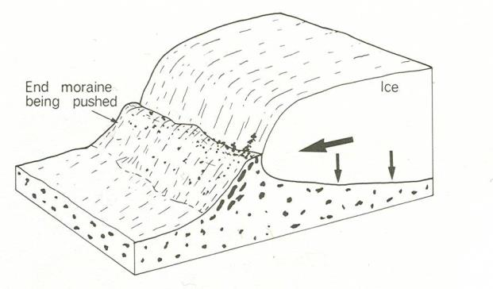
End moraine:
deposited at snout, either terminal or recessional
Eg, End moraine of cirque, steep angle of repose in coarse material. BC.
End Moraine, Recessional Moraine, Push Moraine
Material is pushed by ice or dragged along base,
Left in series of stacks and ridges
Glacial till at terminus of Athabasca Glacier, BC. Unsorted, angular, small push ridges from annual winter re-advances. Ice-cored in patches.
Fig 15.19 f, Glaciers and Glaciated Landforms, M.J Selby, 1985

Slide 8
End moraine (terminal or recessional)
Eg, Terminal moraine, southern Bylot Island, west of Aktineq Glacier, Nunavut..
Eg, Push moraine of Glacier C79, Bylot Island, Nunavut.
Eg, South Axel Heiberg Island
Icefall, small regenerated glacier and “remarkably large set of terminal moraines” (northwest of Steacy Icecap; July 23rd, 2008)
Eg, Small push moraines in front of Thompson Glacier, Canadian Arctic. Overall retreat, small winter re-advances

Slide 9
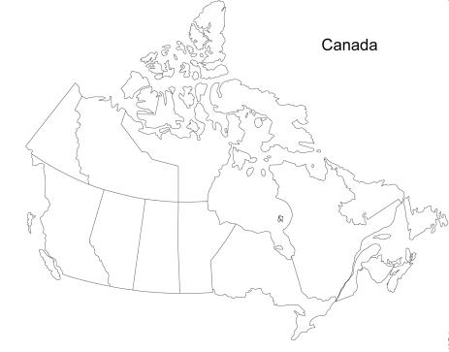
Push (“Thrust”) moraine, The Dirt Hills and Cactus Hills, Saskatchewan: “most defined and biggest …glaciotectonic hills of the world”! (Aber 2007)
(just south of Moose Jaw)
7.5 km wide, 120 m high, 40 km long
Ice lobe repeatedly pushed forward, caused crumpling, etc.
Large-scale thrust faults within moraine

Slide 10
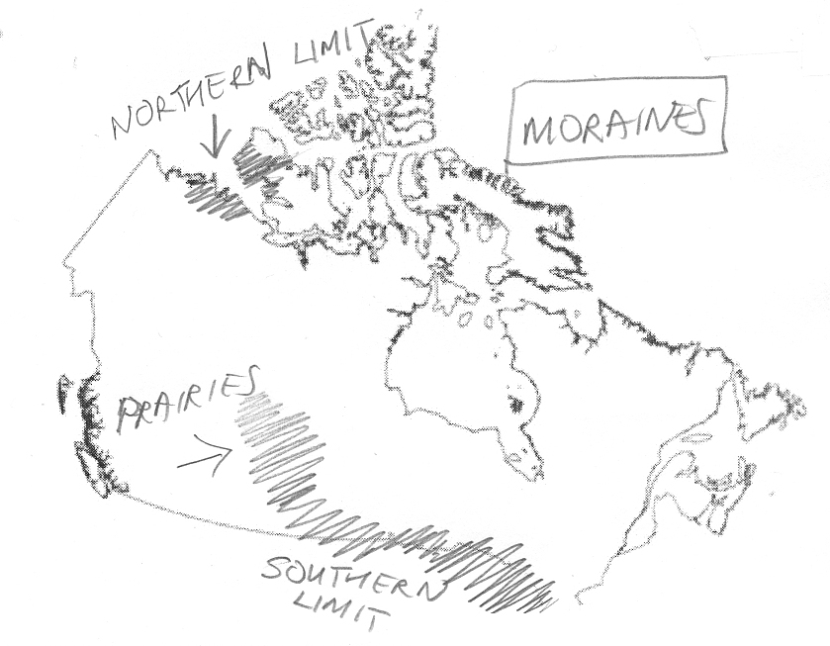
Distribution of moraines from Laurentide Icesheet
Northern limit
Prairies: mainly push and hummocky moraine
Southern limit

Slide 11
Major recessional moraines from Laurentide ice in the Great Lakes Region
Inter-lobate moraine: Oak Ridges Moraine, north of Lake Ontario
Local scale only: Lateral moraines
Typical of valley glaciers, piedmont, and outlet glaciers
Large ones result from recurring glacial advances
Composed of unstratified, unsorted till

Slide 12
C. Drumlins
elongate hills, regularly spaced in swarms, streamlined
of variable composition (depositional, sometimes erosional)
grade into crag and tail features (mainly erosional)
Eg, Drumlin, southern Nova Scotia: stoss or blunt end at front; tapered end points away, in the direction of glacier flow
Eg, Drumlins, Peterborough, Ontario
Eg, Livingstone Lake, N. Saskatchewan
Cool video clip
https://macwiki.mcmaster.ca/clip/index.php/Main/DistributionWithinCanada

Slide 13
Glacial origin or Glaciofluvial?
Did drumlins form from sub-glacial catastrophic floods?
Proposed mechanism:
Release of meltwater from Lake Aggassiz
Sheet flow underneath ice sheet
Evidence supporting theory:
Streamlined forms similar to water-flow forms
Ripple-like features in association with the drumlins
Diverging fan-like flow patterns
Arguments against theory:
requires melting from below
discharge not likely to remain as sheet flow, but would be channelled
in some places flow is out from the sea .
Eg Livingstone Lake drumlin field, Saskatchewan.

Slide 14
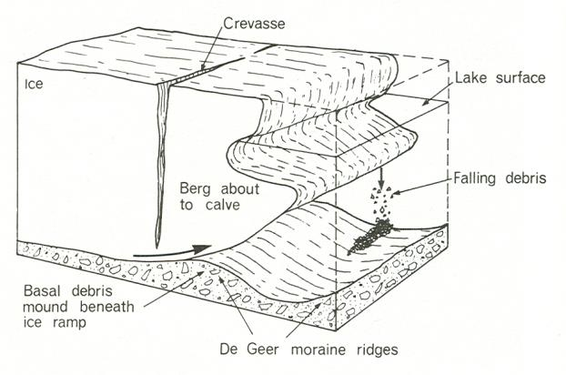
Extra: De Geer moraine
Ribbed moraines: moraines that mark retreating ice front, each year a little further back. De Geer moraine is one example
Fig 15.19 e, Glaciers and Glaciated Landforms, M.J Selby, 1985

Slide 15
Eg, De Geer moraine, just east of Hudson Bay, northern Quebec
Offshore example!
Digital elevation Model of De Geer Moraines, Southwest of the coast of Nova Scotia
Canadian Landform Inventory Project

Slide 16
Outwash plain:
area of stratified deposits (sorted materials) in front of the terminal moraine
Source of material: glacial deposits
Process of deposition: fluvial
Characteristics that are same as fluvial: sorted, layered, rounded
Characteristics that are different from fluvial: provenance not all local
Eg, Outwash plain in front of Berg Glacier, BC, Mt. Robson Provincial Park
Eg, Outwash plain in front of Thompson Glacier, Axerl Heiberg Island.
Eg, Outwash plain, Peyto Glacier, Alberta, and moraine-dammed lake (braided streams carrying glacial debris)
.
Notes:
16

Slide 17
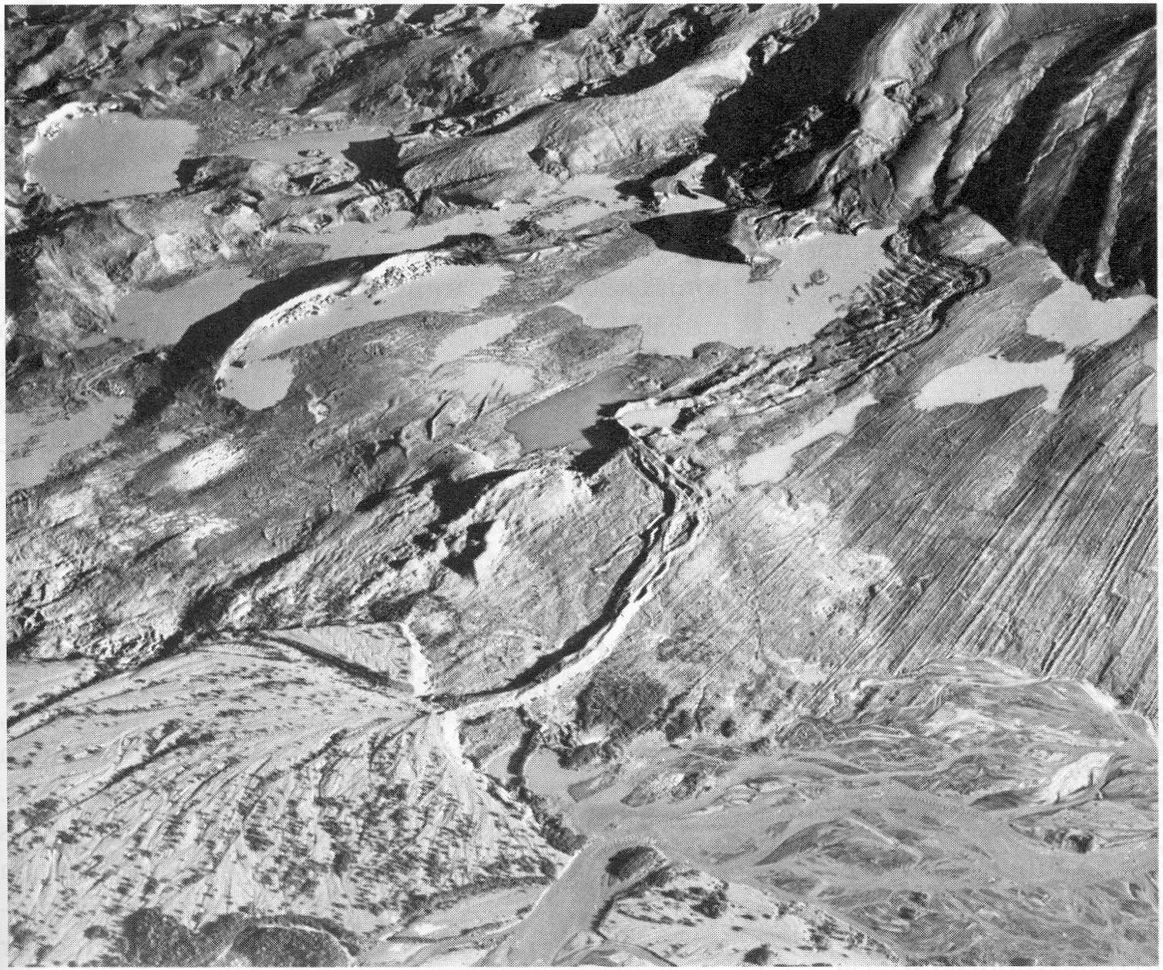
Eskers
Kames, kettles,
eskers,
fan/delta
(Alaska)
Figure 15.27, Understanding the earth systems, Frank Press & Raymond Siever (2nd Ed.), 1998.

Slide 18
Eg, Esker deposits exposed, Arrow Hills, Manitoba (composed of sand & gravel, stream-laid beds)
Eg, Complex Esker, Liard R. BC
The Thelon Esker (east of Great Slave Lake)
The largest in Canada
“A sand esker system on the Thelon River region as seen from the air - these sandy areas offer major migratory paths for the barrenland caribou herds, and perfect den conditions for wild wolves and assorted fox. - photo copyright Glen Grambo”
http://www.thelon.com/graphics/campesker1.jpg

Slide 19
Outwash delta: Parrsboro, Nova Scotia
Glacio-fluvial deposition of outwash delta
Sequence of events:
Glacier in Parrsboro Valley
Outwash delta in front
Ice retreat
Isostatic rebound
Meltwater streams cut into deltas
Lateral migration of streams formed terraces
Carved into 4 levels, from isostatic uplift and meltwater rivers cutting into delta

Slide 20
Features of the outwash delta: Kettles and Kames
Leak Lake, a kettle, dated to ~15,600 yrs BP from wood at base of lake sediments.
What does this date tell us?
Latest possible date of ice retreat
Hummocky kame and kettle terrain. Ice edge was north of Leak Lake.
Sequence of events
~14 ka: Delta growing outwards, top of steeply-dipping beds = former sea level, beginning of isostatic rebound
~12.5 ka: Accelerating rebound, delta becomes dissected
<5 ka: Most of the rebound has finished, terrace dissection stops, relative sea level rises (slowly)

Slide 21
Case Study: glacio-fluvial fan deposit, Renfrew, Ontario
Processes:
Meltwater river emergent from ice front into lake
Spreads out into fan shape
Deposits sorted laminated beds of sands/silts/clays
Also has varves (annual couplets of coarser= summer melt and fine = winter lake freeze)
Cross bedding (evidence of fluvial current )
Ripple units (evidence of fluvial current )
Varves (annual couplets) = evidence of frozen lake

Slide 22
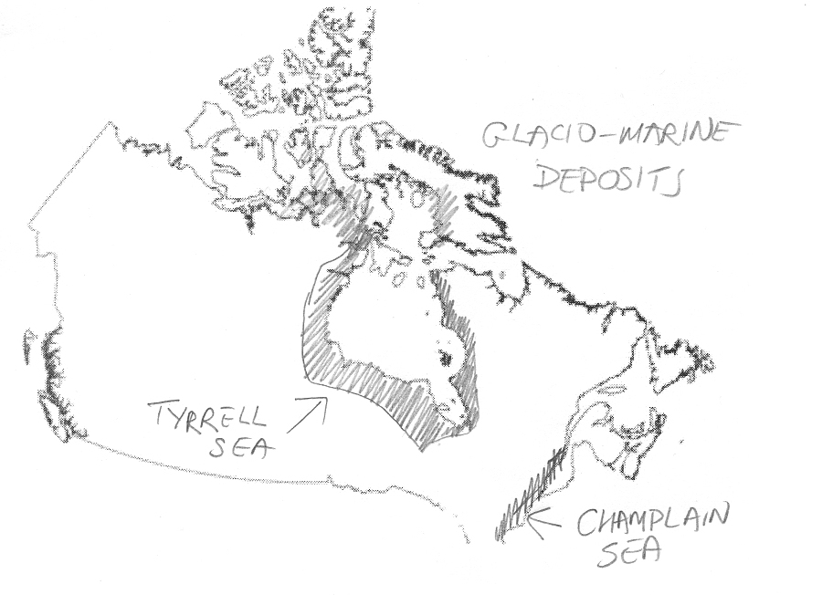
Glaciomarine deposits
Typically: Blue-grey silty clays, often “quick”
Tyrrell Sea
Champlain Sea
8000 years ago, Tyrrell Sea

Slide 23
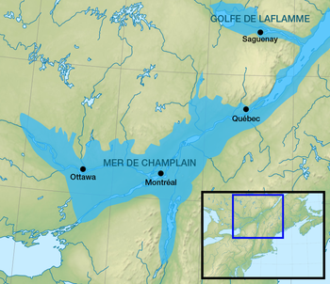
Champlain Sea clays
~13-10 ka marine inundation of Ottawa-St. Lawrence valley
Competition: rate of isostatic rebound v post-glacial sea level rise
Evidence:
Marine clays – “Leda” clays
Marine fossils
Old shorelines
Leda clay = “quick” sensitive marine clays (on disturbance tend to change behaviour from solid to liquid consistency)
en.wikipedia.org
Lots of landslides in the Leda Clays, from Arnprior (west) to Hawkesbury (east)
Eg, Quick clay failure, retrogressive slide, St. Jude, north of Montreal. 11th May 2010

Slide 24
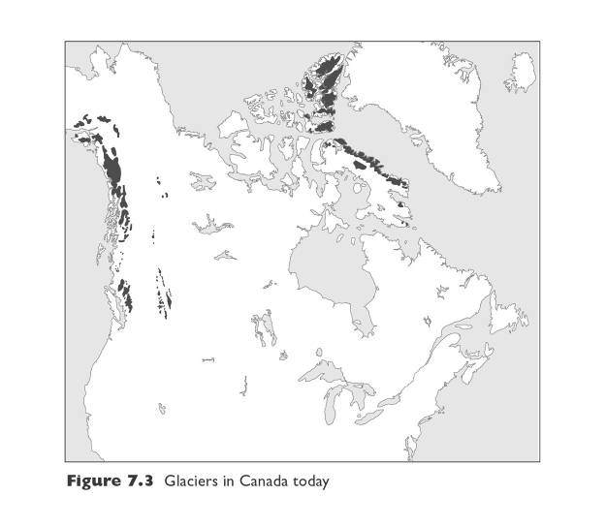
Sample test questions
The map shows the distribution of modern ice in Canada.
a) What is the general control on development of the snow line and glacial ice? 2 mks
Ice develops as result of balance between temp and precipitation. OR balance of accumulation and ablation … incoming snowfall versus melting.
b) For Arctic Canada, explain why some areas have ice and some do not. 4 mks
Lower temperatures related mostly to latitude, less to elevation. So, arctic islands ice obviously = cold conditions. Source of moisture from nearby Atlantic ocean.
Absence of ice in other parts of arctic because much of arctic is low precipitation, Arctic Sea is poor source of moisture, being frozen mostly.
No ice in Labrador because not high enough elevation … just an elevated plateau, not a highland.

Slide 25
c) For Western Canada, explain why some areas have ice and some do not. 4 mks
Low temp related to elevation. Snow line is at higher elevation further south, lower elevation further north.
Ice on western side = Coastal Mts. and Rocky Mts. Coast = lots of precipitation and high elevation. Rain shadow effect operate on Rocky Mts … but still enough precip gets past rain shadow. Snow line is at higher elevation inland compared to coastal zone (balance of accumulation to ablation greater here)
Possible point: further north summer is shorter, so less ablation

Slide 26
One way of classifying glaciers is on Ice Temperature: Polar Glaciers and Temperate Glaciers. What do these terms mean and what are the difference between polar glaciers and temperate glaciers? For each give an example from Canada. (Fill out the table below) 8 mks
 | Polar Glaciers | Temperate Glaciers
Definition | ice below its pressure melting point | ice close to its pressure melting point
Characteristics | not restricted to high-elevations, usually continental icesheets typically unconfined by topography | high-elevation only (alpine glacier) tend to be "confined" by topography
Example | eg, Barnes Ice Cap, Penny Ice Cap, Devon Ice Cap, Bylot Island Ice Cap. Glaciers of Arctic Islands. | eg, glaciers of BC and Alberta, Athabasca, Peyto, St. Elias Mts, Kluane Mts., Salmon, Kaskawulsh

Slide 27
Explain why there is differential isostatic uplift in Newfoundland and discuss the effect on the fiords of the island? 3 mks
Differential uplift because the centre of uplift (from Laurentide icesheet) was to west of Newfoundland. Western side uplifted more than eastern side. Effect on fiords was to tilt the western ones upwards, lifting the lip above sea level and filling the fiord with fresh water rather than sea water.
What is the main area of hummocky moraine in Canada? 1 mk Prairies
Mark on this blank map of Canada the main glaciomarine deposits of the Tyrrell Sea and the Champlain Sea

