Slide 1
GEOG 2020 Final Exam
Saturday, Dec 21st 09:00 hours
(sorry … horrible time!)

Slide 2
Canada’s Glacial Landforms
The impact of ice on the Canadian landscape

Slide 3
Modern Ice
Continental/Polar Glaciers (ice sheets/caps/domes)
  processes
  landforms
Alpine/Temperate Glaciers (cirque, valley, fjord glaciers)
  processes
  landforms
  Quaternary Ice
  Glacial geomorphology of Canada
    Glacial erosion
    Glacial deposition

Slide 4
GLACIER: a mass of ice formed largely from atmospheric precipitation which is capable of moving under its own weight
GLACIOLOGY: the science of natural ice in all of its diversity
GLACIAL GEOMORPHOLOGY: the impact of glacial action on the landscape
Aside: useful website .. Canadian landform Inventory Project

Slide 5
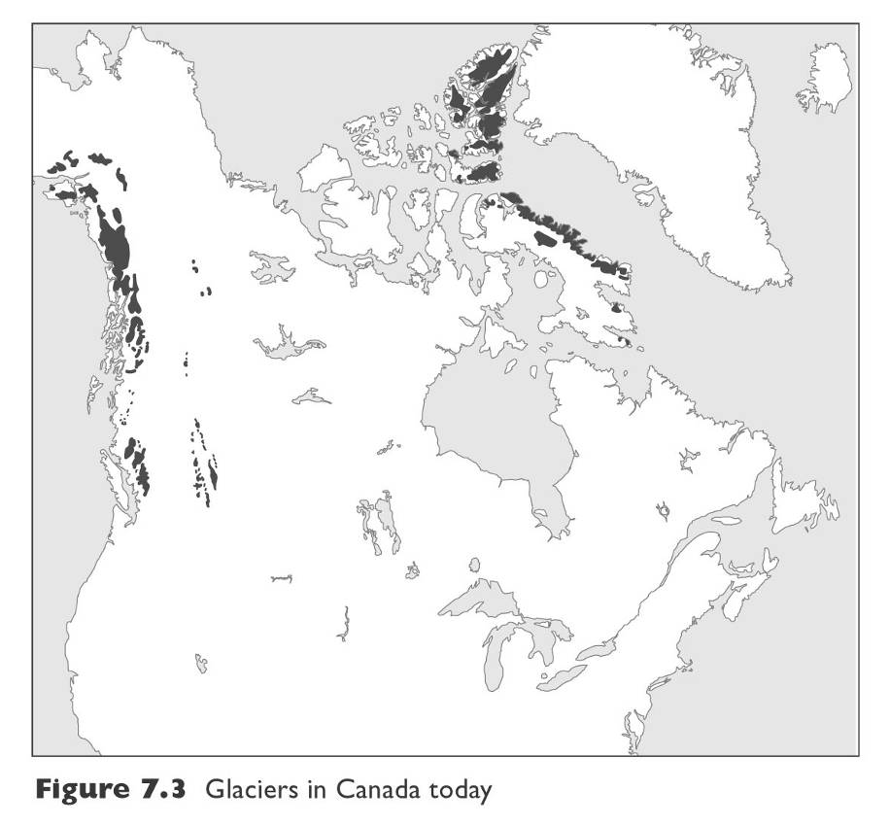
Modern ice
Close to glacial conditions still ...
Glacial ice in Canada today
a) Coastal region
b) Rocky Mountains
c) Arctic region
Fig 8.5 Trenhaile

Slide 6
Occurrence of glaciers controlled by …
  Temperature
    Latitude
    Elevation
  Precipitation
Eg, Athabasca Glacier, Alberta
Eg, Salmon glacier, Stewart, BC to Alaska

Slide 7
Glaciers and Ice Sheets in Canada today
a) Coastal region
-S.W. Yukon – St Elias Mountains
Icefield Ranges
-Coast Mountains of BC
b) Rocky Mountains
-Rocky Mountains of BC/Alberta and Yukon/NWT border
c) Arctic region
-Barnes & Penny Ice Caps – Baffin Island
-Devon Island
-Ellesmere Island and islands of the Arctic
Archipelago
Fig 8.5 Trenhaile
Why are the Rocky Mts. glaciers smaller than the Coast Mts. Glaciers?
Why are there no glaciers in the farthest north?
Why are the glaciers in the Rocky Mts. at higher elevation than the Coast Mts.?

Slide 8
Classified by scale/size
Two basic types of glaciers:
  1) “Continental” (or “Ice Sheet”) - high latitudes
  2) “Valley” (or “Alpine” or “Mountain”) - high elevations
Eg, Ice Sheet on Ellesmere Island
Eg, Kaskawulch Glacier, Kluane National Park

Slide 9
Classified by ice conditions (ice temperature)
Two basic types of glaciers:
Polar Glaciers
b) Temperate Glaciers
Polar Glaciers (below pressure melting point)
      not restricted to high-elevations
      typically unconfined
    So usually continental icesheets
Usually cold-based (frozen to base, not much sliding)
Eg, Barnes Ice Cap, Penny Ice Cap, Devon Ice Cap
Eg, Bylot Island ice cap with outlet valley glaciers
Contains relict ice from Laurentide ice

Slide 10
Classified by ice conditions (ice temperature)
Two basic types of glaciers:
Polar Glaciers
b) Temperate Glaciers
Temperate Glaciers (close to pressure melting point):
      high-elevation (alpine glacier)
      tend to be confined by topography
    So usually alpine valley glaciers
Usually warm-based (water film at base, slide easily)
Eg, Glaciers of BC, Alberta
Eg, Athabasca Glacier, Peyto Glacier: Jasper-Banff National Park
Compare with cold-based: eg, John Evans Glacier, Ellesmere Island, Canadian High Arctic

Slide 11
Alpine/Temperate Glaciers (cirque, valley, fjord glaciers)
Ice in mountainous region
  partial submergence of bedrock topography
  flow is governed largely by topography
Canada has more alpine glaciers than any other country in the world
Major role in shaping landscape by erosion and deposition
Important interplay with slope processes
Major water and power resource
Source of hazards - outburst floods and ice avalanches

Slide 12
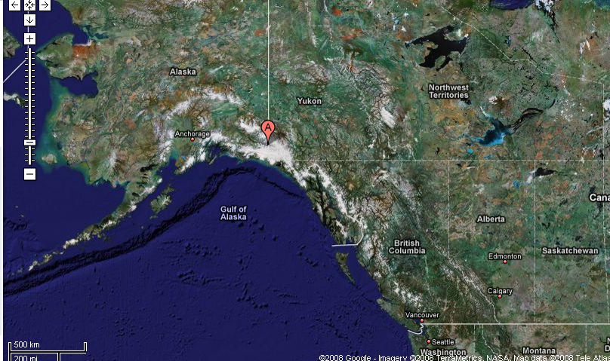
Examples: Kluane Mts. (Canadian side) and Wrangell – St. Elias Mts. (US side)
Mt Logan
Glacier Bay

Slide 13
Characteristics of Alpine Glaciers
Valley Glaciers …
Occupy rock-walled troughs
Troughs form dendritic patterns
Eg, Dendritic network (on border of Wrangell Mts. And Kluane Park)
Icefields …
high level basins surrounded by peaks that feed valley glaciers
Partial submergence of bedrock topography (nunataks)
Eg, Columbia Icefield, BC

Slide 14
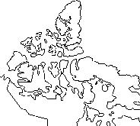
Tidewater Glaciers …
Reach sea level
Terminal regions may float
Iceberg calving becomes an important mass loss process
Eg, Tidewater glacier, Hayes Fiord, Ellesmere Island
Eg, Tidewater glacier, Royal Society Fiord, NE Baffin Island
Eg, Glacier Bay, Alaska

Slide 15
Features of glaciers
A. Mass balance + effect of global warming in Canada
B. Movement + example of surging glaciers in Canada

Slide 16
A. Mass balance and the effect of global warming on Canada’s glaciers
Ablation zone, equilibrium zone, Accumulation zone
Rate of movement and rate of replenishment?
Contributes to “mass balance” of glacier

Slide 17
Mass balance of glaciers (ice in v. ice out)
= accumulation v ablation
Controlled by?
Controlled by?
Precipitation
(especially snow)
Temperature
(especially summer)
Ice Flow rate
Positive mass balance = net gain = accumulation > ablation
Negative mass balance = net loss = ablation > accumulation

Slide 18
Changes in mass balance over time?
eg, Athabasca glacier, Alberta
Images from 1939, 1966, 1993, 2012
No real data on rates of retreat!
Rough estimate: 1939-1966 ~1000m = 37 m /yr
1966-1993 ~200 m = 7m/yr
1993-2012 ~190 m = 10 m /yr

Slide 19
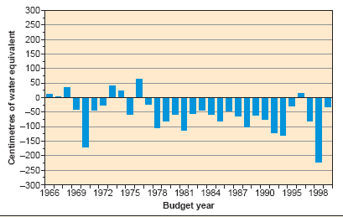
Eg, Peyto Glacier: Jasper-Banff National Park
Peyto Glacier Loses Ice
Mass Balance:
Early 1900s to recent

Slide 20
B. Glacier movement and surging glaciers of Canada

Slide 21
GLACIER MOVEMENT:
Moves under its own weight (so thicker = faster)
2. Moves by plastic flow (all ice) and basal sliding (only warm-based ice)
Rates of movement:
  Normal (eg, 500 m/yr)
  Streaming – within ice sheets, ice flow focused into linear outlet channels (none today in Canada, important in past
  Surging – periodic changes in rates of flow (eg, 5000 m/yr)

Slide 22
Example of Streaming Glacier: (none today in Canada)
Byrd Glacier, Antarctica
24 km wide, 160 km long, rock-floored ice stream
streams through deep valley in the Transatlantic Mountains and into the Ross Ice Shelf
flow rate ~800 m/yr

Slide 23
What Is a Surging Glacier?
Rapid flow over a short time (active stage) followed by long periods of no movement (quiescent stage)
Maximum velocities 10x more than quiescent stage
During active stage ice is moved from upper area (reservoir) to the snout (ice-receiving)
Active and quiescent cycles usually consistent, but every surging glacier has their own cycle length
Amount of ice in accumulation zone affects surging
4% all glaciers are surging glaciers
Temperate and cold glaciers both are subject to surge
Glaciers of surge type appear to occur mostly on sedimentary rocks

Slide 24
Surging Glacier Example
St. Elias Mountains, Alaska-Canada border.
Eg, the Malaspina Glacier, a piedmont outlet glacier (pto).
Eg, Hubbard Glacier. dammed Russell Fiord between 29 May and 8 October 1986. When the ice dam failed, an enormous glacier-outburst flood (jökulhlaup) discharged into Disenchantment Bay

Slide 25
Features of surging glaciers?
Ice structures formed during quiescent phases are deformed
Looped medial moraines
intense folding on surface
Thrusting (shear) in the ice occurs at the surge front
heavy surface crevassing
high + fluctuating surface velocities
rapid terminus advance (eg, few km’s in few months)
large amounts of melt water released
Thrusting/Shear: upstream ice overrides downstream ice
Internal shear planes dip upstream
Moving ice over-rides obstruction
Frozen to base or debris-laden

Slide 26
Example of glacier that surges slowly!
Trapridge Glacier (Yukon Territory, just north of Mt Logan)
~50 years per cycle: 1951-2005 for one cycle
The 1951 image shows the glacier in an expanded state following a major surge in the 1940s.
The 1968 images shows the glacier greatly diminished by melting in its lower regions and with few open crevasses.
The 1977 images shows the formation of a wave-like bulge as the glacier "reloads" for its next surge.

Slide 27
Surging Glacier Distribution in North America
Surging glaciers of Northwestern highlands and coast: St Elias mountains, Alaska range, Wrangell mountains
Alaska Range
Wrangell Mts.
St. Elias Mts.

Slide 28
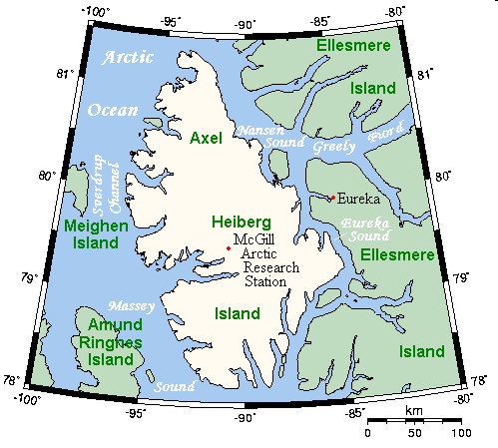
2. Surging Glaciers of the Canadian High Arctic
51 surging glaciers identified!
Most dramatic example: some glaciers on Axel Heiberg Island advanced 4-7 km in 40 years
Eg, Iceberg glacier,
Good Friday Bay glacier, Airdrop glacier
Distribution of the 51 studied?
All over the place!
http://en.wikipedia.org

Slide 29
Iceberg Glacier on Axel Heiberg Island
Iceberg Glacier 1997-2008
curved medial moraines indicate irregular inflow of tributary glaciers, probably associated with surges (Aug. 24th, 1977).

Slide 30
Distribution of surging glaciers in North America?
Maritime to continental and temperate to subpolar environments
No particular type of glacier, size of glacier, topography, bedrock
No faults, earthquakes
So .. Why?
Maybe abnormal geothermal heat flow?
Unusual bedrock permeability?

Slide 31
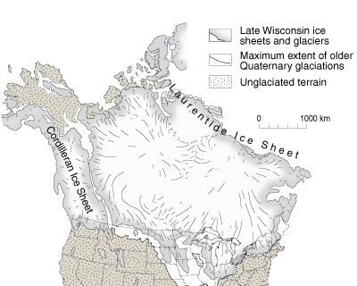
Quaternary ice
Quaternary ice sheets of Canada
http://www.isgs.uiuc.edu/maps-data-pub/publications/geonotes/geonote3.shtml

Slide 32
Geomorphological effect of glaciers:
Erosion (Ice-sheet erosion, Valley glacier erosion)
Deposition (Glacial deposits, Glaciofluvial, Glaciomarine)

Slide 33
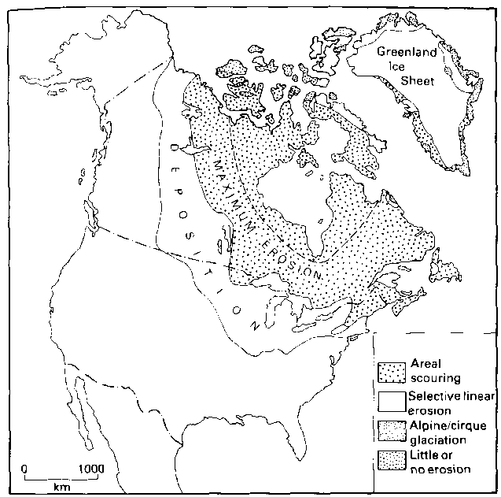
Pattern of glacial erosion and deposition from Laurentide Icesheet
Scour of Canadian Shield
Moraine complex of US-Canada border

Slide 34
Features of Ice Sheet Erosion
Differential erosion of geological planes of weakness
Rock basins
Rounded topography
Erosional flutes and grooves
Streamlined forms (eg, whalebacks, roches moutonées, crag-and-tail)

Slide 35
Differential erosion
Eg, Great Slave Lake
Eg, Glacially scoured remnant of Canadian Shield rock, dykes more resistant.
What do you need to get differential erosion?
Rounded topography
Rounded topography from ice-sheet scour, St. Lawrence
What do you need to get rounded topography?

Slide 36
Roche Moutonée – erosional feature of ice sheets and valley glaciers
Compressing flow, HP, abrasion
Ice
Extending flow, regelation, plucking
Joint-poor zone
Joint-rich zone
Bedrock
Streamlined forms
Eg, Streamlined forms, crag-and-tail NWT

Slide 37
Features of Valley Glacier or Outlet Glacier Erosion
Cirques, Hanging valleys, Pyramidal peaks/horns
U-shaped valleys/Glacial Troughs
Overdeepened and irregular long profiles
Fjords
Where in Canada would you expect these?

Slide 38
Cirques
Occupy armchair shaped hollows in bedrock
Overlooked by headwall
Cirques feed into valley glaciers
Cirque Glacier cross profile
Equilibrium line
Headwall and headwall crevasse
Terminal moraine and lip
Cirque floor

Slide 39
Eg, Small cirque in retreat, obvious trim line and former terminal moraine forming lip, headwall not very steep (sedimentary rocks, BC).
Eg, Hanging valley, Mt. Edith Cavell, Jasper
Eg, Athabasca Glacier emerging from Columbia Icefield; cirques
E, Horn or pyramidal peak: Mt. Columbia, Alberta (+BC border, Columbia Icefield)

Slide 40
Glacial Trough: over-deepened valley of U- or parabolic cross section, usually following former river valleys, straight in plan (truncates spurs), irregular long-section, often with lakes.
Eg, Glacial trough, BC: influence of rock strength and bedding
Eg, Glacial valley with finger lake, Peyto Lake, Jasper-Banff, BC (may be moraine dammed)
Eg, Paternoster lakes, Baffin Island

Slide 41
Equilibrium line and basins (thick ice): rotational flow
Headwall: crevasse
Upstanding bars (thin ice)
Snout and Terminal moraine
Glacial trough in long section

Slide 42
Fjords
Ice floats on water, thinner ice, no erosion, deposition only
Ice in valley: Normal glacial over-deepening
Water
Grounding line, boundary of glacial over-deepening and deposition
Water
Over-deepened glacial valley, drowned
Lip, grounding point

Slide 43
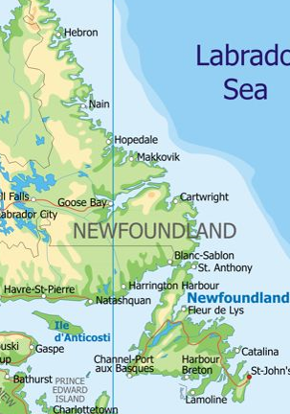
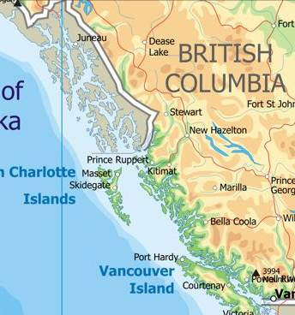
Fiords in Canada? West coast, East coast, Northern coast!
www.canadamaps.info/provincemaps

Slide 44
Complicated by isostatic rebound!
Eg, The Canon Fjord, Ellesmere Island
Eg, Glacier Fiord, Axel Heiberg Island
Eg, Rawlings Bay, Ellesmere Island, fiord, showing shallow part at lip, traps the floating ice
Eg, Southern Ellesmere Island, Grise Fiord in centre. Lip = shallow, interior = deeper.

Slide 45
Impact of isostatic uplift
In Arctic uplift began ~ 10 ka
Emergence of coastal regions ... Eg, to 123 masl in Northern Ellesmere Island.
Created series of outwash deltas, each successively inset beneath older deltas & each gullied as base level lowered, creating badlands
Impact on fiords ... Bottom of fiord now exposed!
Best eg, Western Newfoundland
Western Newfoundland (fjords cut off from the sea, worst on side facing Laurentide ice): Trout River Pond, Western Brook Pond

Slide 46
What about erosion under streaming ice?
Lots! + rapid!
Shield
Example 1: Last glacial maximum - Evidence of large ice stream over Great lakes, 800 km long, 250 km wide
Escarpment
Flowed from Shield to south, over Niagara escarpment and Lake Huron
Eyles 2012

Slide 47
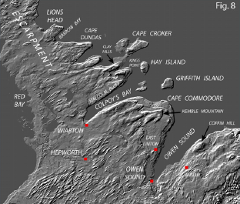
Produced huge streamlined forms in rock
Indicates rapid erosion
Eg, “promontories” in the escarpment, facing up-glacier and re-entrant valleys
Eg, swarms of rock drumlins
Eg, mega-grooves and mega-flutes around resistant rock mounds
Eyles 2012

Slide 48
What about erosion under cold-based ice?
Not so much!
Example 1: Modern cold-based ice, Ellesemere Island
Outlet Glacier From Small Ice Cap, Head of Canon Fiord: After readvancing during the mid-20th century, this glacier is now receding. It overran the outwash terrace on the left, but did not disturb the loose gravel because the ice is "cold-based", meaning the glacier is frozen to its bed and does not slide.

Slide 49
Example 2: Quaternary cold-based ice, Nova Scotia
“Saprolite”: chemically weathered rock
South Mountain Batholith, Nova Scotia has undisturbed saprolites underneath glacial till
Eg, Weathered saprolite underlying till, Sammys Barren, Nova Scotia
Wahl 2007, Atlantic Geology 43

