Slide 1
Canada’s
Biomes

Slide 2
What controls vegetation?
Climate
Precipitation
Light (canopy cover)
Temperature
2. Soils
Nutrients
Air
Water
(Glacial history)
3. Topography
Availability of moisture (precipitation, drainage)
Availability of radiation
Slope – stability of ground
Altitude (temperature)
4. Quaternary history
Deposition
Erosion
  Glaciers erased pre-glacial vegetation (except from 2 areas – S. Prairies & Beringia)

Slide 3
What is a biome?
• Large (global patterns), stable, terrestrial ecosystem characterized by a specific plant and animal communities
• Named after dominant vegetation (6 broad biomes):
  forest
  savanna
  grassland
  shrubland
  desert
  tundra
Canada’s 5 Biomes
Midlatitude Broadleaf and Mixed Forest
Needleleaf Forest and Montane Forest
Temperate Rain Forest
Midlatitude Grasslands
Arctic and Alpine Tundra
3
Controlled by rainfall and temperature
Notes:
3

Slide 4
BIOMES: rel. with temp. and precip.
(Boundaries = ecotones)
32
HOT
Desert
Tropical rainforest
24
Grassland
Temperate forest
Temperate rainforest
16
Mean annual temperature (°C)
Getting drier …
1.Temperate rain forest
2. Midlatitude broad-leaf & mixed forest
3. Grassland
Getting colder …
4. Needle-leaf forest
5. Arctic & Alpine Tundra
8
Coniferous forest
0
Arctic and alpine tundra
-8
-16
COLD
500
1000
1500
2000
2500
3000
3500
4000
Mean annual precipitation (mm)
DRY
WET

Slide 5
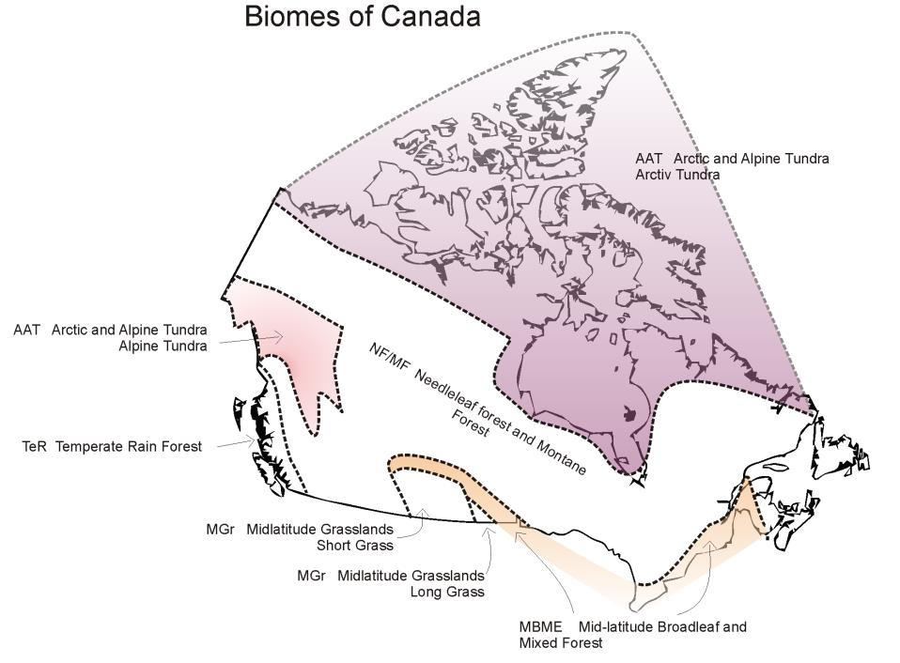
Notice anything about this boundary?

Slide 6
Canada’s Vegetation regions: (quick summary)
Arctic & Alpine tundra – very cold and dry; herb, shrub
(Subarctic – cold winters, dry warmer summers; shrub tundra –forest, boreal forest & barrens)
Needleleaf forest & Montane Forest – cold, dominant summer precipitation; boreal forest & grass
Midlatitude Broadleaf and Mixed Forest – range in temperature, moist all year, mixed forests
Midlatitude Grassland – dry, great range of temperature; prairie
Temperate Rain Forest – wet, relatively warm, smaller temp range, elevation differences, coasts

Slide 7
Temperate Rainforest
Affected by latitude and altitude: 2 zones
1. (Northerly) Perhumid rain forest: Western red cedar, Sitka spruce, western hemlock; eg, Vancouver island
What might change?
2. (Southerly) Seasonal rain forest: Douglas fir, Western red cedar, Sitka spruce, Western hemlock; eg, Haida Gwaii
Climate
Temp (at low elevations): all mean monthly temperatures above 0ºC
Precip: winter maximum precipitation (Oct-Apr) from cyclonic storms, summer drier
Snow minor
Fog important

Slide 8
Vegetation characteristics
Canopy: dominated by conifers
Hardwood trees common (eg, Bigleaf maple & Alder) – these provide N fixing
Understorey: Lush diverse understory – broadleaf shrubs, ferns, moss, lichen
Lots of Epiphytes
Floor covered with thick layer of detritus + undergrowth
Huge trees (>80 m tall, diam 30 m)
Many v old, >1000 years

Slide 9
Support the most productive forests in Canada
Western hemlock
Western red cedar
Douglas fir
Hemlock and Sitka spruce more to north
Douglas fir, Western red cedar more at coast
Why are the trees so large?
Fire rare
Result: Amount of biomass may be x4 an equatorial rain forest!

Slide 10
Arctic Tundra
Dominated by cold air masses (warmest month <10ºC)
Low precipitation (bare ground in winter)
Soils have continuous permafrost
Highly asymmetrical energy input (long days summer, no days winter)
Greatly shortened growing season (60 – 80 days)
High winds
(Arctic = North of tree-line)
Climate

Slide 11
Vegetation characteristics
Plant life is strongly conditioned by the severe environments
Roots subject to constant freeze-thaw + very shallow active layer
Grasses and sedges form tussocks (dead leaves etc. provide protection -reduce wind, limit energy loss + comp for water supply)
Grow close to the ground (out of wind, warmer temps)
Patchy distribution/coverage
Leaf out occurs rapidly (short growing season)
Dominant: vascular species (herbs, shrubs, sedges)
Dwarf forms common

Slide 12
High Arctic
(Arctic islands; most extreme env)
reduced floristic diversity
reduced % cover of vegetation
herbaceous life forms dominant
lichens, mosses, cushion plants
distribution controlled by frost action (patterned ground)
High Arctic, NWT:
Sparsely vegetated - Saxifrage and arctic willows
Lots of bare regolith, patterned ground
In extreme cold, only mosses and lichens survive – may go dormant for many years

Slide 13
2. Low Arctic
(Mainland, north of tree line; less extreme)
increased floristic diversity
increased % cover of vegetation
more dwarf shrubs + herbaceous life forms dominant
not so much patterned ground
nearly complete plant cover
a) Tussock tundra
Northern part of low arctic
Height of the plant canopy: 20-40 cm
Numerous sedges, lichens, mosses
Peat tussocks in tundra, Churchill, Manitoba, part of the poorly drained coastal lowlands of northern Manitoba.
Tussocks = grassy, organics + mineral soil

Slide 14
Effect of elevation?
Same as latitudinal effect
Upland sites: vegetation is discontinuous or absent; dominated by herbaceous plants, mosses and lichens
Lowland sites: poorly drained; almost a continuous cover of herbaceous plants, bog cotton, peat moss

Slide 15
b) Shrub Tundra
Southern part of low arctic
More shrubs, more biomass
Height of the plant canopy: 30-60 cm
Dwarf forms; eg, alder, birch, willow
Deciduous habit
Heaths, sedges, lichens
Heaths: eg cranberry, Labrador tea
May be v. old

Slide 16
Alpine tundra:
High elevation, high winds, extreme temperature ranges
Water supply problem (steep slopes = rapid drainage)
Many are succulent (store meltwater)
Some use taproots, (for water + food storage; eg 2 m deep!)
Response to constant wind?
Krummholz form (asymmetry)
Krummnolz patterns in dwarf spruce and fir trees (best growth in shelter, leading edge dies)

Slide 17
Subarctic Zone
Between the southern limit of shrub tundra and northern limit of the closed crown continuous coniferous forest (boreal)
Includes the latitudinal tree line
Climate not as extreme
Northern part:
scattered individual trees
groves alternating with shrub-tundra
forest-tundra
Southern part:
more extensive/continuous trees cover,
generally open-crowned
Black and white spruce dominate

Slide 18
Treeline:
Trees at their physiological limits
Often cannot produce seeds
Spread vegetatively
V sensitive to aspect
V sensitive to soil conditions

Slide 19
How does treeline respond to climate warming? a) May change reproductive strategy
  Normal reproduction: Vegetative growth, very slow
  “Mast event”: = huge seed-production following warm dry summers. If followed by a few years of above-average temperatures, seedlings germinate and grow
  Causes sudden rapid shift in treeline
Kluane Ranges of the St. Elias Mountains in Yukon, Canada; spruce tree lines jumped as many as 85 meters in elevation on some slopes during the 1900s - only S-facing slopes
How does treeline respond to climate warming?
  b) May be limited by fire
  Fires destroy seed banks, and alter the seed bed
  May limit ability of treeline to move
  May change dominant species
Most tree-line species not fire-adapted
Why not?

Slide 20
Needleleaf, Boreal Forest
Cold, long winters
Cool, short summers
East-west gradient
Climate
Big annual temp range (-30°C to 15°C)
Temps rise quickly in summer
Frost-free season lasts about 50-100 days
Growing season: 5 to > 6 months (more to south)
Long day length in summer compensates for short growing season
www.worldexposure.com/taiga/advocacy/index.html

Slide 21

Temperature
Winter: cold, dry polar and arctic air mass
Summer: replaced by warmer air mass from Pacific
Timing of replacement? west first, then east
Result? west-to-east delay of growing season + extension further south of the boreal and arctic zones in eastern Canada (about 1000 km further south)
Winter, cold dry Polar/Arctic air
Summer, warm Pacific air

Slide 22

Precipitation
Gradient: W to E: less in W, more in E. Typically < 500 mm in W, 800-1200 mm in E
East: lots of deep snow, stays all winter
  Why? mid-latitude cyclones in E, not imp in W in winter
Arctic/Polar
air, cold, dry
Less Rain
More rain
Mid-latitude cyclones

Slide 23
Vegetation characteristics
Coniferous: retain needles for several years (except tamarack/larch)
Begin photosynthesis as soon as temperatures rise (none of the growing season lost as new foliage develops)
Xeromorphic features (drought –resistant)
  Reduced area of the leaves (restricts transpiration; water is unavailable from frozen soil)
  Shrunken stomata (pores)
  Waxy leaves and buds
Rates of photosynthesis only moderate (eg, lower than deciduous hardwood)
Temp requirements: 10-20ºC
Conifers have low-light requirements for photosynthesis (helps growth in the spring)
Frozen ground limits water supply, stomata close, prevent CO₂ entry
In some species, photosynthesis is maintained in the winter

Slide 24
Vegetation characteristics
Conifers = dominant species
Remarkably homogenous
Remarkably few species
Dominant coniferous species:
White and black spruce
Jack Pine
Tamarack
Balsam fir
Dominant deciduous species:
White birch
Trembling Aspen
Balsam poplar

Slide 25
Effect of climate?
Lower temp and lower precip have similar effect
Fewer species
Reduction in vegetation height
Reduction in canopy closure
Change in species distribution
eg, Fir limited to eastern part (lower tolerance for drought), spruce more widespread
Where geographically?
North (lower temp) + west (lower precip)
Effect of Fire?
A natural feature of coniferous forests
Every year, ~ 0.6% of forested area burns
Natural fires are typically preceded by rainless periods of at least 1-2 weeks + high temperatures, low humidity and lightning storms
Average interval between fires: ~ 60 yrs (but variable)

Slide 26
Forest response to fire:
Conifers usually survive low intensity fires, but are killed when fires are large
Thick bark resists low-temp fires
Adaptation to fire is principally through seed production
Serotinous cones – bonds sealing the cone melt at high temp, releasing seed which can withstand temps up to 370ºC
Serotinous cones of Jack Pine, opened after fire

Slide 27
Midlatitude Grasslands
Semi-arid, particularly dry autumn periods
Extreme seasonal variation: mean monthly temperatures -20 to +20ºC
Extreme continental climate results in large soil moisture deficits, particularly late summer
Why not autumn?

Slide 28

Precipitation:
Recurring drought - only 350 to 500 mm precipitation
Greatest precipitation in early summer when cyclonic systems pass through the region
Supplemented by convectional showers in the summer
West to east gradient of increasing precip (also S to N, and lowland to highland)
West to east gradient of increasing reliability of precip

Slide 29
Effect of precipitation gradients?
Increase in height eastwards: Short Grass – Mixed Grass – Tall Grass
Increase in diversity eastwards
Ecotones (next map)
  Dynamic ecotone with the mountains and deserts to the west
  Dynamic ecotone with the eastern deciduous forests to east and north

Slide 30
Species Tall-grass Prairie
Dominants:
Big bluestem
Little bluestem
Indian grass
Switchgrass
Species Mixed-grass Prairie
Dominants (highest diversity):
Needle-and-thread grass
Western wheatgrass
Species Short-grass Prairie
Dominants:
Blue grama
Buffalo grass

Slide 31
Farming the grasslands:
Much of this ecozone and the “parkland” ecozone to the north was cultivated (except a few small parks).
Only 1 percent of the tall-grass remains; half of the short-grass is uncultivated; unproductive cropland is being put back to grass.
Much of the grassland species distribution has been altered to provide more palatable plants for grazing
Grasses typically account for < 20% of the species present at any site but > 90% of the biomass
Invasive exotics
Eg, leafy spurge (Euphorbia esula) an aggressive perennial, accidentally introduced into the USA from eastern Europe or western Asia
Eg, Japanese brome grass Bromus japonicus often competes with native grasses

Slide 32
Midlatitude Broadleaf and Mixed Forest
Eastern temperate zone
Mixed coniferous-deciduous forest + temperate deciduous
(Deciduous + Great Lakes and St. Lawrence)
Merges with boreal across a broad northern band
Temperature is the main factor in the change from predominantly coniferous to deciduous forests
April to November have average annual temperatures above zero
July temperatures > 18ºC
Precipitation from 700-1200 mm spread uniformly throughout the year.

Slide 33
Vegetation characteristics:
"Deciduous" means shedding at end of growing season
deciduous habit = drought avoidance adaptation (evolved in dry subtropical regions)
Water demand is reduced by shedding leaves during dry seasons
Species are almost always mixed together
  broad range of groupings based on latitude
    eg, hemlock not as far north as sugar maple

Slide 34
Vegetation characteristics contd.
Lots of variation!
Most common Species:
eastern hemlock
yellow birch
beech
sugar maple
white pine
white oak
red pine
red maple
basswood
elm
aspen
hickory

Slide 35
Effect of soil?
Soil fertility in this region is high
Widespread clearing of the land and removal of deciduous forests
Local variations:
Great Lakes-St. Lawrence Lowland climate – humid conditions, influenced by lakes and Atlantic ocean
Local variations:
Carolinian Zone, south west of Toronto –
warmer average temperatures than rest of Ontario
greatest biodiversity in Ontario
species with southern affiliations, eg, tulip tee, sassafras, black gum
extremely threatened ecosystem (<10% left)

