Slide 1
How Does the Nervous System Develop and Adapt?

Slide 2
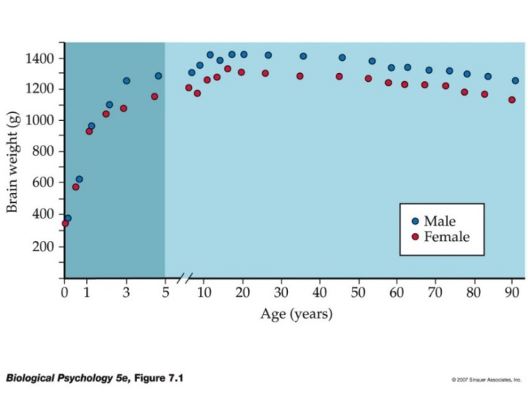
Growth and Development of the Brain Are Orderly Processes
The mature human brain has about 100 billion neurons
The developing nervous system relies on genetic information and its environment for normal growth
One measure of brain development is brain weight

Slide 3
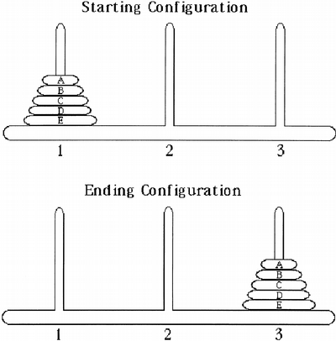
Three Perspectives on Brain Development
Neuroscientists study the relation between brain and behavioral development from three perspectives:
  Structural development can be studied and correlated with the emergence of behavior
    E.g., Development of frontal lobe should correspond with social development
    Tower of Hanol – Test that has 3 pegs with an x number of rings that increase in diameter. Goal is to get the rings from 1st peg to the last peg without putting larger rings on top of smaller rings and only one at a time can move. Errors are measured essentially.

Slide 4
Three Perspectives on Brain Development
  Behavioral development can be analyzed and predictions made about what underlying circuitry must be emerging
    E.g., Development of language → development of language regions

Slide 5
Three Perspectives on Brain Development
  Factors that influence both brain structure and behavioral development, such as hormones, genes, experience, or injury, can be studied
    E.g., abnormal hormonal levels influence given behaviour and brain structure
    Conclude structure implicated must play a role in behaviour normally

Slide 6
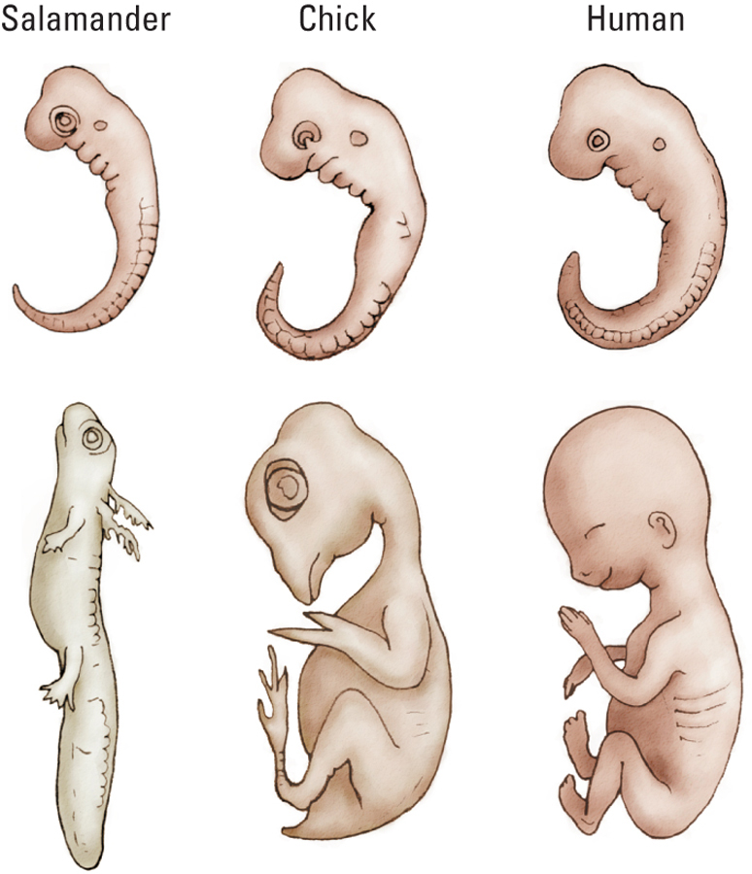
Neurobiology of Development
Early in development, all vertebrates look alike…
…we don’t look like mini-humans (pre-formation)!

Slide 7
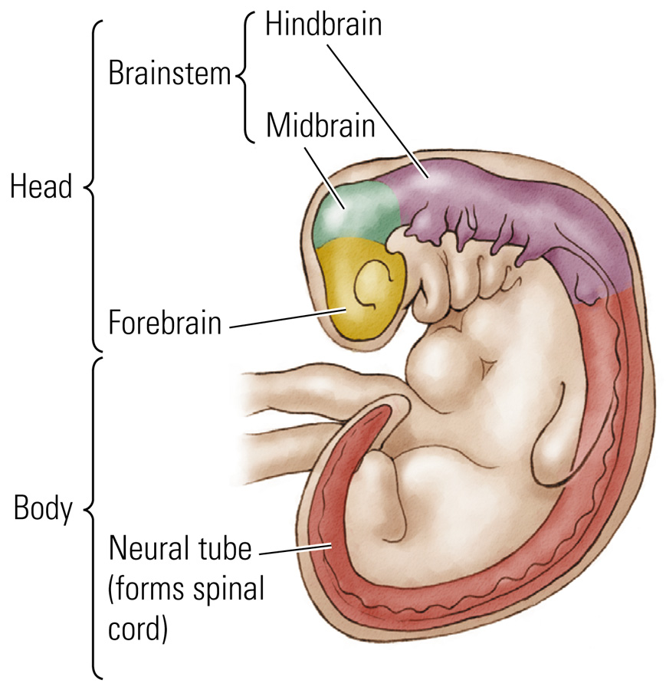
Embryonic Vertebrate Nervous System
Notes:
At 28 days

Slide 8
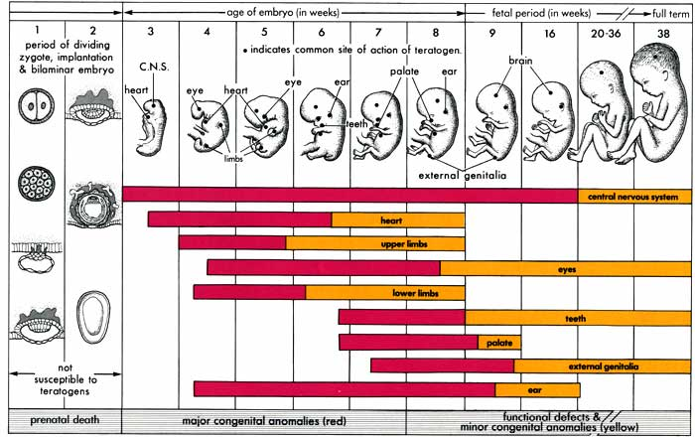
Gross Development of the Human Nervous System
Prenatal Stages
  Zygote: Fertilization to 2 weeks
  Embryo: 2 to 8 weeks
  Fetus: 9 weeks to birth

Slide 9
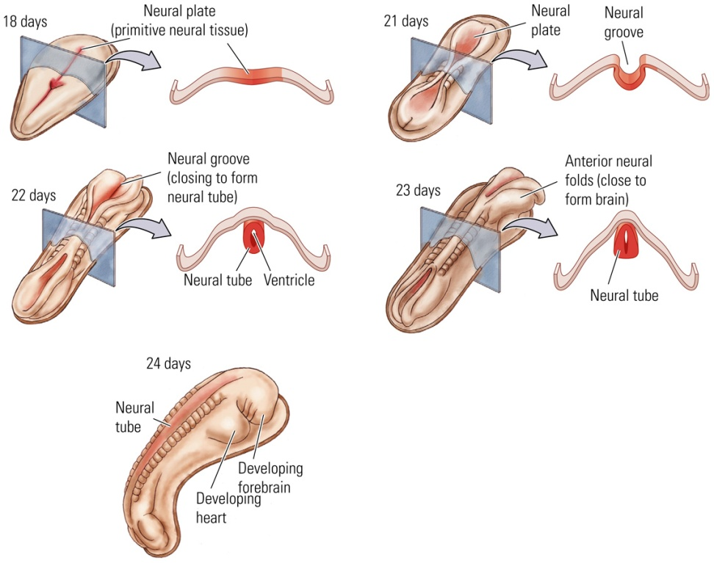
Gross Development of the Human Nervous System (2)
By day 21: Neural Plate
  Thickened region of the ectodermal layer that gives rise to the neural tube
  Folds to form neural groove
  Curls up to form…
Neural Tube
  Structure in the early stage of brain development from which the brain and spinal cord develop

Slide 10
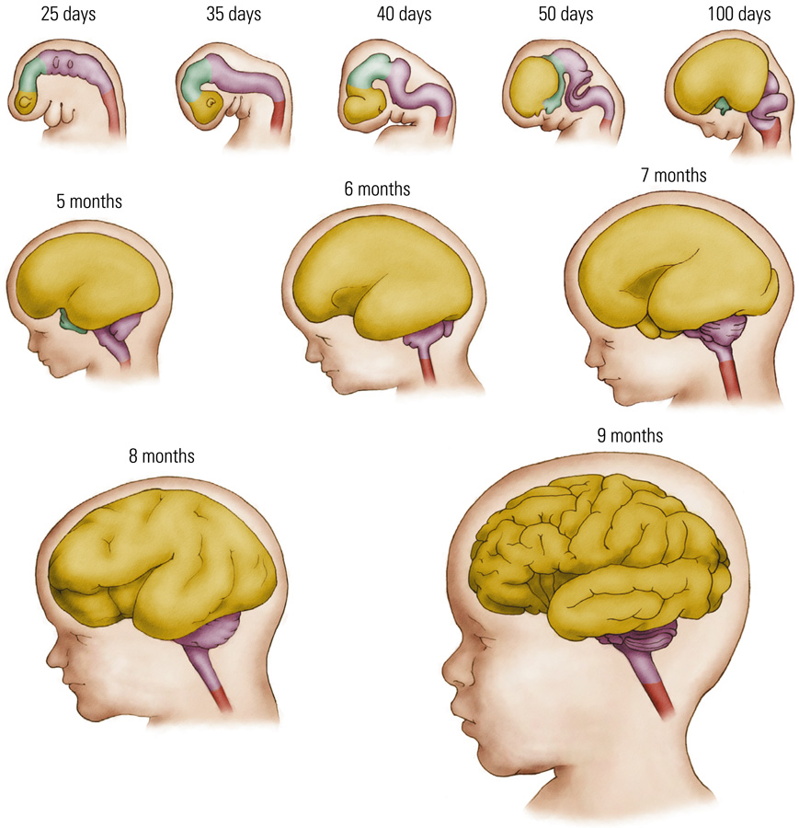
Gross Development of the Human Nervous System (3)
Major Events
  Day 49: Embryo begins to resemble a miniature person
  Day 60: Sexual differentiation
    Genitals and brain regions
  Day 100: Brain looks distinctly human
  7 Months: Gyri and sulci begin to form
  9 Months: Brain looks like an adult brain

Slide 11
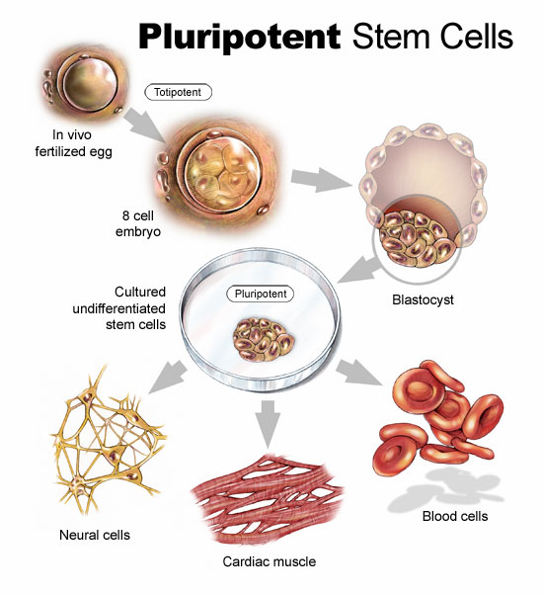
Origins of Neurons and Glia
Neural Stem Cell
  A self-renewing multipotential cell that gives rise to neurons and glia
  Line the neural tube
  When divide, one lives to divide again, the other dies
Subventricular Zone
  Lining of neural stem cells surrounding the ventricles in adults

Slide 12
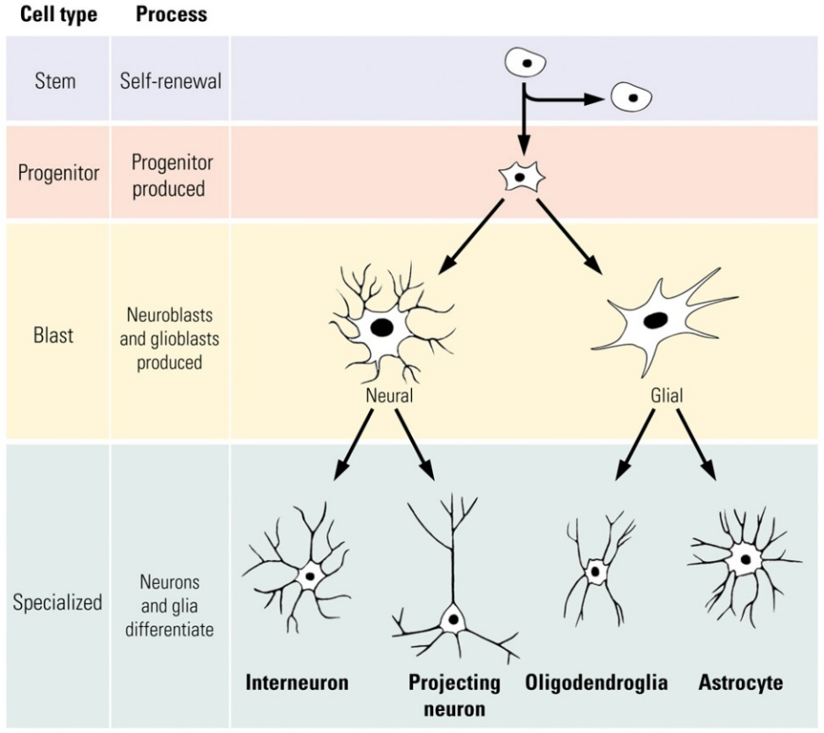
Origins of Neurons and Glia
Stem cells give rise to progenitor cells:
  Precursor cell derived from a stem cell; it migrates and produces a neuron or glial cell
Neuroblast
  Product of a progenitor cell that gives rise to different types of neurons
Glioblast
  Product of a progenitor cell that gives rise to different types of glial cells

Slide 13
How do stem cells know what to become?
Chemical signal
Turns genes on (gene expression)
Specific proteins are made
Specific cells are made

Slide 14
Origins of Neurons and Glia
Neurotrophic Factor: A chemical compound that acts to support growth and differentiation in developing neurons
  May help keep certain neurons alive in adulthood
Epidermal Growth Factor (EGF)
  Stem cell → Progenitor cell
Basic Fibroblast Growth Factor (bFGF)
  Progenitor cell → Neuroblast

Slide 15
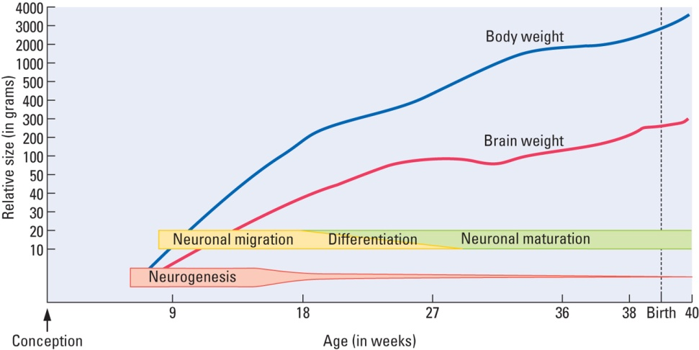
Stages of Brain Development
Cell Birth: neurogenesis; gliogenesis
Cell Migration: cells move to establish distinct populations
Cell Differentiation: cells become distinctive neurons or glial cells
Cell Maturation: dendrite and axon growth
Synaptogenesis: formation of synaptic connections
Cell Death and Synaptic Pruning: selective death of some nerve cells; fine-tuning
Myelogenesis: formation of myelin

Slide 16
1. Cell Birth
A chemical compound acts to support growth and differentiation in developing neurons; begins about 7 weeks after conception
Largely complete by 5 months
  Exception: Hippocampus makes new cells throughout life
Brain can more easily cope with injury during this time (first 5 months of gestation)
  More neurons can be made to compensate for cell death

Slide 17
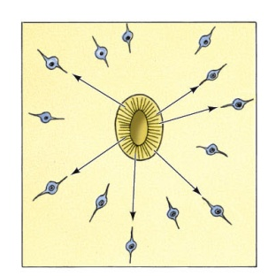
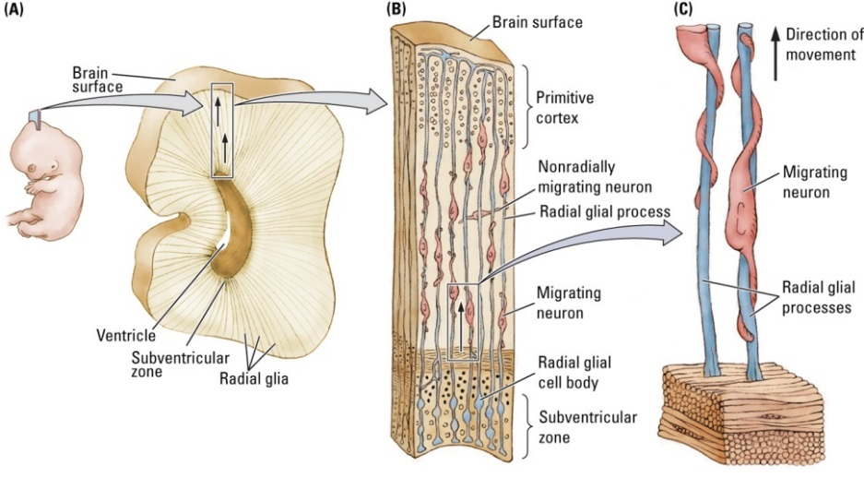
2. Cell Migration
Begins approximately 8 weeks after conception
Largely complete by 29 weeks
Damage has more serious consequences
  Susceptible to teratogens
    E.g., alcohol, heavy metals, certain diseases
Radial Glial Cell
  Path-making cell that a migrating neuron follows to its appropriate destination in the cortex
  Layer VI formed first (innermost layer); top layer (I) formed last

Slide 18

3. Cell Differentiation
Begins after cells have begun to migrate
  When cells reach their destinations they begin to express genes to make the proteins they need
  This cell differentiation allows a cell to acquire its specific appearance and function
  Dependent upon genetic instructions, timing, and signals from other cells in the local environment
Largely complete by 29 weeks
Essentially complete at birth

Slide 19
4. Neural Maturation
Begins about week 20 and continues long after birth
Mature in 2 ways:
  Dendritic Growth and Axonal Growth
Dendritic Growth
  Arborization (branching)
  Growth of dendritic spines where most synapses occur
  Slower (micrometers/day) than axonal growth (millimeters/day)

Slide 20
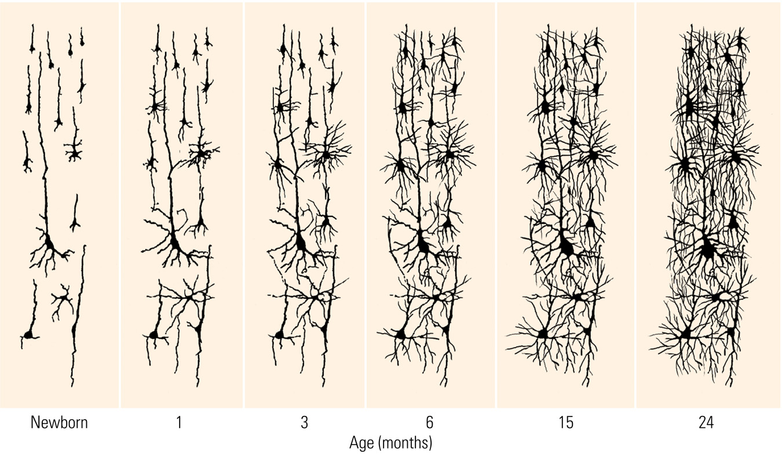

Slide 21
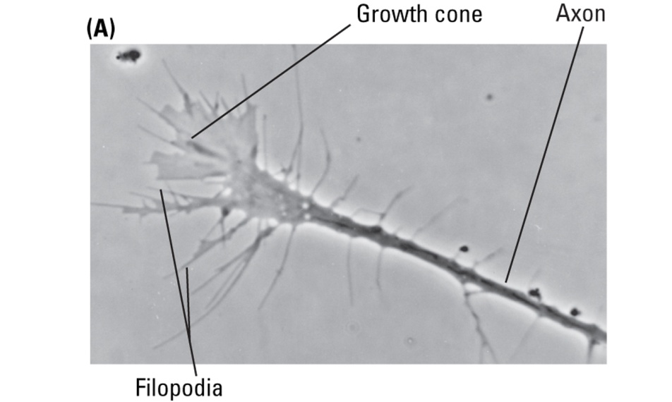
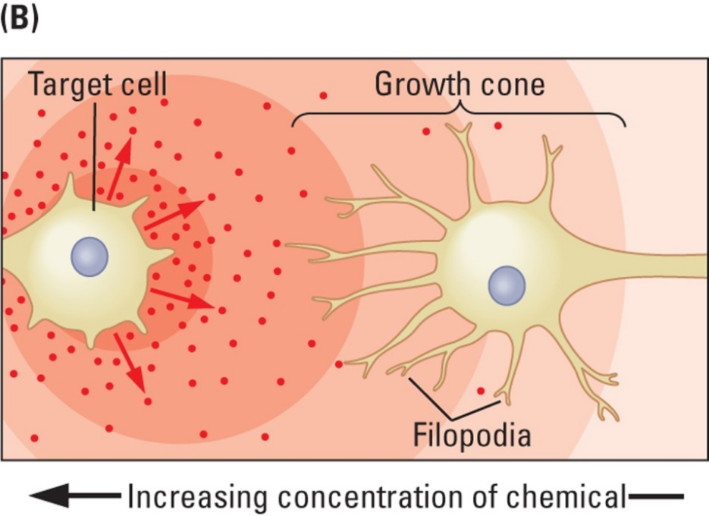
4. Neural Maturation: Axonal Growth
Growth cone: Growing tip of an axon
Filopod: Process at the end of an developing axon that reaches out to search for a potential target or to sample the intercellular environment
Respond to chemical cues:
  Cell-adhesion molecule (CAM): A chemical to which specific cells can adhere, thus aiding in migration
  Tropic molecule: Signaling molecule that attracts or repels growth cones
  Theoretical

Slide 22
5. Synaptic Development
10¹⁴ synapses in the adult human cerebral cortex!
Combination of genetic programming and environmental cues and signals
5th gestational month: Simple synaptic contacts
7th gestational month: Synaptic development of deep cortical neurons
After birth: synaptic development increases rapidly during the first year of life
  Visual cortex: density doubles between 2 months and 4 months!

Slide 23
6. Cell Death and Synaptic Pruning
We are born with an overabundance of neurons and synaptic connections
Neural Darwinism
  Hypothesis that cell death and synaptic pruning are, like natural selection in species, the outcome of competition among neurons for connections and metabolic resources in a neural environment
Apoptosis
  Genetically programmed cell death
Synaptic connections that are not part of a functional network are pruned away in an experience-dependent manner

Slide 24
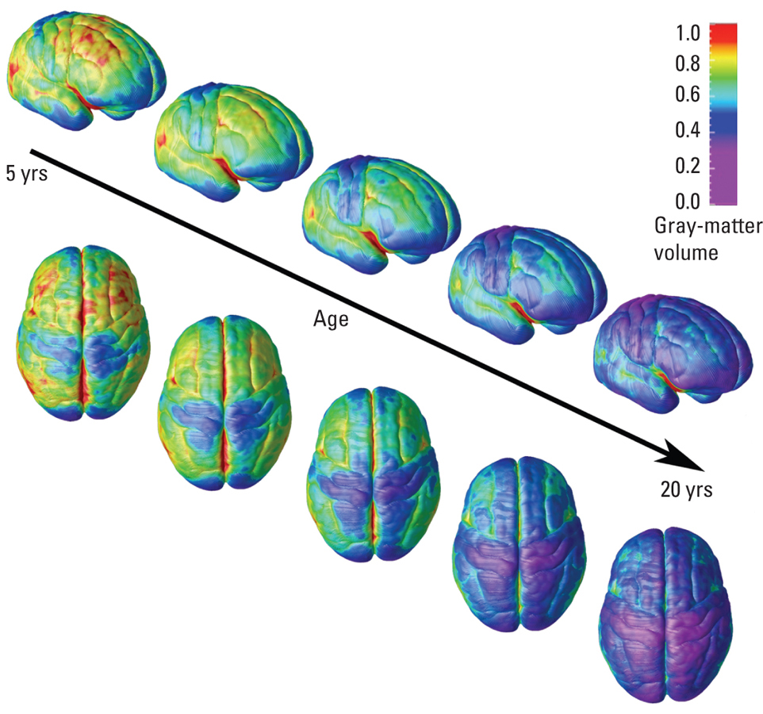

Slide 25
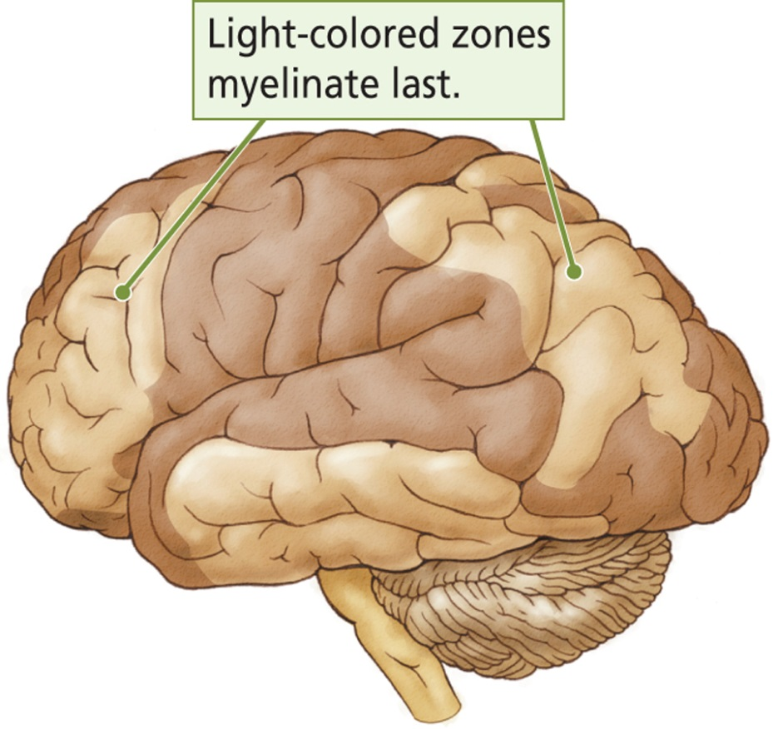
7. Glial Development
Birth of astrocytes and oligodendrocytes begins after most neurogenesis is complete and continues throughout life
Myelination provides a useful rough index of cerebral maturation
Flechsig (1920s)
  Myelination of cortex begins after birth and continues until at least 18 years of age
  Some areas are myelinated earlier (those that perform simpler functions) than others (that perform more complex functions)

Slide 26
Correlating Behavior with Nervous-System Development

Slide 27
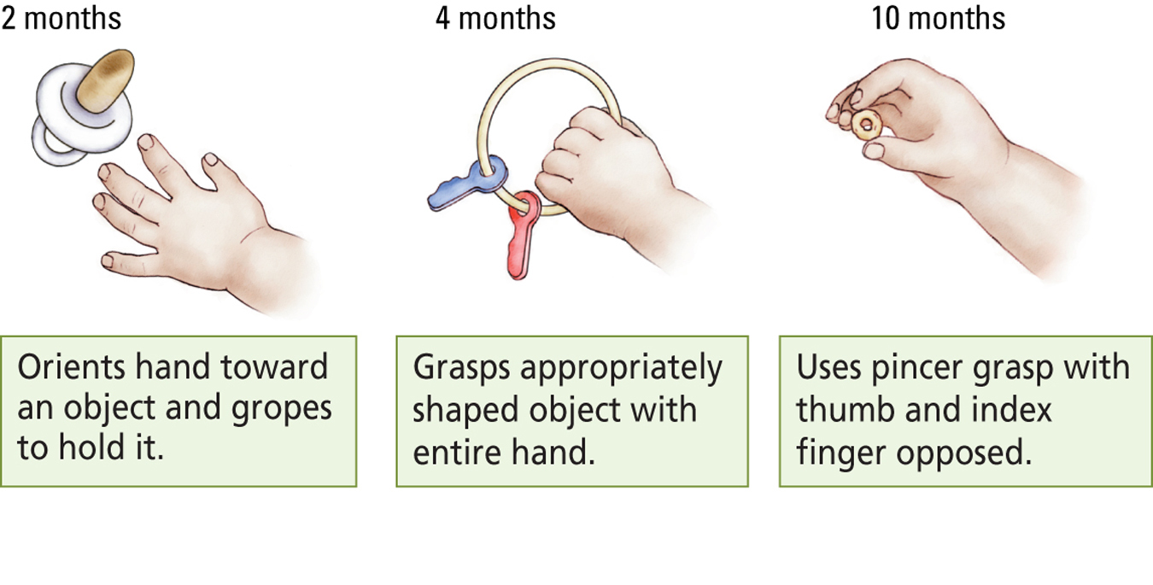
Motor Behaviors
Neural changes should proceed these behavioral changes
  Connections between neocortex and spinal cord

Slide 28
Language Development
Language onset is usually between 1 and 2 years of age
Language acquisition is largely complete by age 12
Neural changes during this time:
  Increased dendritic complexity and interconnections
  Increased myelination of speech areas

Slide 29
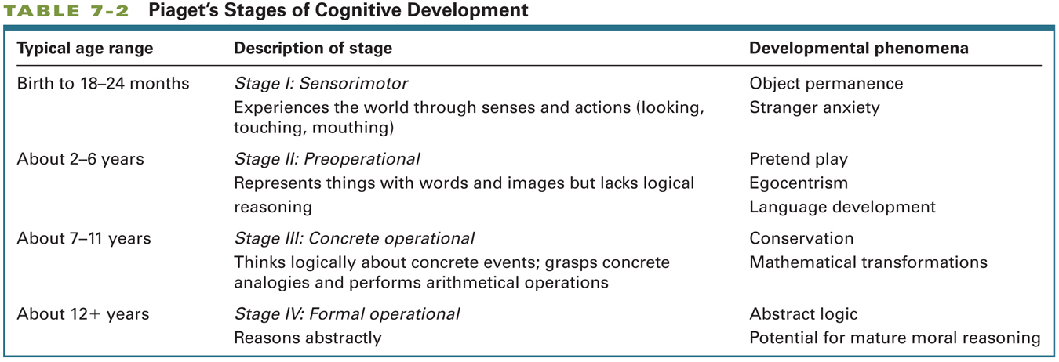
Development of Problem-Solving Ability

Slide 30
Development of Problem-Solving Ability
Growth Spurts: Sporadic period of sudden growth that lasts for a finite time
Epstein (1979)
  Identified five spurts in brain growth during development
  First four coincide with onset of Piaget’s stages, and the last occurs around 14 to 16 years
  Likely due to growth of glial cells and synapses

Slide 31
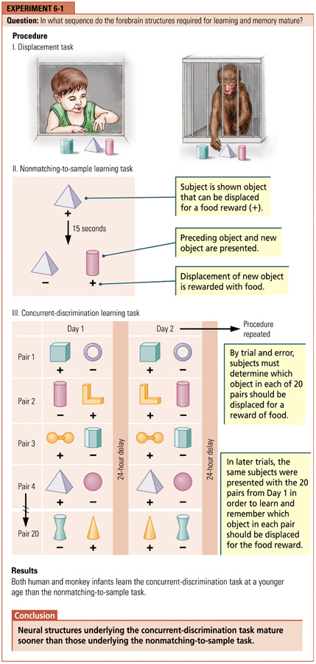
  Children can learn a nonmatching-to-sample task, believed to depend on the temporal lobe, around 18 months
  Children can learn a concurrent-discrimination task, believed to depend on the basal ganglia, around 12 months

Slide 32
Brain Development and the Environment

Slide 33
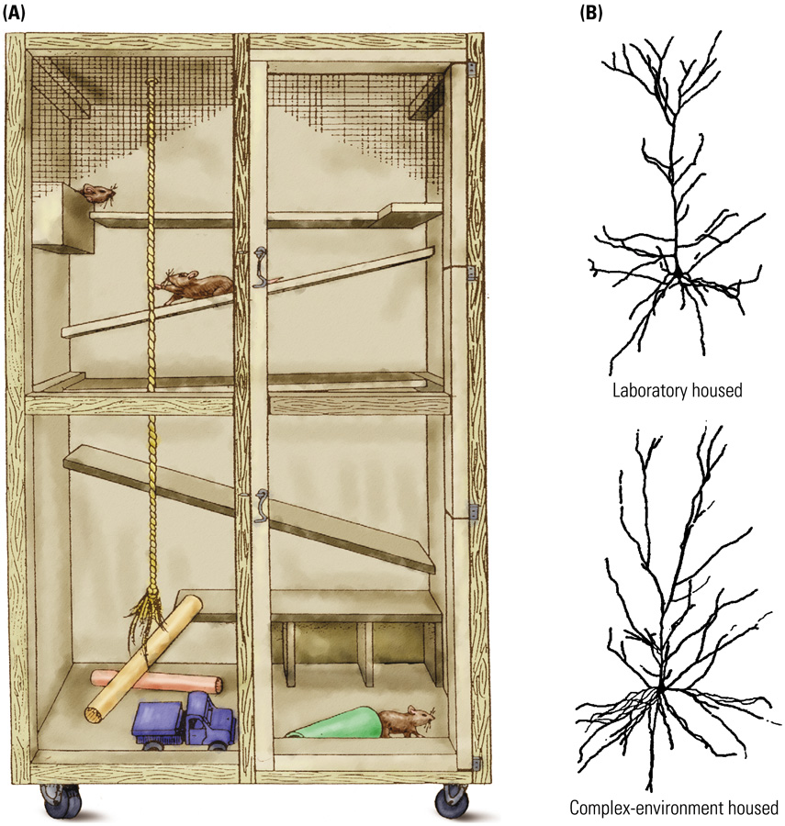
Experience and Cortical Organization
Hebb (1947)
  Home rats v. lab rats
  Cognitively stimulating environments help maximize intellectual development
Compared with rats raised in standard lab cages, those raised in “enriched environments” have:
  Larger and more synapses
  Larger and more astrocytes

Slide 34
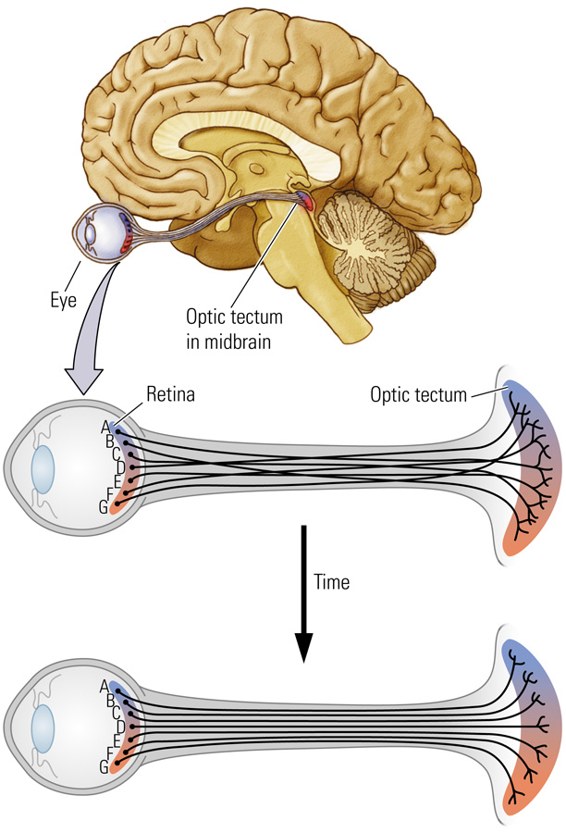
Experience and Neural Connectivity
Prenatally
  Chemoaffinity Hypothesis: Neurons or their axons and dendrites are drawn toward a signaling chemical that indicates the correct pathway (Sperry, 1963)
Postnatally
  Fine-tuning of connections proceeds in an activity-dependent manner
  Adjacent receptors activated at the same time; form synapses on the same regions in the midbrain

Slide 35
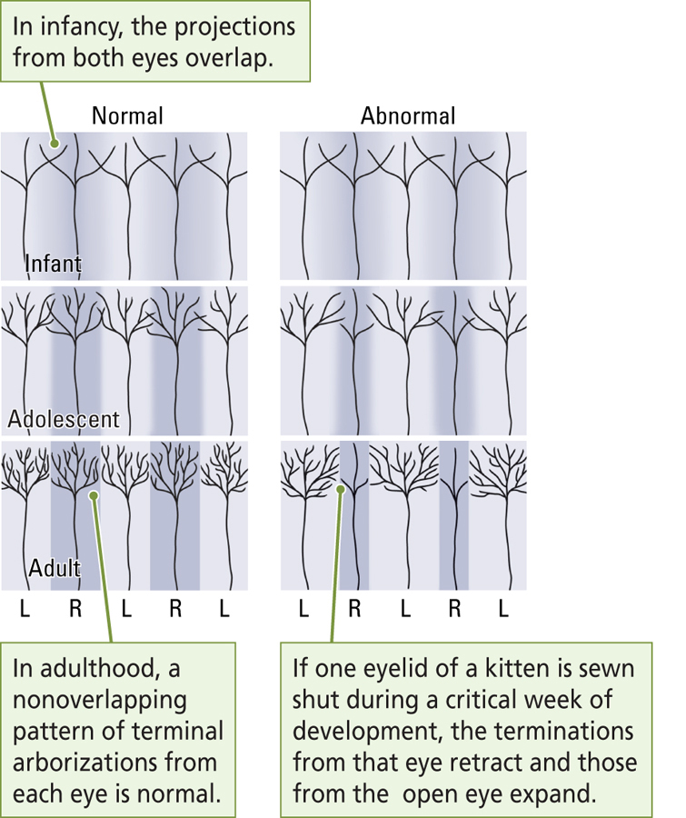
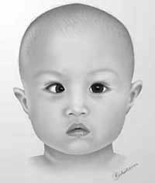
Experience and Neural Connectivity
Amblyopia: A condition in which vision in one eye is reduced as a result of disuse; usually caused by a failure of the two eyes to point in the same direction
Visual input from the “lazy eye” does not contribute to the fine tuning of neural connections

Slide 36

Critical Periods for Experience and Brain Development
Critical Periods: Developmental “window” during which some event has a long-lasting influence on the brain; often referred to as a sensitive period.
Example: Imprinting
  Process that predisposes an animal to form an attachment to objects or animals at a critical period in development
    Enlargement of synapses in chick forebrain

Slide 37
Abnormal Experience and Brain Development
Early deprivation of sensory experience (e.g., being placed in dark) has the opposite effect of cognitively stimulating environments: atrophy of dendrites
Early deprivation of social experience (e.g., raised without maternal contact) has a profoundly negative effect on later intellectual and social behaviors

Slide 38
Abnormal Experience and Brain Development
Human Cases: If deprivation is relatively short (e.g., less than a few months), the child may be able be to overcome some of the negative effects
  However, critical window for normal attachment/emotional regulation?
Stress in early life has been associated with:
  Increase in size of amygdala
  Decrease in size of hippocampus
  Later development of depression and anxiety disorders, addictions

Slide 39
Hormones and Brain Development
Testosterone (Androgens)
  Stimulates development of male reproductive organs and the later development of male secondary sexual characteristics (e.g., facial hair) during puberty
  Activational effect
Masculinization
  Process by which exposure androgens (male hormones) alters the brain, rendering it identifiably male
  Organizational effect

Slide 40
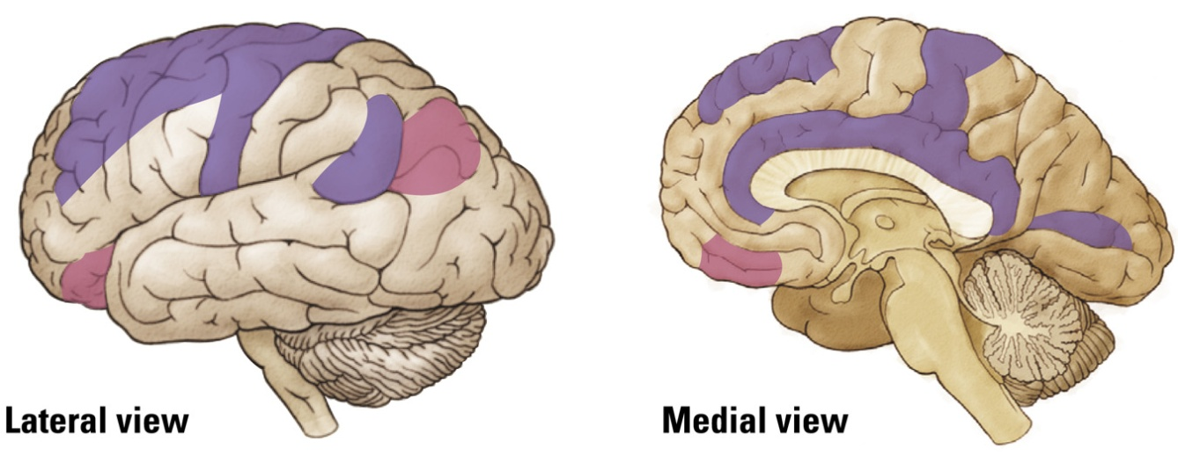
Hormones and Brain Development (2)
The presence of testosterone and estrogen both affect the development of the brain
  Can alter:
    Number of neurons
    Dendritic branching
    Synaptic growth
  Not just areas of brain related to sexual behavior: These hormones can affect “higher functions” such as cognition
Cerebral distribution of estrogen (purple) and androgen (pink) receptors

Slide 41
Hormones and Brain Development
Bachevalier and colleagues: Postnatal Effects
Monkeys
  Object reversal task & concurrent discrimination task
  Male and females showed different patterns of performance on tests at 2.5 months old
    Males better at object reversal; females at concurrent task
  Males that had testes removed at birth performed more like females
Humans
  Similarly, males and females showed different patterns of performance around 15 to 30 months of age
  Males better at object reversal; females at concurrent task
  Sex differences disappeared at 32 to 55 months of age
    Rate of maturation differs between sexes; at later age, brain has completely matured in both sexes

Slide 42
Hormones and Brain Development
Juraska (1990): Postnatal Effects
Rats Reared in Complex Environments
  Males showed more dendritic growth in the visual cortex than females
  Females showed more dendritic growth in frontal lobes than males
Summary:
  Sex differences in brain structure exist throughout development

Slide 43
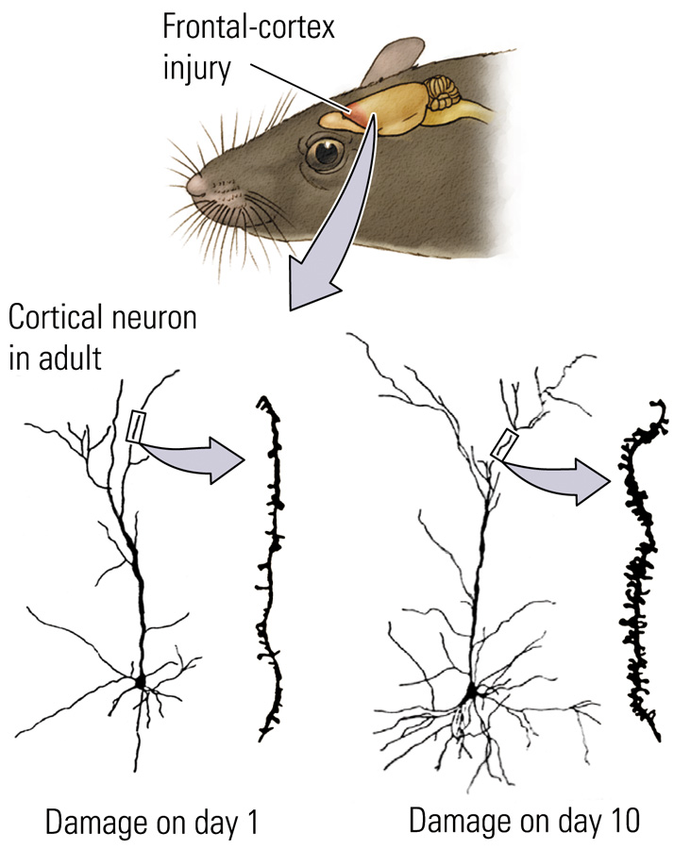
Injury and Brain Development
Humans:
Worst time for brain injury:
  Last half of intrauterine period and the first few months after birth
“Better” time for brain injury:
  First few years after birth
  More resilient to deficits (e.g., language impairments) than when damage occurs in adults
Analogous in rats

Slide 44
Drugs and Brain Development
Precise effects of drugs on prenatal brain development are poorly understood
There is some evidence that:
  Prenatal exposure to psychoactive drugs may increase the chance of later drug use
  Prenatal exposure to drugs such as nicotine and caffeine increase the chance of learning disabilities and hyperactivity

Slide 45
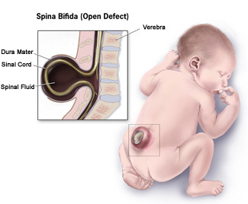
Genetic Abnormalities
Spina bifida
  Spinal cord abnormality due to the failure of the neural tube to close completely
  Associated with serious motor problems
Anencephaly
  Front end of the neural tube does not close
  Failure of the forebrain to develop
  Infants typically die soon after birth

Slide 46
Other Kinds of Abnormal Brain Development
Abnormal Cell Migration and Differentiation
  Faulty connections may produce a range of problems
  Example: Schizophrenia
    Disorganized pyramidal neurons in the hippocampus
Too many synapses (failure of pruning) can also produce neural dysfunction
Behavioral effects of brain damage to a certain area are often not seen until the time at which that particular area matures
  Example:
    The frontal lobes continue to develop into adulthood, therefore, the behavioral effects of frontal lobe damage may not be seen until adolescence

Slide 47
Developmental Disability
Impaired cognitive functioning due to abnormal brain development
Many causes
  Genetic abnormalities (e.g., Down syndrome)
  Prenatal exposure to infections (e.g., rubella) or toxins such as alcohol (e.g., fetal alcohol syndrome)
  Birth trauma, such as anoxia (e.g., cerebral palsy)
  Malnutrition
  Environmental abnormality, such as sensory deprivation (e.g., Romanian orphans)

Slide 48
How Do Any of Us Develop a Normal Brain?
Brain has a substantial capacity to repair minor abnormalities that may occur during development (plasticity)
There is a “range of normality” with respect to brain development
  Most of us develop a brain that falls within a certain range of normality
Plasticity occurs into older adulthood

