Slide 1
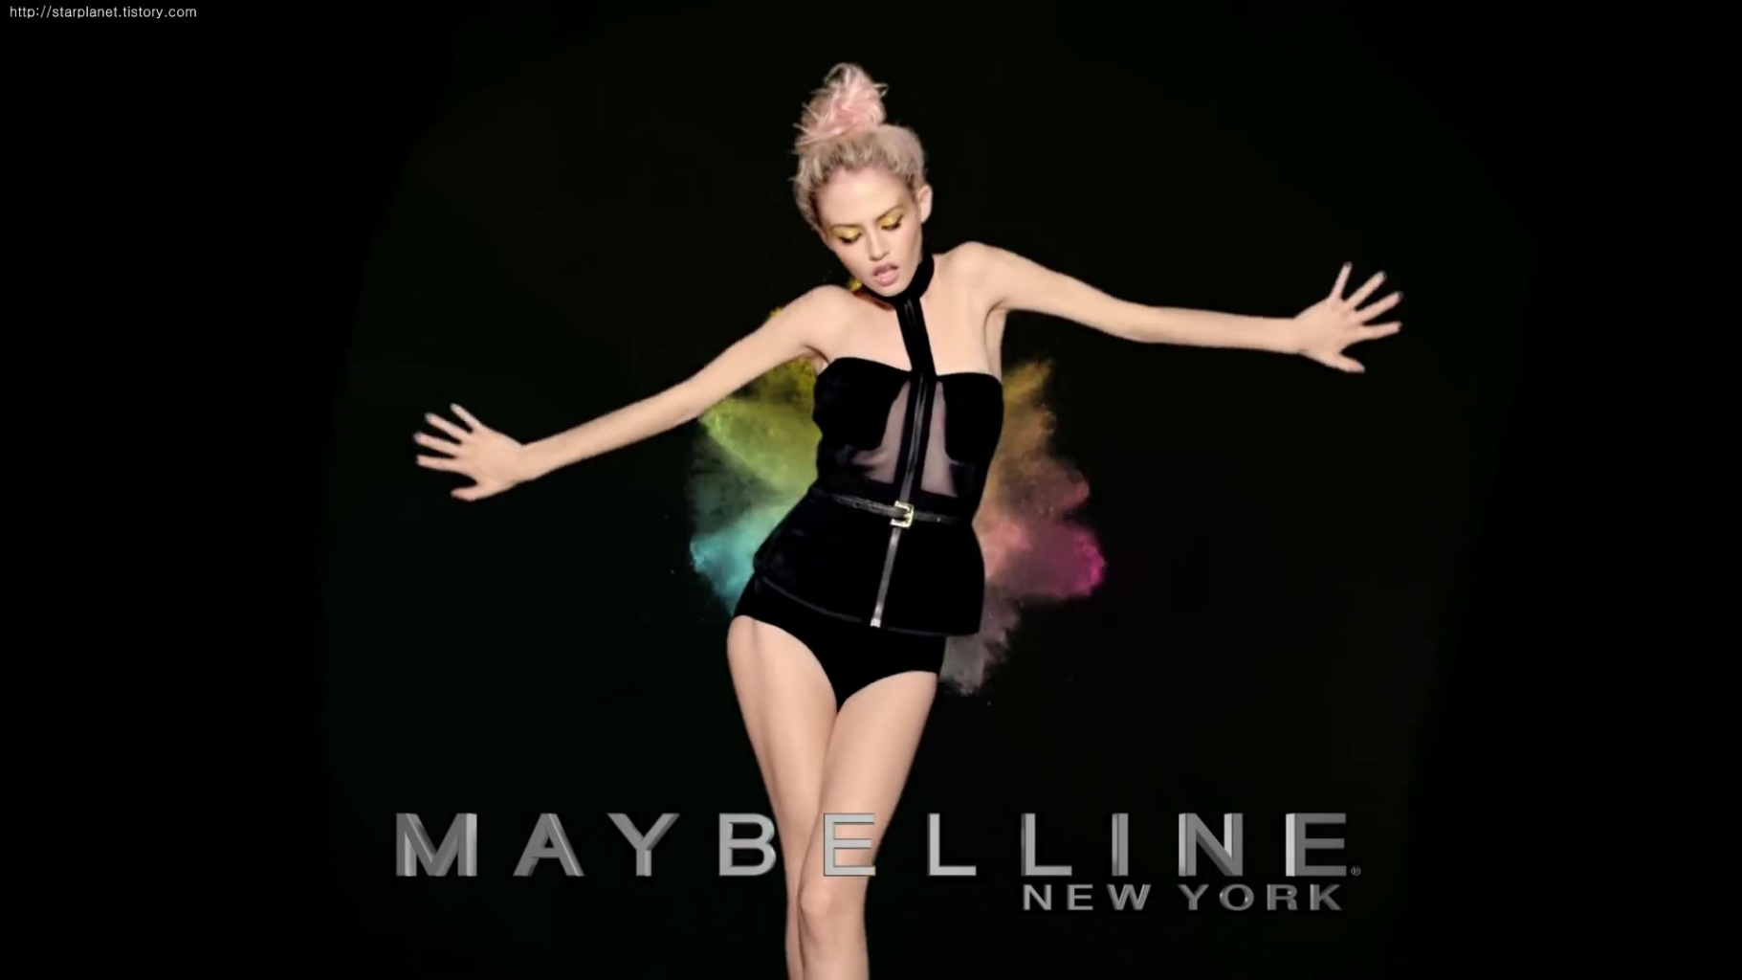



2014-2 Advertising, case study
with
Jeong Dae Geun
Abdullah Hokroh
Maybe She’s Born with It. Maybe It’s Maybelline.

Slide 2
Ⅰ
About Maybelline
Ⅱ
Case Study
Ⅲ
Discussion Questions
Ⅳ
Students’ Questions

Slide 3
About Maybelline
Company & History

Slide 4
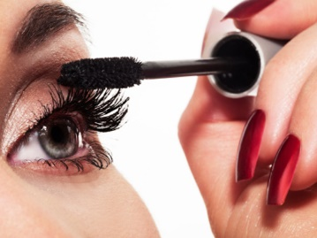
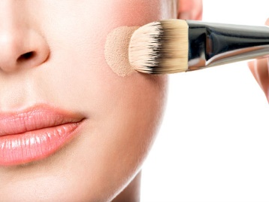
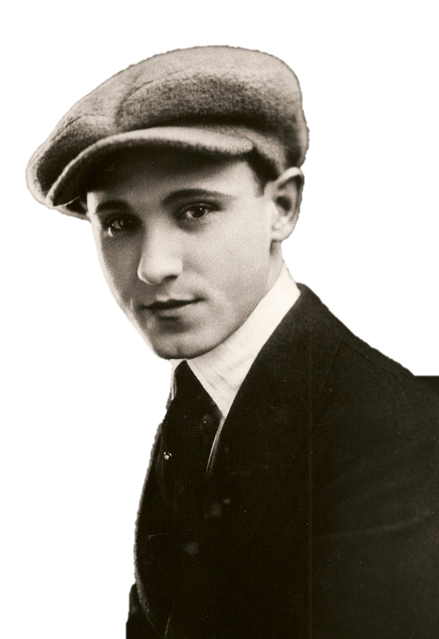
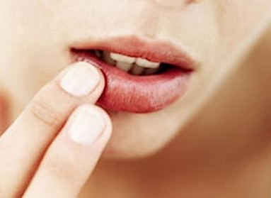
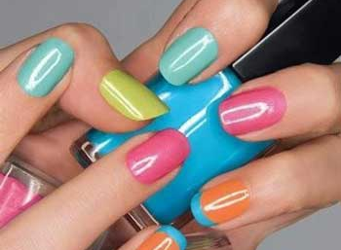
About Maybelline
Company
Eye makeup
Founder
Industry
Tom Lyle Williams
Cosmetic
(19 years old)
Products
4 Categories
Face makeup
Lip makeup
Nail makeup

Slide 5
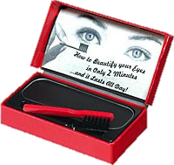


About Maybelline
History
1915
Founded Maybelline: Maybel + Vaseline
1917
Launched 1st product: Cake mascara
1971
Launched Legendary product: Great Lash Mascara Water
Ranked 1st worldwide
Sold per 1.5 sec
1991
New Slogan, “Maybe She’s born with it. Maybe it’s Maybelline”
1996
Acquisition by L'Oreal
2000
This case; changing positioning

Slide 6
Case study
Determining the best positioning

Slide 7
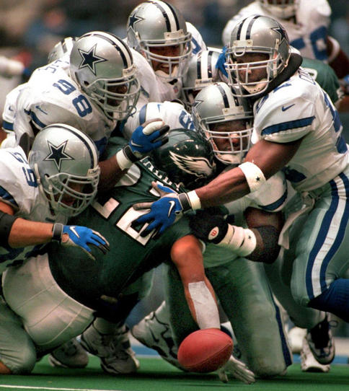
Case study
Summary
Situation in 1999/2000...
L'Oreal
Cover Girl
Olay
Revlon
Lancôme
Maybelline
Estee Lauder
Neutrogena
More competitive environment

Slide 8
Case study
Summary
1
Situation in 1999/2000...
Maybelline want to become top in the mass market
Cover Girl
2
Maybelline
But, Maybelline had long been perceived
Cheap, Garish, Tacky
=Bad brand imagery

Slide 9
Case study
Summary
So, Maybelline set 2 goals
Focus of target audience
Broaden the product area
Effort had to be made against 10s & 18-24
Historical strength was in Eyes.
1
2
( This group was beauty influential)
(e.g. Great Lash had been leader for 30years)
Discern targets' preference, character
But, Face & Colour are not.
( Easy to use, need more product information)
( Cover Girl in Face, Revlon in Colour )
Maybelline make 2 plans
Had to appear in their media
Broaden Face & Colour segments
Keep the leader in the Eyes
Broaden the product area
Focus of target audience
New Strategy focused on Positioning as a lifestyle cosmetic

Slide 10
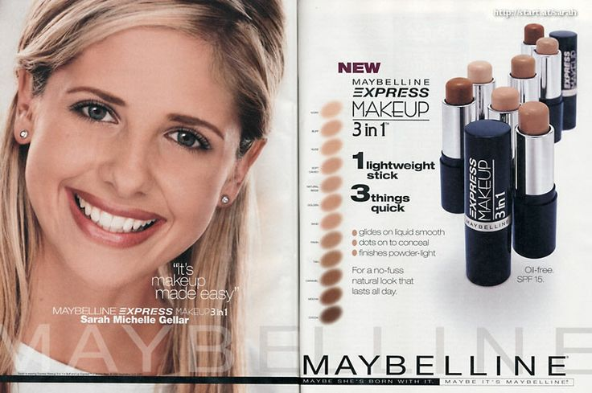

Case study
Summary
Activities for changing
Advertising would tap into relevant issues concerning lifestyle and needs
Easy to use
: Several functions
<base, powder and concealer>
Provide information on product
: consider target consumer characteristic
<young women are in a learning mode>

Slide 11

Case study
Summary
Activities for changing
Select celebrities as advertisement models.
Because of young women characteristic : like “cool” image
Maybelline had to find the right celebrity that would make younger women aspire to the brand
Sarah Michelle Gellar
Younger women’s idol
coolness

Slide 12
Case study
Summary
Activities for changing
In line with the product’s nature, advertising was brought to support Maybelline’s Colour Businesses
Advertising for Face and Eyes was supplemented with strong stories on shades
that could be found across several products
Along with the media plan came several special programmes.
1. The introduction of Sarah Michelle Geller as the new ‘face’ of Maybelline
2. All included in a comprehensive public-relations programme that ranged from extensive publicity

Slide 13
Case study
Summary
Activities for changing
Maybelline used various advertising channels
The role of these help to the campaign extend its reach among youmger women
TV
National TV, WB, cable networks
Channels
print
Magazines, books
internet
Homepage, banner

Slide 14
Case study
Summary
Result of activities
1.The campaign succeed in objectives
Became the No.1 cosmetics brand in mass market
Gaining category leadership
1_{st}
Cosmetic category growth 5%, Maybelline growth 11%
Foundation category rose 4%, Maybelline growth 20%
Face category rose 10%, Maybelline growth 17%
Lip category rose 0%, Maybelline flagship growth 15%
Nail category down 6%, Maybelline product growth 15%
Maybelline
2.The campaign successfully reached targets as planned
After campaign, penetration among teens rose 20% versus 1997
Among teens, Maybelline’s product persuasion rose
3.Enhancing brand awareness and perceptions
Among women aged 14~24, top-of-mind awareness rose 33%

Slide 15
Discussion Questions
Solution 1, 2, 3 & 4

Slide 16
Discussion Questions
Question 1
How did Maybelline divide the cosmetics market? How would you divide it differently?
Solution 1
Notes:
메이블린은 크게 눈,색조,얼굴의 세가지로 분류했다. 여성의 화장품에 대해서는 아직도 잘 모르지만, 손톱화장과 입술화장을 하는 경우와 안하는 경우가 있기 때문에 명확하게 네가지로 나누는 것이 좋을 것 같다.

Slide 17
Discussion Questions
Question 2
What are the differences between Maybelline’s old and new positioning?
Solution 2
Cool
New
All
Some
Old
Tacky
Notes:
제품지향적 포지셔닝에서 고객지향적 포지셔닝으로 바뀐것.

Slide 18
Discussion Questions
Question 3
What are the pros and cons for Maybelline to position itself
head-to-head against its major competitors?
Solution 3
First of all, when viewing the result. It has more advantages. So, we pros this position.
In this case situation,
Notes:
만약 메이블린이 대응하지 않았다면 경쟁이 심화하는 상황에서 도태되었을 것이고, 상황에 맞춰 영역확대에 광고확장을 했음에도 불구하고 오히려 성공했기 때문이다. 그러나, 영역확대와 광고확장으로인한 비용측면에 대해서도 고려를 해봐야 할 것이다.

Slide 19
Discussion Questions
Question 4
Why did Maybelline use almost all kinds of media
(TV, print, the Internet, In-store display, etc.) to run the campaign?
Solution 4
Notes:
메이블린이 다양한 광고를 한 가장 큰이유는 아마도 브랜드 이미지의 개선일 것이다.
앞서 사례에서 보면 메이블린이 처한 상황이 경쟁이 심화되는 시장에서 경쟁사와 비교했을 때, 타겟 소비자에게 불리하게 적용되는 이미지였고, 목표를 달성하기 위해서는 가장 시급한게 이미지 개선이었기 때문이다.

Slide 20
Students’ Questions
Discussion about your questions

Slide 21
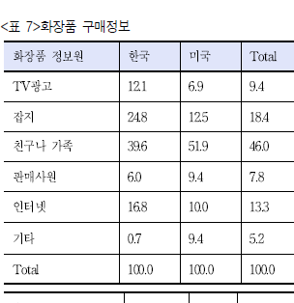
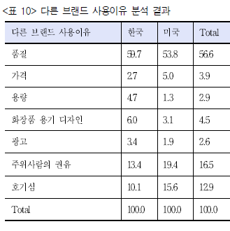
Students’Questions
Seo da eun’s question
Maybelline was targeting young women and to advertise,
it used almost all of media such as TV, print, the Internet, and the like.
Isn't it the waste of money to spend for advertising?
What is the main media to target the young women?
Our solution
USA(%)
USA(%)
quality
TVcf
price
megazine
volume
Friends & family
desgin
seller
Ads
internet
recommend
etc
curiosity
Source: 한국여성과 미국여성의 화장품 구매행동 비교 연구, 류세자 외 2명, 대한피부미용학회지
Notes:
경쟁사들의 광고방식과 미국 여성들의 화장품 광고행태

Slide 22
Students’Questions
it is known that maybelline is mainly targeting for young woman,
they are doing a lot of online marketing such as on and twitter.
what other kind of creative promotion can they take action?
Kim Chan Whi’s question
Our solution

Slide 23



Thank you
QnA..Plz don’t...

