Slide 1
Trade Union Policies and non-market values
Joseph Shister (1950)

Slide 2
Non-market values
Unionism serves as a counterbalancing force to check the pull of the product market place.
Shister looks at non-market policies under two basic headings:
  industrial morale
  life-time productivity

Slide 3
Morale
Management in competitive industry in no position to devote resources to improve morale to the extent necessary.
Yet morale is an important social value, primarily -- though not exclusively -- because it is a necessary condition for the orderly change of the social economic climate.
Union policies that improve morale bring into closer relationship business and social costs.

Slide 4
Lifetime productivity
Individual firm is concerned with the short run rather than lifetime productivity of the worker.
Concessions to lifetime productivity are a loss to the firm and put it at a competitive disadvantage
Industry wide bargaining enables the employer to accept labor policies geared to lifetime rather than short run productivity of worker.

Slide 5
Substantive policies
Seniority in layoffs and recall.
Control of output: reducing hours, reducing speed of work.
Health and welfare funds, sick pay and medical care

Slide 6
Non-market values
Any analysis of the impact of unionism solely in terms of market values is a biased analysis.
Market and nonmarket values cannot be assessed separately because they are not additive
Rationale for broad bargaining units and industry-wide bargaining: "Taking labor out of competition"

Slide 7
"Taking labor out of competition"
Unions cannot be successful in protecting the interests of the worker without having the power to protect the interests of the entrepreneur as well, within limits.
Globalization upsets this logic because it stresses the competitiveness of labour flexibility.

Slide 8
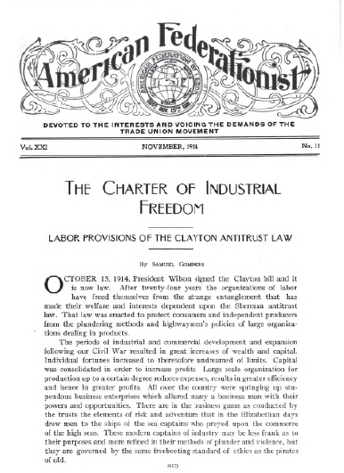

Slide 9
“Bargaining Simulations” Weeks 10 and 11
Howard Zinn, “Comments on ‘Laboratory Method’” (blog under “Pages,” top right corner)

Slide 10
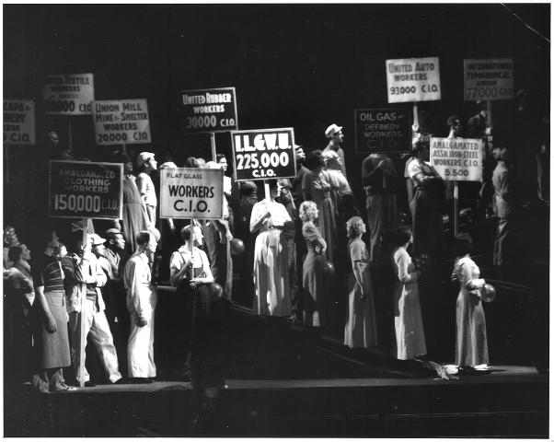

Slide 11
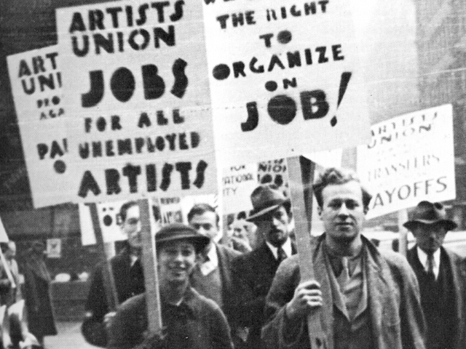

Slide 12
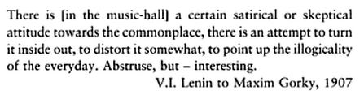

Slide 13
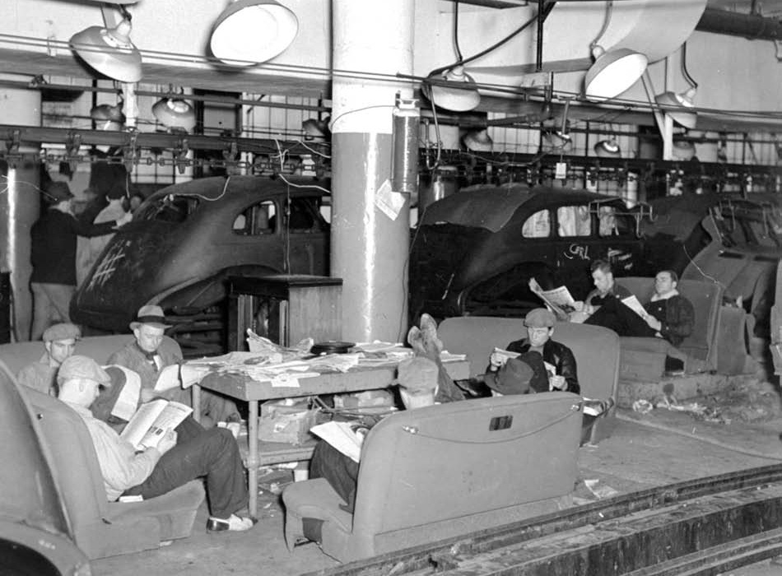

Slide 14
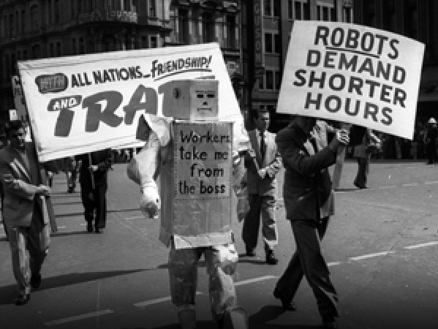

Slide 22


Slide 23


Slide 24
2. Exploration of Options
The skilled negotiator considers a wider range of outcomes or options for action, than the average.
3. Common Ground
The research showed that although both groups of negotiators tended to concentrate on the conflict areas, the skilled negotiators gave over three times as much attention to common ground areas as did average negotiators.ge negotiator.

