Slide 1


Slide 2
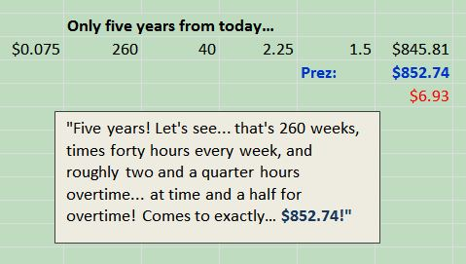
"I figured it out!"

Slide 3
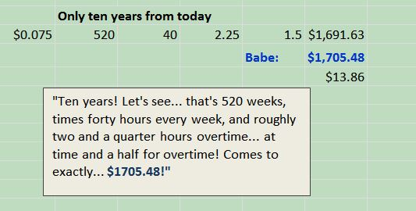
"I figured it out!"

Slide 4
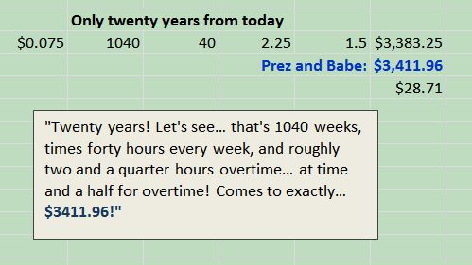
"I figured it out!"

Slide 5
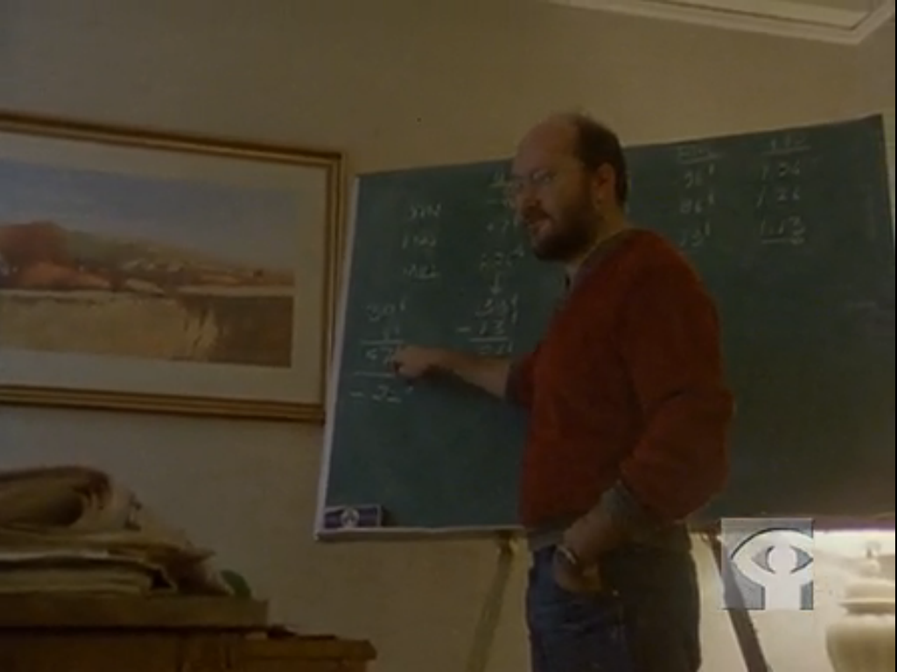
Sam Gindin in Final Offer

Slide 6
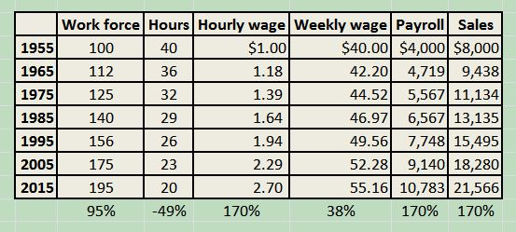
Long run: 2.77% productivity growth, taking 40% as shorter hours, 60% as higher wages

Slide 7
Trend vs. Actual
 | Work force | Hours | Hourly wage | Weekly wage | Actual Hourly | Weekly wage
1955 | 100 | 40 | $15.38 | $615.20 | $15.38 | $621.66
1965 | 112 | 36 | 18.14 | 649.05 | 18.71 | 737.92
1975 | 125 | 32 | 21.40 | 684.75 | 20.67 | 754.87
1985 | 140 | 29 | 25.25 | 722.42 | 20.69 | 750.22
1995 | 156 | 26 | 29.79 | 762.17 | 19.17 | 696.25
2005 | 175 | 23 | 35.14 | 804.10 | 20.06 | 717.75
2014 | 195 | 20 | 41.46 | 848.34 | 19.56 | 692.82
 | 95% | -49% | 170% | 38% | -53% | -18%

Slide 8
Mr. Rodriguez, 26, already receives above-minimum wages at Walmart, and will make at least $10 an hour next year, part of a move by Walmart to raise wages for hundreds of thousands of workers.
"It's not going to help us. We need the hours," said Mr. Rodriguez, a member of the union-supported workers' group, Our Walmart.
He says he constantly begs his managers for full-time work at the bustling Walmart superstore in Rosemead, Calif. He generally works around 28 hours a week, but can be assigned as few as 18.

Slide 9
Maurice Dobb
“It is not aggregate earnings which are the measure of the benefit obtained by the worker, but his earnings in relation to the work he does -- to his output of physical energy or his bodily wear and tear. Just as an employer is interested in his receipts compared with his outgoings, so the worker is presumably interested in what he gets compared with what he gives.”

Slide 10
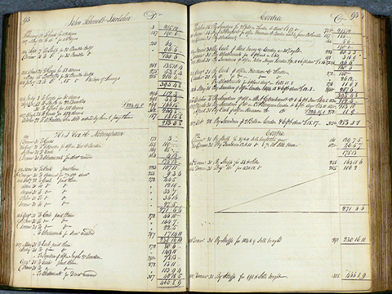

Slide 11
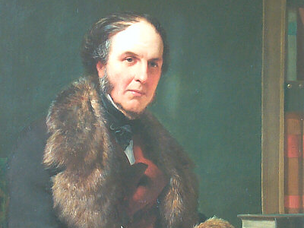

Slide 12
Senior’s “Last Hour”
Combinations Acts repealed in 1824/5
Tolpuddle Martyrs 1834: Friendly Society of Agricultural Labourers – “swore an oath”
Nassau Senior report to Lord Melbourne urged repression of unions by technicalities
1837 wrote “Letters on the Factory Act as it effects the cotton manufacture.”
“…the whole net profit is derived from the last hour.” of an 11 ½ hour day! Therefore a ten-hour day would be ruinous.

Slide 13
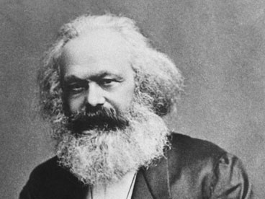

Slide 16
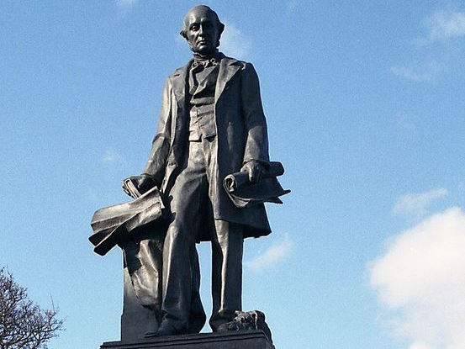

Slide 17
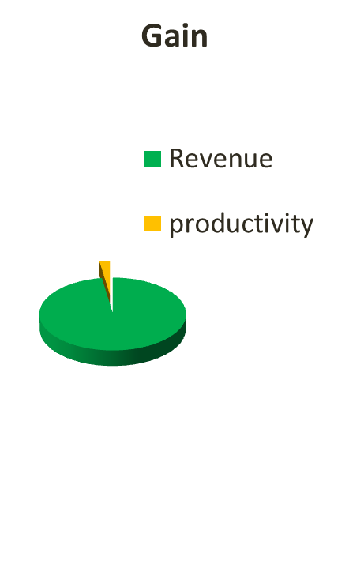

“The point which I chiefly desire to render intelligible is the extent of the loss which would result to the employer by the shortened working of his plant.” -- W. G. Armstrong

Slide 18
As a mere arithmetical question, a reduction from 59 to 54 hours a week represents a money gain to the workman of about 8% on the price of his labour.
To the employer the direct loss is, of course, the same; but the indirect loss must be matter of estimate, varying in each particular instance.

Slide 19
In my own case, I should certainly regard it as equal to the direct loss on wages...
Upon this view the reduction of time claimed by our men would be attended with a gain to them of 8%. on the amount of their wages, and of a loss to us equal to 17% on the same amount.

Slide 21
Using Senior’s Numbers

Slide 22
20% Equity + Interest on Balance

Slide 23
Overtime

Slide 24
“Lump of Labour”

Slide 25
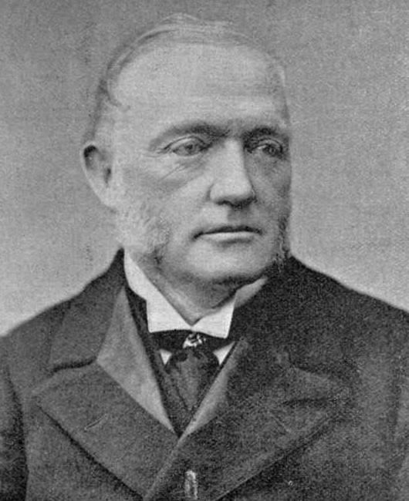
Work and Wages, Thomas Brassey

Slide 26
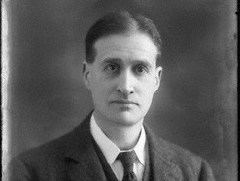

Slide 27
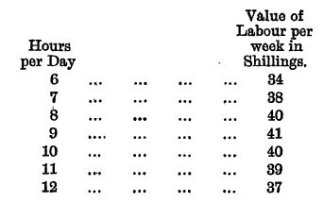

Slide 28
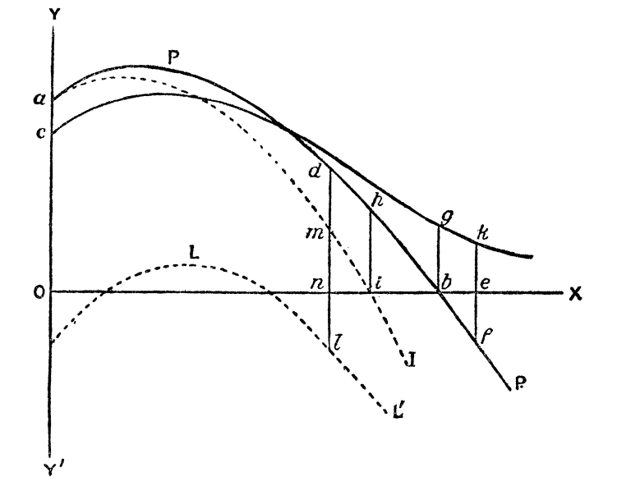
Chapman’s ‘Hours of Labour’ Analysis
Variation in output over time
Length of the working day over the long period

Slide 29
Adjusted for productivity gain

Slide 30
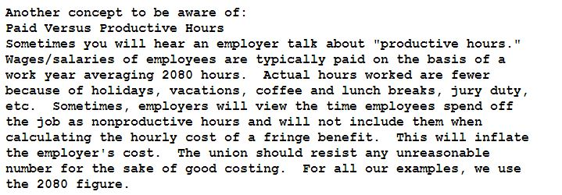
How to Cost Out Your Contract: The Mathematics of Collective Bargaining

Slide 31
OCAW

Slide 32
TW

Slide 34
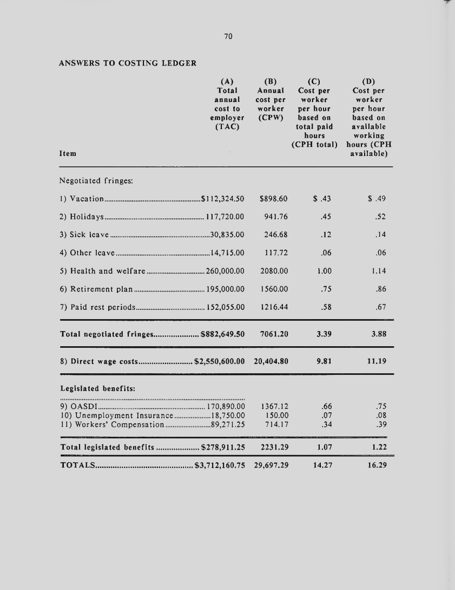
$427,649.50 (13%)
$2.02

Slide 35
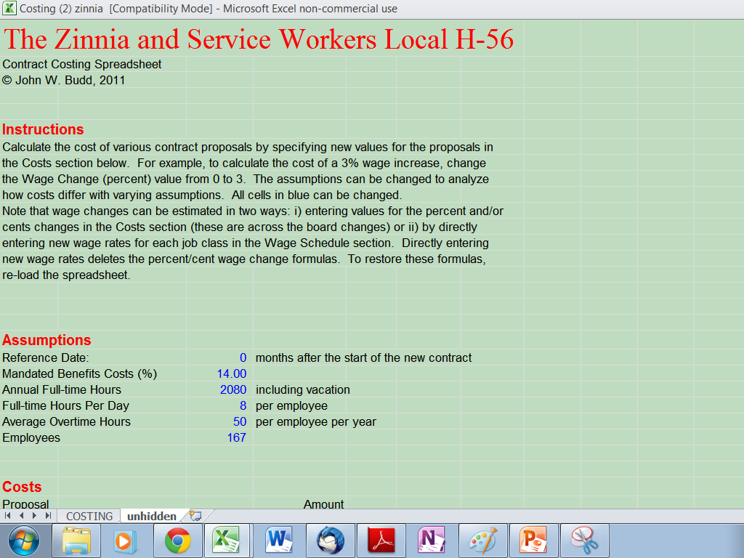

Slide 36
Options
Trust centre
Trust centre settings (over to right)
Trusted locations
Macros settings

Slide 37


