Slide 1
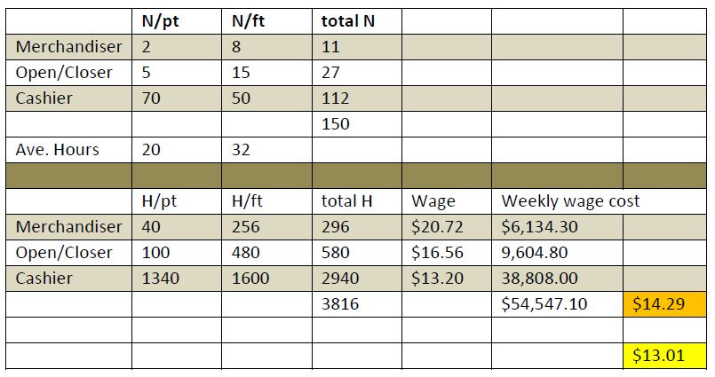

Slide 2
The table breaks down the proportion of wage rates in each job category and calculates a weighted average wage. The portion of the table above the dark shaded line shows the number of part time and full time workers in each of the three job categories. Average part time hours are assumed to be 20 and average full time hours are assumed to be 32. The weighted average wage cost is highlighted in orange = $14.29, which is approximately 10% above the $13.00 average wage (highlighted in yellow) announced in the Walmart wage increase.

Slide 3
Collective Bargaining as a Human Right
Wagner Act: Pernicious Euphoria
Roy Adams

Slide 4
"By most objective standards the Wagner Act Model must be judged a long term failure…The most astounding aspect of the labour policy story in Canada and the United States is that, despite the Model's failure to accomplish its essential objectives, there is very little pressure to scrap it."

Slide 5
In its 2007 BC Health Services Decision the Supreme Court of Canada… affirmed the human rights status of collective bargaining.
prior to the Supreme Court decision, it was neither treated by governments as a human right nor regarded by the public as a human right (Burkett 2005).

Slide 6
Canada was among the more enthusiastic supporters of collective bargaining’s human rights status in the international arena
promoted International Labour Organization’s 1998 Declaration of Fundamental Principles and Rights at Work that vigorously affirmed the human rights status of a core set of rights including collective bargaining

Slide 7
In its BC Health Services decision the Court stated that
“Canada’s adherence to international documents recognizing a right to collective bargaining … supports recognition of that right in s.2(d)2.”
“The Charter should be presumed to provide at least as great a level of protection as is found in the international human rights documents that Canada has ratified.”

Slide 8
Canadian governments put in motion a two part strategy.
public sector: organize a labour policy review “Social Dialogue” to find consensus on an approach, consistent with international norms, acceptable to all.
private sector: challenge labour and business to engage in a parallel exercise to develop an approach promising universal or near universal collective representation consistent with international norms.

Slide 9
Acceptance by management to conform to the Equator Principle that employers not “discourage workers from organizing and bargaining collectively” but instead accept the responsibility to recognize and negotiate in good faith with independent worker representatives.
Establish works councils composed of elected representatives with a statutory mandate to ensure effective implementation of all relevant social and labour legislation such as employment standards, and health and safety standards, to codetermine specified critical aspects of work such as training, employment equity, technological change, job sharing and the terms of plant shutdowns and to cooperate with management in improving the efficiency and competitiveness of the enterprise.
Public commitment by government to seek tripartite consensus on all issues critical to the interests of labour and management as they arise. This process is what the ILO calls social dialogue.

Slide 10
Pernicious Euphoria
The essence of the Wagner Act Model was "the administrative approach.“
the right of workers to join or form unions free from coercion had been affirmed through policy statements and legislation dating back to the turn of the century in both the United States and Canada.

Slide 11
mechanisms and procedures for making the principles effective:
the establishment of labour relations boards
procedures for identifying appropriate bargaining units,
procedures for determining the representativeness of trade unions as agents for employees in appropriate units
regulating the conduct of unions and employers in the context of union organizing campaigns
imposing sanctions for the commission of unfair labour practices.

Slide 12
the Wagner Act Model must be judged a long term failure in terms of original purposes:
  to encourage the practice and procedure of collective bargaining
  provide mechanisms whereby labour and management could work out disputes without those disputes erupting into overt conflict.
despite the Model's failure, there is very little pressure to scrap it.

Slide 13
North American custom and practice is unique. In most liberal democratic countries it is considered improper for employers to oppose worker representation.
American unions insisted that "company" unions be outlawed; the Wagner Act included a clause to that effect.
the outlawing of company unions had the effect of dissipating social pressure for the universal establishment of employee representation

Slide 14
After the great upheaval of the 1930s and 1940s it became increasingly difficult for unions to expand.
maintaining the level of membership was even more difficult because of the continual restructuring of the economy
unions in the mass production industries, lost thousands of members during restructuring in the early 1980s

Slide 15
Why aren't unions clamoring for an end of system?
interests of current members always must be placed ahead of those of potential members
Wagner Act Model has improved the capacity of union leaders to benefit current members
Wagner Act Model provides stability:
  Employers can’t refuse to negotiate with board certified unions;
  can’t renege on written contracts;
  can’t refuse to meet with union stewards to resolve grievances

Slide 16
Union leaders (as well as labour lawyers and company human resource experts) are professionally trained to function within the arena defined by the particular mode of regulation that it has brought forth
lack of knowledge and understanding about alternatives
strength of business unionism and the concomitant relative weakness of social unionism.
"the typical union dues structure discourages allocating resources where unions lack, and have no near prospect of achieving, a majority."

Slide 17
employers beyond the pale of the collective bargaining system have had to surrender no rights or authority but have been all but guaranteed a docile workforce
does not occur to unorganized employees to strike in order to bring pressure on their employer
labor leaders have come to accept that norm
it removed all social pressure to consult with employee representatives over conditions of employment
organized employers learned to like the Wagner Act Model was because it permitted them to insist on the inclusion of management's rights clauses in collective agreements

Slide 18
NEGATIVE CONSEQUENCES OF THE WAGNER ACT MODEL
1. In Canada approximately 60% of working people (75% in the private sector) are subject to rules unilaterally made and administered by their employers without their input.
2. In Canada there are two sets of rules - one for unionized workers and one for the unorganized. The rules for the unionized are similar to those generally available elsewhere. The rules for the unorganized are far inferior.
3. North American custom stimulates unorganized employers to suppress employee attempts to move towards representational democracy and organized employers to exclude labour representatives from as many decision areas as their bargaining strength will allow.

Slide 19
4. Managerial attempts at labour exclusion perpetuate labour-management animosity and "command and control" adversarialism. Wagnerism, in short, encourages conduct precisely opposite to high performance workplaces.
5. Compared to other advanced nations, Canadian economic performance has been slipping for several decades. In short, practices associated with Wagnerism have contributed to relative economic decline.
6.The routines elicited by the Wagner Act Model encourage union leaders to focus primarily on the interests of their own members sometimes to the disadvantage of non-members and to society as a whole.
7. Decentralized collective bargaining encourages both labour and management to disregard the overall public interest in the outcome of their negotiations.

