Slide 1
Towards Permanent Exceptionalism:
Coercion and Consent in
Canadian Industrial Relations
Leo Panitch and Donald Swartz

Slide 2
Coercion and Consent
Canadian legislation followed model of Wagner Act U.S.
wartime order-in-council PC 1003
Rand Formula
Industrial Disputes Resolution Investigation Act IRDIA 1948

Slide 3
Wagner Act, section 7: "employees shall have the right to self-organization, to form, join, or assist labor organizations, to bargain collectively through representatives of their own choosing, and to engage in other concerted activities for the purpose of collective bargaining or other mutual aid or protection..."

Slide 4
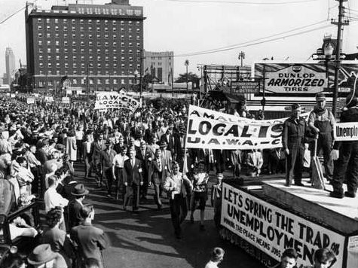
Wagner Act (U.S)
Wartime Order-in-Council PC1003 (Canada)
Industrial Relations Disputes Investigation Act IRDIA (Federal) 1948
Rand Formula

Slide 5
Aside: Origins of W.A. section 7
Black-Connerly thirty-hour bill
FDR thought unworkable, Perkins offered amendments to House version
A.F. of L. amendments to House version: include collective bargaining. “Get rid of Black Bill”
New Deal – N.I.R.A. incorporated coll. barg. right in section 7a: “something for labor”
Supreme Court ruled NIRA unconstitutional. Section 7a resurrected in section 7 of Wagner

Slide 6
Provincial labour codes modeled on federal
Quebec was a holdout until the “Quiet Revolution”
Expectation for slow, steady progress toward full collective bargaining rights.
When Quebec accepted collective bargaining it leapt ahead of other provinces.

Slide 7
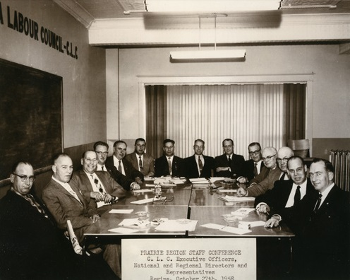

Slide 8
1960s a time of generational change.
Young worker militancy not contained by conservative labour leaders
Era of post war prosperity came to end in 70s
Nixon abandoned Bretton Woods gold convertibility of the U.S. dollar in 1971

Slide 9
anti-inflation act of 1975 – “day of protest” General Strike
Public Sector Restraint Act of 1982
coll. barg. rights suspended not revoked.
“Voluntary” coercion with public sector “the example”
“Temporary” “emergency” (permanent)

Slide 10
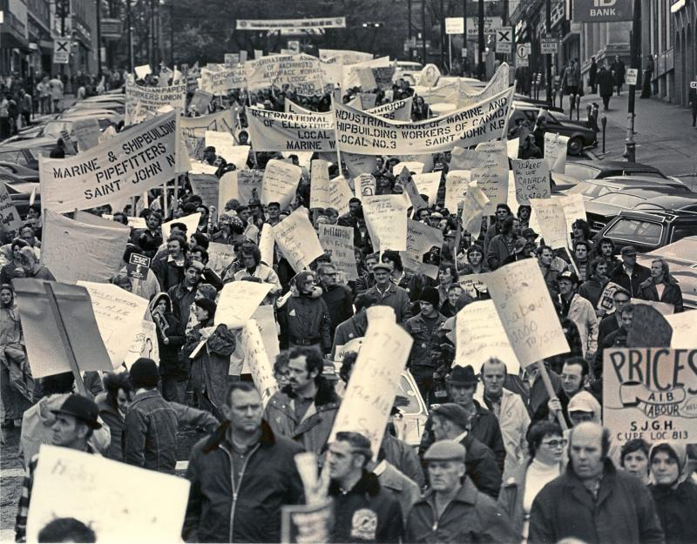

Slide 11
neoliberal policy regime
to fight inflation: wage controls (the lash of unemployment) on workers; “free trade,” loans, tax breaks, insurance, subsidies for business.
to fight deflation: austerity for workers; “free trade,” bailouts, tax breaks, loans to finance.
After Panitch and Swartz: NAFTA, globalization

Slide 12
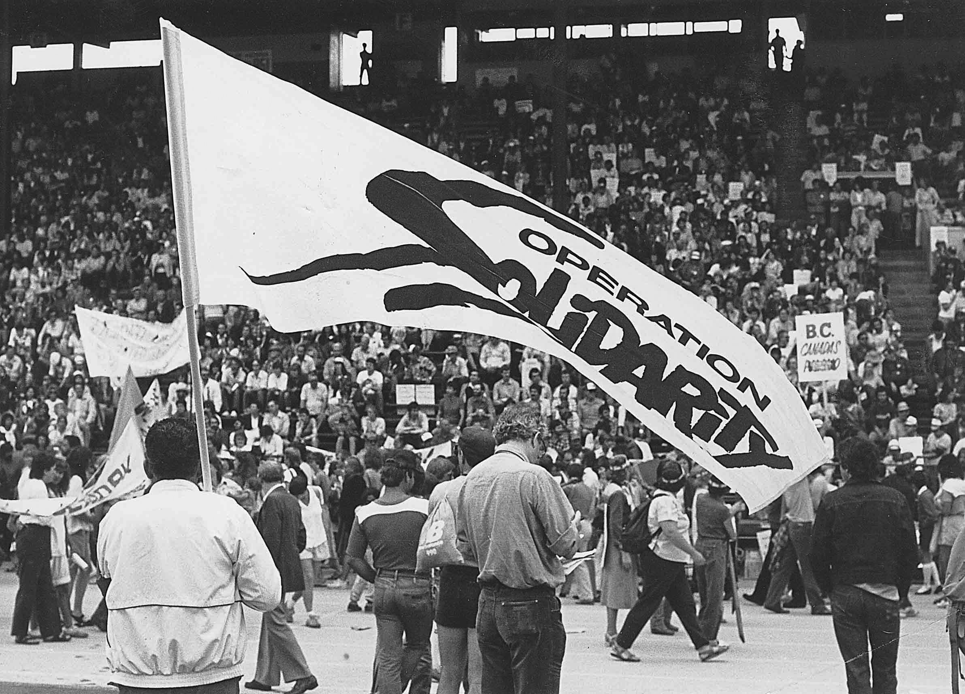

Slide 13
Limiting fight back; weakening militancy
Conservatism of labour leaders
legalistic certification and bargaining process
ban on strikes during contract
obligation of union leaders to enforce discipline

Slide 14
Today: restrictions on right to strike have become customary.
But supreme court rulings (latest on RCMP just recently) suggest new possibility.
Syriza anti-austerity victory in Greece

Slide 15


