Slide 1
Member Involvement

Slide 2
Why is member involvement important? (CUPE local 1281)
"Collective bargaining is not a process of debate in which one party outscores the other by raising the best debating points. It is an exercise of power, the outcome of which is determined by the abilities of each side to make effective use of its own power."
What is the union’s power? “The strength of members’ support for proposals.”

Slide 3
“Members must understand and support the bargaining proposals and be prepared to display their support.”
“This means that members must be involved in the bargaining process from the beginning.”
    http://www.cupe1281.ca/index.php?section_id=21

Slide 4
Examples of member involvement:
Election of and participation on bargaining committee
Informing members about wages and conditions in comparative workplaces and other issues affecting negotiations
Asking members what their priorities are for this round of bargaining
proposal package should be based on these priorities

Slide 5
More examples of member involvement
Getting feedback on the proposal package
Communicating with membership throughout the bargaining process on the progress of negotiations.
In the event of impasse, strike vote, job action
Explaining tentative agreement to members
Ratification of tentative agreement.

Slide 6
Power
“The outcome of bargaining is affected by the bargaining power the parties bring to the table. The most important source of power on the union side is the support of the members of the bargaining unit.”

Slide 7
Five basic principles
Inform
Motivate
Delegate tasks
Build momentum
Acknowledge contributions

Slide 8
More Resources
CUPE Bargaining Committee Handbook
CAW Collective Bargaining and Political Action Program, “Bargaining philosophy”
UNIFOR A New Union for a Challenging World: Unifor’s Vision and Plan
  “involvement” (4x)
  “participation” (6x)
  “engagement” (8x)

Slide 9
CAW
" Our members are more involved in bargaining than in anything else the union does. Their participation, and the democratic structure of our bargaining, are crucial to our continued progress."

Slide 10
CAW: Social Unionism
"Individual employers can never deliver these [broader social] goals [our members want]. That’s why our collective bargaining is always complemented by our work in the broader social and political arena, to win policies and programs that reinforce our progress at the bargaining table.”
Is social unionism enough? See Adams

Slide 11
UNIFOR “Membership Engagement”
“The founding of Unifor is a great opportunity to better engage our members – in the workplace, at home and on-line. Indeed, this is more than an opportunity: it is a necessity.”
“Without more active membership engagement, we cannot strengthen our movement and respond adequately to the assault on labour rights.” (pp. 11-12)

Slide 12
Howard G. Foster Unemployment and Hours of Work
Article in April 1966, Labor Law Journal
Response to “Shorter Workweek” pamphlet by Marcia Greenbaum, “lump of labor”
Both Cornell ILR grad students/researchers

Slide 13
purpose of paper
“to examine and evaluate the controversy over whether the AFL-CIO's bargaining and legislative objective of shorter working hours is or can be an effective device by which to combat unemployment.”
arguments against: vague and sometimes unsupported assertions
cutting hours can reduce unemployment, if effected in step with productivity increases.

Slide 14
The shorter workweek is one of the only issues of national labor policy on which the (Kennedy & Johnson) government unequivocally stood with management.
textbooks on labor economics also tend to reject the shorter-hours proposal. Again, it often seems to be accepted without challenge that unit labor cost must increase with a reduction in hours if weekly pay is held constant.

Slide 15
A common reason given by economists who reject the proposal of a shorter workweek is based on what they call the "lump of labor" fallacy.
shorter hours is one issue on which labor has received virtually no support outside of its own circles.
Hypothetical situation:

Slide 16
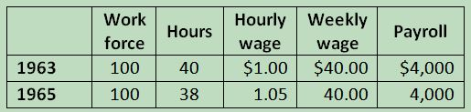
5% productivity gain in 2 years

Slide 17
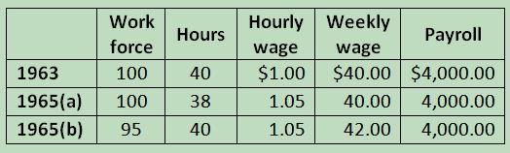
If no worktime reduction

Slide 18
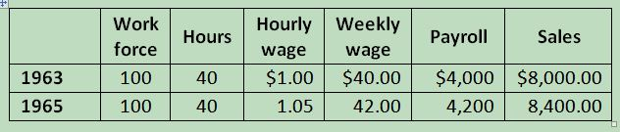
Sales increase, no work time reduction

Slide 19
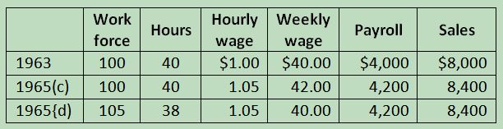
Sales increase, work time reduction

Slide 20
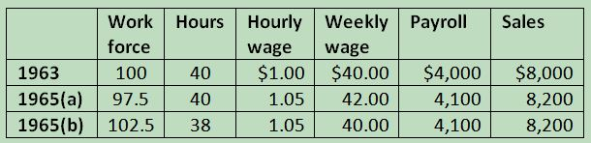

Slide 21
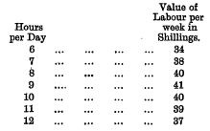
Chapman’s “Hours of Labour”

Slide 22
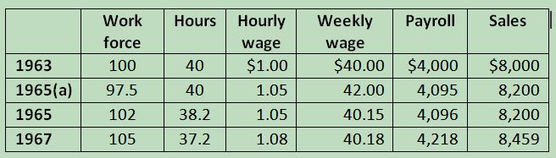
With productivity rebound from worktime reduction

Slide 23
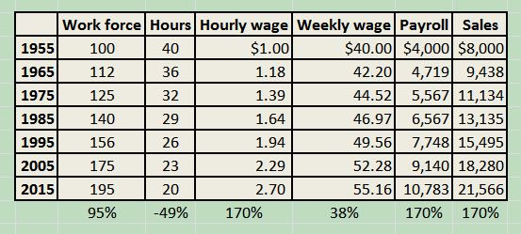
Long run: 2.77% productivity growth, taking 40% as shorter hours, 60% as higher wages

Slide 24
Whether you work by the piece or work by the day decreasing the hours increases the pay
 | Hours | Hourly Wage | Weekly wage
1955 | 40 | $1.00 | $40.00
1965 | 40 | 1.22 | 48.80
1975 | 40 | 1.34 | 53.60
1985 | 40 | 1.34 | 53.60
1995 | 40 | 1.25 | 50.00
2005 | 40 | 1.30 | 52.00
2014 | 40 | 1.27 | 50.80

