Slide 1
“Pluralism or Fragmentation?:
The Twentieth-Century Employment Law Regime in Canada”
Judy Fudge and Eric Tucker

Slide 2
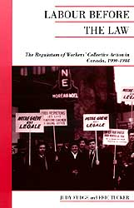

Slide 3
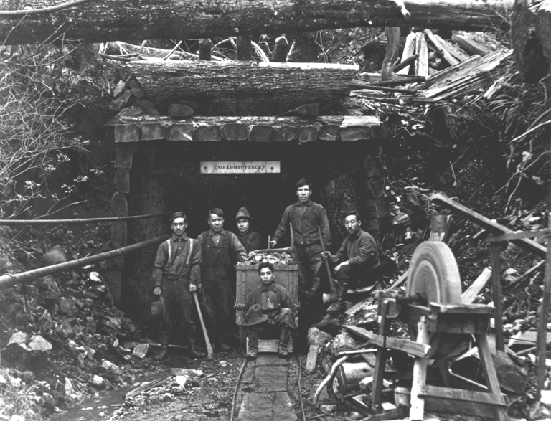

Slide 4
Industrial Voluntarism 1900-1948
Constructing the Regime of Industrial Voluntarism, 1900-1914
World War I Labour Policy, 1914-1918
The Defeat of the Post-War Workers' Revolt, 1918-1929
The Final Crises of Industrial Voluntarism, 1929-45
Refining the Contours of Industrial Pluralism, 1945-48

Slide 5
Industrial Pluralism, 1948-2000
Stalemate or Beachhead: 1948 -1964
The Golden Age of Industrial Citizenship: 1965-1980
Deepening Contradictions: 1980s
The Hegemony of the Market: The l990s

Slide 6
Fudge and Tucker
Employment a subset of broader domain of work has come to be treated as a synonym for work.
Work also includes small independent producers and [primarily] women in the household.
Focus on employment reflects the separation of home and waged work that characterized the new industrial age.
False equivalence (work/employment) is evidence of neo-classical vision of labour market in which employment dominates.

Slide 7
Exclusive focus less defensible at the end of 20th century.
Magnet for legal regulation because:
  through employment that most families obtained access to the means necessary for their survival
  conflictual character threatened to disrupt the social order.

Slide 8
Fudge and Tucker
Fudge and Tucker look at the regime of legal regulation through which employment relations are organized.
Central to the regime is the employment contract It legally subordinates worker to employer:
  implying duty of obedience and loyalty derived from older notions of status
  free exchange and
  exclusive property rights.

Slide 9
Fudge and Tucker
Three concepts of justice to deal with conflicts over employment relations:
  market competition, voluntary individual contracts
  Workers collective action offset employers' superior bargaining power
  Direct state regulation rooted in democratic politics norms of social and economic justice

Slide 10
Fudge and Tucker
by 1900, the regime consisted roughly of three parts:
the common law contract of employment,
the law of collective action, and
statutory minimum standards

Slide 11
Industrial Pluralism
After World War II, collective bargaining legislation administered by independent labour boards combined with a system of grievance arbitration to enforce collective agreements, to create a fundamentally different regime in which workers enjoyed the benefits of industrial citizenship (Harry Arthurs).

Slide 12
Sources of fragmentation
Fragmentation is socially constructed not "natural."
Canada's highly regionalized political economy
complicated and decentralized political geography that divides state power between national, provincial, and local authorities.
primary and secondary labour markets
ascribed characteristics such as gender and race

Slide 13


Slide 14
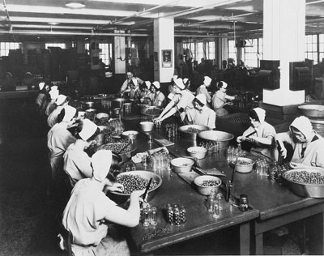

Slide 15
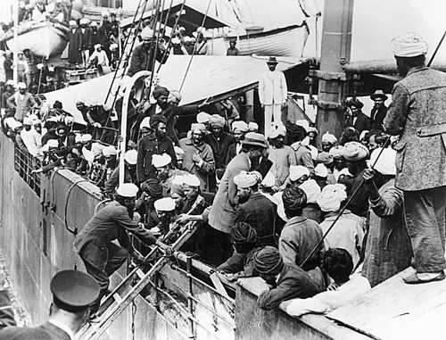

Slide 16
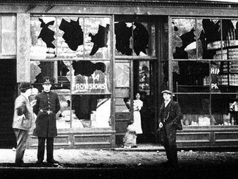

Slide 17
Fragmented labour markets
Law is an instrument and ideology through which fragmentation is institutionalized, reinforced and contested.
collective bargaining expanded selectively
most workers relied on individual contracts and minimum standards for the determination of their working conditions.
contours of labour market fragmentation significantly affected workers' access to the industrial regime's various components.

Slide 18
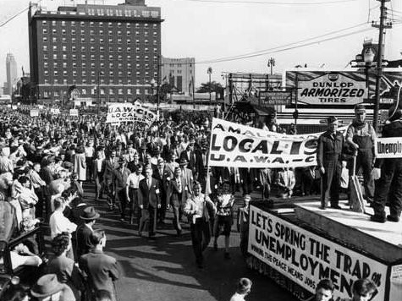

Slide 19
Refining the Contours of Industrial Pluralism, 1945-48
The Windsor Ford strike in 1945 set a number of important precedents
state would not deploy massive force
the Rand formula was used to settle the strike
established principle that trade unions were entitled to financial security (but not necessarily membership security)
dues check-off for all workers in the bargaining unit whether or not they were members of the union.

Slide 20
Background (Wells p. 200)
During the early war years, union stewards and committeemen were important allies of this resistance. Elected by groups of rank and file workers, they conducted informal negotiations with front line supervisors, and became the UAW's backbone as a workplace organization. This was partly due to dense representation the 1942 contract provided 50 stewards and 13 committeemen for some 7,000 members. There was also a sub-steward for every 50 or so workers. These latter played a critical role. While they collected dues and signed up new members, they communicated union policy to the members (and the members' concerns to the leaders) on a daily basis.

Slide 21
The 1945 Ford Strike and the Rand Formula
Considered "very hostile" by the UAW during contract bargaining, Ford submitted "drastic recommendations,“ and threatened major layoffs.
Local 200 went on strike in September 1945, just after the war ended.
on the plant floor the key issues were speedup and favouritism in job allocation.
the main bargaining issues were a dues check-off and union security.

Slide 22
importance
The 99-day strike by 10,000 Ford workers marked the start of the massive 1945-46 strike wave.
solidarity of the mass picketers, the community, and much of the organized Canadian and American industrial working classes.
its settlement set the contours of Canada's postwar Fordist industrial relations system.

Slide 23
not all UAW leaders supported the strike but impossible to restrain membership
politicians threatened military intervention against “insurrection”
Federal labour minister promised UAW leaders that he would appoint arbitrator who favored union security and dues check-off.
shop floor leaders not told of deal.

Slide 24
6,000 members at a meeting voted to reject their leaders‘ advice to end the strike and go to arbitration
UAW leaders had to force a second ballot before a majority of the members agreed.
arbitration decision a watershed in Canadian labour history.
Although he refused the union shop, Justice Rand granted the essence of union security: a dues check-off.

Slide 25
Big Price for Check-off
union paid a big price for the check-off.
prior to Rand, the stewards (particularly sub-stewards)collected dues on the plant floor,
Without dues-collecting function, the substewards disappeared.
union security provisions were not required to maintain a de facto union shop if workers were imbued with the spirit of rank and file unionism.
At Kelsey Wheel, they "dumped any newcomer who refused to join the union into a wheel barrow and rolled him out to the scrapheap"

Slide 26
UAW became financially independent of its members, it became dependent on management.
continued check-off was contingent on UAW repudiation of unauthorized strikes.
Rand's decision divided union leaders from their members in other ways
stewards and committee persons were to enjoy super-seniority during layoffs and in the allocation of overtime.
enhanced the power of the local leaders by giving them more authority to bring grievances to arbitration

Slide 27
Rand: “But the expense can properly be taken as the employer's contribution toward making the union through its greater independence more effective in its disciplinary pressure even upon employees who are not members, an end which the Company admits to be desirable.”
Despite these serious implications for the union's role as a demobilizer of militancy in the workplace, the Rand decision was seen as a major gain for labour.
The benefits were considered to be well worth the costs.

