Slide 1
BIOLOGY 1104
Evolution, Natural Selection and Ecology

Slide 2
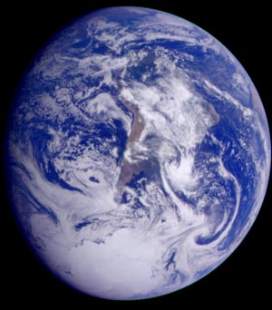
Introduction to Selection and Biodiversity
Cell
Multicellular organism
Population
Community
Ecosystem
Biosphere

Slide 3
Selection
Occurs when some force or phenomenon affects the survival of individual organisms.
The major force responsible for evolution and biodiversity
Occurs when a large population of individuals is exposed to a lethal factor and only resistant individuals survive to reproduce.
  If resistance is inherited, offspring will be resistant.

Slide 4
What key elements aid in the selection and survival of certain individuals and their genetic traits?

Slide 5
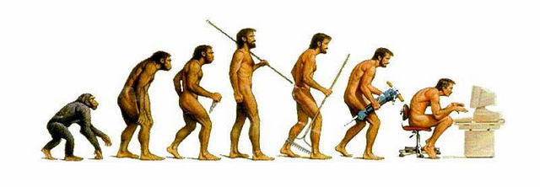
Evolution
A gradual change in the characteristics of a population over time
Can be the result of selection
Explains both the unity and diversity of life
All organisms alive today descended from a common ancestor.

Slide 6
Darwin’s Main Points on Evolution
Individual organisms in a population vary in many heritable traits
Any population has the potential to produce far more offspring than the environment can support. Competition for limited resources means that only some individuals survive.
Some individuals in the population have traits that give them an advantage in their local environment; these organisms are more likely to survive and reproduce.
These organisms pass on favourable traits to their offspring. Over time, the incidence of the trait(s) will change in the population.

Slide 7
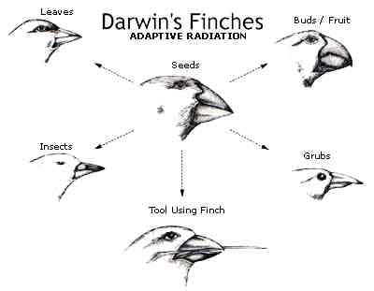
Different environments favour different traits
Even though all organisms share a common ancestor, they have diverged and evolved differently according to the selection pressures of different environments.

Slide 8
Adaptive radiation: A cluster of closely related species that are each adaptively specialized to a specific habitat or food source. Ex: Darwin’s Finches

Slide 9
1) How does the theory of evolution explain the unity and diversity of all life?
2) What are the four central ideas of Darwin's theory of evolution by natural selection?

Slide 10
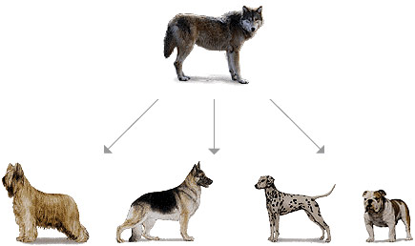
Microevolution:
Genetic Changes Within Populations

Slide 11
17.1: Variations in Natural Populations
Phenotypic variation: Differences in appearance and function that are passed from generation to generation.
  Quantitative variation: Individuals differ in small incremental ways. Ex: mass, height, length of toes.
  Qualitative variation: Exists in multiple discrete states (nothing in between). Ex: colour, gender
    Polymorphism: “many forms”. The existence of discrete variants of a character. To describe quantitavely, we calculate the frequency of each trait.

Slide 12
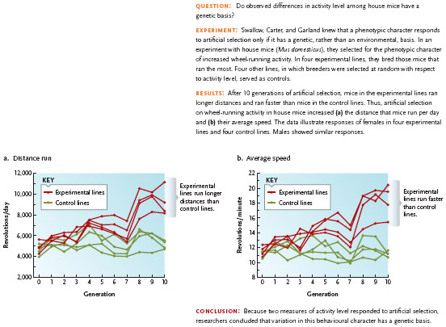
Phenotypic variation may be due to genetic and/or environmental causes.
  Genotype and phenotype may not be perfectly correlated.
  Only genetically based variation is subject to evolutionary change.
  To determine whether phenotypic variation is due to genetics or environmental factors, we perform breeding experiments.

Slide 13
Sources of genetic variation
  Production of new alleles:
    Small scale DNA mutations
  Rearrangement of existing alleles
    Changes in chromosome structure, number or genetic recombination (physical exchange of segments between the chromatids of homologous chromosomes or between the chromosomes of prokaryotic cells or viruses which leads to a phenotype with a different combination of traits from those of the original parents.)

Slide 14
What is a genetic polymorphism?
If a population of skunks includes some individuals with stripes and others with spots, would you describe the variation as quantitative or qualitative?
What factors contribute to phenotypic variation in a population?

Slide 15
17.2: Population Genetics
Gene pool: The sum of all alleles at all gene loci in all individuals
Genotype frequencies: percentage of individuals possessing each genotype.
Allele frequencies: the relative abundances of the different alleles

Slide 16
Hardy-Weinberg Equilibrium
Null model that defines how evolution does not occur.
Specifies the conditions under which a population of diploid organisms achieves genetic equilibrium
Genetic equilibrium: The point at which neither allele frequencies nor genotype frequencies change in succeeding generations.

Slide 17
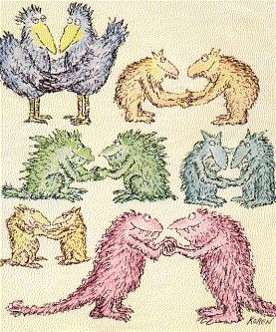
Dominant alleles need not replace recessive ones
Gene shuffling as a result of sexual reproduction does not cause the gene pool to change.

Slide 18
Hardy-Weinberg Conditions
No mutations occuring
No migration to and from other populations (no gene flow)
Population is infinite in size (no genetic drift)
All genotypes in the population survive and reproduce equally well (no natural selection)
Random mating is present

Slide 19
What comprises the gene pool of a population?

Slide 20
17.3 Agents of Microevolution

Slide 21
Mutations
A heritable change in DNA
Introduces new genetic variation in the population
Rare events, therefore they exert little to no immediate effect on allele frequencies of a population.
Accumulative, therefore,
Mutation is a major source of heritable variation

Slide 22
Types of Mutation
Deleterious Mutation:
  alter an individual’s structure/function/behaviour in harmful ways
  May or may not lead to fatality
Lethal Mutation:
  Cause the death of organisms carrying them
  If recessive, affects only homozygous recessive individuals
Neutral Mutation:
  Neither harmful nor beneficial
  May not even change phenotype of individual
Advantageous Mutation:
  Helpful to carrier
  Allele frequency may or may not increase over time

Slide 23
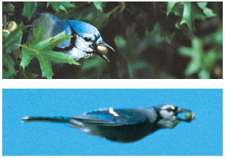
Gene Flow
Change in allele frequencies as individuals join a population and reproduce
May introduce genetic variation from another population
Documenting gene flow among populations is difficult
If populations are already similar, gene flow will have little effect

Slide 24
Genetic Drift
Random changes in allele frequencies caused by chance events
Reduces genetic variation, especially in small populations
Can eliminate alleles
Chance deviations occur whenever sexual reproduction occurs

Slide 25
Two General Circumstances that can cause Genetic Drift
Population Bottlenecks:
  Epidemics, starvation, drought or any other event that results in a wipeout of a significant portion of a population creates a population bottleneck.
  Reduces genetic variation, even if numbers rebound
Founder Effect:
  When a few individuals move to a new region and start a new population
  Some alleles may be missing in new population, rare alleles may be less rare now
  Change in gene pool

Slide 26
Natural selection
Differential survivorship or reproduction of individuals with different genotypes
One allele can replace another or allelic variation could be preserved
It is the phenotype of an individual organism, rather than any particular allele, that is successful or not.
Exerts little to no effect on traits that appear during an individual’s post reproductive life

Slide 27
Types of Selection
Directional Selection:
  Shifts a trait away from the existing mean towards a favourable extreme
  Extremely common
Stabilizing Selection:
  Eliminates phenotypic extremes (mean is favourable.)
  Most common mode
Disruptive Selection:
  Both extremes are favourable, mean is not.
  Promotes polymorphism

Slide 28
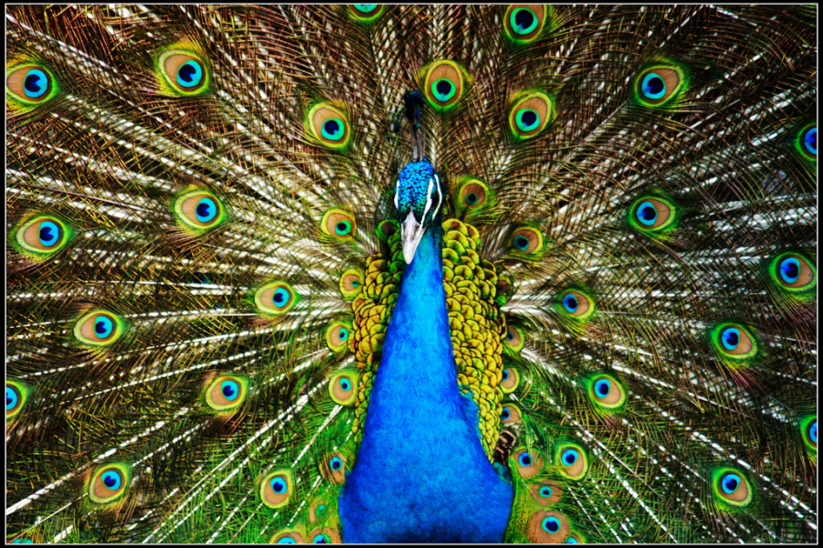
Sexual Selection
Fosters the evolution of showy structures: bright feathers, long tails, impressive antlers.
Intersexual: selection based on attractiveness
Intrasexual: selection based on competition
Most probable cause of sexual dimorphism (differences between males and females)

Slide 29
Non Random Mating
Choice of mates based on their phenotype and genotype
Does not directly affect allele frequencies but usually prevents genetic equilibrium.
Random mating occurs more often
Inbreeding is non random. Inbreeding decreases heterozygote genotypes because relatives usually have the same alleles.

Slide 30
Which agents of microevolution tend to increase genetic variation within populations, and which ones tend to decrease it?
In what way does non random mating affect the predictions of the Hardy–Weinberg equation?

Slide 31
17.4 Variation
Dipoloidy can hide recessive alleles.
May be caused by environmental or genetic factors
Heterozygote Advantage: when heterozygotes for a particular locus have higher relative fitness than either homozygote. Ex: Sickle Cell Anemia
Frequency-Dependent Selection: when rare phenotypes have a selective advantage simply because they are rare.
  Eventually it becomes so common that it loses advantage

Slide 32
Acclimation: variation due to environmental factors
Adaptation: variation due to genetic factors

Slide 33
17.5 Adaptation
The accumulation of adaptive traits over time
Increases the “fitness” of an organism
Natural selection does not select the fittest but the fit enough.

Slide 34
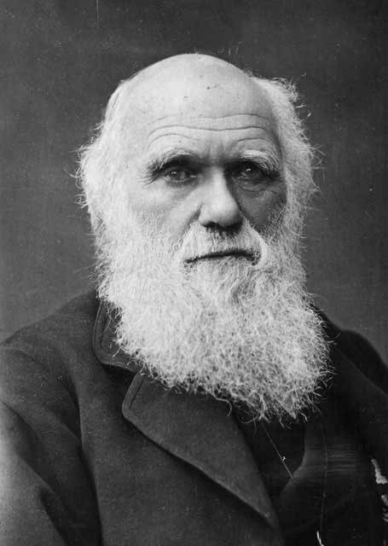
Charles Darwin (1809-1882)
HMS Beagle (Darwin’s voyage):
  Observed the distribution of species on the Galapagos Islands
Artificial Selection: selectively breeding individuals with favourable characteristics
Proposes the Theory of Evolution by Natural Selection

Slide 35
What makes Darwin’s theory unique?
Provides physical and not spiritual explanations for the origins of biological diversity.
Recognizes that evolution occurs in groups of organisms, not individuals. Some members of a group survive and reproduce more successfully than others.
Evolution is a multistage process: mutation, variation, selection, adaptation!
Evolution occurs because organisms function better than others in a particular environment.

Slide 36
Chapter 18: Speciation
Allopatric Speciation:
  Occurs when two populations become geographically separated.
  Over time, they accumulate genetic differences that separates them reproductively.
Parapatric Speciation:
  Occurs when two populations live beside each other and hybrid offspring have low fitness.
Sympatric Speciation:
  Reproductive isolation evolves between two distinct subgroups that arise within one population.

