Slide 1
Sensation and Perception
Chapter 4

Slide 2
Difference between
Sensation and Perception
Sensation is the stimulation of sense organs
  i.e. absorbing energy from light by the eyes
Perception is the selection, organization, and interpretation of sensory input
  translating the sensory input into something meaningful.
These two are hard to separate because people automatically start organizing incoming sensory stimulation the moment it arrives

Slide 3
Psychophysics
The study of how physical stimuli are translated into psychological experience
  Psychologists in this area are interested mainly in sensation and perception
Sensation begins with a detectable stimulus
  But what counts as detectable depends on whom or what is doing the detecting
Gustav Fechner (1860) – The concept of threshold
  He questioned, for any given sense, what is the weakest detectable stimulus
  Threshold:
    A dividing point between energy levels that do and do not have a detectable effect
  Absolute Threshold
    The minimal amount of stimulation that an organism can detect
    Researchers further defined it as the stimulus intensity that can be detected 50% of the time

Slide 4
Psychophysics
Just Noticeable Difference (JND)
  JND: smallest difference in the amount of stimulation that a specific sense can detect
  People’s sensitivity to difference in stimuli
Weber’s Law
  Demonstrated by Ernst Weber
  The law states that the size of a just noticeable difference is a constant proportion of the size of the initial stimulus
    If there is an increase in magnitude, then the just noticeable difference becomes larger
    300 grams of weight versus 310 grams of weight
    900 grams of weight versus 910 grams of weight
      Magnitude of 900 grams is greater than 300 grams --- therefore a larger difference is needed to be noticed

Slide 5
Psychophysics
Signal Detection Theory
  The detection of stimuli involves decision processes as well as sensory processes
    Both are influenced by a variety of factors besides stimulus intensity
  4 possible outcomes in Signal Detection Theory
    Hits – detecting signals with they are present
    Misses – failing to detect signals whey they are present
    False Alarm – detecting signals whey they are not present
    Correct Rejections – not detecting signals when they are absent

Slide 6
Psychophysics
Subliminal Perception
  The registration of sensory input without conscious awareness
    Means below the threshold
Many researchers have demonstrated that perception can occur without awareness
  Subliminal messages in advertising
    Research shows that the effects of subliminal perception are relatively weak and of little practical impact
Prolonged stimulation may lead to sensory adaptation -- a decline in sensitivity to the stimulus
  i.e. the pool is only cold at first

Slide 7
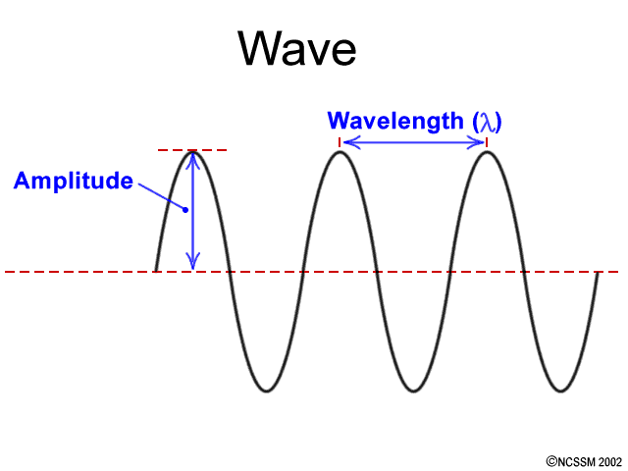
Vision
Light is electromagnetic radiation that travels as a wave
  The height of a light wave (amplitude) affects brightness
  The wavelength (distance between peaks) affects colour
    Individuals light waves vary from one another
  Purity of a light wave is determined by how many different wavelengths are mixed together
    Influences the perception of saturation, or richness of colours.
Our Eyes have two main purposes
  Provide housing for the retina: the neural tissue that receives light
  Channeling light toward the retina

Slide 8
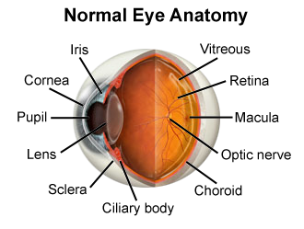
The Eye
  Lens - Focuses the light rays on the retina
    Visual deficiencies
      Nearsightedness: close objects are seen clearly
      Farsightedness: distant objects are seen clearly
  Retina
    A piece of neural tissue that lines the back of the eye
    It absorbs light
    Processes images
    Sends information to the brain
Optic disk
  A hole in the retina where the optic nerve leaves the eye
    Blind spot – images that fall on this spot cannot be seen

Slide 9
The Eye
Visual Receptors
  Rods
    Plays a key role in night vision and peripheral vision
  Cones
    Plays a key role in daylight vision and colour vision
  Fovea
    A tiny spot in the centre of the retina that contains only cones
      Visual acuity is greatest at this spot
Adaptations
  Dark adaptation
    Process where the eyes become more sensitive to light in low illumination
  Light adaptation
    Process whereby the eyes become less sensitive to light in high illumination

Slide 10
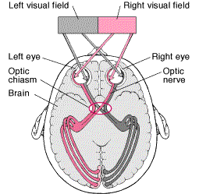
Visual Information Processing
Receptive Fields
  The collection of rod and cone receptors that funnel signals to a particular visual cell in the retina
Light strikes the rods and cones
  Rods and cones triggers neural signals
    Neural signals move to bipolar cells and then continue to move to ganglion cells
      Neural signals continue along the optic nerve to the optic chiasm
      At this point the optic nerves from the inside half of each eye cross over and project to the opposite half brain
        This crossing ensures that signals from both eyes go to both hemispheres of the brain.
        After the crossing, 2 visual pathways exist

Slide 11
Visual Pathways
The Main Pathway
  Goes through the lateral geniculate nucleus in the thalamus and on to the primary visual cortex in the occipital lobe
    Divided into two subspecialty pathways
      The magnocellular channel handles brightness
      The parvocellular channel handles perception of colour
        These channels engage in parallel processing, which involves simultaneously extracting different kinds of information from the same input
The Other Pathway
  Goes through the superior colliculus to the thalamus and onto the primary visual cortex

Slide 12
Colour Vision
Colour is a function of the dominant wavelength in a mixture of wavelengths
  Lights with longer wavelengths appear red
  Lights with shorter wavelengths appear violet
  Colour is a psychological interpretation
    The “colour” we see is the wavelengths that are being reflected by a specific object
Humans can differentiate between millions of colours
  Mixing of colours helps with this process
Subtractive Colour Mixing
  The removal of some wavelengths of light – leaving less light than was originally there
Additive Colour Mixing
  Superimposing lights – putting more light in the mixture than exists in any one light by itself

Slide 13
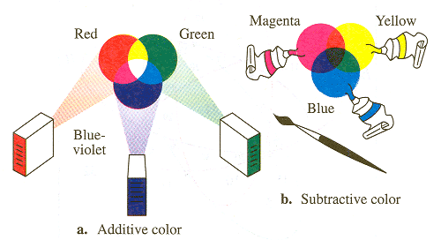

Slide 14



Effects of Colour on Behaviour
Andrew Elliot and colleagues (2007) reported that colours can have automatic, unconscious effects on behaviour
People learn associations based on certain colours being paired repeatedly with certain experiences
What do you think when you see . . .
  Red ink on your homework?
  Red sign while driving?
  Pink ribbon?

Slide 15
Information Processing
We need to understand how people organize their visual inputs
Feature analysis
  The process of detecting specific elements in visual input and assembling them into a more complex form
  Include two different processes
    Bottom-up processing
      A progression from individual elements to the whole
    Top-down processing
      A progression from the whole to the elements
      i.e. being able to read a word before its individual letters

Slide 16

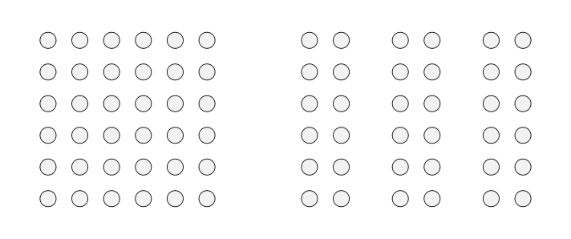
Gestalt Principles of Perception
As we learned in Chapter 1, Gestalt psychologist demonstrated that the whole can be greater than the sum of its parts
  Gestalt emphasis is still present in the study of perception
1. Figure and Ground
  Dividing visual displays into figure and ground helps people organize visual perceptions
    Figure: the thing being looked at
    Ground: the background
2. Proximity
  Things that are close to one another seem to belong together

Slide 17
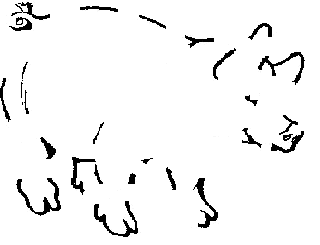
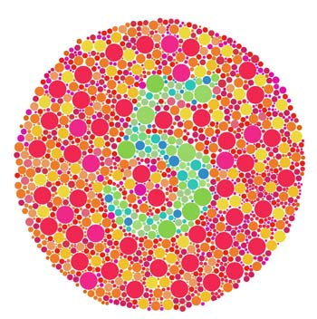
Gestalt Principles of Perception
3. Closure
  Group elements to create a sense of closure – or completeness
    May “close” an image that has gaps in it
4. Similarity
  Group stimuli that are similar
    Objects of the same colour may be grouped together to see a larger image

Slide 18

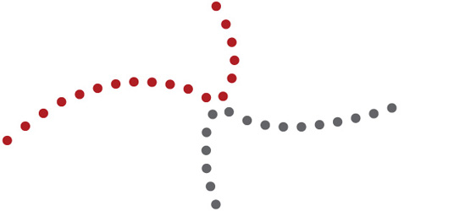
Gestalt Principles of Perception
5. Simplicity
  Group elements that combine to form a more simpler figure
6. Continuity
  To follow in whatever direction your eye has been led
    Connection of points that result in a “smooth” path

Slide 19
Gestalt - Perceptual Hypotheses
Need to understand how these organized perceptions result in a representation of the real world
Two Kinds of Stimuli
1. Distal stimuli
    Stimuli that lies in the distance (in the world outside the body)
      These are the objects you are looking at
2. Proximal stimuli
  Stimuli energies that impact directly on sensory receptor
    Images formed by patterns of light falling on the retinas
    Stimuli are distorted 2-dimensional versions of their actual 3-dimensional counterparts

Slide 20
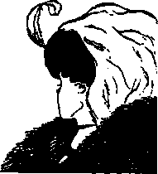
Formulating Perceptual Hypotheses
Perceptual hypothesis
  An inference about which distal stimuli could be responsible for the proximal stimuli sensed
    People make educated guesses about the pattern to determine what they are exactly viewing
    The context in which something appears often guides people’s perceptual hypotheses

Slide 21
Perceiving Depth or Distance
Depth Perception
  Interpretation of visual cues that indicate how near or far away objects are
  People rely upon two types of cues to judge distance
    Binocular and Monocular Cues
1. Binocular Cues
  Clues about distance based on the differing views of the two eyes
Retinal disparity
    The fact that objects project images to slightly different locations on the right and left retinas --- the right and left eye see slightly different views of the object
    The closer the object gets the greater the disparity between the images
Convergence
    sensing the eyes converging toward each other as they focus on closer objects

Slide 22
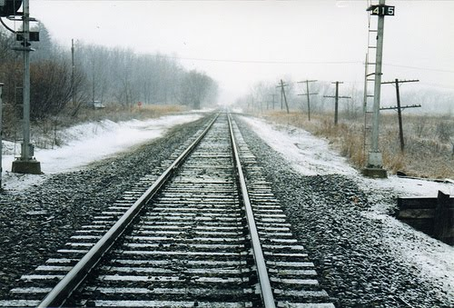

    Perceiving Depth or Distance
2. Monocular Cues
  Clues about distance based on the image in either eye alone
  Motion Parallax
    Images of objects at different distances moving across the retina at different rates
  Pictorial Depth Cues
    clues about distance that can be given in a flat picture
    Linear perspective
      reflecting the fact that lines converge in the distance
    Texture gradients
      details of an object are too small to see when the object is far away

Slide 23
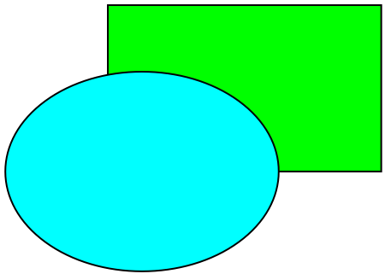
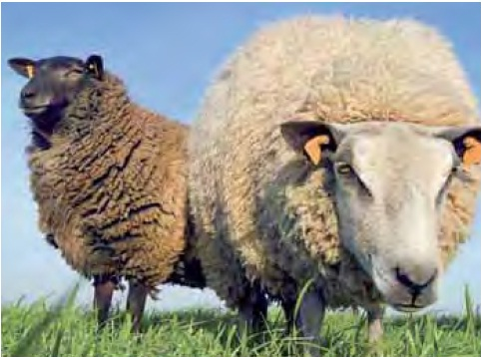
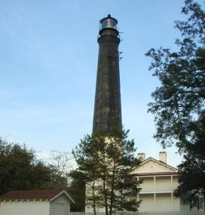

Perceiving Depth or Distance
  Pictorial Depth Cues (continued)
Interposition
  when an object becomes between you and another object allowing you to know that one object is closer
Relative size
  closer objects appear larger
Height in plane
  distant objects appear higher in a picture
Light and shadow
  effects of shadowing help judge distance

Slide 24
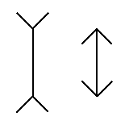
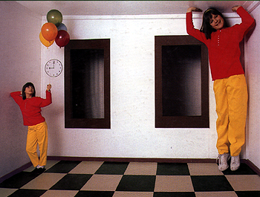
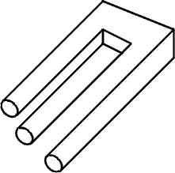
Optical Illusions
Optical Illusion
  An apparently inexplicable discrepancy between the appearance of a visual stimulus and its physical reality
Muller-Lyer Illusion
  Two vertical lines are equal in length, but appear different
Ames Room
  A room built with a trapezoidal rear wall and a sloping floor and ceiling
Impossible Figures
  Objects that can be represented in two-dimensional pictures but cannot exist in three-dimensional space

Slide 25
Sense of Hearing
  Sound waves are vibrations of molecules traveling through the air
  Characterized by:
    Amplitude (loudness)
      Description of sound pressure and is measured in decibels (db)
      Perceived loudness is higher with increasing decibel level
    Wavelength (pitch)
      Described in terms of frequency and is measured in cycles per second, or hertz (Hz)
      In general, the higher the frequency (more cycles per second), the higher the pitch
    Purity
      A single frequency vibration is the purest – i.e. a tuning fork
      Most sounds are complex mixtures of frequencies

Slide 26
Sense of Hearing
Timbre
  The quality of a sound that distinguishes different types of sound production
    It is what makes a particular sound different from another --- even if they have the same pitch and loudness
    i.e. the difference in sound when a b-flat is played with the same pitch and loudness on a French horn and a piano

Slide 27
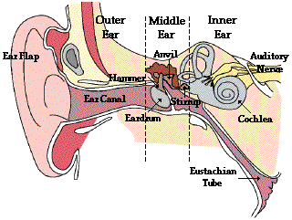
The Auditory Pathway
Sound waves vibrate bones of the middle ear
Stirrup hits against the oval window of cochlea
Sets the fluid inside in motion
Hair cells are stimulated with the movement of the basilar membrane
Physical stimulation converted into neural impulses
Sent through the thalamus to the auditory cortex (temporal lobes)

Slide 28
Auditory Localization
Auditory Localization
  Locating the source of a sound in space
2 Important Cues
  Intensity – Loudness
  Timing of sounds arriving at each ear
    A sound in your left ear produces a greater intensity in your left ear, as opposed to your right ear.
      Also, your head produces a “shadow” or partial sound barrier
    Humans have been shown to detect timing differences as small as 1/100,000 of a second

Slide 29
Taste
The Gustatory System
  Stimuli for taste are chemical substances that are dissolvable in water
  Receptors for taste are cells found in the taste buds
    They line the trenches around tiny bumps on the tongue.
    These cells absorb chemicals, trigger neural impulses, and send the information throughout the thalamus and on to the cortex
  Four primary tastes
    Sweet, Sour, Bitter, and Salty
    Unevenly distributed on the tongue
      Taste results from a complex blend of these 4
      Learned and social processes also affect our preferred tastes
        Cultural difference
        Western versus Non-Western dietary habits

Slide 30
Smell
The Olfactory System
  Stimuli: substances carried in the air
  Dissolved in the mucus in the nose
  Olfactory receptors are called olfactory cilia and are located in the upper portion of the nasal passages
    Receptors synapse directly with cells in the olfactory bulb at the base of the brain.
    Olfaction is the only sense, therefore, that is not routed through the thalamus
  Humans can distinguish among about 10,000 odours, but for some reason have a hard time attaching names to odours quite frequently
Smell as a form of communication
  Pheromones: chemical messages that can be sent by one organism to another member of the same species

Slide 31
Touch
When our skin is “stimulated” it can occur in three forms:
Temperature is registered by free nerve endings in the skin that are specific for cold and warmth
Pain receptors are also mostly free nerve endings which transmit information to the brain via two types of pathways...
The fast pathway that registers localized pain and relays it to the brain in a fraction of a second
The slow pathway that lags a second or two behind and carries less localized, longer-lasting aching or burning pain
Mechanical – pinching or crushing
Chemical -- bleach on your skin
Thermal – heat and cold

Slide 32
Feeling Pain
Gate-control theory
  Incoming pain sensations must pass through a “gate” in the spinal cord that can be closed, thus blocking ascending pain signals
    Not a physical “gate” – but neural activity that inhibits incoming pain signals
The psychological element in pain perception is clear when something distracts your attention from pain and the hurting temporarily disappears

Slide 33
Other Senses
The Kinesthetic System
  Monitors the positions of the various parts of the body
  Kinesthetic receptors lie in the joints indicating how much they are bending
    They are also in the muscles registering tautness or extension
The Vestibular System
  Responds to gravity and keeps you informed of your body’s location in space
  Provides your sense of balance and equilibrium
  Fluid-filled semicircular canals, filled with hair cells, make up the largest part of the vestibular system
    When your head moves, the fluid moves, which moves the hair cells, which in turn initiate neural signals that travel to the brain

Slide 34
Questions?
Comments?

