Slide 1

Chapter 12
Differential Analysis and Product Pricing

Slide 2
Learning Objectives
Prepare a differential analysis report for a variety of managerial decisions.
Determine the selling price of a product, using the total cost, product cost, and variable cost concepts.

Slide 3
Differential Analysis
Differential analysis looks at the effects of different alternatives.
  Uses estimated revenues and costs
  Focuses on differences in revenue and differences in costs between alternatives.
  Focuses on relevant revenues and costs.
  Ignores sunk costs – those costs that have occurred in the past and are irrelevant for future decision making.

Slide 4

Cost Concepts for Decision Making
A relevant cost is a cost that differs between alternatives

Slide 5
Relevant Costs
Avoidable Costs – those that can be eliminated in whole or in part by choosing one alternative over another.
Opportunity Costs – economic benefits foregone as a result of pursuing some course of action.

Slide 6

Irrelevant Costs
Sunk Cost – a cost that has already been incurred and that cannot be avoided regardless of what a manager decides to do

Slide 7
Differential Analysis in 4 (not 6) Situations
Discontinuing an unprofitable segment.
Manufacturing or purchasing a needed part.
Processing further or selling an intermediate product.
Accepting additional business at a special price.

Slide 8
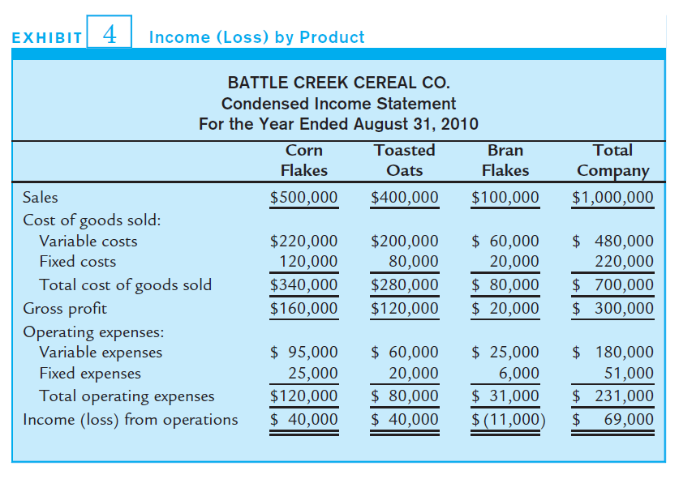
Discontinue a Segment/Product:
Montana Wheat Cereal Co. produces and sells three kinds of cereal. Bran Flakes exhibits an operating loss so the company is considering discontinuing production and sale of the product.

Slide 9
What are the relevant revenues and costs for this decision?
What will change if Bran Flakes are dropped?

Slide 10
Discontinue a Segment/Product
Need to know how fixed costs would behave if Bran Flakes were dropped:
  Are the fixed costs allocated Bran Flakes going to continue if Battle Creek does not make Bran Flakes anymore?
OR
  Are the fixed costs specific to the production of Bran Flakes? i.e. will the fixed costs be saved if Bran Flakes are dropped?

Slide 11
Discontinue a Segment/Product
Let’s assume that the fixed costs are only allocated to Bran Flakes – they will continue to be incurred even if the line is dropped.
Differential Analysis Report
Differential revenue from annual sales of Bran Flakes
Revenue from sales |  |  | $100,000
Differential cost of annual sales of Bran Flakes:
- Variable Cost of Goods Sold |  | $60,000
- Variable operating expenses |  | 25,000 | 85,000
Annual differential income from sales of Bran Flakes |  |  | $15,000

Slide 12
It’s not just about the money!
What else should Battle Creek consider in their decision to drop Bran Flakes?

Slide 13
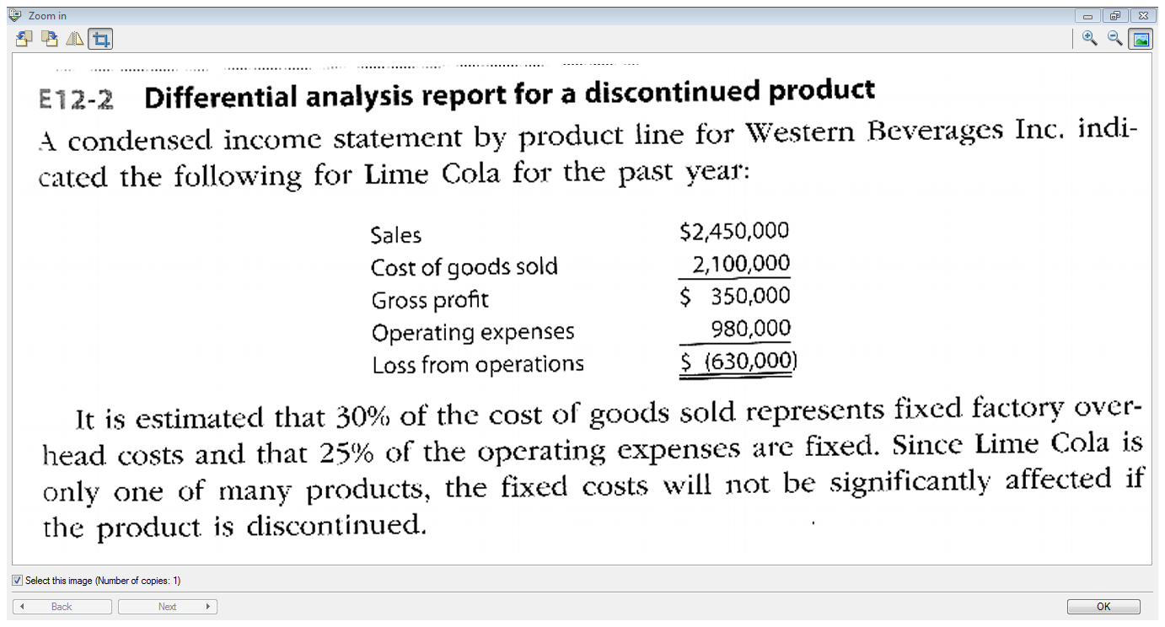

Slide 14
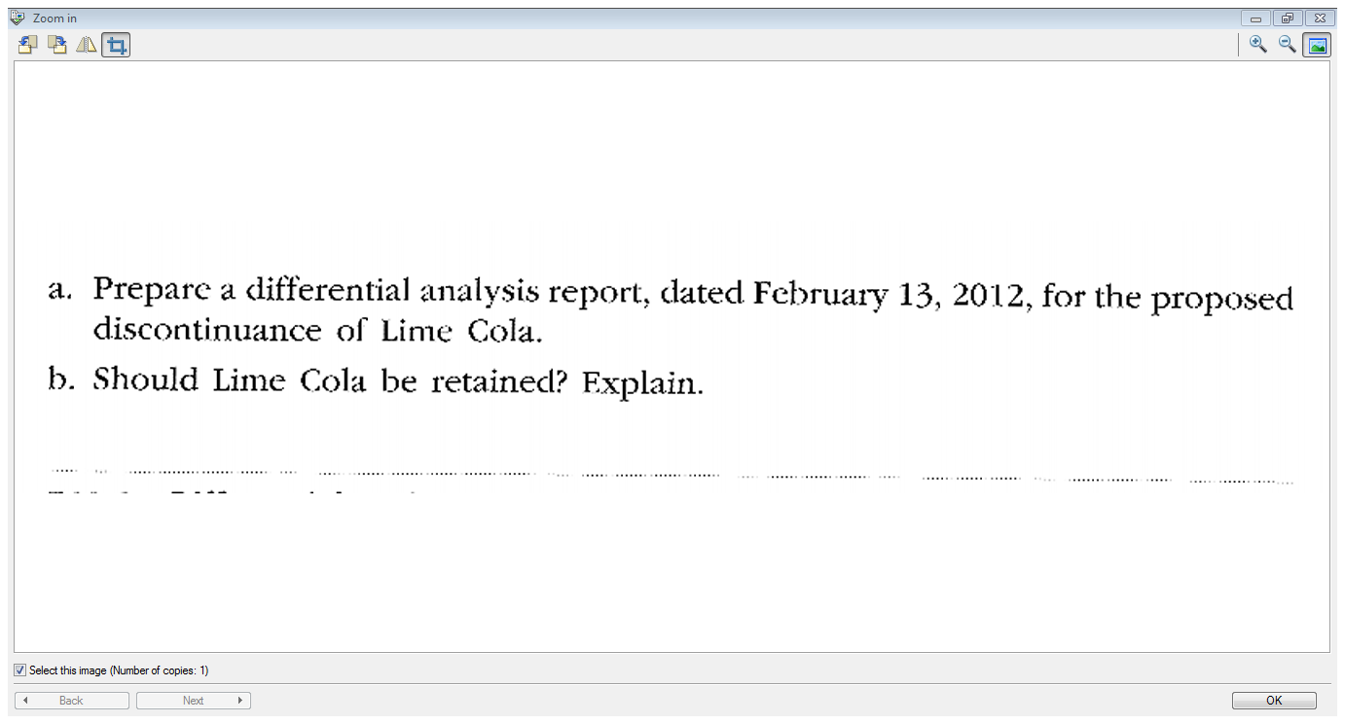

Slide 15
Make or Buy
An automotive company has been buying instrument panels for $240 per unit. It is considering making the part at the following cost:
  $80 in direct materials
  80 in direct labor
  52 in variable overhead
  68 in fixed overhead
  $280 Total cost per unit
  The factory is currently operating at 80% of capacity.
Should the company make or buy the part?

Slide 16
What are the relevant revenues and costs for this decision?
What costs and revenues will change if the company makes the instrument panel?

Slide 17
Make or Buy Differential Analysis:
Proposal to Manufacture Instrument Panels
Purchase price of a panel |  | $240
Differential costs to manufacture:
Direct Materials | $80
Direct labour | 80
Variable factory overhead | 52 | 212
Cost savings from manufacturing an instrument panel |  | $28
Focus the analysis on differential costs.
If the automotive company has excess factory capacity, fixed costs are not relevant to the decision since they will not change.

Slide 18
It’s not just about the money!
What else should the automotive company consider in their decision to make versus buy the part?

Slide 19
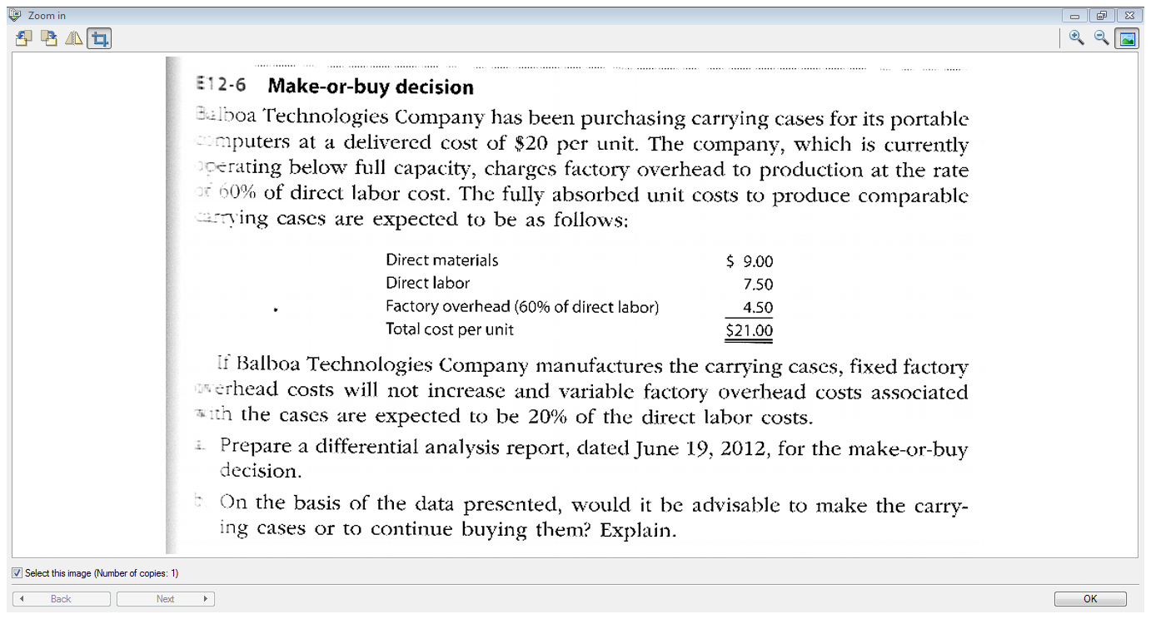

Slide 20
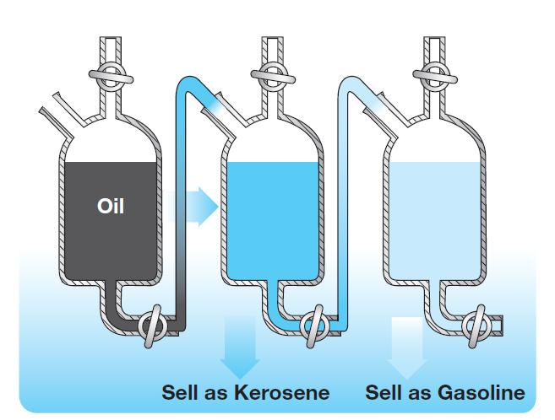
Process Further or Sell
4,000 gallons of kerosene can be sold at $2.50/gal
A 4,000 gallon batch of kerosene sells at $2.50 per gallon; produced from 4,000 gallons of raw material costing $0.60 per gallon.
Alternatively, could continue processing the raw material into gasoline selling at $3.50/ gallon for an additional cost of $650 per batch; 20% of the gallons of kerosene will evaporate during production.
Should the company sell or process further?
4,000 gallons of oil costing 60¢/gal
3,200 gallons of gas can be sold $3.50/gal

Slide 21
Process Further or Sell
So what costs and revenues will change if they decide to process the kerosene further to make gas?

Slide 22
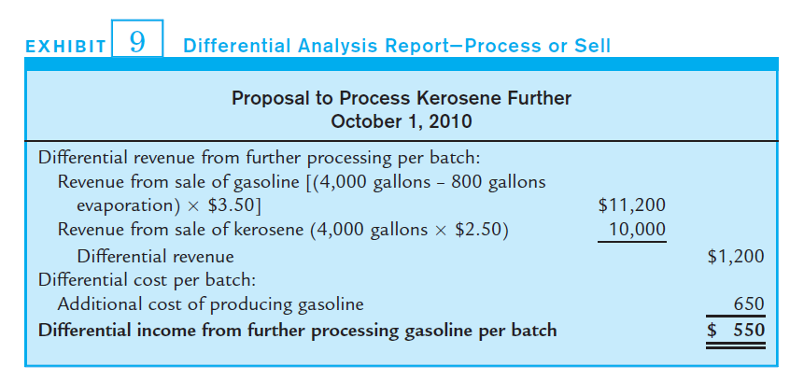
Process Further or Sell Differential Report
Initial raw material cost will be incurred in both alternatives and is not considered.
The differential revenue and the cost to process the batch further will be the focus.

Slide 23
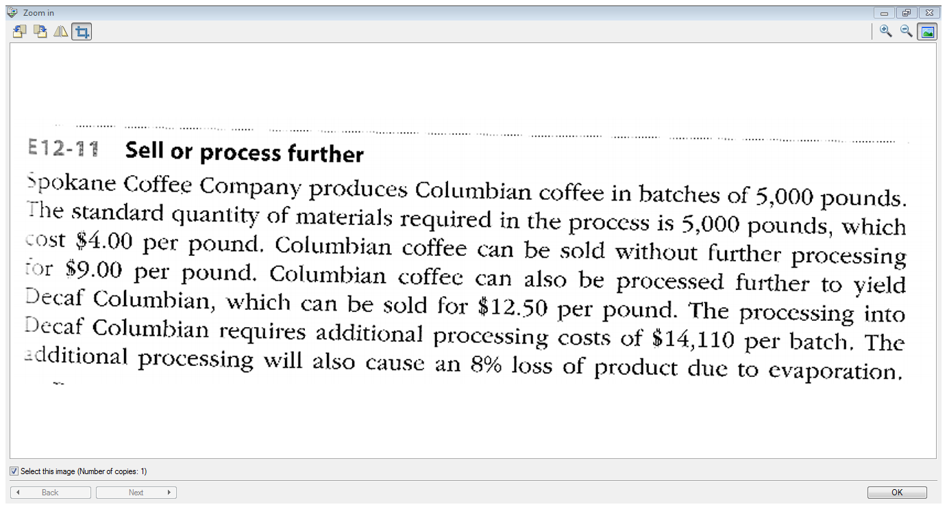

Slide 24
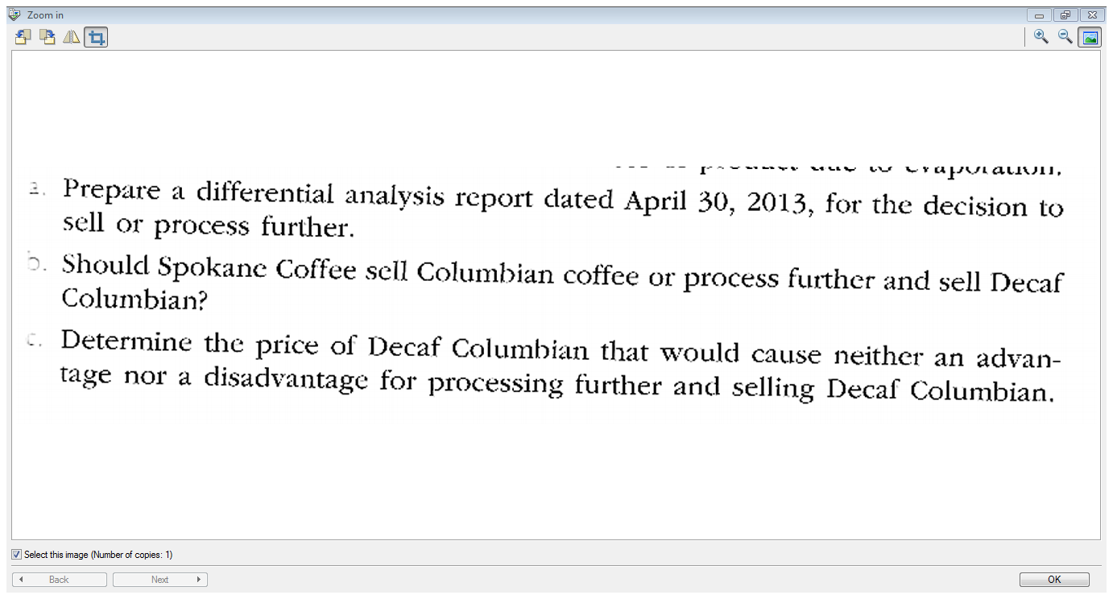

Slide 25

Accept Business at a Special Price
A company currently produces an average of 10,000 basketballs per month, although the factory has a monthly capacity of 12,500 basketballs.
  Variable costs are $12.50 per ball.
  Fixed costs are $7.50 per ball.
  The domestic selling price is $30 per ball.
The company received an offer for 5,000 additional basketballs at $18 each from a foreign buyer.
Should the company accept the offer?

Slide 26
Accept Business at a Special Price
So:
- What revenues will change if they accept this order?
- What costs will change?

Slide 27
Accept Business at a Special Price
Proposal to Sell Basketballs to Exporter
Differential revenue from accepting offer: Revenue from sale of 5,000 balls @$18 | $90,000
Differential cost of accepting offer: Variable costs of 5,000 balls @$12.50 | 62,500
Differential income from accepting offer | $27,500
The company has excess capacity and can produce additional product without incurring additional fixed costs.
Whether differential revenue covers relevant costs and produces income is the issue.

Slide 28
Accept Business at a Special Price
So why doesn’t this company sell all of their basketballs at $18/ball?
What other factors should they consider before accepting the order?

Slide 29
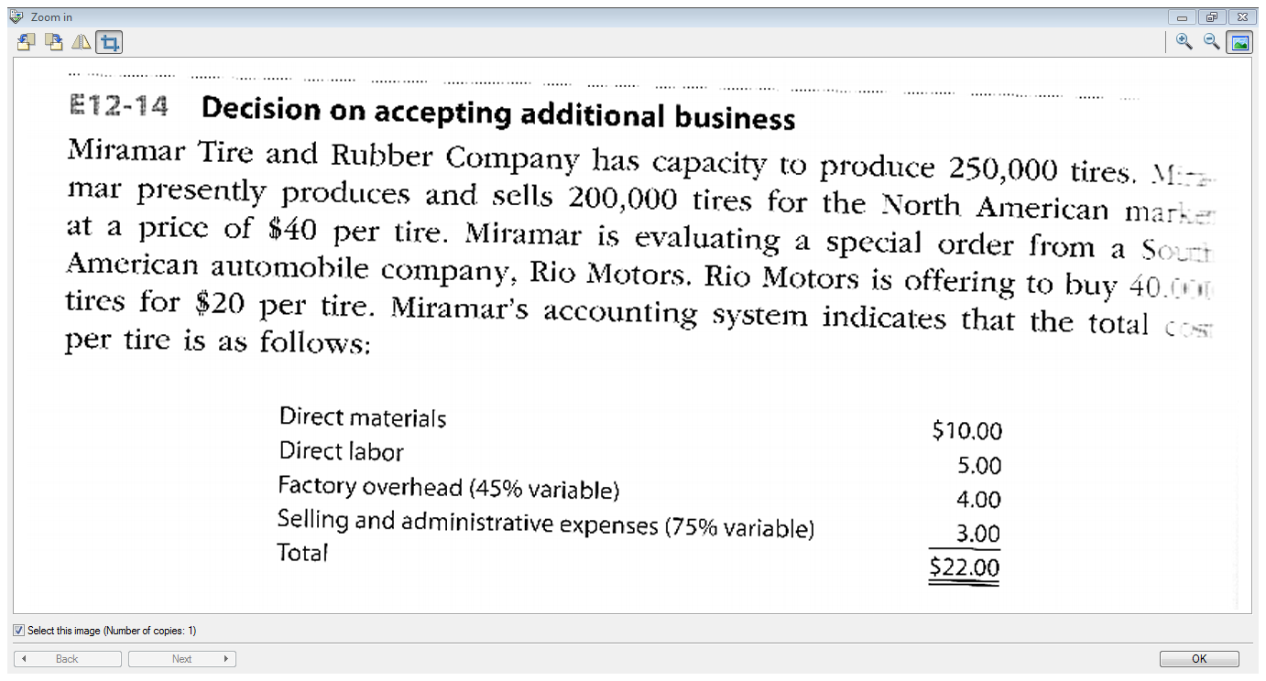

Slide 30
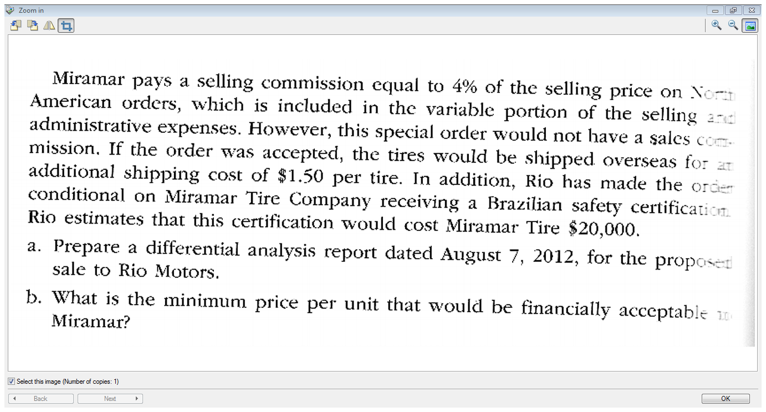

Slide 31
Setting Normal Product Selling Prices
In the long run, the normal selling price must be enough to cover all expenses and provide a reasonable profit.
Approaches for setting prices:
  Market methods - set the selling price according to demand for the product or set the price according to the price offered by competitors
  Cost-plus methods

Slide 32
Cost-Plus Methods
Managers price the product in order to achieve a target profit. The price covers all costs plus a profit.
Markup: Desired Profit
Total Cost
Desired Selling Price =

Slide 33

Cost Plus Pricing
Total Cost Concept
  Markup added to all costs (including selling & administrative).
Product Cost Concept
  Markup added to product costs.
Variable Cost Concept
  Markup added to variable costs.

Slide 34
Cost-Plus Examples
UNIT VARIABLE COSTS
Direct materials | $ 3.00
Direct labor | 10.00
Factory overhead | 1.50
Selling & admin.exp. | 1.50
Total | $ 16.00
FIXED COSTS
Factory overhead | $50,000
Selling & admin. exp. | 20,000
We’ll use these facts to illustrate the three cost-plus methods.

Slide 35
Total Cost Concept
Markup is added to all costs (including selling & administrative expenses)
Assuming 100,000 units, the total cost per unit is as follows:
UNIT VARIABLE COSTS |  | Per Unit
Direct materials | $ 3.00
Direct labor | 10.00
Factory overhead | 1.50
Selling & admin.exp. | 1.50 | $ 16.00
FIXED COSTS
Factory overhead | $50,000
Selling & admin. exp. | 20,000
Total ÷ 100,000 units | $ 70,000 | 0.70
Total Unit Cost |  | $16.70

Slide 36
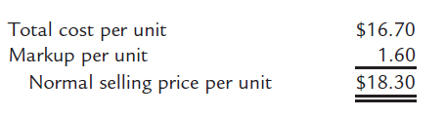
Total Cost Concept
Digital Solutions, Inc. desires a profit equal to 20% of total assets. If total assets are $800,000, the desired profit is $160,000. or $1.60 per unit, assuming 100,000 units.
After adding the markup to the total cost the selling price per unit is:

Slide 37
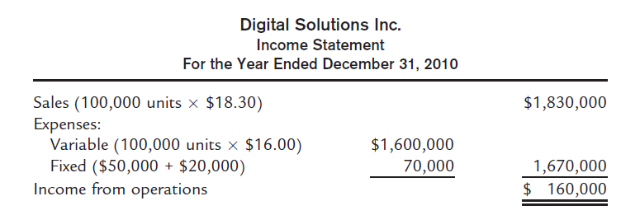
Total Cost Concept
Markup Percentage = Desired Profit
Total Cost
= $ 1.60
$16.70
= 9.6%
Price per unit = $16.70 total cost/unit × 1.096% = $18.30

Slide 38
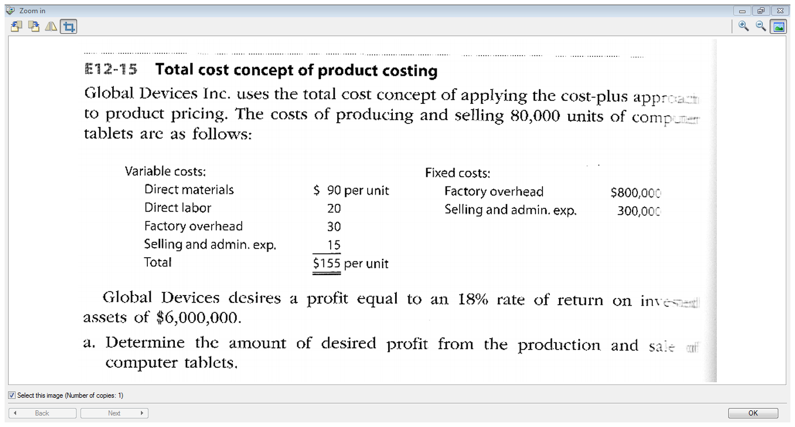

Slide 39
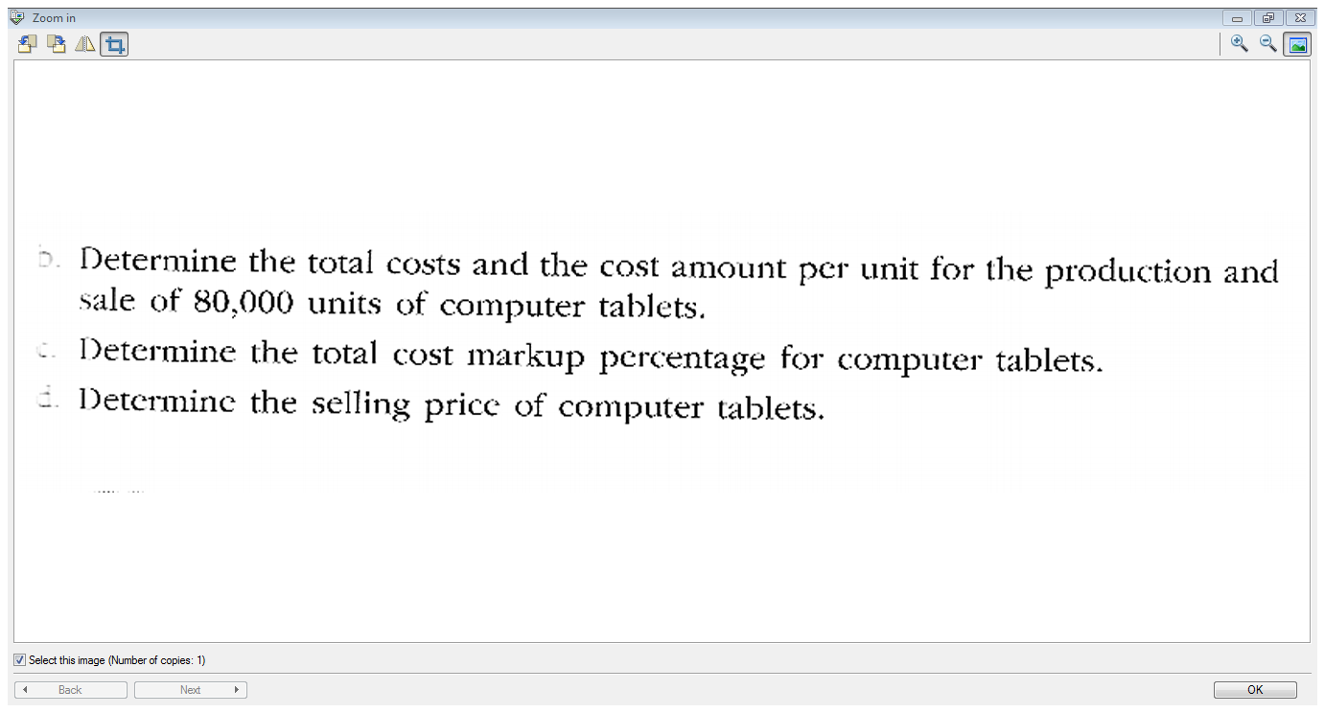

Slide 40
End of Chapter 12!

