Slide 1
Chapter 11
Cost Behavior and Cost-Volume-Profit Analysis

Slide 2
Learning Objectives
Classify costs by their as variable costs, fixed costs, or mixed costs.
Compute the contribution margin, the contribution margin ratio, and the unit contribution margin.
Determine the break-even point and sales necessary to achieve a target profit.
Compute the break-even point for a company selling more than one product, the operating leverage, and margin of safety.

Slide 3



Cost Behaviour

Slide 4
Cost Behavior
Refers to the manner in which a cost changes as a related activity changes. Can be:
  Variable
  Fixed
  Mixed.
Two factors to consider:
  Activity bases –measure of whatever causes the incurrence of variable cost. Example: Direct Labour Hours, Machine Hours, Units Produced, Units Sold, km driven, # of sq.feet, # of text messages
  Relevant range – range of activity of interest.

Slide 5
Cost Behavior: Variable Costs
Costs that vary in proportion to changes in the activity level
# of Blackberries made | Direct Material Cost per unit | Total Direct Material Cost
1 | $100 | $100
50 | $100 | 5,000
100 | $100 | 10,000
150 | $100 | 15,000
200 | $100 | 20,000
250 | $100 | 25,000

Slide 6
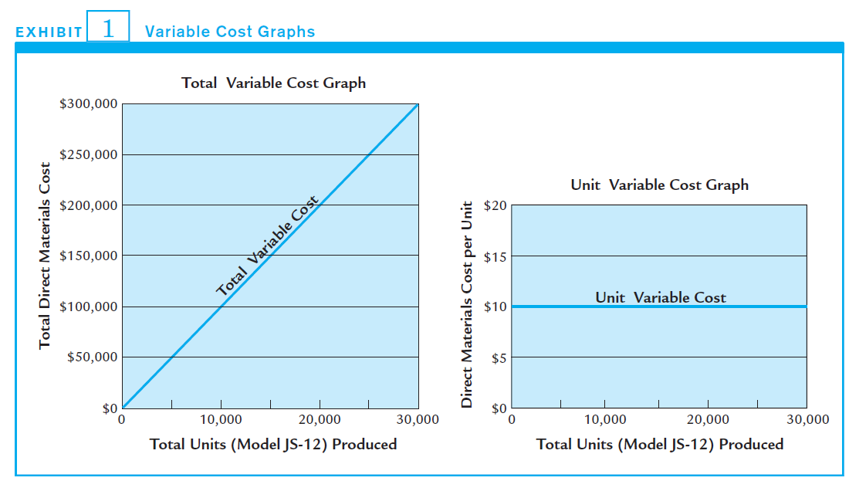
Cost Behavior: Variable Costs

Slide 7
Cost Behavior: Fixed Costs
Costs that remain the same in total over the relevant range of activity, but change per unit with the level of activity
# of Blackberries made | Salary of Thorsten Heins | Salary per blackberry made
50,000 | $1,000,000 | $20.00
100,000 | $1,000,000 | 10.00
150,000 | $1,000,000 | 6.67
200,000 | $1,000,000 | 5.00
250,000 | $1,000,000 | 4.00

Slide 8
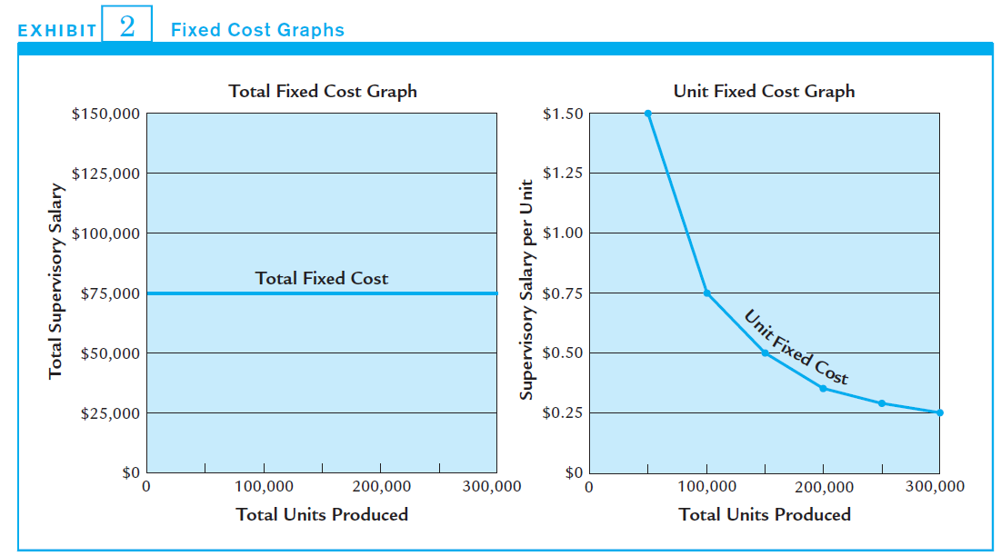
Cost Behavior: Fixed Costs

Slide 9
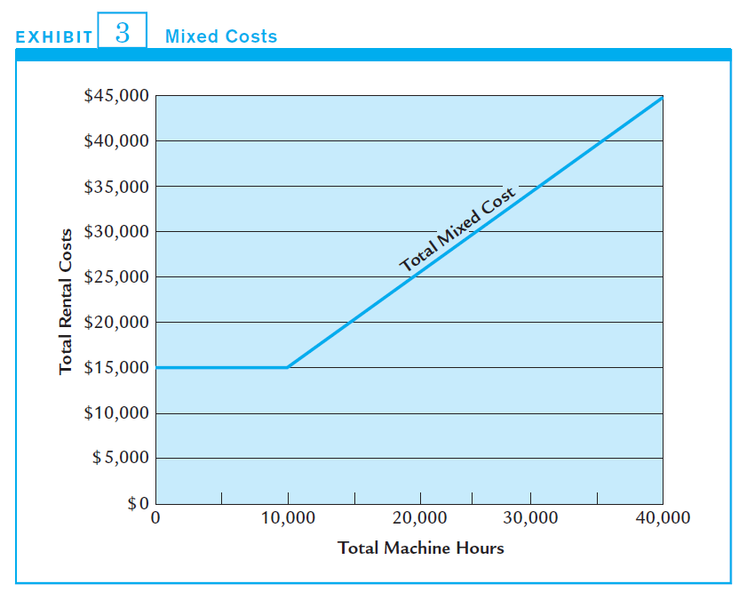
Cost Behavior: Mixed Costs
Mixed costs share characteristics of both a variable and a fixed cost: fixed over a range, then increasing based on activity

Slide 10
Mixed Costs
Combination of fixed and variable costs
Need to distinguish between fixed and variable cost components in order predict what total cost will be at a certain activity level

Slide 11
High-Low Method
To isolate fixed and variable costs, use formula for a Straight Line:
Total Mixed Cost
= (Variable cost per unit × # of units) + Fixed cost
  Y = mx + b

Slide 12
High-Low Method
Step #1: Calculate Variable Cost per Unit (or m, the slope of the line):
= Cost at highest activity level – Cost at lowest activity level
Highest activity level – Lowest activity level
= Change in total cost
Change in activity level
Step #2: Calculate Fixed Cost: Substitute Variable Cost per unit back into the formula at the highest or lowest point

Slide 13
High-Low Method
Bazinga Atomic Models Inc. specializes in making molecular models out of plastic balls found in children’s ball pits. Management wants to improve its planning of overhead costs and provides you with the following data:
Month | Number of Models Manufactured | Factory overhead
January | 1,000 | $12,000
February | 1,250 | 10,900
March | 2,000 | 13,300
April | 1,500 | 12,100
May | 2,125 | 16,500
June | 1,750 | 13,000
July | 1,800 | 13,700

Slide 14
High-Low Method
Step #1: Calculate Variable Cost per Unit (or m, the slope of the line):
The slowest month is January & the busiest month is May.
= Change in total cost
Change in activity level
= $16,500 – $12,000
2,125 – 1,000
= $4,500
1,125
= $4/unit
Notes:
14

Slide 15
High-Low Method
Step #2: Calculate Fixed Cost: Substitute Variable Cost per unit back into the formula at the highest or lowest point.
Total Cost = (Variable cost per unit × # of units)
+ Fixed cost
12,000 = (4 ×1,000) + Fixed Cost
Fixed Cost = 8,000

Slide 16
High Low Method
The formula for this mixed cost is
Y = 4x + $8,000
Variable cost
Fixed Cost

Slide 17
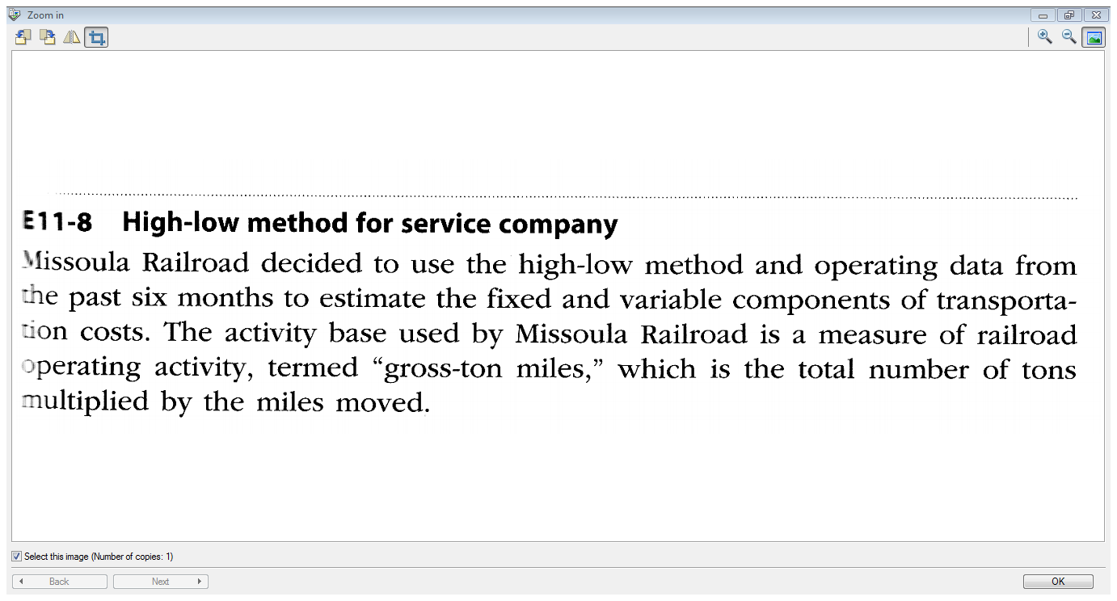

Slide 18
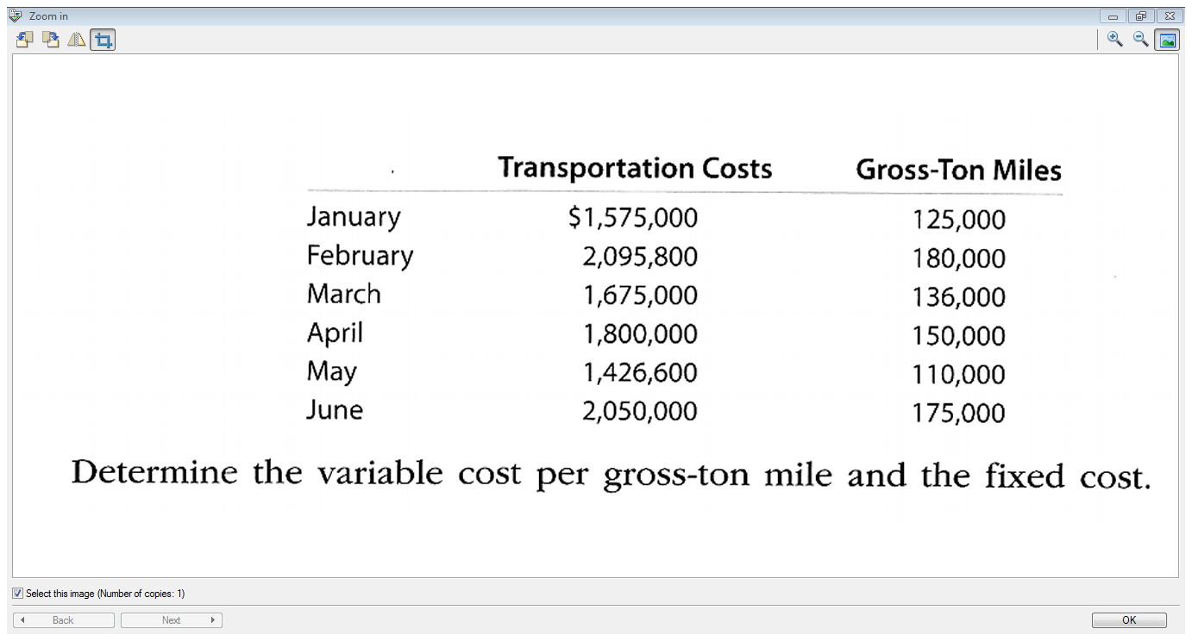

Slide 19
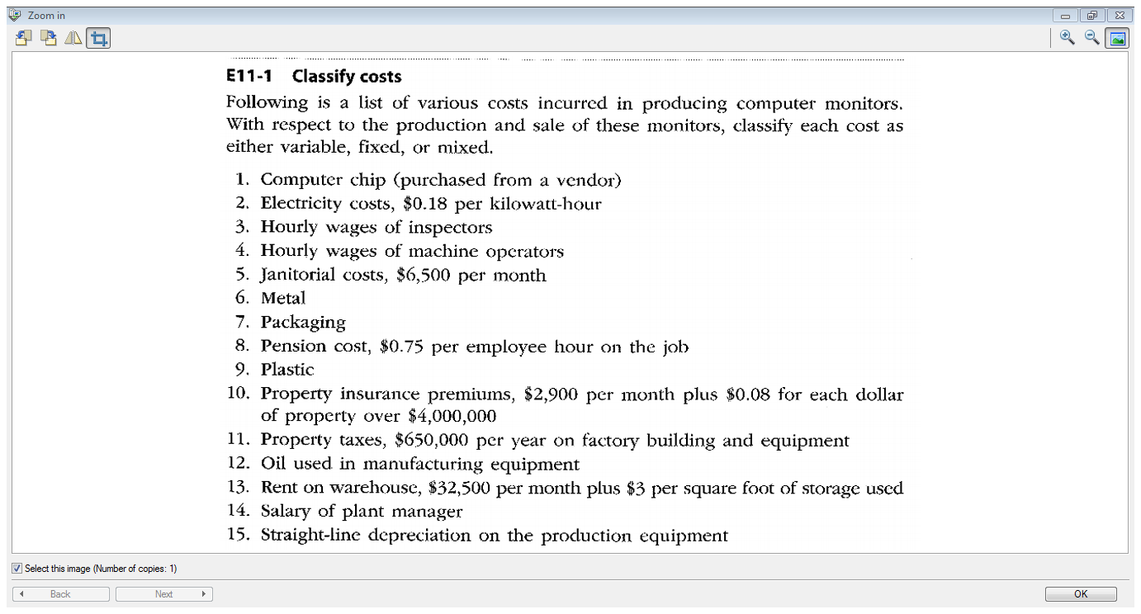

Slide 20
Cost-Volume-Profit Analysis
The systematic examination of the relationships among selling prices, sales and production volume, costs, expenses, and profits.
Provides management with useful information for decision making:
  Setting selling prices
  Selecting product mix
  Choosing marketing
  strategies
  Analyzing the effects of
  cost changes on profit
$$$
Sales
Total Costs
units

Slide 21
Contribution Margin
= Sales – Variable Costs
 | Total | Per Unit
Sales (2,000 units) | $100,000 | $50
Variable Costs | 60,000 | 30
Contribution Margin | $40,000 | 20
Contribution Margin Ratio
= $20/$50 or 40%

Slide 22
The Contribution Format Income Stmt.
The contribution margin format emphasizes cost behaviour. Contribution margin covers fixed costs and provides for income.

Slide 23
Contribution Margin Ratio
An $80,000 increase in sales would increase contribution margin by 40% of $80,000- that’s $32,000.
Operating Income would also increase by $32,000 because fixed costs stay fixed!

Slide 24
Unit Contribution Margin
If sales increases by 10,000 units, from 2,000 units to 12,000 units:
 | Before (2,000 units) | After (12,000 units)
Sales ($50) | $100,000 | $600,000
Variable Costs ($30) | 60,000 | 360,000
Contribution Margin ($20) | $ 40,000 | $240,000
Increase of $200,000
Total increase in Contrib.Margin
Sales increased by 10,000 units
X unit Contrib.Margin x $20
= $200,000

Slide 25
Break-Even Point
Level of operations where revenues and costs are the same.
Useful in business planning, especially when increasing or decreasing operations.
Revenues
Costs
=
Break-Even Point

Slide 26
Break-Even Point
Contrib.
Margin Ratio
= $20/$50
= 40%
Break-Even Sales (Units) = Fixed Costs
Unit CM
= $30,000
$20
= 1,500 units
Break-Even Sales ($) = Fixed Costs = $30,000 = $75,000
CM Ratio 40%

Slide 27
Break-Even Point – Here’s the proof!
 | Total
Sales (1,500 units x $50) | $ 75,000
Variable Costs (1,500 x $30) | 45,000
Contribution Margin (1,500 x $20) | 30,000
Fixed Costs | 30,000
Operating income | $ 0
$30,000/$20 = 1,500 units needed to break even

Slide 28
✴ Break Even Point 
Break-Even Sales (Units) = Fixed Costs
Unit CM
Break-Even Sales ($) = Fixed Costs CM Ratio

Slide 29
Effect of Changes in Fixed Costs
Fixed
Costs
Break
Even
If
Then
There is a direct relationship between fixed costs and break-even units.
Fixed
Costs
Break
Even
If
Then

Slide 30
Effect of Changes in Fixed Costs
How would a $100,000 increase in fixed costs affect the break-even sales units?
ITEM | NOW | PROPOSED | CHANGE
Selling Price | $50 | $50 | Same
Variable Cost per Unit | $30 | $30 | Same
Unit Contribution Margin | $20 | $20 | Same
Fixed Costs | $30,000 | $130,000 | $100,000
Break-Even Sales (units) | 1,500 | 6,500 | 5,000 units
Now: $30,000/$20 UCM = 1,500 break-even
Proposed: $130,000 / $20 UCM = 6,500 break-even

Slide 31
Effect of Changes in Unit Variable Costs
Unit
Variable
Cost
Break
Even
There is a direct relationship between unit variable costs and break-even units.
If
Then
Unit
Variable
Cost
Break
Even
If
Then

Slide 32
Effect of Changes in Unit Variable Costs
How would an extra 2% commission (increase in variable cost per unit) affect the break-even sales units?
ITEM | NOW | PROPOSED | CHANGE
Selling Price | $50 | $50 | Same
Variable Cost per Unit | $30 | $31 | 2% of sales
Unit Contribution Margin | $20 | $19 | $1 per unit
Fixed Costs | $30,000 | $30,000 | Same
Break-Even Sales (units) | 1,500 | 1,579 | 79 units
Now: $30,000/$20 UCM = 1,500 break-even
Proposed: $30,000 / $19 UCM = 1,579 break-even

Slide 33
Effect of Changes in Unit Selling Price
Unit
Selling
Price
Break
Even
If
Then
There is an inverse relationship between unit selling price and break-even units.
Unit
Selling
Price
Break
Even
If
Then

Slide 34
Effect of Changes in Unit Selling Price
How would a $10 price increase affect the break-even sales units?
ITEM | NOW | PROPOSED | CHANGE
Selling Price | $50 | $60 | $10
Variable Cost per Unit | $30 | $30 | Same
Unit Contribution Margin | $20 | $30 | $10
Fixed Costs | $30,000 | $30,000 | Same
Break-Even Sales (units) | 1,500 | 1,000 | 500 units
Now: $30,000/$20 UCM = 1,500 break-even
Proposed: $30,000 / $30 UCM = 1,000 break-even

Slide 35
Target Profit
To find units needed to attain a certain target profit, add the target profit to the fixed costs in the break-even formula.
Required Sales (Units) = Fixed Costs + Target Profit
UCM

Slide 36
Calculating Target Profit
Fixed Costs = $30,000
Target Profit = $100,000
Selling price
Per unit
Variable Cost
Per unit
$50
$30
Contribution
Margin per unit
$20
Fixed Costs + Target Profit
UCM
= $30,000 + $100,000
$20
= 6,500 units

Slide 37
Here’s the proof!
 | Total
Sales (6,500 units x $50) | $ 325,000
Variable Costs (6,500 x $30) | 195,000
Contribution Margin (6,500 x $20) | 130,000
Fixed Costs | 30,000
Operating income | $100,000

Slide 38
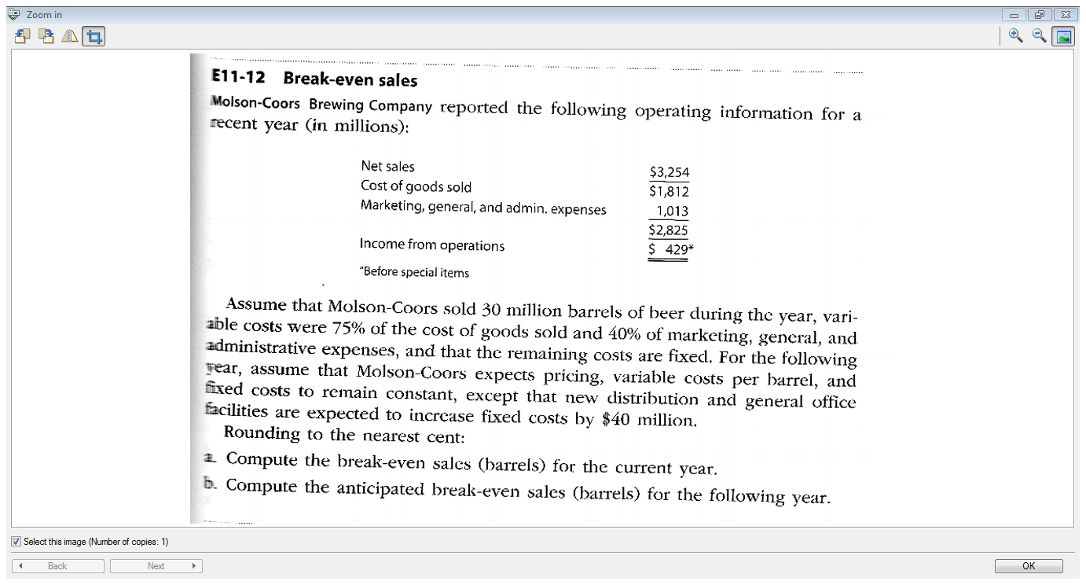

Slide 39
c. Molson would like to earn Income from operations of $500 next year. What would their Net Sales have to be?
d. If the variable cost of beer increases by $10 per barrel next year, what will their break-even sales (in units) be?

Slide 40
Operating Leverage
A measure of how sensitive net income is to a percentage change in sales.
With high leverage, a small percentage increase in sales can produce a much larger percentage increase in net income
Operating Leverage = Contribution margin
Net income
Net income
sales

Slide 41
Jabot Cosmetics:
 | Actual sales 500 units
Sales | $250,000
Less: variable expenses | 150,000
Contribution margin | $100,000
Less: fixed expenses | 80,000
Net income | $20,000
Operating Leverage
= $100,000
$20,000
= 5

Slide 42
Operating Leverage
With a measure of operating leverage of 5, if Jabot increases its sales by 10%, net income would increase by 50%.
Percent increase in sales 10%
Degree of Operating Leverage × 5
Percent increase in profits 50%

Slide 43
Here’s the proof!
 | Actual sales 500 units | Increased sales (550)
Sales | $250,000 | $275,000
Less: variable expenses | 150,000 | 165,000
Contribution margin | $100,000 | 110,000
Less: fixed expenses | 80,000 | 80,000
Net income (loss) | $20,000 | $30,000
Increase of $25,000 (10%)
Increase of $10,000 (50%)

Slide 44
Cost Structure and Profit Stability
There are advantages and disadvantages to high fixed cost (or low variable cost) and low fixed cost (or high variable cost) structures.
An advantage of a high fixed
cost structure is that income
will be higher in good years
compared to companies
with lower proportion of
fixed costs.
A disadvantage of a high fixed
cost structure is that income
will be lower in bad years
compared to companies
with lower proportion of
fixed costs.

Slide 45
Margin of Safety
Margin of safety measures how much sales revenue can drop before you start to loose money.
Sales – Sales at Break-Even Point
Sales

Slide 46
Margin of Safety
Sales – Sales at Break-Even Point
Sales
Jabot’s current sales = $250,000
Their break-even sales = $200,000.
The margin of safety
= (250,000-200,000) = 20%
250,000
Sales would have to drop by more than 20% before an operating loss would result

Slide 47
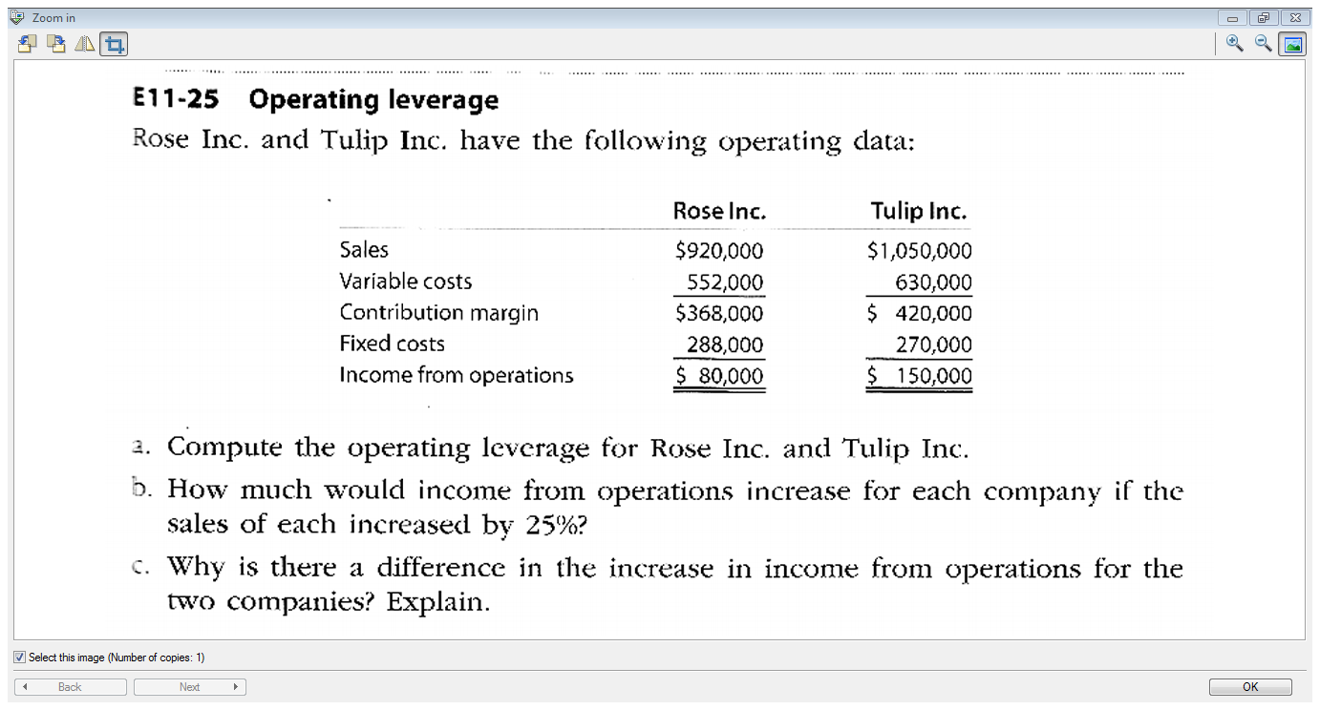
d. Calculate the margin of safety for Rose Inc.

Slide 48
End of Chapter 11

