Slide 1

Chapter 9
Financial Statement Analysis

Slide 2
Learning Objectives
Describe basic financial statement analytical methods.
Use financial statement analysis to assess the liquidity and solvency of a business.
Use financial statement analysis to assess the profitability of a business.
Describe the contents of corporate annual reports.

Slide 3
Horizontal Analysis
The percentage analysis of increases and decreases in related items in comparative financial statements
 |  |  | Increase (Decrease)
Assets | 2012 | 2011 | Amount $ | Percent
Current Assets
Cash & cash equiv. | $ 73.3 | $ 255.5 | ($182.2) | (71%)
Accounts receivable,net | 332.8 | 300.3 | 32.5 | 11%
Inventories | 784.4 | 728.3 | 56.1 | 8%
Other current assets | 20.5 | 13.9 | 6.6 | 47%
Fixed Assets | 1,280.3 | 1,226.1 | 54.2 | 4%
Goodwill | 1,859.5 | 1,649.1 | 210.4 | 13%
Intangible Assets | 373.1 | 297.2 | 75.9 | 26%
Investments & Other Assets | 426.5 | 356.7 | 69.8 | 20%
Total Assets | $5,150.4 | $4,827.1 | 323.3 | 7%
182.2 ÷255.5 = 71%

Slide 4
Horizontal Analysis | 2012 | 2011 | Increase (Decrease)
 |  |  | Amount $ | Percent
Sales | $12,010.8 | $11,396.4 | 614.4 | 5%
Cost of Sales | (9,800.3) | (9,333.6) | 466.7 | 5%
Operating Expenses | (1,388.8) | (1,318.4) | 70.4 | 5%
Depreciation & Amortization | (183.9) | (179.3) | 4.6 | 3%
Other income | 72.6 | 21.9 | 50.7 | 232%
Operating Income | 710.4 | 587.0 | 123.4 | 21%
Financial costs | (46.4) | (41.5) | 4.9 | 12%
Earnings before Income Taxes | 664.0 | 545.5 | 118.5 | 22%
Income Taxes | (174.7) | (152.8) | 21.9 | 14%
Net earnings | $489.3 | $392.7 | $96.6 | 25%

Slide 5
Vertical Analysis
A percentage analysis used to show the relationship of each component to the total within a single statement
On the Balance Sheet, Total Assets is used:
  Example: Cash is expressed as a percentage of total assets
On the Income Statement, Total Sales is used:
  Example: Cost of Merchandise Sold is expressed as a percentage of total sales

Slide 6
Vertical Analysis | 2012 | As a % of Sales | 2011 | As a % of Sales
Sales | $12,010.8 | 100% | $11,396.4 | 100%
Cost of Sales | (9,800.3) | 82% | (9,333.6) | 82%
Operating Expenses | (1,388.8) | 12% | (1,318.4) | 12%
Depreciation & Amortization | (183.9) | 1% | (179.3) | 1%
Other income | 72.6 | 0% | 21.9 | 0%
Operating Income | 710.4 | 5% | 587.0 | 5%
Financial costs | (46.4) | 0% | (41.5) | 0%
Earnings before Income Taxes | 664.0 | 5% | 545.5 | 5%
Income Taxes | (174.7) | 1% | (152.8) | 1%
Net earnings | $489.3 | 4% | $392.7 | 4%

Slide 7
Benefits of Analysis
Horizontal and vertical analysis are useful in assessing relationships and trends in financial conditions and operations of a business
Vertical analysis is useful for comparing one company with another or with industry averages
Both are made easier with common-size financial statements

Slide 8
Common-Size Statements
 | Metro Inc. | Loblaws
Sales | 100% | 100%
Cost of Sales | 82% | 76%
Operating Exp., Deprec.& Amort | 13% | 20%
Operating Income | 5% | 4%
Financial costs | 0% | 1%
Earnings before Income Taxes | 5% | 3%
Income Taxes | 1% | 1%
Net earnings | 4% | 2%

Slide 9
Liquidity and Solvency Analysis
Liquidity – the ability to convert assets into cash (or the ability to pay short term obligations as they come due)
Solvency – the ability to meet debt obligations as they become due

Slide 10
Liquidity & Solvency Analysis
Normally assessed by examining balance sheet relationships, using the following major analyses:
  Current position analysis
  Accounts receivable analysis
  Inventory analysis
  Ratio of fixed assets to long-term liabilities
  Ratio of liabilities to stockholders’ equity
  Number of times interest charges are earned

Slide 11
1. Current Position Analysis
Using measures to assess a business’s ability to pay its current liabilities
  Working capital
    = current assets - current liabilities
  Current ratio
  = current assets ÷ current liabilities
  Quick ratio
  = Cash + temporary investments + receivables
  current liabilities

Slide 12
1. Current Position Analysis
  Working capital
    = current assets - current liabilities
    = $1,211.6 - $1,170.5 = $41.1 (in 2012)
    = $1,304.6 - $1,503 = $(198.4) (in 2011)
  Current ratio
  = current assets ÷ current liabilities
    = $1,211.6 ÷ $1,170.5 = 1.04 (in 2012)
  = $1,304.6 ÷ $1,503 = 0.87 (in 2011)
Loblaw’s Current Ratio in 2012 = 1.24

Slide 13
1. Current Position Analysis
  Quick ratio
  = Cash + temporary investment + receivables
  current liabilities
  = $73.3 + $0 + $332.8
  1,170.5
  = 0.35 (in 2012)
    = 0.37 (in 2011)
Loblaw’s Quick ratio in 2012 = 0.42

Slide 14
2.Accounts Receivable Analysis
Accounts receivable turnover
= Net Sales
Avg. Accounts Receivable
Number of Days’ Sales in Receivables
= 365 ÷ A/R Turnover
Also referred to as Average Collection Period
Measures efficiency of collection
Reflects liquidity

Slide 15
2. Accounts Receivable Analysis
Accounts receivable turnover
= Net Sales
Avg. Accounts Receivable
In 2012 = $12,010.8
(332.8 + 300.3)/2
= 37.9 times
In 2011 = $11,396.4
(300.3 + 311.3)/2
= 37.3 times
Loblaw’s A/R Turnover in 2012
= 68.5 times

Slide 16
2. Accounts Receivable Analysis
Number of Days’ Sales in Receivables
= 365 ÷ A/R Turnover
In 2012 = 365 ÷ 37.9 times
= 10 days
In 2011 = 365 ÷ 37.3 times
= 10 days
Loblaw’s
= 5 days

Slide 17
3. Inventory Analysis
Measures inventory efficiency
  Avoid tying up funds in inventory.
  Avoid obsolescence.
Reflects liquidity
Inventory turnover = Cost of Goods Sold
Avg. Inventory
Number of Days’ Sales in Inventory
= 365 ÷ Inventory turnover

Slide 18
3. Inventory Analysis
Inventory turnover = Cost of Goods Sold
Avg. Inventory
In 2012: = $12,010.8
(784.4+ 728.3)/2
= 15.9 times
In 2011: = $11,396.4
(728.3 + 699.3)/2
= 16.0 times
Days’ Sales in Inventory = 365 ÷ Inv. turnover
In 2012: = 365 ÷15.9 times = 23 days
In 2011: = 365 ÷16.0 times = 23 days
Loblaw’s = 16 days

Slide 19
4. Ratio of Fixed Assets to Long-Term Liabilities
Fixed Assets (net)
Long-term Liabilities
Provides a measure of whether note-holders or bondholders will be paid
Indicates the ability to borrow additional funds on a long-term basis as fixed assets are often pledged as security for long term notes
Shows how many times over fixed assets can cover long-term liabilities

Slide 20
4. Ratio of Fixed Assets to Long-Term Liabilities
Fixed Assets (net)
Long-term Liabilities
In 2012: $1,280.3 ÷ $1,434.8 = 0.89 times
In 2011: $1,226.1 ÷ $924.8 = 1.33 times

Slide 21
5. Ratio of Liabilities to Stockholders’ Equity
Total Liabilities
Total Stockholders’ Equity
Indicates the margin of safety for creditors.
Indicates the ability to withstand adverse business conditions.

Slide 22
5. Ratio of Liabilities to Stockholders’ Equity
Total Liabilities
Total Stockholders’ Equity
In 2012: = $2,605.3 ÷ $2,545.1 = 1.02 : 1
In 2011: = $2,427.8 ÷ $2,399.3 = 1.01 : 1
Loblaw’s
= 1.80

Slide 23
6. Number of Times Interest Charges Earned
Income before Taxes + Interest Expense
Interest Expense
Indicates the general financial strength of the business.
Indicates the ability to withstand adverse business conditions.

Slide 24
6. Number of Times Interest Charges Earned
Income before Taxes + Interest Expense
Interest Expense
In 2012: =$664 + $46.4
46.4
= 15.3 times
In 2011: = $545.5 + $41.5
41.5
= 14.1 times
Loblaw’s
= 3.6 times

Slide 25
Liquidity & Solvency Analysis
Would you lend money to Metro Inc. in the short term?
Would you lend money to Metro Inc. in the long term?

Slide 26
Profitability Analysis
Normally assessed by examining the income statement and balance sheet resources, using the following major analyses:
  Ratio of net sales to assets
  Rate earned on total assets
  Rate earned on stockholders’ equity
  Rate earned on common stockholders’ equity
  Earnings per share on common stock
  Price-earnings ratio
  Dividends per share
  Dividend yield

Slide 27
Ratio of Net Sales to Assets
Shows how effectively a firm utilizes its assets
Net Sales
Avg. Total Assets (excluding L-T Investments)
In 2012: $12,010.8
[($5,150.4 - $324.5) + ($4,827.1 - $258.7)] ÷2
= 2.56 times
In 2011: = $11,396.4
[($4,827.1 - $258.7) + ($4,695.2 – $220.9)] ÷2
= 2.52 times
Loblaw’s
= 1.79

Slide 28
Rate Earned on Total Assets
Measures the profitability of total assets without considering how the assets are financed.
Interest Expense + Net Income
Avg. Total Assets
In 2012: $46.4+ $489.3
($5,150.4 + 4,827.1) ÷ 2
= 11 %
In 2011: $41.5 + $392.7
($4,827.1 + $4,695.2) ÷2
= 9.1 %
Loblaw’s
= 5.5 %

Slide 29
Rate Earned on Stockholders’ Equity
Emphasizes the rate of income earned on the amount invested by the stockholders.
Net Income
Avg. Stockholders’ Equity
In 2012: $489.3
($2,545.1+ $2,399.3) ÷2
= 19.8 %
In 2011: $392.7
($2,399.3 + $2,318.9) ÷2
= 16.6 %
Loblaws
=10.4 %

Slide 30
Rate Earned on Common Stockholders’ Equity
Focuses on the rate of profits earned on the amounts invested by the common stockholders.
Net Income – Preferred Dividends
Avg. Common Stockholders’ Equity
In 2012: $489.3 - $0
($2,545.1+ $2,399.3) ÷2
= 19.8 %
In 2011: $392.7
($2,399.3 + $2,318.9) ÷2
= 16.6 %

Slide 31
Earnings Per Share on Common Stock
The income earned for each share of common stock.
Net Income – Preferred Dividends
Common Shares Outstanding
In 2012: $4.87
In 2011: $3.81

Slide 32
Price-Earnings Ratio
Indicator of the firm’s future earnings prospects.
Market Price Per Share of Common Stock
Annual Earnings Per Share

Slide 33
Dividends per Share and Earnings per Share
Dividends per Share = Common Dividends
# of Common Shares
In 2012: $82.9/97.186 = $0.85
In 2011: $77.1/101.084= $0.76

Slide 34
Dividends Per Share and Dividend Yield
Dividend yield shows the rate of return to common stockholders in terms of cash dividends.
Dividend Yield = Common Dividend/Share
Market Price/Share
In 2012: 1.537%
Dividend Yield is readily available from tmx.com

Slide 35
Profitability Analysis
Would you buy Metro’s shares?

Slide 36
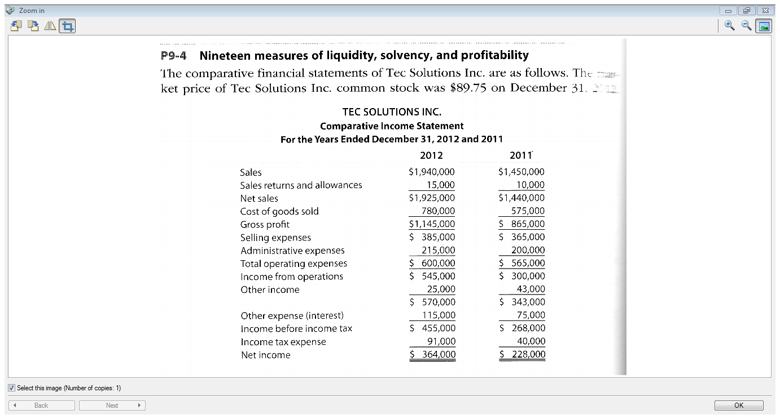

Slide 37
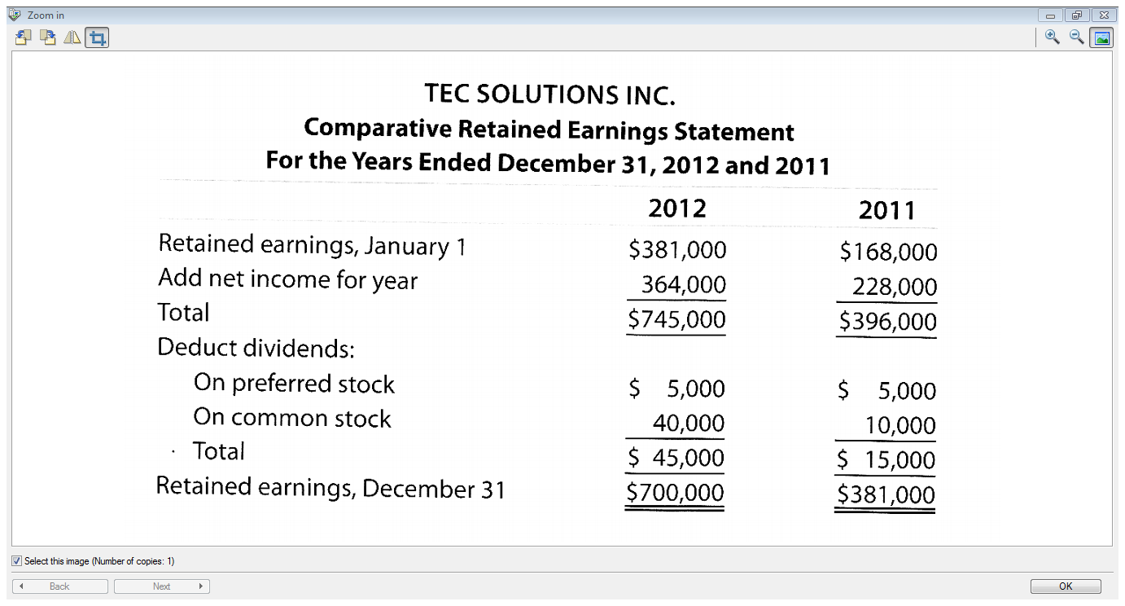

Slide 38
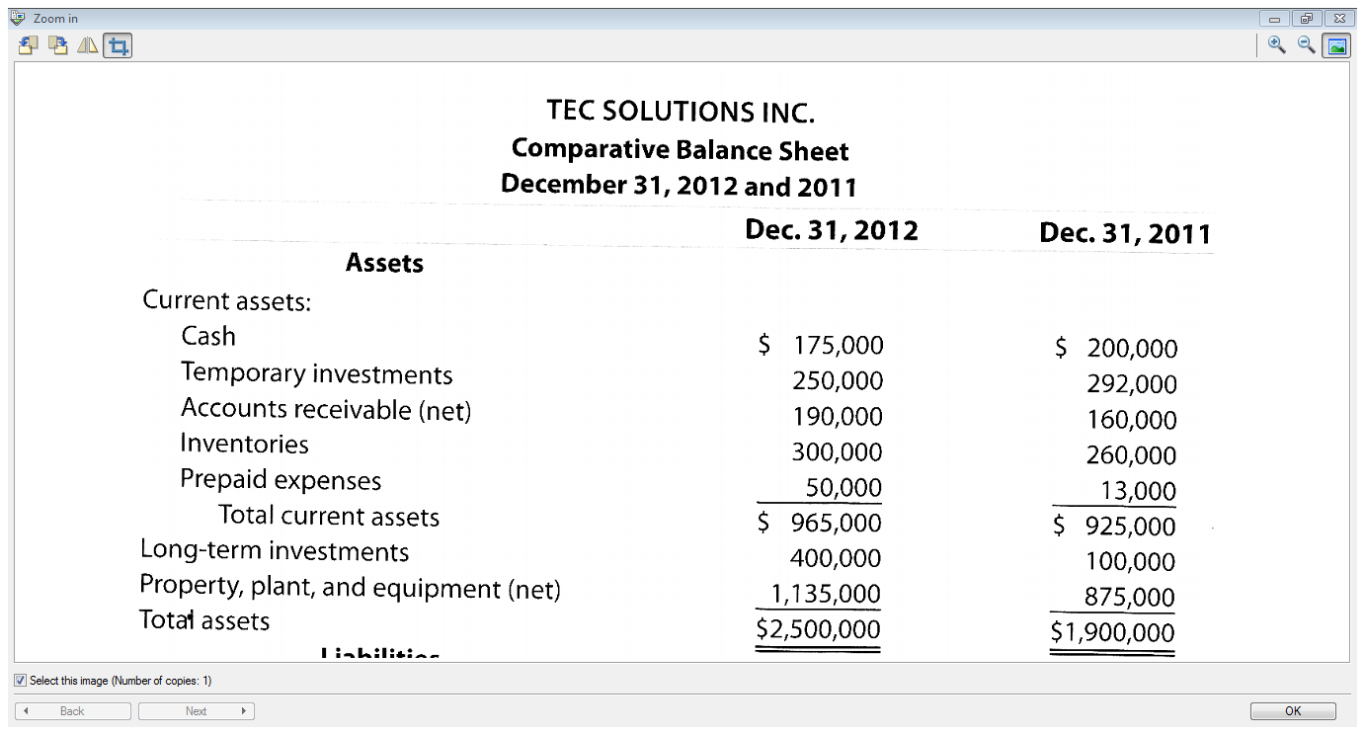

Slide 39
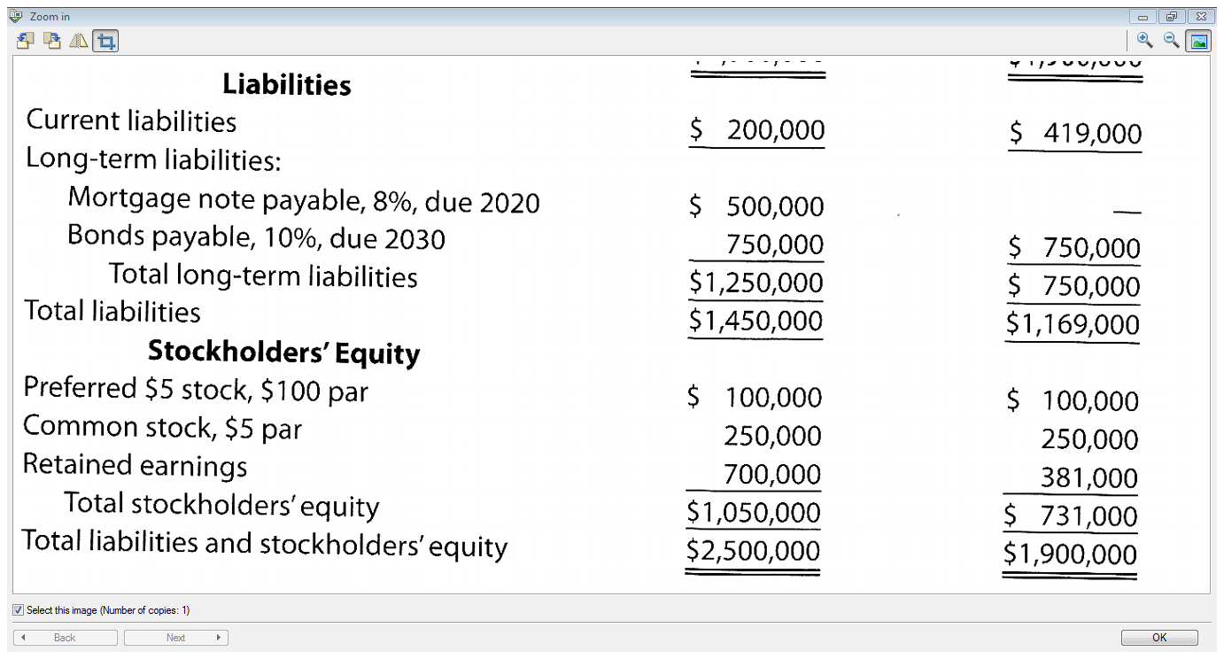

Slide 40
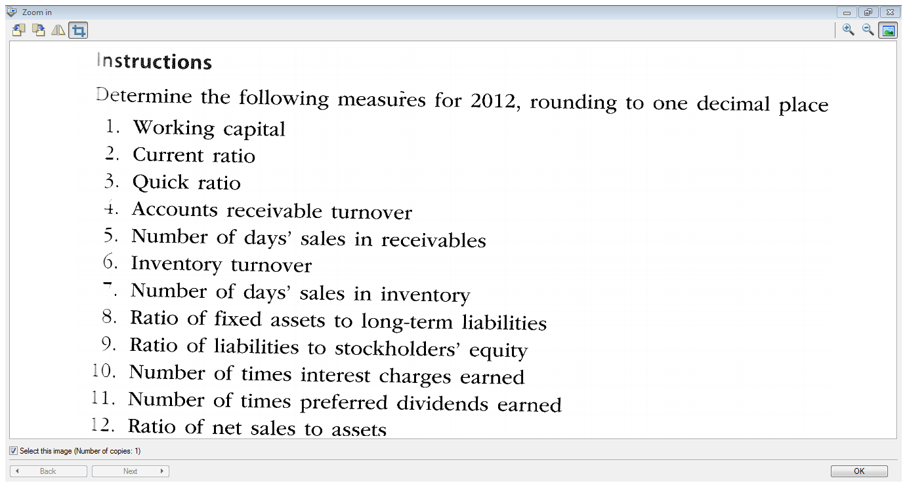

Slide 41
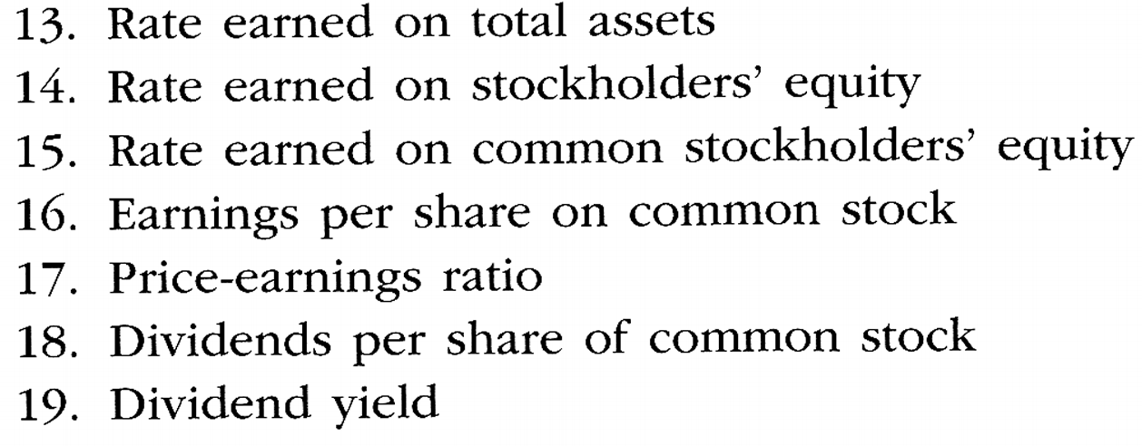

Slide 42
Corporate Annual Reports
Summarize operating activities for the past year and plans for the future.
Many variations in the order and form, but all include:
  Financial statements and notes
  Management discussion and analysis
  Independent auditors’ report

Slide 43
Management Discussion and Analysis (MDA)
Provides critical information in interpreting the financial statements and assessing the future of the company.
Includes an analysis about past performance and financial condition.
Discusses management’s opinion about future performance.
Discusses significant risk exposure.

Slide 44
Independent Auditors’ Report
Publicly traded companies must get an independent opinion on the fairness of the financial statements.
This opinion must be included in the annual report along with an opinion on the accuracy of management’s internal control assertion.

Slide 45
End of Chapter 9

