Slide 1

Chapter 8
Liabilities and Stockholders’ Equity

Slide 2
Learning Objectives
Describe how businesses finance their operations.
Describe and illustrate current liabilities, notes payable, taxes, contingencies, and payroll.
Describe and illustrate the financing of operations through issuance of bonds.
Describe and illustrate the financing of operations through issuance of stock.
Describe and illustrate the accounting for cash and stock dividends.
Describe the effects of stock splits on the financial statements.
Describe financial statement reporting of liabilities and stockholders’ equity.
Analyze the impact of debt or equity financing on earnings per share.

Slide 3
Financing Operations
Businesses might finance operations through one of two ways:
  Debt Financing – includes all liabilities owed by a business
  Equity Financing – investments from owners of the business. Stock is issued to represent ownership interest in a corporation.

Slide 4
Current Liabilities
Liabilities: Debts or obligations arising from past transactions that will be paid with assets or services
  Current Liabilities: Obligations due within one year or within the company’s normal operating cycle, whichever is longer.
Measured at cash equivalent

Slide 5
Accounts Payable
Accounts Payable – Also called Trade Accounts Payable
– Obligations to pay for goods and services used in the basic operating activities of the business.
- Inexpensive way to finance activities of a business. Generally, there is no interest until 30 days after invoice date.

Slide 6
Notes Payable
Promissory notes are used to settle an account payable or when a business lends money to an individual or another business. They are sometimes called IOUs.
Interest is accrued using the formula for “Simple Interest”.
  To the lender, interest is a revenue.
  To the borrower, interest is an expense.
Interest
= Principal × Annual Interest Rate
× Time Period to Accrue For

Slide 7
Notes Payable
A business may sign a promissory note to settle an Account Payable.
Example: On Nov. 1, 2013, Newman Enterprises signs a $10,000 promissory note interest at 6%. They must pay back the $10,000 plus interest in six month’s time.
A = | L |  | + E
 | Accounts Payable - $10,000 | Notes Payable + $10,000

Slide 8
Notes Payable
On April 30, 2014, the note is repaid, along with accrued interest.
Interest
= Principal × Annual Interest Rate × Time Period
= $10,000 note × 6% interest × (6 months/12 months)
= $300
A = | L | + E
Cash - $10,300 | Notes Payable - $10,000 | Retained Earnings (interest expense) - $300

Slide 9
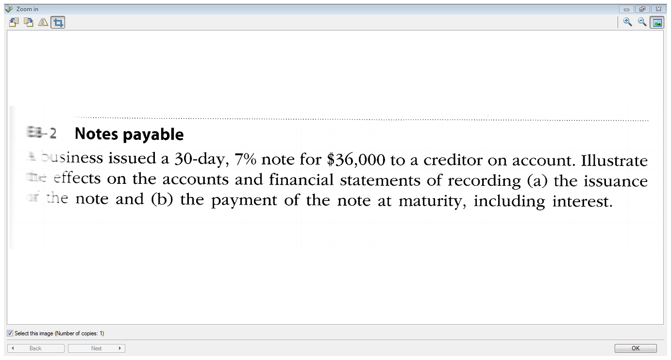

Slide 10
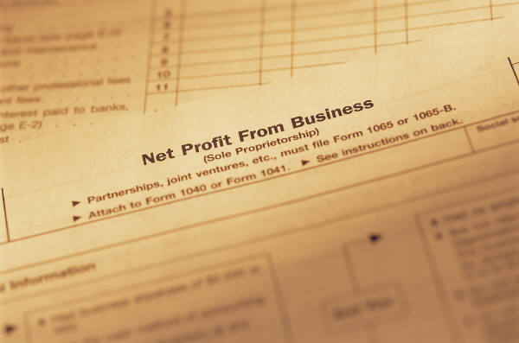
Income Tax Payable
Corporations must pay provincial and federal income tax on their income.
Entry to accrue at month end or year end:
10% of $1,000 income before income tax = $1,000
A = | L | + E
1) | Income Tax Payable + $1,000 | Retained Earnings (income tax expense) - $1,000
2) Cash - $1,000 | Income Tax Payable -$1,000

Slide 11
Contingent Liabilities
Potential liabilities that arise because of events or transactions that have already occurred.

Slide 12
Contingent Liability - Product Warranty Payable
Manufacturers often offer a warranty on their products.
It is “likely” that they will have to honour this warranty and the amount “can be estimated” based on prior experience. Therefore, manufacturers need to record this liability.
Often expressed as a percentage of sales.

Slide 13
Product Warranty Payable
Example: Ford sells 20,000 Ford Fusions this year @$21,000 each. They estimate that repairs expense will total 1% of the sales price.
They should record a Warranty Expense of:
20,000 × $21,000 × 1% = $4,200,000
A = | L | + E
 | Product Warranty Payable + $4,200,000 | Retained Earnings (Warranty Exp.) - $4,200,000

Slide 14
Product Warranty Payable
As repairs are made, Ford can reduce the warranty payable account.
A = | L | + E
Cash and/or Parts Inventory - $100,000 | Product Warranty Payable - $100,000

Slide 15
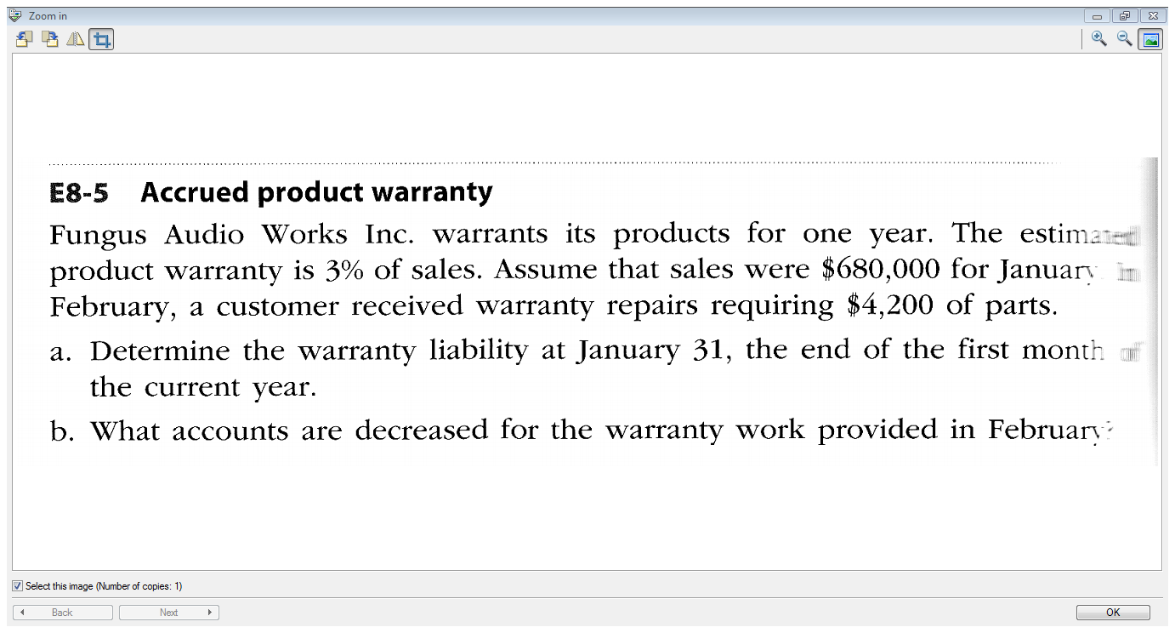

Slide 16
Recording Payroll
Employees at Chancellor Industries earned $25,000 during the pay period. Of that amount, the employees had the following deductions:
- CPP premiums $2,000
EI premiums $1,500
Income taxes $8,000
Premiums for benefits plan $1,500
A = | L |  |  |  | + E
Cash - $12,000 | CPP Payable + $2,000 | EI Payable + $1,500 | Inc.Tax Payable + $8,000 | Benefits Payable + $1,500 | R/E (wages & sal.exp.) - $25,000
Employees get what’s left: $25,000 - $2,000 - $1,500 - $8,000 - $1,500 = $12,000

Slide 17
Recording Payroll – Employer’s Contributions
Chancellor Industries must also pay into the CPP and EI plans:
  - CPP premiums – must match employees’ premiums
  EI premiums – must pay 1.4 times the employees’ premiums
A = | L |  | + E
 | CPP Payable + $2,000 | EI Payable + $2,100 (1.4 x $1,500) | R/E (payroll taxes exp.) - $4,100
Notes:
17

Slide 18
Long Term Liabilities: Bonds
Notes payable issued to multiple lenders (bondholders)
Certificate that is issued shows:
  Interest rate (face rate or coupon rate)
  Principal
  Maturity date
  Interest dates

Slide 19
Bond Interest Rates
Face Rate / Coupon Rate
interest is paid at the rate specified on the bond
Market Rate /Yield/ Effective Interest Rate
the interest rate the bond will yield after selling at a discount or premium
Date
Dept.. of Treasurer
Paycheck for
Jane Doe
8% Return

Slide 20
Recording Bond Issuance
Coupon and effective interest rates are the same.
Assume that a business issues $100,000 of 12% bonds that mature in 5 years time.
To calculate semi-annual interest payments:
Interest = Principal × Rate × Time period
    = $100,000 x 12% x (6 mos/12 mos.)
    = $6,000
A = | L | + E
Cash +$100,000 | Bonds Payable + $100,000

Slide 21
Additional Bond Entries
Semi-annual interest payment
A = | L | + E
Cash -$6,000 |  | Retained Earnings (Interest expense) - $6,000
Repayment at maturity
A = | L | + E
Cash -$100,000 | Bonds Payable - $100,000

Slide 22
Bonds Not Issued at Face Value
Discount on Bonds Payable
  Market rate of interest > contract rate
  Buyers are not willing to pay face value for the bonds
Premium on Bonds Payable
  Market rate of interest < contract rate
  Buyers are willing to pay more than face value for the bonds
Notes:
22

Slide 23
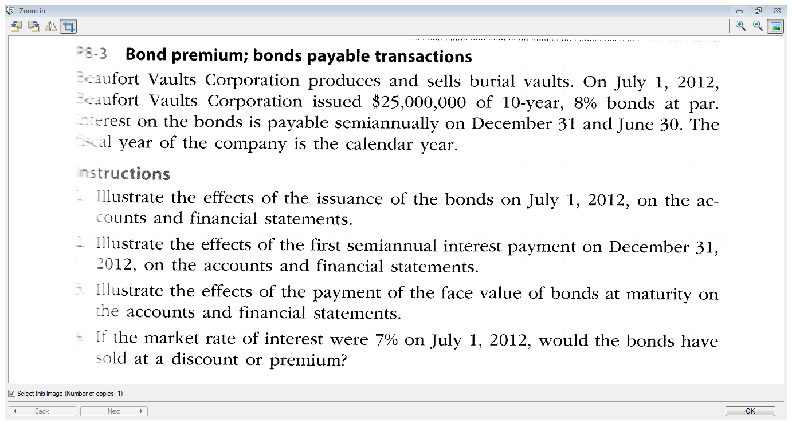

Slide 24

The Corporate Form of Organization
Profit/Not for profit
Private/Public Corporation
Canada Business
Corporations Act

Slide 25
Characteristics of a Corporation
Separate Legal Existence
Limited Liability of Shareholders
Transferable Ownership Rights
Ability to Acquire Capital
Continuous Life
Corporation Management
Government Regulation
Income Taxes

Slide 26
Shareholder Rights
Right to sell shares
Right to vote
Right to receive dividends
Liquidation
Preemption

Slide 27
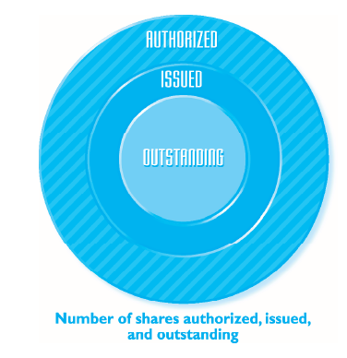
Stock
Shares
  Authorized – total number allowed to issue
  Issued – shares issued to shareholders
  Outstanding – shares currently in the hands of stockholders

Slide 28

Common and Preferred Shares
Common Shareholders
  Have the 5 rights of share ownership, unless a right is withheld. Example, Rogers has Class A voting and Class B non-voting common shares
Preferred Shares
  Preferred shareholders receive dividends before the common shareholders and receive assets before the common shareholders.
  Preferred Shares do not assure the payment of dividends, but the company must pay the stated dividend rate before paying dividends on common stock.
  Usually carry no voting rights

Slide 29
Preferred Shares
May be • Cumulative • Convertible • Callable
Preferred shareholders receive dividends as described in the name:
  “Preferred shares $1 per share quarterly cumulative dividend” – this shareholder will receive $1 for each share she holds. If a dividend is not declared, the dividend will accumulate and be paid the next time the board of directors declares a dividend

Slide 30
No Par Value
No value assigned to them by the Articles of Incorporation
Older corporations’ shares have Par Value assigned to them
  Nominal value per share established in Articles of Incorporation (pre-1985)
    Example: Rogers, note 13 a) ii)
  “There are 1.4 billion authorized Class B non-voting shares with a par value of $1.62478 per share”

Slide 31
Issuance of Stock
The price at which stock sells depends on a variety of factors:
  The financial condition, earnings record, and dividend record of the corporation.
  Investor expectations of the corporation’s potential earning power.
  General business and economic conditions and prospects.

Slide 32
Stock Issuance
Chancellor Industries issues 2,000 shares of common stock for $55 per share.
A = | L | + E
Cash +$110,000 |  | Capital Stock + $110,000

Slide 33
Stock Issuance
Chancellor Industries issues 2,000 shares of common stock for equipment with a market value of $100,000.
A = | L | + E
Equipment +$100,000 |  | Capital Stock + $100,000

Slide 34
Repurchased Stock
Stock that a corporation has issued and then repurchases and cancels
  Repurchase 1,000 shares @$10/each. Book value was $10/each
A = | L | + E
Cash -$10,000 |  | Capital Stock - $10,000
Book Value
= Bal. of Common Shares Account
# of outstanding shares

Slide 35
Cash Dividends
Cash distribution of earnings by a corporation to its shareholders
Most common form of dividend
Usually three conditions:
  Sufficient retained earnings
  Sufficient cash
  Formal action by the board of directors

Slide 36
Dividend Announcement Dates
Date of Declaration – Board of directors take action to declare dividend. Stated on a per share basis ex. $0.50/share
Date of Record – Owners of the shares on this date receive dividends
Date of Payment – Dividend is paid.

Slide 37
Cash Dividends
On November 23, Jabot Cosmetics declares a $1 per share cash dividend for those shares on record December 15. Payment will be made December 24. There are 20,000 shares outstanding. On November 23 – Date of Declaration:
A = | L | + E
 | Dividends Payable + $20,000 | Retained Earnings - $20,000
Notes:
37

Slide 38
Dividends
December 15: Date of Record - no entry
On December 24 – date of payment:
A = | L | + E
Cash - $20,000 | Dividends Payable - $20,000

Slide 39
Stock Dividends
Stock Dividends may be declared instead of cash dividend
  Example – Board of Directors declares a 20% stock dividend. There are 1,000 shares outstanding. Market Value = $20/share
  Entry:
  1,000 shares x 20% x $20/share = $4,000
A = | L | + E
 | Stock dividend distributable + $4,000 | Retained Earnings - $4,000
Notes:
39

Slide 40
Stock Dividends
On issue date:
A = | L | + E
 | Stock dividend distributable - $4,000 | Capital Stock + $4,000
Notes:
40

Slide 41
Stock Split
Increases the number of shares outstanding
Example: Company issues a 2 for 1 stock split. 20,000 shares outstanding at that time. After stock split, 40,000 shares will be outstanding.
No entry in the accounting system
Notes:
41

Slide 42
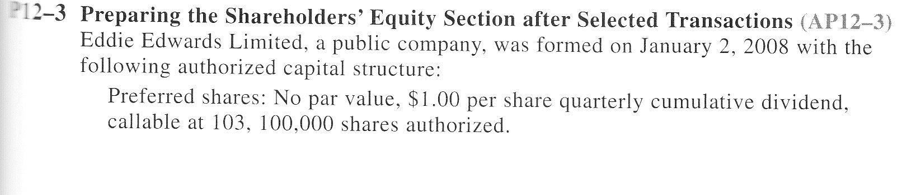
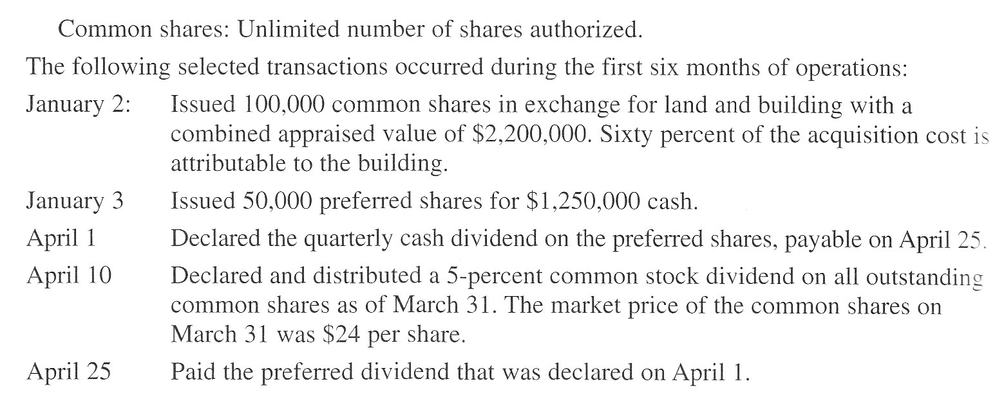
Problem – not from Warren textbook

Slide 43
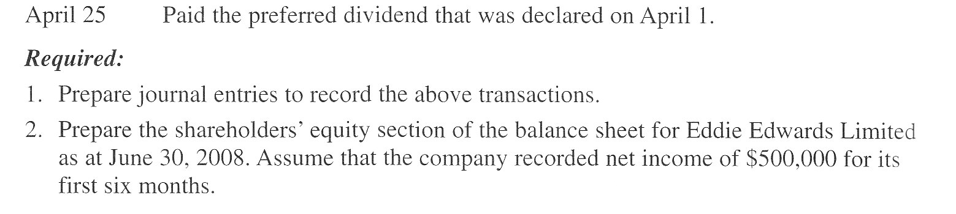

Slide 44
Financial Reporting of Liabilities and Equity
Balance Sheet
Statement of Changes in Shareholders’ Equity

Slide 45
Earnings Per Share
Net Income – Preferred Dividends
Number of Common Shares Outstanding
Major profitability measure reported in the financial statements
Followed closely by the financial press

Slide 46
Bonds or Shares?
Long-term Liabilities - Must pay interest expense which lowers net income. Does not dilute share ownership or control of the company. Increases liabilities which increases debt ratio.
Shares – No interest expense which results in higher net income. More shares outstanding which lowers earnings per share. Dilutes control of company.

Slide 47
Effect of Alternative $4M Financing
 | Plan 1 | Plan 2 | Plan 3
6% bonds | $ 0 | $ 0 | $2,000,000
Preferred stock – $2 dividend/year | 0 | 2,000,000 | 1,000,000
Common stock | 4,000,000 | 2,000,000 | 1,000,000
Total Financing | $4,000,000 | $4,000,000 | $4,000,000
Earnings before income tax | $400,000 | $400,000 | $400,000
Deduct interest on bonds | 0 | 0 | 120,000
Income before income tax | 400,000 | 400,000 | 280,000
Deduct income tax (40%) | 160,000 | 160,000 | 112,000
Net Income | 240,000 | 240,000 | 168,000
Dividends on preferred shares |  | 80,000 | 40,000
Avail. for dividends on common stock | 240,000 | 160,000 | 128,000
Divide by # of shares outstanding | ÷ 400,000 | ÷200,000 | ÷100,000
Earnings per Share | $0.60 | $0.80 | $1,28

Slide 48
End of Chapter 8!

