Slide 1
Chapter 2
Basic Accounting Concepts

Slide 2
Learning Objectives
Describe the basic elements of a financial accounting system.
Analyze, record, and summarize transactions for a corporation’s first period of operations.
Prepare financial statements for a corporation’s first period of operations.

Slide 3

Financial Accounting System
Designed to produce financial statements
  Income statement
  Statement of Retained Earnings
  Balance Sheet
  Statement of Cash Flows

Slide 4

Financial Accounting System
Rules to determine the:
  Rules for
    What
    When
    the Amount
  that should be recorded.
  Need to record transactions (or economic events)
Framework for preparing financial statements
Controls to determine whether errors have arisen in the recording process

Slide 5
Framework of an Accounting System
Assets = Liabilities + Equity
Every transaction affects at least two accounts.
The accounting equation must remain in balance after each transaction.

Slide 6
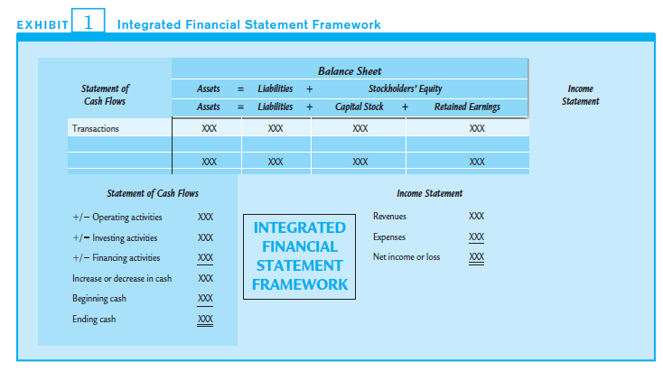
Integrated Financial Statement Framework: Template
By expanding the accounting equation, transactions can be analyzed, summarized, and recorded within the integrated financial statement framework.
Retained Earnings
= Beg.R/E
+ Net Income
- Dividends
Notes:
6

Slide 7
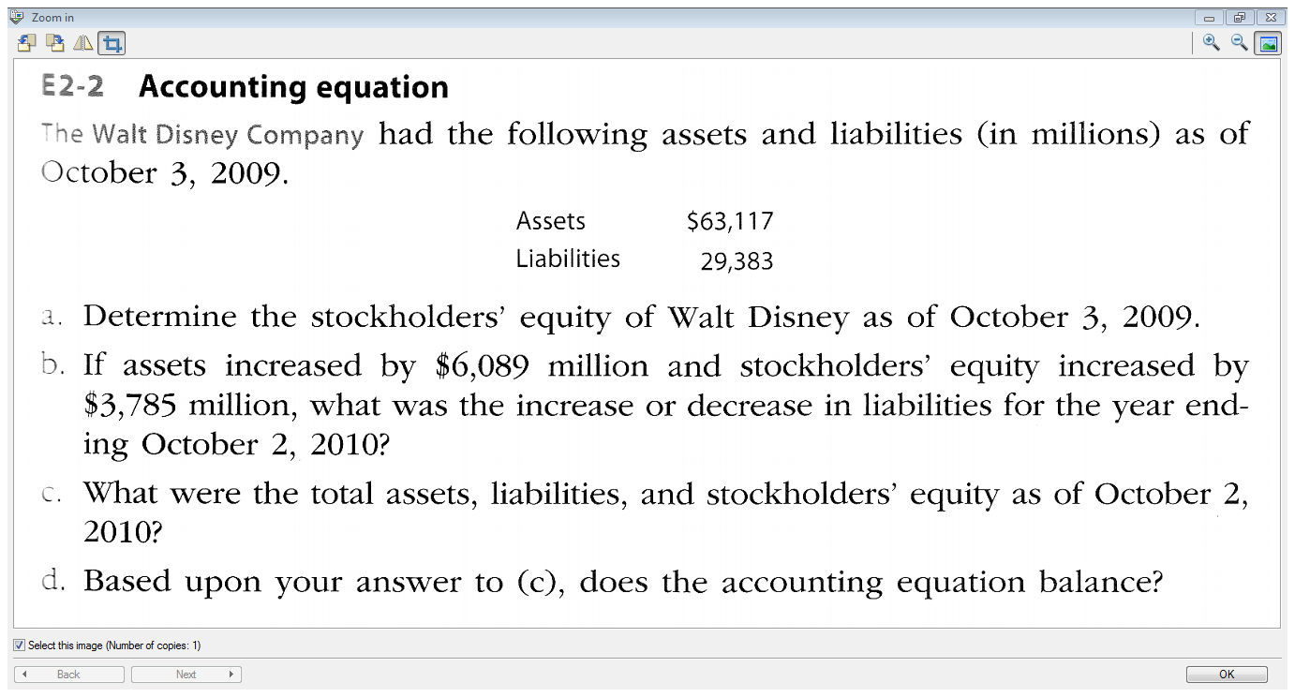

Slide 8
Transactional Analysis
Transaction #1:
Mom invests $100 in our new lemonade stand. The company issues her 10 shiny new share certificates.
A = | L + | E
 |  | Cptl Stock Ret’d Earnings
The business has rec’d cash – assets have increased |  | The business has issued share certificates – we have our 1st owner! Capital Stock has increased
Cash + $100 |  | Cptl Stock + $100

Slide 9
Transactional Analysis
Transaction #2:
We still need more cash to start our business. Our bank lends us $200.
A = | L | + E
The business has rec’d cash – assets have increased | We now owe the bank money – liabilities have increased.
Cash +$200 | Bank Loan +$200

Slide 10
Transactional Analysis
Transaction #3:
We buy equipment totaling $150 with cash.
A = | L | + E
- The business has paid cash – assets have decreased - Equipment has increased.
Equip’t Cash +$150 - $150

Slide 11
Transactional Analysis
Transaction #4:
We buy lemonade making supplies of $125 “on account” from our supplier.
A = | L | + E
- Supplies have increased. | We now owe our supplier – liabilities have increased
Supplies +$125 | Accounts Payable +$125

Slide 12
Transactional Analysis
Transaction #5:
Sold 20 glasses of lemonade on our first day of business for $20.
Retained Earnings = Beg.R/E + Net Income - Dividends
A = | L | + E
Cash goes up |  | Cptl.Stock Ret’d Earnings R/E goes up because revenue is recognized
Cash +$20 |  | Sales +$20

Slide 13
Transactional Analysis
Transaction #6:
Paid employee wages for the week $1and paid advertising $15
Retained Earnings = Beg.R/E + Net Income - Dividends
A = | L | + E
Cash goes down |  | Cptl.Stock Ret’d Earnings R/E goes down because an expense is recognized
Cash - $16 |  | Wages Exp. - $1 Adv.Exp. $15

Slide 14
Transactional Analysis
Transaction #7:
Pay $2 to Mom, our shareholder, as a dividend.
A = | L | + E
Cash goes down |  | Cptl.Stock Ret’d Earnings R/E goes down because dividends are paid.
Cash - $2 |  | Dividends - $2

Slide 15
Summary
 | Assets |  |  | Liabilities |  | Shareholders’ Equity
Trans.# | Cash | Supplies | Equip-ment | Accounts Payable | Bank Loan | Cptl. Stock | Ret’d Earn’gs
1. | +$100 |  |  |  |  | +$100
2. | +$200 |  |  |  | +$200
3. | -$150 |  | +$150
4. |  | +$125 |  | +$125
5. | +$20 |  |  |  |  |  | +$20
6. | -$16 |  |  |  |  |  | - $16
7. | -$2 |  |  |  |  |  | -$2
Balance | $152 | $125 | $150 | $125 | $200 | $100 | $2

Slide 16
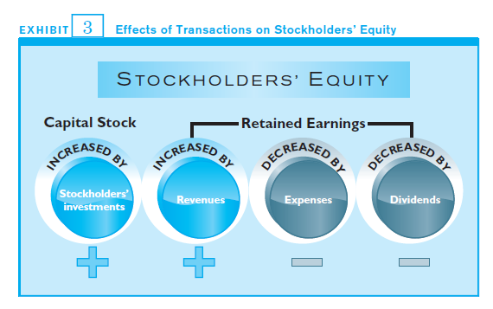
Shareholders’ Equity

Slide 17
Income Statement
Julianne’s Lemonade Stand Inc. Income Statement For the month ended September 30, 2013
Sales revenue |  |  | $ 20
Operating Expenses:
Wages Expense |  | $ 1
Advertising Expense |  | 15
Total operating expenses |  |  | 16
Net Income |  |  | $ 4

Slide 18
Retained Earnings Statement
Julianne’s Lemonade Stand Inc. Retained Earnings Statement For the month ended September 30, 2013
Retained Earnings, Sept.1, 2013 | $ 0
Net income for September | 4
Less dividends | 2
Retained Earnings, Sept.30, 2013 | 2

Slide 19
Julianne’s Lemonade Stand Inc. Balance Sheet As at September 30, 2013
ASSETS
Cash |  | $ 152
Supplies |  | 125
Equipment |  | 150
Total assets |  | $ 427
LIABILITIES AND SHAREHOLDERS’ EQUITY
LIABILITIES
Accounts Payable | $125
Bank Loan | 200 | $ 325
SHAREHOLDERS’ EQUITY
Capital Stock | 100
Retained Earnings | 2 | 102
Total Liabilities and Shareholders’ Equity |  | $ 427

Slide 20
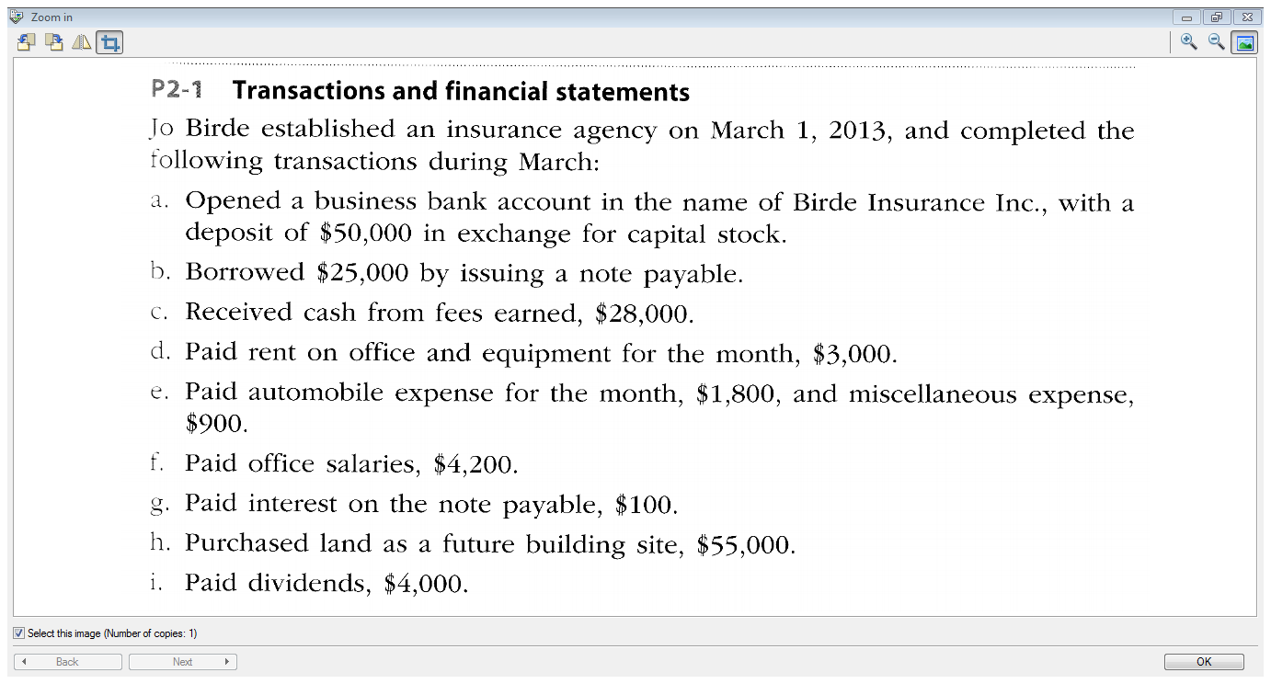

Slide 21
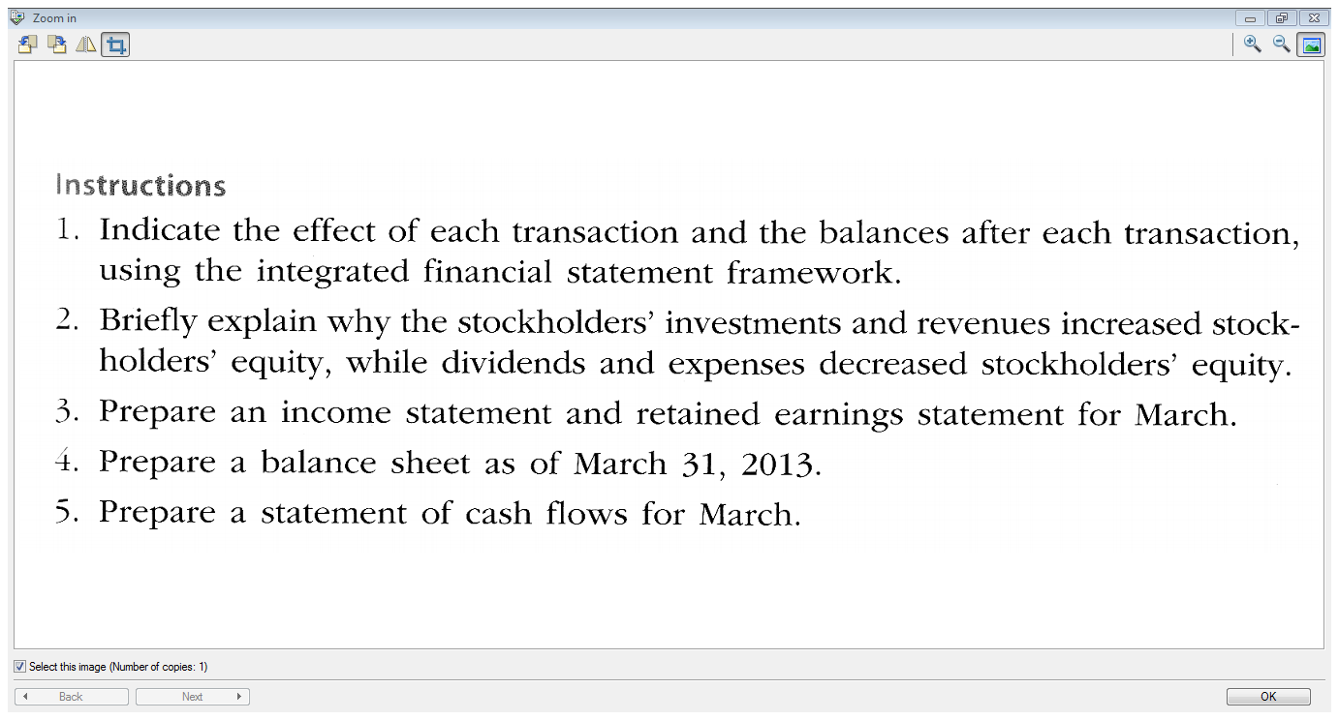

Slide 22
End of Chapter 2 !
Next week: Chapter 3

