Slide 1
Chapter 13
Game Theory

Slide 2
Topics
Concepts and Definitions
Static Games
Solution concepts: Dominance, Nash
Dynamic Games.
Auctions (optional).
Notes:
2

Slide 3
Game Theory
Game theory - a set of tools that economists, political scientists, military analysts and others use to analyze decision making by players who interact strategically
Notes:
3

Slide 4
Application Examples
Matching of residents and hospitals, kidney donors and recipients… (latest Nobel in economics)
Auction design for broadband licenses
Military: mutually assured destruction (MAD)
And many more!

Slide 5
Example
Jules and Vincent are mobsters; they have killed someone, are being arrested, but evidence only enough for illegal weapon holding
Police sit them in separate rooms, offering each to get jail reduction if they implicate the other
2 years for weapons; 15 years for murder; 1 year off for both confessing, 0 if you are the only one to implicate the other.

Slide 6
An Overview of Game Theory
Game - any interaction between players (firms) in which strategic behavior plays a major role.
Action - a move that a player makes at a specified stage of a game, such as how much output a firm produces in the current period.
Notes:
6

Slide 7
An Overview of Game Theory (cont.)
Strategy - a battle plan that specifies the action that a player will make conditional on the information available at each move and for any possible contingency.
Payoffs - players’ valuations of the outcome of the game, such as profits for firms or utilities for individuals.
Notes:
7

Slide 8
Main Assumptions
players are interested in maximizing their payoffs.
all players have common knowledge:
  about the rules of the game,
  that each player’s payoff depends on actions taken by all players,
  that all players want to maximize payoffs,
  that all players know that all players know the payoffs and
  that their opponents know they are payoff maximizing, and so on.
Notes:
8

Slide 9
An Overview of Game Theory (cont.)
Strategic behavior - a set of actions a firm takes to increase profit, taking into account the possible actions of other firms
Strategic interdependence - a player’s optimal strategy depends on the actions of others.
Notes:
9

Slide 10
An Overview of Game Theory (cont.)
Rules of the game - regulations that determine the timing of players’ moves and the actions that players can make at each move
Notes:
10

Slide 11
Information Definitions
Complete information - the situation where the payoff function is common knowledge among all players
Perfect information - the situation where the player who is about to move knows the full history of the play of the game to this point, and that information is updated with each subsequent action
Notes:
11

Slide 12
Static vs. Dynamic Games
Static game - game in which each player acts only once and the players act simultaneously (or, at least, each player acts without knowing rivals’ actions).
Dynamic game - game in which players move either sequentially or repeatedly
Notes:
12

Slide 13
Normal-Form Games
Normal form - representation of a static game with complete information specifies the players in the game, their possible strategies, and the payoff function that identifies the players’ payoffs for each combination of strategies
Notes:
13

Slide 14
Normal-Form Games: Example
Two airlines: American and United.
Each airline can take only one of two possible actions:
  Each can fly either 64 or 48 thousand passengers between Chicago and Los Angeles per quarter.
Notes:
14

Slide 15
Normal-Form Games: Example (cont.)
Because the firms choose their strategies simultaneously, each firm selects a strategy that maximizes its profit given what it believes the other firm will do.
The firms are playing a noncooperative game of imperfect information.
Notes:
15

Slide 16
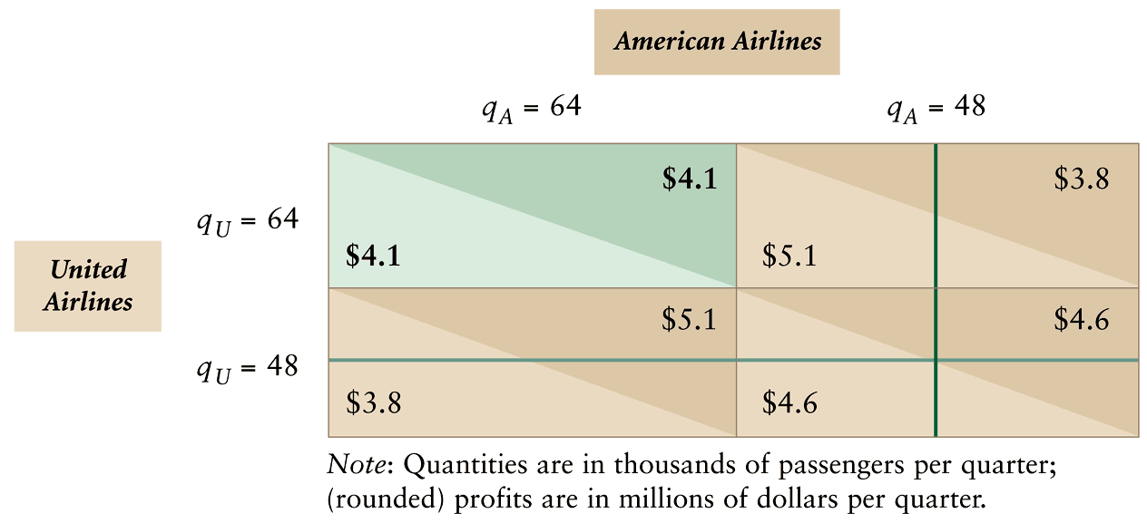
Table 13.1 Profit Matrix for a Quantity-Setting Game: Dominant Strategy
Notes:
16

Slide 17
Predicting a Game’s Outcome
Dominant strategy - a strategy produces a higher payoff than any other strategy the player can use for every possible combination of its rivals’ strategies.
Notes:
17

Slide 18
Predicting a Game’s Outcome
If United chooses the high-output strategy (q_{U} = 64), American’s high-output strategy maximizes its profit.
If United chooses the low-output strategy (q_{U} = 48), American’s high-output strategy maximizes its profit.
Thus, the high-output strategy is American’s dominant strategy.
  Whichever strategy United uses, American’s profit is higher if it uses its high-output strategy.
Notes:
18

Slide 19
Predicting a Game’s Outcome
A striking feature of this game is that the players choose strategies that do not maximize their joint profit.
Prisoners’ dilemma - a game in which all players have dominant strategies that result in profits (or other payoffs) that are inferior to what they could achieve if they used cooperative strategies
Notes:
19

Slide 20
Iterated Dominance
Dominated strategy – a strategy that produces a lower payoff for every possible combination of its rivals’ strategies than some other strategy the player can use
Iterated Dominance – Eliminate dominated strategies one at a time

Slide 21
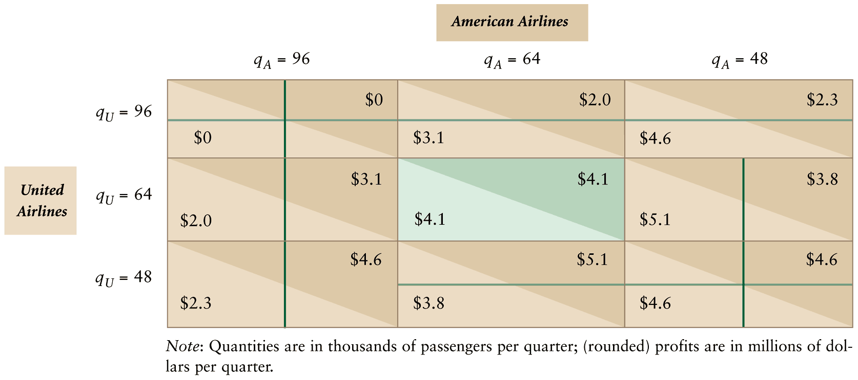
Table 13.2 Profit Matrix for a Quantity-Setting Game: Iterated Dominance
Notes:
21

Slide 22
Best Response
Best response - the strategy that maximizes a player’s payoff given his beliefs about his rivals’ strategies.
Notes:
22

Slide 23
Nash Equilibrium
Nash equilibrium - a set of strategies such that, when all other players use these strategies, no player can obtain a higher payoff by choosing a different strategy – no incentive to deviate
All players use best-response strategies to others’ best response strategies

Slide 24
Nash Equilibrium
Always exists
Only solution concept where beliefs are consistent with actual strategies

Slide 25
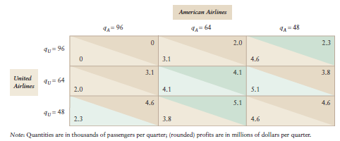
Best Responses and Nash Equilibrium
In a game without dominant strategies, calculate best responses to determine Nash equilibrium

Slide 26
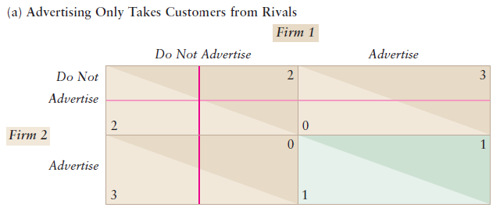
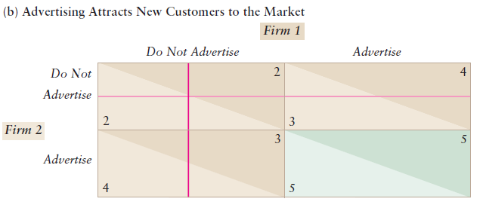
Failure to Maximize
Joint Payoffs
In the Nash equilibrium of the first advertising game, firms maximize joint profits. In the second, they do not.

Slide 27
Multiple Nash Equilibria, No Nash Equilibrium, and Mixed Strategies
Pure strategy - each player chooses an action with certainty
  assigns a probability of 1 to a single action.
Mixed strategy - a firm (player) chooses among possible actions according to probabilities it assigns.
  probability distribution over actions
Notes:
27

Slide 28
Multiple Nash Equilibria, No Nash Equilibrium, and Mixed Strategies (cont.)
Suppose that two firms are considering opening gas stations at a highway rest stop that has no gas stations. There’s enough physical space for at most two gas stations.
Notes:
28

Slide 29
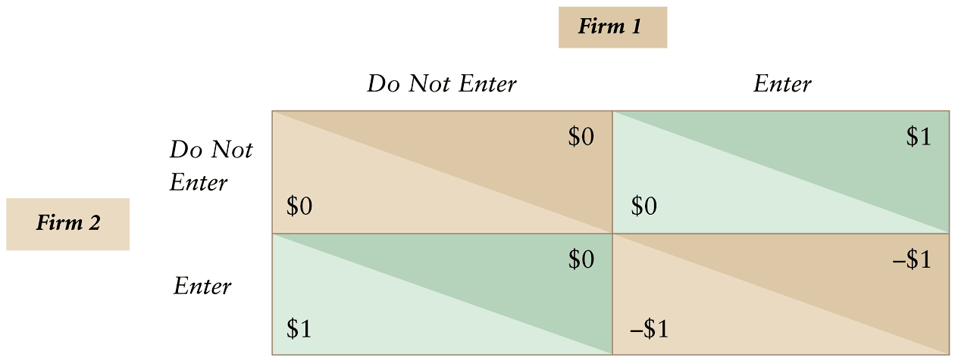
Table 13.4 Simultaneous Entry Game
Notes:
29

Slide 30
Multiple Nash Equilibria, No Nash Equilibrium, and Mixed Strategies (cont.)
This game has two Nash equilibria in pure strategies:
  Firm 1 enters and Firm 2 does not enter, or
  Firm 2 enters and Firm 1 does not enter.
How do the players know which (if any) Nash equilibrium will result?
  They don’t know.
Notes:
30

Slide 31
Mixed-strategy Nash Equilibrium
Every finite game has at least one Nash Equilibrium – possibly in mixed strategies
Assign a probability to each action
Expected payoff for opponent has to be equal for all actions in its mixed strategy
If true for both, then Nash Equilibrium

Slide 32
Example: Gas Station Entry
Use probability θ for not entering, (1 - θ) for entering
Opponent’s expected payoff is then
  Not enter: θ*0 + (1 - θ)*0 = 0
  Enter: θ*1 + (1 - θ)*(-1) = 2*θ - 1
  Setting them equal: 0 = 2*θ - 1→ θ = 1/2
Game is symmetric so if each player uses the strategy {Pr(e)=1/2, Pr(n)=1/2}, that is a Nash Equilibrium in mixed strategies

Slide 33
Table 13.4 Simultaneous Entry Game
Notes:
33

Slide 34
Solved Problem 13.2
Mimi wants to support her son Jeff if he looks for work but not otherwise. Jeff wants to try to find a job only if Mimi will not support his life of indolence. If they choose actions simultaneously, what are the pure- or mixed-strategy equilibria?
Notes:
34

Slide 35
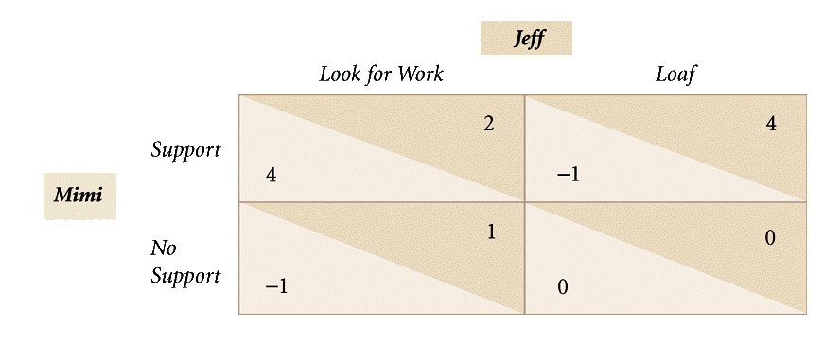
Solved Problem 13.2
Notes:
35

Slide 36
Example 2: Shirking
Jeff: probability θ_{J} for working, (1 – θ_{J}) for loafing
Mimi: θ_{M} for support, (1 – θ_{M}) not support
Mimi indifferent if
  θ_{J}*4 + (1 – θ_{J})*(-1) = θ_{J}*(-1) + (1 – θ_{J})*0
  θ_{J} = 1/6
Jeff indifferent if
  θ_{M}*2 + (1 – θ_{M})*1 = θ_{M}*4 + (1 – θ_{M})*0
  θ_{M} = 1/3
Nash Equilibrium in mixed strategies for {Pr(w)=1/6,Pr(l)=5/6} and {Pr(s)=1/3,Pr(n)=2/3}

Slide 37
Dynamic Games
Dynamic games - players move sequentially or move simultaneously repeatedly over time
Extensive form - specifies the n players, the sequence in which they make their moves, the actions they can take at each move, the information that each player has about players’ previous moves, and the payoff function over all the possible strategies
Notes:
37

Slide 38
Subgames
Subgame – all subsequent decisions that players may make given the actions already taken and corresponding payoffs
  One subgame for every node of information
  (Game itself is also a subgame of itself)

Slide 39
Sequential Game
Two-stage game:
  In the first stage, Player 1 moves.
  In the second stage, Player 2 observes Player 1’s actions and then makes a choice based on this observed action.
  Game ends with the players’ receiving payoffs based on their actions.
Notes:
39

Slide 40
Sequential Game
Same airline game as before.
  Assume that American and United Airlines can choose output levels of 96, 64, and 48 thousand passengers per quarter.
  American moves first and United can observe this choice before making its own choice
Notes:
40

Slide 41
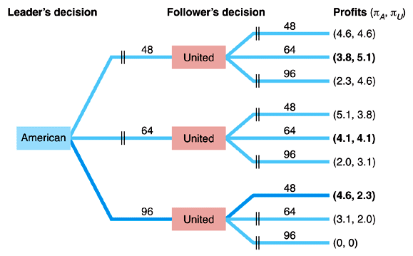
Figure 13.1 Airlines Game Tree
Notes:
41

Slide 42
Compare to Table 13.2, Profit Matrix for a Quantity-Setting Game
Notes:
42

Slide 43
Sequential Game (cont.)
Subgame perfect Nash equilibrium - players’ strategies are a Nash equilibrium in every subgame.
Backward induction - first determine the best response by the last player to move, next determine the best response for the player who made the next to-last move, then repeat the process back to the move at the beginning of the game
Notes:
43

Slide 44
Sequential Game (cont.)
How should American, the leader, select its output in the first stage?
  For each possible quantity it can produce, American predicts what United will do and picks the output level that maximizes its own profit.
Notes:
44

Slide 45
Sequential Game (cont.)
The subgame perfect Nash equilibrium requires players to believe that their opponents will act optimally—in their own best interests.
Not all Nash equilibria are subgame perfect Nash equilibria. We focus on the latter for dynamic games
Notes:
45

Slide 46
Credibility
Why doesn’t American announce that it will produce output q_{A}=96 to induce United to produce output q_{U}=48?
  when the firms move simultaneously, United doesn’t believe American’s warning that it will produce a large quantity, because it is not in American’s best interest to produce that large a quantity of output.
Notes:
46

Slide 47
Credibility (cont.)
Credible threat - an announcement that a firm will use a strategy harmful to its rival and that the rival believes because the firm’s strategy is rational in the sense that it is in the firm’s best interest to use it
Notes:
47

Slide 48
Credibility (cont.)
Why commitment makes a threat credible?
  “burning bridges.” - If the general burns the bridge behind the army so that the troops can only advance and not retreat, the army becomes a more fearsome foe
Notes:
48

Slide 49
Repeated Game
Static games that are repeated - in each period, there is a single stage:
  Both players move simultaneously.
    Player 1’s move in period t precedes
    Player 2’s move in period t + 1; hence, the earlier action may affect the later one.
  The players know all the moves from previous periods, but they do not know each other’s moves within any one period because they all move simultaneously.
Notes:
49

Slide 50
Repeated Game (cont.)
Suppose now that the airlines’ single-period prisoners’ dilemma game is repeated quarter after quarter.
  If they play a single-period game, each firm takes its rival’s strategy as a given and assumes that it cannot affect that strategy.
In a repeated game, a firm can influence its rival’s behavior by signaling and threatening to punish.
Notes:
50

Slide 51
Auctions
Auction - a sale in which property or a service is sold to the highest bidder.
Three key components:
  the number of units being sold,
  the format of the bidding, and
  the value that potential bidders place on the good.
Notes:
51

Slide 52
Format of Bidding
English auction - The auctioneer starts the bidding at the lowest price that is acceptable to the seller and then repeatedly encourages potential buyers to bid more than the previous highest bidder.
Notes:
52

Slide 53
Format of Bidding (cont.)
Dutch auction - ends dramatically with the first “bid.”
  The seller starts by asking if anyone wants to buy at a relatively high price.
  The seller reduces the price by given increments until someone accepts the offered price and buys at that price.
Notes:
53

Slide 54
Format of Bidding (cont.)
Sealed-bid auction - everyone submits a bid simultaneously without seeing anyone else’s bid (for example, by submitting each bid in a sealed envelope), and the highest bidder wins.
  first-price auction - the winner pays its own highest bid.
  second-price auction - the winner pays the amount bid by the second-highest bidder.
Notes:
54

Slide 55
Value
Private value - If each potential bidder places a different personal value on the good.
Common value - good that has the same fundamental value to everyone, but no buyer knows exactly what that common value is.
Notes:
55

Slide 56
Bidding Strategies in Private-Value Auctions
In a traditional sealed-bid, second-price auction, bidding your highest value weakly dominates all other bidding strategies:
  The strategy of bidding your maximum value leaves you as well off as, or better off than, bidding any other value.
Notes:
56

Slide 57
Bidding Strategies in Private-Value Auctions (cont.)
Should you ever bid more than your value?
  Suppose that you bid $120. Your value is $100. There are three possibilities.
    If the highest bid of your rivals is greater than $120, then you do not buy the good and receive no consumer surplus.
    If the highest alternative bid is less than $100, then you win and receive the same consumer surplus that you would have received had you bid $100.
    if the highest bid by a rival were an amount between $100 and $120—say, $110—then bidding more than your maximum value causes you to win, but you purchase the good for more than you value it, so you receive negative consumer surplus: −$10 (= $100 − $110).
Notes:
57

Slide 58
Bidding Strategies in Private-Value Auctions (cont.)
Should you ever bid less than your maximum value, say, $90?
  No,
    because you only lower the odds of winning without affecting the price that you pay if you do win.
Thus, you do as well or better by bidding your value than by over- or underbidding.
Notes:
58

Slide 59
English Auction Strategy
The seller uses an English auction to sell the carving to bidders with various private values.
  Your best strategy is to raise the current highest bid as long as your bid is less than the value you place on the good, $100.
Notes:
59

Slide 60
Winner’s Curse
Winner’s curse - auction winner’s bid exceeds the common-value item’s value
If bidders are right on average, then highest bid likely to be above true value
Example: Jar full of coins
Example: early auctions for drilling rights
Notes:
60

