Slide 1
Dragonflies and Swarming: Technical Information
By:
Katelynn Bolster, Anna Wailand, Jason Mooney, and Cam Wong

Slide 2
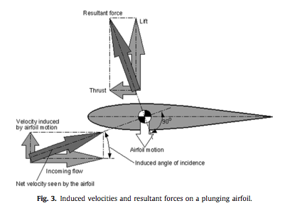
Figure: lift and thrust forces on a plunging airfoil
Original Figure
Figure for Presentation
Y. Lian et al., “The characterization of tandem and corrugated wings,” Progress in Aerospace Sciences, vol. 65, p. 43, Feb. 2014.
Notes:
-- This diagram is relevant because it shows the forces acting on an airfoil in plunging flight. A dragonfly wing is a very specific type of airfoil.
-- This diagram came from a journal article, titled “The characterization of corrugated and tandem wings” in the Journal of Progress in Aerospace Sciences.
-- The audience of this information would be anyone doing research in the field of dragonfly flight, possibly someone more advanced in their studies as there is some information in the article that goes far beyond our knowledge base as second-year engineering students.
-- This diagram gives a good visualization of how thrust and lift forces affect airfoils or wings
-- Changes that we made to this figure were removing the diagram components showing the net velocity seen by the airfoil because this part of the diagram is unnecessary to demonstrate how lift and thrust forces act on an airfoil. The velocity as seen by the airfoil is irrelevant to our explanation(s) of dragonfly flight.

Slide 3
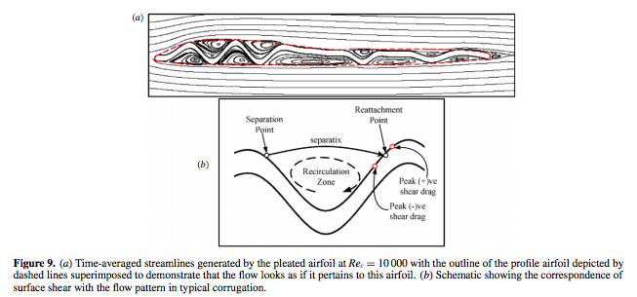
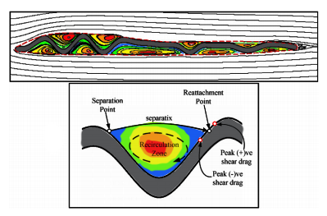
Figure: Wing Corrugation Vortices
Original Figure
Figure for Presentation
A. Vargas, R. Mittal and H. Dong, “A computational study of the aerodynamic performance of a dragonfly wing section in gliding flight,” Bioinspiration and Biomimetics, vol. 3, no. 2, p. 10, June 2008.
Notes:
-- This diagram is relevant because it illustrates how vortices form in the valleys of corrugation in a dragonfly wing. The formation of these vortices in flight is what makes dragonfly wings so unique.
-- This diagram came from a journal article, titled “A computational study of the aerodynamic performance of a dragonfly wing section in gliding flight,” in the Journal of Bioinspiration and Biometrics.
-- Similar to the journal from which our first figure came, the audience of this information could be anyone doing research in the field of dragonfly flight, and again possibly someone more advanced in their studies as there is some information in the article that goes far beyond our knowledge base as second-year engineering students.
-- This diagram allows you to visualize what the cross-section of a dragonfly wing might look like, and how airflow across that wing profile behaves. Understanding how the air flows across dragonfly wings is instrumental to understanding how these insects fly and what makes them different from other flapping insects and birds.
-- One change that we made to this figure was removing the diagram comments, as they go into much more detail than the scope of this project allows. Another change that we made was adding some colour variation to the diagram to better illustrate what is happening. In black and white it was confusing to determine which part of the diagram represented the wing, and which part or parts represented the vortices.

Slide 4
Thank You!
Does anyone have any questions?

