Slide 1
Gender I: Women and inequality
November 6th, 2012

Slide 2
Key Terms
Gender Stratification
Sex
Gender
Gender Binary
Intersectionality
Transgender
Gender Inequality
Biological Essentialism
Social construction
Gender roles
Gender Identity
Double day/second shift
Sexism
Institutional Sexism
Feminism
Patriarchy
Jean Kilbourne

Slide 3
Discussion Boards reminder
5 weeks left. If you haven’t begun to post you have to start this week in order to be eligible for full marks.
If you have not posted on the “Discussion Boards” that says: “Posting here will be used for your 5% online participation mark” you WILL NOT be credited for that post.

Slide 4
“Talking about gender for most people is the equivalent of fish talking about water. Gender is so much the routine ground of everyday activities that questioning its taken-far-granted assumptions and presuppositions is like thinking about whether the sun will come up” (Lorber: pg 54).

Slide 5
Gender: Starting Points
Gender is one of the major ways that we organize our lives
Gender is not biological—it is socially constructed
Men and women are not equal, and as a social category men have more power and women less
Gender inequality is pervasive in Canadian society
Gender inequality has a wide range of consequences

Slide 6
Sex and Gender
Sex
Gender
Genetically male or female; determines role in reproduction; biological standpoint
All expected and actual thoughts, feelings, and behaviours associated with masculinity and femininity

Slide 7
Intersexed body
Biological facts associated with being born male or female
Intersexed infants (previously hermaphrodites) are born with hormonal, anatomical, and genetic configurations
    Do not fit our traditional ideas of sexual difference

Slide 8

Gender: a dichotomous category
Any variable which has only two categories.
These categories are meant to be mutually exclusive (nothing can belong simultaneously to both parts) and jointly exhaustive (everything must belong to one part or the other)
Dichotomies often form the basis of divisions and inequality because one is valued more

Slide 9
Gender Binary
The classification of sex and gender into two distinct and disconnected forms of masculine and feminine.
People are categorized exclusively as either male or female, often basing gender on biological sex.

Slide 10
Gender Belief Systems
Men | Women
strong | weak
rational | emotional
dominant | nurturing
independent | dependent
less care for appearance | care for appearance

Slide 11
Alternatives to the binary
Genders that are neither man nor woman have been described for many societies:
  Two-spirit—a man living as a woman and considered to have supernatural powers in native American society.
  Hijra—an alternative gender role in India conceptualized as neither man nor woman.

Slide 12
Transgender
Experiencing gender-identity in one of many non-traditional ways
“Trans” means to cross or change:
    socially accepted gender codes through our appearance (dress);
    behaviours (gender roles);
    natural biology (neither totally male nor female); or
    conflict between our internalized gender and biological sex

Slide 13
Intersectionality
Our identities and position in social categories (i.e. woman, heterosexual, Aboriginal) are complex and interconnected.
Various socially and culturally constructed categories (race/ethnicity, gender, sexuality, socio-economic, dis/ability, age, nationality etc.) all interact on multiple levels to manifest themselves as inequality in society

Slide 14
Explanations of Gender Difference: Nature or Nurture?
Are two main perspectives:
Biological Essentialism ⇨ School of thought that views gender differences as reflection of biological differences between women and men
Social constructionism ⇨ Regards gender differences as constructed by social structure and culture

Slide 15
A Critique of Essentialism
Main criticisms of essentialism:
Ignores historical and cultural variability of gender and sexuality
Tends to generalize from the average, ignoring variations within gender groups
There is little empirical basis for assuming that different biology causes particular behaviours
Ignores the role of power

Slide 16
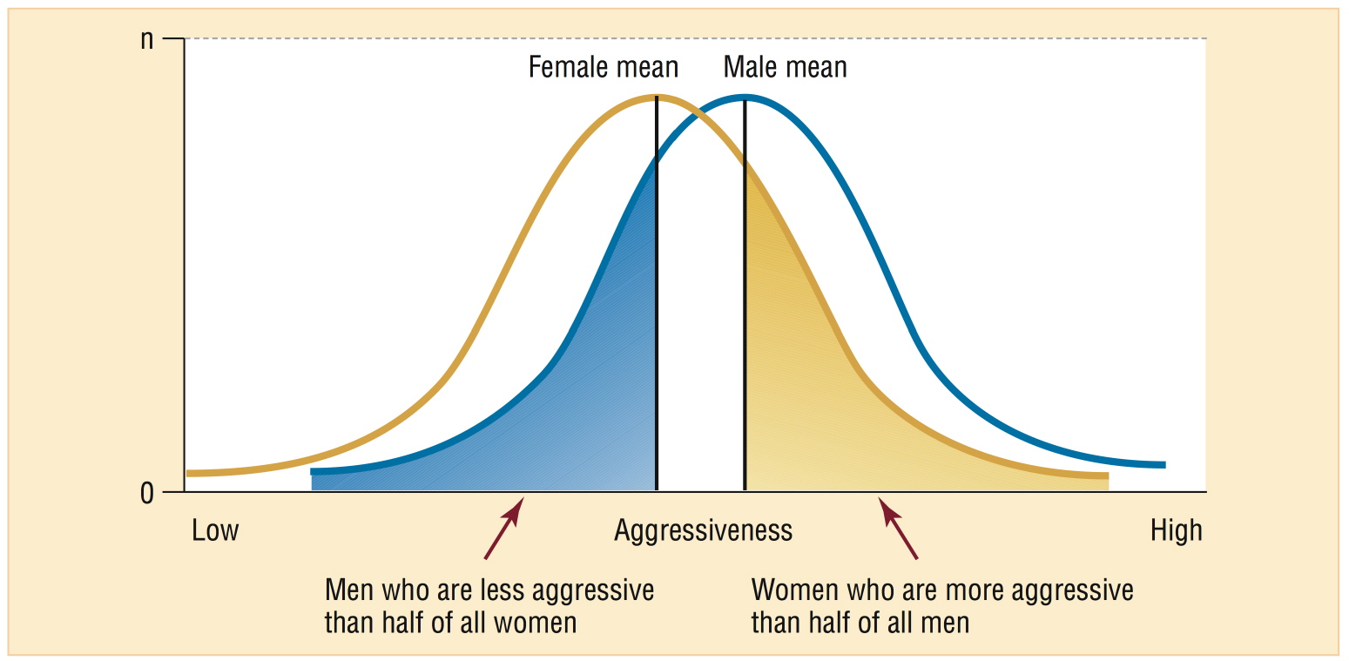
The Distribution of Aggressiveness among Men and Women
Notes:
FIGURE 11.1 on p. 311 - The Distribution of Aggressiveness among Men and Women

Slide 17
Social Construction
The perspective that there is not a natural or objective basis to ‘reality’.
All knowledge, customs, habits etc., no matter how basic and natural they seem, are the by-products (mostly unintended or unconscious) of countless human choices rather than resulting from divine will or nature.

Slide 18
Gender is a Social Construction
Gender does not flow from genitalia and reproductive organs (sex).
Gender is:
Taught
Learned
Done

Slide 19
Gender identity
One’s self-concept of being male or female, something in between or something outside the two-gender spectrum
Gender identity does not necessarily drive romantic attractions towards others

Slide 20
Gender differences are socially constructed, but have real consequences
Face sexism, discrimination, harassment, and violence
Make less income than men
Are at a higher risk of living in poverty, especially if they are a single parent or another marginalized status
Are responsible for the majority of the domestic labour and childcare

Slide 21
Gender Inequality

Slide 22
Equal Rights
In Canada we have a ‘Charter of Rights and Freedoms’ that says:
“Every individual is equal before and under the law and has the right to the equal protection and equal benefit of the law without discrimination and, in particular, without discrimination based on race, national or ethnic origin, colour, religion, sex, age or mental or physical disability” AND
“Notwithstanding anything in this Charter, the rights and freedoms referred to in it are guaranteed equally to male and female persons”

Slide 23
In Practice:
Women who work full-time make only 68-76% of their male counterparts
More women than men live in poverty
The rate of spousal homicide against women was about three times higher than that for men
51% of Canadian women report having experienced at least one incident of physical or sexual violence since the age of sixteen

Slide 24
Globally
Up to six out of every ten women experience physical and/or sexual violence in their lifetime
Each year more than half a million women—roughly one woman every minute— will die as a result of pregnancy complications and childbirth (99% in developing countries)
2/3 three poor adults are women
2/3 of the 774 million adult illiterates are women

Slide 25
Gender Stratification
The unequal distribution of wealth, power and privilege between men and women

Slide 26
Gender Inequality
Social structures privilege men as a group and oppress women as a group.
Gender differences are equated with female inferiority.
There is NOTHING natural about the gender distinctions that we draw

Slide 27
Maintenance of gender inequality
Patriarchy: a form of social organization in which males dominate females
  literally means the rule of fathers
Sexism: the belief that one sex is innately superior to the other. Not simply a matter of individual attitudes.
Institutional Sexism: sexism built into the operation of society’s institutions. I.e. The economy with women concentrated in low-paying jobs.

Slide 28
Women, by virtue of being women:
face sexism, discrimination, harassment, and violence
make less than men
are at a higher risk of living in poverty, especially if they are a single parent
are responsible for the majority of the domestic labour and childcare

Slide 29
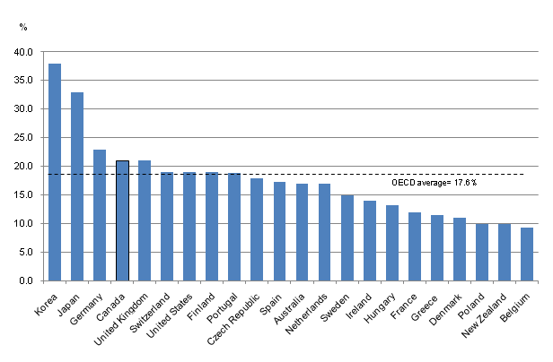
Gender and Work
Gender Gap in Median Earnings of Full-time Employees,
2006 or latest year available

Slide 30
Canadian men on average get paid more than 20% more than their female colleagues
Year | Males | Females | Ratio
1978 | 50,600 | 31,200 | 0.62
1988 | 49,700 | 32,100 | 0.65
1998 | 49,000 | 36,300 | 0.74
2008 | 50,600 | 38,600 | 0.76
Source: Table prepared by the author using data obtained from Statistics Canada, “Distribution of earnings, by sex, 2008 constant dollars, annual,” Table 202-0101, CANSIM (database), Using E-STAT (distributor), 10 September 2010.
Median Earnings of Full-year, Full-time Workers (2008 constant dollars)
Notes:
http://www.parl.gc.ca/Content/LOP/ResearchPublications/2010-30-e.htm

Slide 31
University Educated Women
50% of women aged 25 to 44 have a post-secondary degree
40% of men aged 25 to 44 have a post-secondary degree
The wage gap is even greater for university-educated women. They earned just 68% as much as men in 2005 (75% a decade ago).
Notes:
http://bpwdurham.com/wordpress/2010/09/17/wage-gap-widest-for-university-educated-women/

Slide 32
Why Do Women Make Less $?
Direct Salary Difference
Women taking time out of the paid work force
Cumulative
Pink-collar ghetto
Men work longer hours
Women dominated specialties = lower pay
Discrimination, sexism, patriarchy

Slide 33
Double Day or The Second Shift
Women are in most societies responsible for most of the domestic activities such as housework, food preparation and child rearing in addition to their involvement in formal or informal economic activities.

Slide 34
Women and the Media

Slide 35
Gender Socialization
We start learning at an early age what is accepted and expected of each gender
  Family
  Peers
  Media
  School
  Religion

Slide 36
Gender Roles
Cultural expectations of men and women in a particular society, including the division of labour.
We learn ‘proper’ gender roles from multiple sources, media is a significant source
‘Proper’ gender roles are reinforced through the media representation of women and men

Slide 37
The Power of Advertising
Advertising is the most influential media in our culture
It influences our relationships, what we eat, the perception of our body, what we desire, what we wear, how we look and play and even our daydreams.

