Slide 1
Global Inequality
October 30th, 2012

Slide 2
Key Words
Globalization
The Global Economy
Consumerism
Consumption
Over-consumption
Conspicuous Consumption
Colonialism
Neo-Colonialism
Global Stratification of Health Care
Maternal Mortality
Food Insecurity

Slide 3
1.2 billion people do not have adequate access to water
2.7 billion lack basic sanitation
24 000 children under 5 die every day from preventable causes

Slide 4
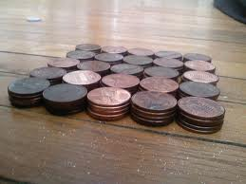
International Poverty Line
1.4 billion people in the ‘global south’ (1/4) were living on less than US $1.25 a day in 2005
Notes:
http://web.worldbank.org/WBSITE/EXTERNAL/EXTDEC/EXTRESEARCH/0,,contentMDK:21882162~pagePK:64165401~piPK:64165026~theSitePK:469382,00.html

Slide 5
% of Population Living at $1.25 at Day (2008)
East Asia & Pacific 14.3%
Europe & Central Asia 0.5%
Latin America & Caribbean 6.5%
Middle East & North Africa 2.7%
South Asia 36.0%
Sub-Saharan Africa 47.5%
Notes:
http://data.worldbank.org/topic/poverty

Slide 6
Wealth and Poverty in Global Perspective
Global Stratification: the unequal distribution of wealth, power, and prestige on a global basis
The gap between the rich and the poor worldwide is growing

Slide 7
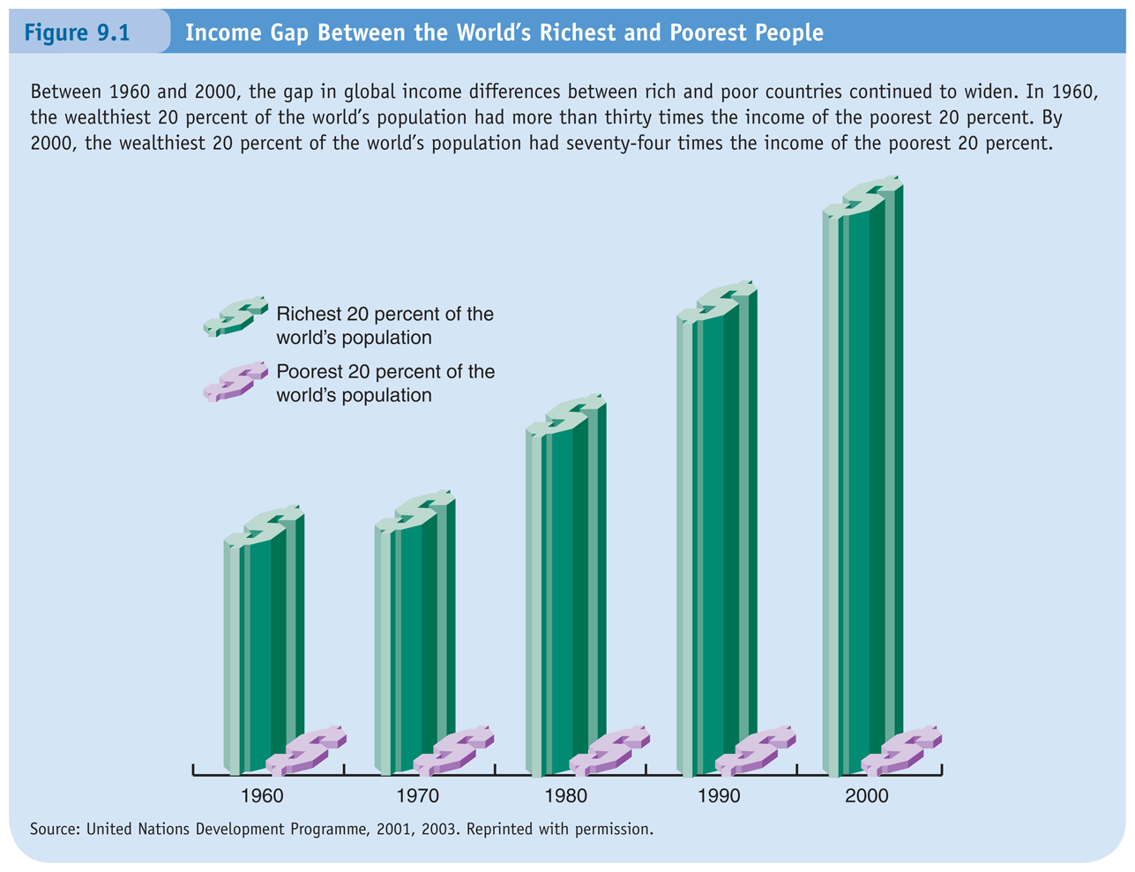

Slide 8
Wealth and Poverty in
Global Perspective
By 1998, the 225 richest people had a net worth of $1.3 Trillion
It would take 4% of this ($53 billion) to achieve basic living such as reproductive health care for all women, and education, medical care, and adequate food, water, and sanitation for all.

Slide 9
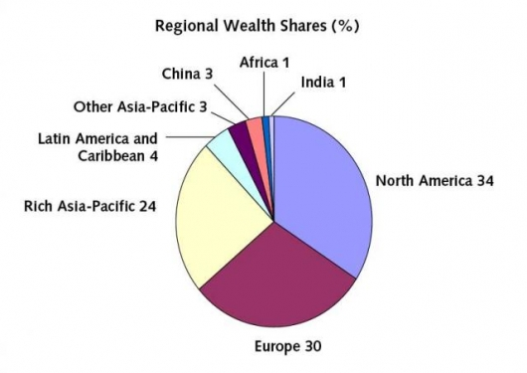

Slide 10
Measuring Global Wealth and Poverty
Absolute poverty: living on less than $1.25 (U.S.) a day
Relative poverty: when people may be able to afford basic necessities but are unable to maintain an average standard

Slide 11
Globalization
Referring to a diverse series of trends and forces
Vast set of economic, political and social issues
The tendency for businesses, technologies and political philosophies (e.g. democracy) to spread across the world
Fully or partially ‘world-wide’ in scale
  and ramifications

Slide 12
Globalization
Process of interaction and integration among the people, companies, and governments of different nations
Driven by international trade
People are increasingly aware of living in a ‘global world’
  Growing awareness of global inequality
  and oppression

Slide 13
Integration of Economies
The increasing reliance of economies on each other
The opportunities to be able to buy and sell in any country in the world
The opportunities for labour and capital to locate anywhere in the world
The growth of global markets in
finance

Slide 14
The Global Economy
Transnational corporations pursue cheap labour, low-cost infrastructure, and absence of labour regulation
Labour in developing countries:
  Legally unprotected and non-unionized

Slide 15
Positives of the Global Economy (Globalization)
Greater freedom of movement of goods, services, capital, people
Sharing cultural products
Travel and migration
Trade and commerce
Access to more goods and service
Cheaper goods (for us)

Slide 16
Negatives of the Global Economy
Negative consequences of globalization:
  Environmental degradation
  Homogenization of culture
  Exploitation of workers
Consequences for workers in Canada:
  Loss of domestic jobs (esp. manufacturing)
  Weakening of the political power of workers and unions

Slide 17
Why does the gap exist and continue to grow?

Slide 18
Colonialism
When a foreign power maintains political, social, economic and cultural domination over a people for an extended period of time.
Neo-colonialism: continuing dependence and foreign domination.

Slide 19
Debt and Global Stratification
The debts that these countries owe to the rich nations
Many countries have been forced to devalue their currency, cut welfare, and not put money into their economies
Cannot invest in domestic education, agriculture, social programmes, health care, infrastructure

Slide 20
Consumerism
Economic policies placing emphasis on consumption
Encouraging the buying consumer goods

Slide 21
Consumption
‘The ‘selection, purchase, use, reuse and disposal of goods and services’ (Campbell 1995: 104)

Slide 22
Over-Consumption
Resource-use outpacing the sustainable capacity of the ecosystem.
A long pattern of overconsumption leads to environmental degradation and the loss of resource bases.

Slide 23
Over-Consumption
One of the main contributors to global inequality (and environmental problems) is patterns of consumption— particularly over-consumption

Slide 24
Conspicuous Consumption
Consuming the right type of goods, but about consuming them in a way that is visible to the ‘right’ people to prove the social status of those consuming.
A term developed by Thorstein Veblen (1857-1929)

Slide 25
Global Priority | $U.S. Billions
Cosmetics in the United States | 8
Ice cream in Europe | 11
Perfumes in Europe and the United States | 12
Pet foods in Europe and the United States | 17
Business entertainment in Japan | 35
Cigarettes in Europe | 50
Alcoholic drinks in Europe | 105
Narcotics drugs in the world | 400
Military spending in the world | 780
Notes:
http://www.globalissues.org/issue/235/consumption-and-consumerism

Slide 26
Global Priority | $U.S. Billions
Basic education for all | 6
Water and sanitation for all | 9
Reproductive health for all women | 12
Basic health and nutrition | 13
Notes:
http://www.globalissues.org/issue/235/consumption-and-consumerism

Slide 27
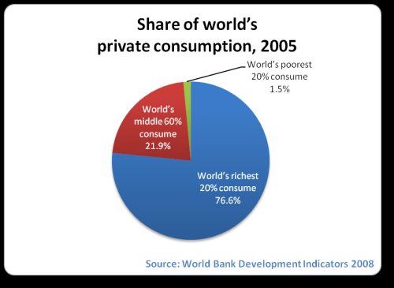
Notes:
http://www.globalissues.org/issue/235/consumption-and-consumerism

Slide 28
Corporate Domination
Made possible by:
  Technology
  Communication networks
  Internet access
  Growth of economic cooperation – trading blocs (EU, NAFTA, etc.)
  Collapse of ‘communism’
  Movement to free trade

Slide 29
Corporate Expansion
Multi-national
or trans-national corporations (MNCs or TNCs) – businesses with
a headquarters
in one country but with business operations in a number of others.

Slide 30
Some consequences of global stratification

Slide 31
Global Stratification of Health Care
Most people who like in the industrialized world can expect to live about 75 years, less developed countries up to 25 years shorter
Higher infant mortality and maternal mortality in developing countries
Factors: lack of access to clean water and sanitation

Slide 32
Country of Residence
Prosperity of country increases health through biomedical advances.
Vaccines have done much to improve health and ensure longer life.
Public health system even more important.
If country can provide its citizens with clean water and sewage system, epidemics decline in frequency and severity, while life expectancy soars.

Slide 33
Life Expectancy
Average increase: about 33% in the past three decades and is now more than 70 years in 87 nations
In some countries, it has decreased—in Sub-Saharan Africa-due, especially, to AIDS

Slide 34
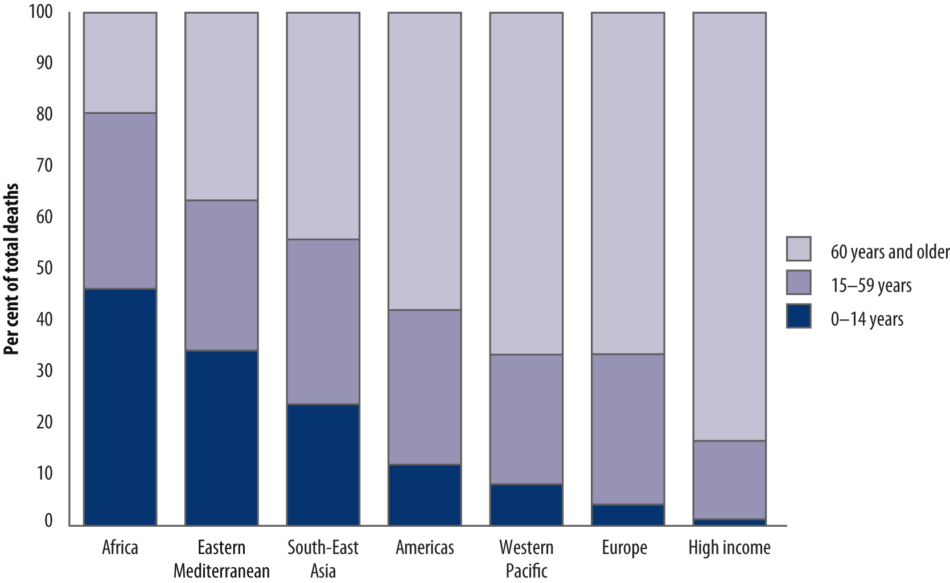
Per cent distribution of age at death by region, 2004

Slide 35
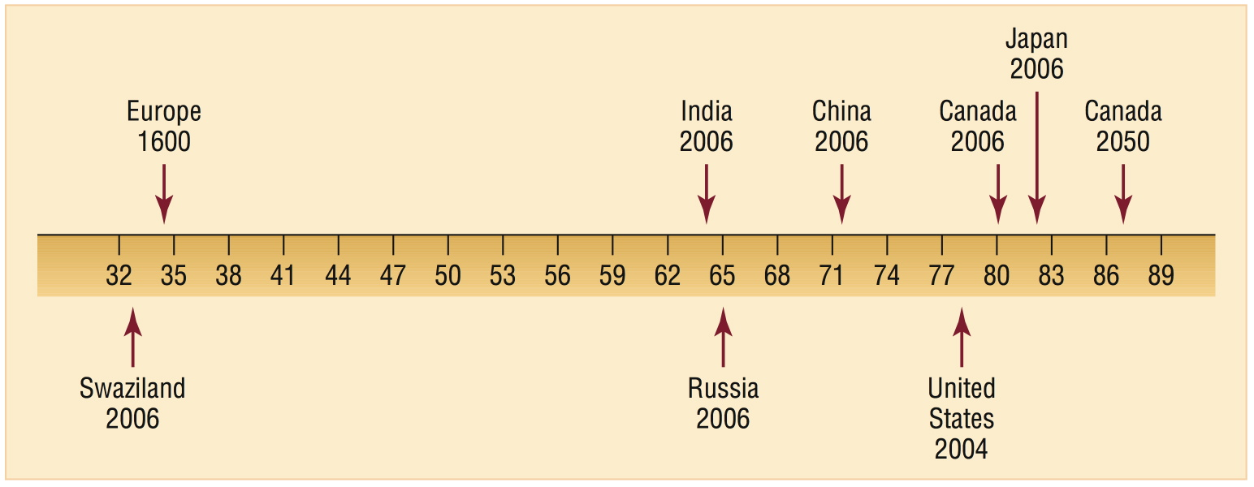
Life Expectancy,
Selected Countries and Years
Notes:
Life Expectancy, Selected Countries and Years Sources: Population Reference Bureau, 2007; Tuljapurkar, Li, and Boe, 2000.

Slide 36
Country of Residence: HIV/AIDS
HIV/AIDS is leading cause of death in Sub-Sahara Africa.
HIV/AIDS is 10 times more common in sub-Saharan Africa than in North America and nearly 17 times more common than in Western Europe.
But, spending on research and treatment is concentrated overwhelmingly in the rich countries of North America and Western Europe.

Slide 37
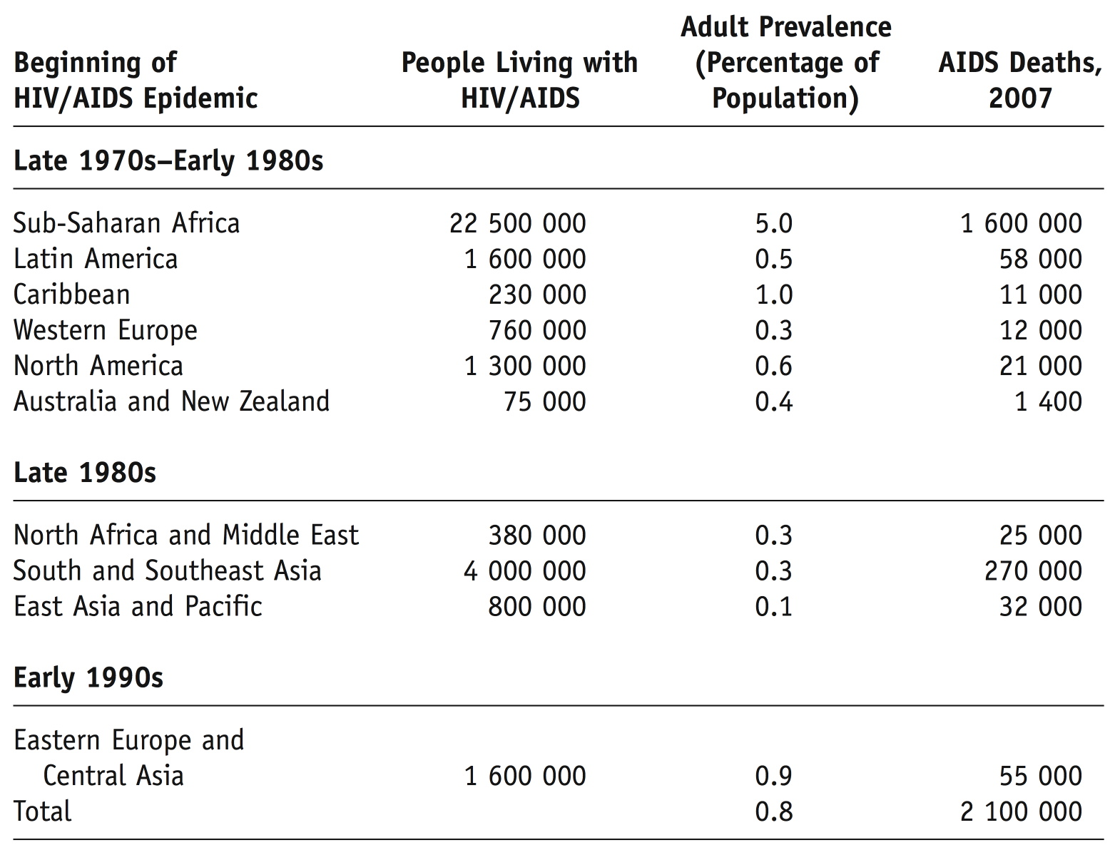
A Global View of HIV/AIDS, 2007

Slide 38
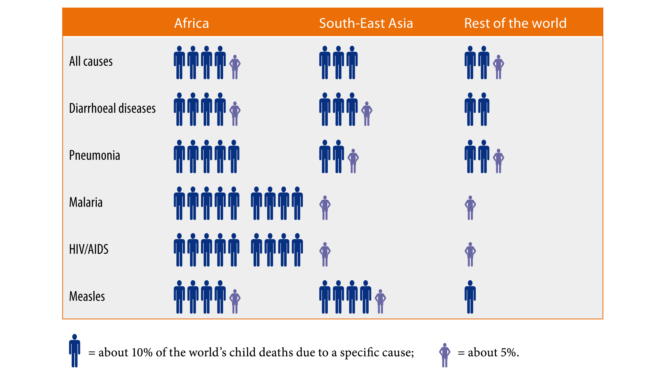
Distribution of child deaths for selected causes by selected WHO region, 2004

Slide 39
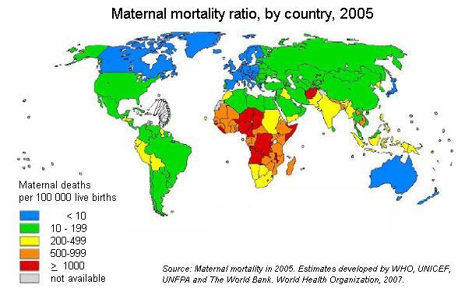
Maternal Mortality

Slide 40
“Right to Pee”
Campaign in Mumbai
Redress gross inequities in the allocation of public restrooms.
In New Delhi there are more than 1,500 public restrooms for men and only 132 for women.
To avoid the need to urinate women often withhold hydration

Slide 41
Global Distribution of Environmental Risk
When disaster strikes, economically and politically disadvantaged people suffer most because their circumstances render them most vulnerable

Slide 42
Poor Countries (Global South)
Underprivileged face more environmental dangers than the privileged
Several developing countries industrializing rapidly but cannot afford pollution control, so little anti-pollution regulations
Lack of regulations draw multinational corporations to situate some of their operations in developing countries

Slide 43
Rich Countries (Global North)
Overall, “rich” countries:
  Cause disproportionately large share of world’s environmental problems
  Enjoy disproportionate share of benefits of technology
  Live with fewer environmental problems than poorer countries

Slide 44
Global Food Crisis
44 million people around the globe have been pushed into extreme poverty between June 2010 and April 2011
The global price of food rose 36% between April 2010 and 2011.
At least 80% of humanity lives on less than $10 a day.

Slide 45
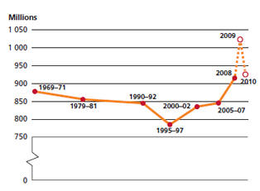
Number of hungry people, 1969-2010
Notes:
http://www.worldhunger.org/articles/Learn/world%20hunger%20facts%202002.htm
The 2010 estimate, the most recent, says that 925 million people were undernourished in 2010 (FAO 2010). As the figure below shows, the number of hungry people has increased since 1995-97. The increase has been due to three factors: 1) neglect of agriculture relevant to very poor people by governments and international agencies; 2) the current worldwide economic crisis, and 3) the significant increase of food prices in the last several years which has been devastating to those with only a few dollars a day to spend. 925 million people is 13.6 percent of the estimated world population of 6.8 billion. Nearly all of the undernourished are in developing countries.
Thus, with an estimated 925 million hungry people in the world, 13.1 percent, or almost 1 in 7 people are hungry.

Slide 46
Food Insecurity
Women are 70% of the world's farmers, produce 90% of the world's staple food crops and own less than 2% of land.
  Mortality
  Birthrates
  Long-term lack of access to land and food production

Slide 47
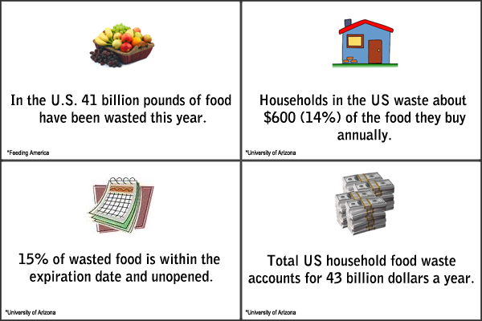
Food Waste

