Slide 1
Inequality: Class and Stratification
October 23rd, 2012

Slide 2
Key Terms
Meritocracy
Social inequality
Social Class
Socioeconomic Status (SES)
Class system
Stratification
Social capital
Cultural capital
Income inequality
Wealth inequality
Poverty

Slide 3
Meritocracy
Getting ahead is based on individual merit, which is generally viewed as a combination of factors including innate abilities, working hard, having the right attitude, and having high moral character and integrity

Slide 4
The Myth of Meritocracy
Great many factors that impact on a person’s ability to succeed
Ascribed statuses play a large role in the opportunities and barriers that people face (the deck is stacked)
There are structural, not individual!

Slide 5
Social Inequality
The long term existence of significant differences in access to goods and services among social groups.
Differences in wealth, prestige and power
Income and wealth are unequally distributed in Canada

Slide 6
Social Structures
The way in which society is organized into predictable relationships, patterns of social interaction.
Social structure shapes the distribution of inequality

Slide 7
Social Stratification
A system by which a society ranks categories of people in a hierarchy (based on property, prestige, and power)

Slide 8
Social Class
The relative location of a person or group within a larger society, based on wealth, power, prestige, or other valued resources
In a class system people can move ‘up’ (or ‘down’), but it is heavily dependent on family and ascribed factors (i.e. race and gender)

Slide 9
Class System: Beliefs
System of inequality– society defines this as fair
The explanation of why people should be unequal differ from society to society
Cultural beliefs serve to justify social stratification

Slide 10
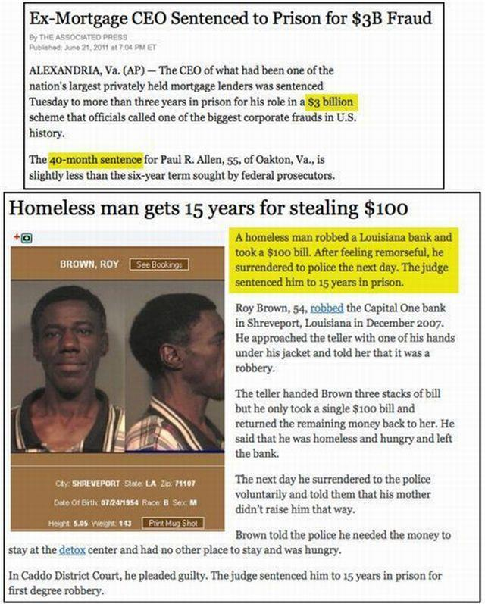

Slide 11
Class System: Generational
Children’s social class reflect parents’ social class
We can experience social mobility
Most people move horizontally, switch from job to another at about the same social level
Typically the level remains the same over a lifetime

Slide 12
Impact of Class Position
Class at birth affects life chances: ability to fulfill one’s potential
Persons in the same class more likely to associate with each other, intermarry, have similar hobbies, tastes, political views

Slide 13
Variables of Social Class
Power
  The degree to which a person can control other people
Wealth
  Objects or symbols owned by people which have value attached to them
Prestige
  The degree of respect, favourable regard, or importance accorded to a person by members of society

Slide 14
Socioeconomic Status (SES)
Combination of income, education, and occupational prestige data in a single index of a person’s position in the socioeconomic hierarchy.

Slide 15
Types of Resources:
3 categories of resources that shape the positions we occupy and influence our likelihood for social mobility
Material
Social
Cultural

Slide 16
Material
Economic resources that we own of control
Money
Property
Land

Slide 17
Social
Prestige based on the position we occupy and connections based on the social networks we are part of
Position and connection make it possible for use to increase the likelihood of accomplishing our goals

Slide 18
Cultural
Derived mostly through education.
Includes the knowledge, skills, education, and advantages that a person has, which give them a higher position in society

Slide 19
Multiple intersections of inequality impact each other.
Those who occupy a lower socio-economic position have barriers to education, networks, skills etc. (social and cultural capital) that would facilitate upward social mobility.

Slide 20
Income
The economic gain derived from wages, salaries, income transfers (government aid), and ownership of property

Slide 21
Income Inequality
Gap between the rich and the poor
The increase in income inequality has been more rapid in Canada than in the U.S. since the mid-1990s.
A significant increase in income inequality occurred in Canada between 2000 and 2006.

Slide 22
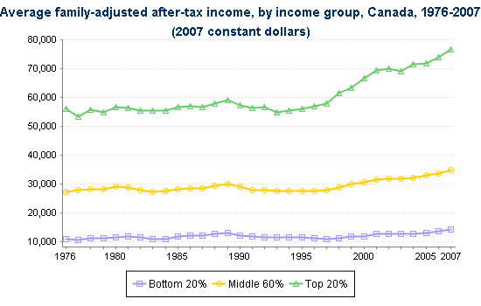

Slide 23
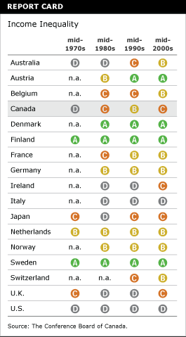
Income inequality has gotten worse!

Slide 24
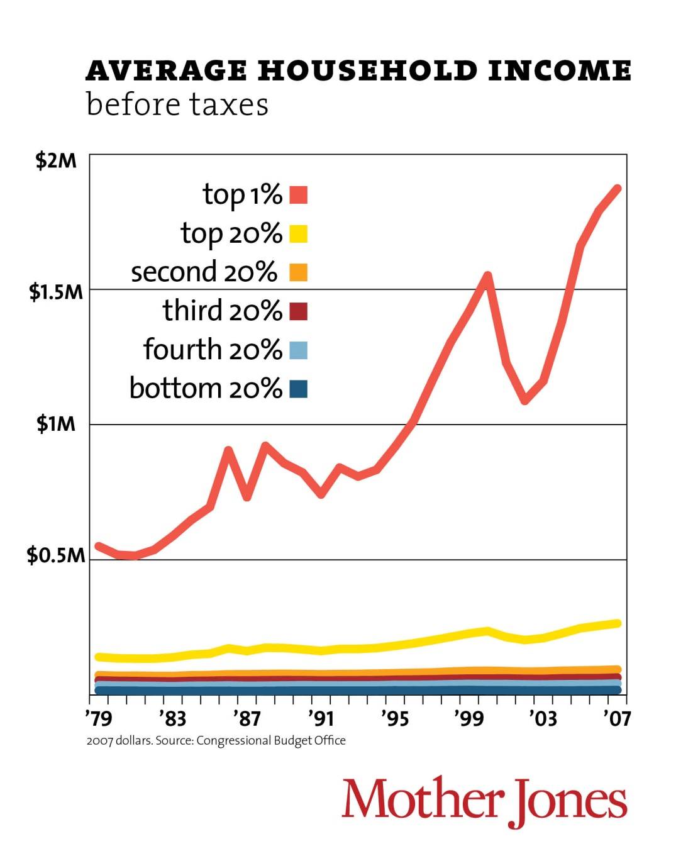
Notes:
http://www.motherjones.com/politics/2011/02/income-inequality-in-america-chart-graph

Slide 25
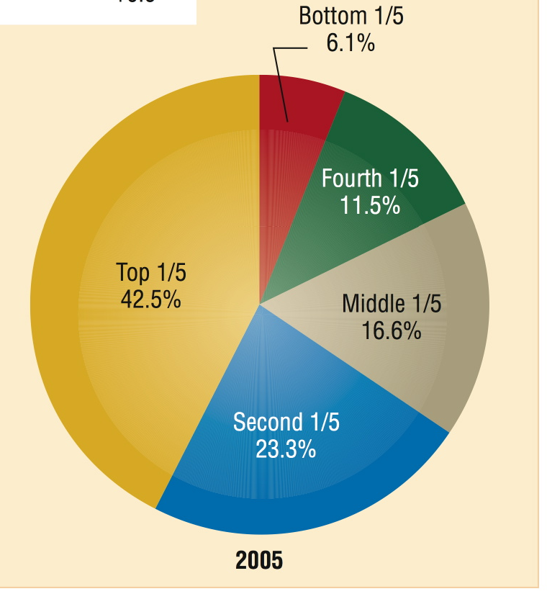
The Distribution of Total Market Income among Families, Canada, 2005
Notes:
FIGURE 8.3 on p. 218 - The Distribution of Total Market Income among Families, Canada, 1951 and 2005
Source: Dominion Bureau of Statistics, Statistics Canada Cat. 13-159, 2008. CANSIM Table 2020701.
Retrieved May 1, 2008 (http://dc1.chass.utoronto.ca.myaccess.library.utoronto.ca/chasscansim).

Slide 26
Wealth
Wealth: “net worth”
  The sum total of assets minus liabilities.
  Is often inherited

Slide 27
Wealth Inequality
Unequal distribution of assets within a population.
Growing faster than ever before

Slide 28
Wealth Distribution, Canada 2005
Fourth1/5
2.3%
Bottom 1/5 = 0.1%
Notes:
http://www.statcan.gc.ca/pub/13f0026m/13f0026m2006001-eng.pdf
http://www.statcan.gc.ca/daily-quotidien/061213/dq061213c-eng.htm

Slide 29
Class inequalities and health
More wealth, more health
Less wealth, less health
2010 study found a 21-year difference in life expectancy between the poorest neighbourhood and the wealthiest neighbourhood in Hamilton, Ontario

Slide 30
Inequality and Health
Unnatural Causes...is inequality making us sick? 2008.

Slide 31
Consequences of Inequality
Impact on children, esp. vulnerable pops
  Long-term societal consequences
Political instability
  U.K. (London)
  Greece
  France
  Occupy Wall Street

Slide 32
Poverty

Slide 33
Who are the Poor?
Children (17% of all)
66% of the poor are women
1/3 of Aboriginals live below the poverty line
50% of workers with disabilities earn incomes below $10 000/yr

Slide 34
The Cost of Poverty
Annual financial cost to Canadians???
Cost approx $25 billion annually
In moving people from the lowest incomes bracket to the second lowest income bracket– save $7.6 billion/yr in health expenditures
Notes:
http://www.cbc.ca/news/canada/story/2011/09/28/poverty-report.html

Slide 35
Working Poor
50% of families who are considered poor have at least one adult employed in full-time, full-year work
70% have at least one parent working part-time
Many who don’t work are ill or disabled

Slide 36
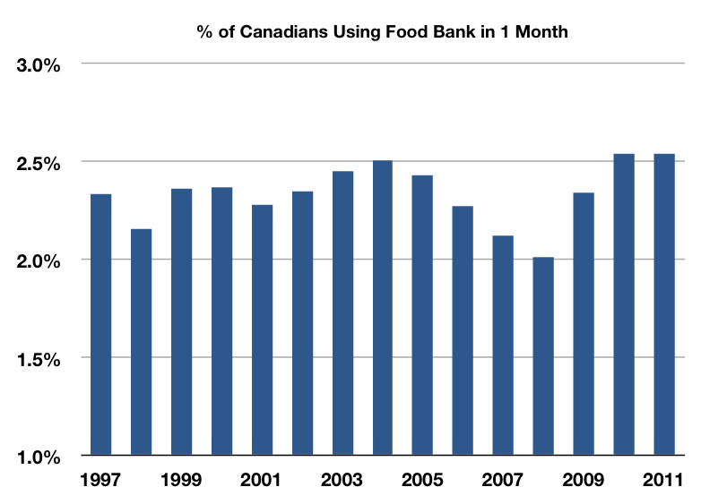
% of Canadians Using a Food Bank 1 month (March)
Notes:
http://foodbankscanada.ca/getmedia/0fdd7346-7f6e-409b-8af6-79da153b7e93/Selected-HungerCount-information-1999-2011.xls.aspx?ext=.xls

Slide 37
How the past shapes the future: Child Poverty
Approx. 1/10 Canadian children live below the poverty line
  2012 poverty rate: 13.3%
Every $1 invested in early years (before the age of 6) saves $9 in future spending on health, welfare and justice systems
Notes:
http://www.thestar.com/news/canada/article/1202030--canada-lags-on-fighting-child-poverty-report-finds

Slide 38
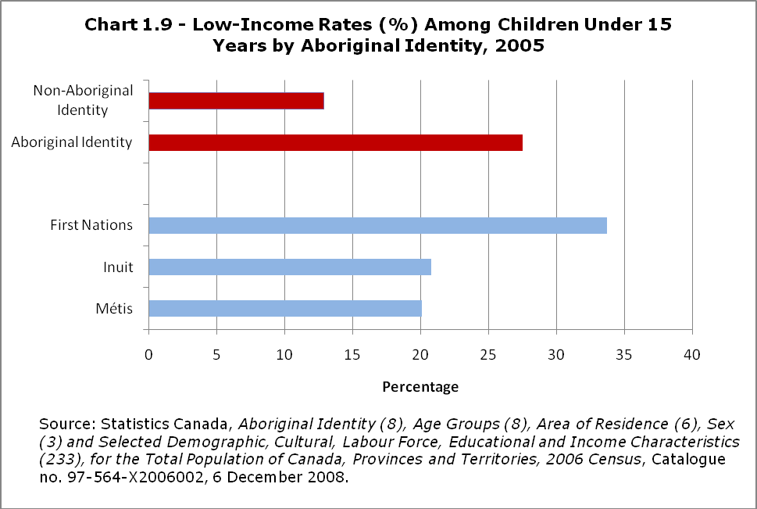
Aboriginal Children

Slide 39
Consequences of Child Poverty
Poor Children Are:
More likely to experience a host of immediate and long-term health negative outcomes
Less likely to live in safe neighbourhoods
At disproportionate risk of exposure to environmental contaminants
Have problems concentrating and learning

Slide 40
Economic and Structural Causes of Poverty
Economic: because over 50% of the poor are the working poor, it means that wages are much lower than the average cost of living
This has increased over time
Structural:
  International competition
  Automation
  Closure of many factories (deindustrialization of North America)
  Shift from manufacturing to service

Slide 41
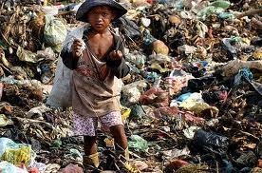
Next Week
Global Inequality
Textbook: Chapter 9

