Slide 1
Culture
October 2nd, 2012

Slide 2
Critical Thinking Assignments
Critical Thinking Assignments are due next week, Oct. 9th.
Hand them in to your TA in your tutorial or in the drop-box Loeb B750. Please do not hand them in class.

Slide 3
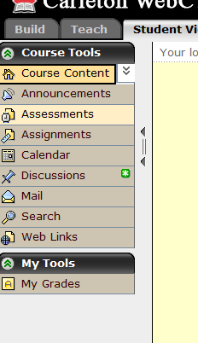
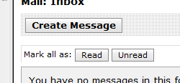


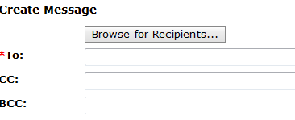
Emailing Me
tsuperle

Slide 4
Key Terms
Culture
Material and non-material culture
Symbols
Language
Beliefs
Values
Norms
Mores
Folkways
Laws
Breaking norms
Ethnocentrism
Subculture
Counterculture

Slide 5
Culture
“The knowledge, language, values, customs, and material objects that are passed from person to person and from one generation to the next in a human group or society” (p. 57)
Enables people to adapt to, and thrive in, their environments

Slide 6
Culture
Begins at the point at which humans surpass whatever is simply given in their natural inheritance.

Slide 7
Members of a culture share values and norms
The way people learn to interact with one another is cultural
Types and expression of emotions is cultural

Slide 8
Social Construction
All knowledge, customs, habits etc., no matter how basic and natural they seem, are the by-products (mostly unintended or unconscious) of countless human choices rather than resulting from divine will or nature/biological imperatives.

Slide 9
Social Construction in a Nutshell
“This thing could not have existed had we not built it; and we need not have built it at all, at least not in its present form. Had we been a different kind of society, had we had different needs, values, or interests, we might well have built a different kind of thing, or built this one differently” (Boghossian)

Slide 10
Culture and Nature
There is no set of complex, innate behaviours that accompanies any specific human bodily need.
Every human has bodily needs that must be fulfilled, how those needs are fulfilled is purely a matter of culture.
The rules for bodily needs are fulfilled vary from culture to culture.

Slide 11
Characteristics of Culture...
It is Learned
It is Shared
It is Symbolic
It is Transmitted
It is Cumulative

Slide 12
Material culture
Production
Comprised of tools and techniques that enable people to get tasks accomplished

Slide 13
Production
Human capacity to make and use tools, and thereby improve our ability to take what we want from nature

Slide 14
Technology
Knowledge, techniques, and tools that make it possible for people to transform resources into usable forms, and the knowledge and skills required to use them after they have been developed

Slide 15
Non-material Culture
Nonphysical ideas that people have about their culture
Composed of symbols, norms, values, and language (and other intangible elements)

Slide 16
Components of Non-Material Culture
Symbols
Language
Beliefs
Values
Norms
  Folkways
  Mores
  Laws

Slide 17
Symbols
Anything that carries a particular meaning recognized by people who share a culture.
All cultures involve the use of language and symbols

Slide 18
Language
A set of symbols that expresses ideas and enable people to think and communicate with one another
Why is language so important?

Slide 19
Importance of Language
Language communicates a culture’s most important norms, values and sanctions to people.

Slide 20
The Social Roots of Language
We are biologically pre-wired to acquire language and create grammatical speech patterns
  The social environment gives these predispositions form
  Language, therefore, must be learned

Slide 21
Beliefs
Specific statements that people hold to be true.
Beliefs are particular matters that individuals consider to be true of false.

Slide 22
Values
Culturally defined standards that people use to decide what is desirable, good, and beautiful.
Values are standards that people who share a culture use to make choices about how to live.
More general and abstract than norms
General principles which underline the norms

Slide 23
Norms
Rules and expectations by which a society guides the behaviour of its members.
  Proscriptive norms—stating what we should not do.
  Prescriptive norms—state what we should do.

Slide 24
Norms
What is considered ‘normal’
Our ability to function in society depends upon the existence of these societal norms
Vary over time, context and degree of enforcement

Slide 25
Mores
Norms that are widely observed and have great moral significance
Difference between right and wrong

Slide 26
Folkways
Norms for routine or casual interaction
Difference between right and rude

Slide 27
Laws
Institutionalized and standardized norms
Formal, standardized norms that have been enacted by legislatures and are enforced by formal sanctions

Slide 28
Breaking Norms
What happens when we break norms?
Sanctions
  We are punished for inappropriate behaviour
  Also rewarded for appropriate behaviour

Slide 29
Subculture
A category of people who share distinguishing attributes, beliefs, values, and/or norms that set them apart in some significant manner from the dominant culture.

Slide 30
Counterculture
A group that strongly rejects dominant societal values and norms and seeks alternative lifestyles
Subversive subcultures

Slide 31
Culture and Globalization
The wide range of cultural differences found between and within nations
  Can be a result of natural circumstances (climate, geography) or social circumstances (technology or demographics)

Slide 32
Ethnocentrism
The view that one particular ethnic group is somehow superior to all others and that a particular ethnic group’s system of beliefs and values is morally superior to all others.
Practice of judging another culture by the standards of one’s own

Slide 33
Next Week
Socialization and Social Interaction
Sociology in Our Times:
Chapter 4: Socialization. PP 88-101
AND
Chapter 5: Society, Social Structure, and Interaction. PP 114-123 (stop at Stability and Change…)

