Slide 1
Sociological Foundations II: Founders of Sociological Thought
September 25th, 2012

Slide 2
Key Terms and People
August Comte
Karl Marx
Materialist Approach
Bourgeois
Proletariat
Social Class
Class conflict
Emile Durkheim
Social Solidarity
Anomie
Max Weber
Verstehen
Ideal Types
Harriet Martineau
Structural functionalism
Conflict theory
Symbolic interactionism
Feminism
Postmodernism

Slide 3
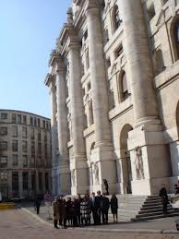
Social Structure
Life entails social processes that sift and sort people into and out of various settings, and open or close opportunities depending on the characteristics of people and the contexts that surround them.

Slide 4

Agency
Individuals are the primary architects of their own lives – making their own decisions, creating their own opportunities, and generating their own meanings

Slide 5
Agency within Structure
Individuals actively create their own lives, but do so within parameters set by their social worlds (can constrain or enable).
People interact with and make attempts to alter those worlds.

Slide 6
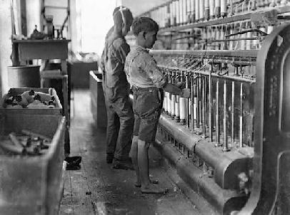
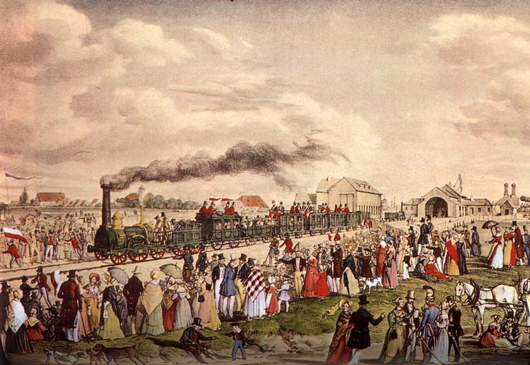
Sociology emerged in the late 19th and the early 20th century as an attempt to understand the rapid social change accompanying the transition to ‘Modernity’.

Slide 7
The Founders’ Focus
Each founder focused on the transition from feudalism to industrial capitalism, pre-modern to modern society.
Change and Stability

Slide 8
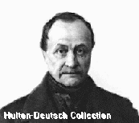
August Comte and the Emergence of Sociology
We should study social reality using a scientific approach. We should call this new discipline SOCIOLOGY!

Slide 9
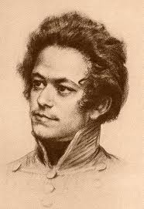
In a country so rich, how could so many people be so poor?
Karl Marx

Slide 10
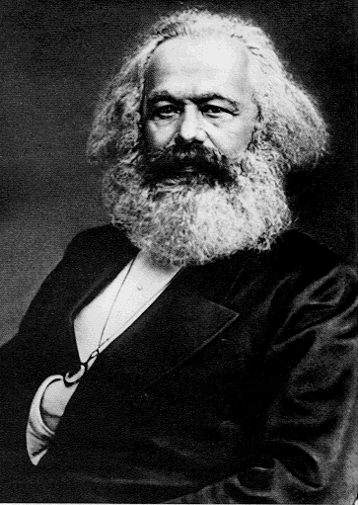
Karl Marx (1818–1883)
Inequality was the key feature of any society
Society’s system of production shapes everything else
Social revolutionary seeking a utopian future.

Slide 11
Materialist Approach
Material production (production of satisfaction for our material needs) is deemed to be the main essential human activity.

Slide 12
Bourgeois and Proletariat
Bourgeois
Owners
The oppressors
Proletariat
Workers
The oppressed

Slide 13
Social Class
Determined by his or her relationship to the means of production.
Made up of all individuals who have the same relationship to the means of production.

Slide 14
Class Conflict
Class Conflict: the struggle between classes to resist and overcome the opposition of other classes.
Differential, unequal and oppressive power relations are constantly present.
Change and social conflict normal and constant

Slide 15
Solution = Revolution

Slide 16
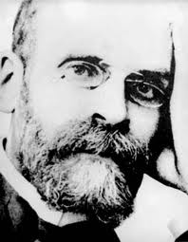
Q:What holds individuals together in social institutions? What holds society together?
A: Solidarity
Emile Durkheim

Slide 17
Emile Durkheim (1858–1917)
Wanted to establish sociology as a legitimate science that could make a positive contribution to social order.
Overriding concern: Social order and stability.
Intense dislike of social disorder.

Slide 18
Social Solidarity
The degree to which group members share beliefs and values
The intensity and frequency of their interactions

Slide 19
Anomie
Breakdown of social norms
Norms no longer control the activities of members in society
Social disorder

Slide 20
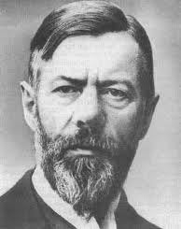
How do social actors conceptualized their social action?
Max Weber

Slide 21
Max Weber (1864–1920)
Considered sociology to be about understanding and explaining individual social actions.

Slide 22
Human Social Action
Social behaviour and actions have subjective meanings to the actor.
We should try to uncover and understand these motives and subjective meanings.

Slide 23
Verstehen
German word which means ‘understanding’ or ‘insight’
Weber used it to mean understanding arrived at through empathetic connection with the actor.
Stresses the importance of taking into account people’s emotions, thoughts, beliefs, and attitudes

Slide 24
Where to we begin?
To guide our thinking, facilitate explanation, and allow comparative analysis Weber suggested we create ‘ideal types’ of the phenomenon we are studying.

Slide 25
Ideal Types
An abstract statement of the essential characteristics of any social phenomenon
A mental construct or abstract representation of what we are studying
Benchmarks to analyze and understand behaviour

Slide 26
Weber Today: Rationalization
The process by which traditional methods of social organization, characterized by informality and spontaneity, are gradually replaced by efficiently administered formal rules and procedures

Slide 27
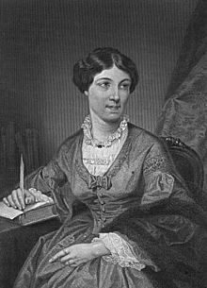
What about the ladies?

Slide 28
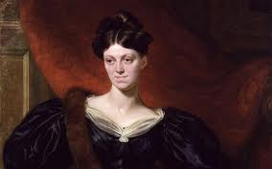
Harriet Martineau (1802-1876)
Called the first female sociologist
Believed that an analysis of a society was need to have an understanding of women's lives
Brought attention to previously ignored topics such as marriage, children, domestic and religious life, and race relation

Slide 29
Why Are the Founders Important?
Established foundational ideas for the discipline of sociology
Many of these founding ideas still have relevance
Founded social theories that are still employed today

Slide 30
Paradigms
A set of assumptions about society and behaviour
Directs sociological research:
  What kinds of questions are asked?
  How are research results interpreted?

Slide 31
Sociological Paradigms
Structural functionalism
Conflict theory
Symbolic interactionism
Feminism
Postmodernism

Slide 32
Structural Functionalism
Structures within the system exist to fulfill one or more of these needs
The normal state of the system is equilibrium
Changes in one structure provoke changes in other structures
  Change is disruptive

Slide 33
Conflict Theory
Social inequality—the most important social fact in society
Inequality gives rise to social classes and other social groups
Conflict between classes and other social groups is the main engine of social change

Slide 34
Symbolic Interactionism
Human beings act toward things on the basis of the meanings that the things have for them
Meanings arise out of social interaction
Meanings are modified through an interpretive process

Slide 35

Feminism
Focuses on various aspects of patriarchy (system of male domination in society).
Patriarchy is present in nearly all societies
Gender inequalities are not biologically determined, but socially constructed

Slide 36
Postmodern Social Theory
Societies characterized by post-industrialization, consumerism, and global communications bring into question existing assumptions about social life and the nature of reality

Slide 37
Next Week
Culture
Sociology in Our Times: Chapter 3: Culture

